Slide 1
Data Modeling
Lucas Cordova

Slide 2

Where we are…
Now we’re here…
Data entry
Transactional Database
Data extraction
Analytical Data Store
Data analysis
Stores real-time transactional data
Stores historical transactional and summary data

Slide 3
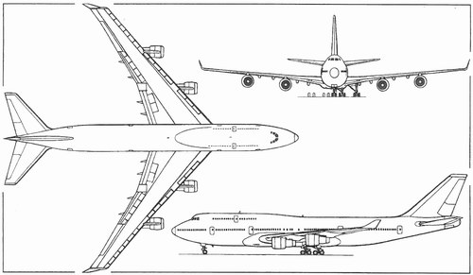

What is a model?
Representation of something in the real world

Slide 4
Modeling a database
A representation of the information to be captured
Describes the data contained in the database
Explains how the data interrelates

Slide 5
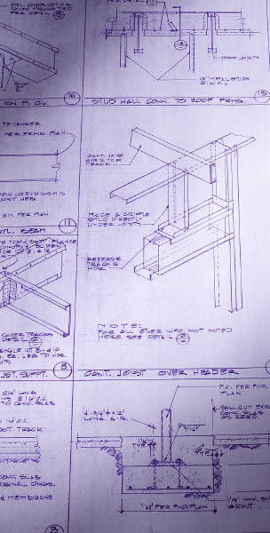
Why bother modeling?
Creates a blueprint before you start building the database
Gets the story straight: easy for non-technical people to understand
Minimize having to go back and make changes in the implementation stage

Slide 6
Systems analysis and design in the context of database development
Systems Analysis is the process of modeling the problem
Requirements-oriented
What should we do?
Systems Design is the process of modeling a solution
Functionality-oriented
How should we do it?
This is where we define and understand the business scenario.
This is where we implement that scenario as a database.

Slide 7
Start with a problem statement
Design a database to track orders for a store. A customer places an order for a product. People can place an order for multiple products.
Record first name, last name, city, state, and zip code for customers. We also want to know the date an order was placed.
Finally, we want to track the name and price of products and the quantity of each product for each order.

Slide 8
The Entity Relationship Diagram (ERD)
The primary way of modeling a relational database
Three main diagrammatic elements
Entity
A uniquely identifiable thing (i.e., person, order)
Relationship
Describes how two entities relate to one another (i.e., makes)
Attribute
A characteristic of an entity or relationship (i.e., first name, order number)

Slide 9
Begin with Identifying the Entities
This is what your database is about.
List the nouns in the problem statement.
When nouns are synonyms for other nouns, choose the best one.
Make a note of nouns that describe other nouns. These will be your entities’ attributes.
Rule out the nouns that don’t relate to the process to be captured.
What’s left are your entities!

Slide 10
So here are the nouns…
Design a database to track orders for a store. A customer places an order for a product. People can place an order for multiple products.
Record first name, last name, city, state, and zip code for customers. We also want to know the date an order was placed.
Finally, we want to track the name and price of products and the quantity of each product for each order.
Which nouns are entities
Which nouns are attributes?
Which nouns are irrelevant?

Slide 11
Here’s where it gets tricky…
store is not an entity because we are not tracking specific information about the store (i.e., store location)
BUT…if there were many stores and we wanted to track sales by store, then store would be an entity!
In this case, “store” is the context
But that isn’t part of the problem statement….

Slide 12
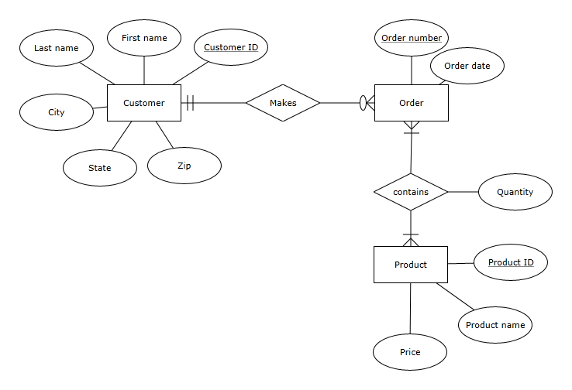
The ERD Based on the Problem Statement

Slide 13
The primary key
Entities need to be uniquely identifiable
So you can tell them apart
They may not be explicitly part of the problem statement, but you need them!
Use a primary key
One or more attributes that uniquely identifies an entity
How about these as primary keys for Customer:
First name and/or last name?
Social security number?
Customer ID
Uniquely identifies a customer
Order number
Uniquely identifies an order

Slide 14
Last component: Cardinality
Defines the rules of the association between entities
Customer
makes
Order
at least – one
at most - one
at least – zero (optional)
at most - many
This is a one-to-many (1:m) relationship:
One customer can have many orders.
A customer could have no orders.
One order can only belong to one customer.
An order has to belong to at least one customer.

Slide 15
Crows Feet Notation
Customer
makes
Order
There are other ways of denoting cardinality, but this one is pretty standard.
So called because this…
…looks something like this
There are also variations of the crows feet notion!

Slide 16
The Many-to-Many (m:m) Relationship
An order can be composed of many products.
An order has to have at least one product.
A product can be a part of many orders.
A product has to be associated with at least one order.
Order number
Order Date
Order
at least – one
at most - many
contains
Quantity
Does it make sense for the maximum cardinality to be 1 for either entity?
Does it make sense for the minimum cardinality to be 0 (optional) for either entity?
at least – one
at most - many
Product
Product name
Price
Product ID

Slide 17
Cardinality is defined by business rules
What would the cardinality be in these situations?
Order
?
contains
?
Product
Course
?
has
?
Section
Employee
?
has
?
Office

Slide 18
Another example of attributes describing a m:m relationship
Name
TUID
The grade and term describes the combination of student and course
(i.e., Bob takes CST116 in Fall 2017 and receives a B; Sue takes CST126 in Winter 2018 and receives an A)
Student
Grade
contains
Term
Course
Course number
Course Title

Slide 19
A scenario: An auto repair shop
A car is described by a VIN, make, and model.
A mechanic is described by a name and SSN.
A repair is described by a repair id and a price.
A transaction occurs on a particular date and has a transaction ID.
An invoice has an invoice number and a billing name, city, state, and zip code.
Each transaction is associated with a repair, a car, and a mechanic.
Many transactions can make up an invoice.
A transaction can only belong to one invoice.
Cars, repairs, and mechanics can all be part of multiple transactions.

Slide 20
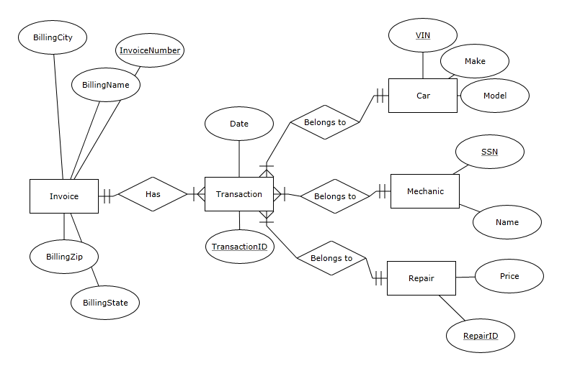
Solution

Slide 21
Implementing the ERD
As a database schema
A map of the tables and fields in the database
This is what is implemented in the database management system
Part of the “design” process
A schema actually looks a lot like the ERD
Entities become tables
Attributes become fields
Relationships can become additional tables

Slide 22
The Rules
1. Create a table for every entity
2. Create table fields for every entity’s attributes
3. Implement relationships between the tables
1:many relationships
Primary key field of “1” table put into “many” table as foreign key field
many:many relationships
Create new table
1:1 relationships
Primary key field of one table put into other table as foreign key field
1:many relationships with original tables

Slide 23
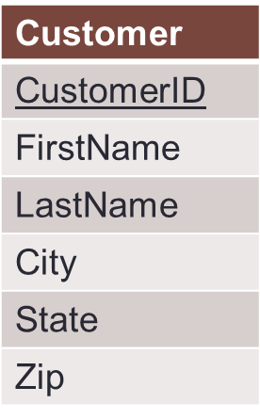
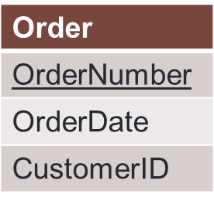
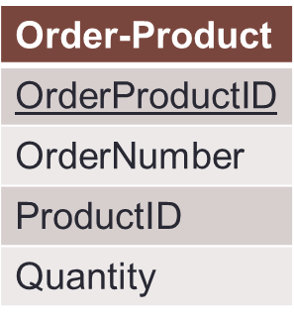
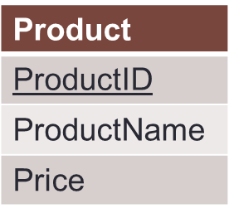
Our Order Database schema
Original 1:n relationship
Original n:n relationship
Order-Product is a decomposed many-to-many relationship
Order-Product has a 1:n relationship with Order and Product
Now an order can have multiple products, and a product can be associated with multiple orders

Slide 24
The Customer and Order Tables: The 1:n Relationship
Customer Table
CustomerID | FirstName | LastName | City | State | Zip
1001 | Greg | House | Princeton | NJ | 09120
1002 | Lisa | Cuddy | Plainsboro | NJ | 09123
1003 | James | Wilson | Pittsgrove | NJ | 09121
1004 | Eric | Foreman | Warminster | PA | 19111
Order Table
Customer ID is a foreign key in the Order table. We can associate multiple orders with a single customer!
In the Order table, Order Number is unique; Customer ID is not!
Order Number | OrderDate | Customer ID
101 | 3-2-2011 | 1001
102 | 3-3-2011 | 1002
103 | 3-4-2011 | 1001
104 | 3-6-2011 | 1004

Slide 25
The Customer and Order Tables: Normalization
Customer Table
CustomerID | FirstName | LastName | City | State | Zip
1001 | Greg | House | Princeton | NJ | 09120
1002 | Lisa | Cuddy | Plainsboro | NJ | 09123
1003 | James | Wilson | Pittsgrove | NJ | 09121
1004 | Eric | Foreman | Warminster | PA | 19111
No repeating orders or customers.
Every order is unique.
This is an example of normalization..
Every customer is unique.
Order Table
Order Number | OrderDate | Customer ID
101 | 3-2-2011 | 1001
102 | 3-3-2011 | 1002
103 | 3-4-2011 | 1001
104 | 3-6-2011 | 1004

Slide 26
Normalization
Organizing data to minimize redundancy (repeated data)
This is good for two reasons
The database takes up less space
Fewer inconsistencies in your data
If you want to make a change to a record, you only have to make it in one place
The relationships take care of the rest

Slide 27
To figure out who ordered what
Match the Customer IDs of the two tables, starting with the table with the foreign key (Order):
We now know which order belonged to which customer
This is called a join
Order Table
Customer Table
Order Number | OrderDate | Customer ID | Customer ID | FirstName | LastName | City | State | Zip
101 | 3-2-2011 | 1001 | 1001 | Greg | House | Princeton | NJ | 09120
102 | 3-3-2011 | 1002 | 1002 | Lisa | Cuddy | Plainsboro | NJ | 09123
103 | 3-4-2011 | 1001 | 1001 | Greg | House | Princeton | NJ | 09120
104 | 3-6-2011 | 1004 | 1004 | Eric | Foreman | Warminster | PA | 19111

Slide 28
Now the many:many relationship
Order Table
Order-Product Table
Order Number | OrderDate | Customer ID
101 | 3-2-2011 | 1001
102 | 3-3-2011 | 1002
103 | 3-4-2011 | 1001
104 | 3-6-2011 | 1004
Order ProductID | Order number | Product ID | Quantity
1 | 101 | 2251 | 2
2 | 101 | 2282 | 3
3 | 101 | 2505 | 1
4 | 102 | 2251 | 5
5 | 102 | 2282 | 2
6 | 103 | 2505 | 3
7 | 104 | 2505 | 8
Product Table
ProductID | ProductName | Price
2251 | Cheerios | 3.99
2282 | Bananas | 1.29
2505 | Eggo Waffles | 2.99
This table relates Order and Product to each other!

Slide 29
To figure out what each order contains
Match the Product IDs and Order IDs of the tables, starting with the table with the foreign keys (Order-Product):
Order-Product Table
Order Table
Product Table
Order ProductID | Order Number | Product ID | Quantity | Order Number | Order Date | Customer ID | Product ID | Product Name | Price
1 | 101 | 2251 | 2 | 101 | 3-2-2011 | 1001 | 2251 | Cheerios | 3.99
2 | 101 | 2282 | 3 | 101 | 3-2-2011 | 1001 | 2282 | Bananas | 1.29
3 | 101 | 2505 | 1 | 101 | 3-2-2011 | 1001 | 2505 | Eggo Waffles | 2.99
4 | 102 | 2251 | 5 | 102 | 3-3-2011 | 1002 | 2251 | Cheerios | 3.99
5 | 102 | 2282 | 2 | 102 | 3-3-2011 | 1002 | 2282 | Bananas | 1.29
6 | 103 | 2505 | 3 | 103 | 3-4-2011 | 1001 | 2505 | Eggo Waffles | 2.99
7 | 104 | 2505 | 8 | 104 | 3-6-2011 | 1004 | 2505 | Eggo Waffles | 2.99
So which customers ordered Eggo Waffles (by their Customer IDs)?

Slide 30
Why redundant data is a big deal
The redundant data seems harmless, but:
What if the price of “Eggo Waffles” changes?
And what if Greg House changes his address?
And if there are 1,000,000 records?

Slide 31
Another rule for normalizing
Create new entities when there are collections of related attributes, especially when they would repeat
For example, consider a modified Product entity
Vendor Name
Vendor Phone
Vendor Address
Don’t do this…
Vendor
Vendor ID
…do this →
Then you won’t have to repeat vendor information for each product.
Vendor Name
Vendor Phone
Vendor Address
sells
Product ID
Product
Product name
Product
Product name
Price
Product ID
Price

