Slide 1
Scientific Python
From NumPy to Neural Networks

Slide 2
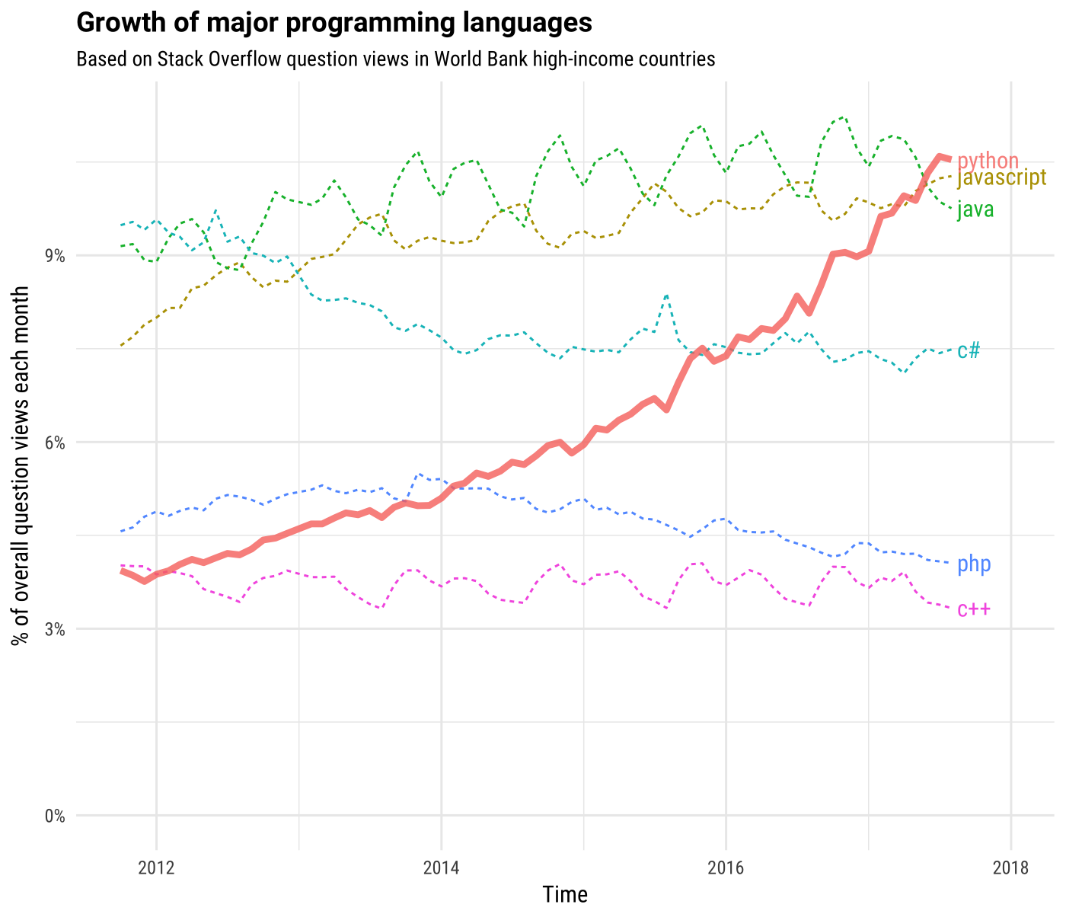
Why I’m learning Python in 2018
The rise of Python can be connected to the rise of interest in data science
pandas, NumPy, matplotlib, scikit-learn
All popular ML and DL frameworks (Tensorflow, Pytorch)
https://news.codecademy.com/why-learn-python/

Slide 3
Setup
Install Anaconda : Anaconda is the most popular Python distribution, it installs everything we need to be able to do data science in python, manage environments and install python apps. (no admin needed)
Python 2.7 or 3? → Short answer Python 3. (3.7 is the latest version right now, get this one)
Install Git (is not mandatory, but is super useful)
After Anaconda finish installing, call the 111 to install Visual Studio Code (a awesome Python editor proposed by Anaconda and Microsoft)

Slide 4
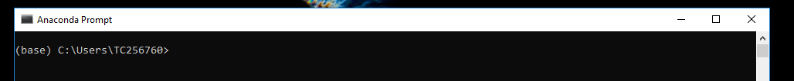
Starting up (Anaconda Prompt)
Command Line interface, important for deploying over SSH.
Basic conda commands:
conda info | Verify conda is installed, check version number
conda update conda | Update conda to the current version
conda install ‘package’ | Install a package included in Anaconda
conda ‘command’ --help | Command line help
conda update ‘package’ | Update installed ‘package’
Check the cheatsheet (https://github.com/tcapelle/python_ines/conda-cheatsheet.pdf)

Slide 5
Creating an Environment
An environment is an enclosed box where your code runs, is like a virtual machine for python only. It enable code reproductibility. It is essential to master this workflow.
λ conda env list will list the environments, (* base) means that the base environment is selected
C:\Users\TC256760
λ conda env list
# conda environments:
#
base * C:\Users\TC256760\AppData\Local\Continuum\anaconda3
TF C:\Users\TC256760\AppData\Local\Continuum\anaconda3\envs\TF
fastai C:\Users\TC256760\AppData\Local\Continuum\anaconda3\envs\fastai
fastaiv1 C:\Users\TC256760\AppData\Local\Continuum\anaconda3\envs\fastaiv1

Slide 6
Creating an Environment
Create a new environment called ‘modelling’ with python 3.7:
λ conda create –name modelling python=3.7
Activate the newly created environment ‘modelling’
λ conda activate modelling
C:\Users\TC256760
(modelling) λ
Let’s install some useful packages:
λ conda install numpy pandas scikit-learn scipy seaborn matplotlib jupyterlab

Slide 7
References
An Excellent Jupyter demo at scipy-2018 conference
Everything @ fast.ai

