Slide 1
US Home Price Predictions

Slide 2
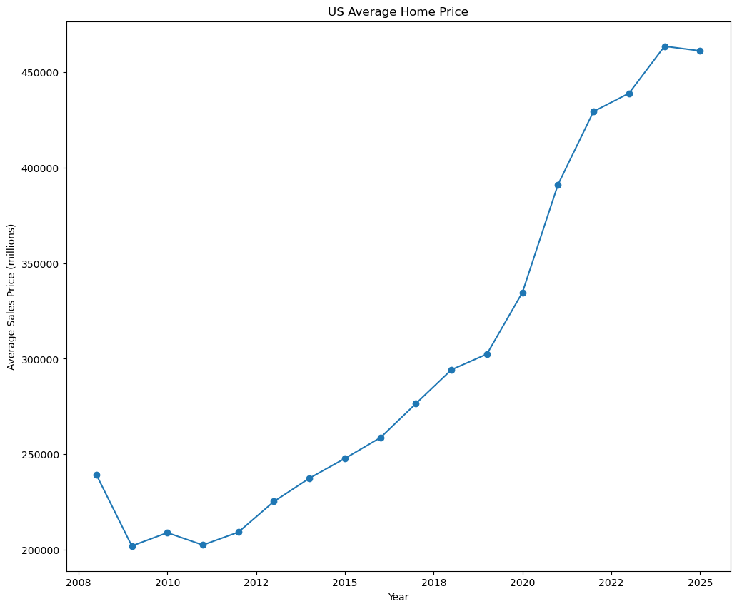
The Problem
Home prices have skyrocketed in the US since 2020.
Uncertainty in the market for investors and home buyers
Help buyers identify the best areas to invest in a home

Slide 3

Data Overview
Main Features:
Sales: Number of home sales
Mean Sales Price: Average sale price
Home Value: Estimated average home value
Market Heat Index: buyer’s vs seller’s market - higher value is seller’s market
Historical housing data from Zillow starting in 2008.
Included only single family homes

Slide 4
Data Wrangling: Actions & Insights
Imputed missing values with forward fill up to 6 months.
Transposed data to create a date column for vertical reading.
Combined data from 4 CSVs into a single dataframe
Created value surplus feature

Slide 5
Exploring the data

Slide 6
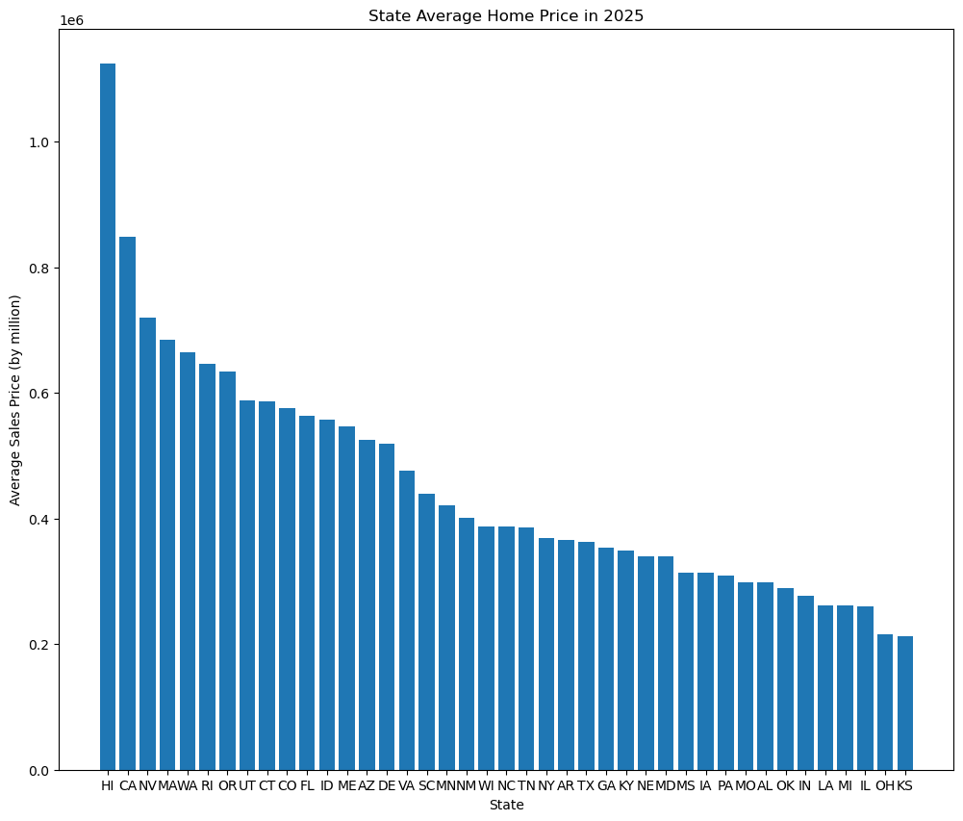
Current Home Prices by State
Hawaii has highest average home price at $1,123,507.
Most states fall between $300,000 and $600,000.
Ohio and Kansas are below $250,000.

Slide 7
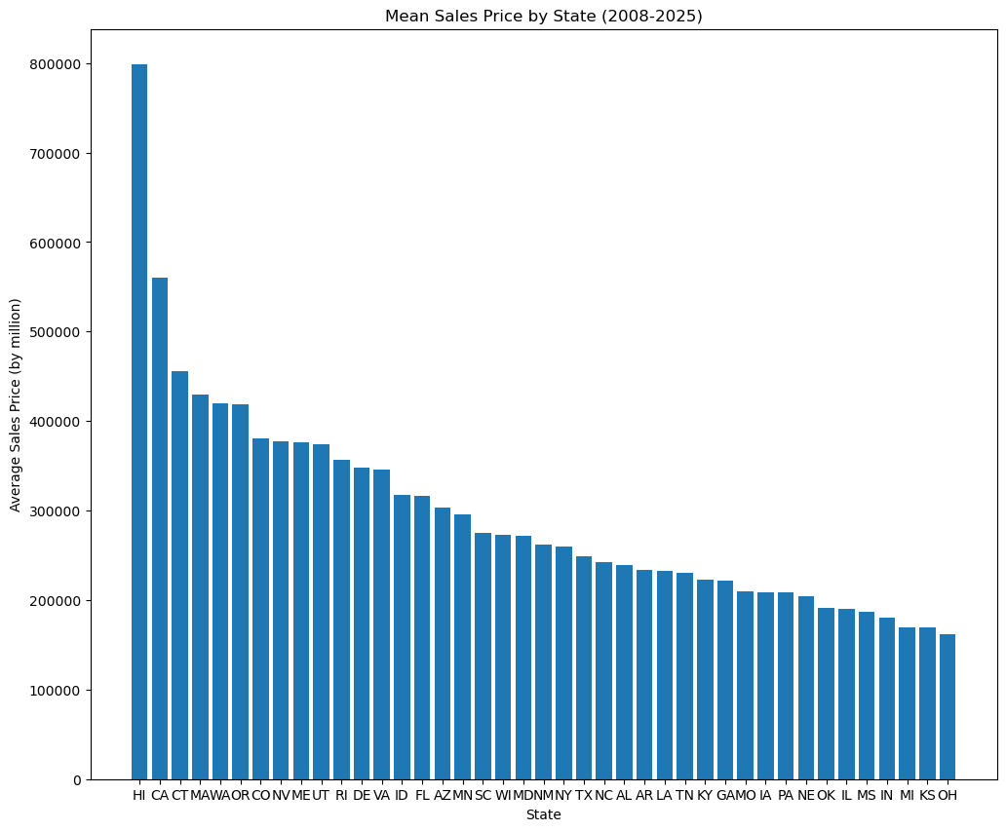
2008-2025 Home Prices by State
Nevada and Rhode Island show an upward trend in prices.
Connecticut home prices have slowed their growth rate.
California and Hawaii continue to lead in home prices.
Ohio and Kansas prices still remain at the bottom.

Slide 8
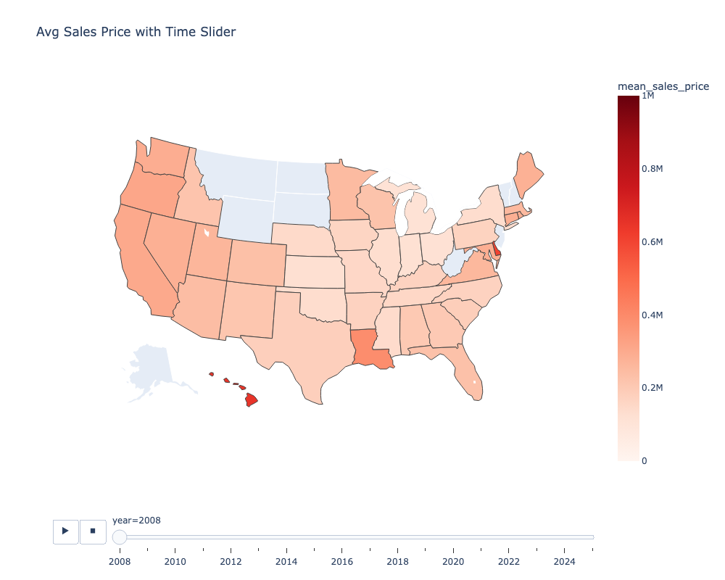
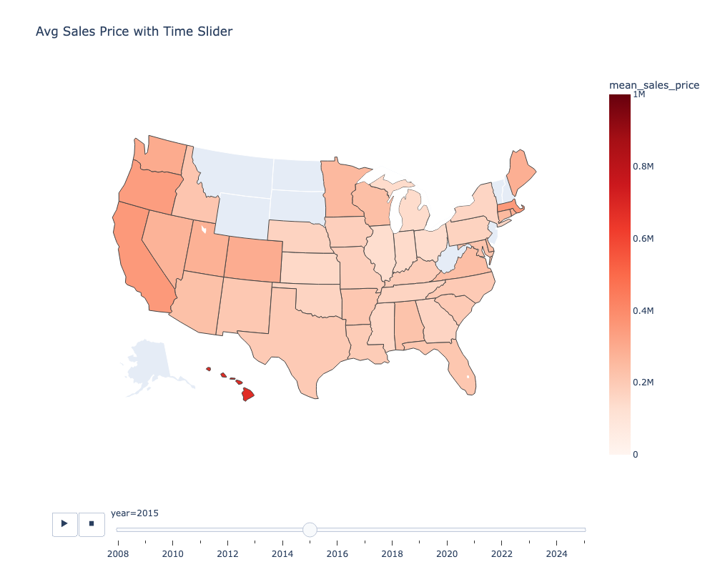
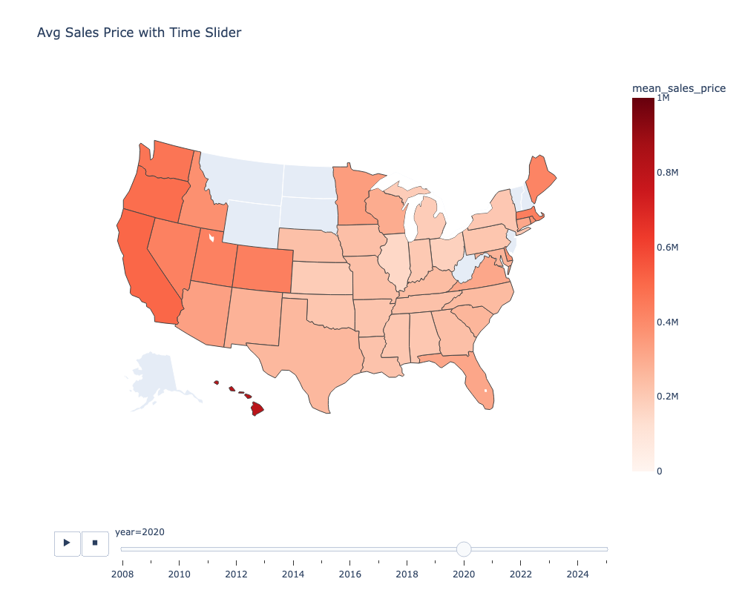
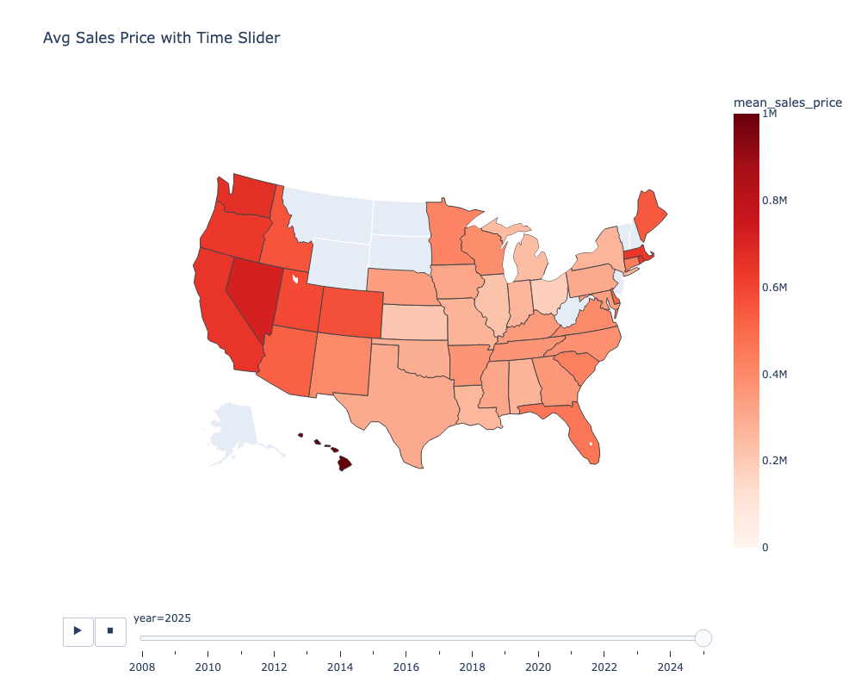
State Prices throughout the years
2008:
2015:
2020:
2025:

Slide 9
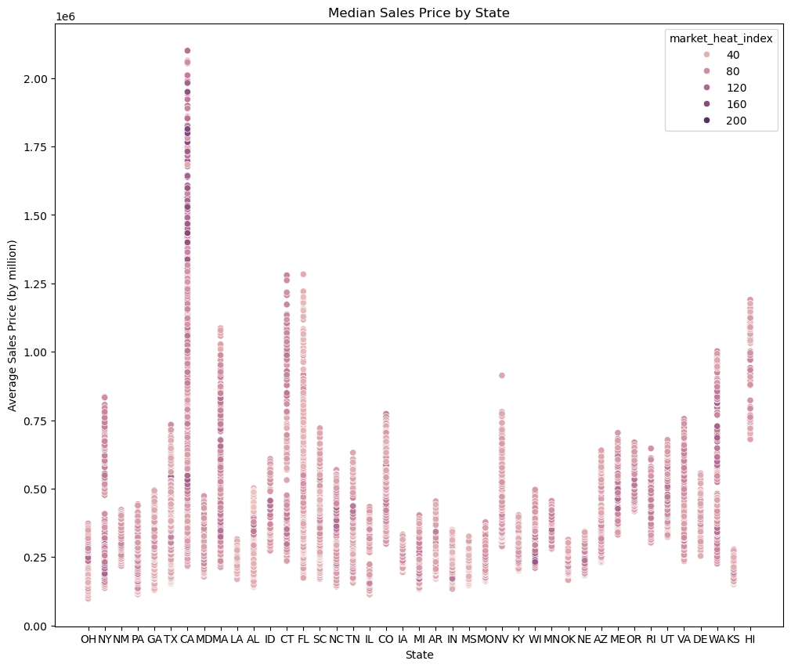
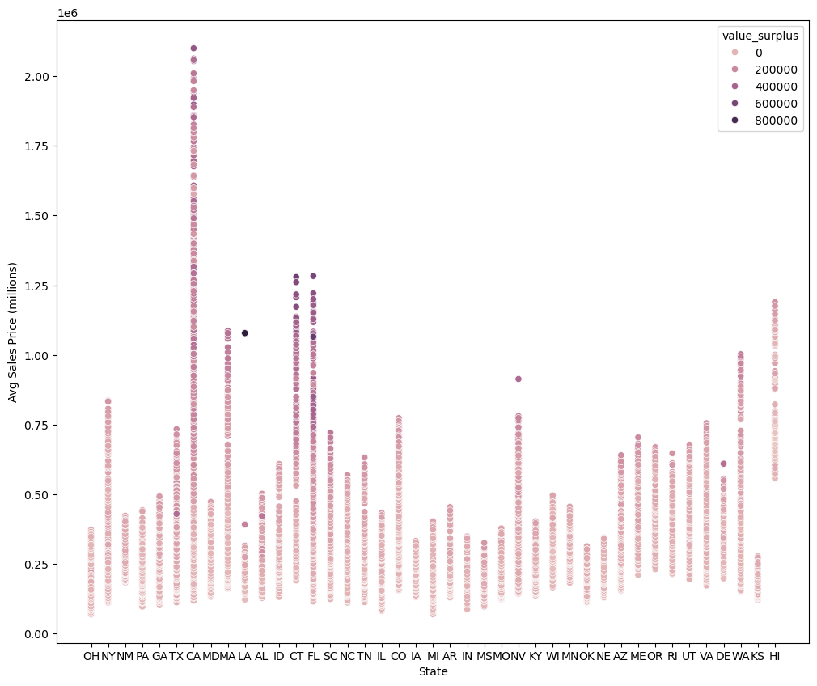
Positive Correlation
Market Heat Index:
Value Surplus:

Slide 10
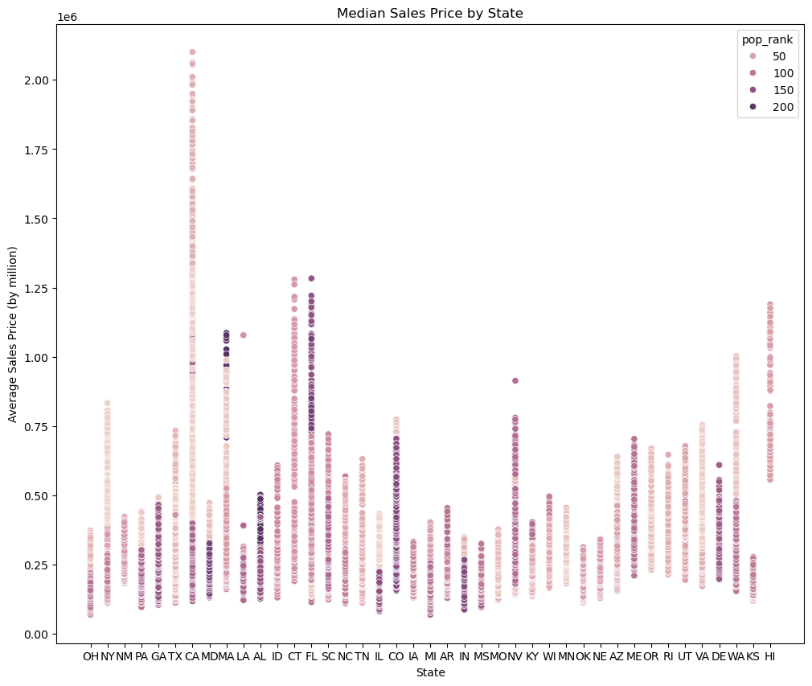
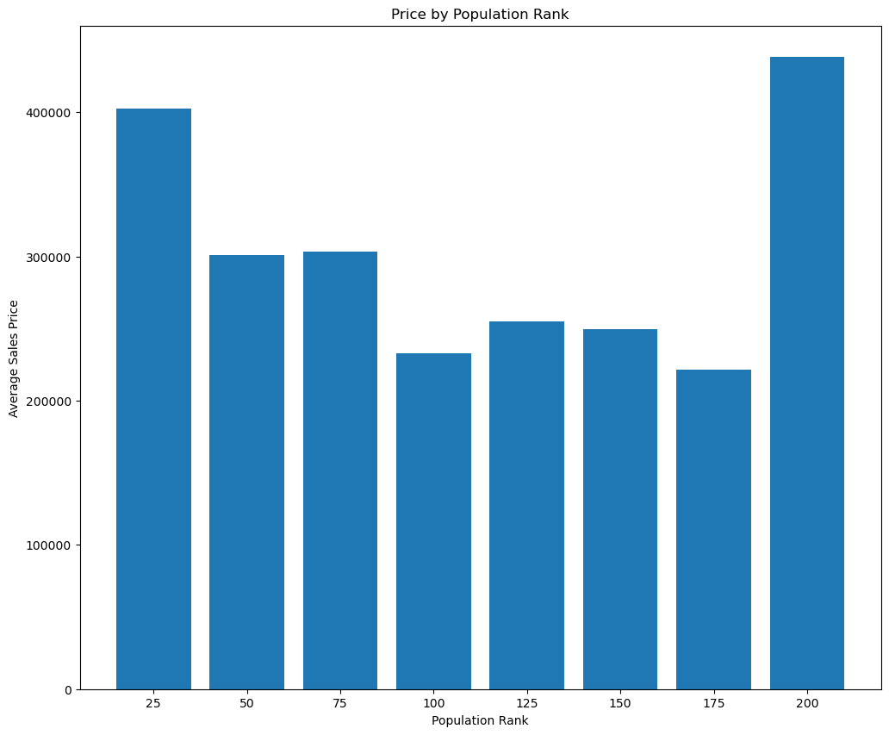
Negative Correlation - Population Rank
Larger cities often have higher home prices
Smallest cities also show surprisingly high sales prices

Slide 11
Modeling & Predictions

Slide 12
Model Selection
Data prepped with Robust scaling and Hashing encoding
Tested linear, Ridge, Lasso, XGBoost, and ARIMA regression models.
Ridge regression achieved 0.888 R-squared coefficient and $29000 RMSE.
Other models overfit or had higher error rates overall.
Ridge Regression

Slide 13
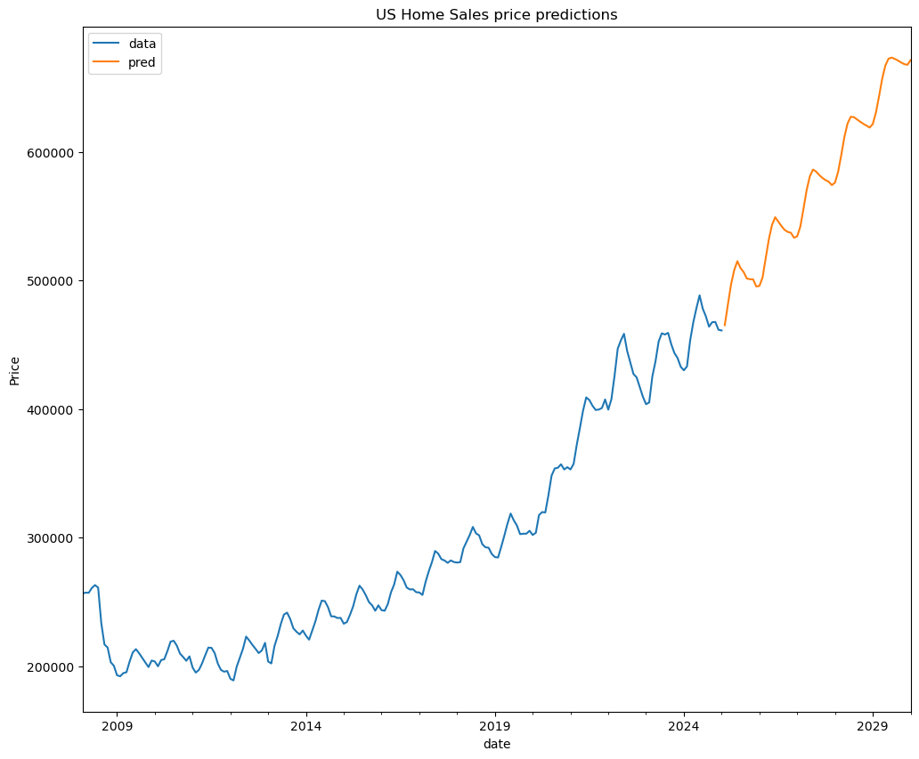
US Home Price Prediction
Predictions generated using Ridge regression
2025 Average: $461,108
2030 Average: $671,450
45.6% increase over 5 years

Slide 14
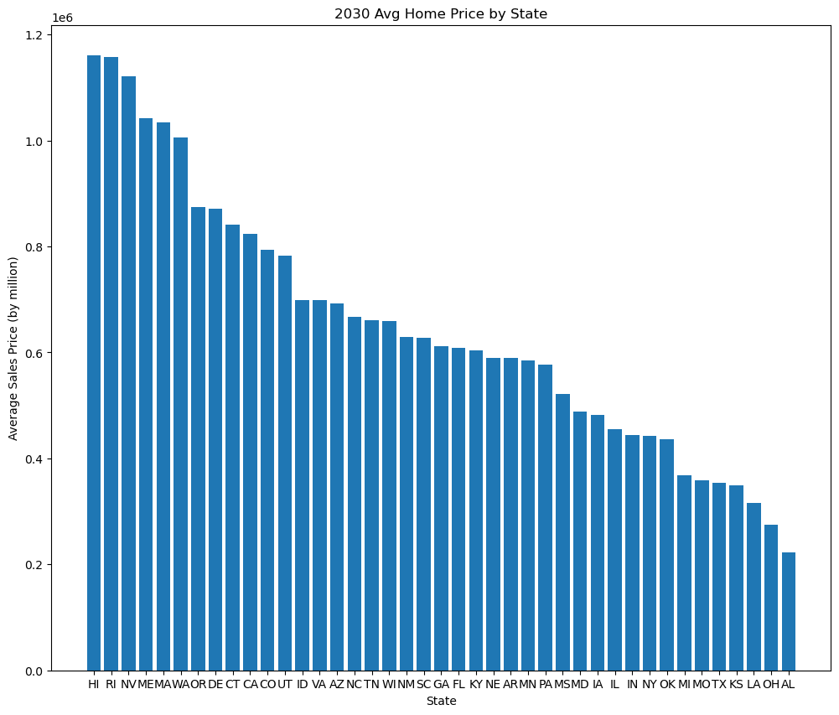
State Home Price Predictions
Top 3 States in 2030:
Hawaii: $1,160,246
Rhode Island: $1,157,088
Nevada: $1,121,203

Slide 15
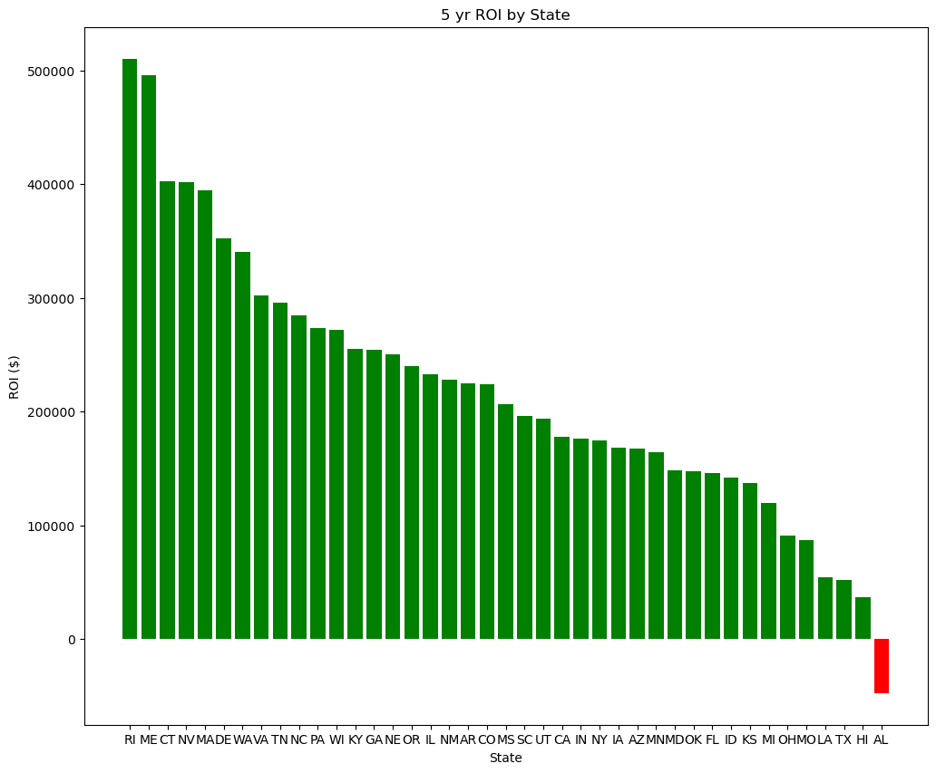
Total ROI by State
Rhode Island leads 5-year ROI with $510,557.
Maine increased by $496,308, close behind Rhode Island.
Alabama only state with negative ROI
Hawaii's high prices do not yield high ROI.

Slide 16
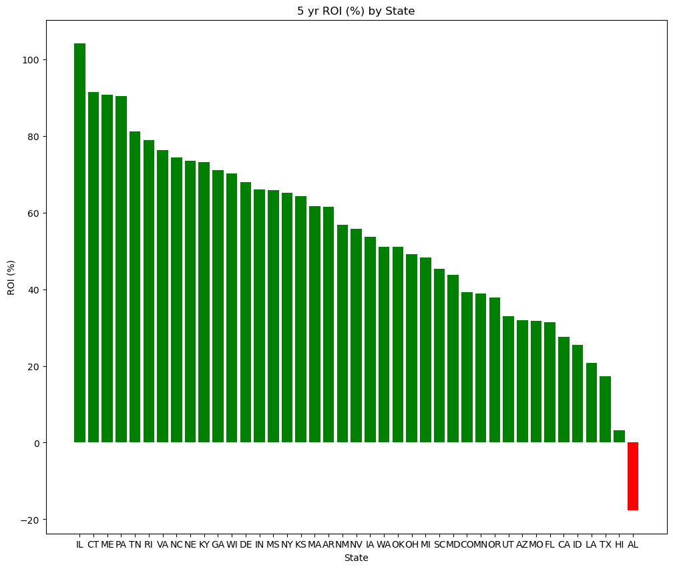
ROI Percentage by State
Illinois has the highest percentage increase at 104%
Others above 90%: PA, ME, CT
Hawaii only 3% ROI
Lowest is Alabama at -18%

Slide 17
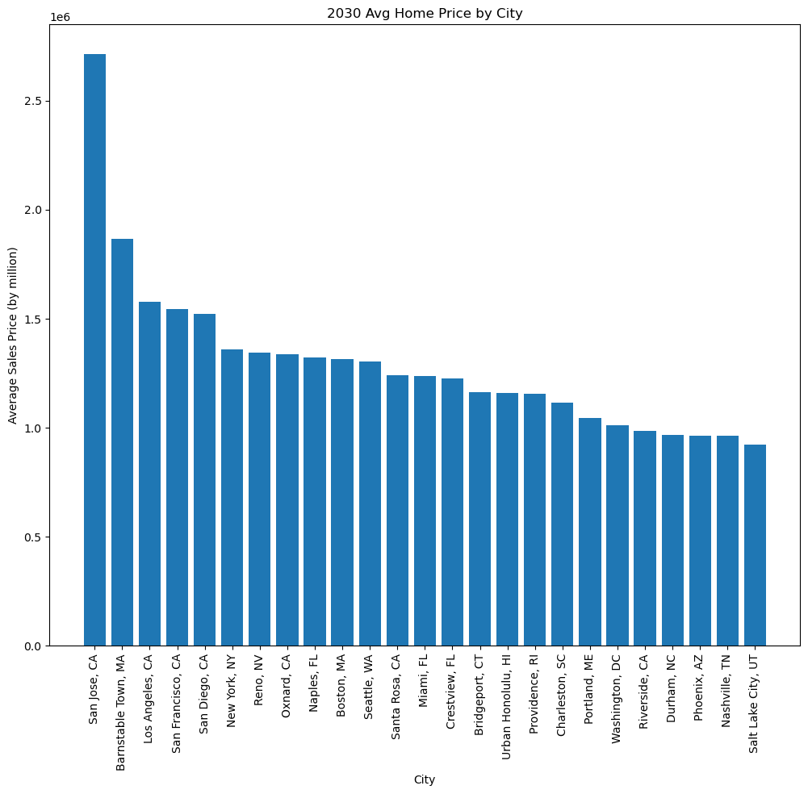
Top 25 Cities by Home Price
San Jose, CA is by far the highest at $2,713,933
California has 7 cities in top 25
19 cities over $1M

Slide 18
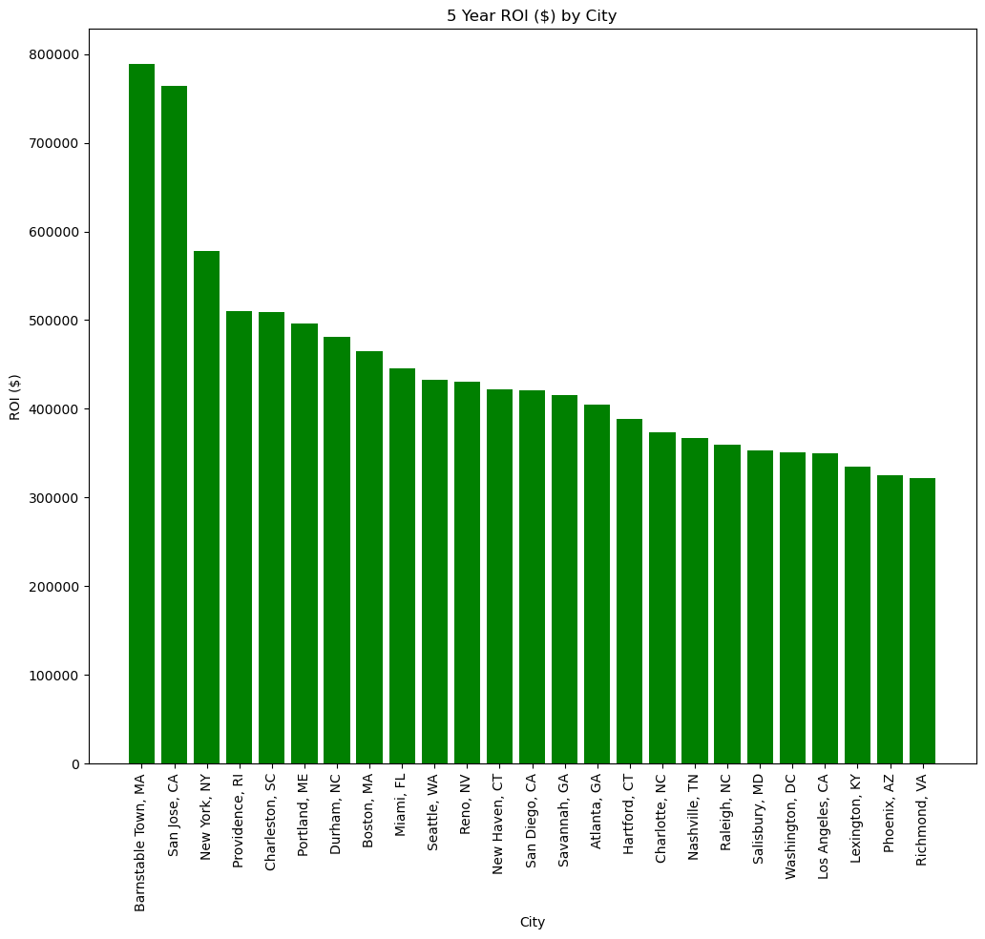
Top 25 Cities by Total ROI
Barnstable, MA leads with a $788,990 gain over 5 years
San Jose, CA: $764,034 ROI
CA and NC have 3 cities in top 25

Slide 19
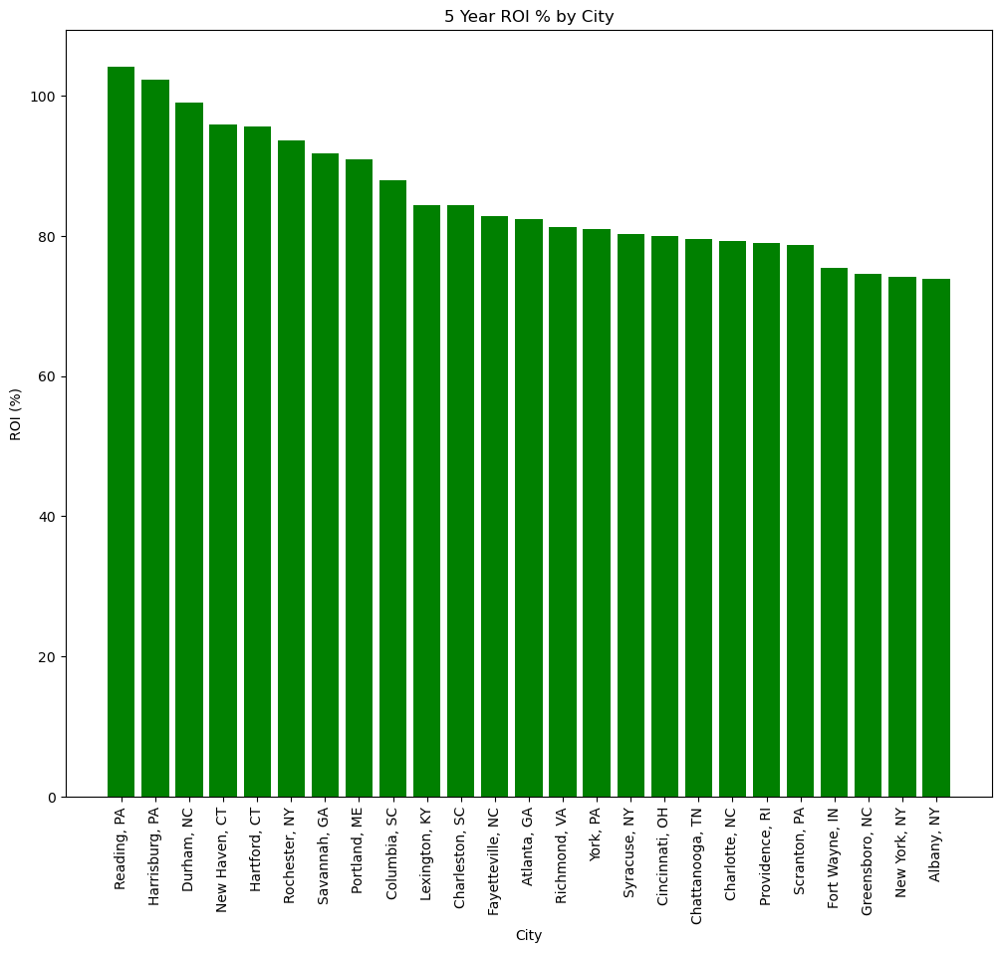
Top 25 Cities by ROI Percentage
Reading, PA & Harrisburg, PA over 100%
8 cities over 90% ROI
19 cities over $1M

Slide 20

Conclusion
States:
Rhode Island and Maine offer best total dollar amount gains.
Illinois presents the top opportunity for percentage gain.
Cities:
Reading and Harrisburg lead in percentage ROI for cities.
Barnstable and San Jose show greatest city dollar gains.

