Slide 1

Business Development Market Recommendation
Tim Carlon

Slide 2
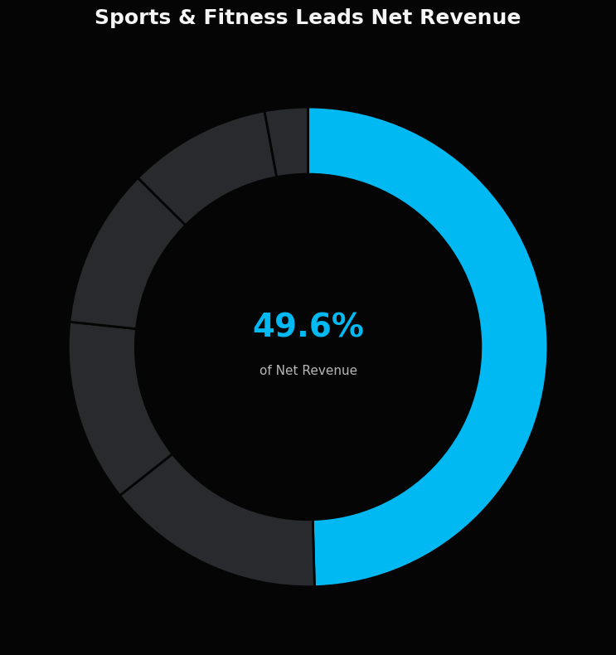
Business Development Recommendation
9.57%
1.52%
$65.1K
Unit Attach Rate
Dollar Attach Rate
Extend Net Revenue
Sports & Fitness Equipment
Highest Unit & Dollar Attach Rate
3x higher Net Revenue than any other industry.
Strongest combination of attach performance, revenue, and market opportunity.

Slide 3
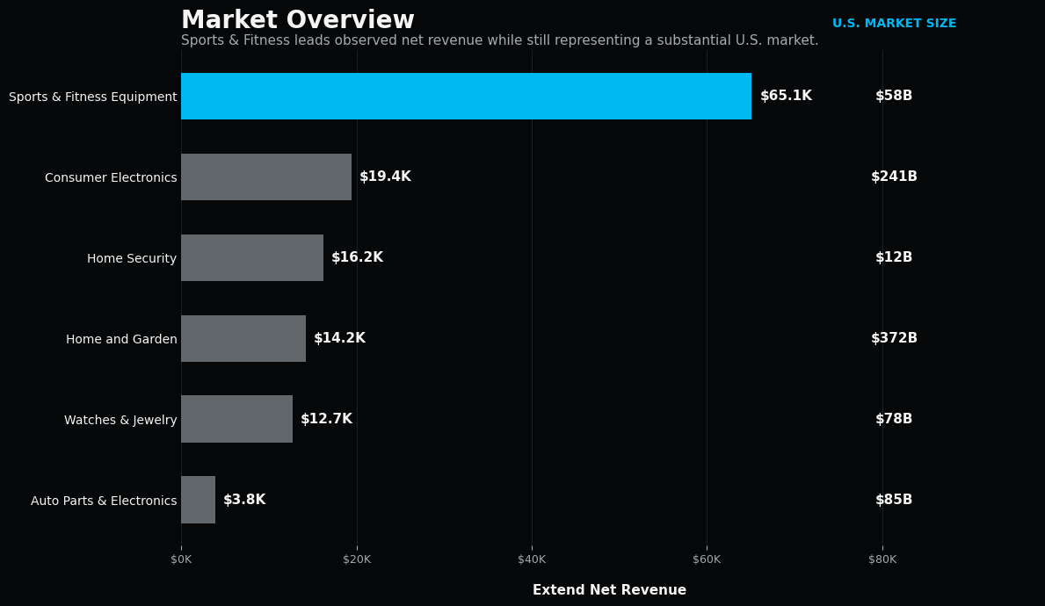
Large Addressable Market
~$58B
U.S. Sporting Goods
Retail Market (2023)*
U.S. Census Bureau – NAICS 451110
(Sporting goods stores)
Why it matters
Sports & Fitness Equipment combines the highest attach performance with a large underlying market, creating meaningful room to expand.
*Directional market size proxy. External definitions may not perfectly align with Extend’s merchant categories.

Slide 4
Why Sports & Fitness Equipment
Proven Warranty Adoption
Proven Economics
Large Expansion Opportunity
Highest unit attach rate (9.57%)
Highest dollar attach rate (1.52%)
Strong performance with multiple merchants
$91.4K in warranty sales
49.6% of total net revenue
More than 3x the net revenue generated by any other industry
~$58B US sporting goods retail market
Evidence consumers in market are receptive to protecting products
Acquiring additional merchants provide path to scale business
★
Recommendation: Prioritize Sports & Fitness Equipment in business development.
Target additional sporting goods, fitness equipment, and adjacent merchants where Extend can replicate the strong warranty attachment demonstrated in its existing portfolio.

Slide 5
Next Steps
1
What is driving the overall decline in attach rate?
2
Why do merchants in the same industry have different attach rates?
Why it matters
Why it matters
Unit attach declined 9.09% → 6.34% and dollar attach declined 1.34% → 0.84% from Mar to May. Reversing this decline represents a meaningful revenue opportunity.
Large variation exists within industries. Identifying drivers can improve performance at lower-performing merchants.
Why I’m asking
Why I’m asking
The decline appears across both unit and dollar attachment, suggesting a broader change in warranty performance.
Consumer Electronics: 3.7%–15.1% unit attach; Sports & Fitness: 6.5%–17.7%.
Additional data needed
Additional data needed
Offer impressions, product category/attributes, warranty-to-product price ratio, checkout placement, device/channel, merchant onboarding/cohort.
Product category, product price, warranty to product price ratio, offer placement/impressions, device/channel, customer/traffic mix.
Approach
Approach
Decompose the decline into mix vs. within-merchant deterioration. Segment across key drivers, quantify with analysis, and validate with A/B tests.
Use segmentation and regression to identify the strongest drivers, then run targeted A/B tests to replicate winning strategies.

