Slide 1
SQL LANGUAGE and Relational Data Model TUTORIAL
Prof: Dr. Shu-Ching Chen
TA: Hsin-Yu Ha

Slide 2
Outline
Relational Data Model
  Step1 Define the purpose
  Step2 Gather data, define constraints
  Step3 Create Relationship
  Step4 Refine and Normalize the design
SQL Language
Notes:
http://www3.ntu.edu.sg/home/ehchua/programming/sql/relational_database_design.html

Slide 3
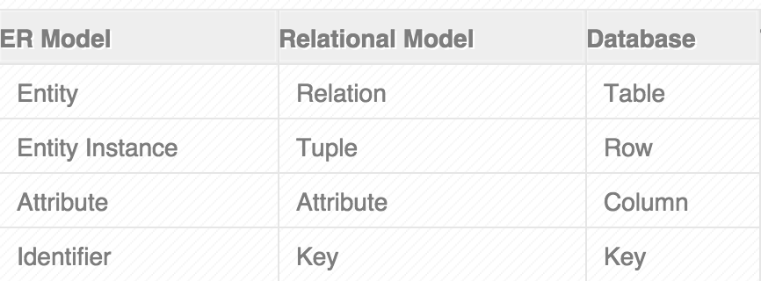
Relational Data Model (1)
Relation : Organizing data into collections of two-dimensional table called “Relations”
ERD ➔ Relational Data Model ➔ Database

Slide 4
Relational Data Model (2)
Fields (Attributes, Columns)
S_id | name | Email | Age | gpa
5000 | Dave | Dave@cs | 19 | 3.3
53666 | Jones | Jone@cs | 18 | 3.4
53888 | Smith | Smith@cs | 18 | 3.2
Tuples
(Records
/Rows )

Slide 5
RD- Step1 Define the purpose
Gather the requirements and define the objective of your database
Notes:
Drafting out the sample input forms, queries and reports, often helps.

Slide 6
RD Step2 Gather data, define constraints
Primary Key
  Unique and not Null
  Simple
  Should not change
  Often uses Integer
Other constraints
  Not null
  Positive values

Slide 7
RD - Step3 Create Relationship (1)
Identify the relationships among tables:
  One-to-Many
  Many-to-Many
  One-to-One

Slide 8
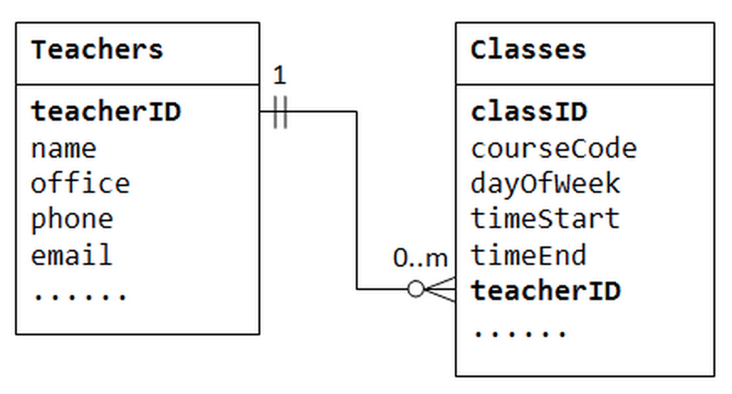
RD - Step3 Create Relationship (2)
One-to-Many
Notes:
The column teacherID in the child table Classes is known as the foreign key. A foreign key of a child table is a primary key of a parent table, used to reference the parent table.
Take note that for every value in the parent table, there could be zero, one, or more rows in the child table. For every value in the child table, there is one and only one row in the parent table.

Slide 9
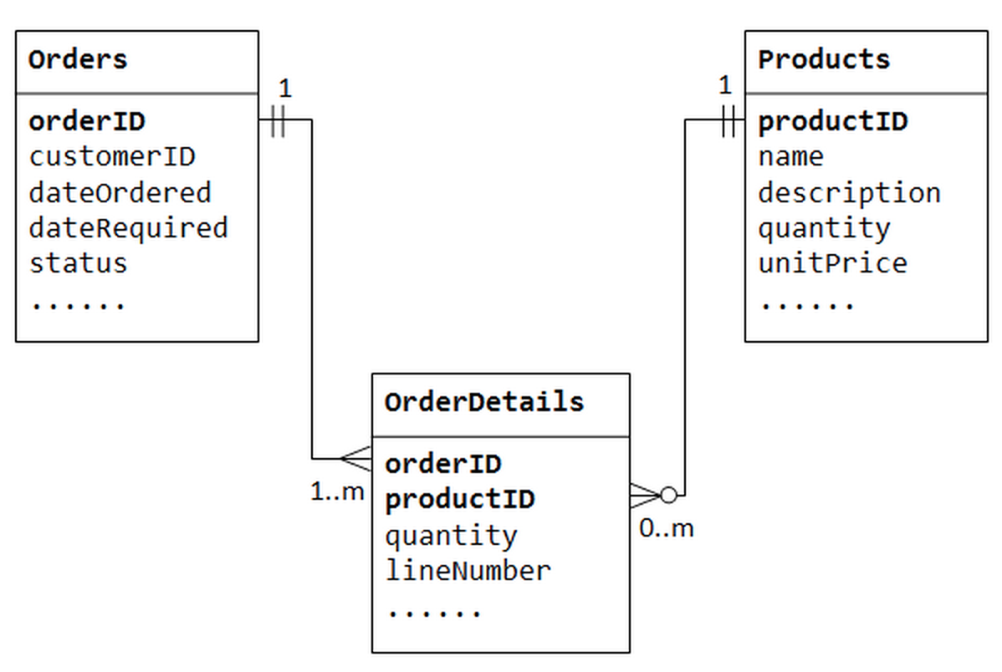
RD - Step3 Create Relationship (3)
Many-to-Many
Notes:
The many-to-many relationship is, in fact, implemented as two one-to-many relationships, with the introduction of the junction table.
- An order has many items in OrderDetails. An OrderDetails item belongs to one particular order.
- A product may appears in many OrderDetails. Each OrderDetails item specified one product.

Slide 10
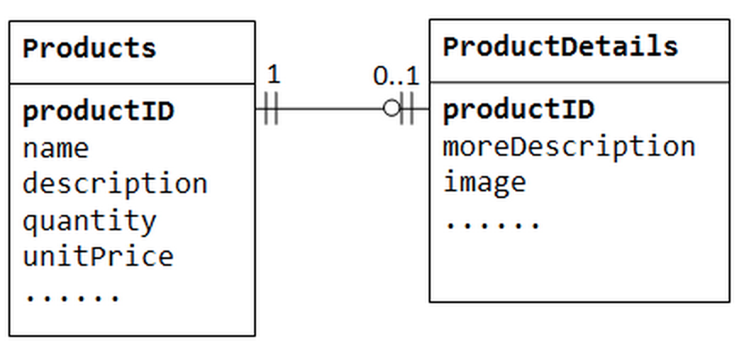
RD - Step3 Create Relationship (4)
One-to-One

Slide 11
RD- Step4 Refine and normalize the design (1)
Normalization
  First Normal Form (1NF)
    A table is 1NF if every cell contains a single value, not a list of values.
  Second Normal Form (2NF)
    A table is 2NF, if it is 1NF and every non-key column is fully dependent on the primary key.
  Third Normal Form (3NF)
    A table is 3NF, if it is 2NF and the non-key columns are independent of each others.
Notes:
2NF - Furthermore, if the primary key is made up of several columns, every non-key column shall depend on the entire set and not part of it.
3NF - In other words, the non-key columns are dependent on primary key, only on the primary key and nothing else. For example, suppose that we have a Products table with columns productID (primary key), name and unitPrice. The column discountRate shall not belong to Products table if it is also dependent on the unitPrice, which is not part of the primary key.

Slide 12
RD- Step4 Refine and normalize the design (2)
Entity Integrity Rule
  The primary key cannot contain NULL.
Referential Integrity Rule
  Each foreign key must be matched to a primary key value in the parent table

Slide 13
Basic Syntax of SQL Language
SELECT attribute name(s)
FROM table name
WHERE comparison predicate (Boolean expression)
GROUP BY attribute name(s)
HAVING comparison predicate
ORDER BY attribute name(s)
Notes:
SQL (Structured Query Language) is a computer language aimed to store, manipulate, and query data stored in relational databases
HAVING is used when you are using an aggregate such as GROUP BY. It is used to check conditions after the aggregation takes place.
WHERE is used before the aggregation takes place.

Slide 14
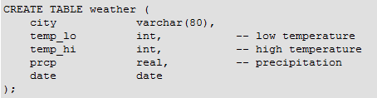




Create Tables
Notes:
Note that all data types use rather obvious input formats. Constants that are not simple numeric values must usually be surrounded by single quotes ('), as in the example. The date column is actually quite flexible in what it accepts, but for this tutorial we will stick to the format shown here.
The syntax used so far requires you to remember the order of the columns. An alternative syntax allows you to list the columns explicitly:
You can list the columns in a different order if you wish or you can even omit some columns, for example, if the precipitation is unknown:
Many developers consider explicitly listing the columns better style than relying on the order implicitly.

Slide 15
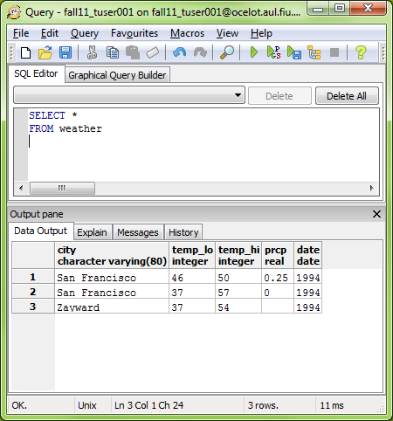
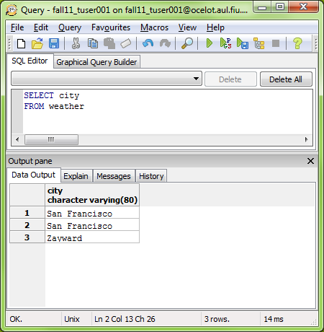
SELECT ALL records
Notes:
SQL is not case sensitive. SELECT is the same as select.
Tip: The asterisk (*) is a quick way of selecting all columns!

Slide 16
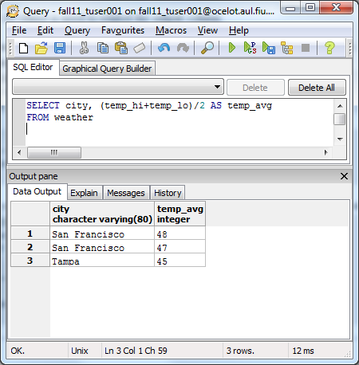
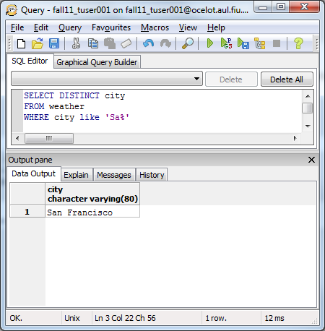
Formula
Like & DISTINCT
Notes:
The LIKE operator is used to search for a specified pattern in a column.
The "%" sign can be used to define wildcards (missing letters in the pattern) both before and after the pattern.
It is also possible to select the city that does NOT contain the pattern “Sa" from the “weather" table, by using the NOT keyword.
SELECT * FROM Persons
WHERE City NOT LIKE '%tav%‘
% => A substitute for zero or more characters
_ => A substitute for exactly one character

Slide 17
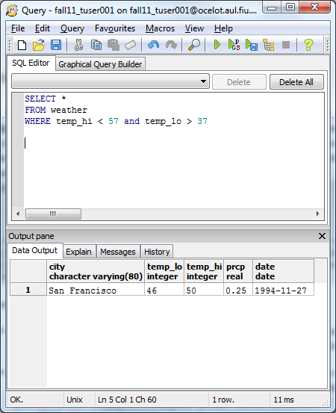
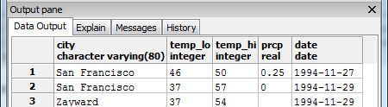
SELECT specific records with conditions

Slide 18
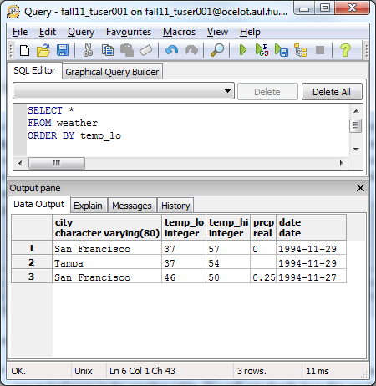
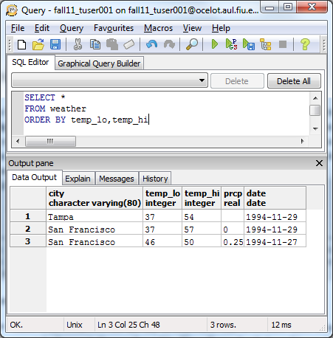
SQL ORDER BY
Notes:
The ORDER BY keyword is used to sort the result-set by a specified column.
The ORDER BY keyword sort the records in ascending order by default.
SELECT * FROM Persons
ORDER BY LastName DESC

Slide 19
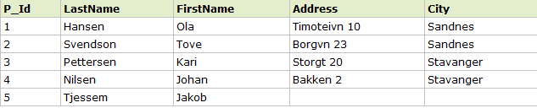


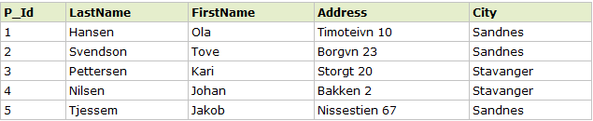
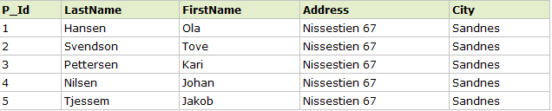
SQL UPDATE
UPDATE table name
SET column1 = value, column2 = value2,…
WHERE comparison predicate (Boolean expression)

Slide 20
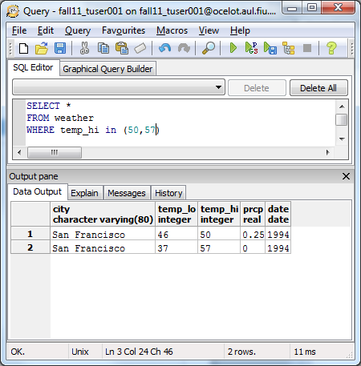
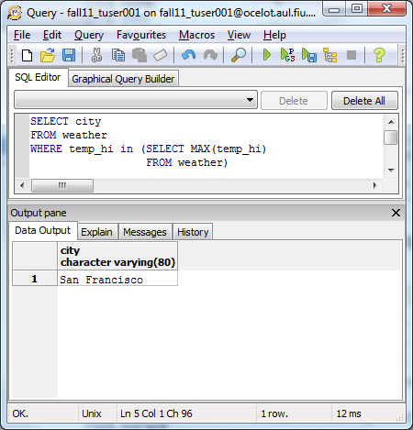
SQL IN OPERATOR
AVG() - Returns the average value
COUNT() - Returns the number of rows
FIRST() - Returns the first value
LAST() - Returns the last value
MAX() - Returns the largest value
MIN() - Returns the smallest value
SUM() - Returns the sum
Notes:
The IN operator allows you to specify multiple values in a WHERE clause
The MAX() function returns the largest value of the selected column
SQL has many built-in functions for performing calculations on data

Slide 21
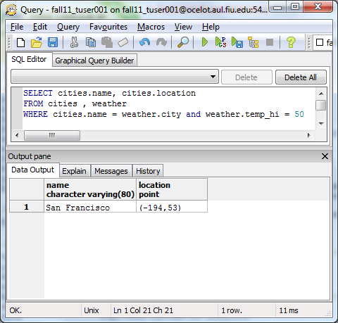
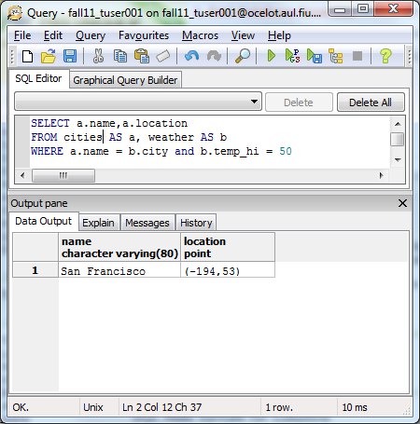
SQL Alias
Notes:
This can be a good thing to do if you have very long or complex table names or column names
An alias name could be anything, but usually it is short.
As you'll see from the two SELECT statements above; aliases can make queries easier to both write and to read.

Slide 22
SQL Joins
SELECT column_name(s)
FROM table_name1 JOIN_TYPES table_name2
ON table_name1.column_name = table_name2.column_name
INNER JOIN: Return rows when there is at least one match in both tables
LEFT JOIN: Return all rows from the left table, even if there are no matches in the right table
RIGHT JOIN: Return all rows from the right table, even if there are no matches in the left table
Notes:
The JOIN keyword is used in an SQL statement to query data from two or more tables, based on a relationship between certain columns in these tables
Tables in a database are often related to each other with keys.
A primary key is a column (or a combination of columns) with a unique value for each row. Each primary key value must be unique within the table. The purpose is to bind data together, across tables, without repeating all of the data in every table

Slide 23

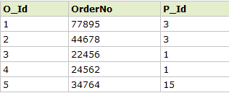

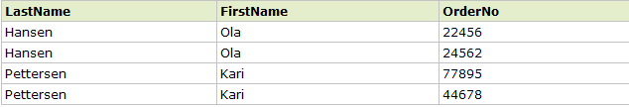
SQL INNER JOIN

Slide 24

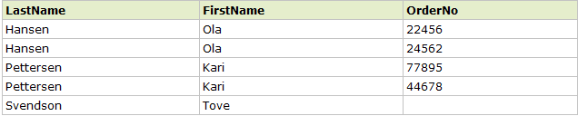
SQL LEFT JOIN

Slide 25

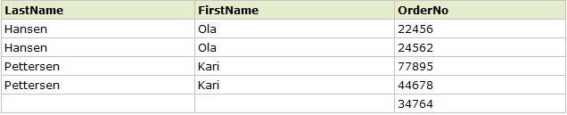
SQL RIGHT JOIN

Slide 26
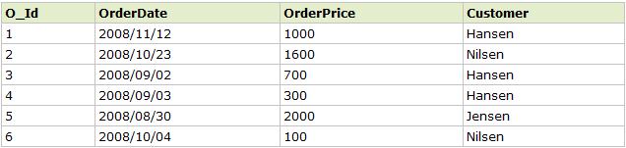

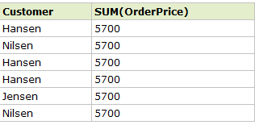
SQL GROUP BY Statement
Notes:
The GROUP BY statement is used in conjunction with the aggregate functions to group the result-set by one or more columns.
Now we want to find the total sum (total order) of each customer.
We will have to use the GROUP BY statement to group the customers

Slide 27

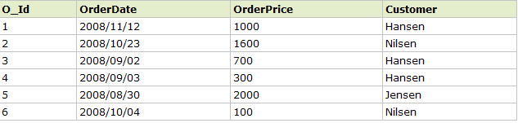

SQL HAVING Clause

Slide 28

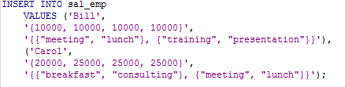

PosgreSQL Arrays (1)
Notes:
PostgreSQL allows columns of a table to be defined as variable-length multidimensional arrays. Arrays of any built-in or user-defined base type, enum type, or composite type can be created. Arrays of domains are not yet supported
As shown, an array data type is named by appending square brackets ([]) to the data type name of the array elements. The above command will create a table named sal_emp with a column of type text (name), a one-dimensional array of type integer(pay_by_quarter), which represents the employee's salary by quarter, and a two-dimensional array of text (schedule), which represents the employee's weekly schedule

Slide 29



PosgreSQL Arrays (2)
Notes:
The array subscript numbers are written within square brackets. By default PostgreSQL uses a one-based numbering convention for arrays, that is, an array of n elements starts with array[1] and ends with array[n]
We can also access arbitrary rectangular slices of an array, or subarrays. An array slice is denoted by writing lower-bound:upper-bound for one or more array dimensions. For example, this query retrieves the first item on Bill's schedule for the first two days of the week:
If any dimension is written as a slice, i.e., contains a colon, then all dimensions are treated as slices. Any dimension that has only a single number (no colon) is treated as being from 1 to the number specified. For example, [2] is treated as [1:2]

Slide 30



PosgreSQL Arrays (3)
Notes:
An array value can be replaced completely:
or using the ARRAY expression syntax:
An array can also be updated at a single element
or updated in a slice:

Slide 31

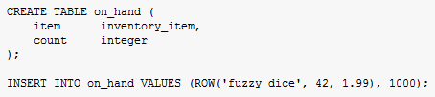

PosgreSQL Composite Types

