Slide 1
COP5725
Database Management
Connect to PostgreSQL sever via pgAdmin
Prof: Dr. Shu-Ching Chen
TA: Hsin-Yu Ha

Slide 2
Procedure outline
Download pgAdmin from http://www.pgadmin.org/
Install pgAdmin
Connect to PostgreSQL through pgAdmin
Start creating your own database.
Notes:
PostgreSQL, often simply Postgres, is an object-relational database management system (ORDBMS) available for many platforms including Linux, FreeBSD, Solaris, Microsoft Windows and Mac OS X
MySQL vs PostgreSQL is a decision many must make when approaching open-source relational database management systems. Both are time-proven solutions that compete strongly with proprietary database software. MySQL has long been assumed to be the faster but less full-featured of the two database systems, while PostgreSQL was assumed to be a more densely featured database system often described as an open-source version of Oracle. MySQL has been popular among various software projects because of its speed and ease of use, while PostgreSQL has had a close following from developers who come from an Oracle or SQL Server background.
These assumptions, however, are mostly outdated and incorrect. MySQL has come a long way in adding advanced functionality while PostgreSQL dramatically improved its speed within the last few major releases. Many, however, are unaware of the convergence and still hold on to stereotypes based on MySQL 4.1 and PostgreSQL 7.4. The current versions are MySQL 5.7 and PostgreSQL 9.4.
For new projects, determine if you are going to port to closed software later on. In that case, PostgreSQL is closer to Oracle, and any code made for PostgreSQL will port to Oracle easily. MySQL has moved away from the SQL standard somewhat. PostgreSQL is more reliable because it is ACID (Atomicity, Consistency, Isolation, and Durability) compliant which means queries will maintain data integrity, and return the same output without error.
MySQL is less reliable and not ACID compliant: The way it handles foreign key references, auditing and transactions make it less reliable. MySQL is good if you are thinking you may use code from other open source projects. Since it is widely used in smaller websites, there are plenty of add-ons, plugins and modules to optimize MySQL from popular software like Wordpress, Drupal and Joomla.

Slide 3
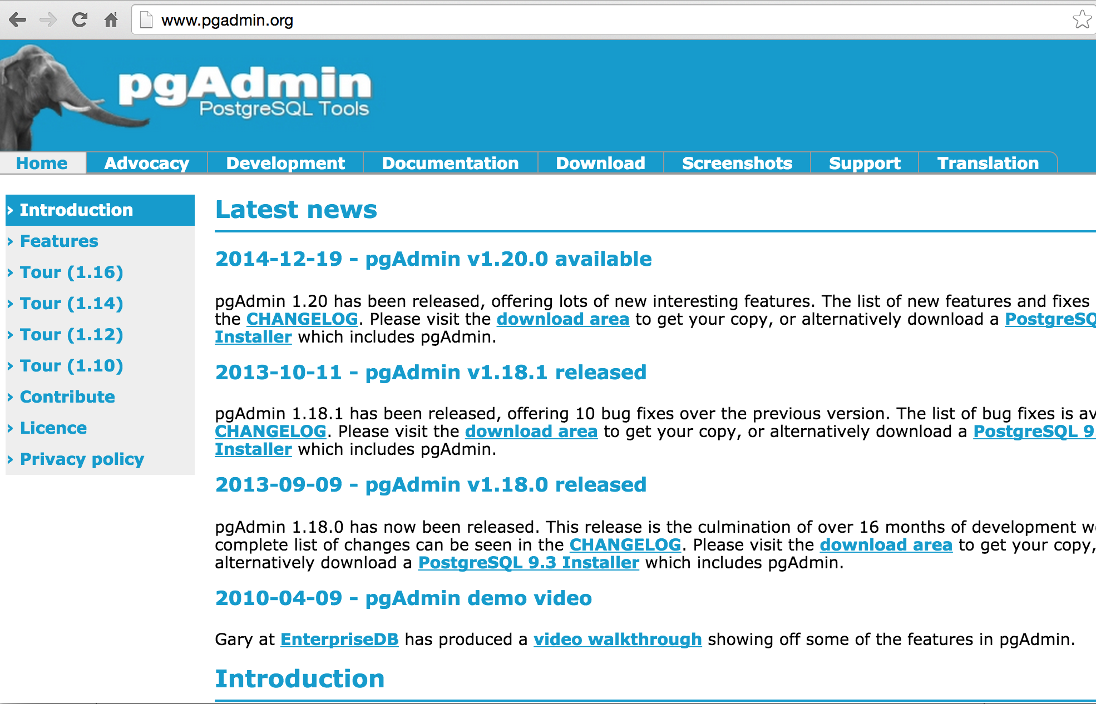
Download pgAdmin (1)
Go to PgAdmin Website
Click download
Notes:
The pgAdmin package is a free and open source graphical user interface administration tool for PostgreSQL, which is supported on many computer platforms.

Slide 4
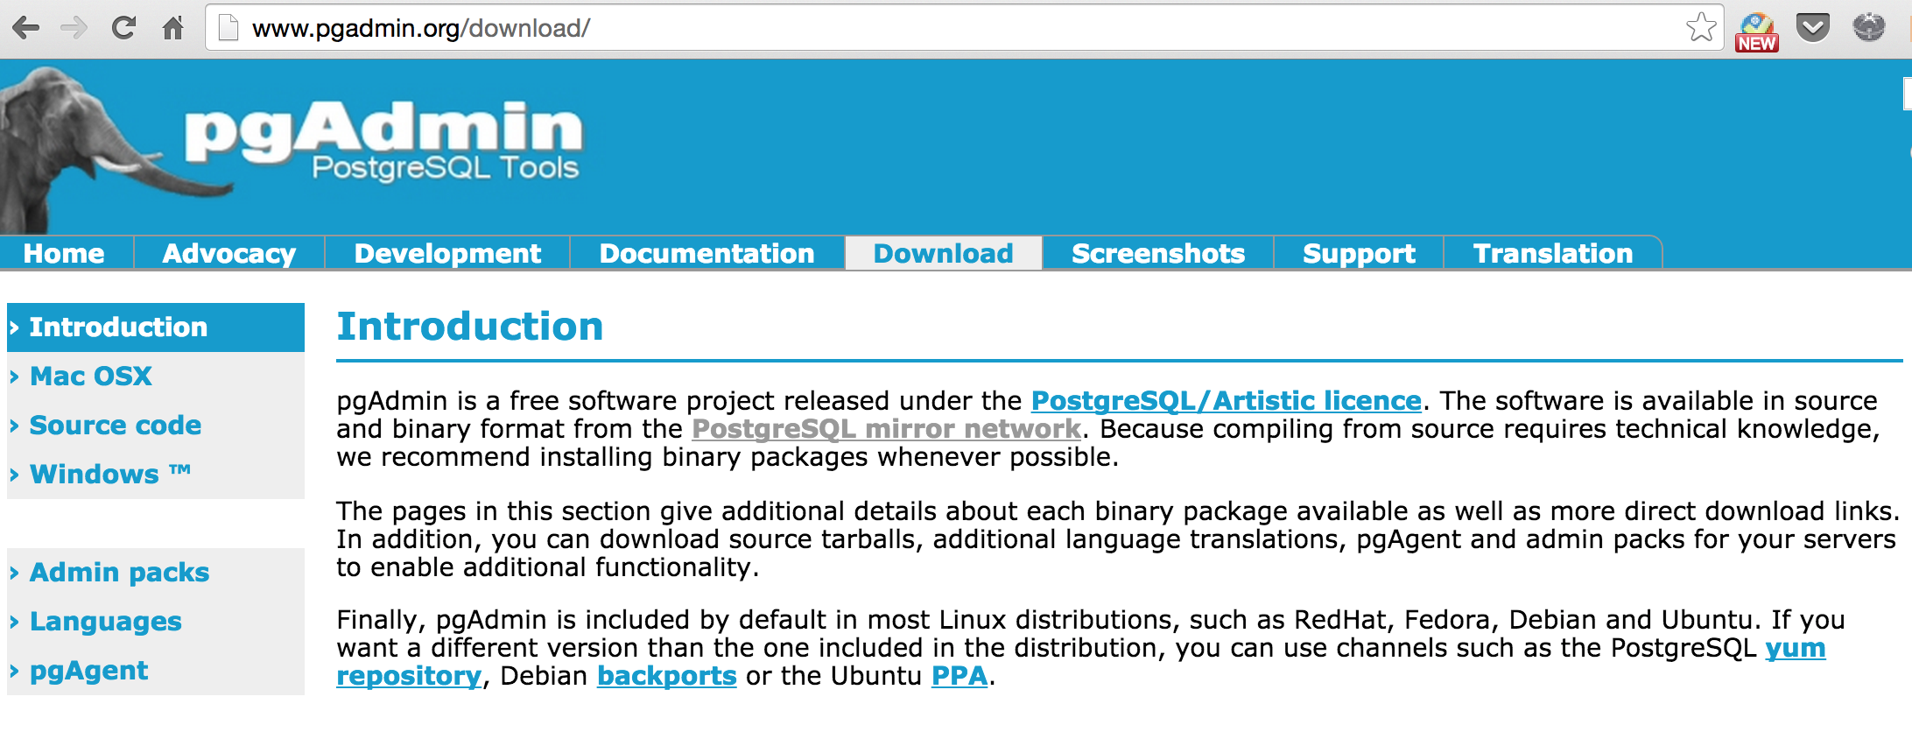
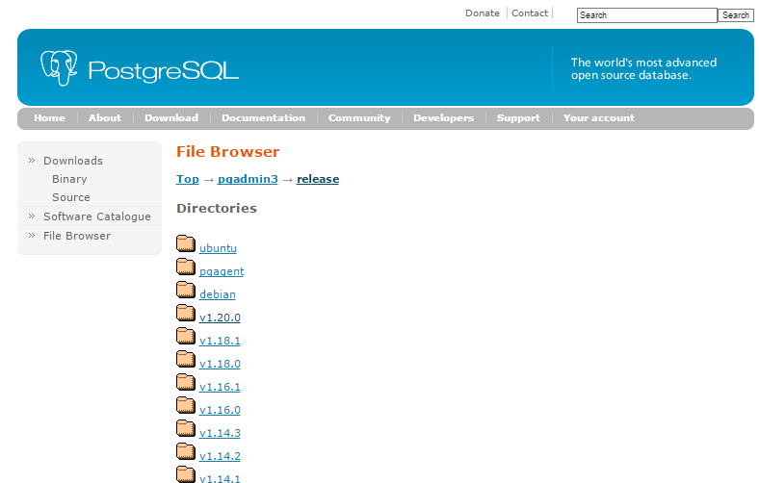
Download pgAdmin (2)
Select the latest reliable version v1.20.0

Slide 5
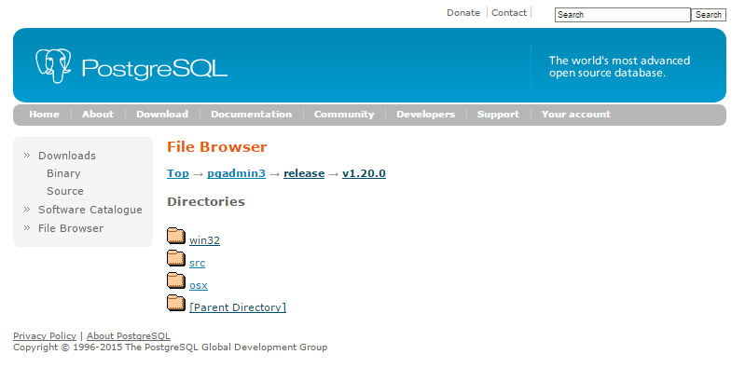
Download pgAdmin (3)

Slide 6
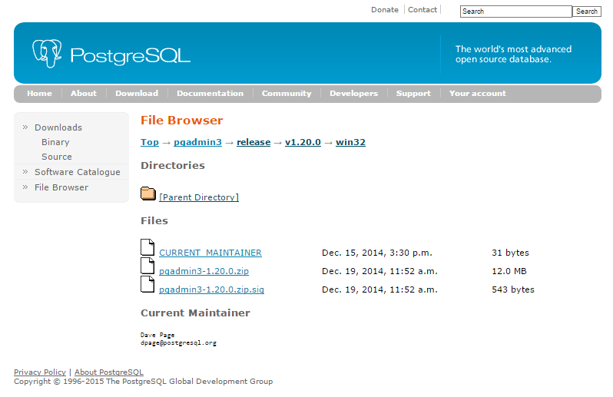
Download pgAdmin (4)
Download pgadmin3-1.20.0.zip and extract.

Slide 7
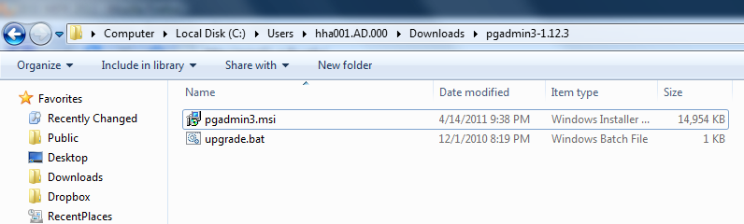
Install pgAdmin (1)
After extracting the zip file “pgadmin3-1.20.0.zip” , execute the file pgadmin3.msi and start the installation process.

Slide 8
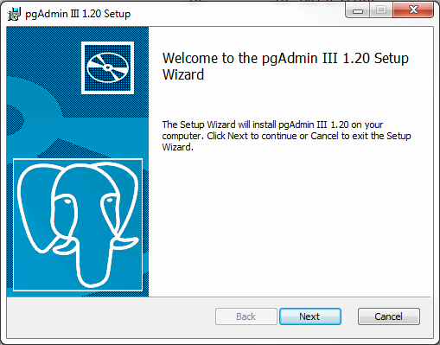
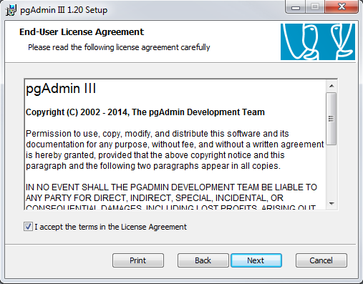
Install pgAdmin (2)

Slide 9
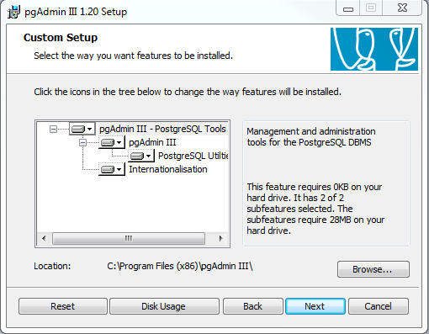
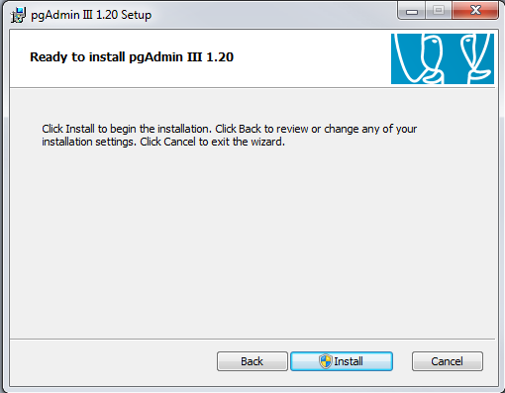
Install pgAdmin (3)

Slide 10
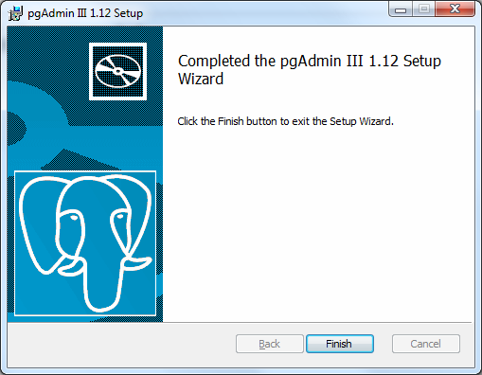
Install pgAdmin (4)
The installation is successfully finished

Slide 11
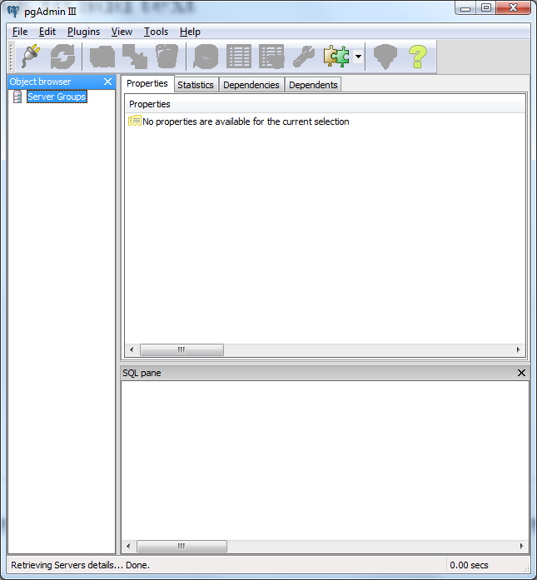
Connect to PostgreSQL (1)
Open pgAdmin and add a connection to a server

Slide 12
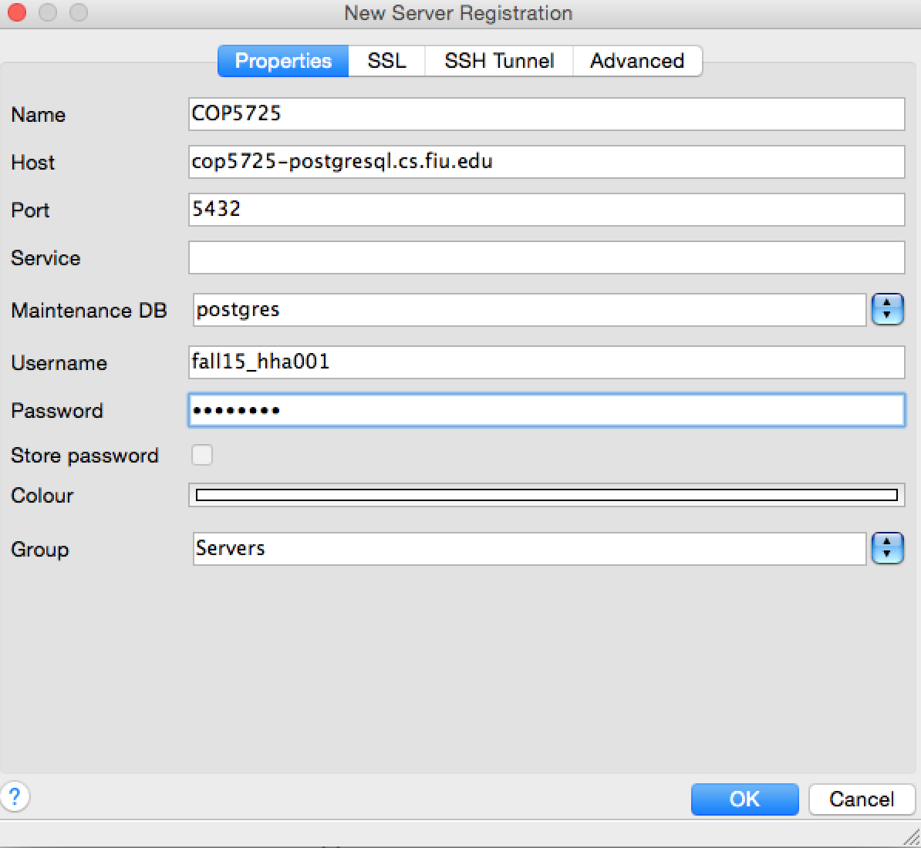
Connect to PostgreSQL (2)
Name for server connection
Hosted server: cop5725-postgresql.cs.fiu.edu
Database Name: postgres
Username: fall15 _”fiu_account”
Password: Panther ID
Notes:
cop4710-postgresql.cs.fiu.edu is an alias for the actual server name, in this way, we don’t have to change host name if use another server to host the database

Slide 13
Connect to PostgreSQL - off-campus (1)

Slide 14
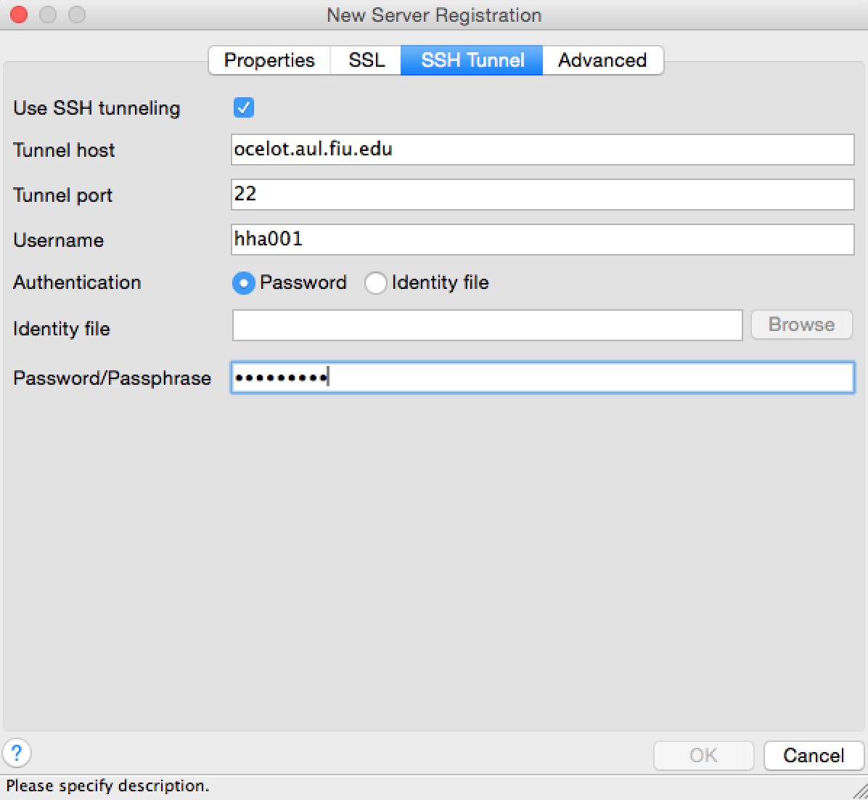
Connect to PostgreSQL - off-campus (2)
Host name
FIU Account
First Initial
+
PantherID
+
Last Initial
Ex: h1234567h

Slide 15
Create a database (1)
Create table
CREATE TABLE products (
product_no integer,
name text,
price numeric
);
Product_no | Name | price
Constraints:
CHECK
NOT NULL
UNIQUE
(4) PRIMARY KEY
(5) FOREIGN KEY
CREATE TABLE products (
product_no integer,
name text,
price numeric CHECK (price > 0)
);
CREATE TABLE products (
product_no integer,
name text,
price numeric CONSTRAINT
positive_price CHECK (price > 0)
);
CHECK Boolean expression
For instance CHECK (price>0)
Notes:
To create a table, you use the aptly named CREATE TABLE command. In this command you specify at least a name for the new table, the names of the columns and the data type of each column. For example:
This creates a table named products with three columns. The first column is named product number and has a data type of integer; the second column has the name name and the type text, the last column is price and the type is numeric. (The numeric type can store fractional components, as would be typical of monetary amounts.)
Note that the column list is comma-separated and surrounded by parentheses.
Data types are a way to limit the kind of data that can be stored in a table. For many applications, however, the constraint they provide is too coarse. For example, a column containing a product price should probably only accept positive values. But there is no standard data type that accepts only positive numbers. Another issue is that you might want to constrain column data with respect to other columns or rows. For example, in a table containing product information, there should be only one row for each product number.
To that end, SQL allows you to define constraints on columns and tables. Constraints give you as much control over the data in your tables as you wish. If a user attempts to store data in a column that would violate a constraint, an error is raised. This applies even if the value came from the default value definition.
A check constraint is the most generic constraint type. It allows you to specify that the value in a certain column must satisfy a Boolean (truth-value) expression. For instance, to require positive product prices, you could use:
the constraint definition comes after the data type
A check constraint consists of the key word CHECK followed by an expression in parentheses. The check constraint expression should involve the column thus constrained, otherwise the constraint would not make too much sense.
You can also give the constraint a separate name. This clarifies error messages and allows you to refer to the constraint when you need to change it. The syntax is:
So, to specify a named constraint, use the key word CONSTRAINT followed by an identifier followed by the constraint definition. (If you don't specify a constraint name in this way, the system chooses a name for you.)
It should be noted that a check constraint is satisfied if the check expression evaluates to true or the null value. Since most expressions will evaluate to the null value if any operand is null, they will not prevent null values in the constrained columns. To ensure that a column does not contain null values, the not-null constraint described in the next section can be used.

Slide 16
Create a database (2)
Not null constraint
Constraints:
CHECK
NOT NULL
UNIQUE
(4) PRIMARY KEY
(5) FOREIGN KEY
CREATE TABLE products (
product_no integer PRIMARY KEY,
name text NOT NULL,
price numeric
);
CREATE TABLE products (
product_no integer UNIQUE NOT NULL,
name text NOT NULL,
price numeric
);
Primary key and Foreign key
CREATE TABLE orders (
order_id integer PRIMARY KEY,
product_no integer REFERENCES products (product_no),
quantity integer,
);
Notes:
A not-null constraint simply specifies that a column must not assume the null value
Unique constraints ensure that the data contained in a column or a group of columns is unique with respect to all the rows in the table.
Technically, a primary key constraint is simply a combination of a unique constraint and a not-null constraint.
Primary keys can also constrain more than one column
A primary key indicates that a column or group of columns can be used as a unique identifier for rows in the table. (This is a direct consequence of the definition of a primary key. Note that a unique constraint does not, by itself, provide a unique identifier because it does not exclude null values.)
A table can have at most one primary key. (There can be any number of unique and not-null constraints, which are functionally the same thing, but only one can be identified as the primary key.) Relational database theory dictates that every table must have a primary key. This rule is not enforced by PostgreSQL, but it is usually best to follow it.
A foreign key constraint specifies that the values in a column (or a group of columns) must match the values appearing in some row of another table. We say this maintains the referential integrity between two related tables.
Say you have the product table that we have used several times already:
Let's also assume you have a table storing orders of those products. We want to ensure that the orders table only contains orders of products that actually exist. So we define a foreign key constraint in the orders table that references the products table:
Now it is impossible to create orders with product_no entries that do not appear in the products table.
We say that in this situation the orders table is the referencing table and the products table is the referenced table. Similarly, there are referencing and referenced columns.
You can also shorten the above command to (REFERENCES products without (product_no))
because in absence of a column list the primary key of the referenced table is used as the referenced column(s).

Slide 17
Create a database (3)
Foreign Key
CREATE TABLE company(
Company_id integer PRIMARY KEY,
Address text
);
CREATE TABLE company_order(
Order_id integer PRIMARY KEY,
Cid integer,
Addr text,
…
FOREIGN KEY (Cid, Addr)
REFERENCES company (Company_id, Address) );
Notes:
A foreign key can also constrain and reference a group of columns. As usual, it then needs to be written in table constraint form. Here is a contrived syntax example:
Of course, the number and type of the constrained columns need to match the number and type of the referenced columns.
You can assign your own name for a foreign key constraint, in the usual way.

Slide 18
Create a database (4)
CREATE TABLE products (
product_no integer PRIMARY KEY,
name text,
price numeric
);
CREATE TABLE orders(
order_id integer PRIMARY KEY,
shipping_address text,
…
);
(1)RESTRICT
(2)NO ACTION (default)
(3)CASCADE
(4)SET NULL
(5)SET DEFAULT
CREATE TABLE order_items (
product_no integer REFERENCES products ON DELETE RESTRICT,
order_id integer REFERENCES orders ON DELETE CASCADE,
quantity integer,
PRIMARY KEY (product_no, order_id)
);
Notes:
A table can contain more than one foreign key constraint. This is used to implement many-to-many relationships between tables. Say you have tables about products and orders, but now you want to allow one order to contain possibly many products (which the structure above did not allow). You could use this table structure
Notice that the primary key overlaps with the foreign keys in the last table.
We know that the foreign keys disallow creation of orders that do not relate to any products. But what if a product is removed after an order is created that references it? SQL allows you to handle that as well. Intuitively, we have a few options:
Disallow deleting a referenced product
Delete the orders as well
Something else?
To illustrate this, let's implement the following policy on the many-to-many relationship example above: when someone wants to remove a product that is still referenced by an order (via order_items), we disallow it. If someone removes an order, the order items are removed as well.
Restricting and cascading deletes are the two most common options. RESTRICT prevents deletion of a referenced row. NO ACTION means that if any referencing rows still exist when the constraint is checked, an error is raised; this is the default behavior if you do not specify anything. (The essential difference between these two choices is that NO ACTION allows the check to be deferred until later in the transaction, whereas RESTRICT does not.)
CASCADE specifies that when a referenced row is deleted, row(s) referencing it should be automatically deleted as well. There are two other options: SET NULL and SET DEFAULT. These cause the referencing columns to be set to nulls or default values, respectively, when the referenced row is deleted. Note that these do not excuse you from observing any constraints. For example, if an action specifies SET DEFAULT but the default value would not satisfy the foreign key, the operation will fail.
Analogous to ON DELETE there is also ON UPDATE which is invoked when a referenced column is changed (updated). The possible actions are the same.
=======================================================================================================
ON DELETE CASCADE (when a referenced parent table row is removed all the child are removed automatically)
The ON DELETE SET NULL action allows data that references the parent key to be deleted, but not updated. When referenced data in the parent key is deleted, all rows in the child table that depend on those parent key values have their foreign keys set to null.
ON DELETE NO ACTION (which is the default) prevents deleting a parent when there are children (would be nice arrangement for real life)
Some other SQL systems make a following distinction: NO ACTION means to allow the change if the new value in the child table is still valid after statement and all the triggers are completed (i.e. still found in the parent table of the relationship), while RESTRICT means that changing the value is not allowed at all (no change or delete is allowed if there are child records).
This is implemented in such way that NO ACTION constraint rules are checked after all other operation, and RESTRICT is checked before any other operation. In current Firebird versions, both keywords are implemented as NO ACTION.
Please note that RESTRICT rule is applied when option is not give in the constraint. That is, if you run:
ALTER TABLE EMPLOYEE ADD CONSTRAINT INTEG_28
FOREIGN KEY (DEPT_NO) REFERENCES DEPARTMENT (DEPT_NO);
Since ON UPDATE and ON DELETE clauses are not given, it means ON UPDATE RESTRICT and ON DELETE RESTRICT.

Slide 19
Create a database (5)
Insert Data
INSERT INTO products VALUES (1,'cheese',5);
INSERT INTO products (product_no , name ,price) VALUES (1,'cheese',5);
INSERT INTO products VALUES
(1,'cheese',5),
(2,’cake’,10) ;
Notes:
When a table is created, it contains no data. The first thing to do before a database can be of much use is to insert data. Data is conceptually inserted one row at a time. Of course you can also insert more than one row, but there is no way to insert less than one row at a time. Even if you know only some column values, a complete row must be created.
To create a new row, use the INSERT command. The command requires the table name and a value for each of the columns of the table. For example, consider the products table
The data values are listed in the order in which the columns appear in the table, separated by commas. Usually, the data values will be literals (constants), but scalar expressions are also allowed.
The above syntax has the drawback that you need to know the order of the columns in the table. To avoid that you can also list the columns explicitly. For example, both of the following commands have the same effect as the one above:
Many users consider it good practice to always list the column names.
You can insert multiple rows in a single command:

Slide 20
Create a database (6)
Import Data
Export Data
COPY country FROM '/usr1/proj/bray/sql/country_data.csv'
WITH DELIMITER ',' ;
COPY country TO '/sql/country_data.csv' WITH DELIMITER '|';
Notes:
COPY moves data between PostgreSQL tables and standard file-system files. COPY TO copies the contents of a table to a file, while COPY FROM copies data from a file to a table (appending the data to whatever is in the table already). COPY TO can also copy the results of a SELECTquery.
If a list of columns is specified, COPY will only copy the data in the specified columns to or from the file. If there are any columns in the table that are not in the column list, COPY FROM will insert the default values for those columns.
COPY with a file name instructs the PostgreSQL server to directly read from or write to a file. The file must be accessible to the server and the name must be specified from the viewpoint of the server. When STDIN or STDOUT is specified, data is transmitted via the connection between the client and the server.
The following example copies a table to the client using the vertical bar (|) as the field delimiter:

Slide 21
Create a database (7)
ALTER Table
  Add columns
  Remove columns
  Add constraints
ALTER TABLE products ADD COLUMN description text;
ALTER TABLE products DROP COLUMN description;
ALTER TABLE products ADD CONSTRAINT namecheck CHECK (name <> '');
ALTER TABLE products ADD CONSTRAINT some_name UNIQUE (product_no);
ALTER TABLE products ADD FOREIGN KEY (product_group_id)
REFERENCES product_groups;
ALTER TABLE products ALTER COLUMN product_no SET NOT NULL;
Notes:
When you create a table and you realize that you made a mistake, or the requirements of the application change, then you can drop the table and create it again. But this is not a convenient option if the table is already filled with data, or if the table is referenced by other database objects (for instance a foreign key constraint). Therefore PostgreSQL provides a family of commands to make modifications to existing tables. Note that this is conceptually distinct from altering the data contained in the table: here we are interested in altering the definition, or structure, of the table.
You can
Add columns,
Remove columns,
Add constraints,
Remove constraints,
Change default values,
Change column data types,
Rename columns,
Rename tables.
All these actions are performed using the ALTER TABLE command
To add a column, use a command like this:
The new column is initially filled with whatever default value is given (null if you don't specify a DEFAULT clause).
To remove a column, use a command like this:
Whatever data was in the column disappears. Table constraints involving the column are dropped, too. However, if the column is referenced by a foreign key constraint of another table, PostgreSQL will not silently drop that constraint. You can authorize dropping everything that depends on the column by adding CASCADE:
To add a constraint, the table constraint syntax is used.
To add a not-null constraint, which cannot be written as a table constraint, use this syntax:
The constraint will be checked immediately, so the table data must satisfy the constraint before it can be added.

Slide 22
Create a database (8)
ALTER Table
  Remove constraints
  Change column data types
  Rename columns
  Rename tables
ALTER TABLE products DROP CONSTRAINT some_name;
ALTER TABLE products ALTER COLUMN product_no DROP NOT NULL;
ALTER TABLE products ALTER COLUMN price TYPE numeric(10,2);
ALTER TABLE products RENAME COLUMN product_no TO product_number;
ALTER TABLE products RENAME TO items;
Notes:
To remove a constraint you need to know its name. If you gave it a name then that's easy. Otherwise the system assigned a generated name, which you need to find out. The psql command \d tablename can be helpful here; other interfaces might also provide a way to inspect table details. Then the command is:
As with dropping a column, you need to add CASCADE if you want to drop a constraint that something else depends on. An example is that a foreign key constraint depends on a unique or primary key constraint on the referenced column(s).
This works the same for all constraint types except not-null constraints. To drop a not null constraint use
(Recall that not-null constraints do not have names.)
To convert a column to a different data type, use a command like this:
This will succeed only if each existing entry in the column can be converted to the new type by an implicit cast. If a more complex conversion is needed, you can add a USING clause that specifies how to compute the new values from the old.
PostgreSQL will attempt to convert the column's default value (if any) to the new type, as well as any constraints that involve the column. But these conversions may fail, or may produce surprising results. It's often best to drop any constraints on the column before altering its type, and then add back suitably modified constraints afterwards.

Slide 23
Create a database (9)
Update Data
UPDATE products SET price = 10 WHERE price = 5;
UPDATE products SET price = price * 1.10;
UPDATE mytable SET a=5, b=3, c=1 WHERE a>0;
Notes:
The modification of data that is already in the database is referred to as updating. You can update individual rows, all the rows in a table, or a subset of all rows. Each column can be updated separately; the other columns are not affected.
To perform an update, you need three pieces of information:
The name of the table and column to update,
The new value of the column,
Which row(s) to update.
it is not necessarily possible to directly specify which row to update. Instead, you specify which conditions a row must meet in order to be updated. Only if you have a primary key in the table (no matter whether you declared it or not) can you reliably address individual rows, by choosing a condition that matches the primary key. Graphical database access tools rely on this fact to allow you to update rows individually.
For example, this command updates all products that have a price of 5 to have a price of 10:
This may cause zero, one, or many rows to be updated. It is not an error to attempt an update that does not match any rows.
Let's look at that command in detail. First is the key word UPDATE followed by the table name. As usual, the table name may be schema-qualified, otherwise it is looked up in the path. Next is the key word SET followed by the column name, an equals sign and the new column value. The new column value can be any scalar expression, not just a constant. For example, if you want to raise the price of all products by 10% you could use:
As you see, the expression for the new value can refer to the existing value(s) in the row. We also left out the WHERE clause. If it is omitted, it means that all rows in the table are updated. If it is present, only those rows that match the WHERE condition are updated. Note that the equals sign in the SET clause is an assignment while the one in the WHERE clause is a comparison, but this does not create any ambiguity. Of course, the WHERE condition does not have to be an equality test. Many other operators are available (see Chapter 9). But the expression needs to evaluate to a Boolean result.
You can update more than one column in an UPDATE command by listing more than one assignment in the SET clause. For example:

Slide 24
Create a database (10)
Delete Data
DELETE FROM products WHERE price = 10;
DELETE FROM products
Notes:
So far we have explained how to add data to tables and how to change data. What remains is to discuss how to remove data that is no longer needed. Just as adding data is only possible in whole rows, you can only remove entire rows from a table. In the previous section we explained that SQL does not provide a way to directly address individual rows. Therefore, removing rows can only be done by specifying conditions that the rows to be removed have to match. If you have a primary key in the table then you can specify the exact row. But you can also remove groups of rows matching a condition, or you can remove all rows in the table at once.
You use the DELETE command to remove rows; the syntax is very similar to the UPDATE command. For instance, to remove all rows from the products table that have a price of 10, use
If you simply write
DELETE FROM products; then all rows in the table will be deleted! Caveat programmer.

Slide 25
ER Tools
Microsoft Visio
MySQL Workbench
  http://dev.mysql.com/downloads/workbench/5.1.html
Draw.io
  https://www.draw.io/
Schema Crawler
  http://sualeh.github.io/SchemaCrawler/diagramming.html

