Slide 1
GitHub

Slide 2
What is GitHub?
GitHub is a popular online platform for software development, often described as a social network for developers.
GitHub is a powerful platform that can be used for a variety of purposes.
Whether you're a solo developer working on a personal project or a member of a large team working on a complex software application, GitHub can help you be more productive and efficient.

Slide 3
What GitHub offers?
It offers several key functionalities:
1. Version Control
Revert to previous versions
Compare changes
Collaborate with others
2. Collaboration
3. Code Sharing and Discovery
4. Additional Features:
Issue tracking:
Project management:
Continuous integration and continuous delivery (CI/CD):
Security features:

Slide 4
Writing and Editing Code
While GitHub is an essential tool for software development, it's not designed to be a standalone development environment.
Writing and Editing Code: GitHub itself doesn't provide a code editor. You'll need a separate text editor or integrated development environment (IDE) to write and modify your code.
Visual Studio Code
Atom
Sublime Text
IntelliJ IDEA
PyCharm (for Python)
Android Studio (for Android development)

Slide 5
Building and Running Code
GitHub doesn't execute code on its own. You'll need to use local development tools or cloud-based services to compile, run, and test your software.
Local Development Environment: Setting up a local environment with the necessary programming languages, compilers, interpreters, and other tools for your project.
Cloud-Based Services: Using cloud platforms that provide virtual machines or containers for building and running code, such as GitHub Codespaces or cloud-based IDEs.

Slide 6
Debugging
GitHub doesn't provide debugging tools for troubleshooting errors in your code.
You'll need to use a debugger integrated with your IDE or a standalone debugger.

Slide 7
Managing Dependencies
GitHub doesn't manage external libraries or dependencies that your project relies on.
You'll need to use tools like package managers (e.g., npm for JavaScript, pip for Python) to handle these dependencies effectively.

Slide 8
Deployment
GitHub isn't designed for deploying software to production environments.
You'll typically use additional tools or services for deployment, such as:
Hosting platforms (e.g., Heroku, AWS, Azure)
Continuous integration and continuous delivery (CI/CD) pipelines

Slide 9
GitHub is an outstanding platform for version control, collaboration, and code sharing.

Slide 10


Slide 11


Slide 12
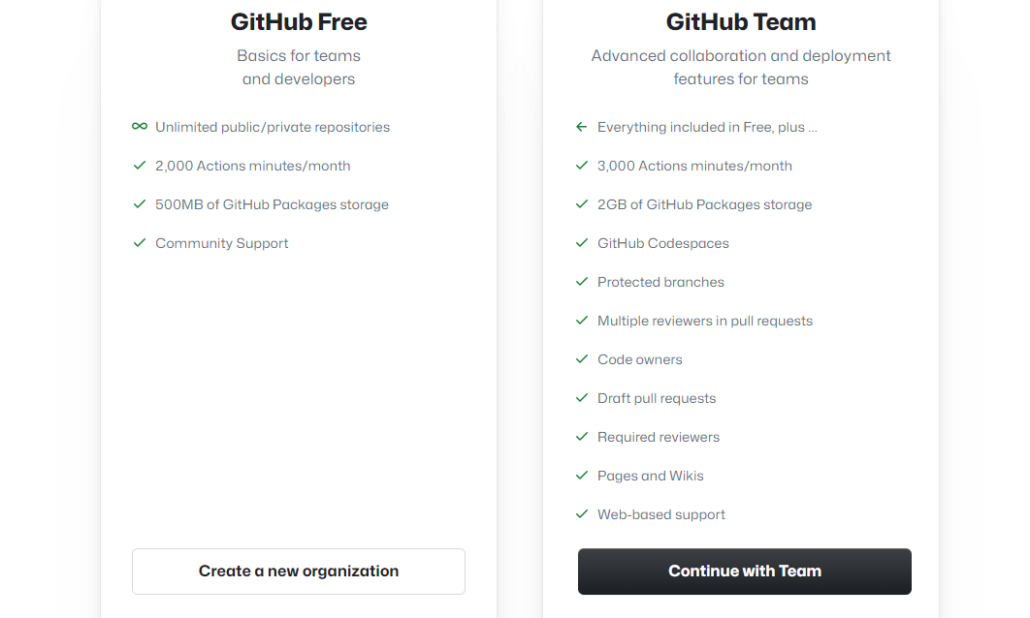

Slide 13
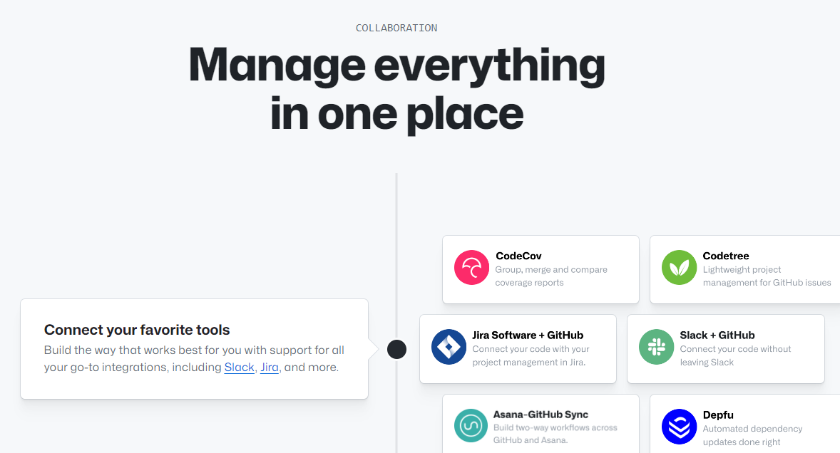

Slide 14
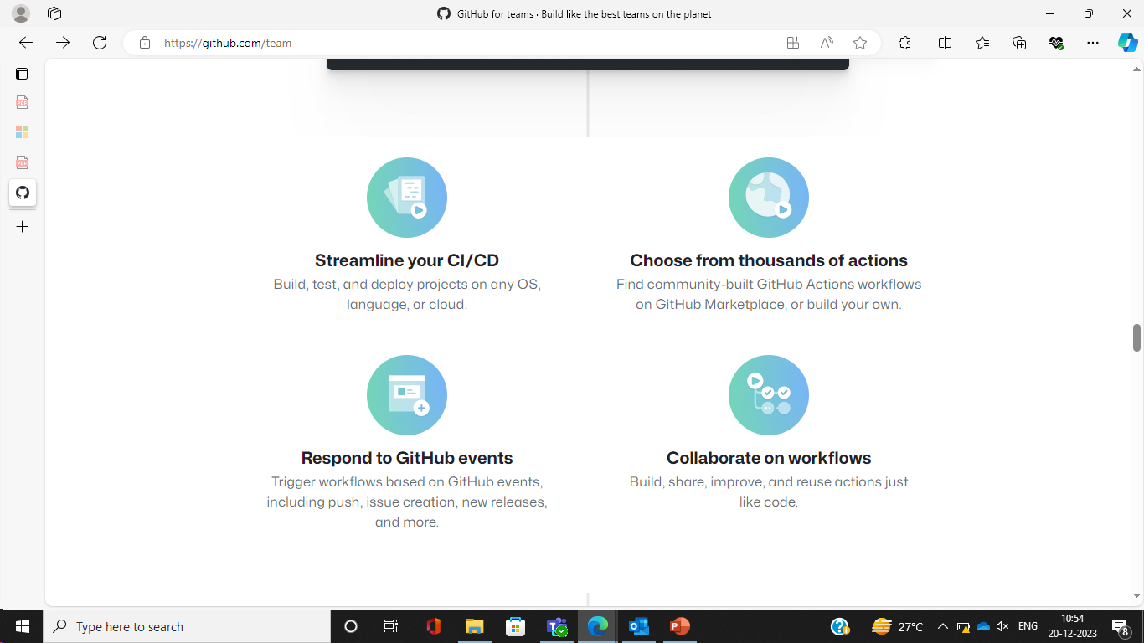

Slide 15
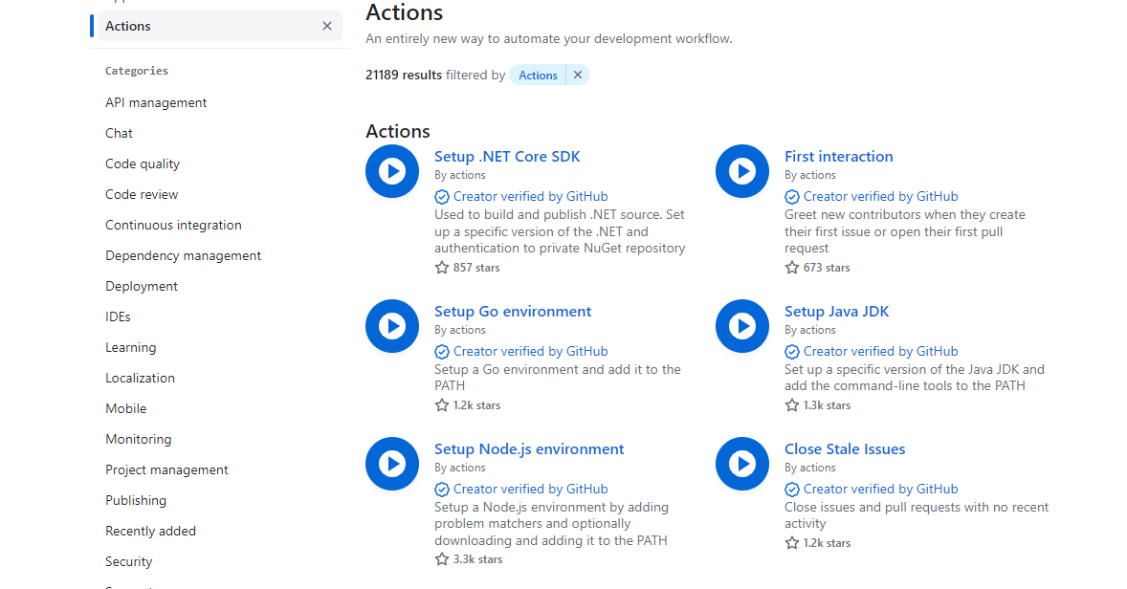

Slide 16
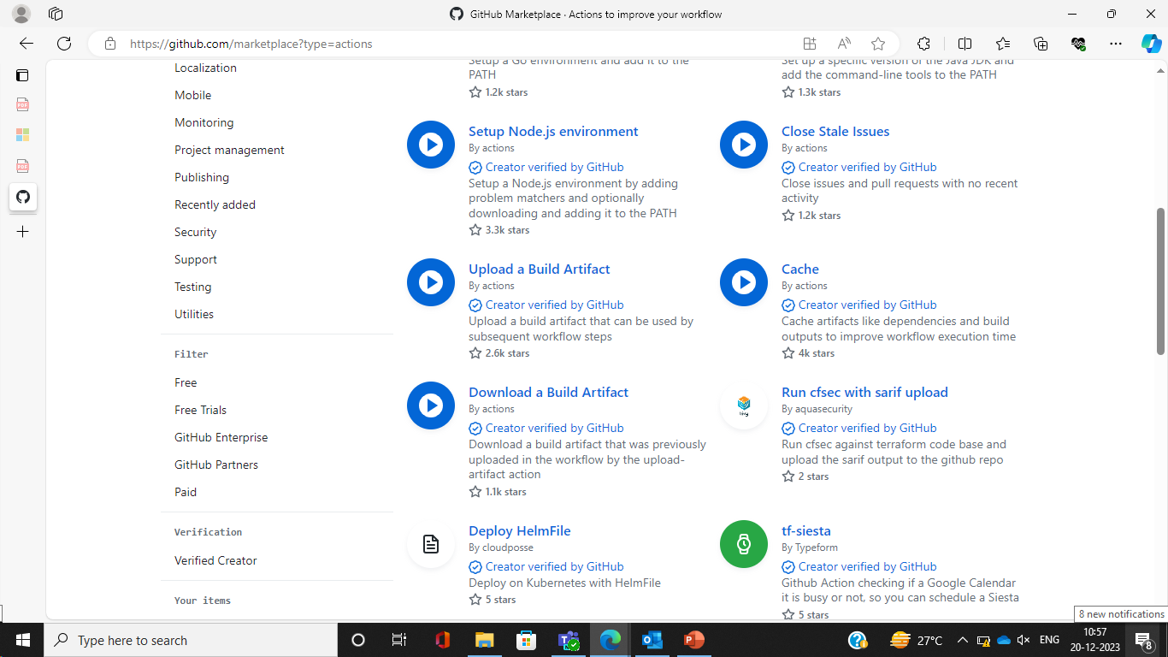

Slide 17
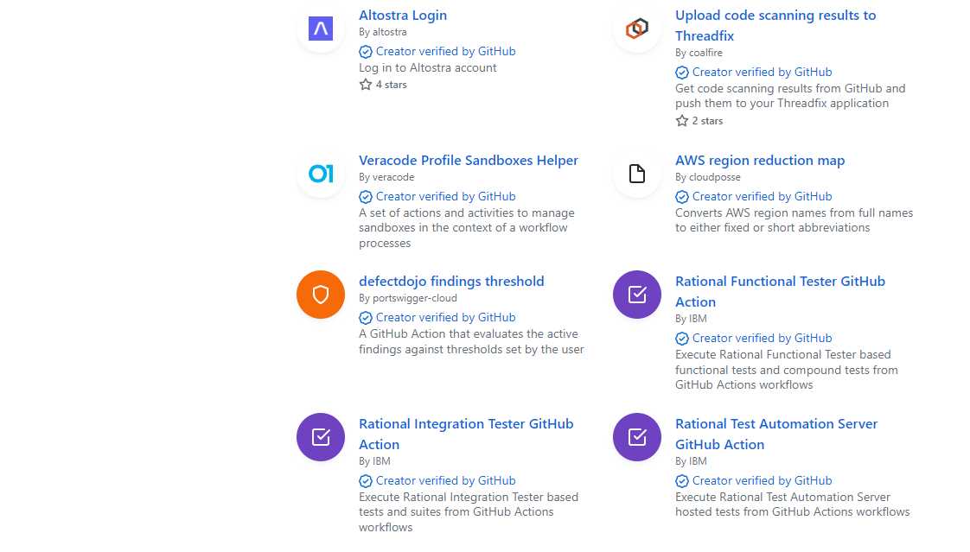

Slide 18
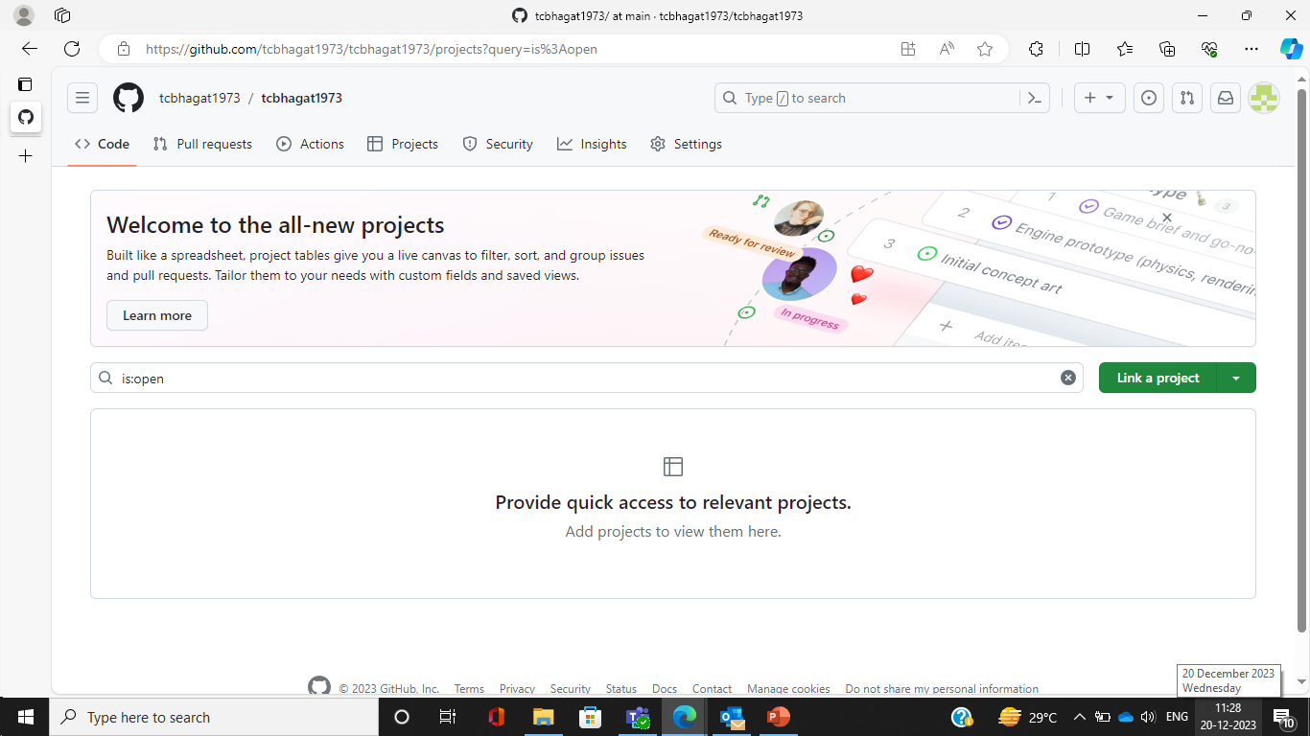

Slide 19
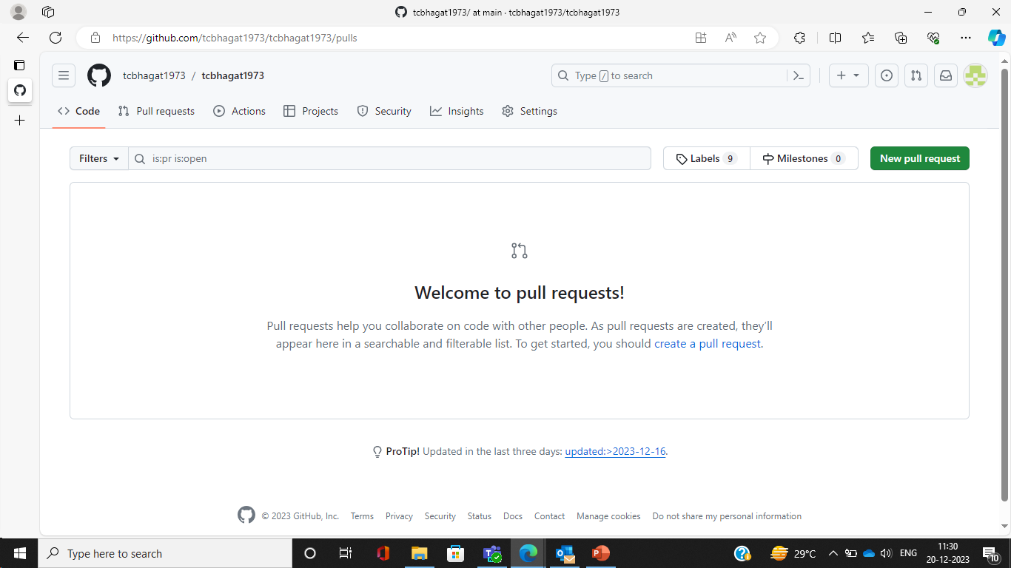

Slide 20
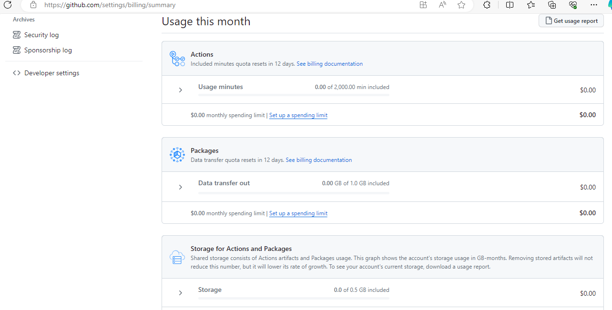

Slide 21
