Slide 1
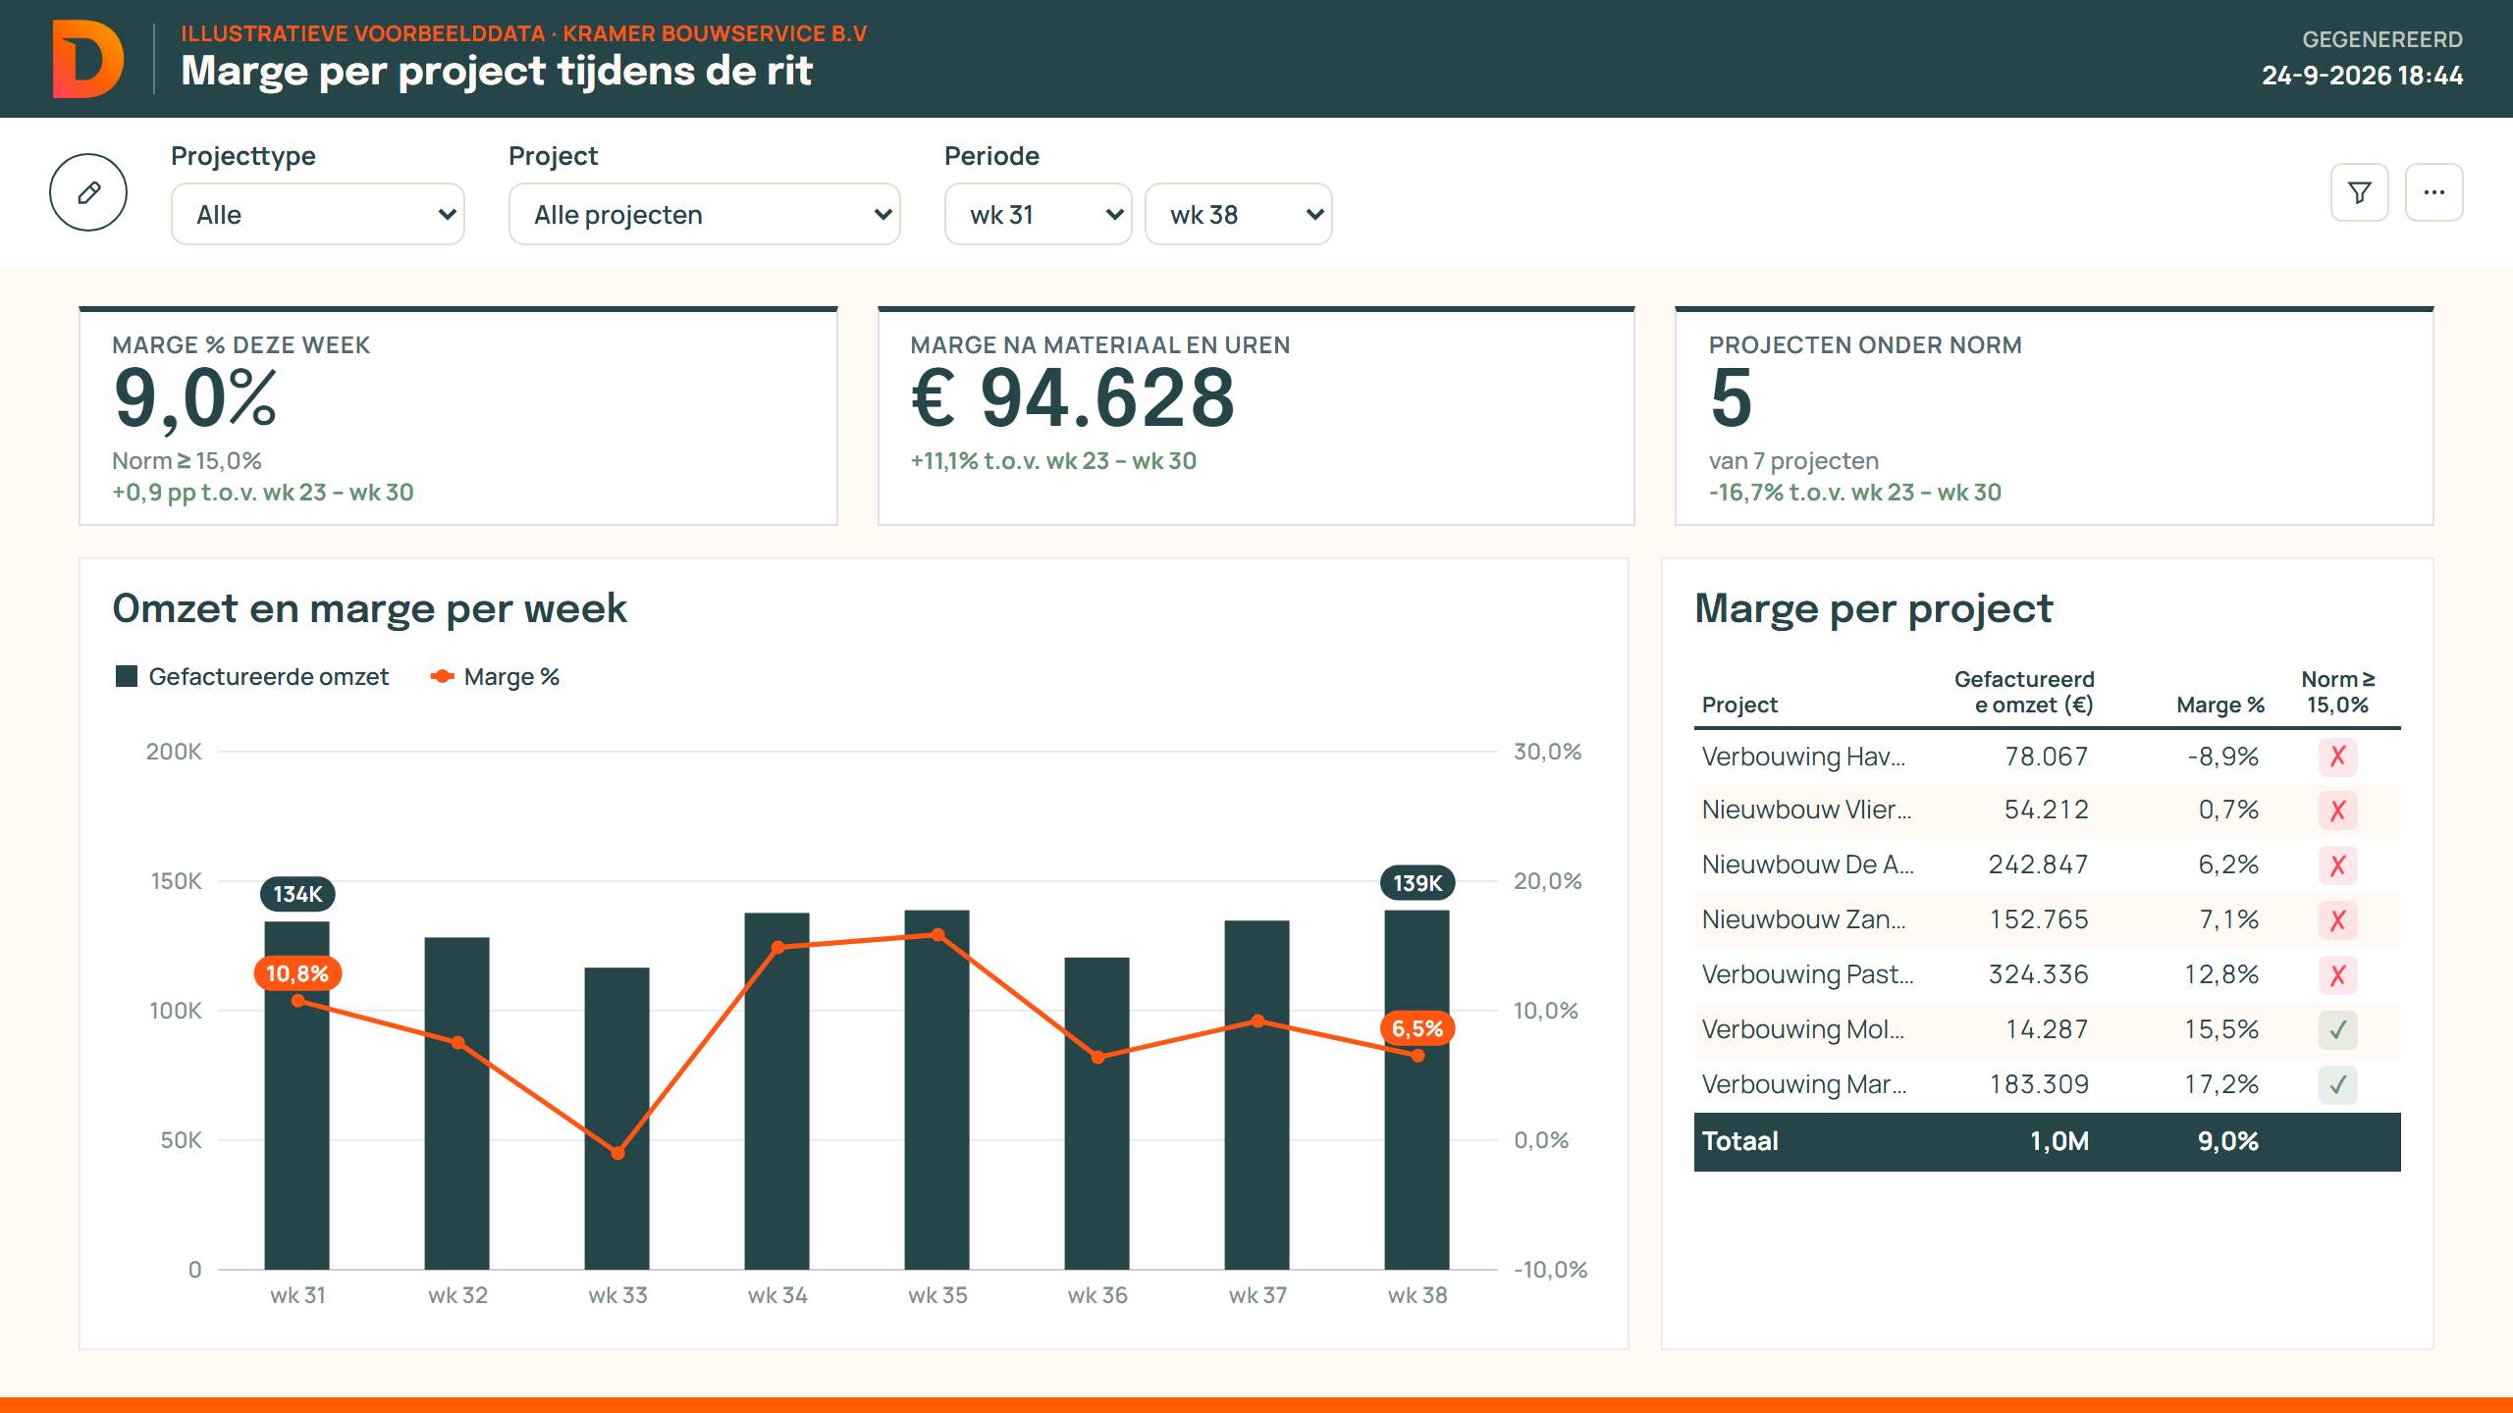
AI STRATEGY LAB · FINAL PRESENTATION · TRACK A
From sales call to a tailored proposal and PoC dashboard — the same day
How Datavance uses GenAI to replace a fully manual pre-sales process, while consultants keep every decision.
PoC dashboard generated for a demo client (illustrative data)
[Team names] · [Course code] · [Date]
Datavance · BI consultancy for Dutch SMEs
Person A · Cover
01
Notes:
OWNER: Person A RUBRIC: Communication (5%) LAB PHASE: — (opening)
WHAT THIS SLIDE DOES: Tells the audience in one sentence what problem we solve, for whom, and what the promise is.
WHAT MUST BE ON IT:
- Title = the promise (sales call → tailored proposal + PoC, same day)
- One subtitle: GenAI replaces manual work, consultant keeps the decisions
- Team names, course, date, Track A
- One real screenshot of the product (dashboard)
STILL TO FILL IN:
- [Team names] · [Course code] · [Date]
COURSE CONCEPT: None on this slide — keep it clean.
PREP QUESTION ANSWERED: —
SCORE A 5: The title already states the value, not the technology ('AI tool'). Technology is a means, not the goal.
SAY (≈1 min): Datavance is a small BI consultancy for Dutch SMEs. Today every sales call turns into days of manual work before the client sees anything. We built and tested a way to go from call to a tailored proposal and a working PoC dashboard the same day — with the consultant in control at every step.
TRANSITION: 'Let's start with how pre-sales works today — and why that is a problem.'

Slide 2
PROBLEM & OPPORTUNITY
Pre-sales at Datavance is fully manual: slow, generic and hard to scale
Slow
[x] hours of consultant work per lead; the proposal arrives days after the call.
“[Quote from a Datavance consultant about the manual process — from your interview]”
Generic
The demo runs on sample data, not on the client's own problem.
— [Name, role, Datavance]
Who benefits
Hard to scale
Every new lead costs unpaid consultant time — more leads means more overtime.
Consultants: less unpaid, repetitive work
SME client: sees their own problem solved, faster
Datavance: more leads per consultant
DISRUPTION HYPOTHESIS GenAI creates an opportunity to turn every sales call into a tailored proposal and PoC the same day, because LLMs can extract needs from a transcript while code keeps every number verifiable.
OUR CHOICE Start from the problem, not the tool: target the manual step between call and proposal.
Person A · Lab: DISRUPT (S1)
02
Notes:
OWNER: Person A RUBRIC: Problem & Opportunity (15%) LAB PHASE: DISRUPT, Session 1
WHAT THIS SLIDE DOES: Proves there is a real, important problem at Datavance and states our disruption hypothesis.
WHAT MUST BE ON IT:
- How it works by hand today (notes → Word → demo on sample data)
- The pain in numbers: hours per lead, days of delay
- Evidence: one real consultant quote + one measured number
- Who benefits (consultant, SME client, Datavance)
- The S1 hypothesis sentence: 'GenAI creates an opportunity to … because …'
STILL TO FILL IN:
- [x] hours per lead — ask 2–3 consultants how long one proposal + demo takes (median)
- [Quote] + [Name, role] — from the consultant interview in week 1
- Optional: number of leads per month (also needed on slide 8)
COURSE CONCEPT: Iansiti & Lakhani (2020): AI changes scale, scope and learning → our pain is exactly a scale problem (every lead = manual work). S1 hypothesis template.
PREP QUESTION ANSWERED: S1 Q5: 'Identify one strategically important problem an appropriate emerging technology could change. Complete: GenAI creates an opportunity to ___ because ___.'
SCORE A 5: Real evidence from Datavance (interview + measured hours), not only claims. The problem is stated without mentioning the tool first.
SAY (≈1 min): Today a consultant takes notes during the sales call, then spends hours writing a Word proposal and building a demo on sample data. The client waits days and then sees a generic demo. [Quote]. Our hypothesis: GenAI can turn every call into a tailored proposal and PoC the same day, because it can read the needs from a transcript — while code keeps the numbers trustworthy.
TRANSITION: 'Why is this urgent now? Because GenAI changes the competitive forces in our market.'

Slide 3
FIVE FORCES & DEFENSIBILITY
GenAI raises buyer power and entry — access to AI itself is not the moat
↑ Buyer power
What stays scarce
SME buyers compare quotes faster and now expect a free, tailored PoC before they sign.
Barney & Reeves (2024): everyone gets the same AI — advantage comes from complements.
↑ New entrants & substitutes
Knowledge of client source systems (Exact, AFAS, …)
Client relationships and trust
Workflow integration and delivery
Own playbook: past proposals and outcomes
Freelancers and 'ChatGPT builds my dashboard' make a first BI demo cheap for anyone.
Newly vulnerable market? (S1 test)
Easy to enter ✓
Attractive to attack ✓
Hard to defend ✓
→ Small BI consultancies like Datavance are newly vulnerable.
OUR CHOICE Adopt before we are disrupted — compete on speed and specificity, defend with what stays scarce.
Person A · Lab: DISRUPT (S1)
03
Notes:
OWNER: Person A RUBRIC: Problem & Opportunity (15%) + Application of Course Concepts (20%) LAB PHASE: DISRUPT, Session 1
WHAT THIS SLIDE DOES: Shows why GenAI makes this problem strategic now, and what Datavance can still defend.
WHAT MUST BE ON IT:
- Only the 1–2 forces that change most, each with its mechanism (S1 says 1–2, not all five)
- Newly-vulnerable test: easy to enter, attractive to attack, hard to defend
- Access to AI is no moat (Barney & Reeves)
- What stays scarce = our defensible complements
- The choice this leads to
STILL TO FILL IN:
- Optional: one example of a competitor / freelancer already offering AI dashboards
COURSE CONCEPT: Session 1: Five Forces + 'newly vulnerable market' framework; Barney & Reeves (2024) 'AI Won't Give You a New Sustainable Advantage' → choice: augment with AI now, defend with complements.
PREP QUESTION ANSWERED: S1 Q1–Q3: 'Which one or two competitive forces change most, and through what mechanism? … Who becomes newly vulnerable? … What complementary assets could remain defensible?'
SCORE A 5: The analysis leads to a decision (adopt now, defend with complements) instead of listing all five forces.
SAY (≈1 min): Two forces change most. Buyers can compare faster and now expect a tailored PoC for free. And the barrier to making a first demo has collapsed. That makes small consultancies like us newly vulnerable. But the AI itself is available to everyone — so our edge must come from what stays scarce: source-system know-how, relationships and our own playbook.
TRANSITION: 'So how does that change our business model?'

Slide 4
BUSINESS MODEL
Same business, stronger value logic: from supplier toward omnichannel
 | Manual today | With the product
Create | Insight only after the contract | Tailored insight before the contract
Deliver | Proposal days later, generic demo | Proposal + client-specific PoC the same day
Capture | Unpaid pre-sales hours, [win rate] | Fewer unpaid hours, [higher win rate]
Weill & Woerner (2013)
Omnichannel
Ecosystem driver
▲ goal
Supplier
Modular producer
● now
↑ more knowledge of the end client (from the call on)
Cook, Hagiu & Wright (2024) ladder
Classification
Rejected alternative
1 Public tool — any LLM
Sustaining — Existing+ (Eastwood). Threat: decoupling of the 'first PoC' by AI tools.
Sell it as SaaS to other BI firms: bigger market, but gives away our edge and needs a platform we can't win.
2 Own templates + spec library — now
3 Feedback loop: edits + won deals — goal
OUR CHOICE Stay in the value chain, own the PoC step, and design for the feedback loop (level 3) from day one.
Person B · Lab: DESIGN (S2)
04
Notes:
OWNER: Person B RUBRIC: Business Model & Strategic Design (20%) + Application of Course Concepts (20%) LAB PHASE: DESIGN, Session 2
WHAT THIS SLIDE DOES: Shows how value creation, delivery and capture change — and which strategic position we choose.
WHAT MUST BE ON IT:
- Current vs proposed value-logic map (create / deliver / capture) — S2 asks for exactly this
- Weill & Woerner position: supplier → toward omnichannel
- Classification: sustaining vs disruptive vs decoupling (and name the decoupling threat)
- Cook et al. ladder: where we are, where we go
- Eastwood agentic model: Existing+
- One rejected alternative with its trade-off
- Two critical assumptions (say them; they are tested on slide 11)
STILL TO FILL IN:
- [win rate] today and expected — ask Datavance or mark as assumption
- Critical assumptions to say out loud: A1 consultants edit < [x]% and save ≥ [y] h per lead; A2 a tailored PoC wins more than a generic demo
COURSE CONCEPT: Session 2: Weill & Woerner (2013) 'Optimizing Your Digital Business Model'; Cook, Hagiu & Wright (2024) public tools → proprietary customization → feedback loops; Eastwood (2026) Existing+ / Customer Proxy / Modular Creator / Orchestrator → choice: stay in the value chain, own the PoC step, build toward level 3.
PREP QUESTION ANSWERED: S2 Q1–Q4: Weill-Woerner classification; 'disruptive, sustaining, or decoupling?'; 'what proprietary data and natural customer-feedback signal could create a self-reinforcing advantage?'; which agentic model fits.
SCORE A 5: Frameworks make a decision (value chain, own the PoC, level 3) and one alternative is explicitly rejected with a trade-off.
SAY (≈1 min): Datavance stays a supplier in the value chain, but the product gives us knowledge of the client from the very first call — moving us toward omnichannel. It is a sustaining innovation of our own process; the threat is that AI tools decouple the first PoC from consultancies, so we own that step. We rejected selling it as SaaS. Our real advantage grows when we climb the ladder: from a public LLM, to our own templates, to a feedback loop on edits and won deals.
TRANSITION: 'What does this look like in the daily workflow?'

Slide 5
WORKFLOW: MANUAL VS PRODUCT
Four steps: the AI drafts, code computes, the consultant decides
Manual today
Call + handwritten notes
Think up follow-up questions
Write Word proposal (hours)
Build demo on sample data (days)
With the product
Transcript + notes → AI extracts needs
Short questions, 'let AI estimate'
Editable AI proposal (Word)
Problem-specific PoC dashboard
Information
Interaction · augment
Action · automate + edit
Decision · reinvent
Consultant
✓ answers & corrects
✓ reviews questions
✓ edits & approves
✓ checks & sends
Why this technology fits better than the alternatives (task–technology fit)
Templates only
Pure LLM
Our hybrid ✓
Cheap, but cannot adapt to the client's specific problem.
Flexible, but invents numbers — unacceptable for a BI firm.
AI designs the spec; code computes every number; human decides.
OUR CHOICE Split architecture: AI where language matters, code for every number, a human at every decision.
Person C · Lab: BUILD (S3)
05
Notes:
OWNER: Person C RUBRIC: Prototype, Experimentation & Evidence (20%) + Application of Course Concepts (20%) LAB PHASE: BUILD, Session 3
WHAT THIS SLIDE DOES: Shows exactly what changes in the workflow and why this technology fits better than simpler options.
WHAT MUST BE ON IT:
- Current vs proposed workflow (S3 asks for both)
- Where the technology changes information, decisions, interactions or actions
- Per step: augment / automate / reinvent (Wilson & Daugherty)
- Where the consultant decides
- Why this fits better than alternatives, including a simpler solution (templates)
STILL TO FILL IN:
- Check the 4 steps match the demo exactly
- Optional: time per step by hand, if you have it from the interviews
COURSE CONCEPT: Session 3: Wilson & Daugherty (2024) augment / automate / reinvent; task–technology fit; Mantia, Chatterjee & Lee (2025) explicit operating controls → choice: split architecture with human decision points.
PREP QUESTION ANSWERED: S3 Q2–Q3: 'Why is your chosen technology a better fit than plausible alternatives? What changes in the workflow, information flow, or user interaction?'
SCORE A 5: The simpler alternative (templates) is compared honestly and the choice for the hybrid is argued, not assumed.
SAY (≈1 min): Top: today, everything is manual. Bottom: with the product. The AI extracts the needs from the transcript, asks a few short questions, drafts the proposal and designs a dashboard for this client's problem. The consultant decides at every step. A template tool can't adapt to the client, a pure LLM invents numbers — so we split it: AI for language and design, code for every number.
TRANSITION: 'Let me show you — live.'

Slide 6
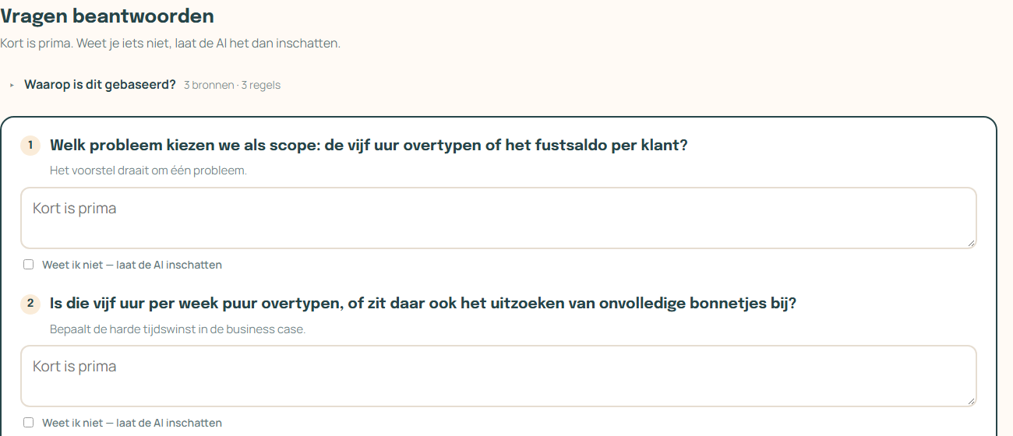
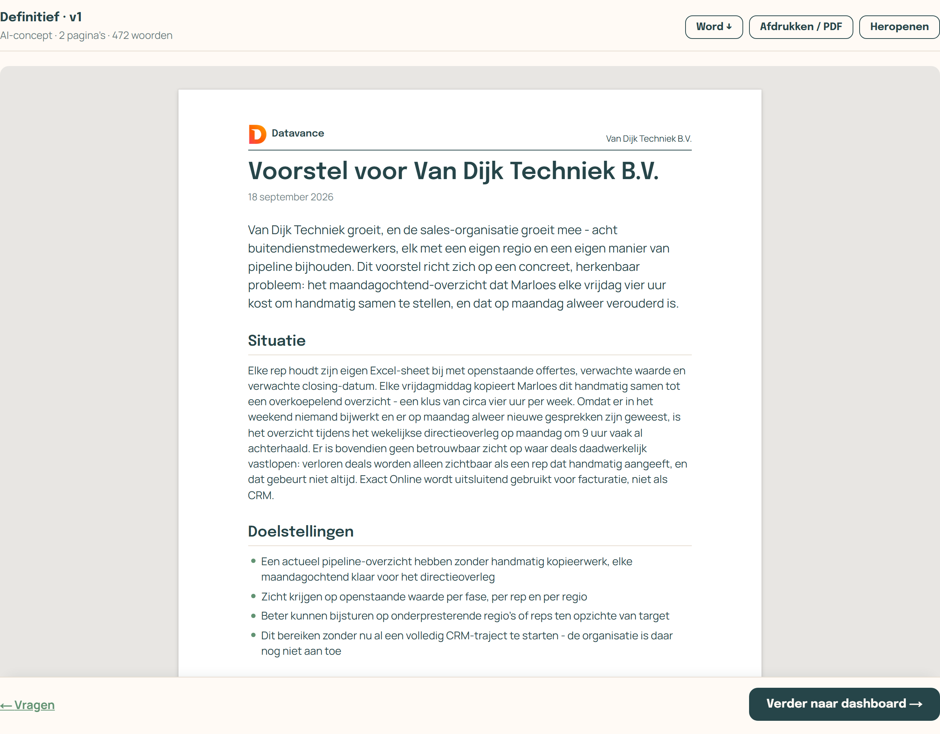
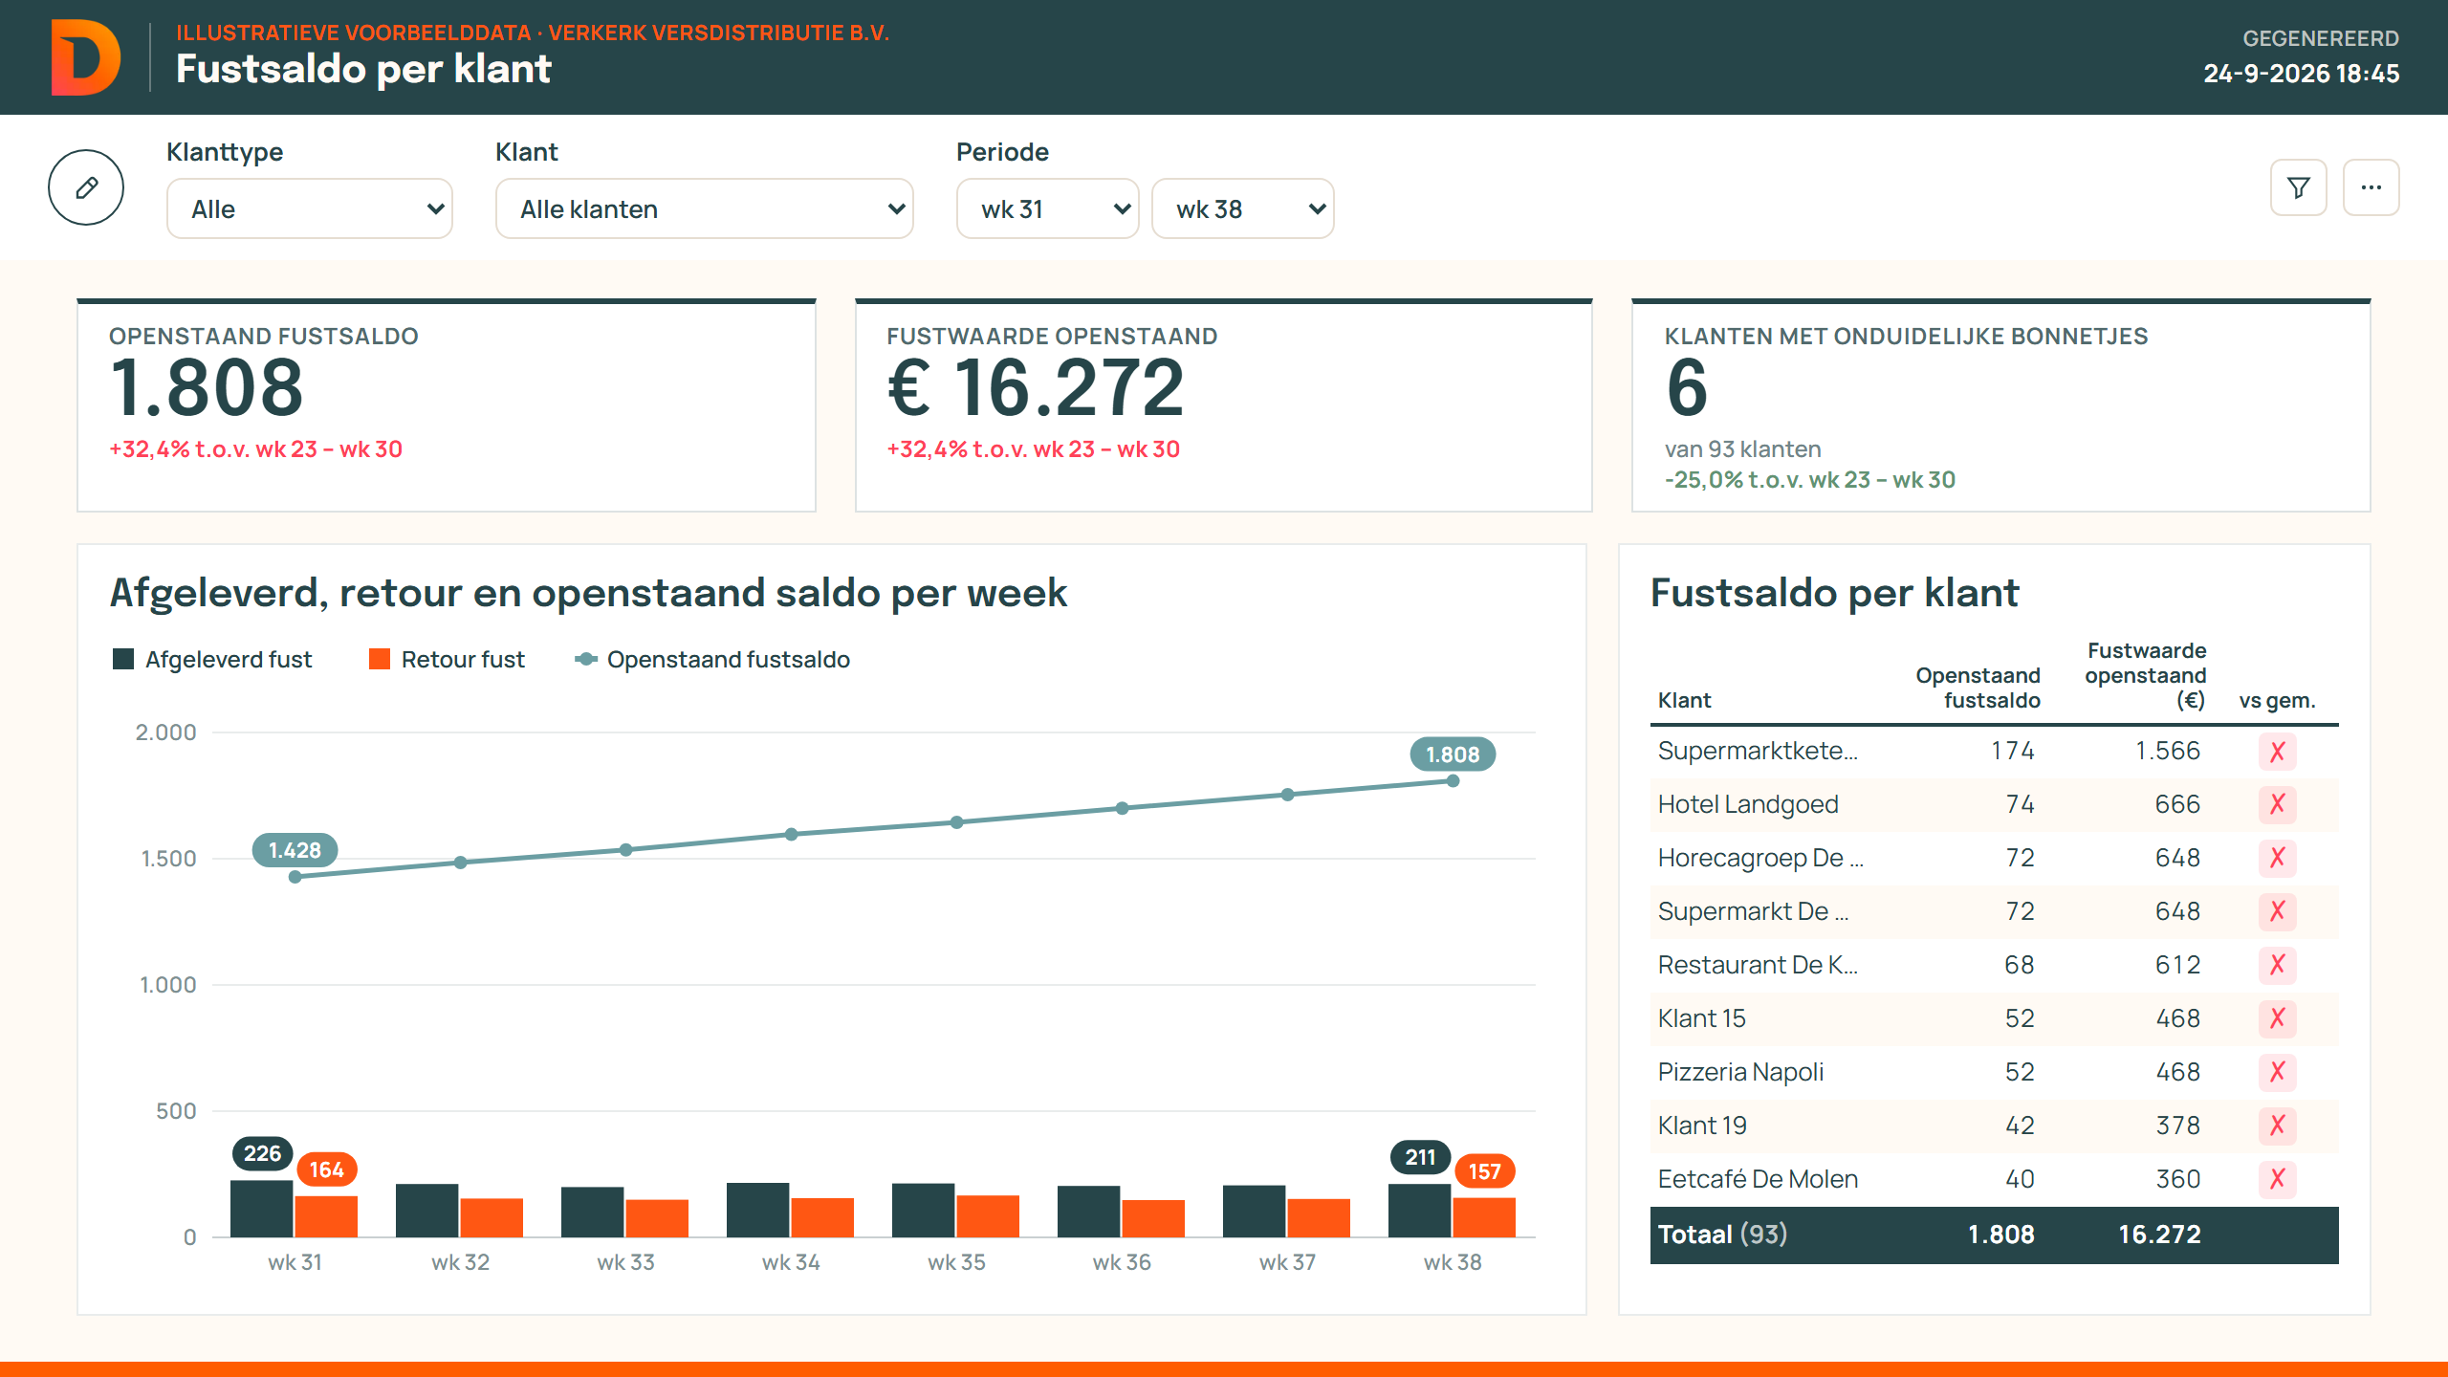
PROTOTYPE
A working prototype, tested end to end on sales-call transcripts
1 · Short questions
2 · Proposal as Word pages
3 · PoC dashboard
One topic per question; 'let the AI estimate' when the answer is unknown.
Edit directly, comment per section, ask the AI to revise, export .docx.
In the client's own terms; illustrative data, every number computed by code.
Next.js web app · DeepSeek LLM · deterministic dashboard engine · ≈20 s AI time per lead
LIVE DEMO →
Person C · Lab: BUILD (S3)
06
Notes:
OWNER: Person C RUBRIC: Prototype, Experimentation & Evidence (20%) + Communication (5%) LAB PHASE: BUILD, Session 3
WHAT THIS SLIDE DOES: Makes the value mechanism observable: the audience sees the product work, then the live demo starts.
WHAT MUST BE ON IT:
- 3 screenshots: questions, Word proposal, dashboard — one caption each
- One tech line only (technology is a means)
- Switch to the live demo (≈2 min)
- Backup: demo recording ready in case the internet or API fails
STILL TO FILL IN:
- Replace screenshots if the UI changes before the presentation
- Pick the demo scenario (Verkerk recommended) and rehearse in 'snel' (replay) mode
COURSE CONCEPT: Session 3: a working prototype 'where feasible' that makes the proposed value mechanism observable.
PREP QUESTION ANSWERED: S3 Lab: 'Develop a working prototype where feasible, or a credible simulation or mock-up.'
SCORE A 5: The demo shows the user's work (what the consultant does and decides), not the code. Keep it under 2 minutes and rehearsed.
SAY (≈1 min): Here are the three outputs. [Switch to demo] I paste the transcript, the AI asks four short questions — I answer two and let it estimate the rest. The proposal appears as Word pages I can edit. Then the dashboard: designed for this client's problem, with every number computed by code, labelled as illustrative data.
TRANSITION: 'But will a prospect trust this? That is the market question.'

Slide 7
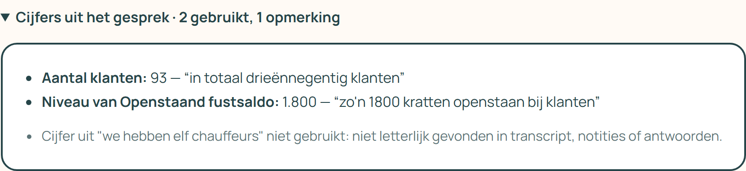
TRUST & UNCERTAINTY
The PoC works as a trust mechanism for the prospect
Uncertainty | Question in the prospect's head | Our mechanism | Type
Description | Is this proposal what we discussed? | Follow-up questions + editable proposal, quotes checked word-for-word | Screening
Performance | Will BI actually deliver value? | A working PoC dashboard before signing | Signal + verification
Fit | Is this right for our data and process? | Dashboard designed from their own transcript; 'illustrative data' label | Verification
Seller | Can Datavance deliver? | Human-checked output; numbers computed by code | Reputation
Stress test: gaming risk
A prospect takes our free PoC and proposal to a cheaper competitor — free-riding on our signal.
Revision
The PoC stays on illustrative data; the real data connection and build start only after signing.
Figures from the call are only used if they match a quote.
OUR CHOICE Use the PoC as a costly signal of fit, and limit free-riding by keeping real data behind the contract.
Person C · Lab: MARKET TEST (S7)
07
Notes:
OWNER: Person C RUBRIC: Application of Course Concepts (20%) + Critical Evaluation & Recommendation (20%) LAB PHASE: MARKET TEST, Session 7
WHAT THIS SLIDE DOES: Explains why a prospect can trust the output, and stress-tests one gaming risk — then shows how we revised the design.
WHAT MUST BE ON IT:
- Split description, performance and fit uncertainty (Dimoka et al.) + seller uncertainty
- Per uncertainty: the mechanism (signaling, screening, verification, reputation)
- One strategic behaviour / gaming risk (free-riding on the PoC)
- The revision it caused
- The contrast with the manual process: a generic demo reduces none of these uncertainties
STILL TO FILL IN:
- Optional: a real prospect reaction to a PoC, if the pilot produced one
COURSE CONCEPT: Session 7: Dimoka, Hong & Pavlou (2012) product vs seller uncertainty (description, performance, fit); signaling, screening, reputation, verification, guarantees → choice: PoC as trust mechanism, real data only after signing.
PREP QUESTION ANSWERED: S7 Q3: 'In your team project, what information, trust, or incentive problem could limit adoption or exchange, and what mechanism could address it?'
SCORE A 5: The stress test actually changes the design (revision), instead of only naming the risk.
SAY (≈1 min): A prospect faces three uncertainties. Is the proposal what we discussed? Will BI deliver? Does it fit our data? The manual generic demo answers none of these. Our PoC is a signal and a verification: built from their own words, with checked quotes and code-computed numbers. We stress-tested one gaming risk — a prospect shopping our free PoC to a cheaper rival — and revised: real data only after signing.
TRANSITION: 'What does this cost — and what is it worth?'

Slide 8
ECONOMICS & PRICING
AI costs cents per lead — consultant time is the cost that matters
≈ €0.005
≈ 20 s
[€ x]
AI cost per lead (measured; verify current DeepSeek prices)
AI processing time per lead (measured)
Manual cost per lead = [hours] × [hourly rate]
Cost structure
Pricing meter (if offered to clients)
Fixed: building the tool, prompts, dashboard engine, templates
Variable: AI tokens + [review minutes] per lead → near-zero marginal cost
Savings: [hours saved] × [leads per month] = [€ per month]
Weakest assumption: [lead volume per month / attribution]
Seat ✗
Usage
Job ✓
Outcome ✗
Job = one pre-sales package; both sides can count it. Seat rejected: AI shrinks seats (BCG). Outcome rejected: who won the deal?
Versioning: Basic = questions + proposal · Premium = + PoC dashboard — only prospects with a real data problem choose Premium.
OUR CHOICE Internally: value = [hours saved] per lead. Externally: price per job, versioned Basic / Premium.
Person B · Lab: MONETIZE (S4)
08
Notes:
OWNER: Person B RUBRIC: Business Model & Strategic Design (20%) + Application of Course Concepts (20%) LAB PHASE: MONETIZE, Session 4
WHAT THIS SLIDE DOES: Shows the cost model and value logic in numbers, and the pricing architecture with one rejected alternative.
WHAT MUST BE ON IT:
- Fixed setup cost vs variable cost per meaningful unit (lead)
- Manual cost per lead as the baseline
- Savings per month
- Meter choice (job) + credible alternatives rejected (seat, outcome)
- Versioning Basic / Premium and why it is incentive compatible
- The weakest assumption
STILL TO FILL IN:
- [hourly rate] and [leads per month] — ask Datavance
- [hours] manual per lead — from slide 2 interviews
- [review minutes] per lead — from the pilot (evaluation page)
- Verify €0.005 against DeepSeek's current price list before presenting
COURSE CONCEPT: Session 4: Shapiro & Varian 'Versioning Information Goods' (self-selection, incentive compatibility); Smith & Telang (bundling); BCG (2025) seat compression, usage/job/outcome meters → choice: job meter + Basic/Premium.
PREP QUESTION ANSWERED: S4 Q5: 'For an AI product, choose a seat, usage, job, outcome or hybrid meter. What can both buyer and seller actually measure and verify?' and Q3 on Basic/Premium.
SCORE A 5: Only validated numbers or clearly marked assumptions, a compared alternative, and the weakest assumption named out loud.
SAY (≈1 min): The AI costs about half a cent and twenty seconds per lead. The real cost is consultant time: [x] euro per lead by hand. That makes the savings [€ per month]. If we offer it to clients, we price per job — one pre-sales package — because both sides can count it. Per seat fails because AI shrinks seats, per outcome fails because nobody can prove who won the deal. Our weakest assumption is [lead volume].
TRANSITION: 'Where does this tool sit in the wider ecosystem — and who could squeeze us?'

Slide 9
ECOSYSTEM
Not a platform: a pipeline tool inside the Microsoft BI ecosystem
Users
Infrastructure & suppliers
Platform?
Datavance consultants · SME prospects
DeepSeek LLM · Microsoft 365 / Word · Power BI
No — a one-sided pipeline; we complement platforms, we are not one.
Datavance tool
Network effects
Core interaction: sales call → proposal + PoC
No cross-side effects; only a weak learning effect from edits and outcomes. Negative: AI proposals start to look alike.
Complementors
Competitors
Envelopment threat
HubSpot CRM · Exact · AFAS (client source systems)
Copilot for Sales · HubSpot AI · other BI firms
Microsoft Copilot (Teams → Word → Power BI) can envelop us: envelopment of complements.
OUR CHOICE Build on M365, not against it — defend with know-how, own templates and verified numbers.
Person A · Lab: MAP (S5)
09
Notes:
OWNER: Person A RUBRIC: Business Model & Strategic Design (20%) + Application of Course Concepts (20%) LAB PHASE: MAP, Session 5
WHAT THIS SLIDE DOES: Positions the product in its ecosystem, states clearly it is not a platform, and names the biggest envelopment threat.
WHAT MUST BE ON IT:
- Ecosystem map: users, complementors, suppliers/infrastructure, competitors
- The core interaction
- 'If the solution is not a platform, state this clearly' (S5 literally asks this)
- Network effects diagnosis with mechanism (and the negative one)
- One envelopment scenario + its type
- The defensibility choice that follows
STILL TO FILL IN:
- Check the list of complementors with Datavance (which source systems matter most?)
COURSE CONCEPT: Session 5: Van Alstyne, Parker & Choudary (2016) pipelines vs platforms; Eisenmann, Parker & Van Alstyne (2006) two-sided markets; envelopment of complements / weak substitutes / unrelated platforms → choice: build on M365, defend with Datavance-specific assets.
PREP QUESTION ANSWERED: S5 Q5: 'How could another platform envelop the focal platform? Classify the move as envelopment of complements, weak substitutes, or unrelated platforms.'
SCORE A 5: Saying honestly that it is not a platform (and why) scores higher than forcing platform language onto it.
SAY (≈1 min): Our tool is a pipeline, not a platform: it sits between the consultant and the prospect, on top of Microsoft 365, Power BI and the client's source systems. There are no real network effects — only a learning effect from edits and outcomes. The biggest threat is Microsoft: Copilot already owns the transcript, Word and Power BI. So we build on top of it and defend with what Microsoft doesn't have: our templates, source-system know-how and verified numbers.
TRANSITION: 'Let's zoom into the decision the AI supports — with the AI Canvas.'

Slide 10
AI CANVAS
The AI predicts the scope; the consultant judges
Decision: which scope and PoC fit this prospect's one problem?
Prediction
Judgment
Action
Outcome
The client's core problem, missing information (→ questions) and a fitting dashboard design.
Consultant weighs scope, price and the risk of over-promising.
Send the questions, the edited proposal and the PoC.
Reply, meeting, deal won — and hours saved.
Input
Training
Feedback ⚠
Binding constraint
Call transcript, notes and the consultant's answers.
Past proposals, Datavance templates, a general LLM.
Consultant edits: logged ✓
Win / loss: not logged ✗
Without win/loss data the system can't learn what wins → fixed on slide 15.
OUR CHOICE Humans own the judgment; log win/loss next so the feedback loop (Cook level 3) can start.
Person C · Lab: TEST (S6)
10
Notes:
OWNER: Person C RUBRIC: Application of Course Concepts (20%) LAB PHASE: TEST, Session 6
WHAT THIS SLIDE DOES: Decomposes the AI-supported decision and identifies which element limits value creation.
WHAT MUST BE ON IT:
- The focal decision in one sentence
- All 7 elements: prediction, judgment, action, outcome, input, training, feedback
- Which element limits value (feedback) and why
- How this connects to the recommendation (slide 15)
STILL TO FILL IN:
- Check the 7 boxes against what the product really does today
COURSE CONCEPT: Session 6: Agrawal, Gans & Goldfarb (2018) 'A Simple Tool to Start Making Decisions with the Help of AI' (AI Canvas) → choice: humans keep judgment; fix the feedback element first.
PREP QUESTION ANSWERED: S6 Q1: 'Choose one decision in your project. Complete the seven elements of the AI Canvas and identify which element currently limits value creation.'
SCORE A 5: The canvas is used to find a weakness that changes the recommendation — not just filled in.
SAY (≈1 min): The decision: which scope and PoC fit this prospect. The AI predicts the problem and designs the dashboard; the consultant judges scope, price and risk. The weak link is feedback: we log every edit, but we don't yet know which proposals won. Without that, the system can't learn what works — so that is the first thing we fix.
TRANSITION: 'Does it actually work better than the manual process? Here is how we test that.'

Slide 11
EVALUATION DESIGN
A randomized test against today's manual process
Element | Our design
Treatment | Pre-sales with the product
Comparison | Same consultant, today's manual process
Unit of randomization | Lead / transcript — order randomized per consultant
Primary outcome (OEC) | Active consultant minutes to a send-ready package
Guardrails | Blind quality score 1–5 · wrong figures (target 0)
Sample / task set | [n] historical transcripts × [k] consultants
Main bias | Small n, learning effect, raters not blind → [how handled]
Decision rule — fixed before the data
Scale if active time drops ≥ [x]%, AND quality is not lower, AND 0 invented figures.
Measured automatically: the app logs active time, AI time and edits per lead (evaluation page + CSV).
OUR CHOICE Test, don't trust intuition — the decision to scale follows a rule we set in advance.
Person D · Lab: TEST (S6)
11
Notes:
OWNER: Person D RUBRIC: Prototype, Experimentation & Evidence (20%) LAB PHASE: TEST, Session 6
WHAT THIS SLIDE DOES: Specifies the causal test that compares the product with the manual baseline.
WHAT MUST BE ON IT:
- Treatment and comparison condition (product vs manual)
- Unit of randomization
- Primary outcome / overall evaluation criterion (OEC)
- Guardrail metrics
- Sample or task set
- Main source of bias and how you handle it
- Decision rule fixed before seeing the data
STILL TO FILL IN:
- [n] transcripts and [k] consultants — plan in week 2 (e.g. 6 transcripts × 3 consultants, each does 3 manual + 3 with product)
- [x]% threshold — agree as a team before the pilot
- [how handled] — e.g. counterbalanced order, a rater who doesn't know which version is which
COURSE CONCEPT: Session 6: Kohavi & Thomke (2017) 'The Surprising Power of Online Experiments' — intuition is unreliable, randomization identifies causal effects; OEC + guardrails → choice: decide by rule, not by gut.
PREP QUESTION ANSWERED: S6 Q2–Q3: 'Specify the treatment, control condition, unit of randomization, and primary outcome … Which guardrail metric could reveal that an apparent improvement creates harm elsewhere?'
SCORE A 5: A clear manual baseline, honest bias handling and a decision rule written down before the results.
SAY (≈1 min): We compare each consultant with themselves: some leads by hand, some with the product, in random order. The main outcome is active minutes to a send-ready package — the app measures this automatically. Guardrails make sure faster doesn't mean worse: a blind quality score and zero invented figures. And we fixed the decision rule before we saw any data.
TRANSITION: 'So — what did we find?'

Slide 12
EVIDENCE
[Main result: active time per lead fell from x to y minutes]
[x → y min]
[± 0.0]
Active time per lead, pilot vs manual (n = [ ])
Blind quality score vs manual (1–5)
≈ 20 s · €0.005
16 / 21
AI time and cost per lead (measured)
Figures verified — 3 misquotes rejected, 2 misuses caught
Learned → changed: [learning 1 → change] · [learning 2 → change]
PLACEHOLDER VALUES — replace with the pilot CSV from /evaluatie
OUR CHOICE Verdict: [meets / does not meet] the decision rule from slide 11 — indicative, n = [ ].
Person D · Lab: TEST (S6)
12
Notes:
OWNER: Person D RUBRIC: Prototype, Experimentation & Evidence (20%) LAB PHASE: TEST, Session 6
WHAT THIS SLIDE DOES: Shows real results against the manual baseline — including what did not work and what we changed.
WHAT MUST BE ON IT:
- Pilot result vs manual baseline: active time, quality, % edited
- Product measurements: ≈20 s, ≈€0.005, 16/21 figures verified (3 misquotes rejected, 2 misuses caught)
- What we learned and what we changed (learning & iteration)
- Honest framing: small n = indicative, not proof
- Verdict against the decision rule of slide 11
STILL TO FILL IN:
- Title: replace with the real main result
- All [ ] numbers — export the CSV from /evaluatie after the pilot
- [learning → change] — two concrete changes after the pilot
- Chart on the right: right-click → Edit Data and enter the real manual vs product minutes (60 / 20 are placeholders!)
COURSE CONCEPT: Session 6: causal vs correlational evidence; OEC + guardrails; scale only if evidence justifies it.
PREP QUESTION ANSWERED: S6 Lab: 'establish causal value and decide whether to scale.'
SCORE A 5: Real numbers from real users, including failures and what they changed — no cherry-picking.
SAY (≈1 min): In the pilot, active time per lead went from [x] to [y] minutes, with quality [not lower]. The AI part itself takes 20 seconds and half a cent. Of 21 figures the AI wanted to use, 16 were verified; 3 misquotes were rejected automatically. We learned [..] and changed [..]. With n = [ ], this is indicative — and it [meets] our decision rule.
TRANSITION: 'Of course, things can go wrong. Here is what we saw and how we guard against it.'

Slide 13
RISKS, ETHICS & GOVERNANCE
What can go wrong — and the safeguard for each
Risk | What we saw | Safeguard
Invented number / norm | AI proposed a norm nobody mentioned | Code computes all numbers; norms only with a verbatim quote
Misquote | 3 quotes did not match the transcript | Quote check drops them automatically + warning
Over-reliance | [e.g. drafts sent with little review] | Approval at 4 checkpoints; nothing is sent automatically
Privacy (GDPR) | Transcripts go to DeepSeek, outside the EU | Consent for recording + EU-hosted model before scaling
Hard gate before scaling
EU-hosted model + recording consent + 100% PII check passed. Affected: prospects and their employees.
Adoption barriers
Smart Card lesson (S1): simple tech still fails on trust, habits and upkeep — consultants must want to use it.
Test limits: small n · historical transcripts · manual baseline partly estimated.
OUR CHOICE Nothing leaves Datavance without a consultant's decision — and no scaling before the privacy gate.
Person D · Lab: TEST (S6)
13
Notes:
OWNER: Person D RUBRIC: Critical Evaluation & Recommendation (20%) LAB PHASE: TEST, Session 6
WHAT THIS SLIDE DOES: Shows honest failure analysis, the ethical/regulatory risk, and the safeguards that must hold before scaling.
WHAT MUST BE ON IT:
- Failures seen in testing: invented norm, misquote, over-reliance
- One ethical/regulatory risk (privacy/GDPR), who is affected
- One safeguard or monitoring metric that must be satisfied before scaling
- Operating controls: human checkpoints, nothing auto-sent
- Limitations of our own test
- Adoption barriers
STILL TO FILL IN:
- [over-reliance example] — from pilot observations
- Check: does Datavance already have a DPA / consent practice for call recordings?
COURSE CONCEPT: Session 6: ethics, transparency, accountability + 'one safeguard before scaling'; Mantia, Chatterjee & Lee (2025) explicit operating controls; Session 1 Smart Card case (adoption barriers) → choice: human approval always, privacy gate before scaling.
PREP QUESTION ANSWERED: S6 Q4: 'How should a firm balance the business value created by AI … against potential risks involving manipulation, discrimination, privacy, transparency, and regulatory compliance?'
SCORE A 5: Real failures shown openly with their fixes; hiding failures costs more points than showing them.
SAY (≈1 min): We saw real failures: the AI proposed a norm nobody mentioned, and three quotes didn't match the transcript — both are now caught automatically. The biggest open risk is privacy: transcripts go to DeepSeek outside the EU. So before scaling there is a hard gate: EU-hosted model, recording consent and a PII check. And nothing ever leaves Datavance without a consultant's decision.
TRANSITION: 'Now let's look further ahead: what if everyone has AI agents?'

Slide 14
AGENTIC FUTURE
When every buyer and rival has an agent, speed stops being an edge
Scenario
Disappears (abundant)
Stays scarce
Prospects' agents write RFPs and compare BI vendors
Rivals run the same LLM pipeline
Microsoft bundles it into Copilot
Fast, polished proposals — including our own speed edge
Generic dashboard mock-ups
First-draft analysis
Context: source-system know-how, sector KPIs
Trust: verified numbers, human sign-off
Workflow integration and delivery
Agentic rails (Walsh, 2026) — where we act:
Identity
Discovery
Verification
Interoperability
Marketplaces
Payments
Move: machine-readable, verifiable proposals a buyer's agent can check · path Existing+ → Orchestrator (Eastwood)
OUR CHOICE Invest in the context layer, not the model — compete on verified outcomes, not on proposal speed.
Person B · Lab: REIMAGINE (S8)
14
Notes:
OWNER: Person B RUBRIC: Critical Evaluation & Recommendation (20%) LAB PHASE: REIMAGINE, Session 8
WHAT THIS SLIDE DOES: Stress-tests our strategy in a world where everyone has capable agents: which advantage disappears, which stays.
WHAT MUST BE ON IT:
- Scenario: customers, competitors and platforms all deploy agents (S8 literally asks this)
- Which current advantage disappears (our speed advantage!)
- The scarce complement that remains defensible
- Which agentic rails matter and our move there
- Path from Existing+ toward Orchestrator
STILL TO FILL IN:
- Optional: a real example of a procurement / RFP agent in B2B
COURSE CONCEPT: Session 8: Yerramilli-Rao, Corwin, Li & Lakhani (2025) 'Strategy in an Era of Abundant Expertise' (what becomes abundant vs scarce); Walsh (2026) 'Who Will Own the AI Agent Economy?' (identity, discovery, verification, interoperability, marketplaces, payments); Eastwood (2026) → choice: invest in context, verifiability.
PREP QUESTION ANSWERED: S8 Q2: 'If AI makes … expertise widely available, what capabilities or assets will continue to differentiate firms?'
SCORE A 5: Admit that our own current advantage (speed) disappears — don't only list opportunities.
SAY (≈1 min): Imagine every prospect has a buying agent and every rival has our pipeline. Then fast, polished proposals are worth nothing — including ours. What stays scarce is context, trust and delivery. So our move is to make proposals machine-readable and verifiable, so a buyer's agent can check them — and to invest in our own context layer, not in the model.
TRANSITION: 'So what do we recommend Datavance does on Monday?'

Slide 15
RECOMMENDATION
Pilot internally, fix privacy first, then scale on evidence
Implement
Change
Scale
Stop
Test next
Internal pilot with [k] consultants for [8] weeks
EU-hosted model + log win/loss in HubSpot
To all consultants once the decision rule is met
Selling the tool as external SaaS
Win-rate experiment: tailored PoC vs generic demo
← slides 11–12
← slides 10 & 13
← slide 11 rule
← slides 4 & 9
← assumption A2, slide 4
DECISION RULE (slide 11) Scale if active time is ≥ [x]% lower, quality is not lower and there are 0 invented figures — otherwise adjust and retest.
Adapt, don't reinvent (Furr & Shipilov, 2019): the consultant stays central; AI removes the manual work.
OUR CHOICE Start small, gate on privacy, and let the evidence — not enthusiasm — decide the scale-up.
Person D (written with all) · Lab: TEST → decision (S6)
15
Notes:
OWNER: Person D presents; written together in the week-3 team session RUBRIC: Critical Evaluation & Recommendation (20%) LAB PHASE: TEST → decision, Session 6 (+ S1, S8)
WHAT THIS SLIDE DOES: Gives a clear, evidence-based recommendation: what to implement, change, scale, stop and test next.
WHAT MUST BE ON IT:
- Implement / change / scale / stop / test next
- Each point traceable to slides 10–13 (canvas weak link, test, evidence, risks)
- The decision rule restated
- Why adaptation instead of reinvention
STILL TO FILL IN:
- [k] consultants, [8] weeks, [x]% — must match slide 11
- If the pilot result does NOT meet the rule: change 'Scale' into 'Adjust [..] and retest' — the rubric rewards honesty
COURSE CONCEPT: Furr & Shipilov (2019) 'Digital Doesn't Have to Be Disruptive' (S1) — adapt rather than reinvent; Session 6: scale only when evidence justifies it.
PREP QUESTION ANSWERED: S6 central question: '… decide whether the evidence justifies scaling.'
SCORE A 5: Every recommendation follows from our own evidence and risks — if the data says otherwise, the recommendation changes.
SAY (≈1 min): Our recommendation: start an internal pilot, fix privacy first with an EU-hosted model, and start logging win/loss so the system can learn. Scale only when the decision rule is met. Stop the idea of selling it as SaaS. Next, test whether a tailored PoC really wins more deals. We don't reinvent Datavance — we remove the manual work so consultants can do what stays scarce.
TRANSITION: 'Thank you — happy to take your questions.' (Keep the demo open for Q&A.)

