Slide 1
System Programming Lab 7 setjmp/longjmp
Lecturer：Professor Pao-Ann Hsiung
Teaching Assistant: Arthur & Koma
Embedded Systems Laboratory
National Chung Cheng University
Chiayi, Taiwan-62102

Slide 2
Outline
setjmp/longjmp
Requirements
Turn In
Download

Slide 3
setjmp/longjmp

Slide 4
Figure 7.11
#include "apue.h"
#include <setjmp.h>
#define TOK_ADD 5
jmp_buf jmpbuffer;
int
main(void)
{
char line[MAXLINE];
if (setjmp(jmpbuffer) != 0)
printf("error");
while (fgets(line, MAXLINE, stdin) != NULL)
do_line(line);

Slide 5
Figure 7.11(cont’d )
exit(0);
}
. . .
void
cmd_add(void)
{
int token;
token = get_token();
if (token < 0) /* an error has occurred */
longjmp(jmpbuffer, 1);
/* rest of processing for this command */
}

Slide 6
setjmp
#include <setjmp.h>
Int setjmp (jmp_buf env);
Stores current state of main at the start of program exec.
Returns: 0 if called directly, nonzero if returning from a call to longjmp.
EX:
jmp_buf jmpbuffer;
int i = setjmp(jmpbuffer);

Slide 7
longjmp
#include <setjmp.h>
void longjmp (jmp_buf env, int val);
Return to the setjmp()
val is a nonzero value that becomes the return value from setjmp.
EX:
longjmp(jmpbuffer, 1);
longjmp(jmpbuffer, 2);

Slide 8
Compare function
Character compare:
char* strchr(char * str, int character);
EX:
char* cptr = strchr(str,'@');
String compare:
char* strstr(char * str1, char * str2 );
EX:
char* cptr= strstr(str,"..");

Slide 9
Requirements

Slide 10
Requirements
Use setjmp/longjmp to implement a checker program for email addresses.
Print out messages to show the errors detected.
You need to implement only the given checking rules, i.e., you do not need to confirm everything.

Slide 11
Requirements(cont’d)
Email checking rules:
One and only one ‘@’ is allowed.
Special characters such as sharp‘#’, Asterisk ’*’, doubleDot ”..” are not allowed.
There should be at least one ‘.’ behind the ‘@’ character.

Slide 12
Example
Example
spta@embed@ded..cs.ccu.edu.tw
@ found at 5
@ found at 11
Email format error: more than one @

Slide 13
Result of Requirements
Submit the following in table (Answers.doc):
Where are the errors located?
What is the error message format?
(you must not print any message after you print error)
How did you use the setjmp/longjmp functions?
Final results.
Please attach screenshot !

Slide 14
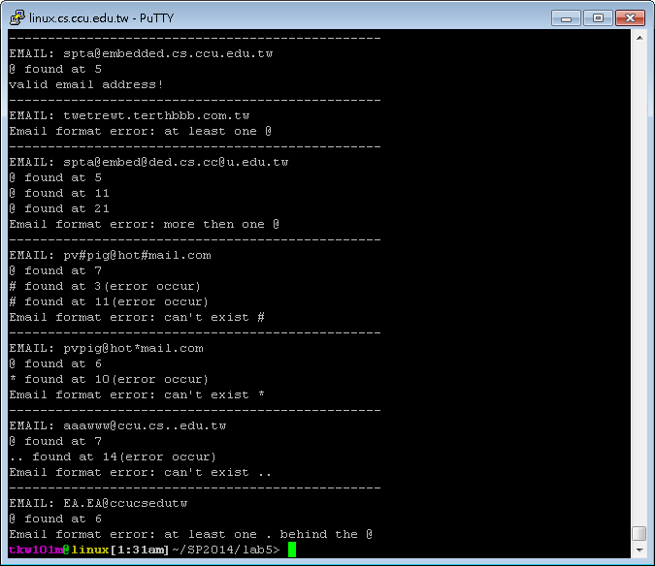

Slide 15
Turn In

Slide 16
Turn In
The E-course2
https://ecourse2.ccu.edu.tw/
Upload 學號.zip into “Lab_7”
Source files
Answers.pdf
Due date
2020/06/09 23:59:59

Slide 17
Turn In (cont’d)
TA’s email:
spta@embedded.cs.ccu.edu.tw

Slide 18
Download

Slide 19
Download command
Code: $wget --no-check-certificate https://ecourse.ccu.edu.tw/29954/textbook/10/5/Lab5.zip

Slide 20
Download
Code: https://ecourse.ccu.edu.tw/29954/textbook/10/5/Lab5.zip
Answers.doc: https://ecourse.ccu.edu.tw/29954/textbook/10/5/Answers.docx

