Slide 1
系統程式 System Programming http://ecourse2.ccu.edu.tw/
熊博安
國立中正大學資訊工程學系
pahsiung@csie.io
Class: 創新341
Tel: (05)2720411 ext. 33119
Office: EA-517

Slide 2
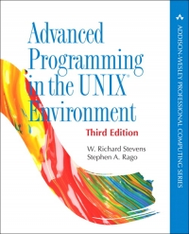
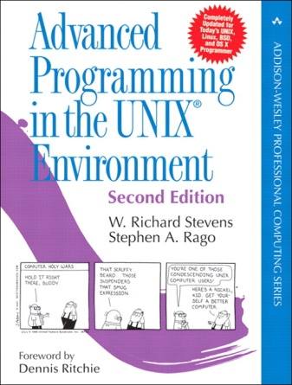
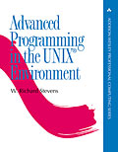
Text and Reference Book
Advanced Programming in the UNIX Environment, 3rd Edition, W. Richard Stevens, Stephen A. Rago, Addison Wesley, 2013, 開發代理 (994 pages), “APUE” in short
1st Edition
2nd Edition
3rd Edition

Slide 3
About Rich Stevens
On Wikipedia:
http://en.wikipedia.org/wiki/W._Richard_Stevens
Guru of the UNIX gurus
http://dir.salon.com/story/tech/feature/2000/09/01/rich_stevens/index.html
Usenix Lifetime Achievement Award, 2000

Slide 4
About Rich Stevens
Stevens set an example for everyone in the Unix world.
What he didn't know, he determined to find out; what he did know, he strove to pass on to anyone who was interested.
In 2000, a year after his death,
memories of one of the Unix community's most beloved experts are still fresh and vital.

Slide 5
Syllabus
Topic Chapter Weeks
Overview 1 1~2
File I/O 3 3~4
Files & Dirs 4 6~8
Mid-Term Exam 9
Stdio 5 10~11
Process Env 7 12~13
Process Control 8 14~15
Signals 10 補課
Final Exam 16

Slide 6
Grading
Online quiz (7 chapters) 14%
Programming assignments (7) 35%
Mid-Term Exam 25%
Final Exam 26%
Bonus (Q/A, quiz, attendance, …)

Slide 7
Details
Midterm Exam: 4/29 13:30~15:30
Final Exam: 6/17 13:30~15:30
Programming Assignments (total 7)
To be done individually
To be submitted in-class or after-class (within 1 week after class)
Online Quiz (total 7)
To be done individually
To be submitted online

Slide 8
Rules
NO COPYING of assignments/projects (a single case of copying ➔ BOTH parties will get ZERO point for ALL assignments and projects)
NO CHEATING in exams (BOTH parties will get ZERO points for that exam)

Slide 9
Rules (cont’d)
Class Quiz:
Correct Answer ➔ Bonus Points
Wrong or No Answer ➔ Deduction Points
Class Attendance:
1 absence ➔ Deduct 5%
2 absences ➔ Deduct 10%
n absences ➔ Deduct 5n%

Slide 10
System Programming
ENJOY THE COURSE!!!

Slide 11
可以先做的事情 (預習)
使用一台有Linux作業系統的主機
用你的帳密登入
學會在系統中以下幾個指令：
資料夾處理指令：ls, rm, touch, chdir, mkdir, rmdir, …
文件編輯指令：vi (vim), joe, …
程式編譯指令：gcc, make, …
學會製作 makefile
3/11 在課堂上還會教大家Linux的基本操作

