Slide 1
Chapter 1. Introduction
System Programming
http://ecourse.elearning.ccu.edu.tw
熊博安
國立中正大學資訊工程學系
pahsiung@cs.ccu.edu.tw Class: EA-001
(05)2720411 ext. 33119 Office: EA-512

Slide 2
1.1 Introduction
Whirlwind tour of UNIX from a programmer’s perspective
Brief descriptions and examples
Services provided by UNIX

Slide 3
1.2 UNIX Architecture
Operating system is the software that
controls hardware resources
Provides program execution environment
Architecture
Kernel
System Calls
Shell
Applications

Slide 4
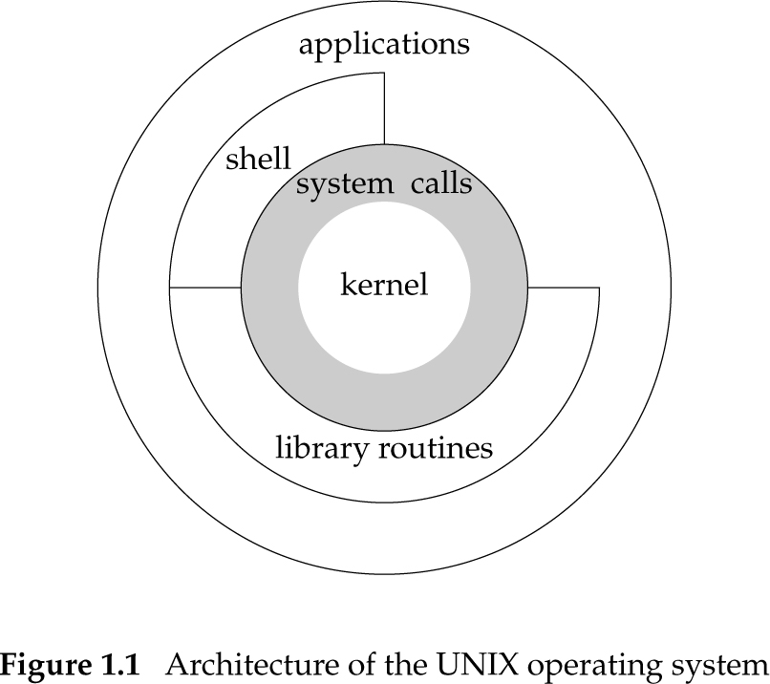
Architecture of UNIX OS

Slide 5
1.3 Logging In
Login name
Password
Colon-separated fields in each entry of /etc/passwd
name,
encrypted password or “x” (password is in /etc/shadow),
numeric user ID,
numeric group ID,
real name,
home directory,
shell program
sar:x:205:105:Stephen Rago:/home/sar:/bin/ksh

Slide 6
1.3 Logging In
Shells: a command line interpreter that reads user input and executes commands
Bourne shell: /bin/sh (used by root)
Bourne-again shell: /bin/bash (all Linux systems)
C shell: /bin/csh (used by users)
Korn shell: /bin/ksh (successor of Bourne shell)
TENEX C shell: /bin/tcsh (replacement of C shell, standardized in POSIX 1003.2)

Slide 7
1.4 Files and Directories
Filesystem: hierarchical arrangement of directories and files
Everything starts in ROOT directory (/)
File attributes: type, size, owner, permissions, last modification time, …
stat(), fstat() functions: (ref: Chapter 4)
return file attribute structure

Slide 8
1.4 Files and Directories
Filename
Chars not allowed: (/) and (NULL)
2 filenames automatically created whenever a new directory is created:
. → current directory (dot)
.. → parent directory (dot-dot)
What is .. in root directory (/)?

Slide 9
1.4 Files and Directories
Pathname
A sequence of zero or more filenames, separated by slashes (/), and optionally starting with a slash
Absolute pathname: begins with /
/etc/motd
Relative pathname: otherwise
local/bin/ls

Slide 10
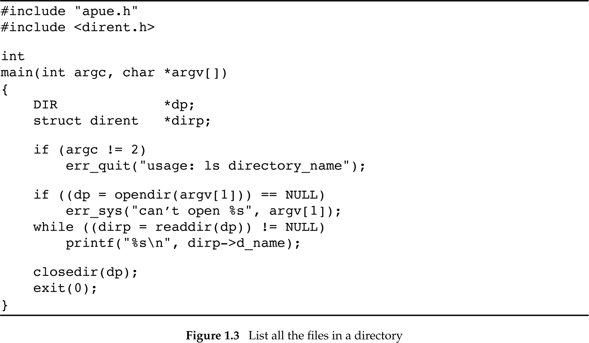
Figure 1.3: (List all the files in a directory)
Own header in Appendix B
For function prototypes 函式雛型: opendir(), readdir()
Defined in “apue.h”
Fatal error unrelated to system call, print a message and terminate
Returns DIR *
資料夾結構
Defined in “apue.h”
Fatal error related to system call, print a message and terminate
Returns dirent *
資料夾項目
Return values:
0 ➔ OK!
1~255 ➔ error

Slide 11
Executing program (Fig. 1.3)
Edit and save in myls.c
$ cc myls.c (output: a.out)
$ ./a.out /dev (output: . .. ………)
$ ./a.out /var/spool/mqueue
can’t open /var/spool/mqueue: Permission denied
$ ./a.out /dev/tty
can’t open /dev/tty: Not a directory
prompt

Slide 12
1.4 Files and Directories
Current working directory (CWD)
工作資料夾
chdir(): change working directory
相對路徑與工作資料夾有關
Eg: doc/my/file
file在my資料夾，my在doc資料夾，doc在目前的工作資料夾 (CWD)
登入時，一開始會在家目錄 (home directory)
Home directory is set in the password file

Slide 13
1.5 Input and Output
File Descriptors
small non-negative integers that kernel uses to identify files being accessed by a process
Examples
0: Standard Input (stdin)
1: Standard Output (stdout)
2: Standard Error (stderr)

Slide 14
1.5 Input and Output
ls
stdin, stdout, stderr: all are terminal
ls > file.list
stdout redirected to file.list
回家學習：
How to redirect stderr to a file?
How to redirect stdin from a file?

Slide 15
1.5 Input and Output
Unbuffered I/O
系統沒有自動配置緩衝空間 (buffer)
需要使用者自己配置buffer
5 functions that work with file descriptors
open
read
write
lseek
close

Slide 16
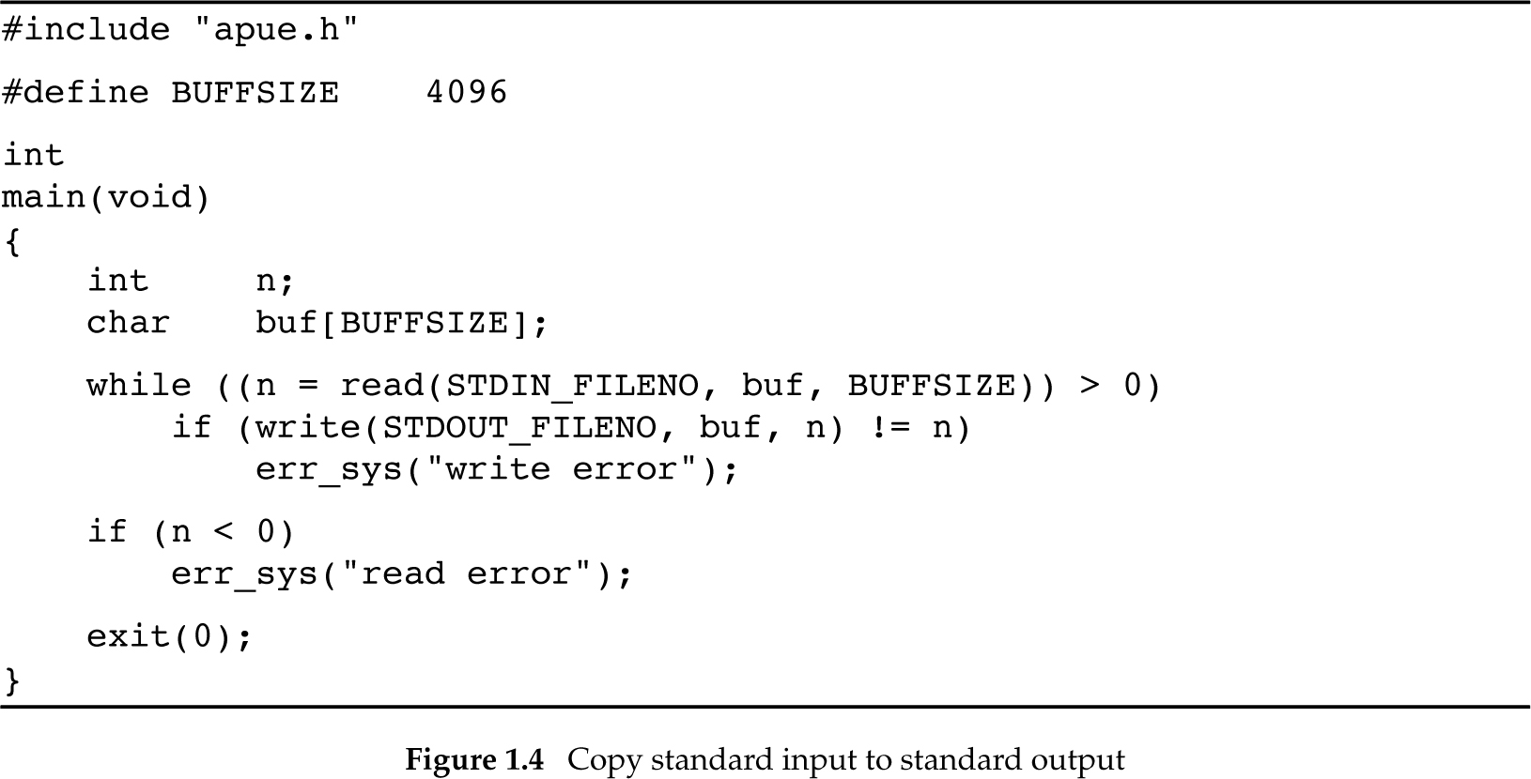
Figure 1.4: Copy standard input to standard output
Includes unistd.h
Affects program efficiency (Sec.3.9)
Constant 0 defined in unistd.h
Constant 1 defined in unistd.h
read() returns:
#bytes read
0 if EOF
-1 if error

Slide 17
1.5 Input and Output
如何使用前面哪支程式，將infile檔案的內容複製到outfile檔案？
./a.out < infile > outfile
導入
導出

Slide 18
Standard I/O
Buffered interface
No need to worry about BUFFSIZE
因為標準輸出入程式庫自動配置緩衝空間，所以使用者不需要擔心要設多大的buffer!
Can deal with “lines of input”
fgets() reads an entire line
Example:
printf() (#include <stdio.h>)

Slide 19
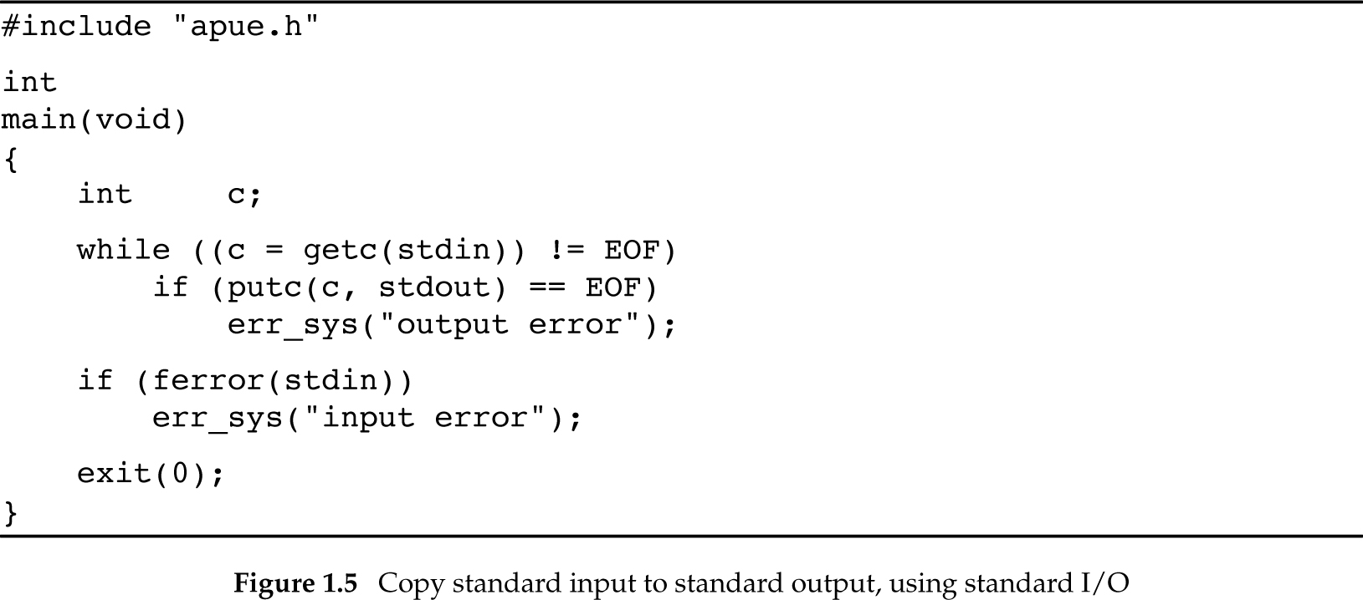
Figure 1.5: Copy stdin to stdout using standard I/O
Reads one char at a time
Constant defined in stdio.h
Writes one char at a time
stdin, stdout:
Constants defined in <stdio.h>

Slide 20
1.6 Programs and Processes
Program
an executable file on disk
Process
an executing instance of a program
Process also called “task” by some OS
Example: Linux OS
Process ID (pid)
Unique non-negative integer identifier for each process

Slide 21
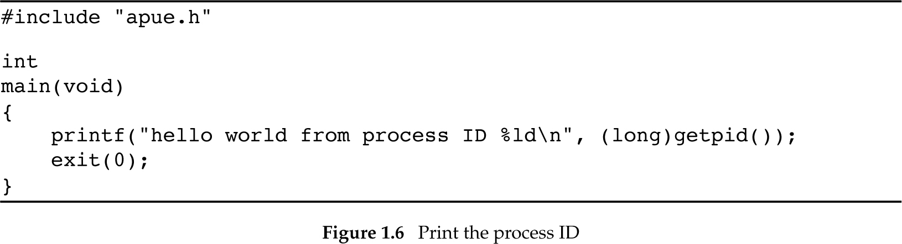
Figure 1.6: Print process ID
To obtain process ID, returns pid_t data type

Slide 22
Process Control
Three functions
fork()
exec(): has 7 variants
waitpid()

Slide 23
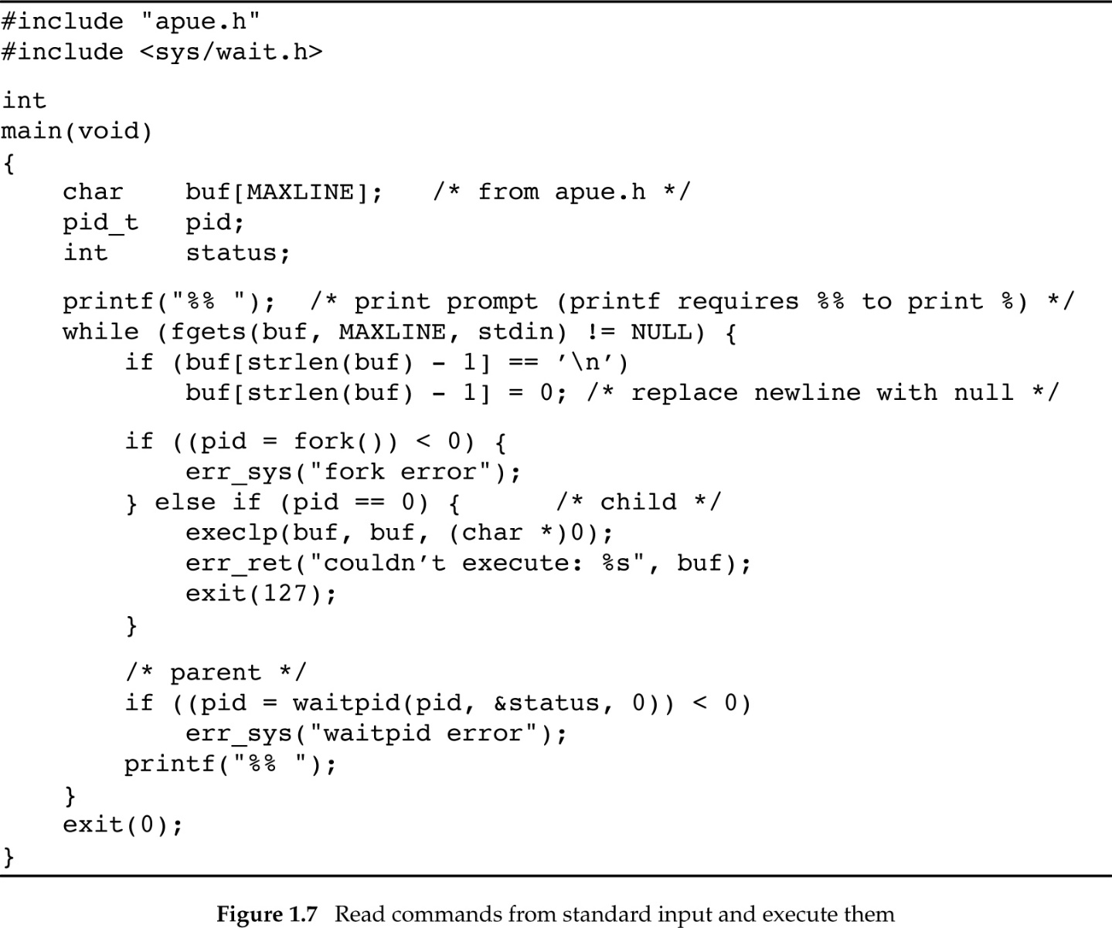
Program 1.7: exec stdin cmds
提示符號
由fork()的回傳值 pid，判斷自己是父程序或子程序。父程序收到的是子程序的編號。子程序收到的是O。
新增一個程序，呼叫一次，會回傳兩次，
一次在父程序，一次在子程序
子程序
(執行命令)
父程序
(等子程序執行結束)

Slide 24
Execution of Prog. in Fig. 1.7
$ ./a.out
% date
Sat Jan 21 19:42:07 EST 2012
% who
…
% pwd
/home/sar/bk/apue/3e
% ls
Makefile
a.out
shell1.c
% ^D
$

Slide 25
Threads
A process can have one or more threads
Can exploit parallelism on multiprocessor systems
Share same address space, file descriptors, stacks, process-related attributes
Need to synchronize access to shared data
Thread IDs: local to process

Slide 26
1.7 Error Handling
Negative return value when error occurs
#include <errno.h>
errno symbol
Assigned constant values, e.g., EACCES
2 Rules
never cleared if error does not occur
never set to 0 by any function
需要自己先確定有錯誤，再來檢查此值

Slide 27
1.7 Error Handling
2 functions for printing error messages:
#include <string.h>
char *strerror(int errnum);
strerror() returns a string
#include <stdio.h>
void perror(const char *msg);
perror() outputs “msg: <error_msg>”

Slide 28
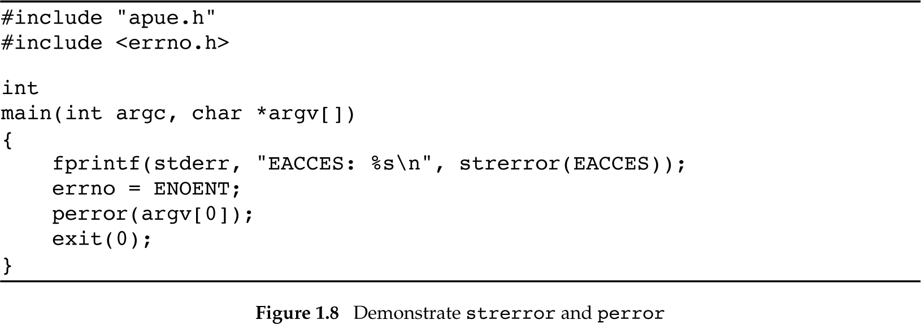
Figure 1.8: demonstrate strerror and perror

Slide 29
Execution results
$ ./a.out
EACCES: Permission denied
./a.out: No such file or directory

Slide 30
Why pass argv[0] to perror?
Consider:
prog1 < inputfile | prog2 | prog3 > outputfile
If only error messages were printed
In which program did the error occur?
With argv[0]:
prog3: Permission denied
We know in which program error occurred!

Slide 31
Error Recover
Fatal error
no recovery action, print error message!
Nonfatal error
delay and retry later (exponential backoff algorithm)
Improves robustness by avoiding an abnormal exit
Examples of resource-related errors:
EAGAIN, ENFILE, ENOBUFS, ENOLCK, ENOSPC, ENOSR, EWOULDBLOCK, ENOMEM

Slide 32
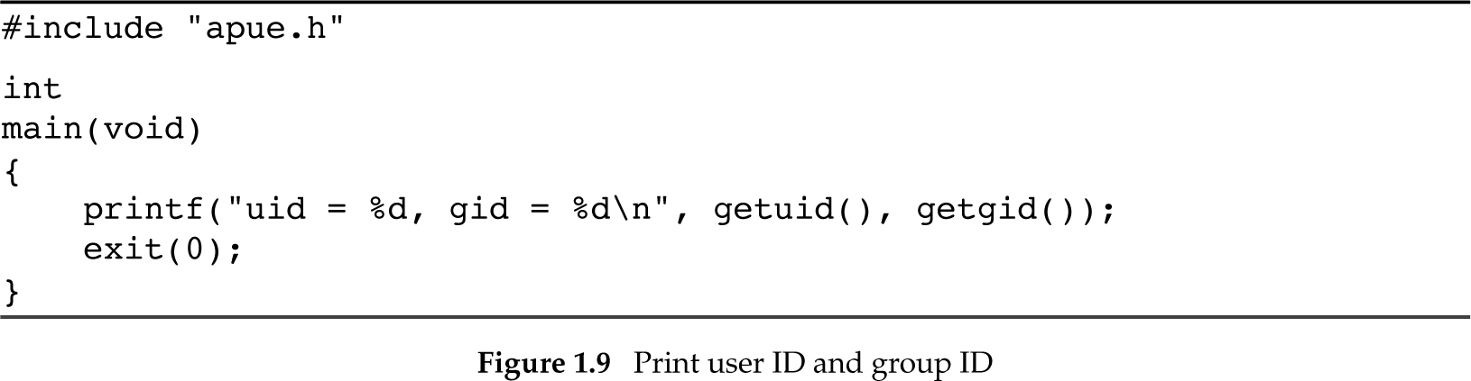
1.8 User Identification
User ID: numeric identifier of a user
/etc/passwd (or on some server)
Group ID: numeric identifier of a group
/etc/group

Slide 33
1.9 Signals
A technique to notify a process that some condition has occurred
Example
If a process divides by zero
Signal SIGFPE (Floating-point exception) is sent to the process

Slide 34
1.9 Signals
Process has 3 choices for dealing with a signal
Ignore the signal (忽略信號)
Not recommended for hardware errors, etc.
Let the default action occur (原定方式處理)
SIGFPE: default action is terminate process
Catch the signal (攔截信號，自訂處理方式)
Provide a function to handle the signal

Slide 35
Figure 1.10 (Read commands from stdin and execute)
#include “apue.h"
#include <sys/wait.h>
static void sig_int(int); /* our signal-catching function */
int
main(void)
{
char buf[MAXLINE];
pid_t pid;
int status;
if (signal(SIGINT, sig_int) == SIG_ERR)
err_sys("signal error");
printf("%% "); /* print prompt (printf requires %% to print %) */
while (fgets(buf, MAXLINE, stdin) != NULL) {
if (buf[strlen(buf) – 1] == ‘\n’)
buf[strlen(buf) - 1] = 0; /* replace newline with null */
if ( (pid = fork()) < 0)

Slide 36
Figure 1.10
err_sys("fork error");
else if (pid == 0) { /* child */
execlp(buf, buf, (char *) 0);
err_ret("couldn't execute: %s", buf);
exit(127);
}
/* parent */
if ( (pid = waitpid(pid, &status, 0)) < 0)
err_sys("waitpid error");
printf("%% ");
}
exit(0);
}
void
sig_int(int signo)
{
printf("interrupt\n%% ");
}

Slide 37
1.10 Time Values
Two different time values
Calendar time: #seconds since the Epoch, which is 00:00:00 Jan 1, 1970, Coordinated Universal Time (UTC).
Process time: measures CPU resources used by a process, in clock ticks, which is 50, 60, or 100 ticks per second.

Slide 38
1.10 Time Values
Execution time of a process has 3 values:
clock time: total amount of time from process start to finish
user CPU time: CPU time due to user instructions in a process
system CPU time: CPU time due to kernel activities on behalf of the process

Slide 39
1.10 Time Values
To measure process execution time, use the “time” command as follows:
$ time ls > /dev/null
real 0m19.81s
user 0m0.43s
sys 0m4.53s

Slide 40
1.11 System Calls & Library Functions
System Calls: Entry points into an OS kernel
Number of system calls
Linux 3.2.0: 380, FreeBSD 8.0: 450
Cannot be changed by user
A function of the same name in the standard C library
User just calls those C functions whenever system calls are needed

Slide 41
1.11 System Calls & Library Functions
Library Functions: not entry points into kernel, just functions, but they may invoke one or more system calls
E.g.: printf() invokes write() system call
E.g.: strcpy(), atoi(): do not invoke any system call
Implementor view: fundamental diff
Programmer view: no critical difference

Slide 42
1.11 System Calls & Library Functions
malloc(): Memory allocation function
Many ways to do memory allocation and garbage collection (best fit, first fit)
sbrk(): UNIX system call, increases or decreases address space of process by a specified number of bytes
Can implement own memory allocation function using sbrk()

Slide 43
System Calls & Library Functions
application code
user process
memory allocation function malloc
sbrk system call
kernel

Slide 44
System Calls & Library Functions
application code
user process
C library functions
system calls
kernel

Slide 45
1.11 System Calls & Library Functions
System call: time in #seconds since Jan 1, 1970
C function: human-readable time and date using local time zone
Both are called “functions” in the textbook

