Slide 1
Chapter 3. File I/O
System Programming
http://www.cs.ccu.edu.tw/~pahsiung/courses/sp
熊博安
國立中正大學資訊工程學系
pahsiung@cs.ccu.edu.tw Class: EA-001
(05)2720411 ext. 23100, 33119 Office: EA-108, 512
Textbook: Advanced Programming in the UNIX Environment, 3rd Edition, W. Richard Stevens and Stephen A. Rago
Notes:
115/11/07

Slide 2
3.1 Introduction
Unbuffered I/O
  each read/write invokes a system call
5 File I/O functions:
(POSIX.1, Single UNIX Specification, not ISO C)
  open
  read (a system call)
  write (a system call)
  lseek
  close
File sharing, atomic operations
  dup, fcntl, sync, fsync, ioctl
Slides©2014 Pao-Ann Hsiung, National Chung Cheng University, Taiwan

Slide 3
3.2 File Descriptors
What is it?
  A nonnegative integer (0, 1, 2, …)
  Represents an open file
How to use it?
  Returned by open or creat
  Argument to read or write
Examples (defined in <unistd.h>)
  STDIN_FILENO = 0 (標準輸入)
  STDOUT_FILENO = 1 (標準輸出)
  STDERR_FILENO = 2 (標準錯誤)
Slides©2014 Pao-Ann Hsiung, National Chung Cheng University, Taiwan

Slide 4
3.3 open and openat Functions
#include <fcntl.h>
int open(const char *path, int oflag, … /* mode_t mode*/);
int openat(int fd, const char *path, int oflag, … /*mode_t mode */);
Return: file descriptor if OK, -1 on error
If pathname is relative, fd can be used to open a dir where pathname is evaluated.
Slides©2014 Pao-Ann Hsiung, National Chung Cheng University, Taiwan

Slide 5
3.3 open and openat Functions
path: name of file to open
oflag = “OR” of one of the following and the others on the next slide (下面的ㄧ個 OR 下頁的)
  O_RDONLY: open for reading only
  O_WRONLY: open for writing only
  O_RDWR: open for reading & writing
  O_EXEC: open for execute only
  O_SEARCH: open for search only (for dir, not supported yet by any OS)
Slides©2014 Pao-Ann Hsiung, National Chung Cheng University, Taiwan
Notes:
115/11/07

Slide 6
3.3 open and openat Functions
Other optional constants:
  O_APPEND: append to end of file
  O_CLOEXEC: Set FD_CLOEXEC fd flag (see Sec. 3.14)
  O_CREAT: create if not existing, need mode
  O_DIRECTORY: gen error if path is not a directory
  O_EXCL: gen error if file exist and O_CREAT specified
  O_NOCTTY: do not allocate as controlling terminal
  O_NOFOLLOW: gen error if path is a symbolic link
  O_NONBLOCK: nonblocking mode for FIFO or block/character special file (see Sec. 14.2)
  O_SYNC: write should wait for physical I/O to complete, including file attribute update
  O_TRUNC: truncate length to 0, if exists and opened for write-only or read-write
  O_TTY_INIT: set terminal to conform to SUS
  O_DSYNC: wait write complete (without waiting for file attributes to be updated)
  O_RSYNC: wait for all pending writes to complete before read operation
Slides©2014 Pao-Ann Hsiung, National Chung Cheng University, Taiwan

Slide 7
3.4 creat Function
#include <fcntl.h>
int creat(const char *path,
mode_t mode);
Returns: file descriptor opened for write-only if OK, -1 on error
Slides©2014 Pao-Ann Hsiung, National Chung Cheng University, Taiwan

Slide 8
3.4 creat Function
Equivalent to:
open(path, O_WRONLY | O_CREAT |O_TRUNC, mode);
Used when open could take only
0 (O_RDONLY), 1(O_WRONLY), and 2(O_RDWR).
Better: open(path, O_RDWR | O_CREAT | O_TRUNC, mode);
Slides©2014 Pao-Ann Hsiung, National Chung Cheng University, Taiwan

Slide 9
3.5 close Function
#include <unistd.h>
int close(int fd);
Returns: 0 if OK, -1 on error
Releases record locks on the file
All open files automatically closed by kernel, when a process terminates.
  Advantage: no explicit close()
Slides©2014 Pao-Ann Hsiung, National Chung Cheng University, Taiwan

Slide 10
3.6 lseek Function
Current file offset:
  nonnegative integer
  #bytes from beginning of file
read, write start from current file offset
  incremented by #bytes read/written
initialized to 0 when file is opened (unless O_APPEND is specified)
Slides©2014 Pao-Ann Hsiung, National Chung Cheng University, Taiwan

Slide 11
3.6 lseek Function
#include <unistd.h>
off_t lseek(int fd,
off_t offset, int whence);
Returns: new file offset if OK, -1 on error
Slides©2014 Pao-Ann Hsiung, National Chung Cheng University, Taiwan

Slide 12
3.6 lseek Function
whence | New offset (bytes)
SEEK_SET | file start + offset
SEEK_CUR | current offset + offset
SEEK_END | file size + offset
+/-
Slides©2014 Pao-Ann Hsiung, National Chung Cheng University, Taiwan

Slide 13
3.6 lseek Function
To determine current offset:
  off_t curpos;
  currpos = lseek(fd, 0, SEEK_CUR);
If fd is a FIFO, pipe, or socket:
  currpos = −1
  errno = ESPIPE
Before System V: whence = 0(absolute), 1(relative to current), 2(relative to EOF)
Hard coded
Slides©2014 Pao-Ann Hsiung, National Chung Cheng University, Taiwan

Slide 14
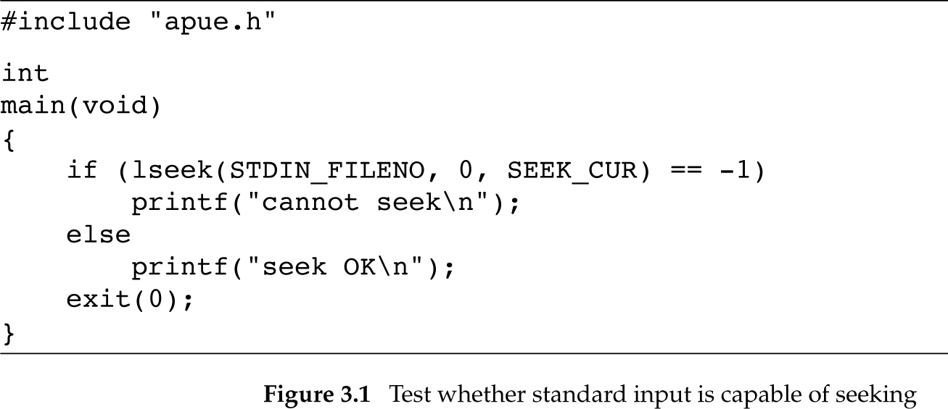
Figure 3.1: Test whether std input is capable of seeking
Slides©2014 Pao-Ann Hsiung, National Chung Cheng University, Taiwan

Slide 15
Figure 3.1 (output)
$ ./a.out < /etc/passwd
seek OK
$ cat < /etc/passwd | ./a.out
cannot seek
$ ./a.out < /var/spool/cron/FIFO
cannot seek
Slides©2014 Pao-Ann Hsiung, National Chung Cheng University, Taiwan

Slide 16
3.6 lseek Function
For regular files, offset is usually nonnegative
For special files, offset can be negative
  Check -1 and not < 0
lseek() only records current file offset in kernel, no I/O takes place
offset > file size?
  OK! Hole in file! All 0!
Slides©2014 Pao-Ann Hsiung, National Chung Cheng University, Taiwan

Slide 17
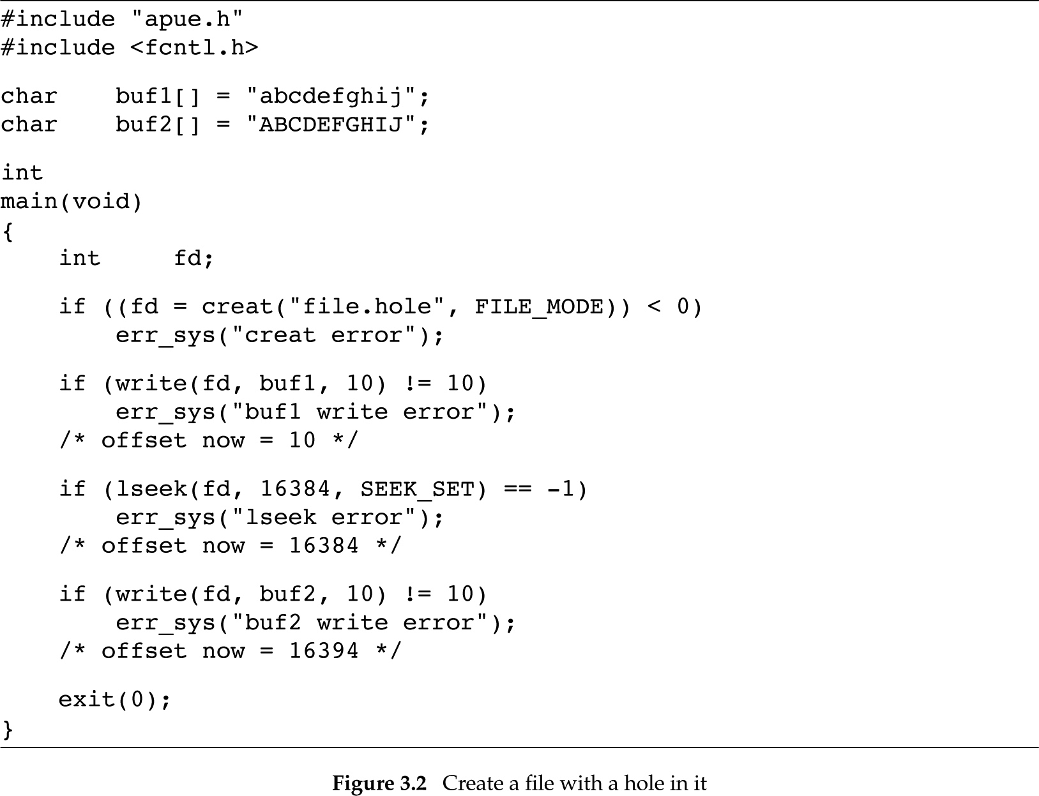
Figure 3.2: Create file with hole
Slides©2014 Pao-Ann Hsiung, National Chung Cheng University, Taiwan

Slide 18
Figure 3.2 (output)
$ ./a.out
$ ls –l file.hole check its size
-rw-r--r– 1 sar 16394 Nov 25 01:01 file.hole
$ od –c file.hole let’s look at the actual contents
0000000 a b c d e f g h i j \0 \0 \0 \0 \0 \0
0000020 \0 \0 \0 \0 \0 \0 \0 \0 \0 \0 \0 \0 \0 \0 \0 \0
0040000 A B C D E F G H I J
0040012
(–c: print as characters)
byte offset in octal
Slides©2014 Pao-Ann Hsiung, National Chung Cheng University, Taiwan

Slide 19
3.7 read Function
#include <unistd.h>
ssize_t read(int fd, void *buf, size_t nbytes );
Returns: #bytes read, 0 if EOF, -1 on error
#bytes read may be < nbytes
signed
unsigned
Slides©2014 Pao-Ann Hsiung, National Chung Cheng University, Taiwan

Slide 20
3.7 read Function
When is #bytes read < nbytes requested?
EOF reached
Terminal: 1 line read at a time
Network: buffer size limit
Pipe or FIFO: pipe contents (whatever available)
Magnetic tape: single record at a time
Interrupted by signal: partially read
Slides©2014 Pao-Ann Hsiung, National Chung Cheng University, Taiwan

Slide 21
3.8 write Function
#include <unistd.h>
ssize_t write(int fd,
const void *buf, size_t nbytes);
Returns: #bytes written if OK, -1 on error
File offset incremented by #bytes written
Slides©2014 Pao-Ann Hsiung, National Chung Cheng University, Taiwan

Slide 22
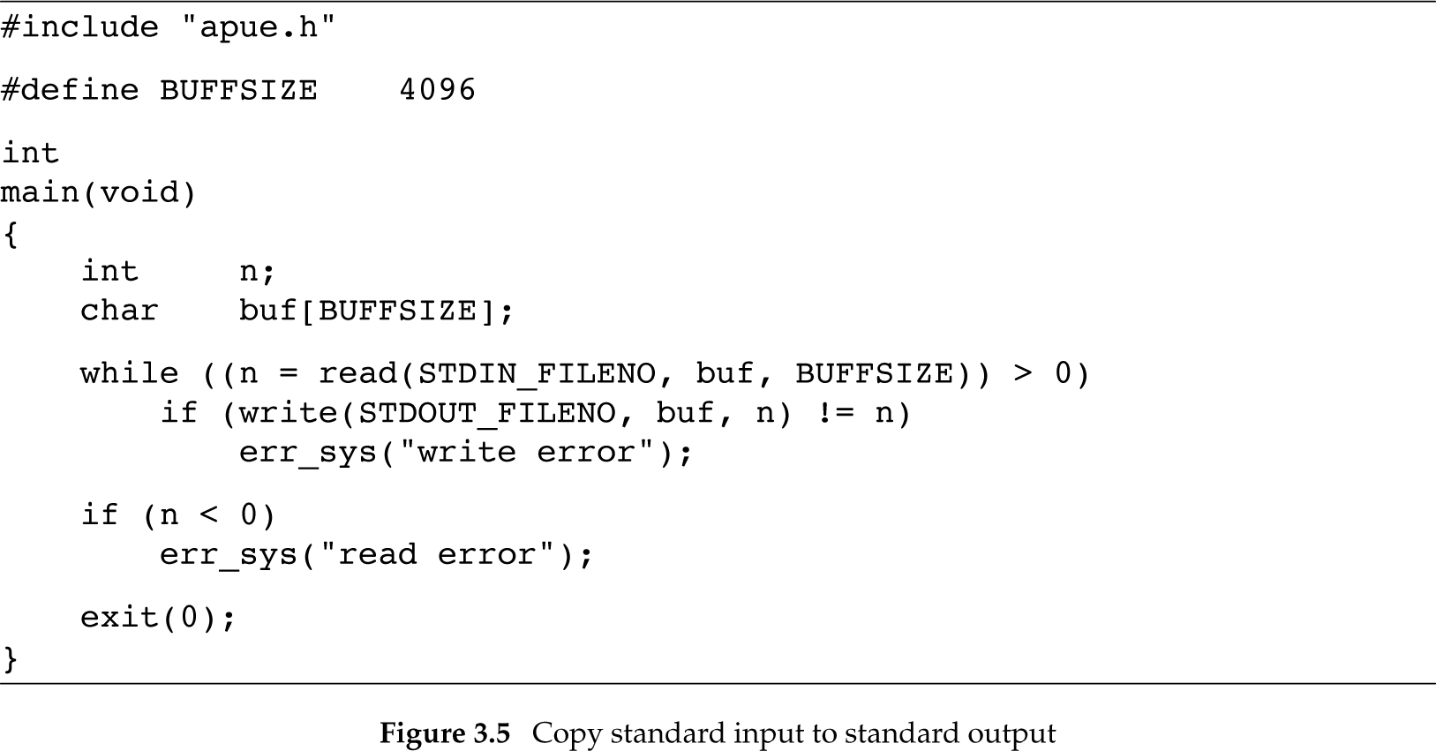
3.9 I/O Efficiency
Figure 3.4: stdout ← stdin
Slides©2014 Pao-Ann Hsiung, National Chung Cheng University, Taiwan

Slide 23
Figure 3.4 (details)
Standard input and standard output opened automatically by UNIX shell
  Will be automatically closed by UNIX kernel
Works for both text and binary files
  No difference between them for UNIX kernel
Slides©2014 Pao-Ann Hsiung, National Chung Cheng University, Taiwan

Slide 24
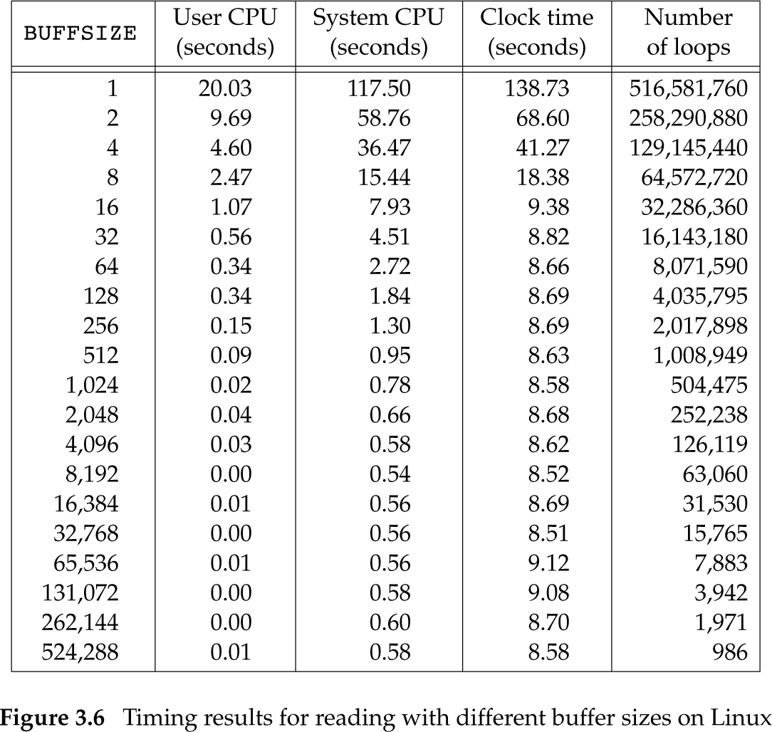
Timing results for reading with different buffer sizes on Linux
516,581,760-byte file
20 buffer sizes
Linux ext4 filesystem
4,096-byte blocks
512 MB RAM
System reads ahead when sequential reads are detected
Min system time
Slides©2014 Pao-Ann Hsiung, National Chung Cheng University, Taiwan

Slide 25
3.10 File Sharing
3 data structures used by kernel
Process Table
File Table
V-node Table
Slides©2014 Pao-Ann Hsiung, National Chung Cheng University, Taiwan

Slide 26
Process Table
An entry for each process
  A table of open file descriptors in each entry
    File descriptor flag (FD_CLOEXEC)
    A pointer to a file table entry
Slides©2014 Pao-Ann Hsiung, National Chung Cheng University, Taiwan

Slide 27
File Table
An entry for each open file
  file status flags: read, write, append, sync, nonblocking, etc.
  current file offset
  a pointer to a v-node table entry for the file
Slides©2014 Pao-Ann Hsiung, National Chung Cheng University, Taiwan

Slide 28
V-node Table
Each open file has a v-node structure
type of file
pointers to functions operating on file
i-node for the file: (see Sec. 4.14)
  file owner,
  file size,
  pointers to actual data blocks for the file on the disk
Slides©2014 Pao-Ann Hsiung, National Chung Cheng University, Taiwan

Slide 29
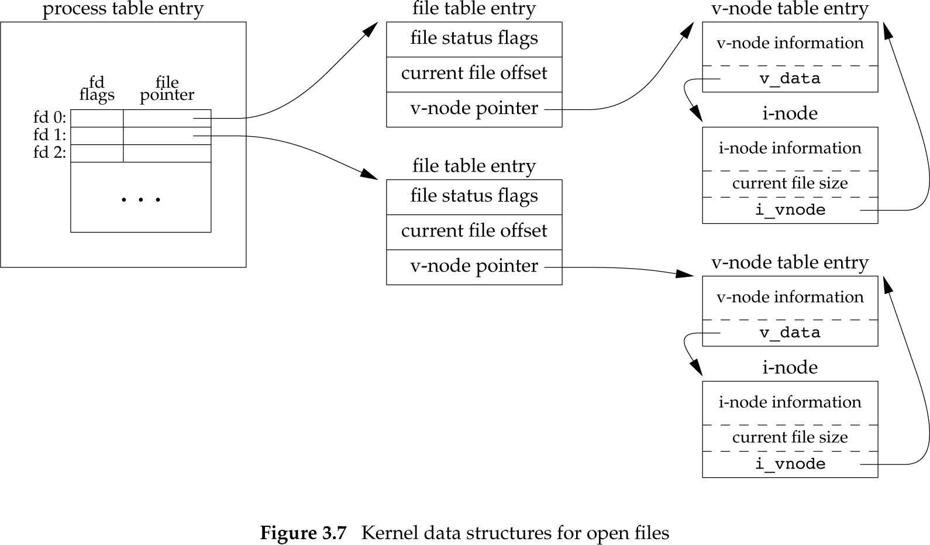
File Sharing
Slides©2014 Pao-Ann Hsiung, National Chung Cheng University, Taiwan

Slide 30
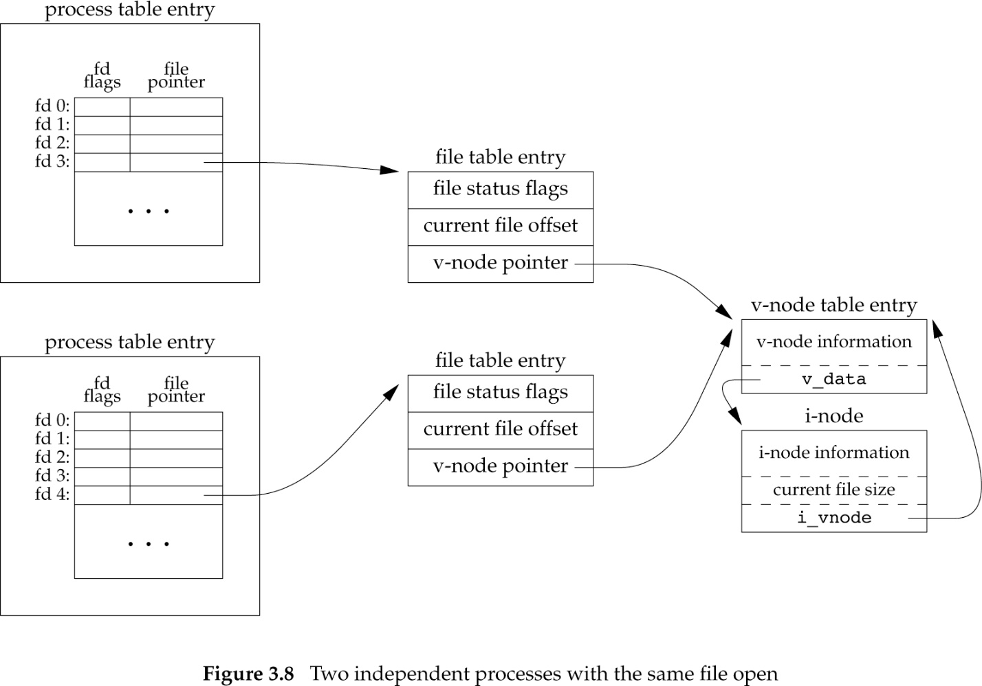
File Sharing
Why not share file table entry?
Slides©2014 Pao-Ann Hsiung, National Chung Cheng University, Taiwan

Slide 31
File Sharing
After each write(), current file offset is incremented by #bytes written.
If file size increases, current file size in i-node table is updated.
If a file open has O_APPEND flag, file status flags are updated and
before each write, current file offset := current file size (from i-node table)
Slides©2014 Pao-Ann Hsiung, National Chung Cheng University, Taiwan

Slide 32
File Sharing
lseek() only modifies current file offset.
  No I/O.
All above work fine for multiple processes reading same file.
  For write of same file by multiple processes, unexpected results can occur
Slides©2014 Pao-Ann Hsiung, National Chung Cheng University, Taiwan

Slide 33
3.11 Atomic Operations (APPEND)
O_APPEND option in open() was not available before, for appending to file:
File appending was coded as follows:
if(lseek(fd, 0L, 2)<0) /*position to EOF*/
err_sys(“lseek error”);
if(write(fd, buff, 100) != 100)
err_sys(“write error”);
2 actions
Slides©2014 Pao-Ann Hsiung, National Chung Cheng University, Taiwan

Slide 34
Atomic Operations (APPEND)
Scenario
Processes A & B appending to same file
Set file offset to EOF (1500) for A
Kernel switches to Process B
Set file offset to EOF (1500) for B
Write by B, file size increased to 1600
Kernel switches back to Process A
Write by A, data of B is overwritten!!!
Slides©2014 Pao-Ann Hsiung, National Chung Cheng University, Taiwan

Slide 35
Atomic Operations (APPEND)
What is the problem?
Append is implemented as 2 actions:
  position to EOF
  write to file
Kernel may switch from one process to another between those two actions
Solution: let append be ATOMIC!!!
Slides©2014 Pao-Ann Hsiung, National Chung Cheng University, Taiwan

Slide 36
Atomic Operations (CREATE)
open() with O_CREAT, O_EXCL fails if file exists
This is an ATOMIC operation!
Can we implement it as follows?
if ( (fd=open(pathname, O_WRONLY)<0)
if (errno==ENOENT) {
if ((fd=creat(pathname, mode)) < 0)
err_sys(“creat error”);
} else err_sys (“open error”);
Slides©2014 Pao-Ann Hsiung, National Chung Cheng University, Taiwan

Slide 37
Atomic Operations
What if the file is created by another process between open() and creat()?
Any data written by the other process will be erased by the creat() of first process.
Thus, we need ATOMIC file creation
ATOMIC = Either all operations are performed or none (NO SUBSETS!)
Slides©2014 Pao-Ann Hsiung, National Chung Cheng University, Taiwan

Slide 38
3.12 dup() and dup2()
#include <unistd.h>
int dup ( int fd );
int dup2 ( int fd, int fd2 );
Return: new file descriptor if OK, -1 on error
Duplicate fd and return as new file descriptor,
  dup: lowest numbered file descriptor
  dup2: specified as fd2
Slides©2014 Pao-Ann Hsiung, National Chung Cheng University, Taiwan

Slide 39
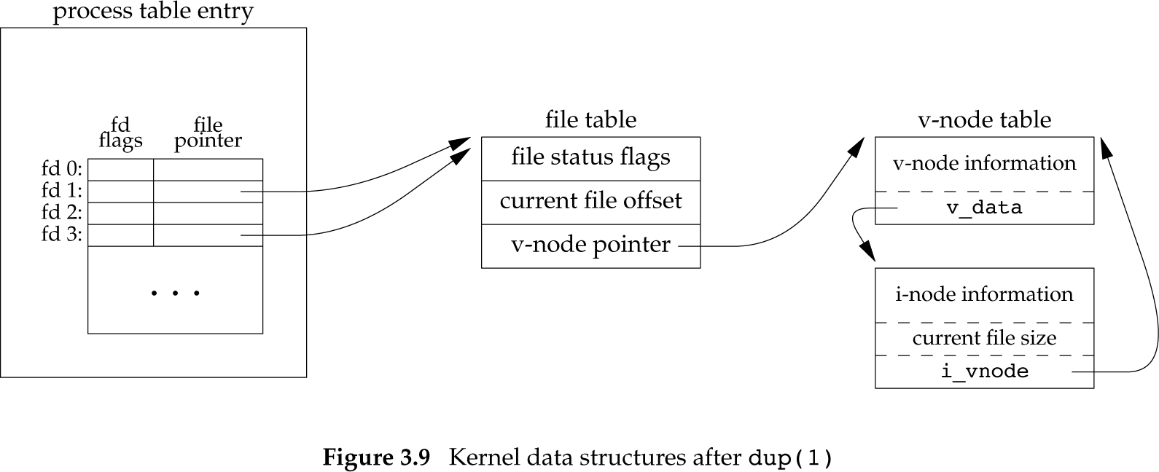
Kernel data structures on dup(1)
Slides©2014 Pao-Ann Hsiung, National Chung Cheng University, Taiwan

Slide 40
3.13 sync, fsync, fdatasync
For efficient I/O, UNIX system has buffer cache or page cache
Delayed write
  Data is first written to buffer
  Kernel eventually writes all delayed-write blocks to disk
To ensure consistency between disk file system and buffer cache contents
  sync, fsync, fdatasync
Slides©2014 Pao-Ann Hsiung, National Chung Cheng University, Taiwan

Slide 41
sync, fsync, fdatasync
#include <unistd.h>
int fsync(int fd);
int fdatasync(int fd);
Returns: 0 if OK, -1 on error
void sync(void);
Slides©2014 Pao-Ann Hsiung, National Chung Cheng University, Taiwan

Slide 42
sync, fsync, fdatasync
sync
  Queues write requests for the modified blocks
  Called by “update” daemon every 30 seconds
fsync
  Single file
  Waits for disk writes to complete
    data + attributes all updated
  Example: used for database
fdatasync
  Single file
  Waits for data update only, not file attributes
sync, fsync supported by all 4 OS
fdatasync: not supported by FreeBSD 8.0
Slides©2014 Pao-Ann Hsiung, National Chung Cheng University, Taiwan

Slide 43
3.14 fcntl Function
#include <fcntl.h>
int fcntl ( int fd, int cmd, … /* int arg */ );
Returns: depends on cmd if OK,
-1 on error
Slides©2014 Pao-Ann Hsiung, National Chung Cheng University, Taiwan

Slide 44
fcntl()
Change properties of an opened file
cmd | fcntl() results
F_DUPFD | duplicate an existing descriptor
F_GETFD or F_SETFD | get/set file descriptor flags
F_GETFL or F_SETFL | get/set file status flags
F_GETOWN or F_SETOWN | get/set async I/O owner
F_GETLK, F_SETLK, or F_SETLKW | get/set record locks
Slides©2014 Pao-Ann Hsiung, National Chung Cheng University, Taiwan

Slide 45
Figure 3.11: print file flags
#include <fcntl.h>
#include "apue.h"
int
main(int argc, char *argv[])
{
int val;
if (argc != 2)
err_quit("usage: a.out <descriptor#>");
if ( (val = fcntl(atoi(argv[1]), F_GETFL, 0)) < 0)
err_sys("fcntl error for fd %d", atoi(argv[1]));
Slides©2014 Pao-Ann Hsiung, National Chung Cheng University, Taiwan

Slide 46
Figure 3.11: print file flags
switch(val & O_ACCMODE) {
case O_RDONLY: printf("read only"); break;
case O_WRONLY: printf("write only"); break;
case O_RDWR: printf("read write"); break;
default: err_dump("unknown access mode");
}
if (val & O_APPEND) printf(", append");
if (val & O_NONBLOCK) printf(", nonblocking");
if (val & O_SYNC) printf(", synchronous writes");
#if !defined(_POSIX_C_SOURCE) && defined(O_FSYNC) && (O_FSYNC != O_SYNC)
if (val & O_FSYNC) printf(“, synchronous writes”);
#endif
putchar('\n');
exit(0);
}
Slides©2014 Pao-Ann Hsiung, National Chung Cheng University, Taiwan

Slide 47
Figure 3.11: (output)
$ ./a.out 0 < /dev/tty
read only
$ ./a.out 1 > temp.foo
$ cat temp.foo
write only
$ ./a.out 2 2>> temp.foo
write only, append
$ ./a.out 5 5<>temp.foo
read write
Slides©2014 Pao-Ann Hsiung, National Chung Cheng University, Taiwan

Slide 48
Figure 3.12: set file status flags for a descriptor
#include "apue.h"
#include <fcntl.h>
void
set_fl(int fd, int flags) /* flags are file status flags to turn on */
{
int val;
if ( (val = fcntl(fd, F_GETFL, 0)) < 0)
err_sys("fcntl F_GETFL error");
val |= flags; /* turn on flags */
if (fcntl(fd, F_SETFL, val) < 0)
err_sys("fcntl F_SETFL error");
}
Slides©2014 Pao-Ann Hsiung, National Chung Cheng University, Taiwan

Slide 49
Figure 3.12: clear flags
How to clear flags for a file?
val &= ~flags; /* turn flags off */
Slides©2014 Pao-Ann Hsiung, National Chung Cheng University, Taiwan

Slide 50
O_SYNC
set_fl(STDOUT_FILENO, O_SYNC);
Add the above line to the start of Figure 3.5
Each write is sync’ed.
Slides©2014 Pao-Ann Hsiung, National Chung Cheng University, Taiwan

Slide 51
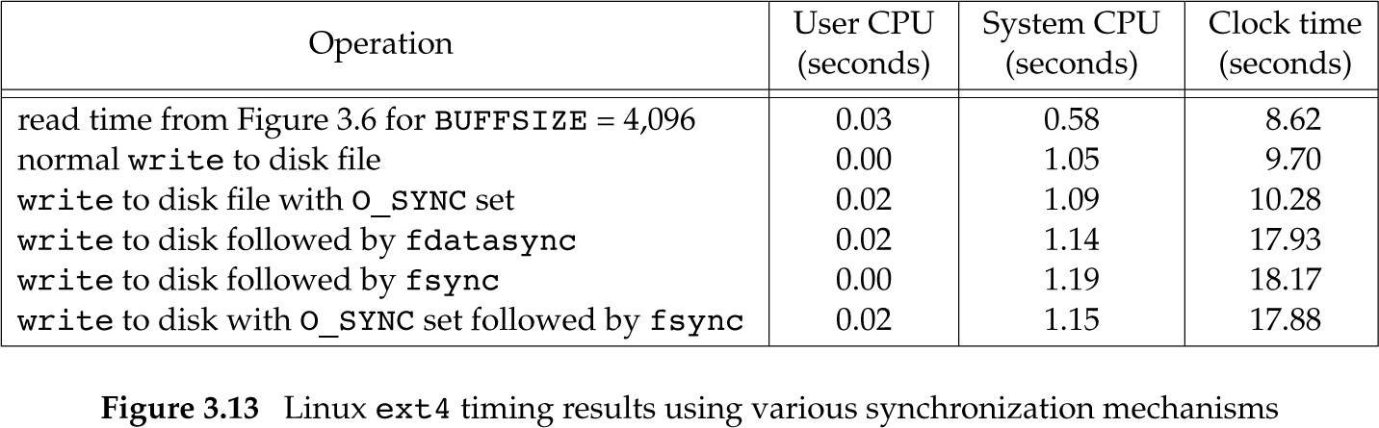
O_SYNC (copying 492.6 MB data)
write to /dev/null
No disk output
Linux does not
honor O_SYNC
Wait for all writes
committed to disk
Linux system with ext4 filesystem, BUFFSIZE=4096
Slides©2014 Pao-Ann Hsiung, National Chung Cheng University, Taiwan

Slide 52
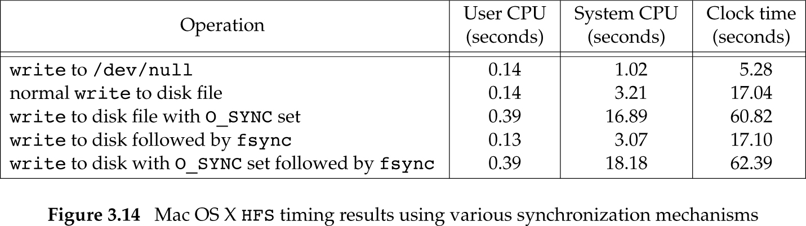
O_SYNC (copying 492.6 MB data)
Synchronous writes more expensive than delayed writes!
OS flushed data to disk as we were writing new data. Very little work was left to be done.
Mac OS X 10.6.8 system (HFS file system)
Slides©2014 Pao-Ann Hsiung, National Chung Cheng University, Taiwan

Slide 53
fcntl()
Is fcntl() really needed?
  We do not know which file is the stdout, we only know descriptor STDOUT_FILENO
  Cannot set O_SYNC when file is opened
  Pipe: All we have with a pipe is a descriptor
Slides©2014 Pao-Ann Hsiung, National Chung Cheng University, Taiwan

Slide 54
3.15 ioctl Function
#include <unistd.h> /* System V */
#include <sys/ioctl.h> /* BSD, Linux*/
int ioctl(int fd, int request, …);
Returns: -1 on error, something else if OK
Terminal I/O was biggest user of ioctl
POSIX.1 prototype
Slides©2014 Pao-Ann Hsiung, National Chung Cheng University, Taiwan

Slide 55
Ioctl commands (FreeBSD)
Category | Constant | Header | #ioctls
Disk labels | DIOxxx | <sys/disklabel.h> | 4
File I/O | FIOxxx | <sys/filio.h> | 14
Mag tape I/O | MTIOxxx | <sys/mtio.h> | 11
Socket I/O | SIOxxx | <sys/sockio.h> | 73
Terminal I/O | TIOxxx | <sys/ttycom.h> | 43
Slides©2014 Pao-Ann Hsiung, National Chung Cheng University, Taiwan

Slide 56
ioctl()
It can be used on magnetic tapes to:
  write end-of-file marks
  rewind tape
  space forward over #files or #records
No other function (read, write, lseek) can be used for the above
Other uses: Sections 18.12, 19.7
Slides©2014 Pao-Ann Hsiung, National Chung Cheng University, Taiwan

Slide 57
3.16 /dev/fd
Files in /dev/fd are named 0, 1, 2, …
open(“/dev/fd/n”, mode) = dup(n)
  mode is mostly ignored or must be a subset of original mode for n
Some systems:
/dev/stdin = /dev/fd/0
/dev/stdout = /dev/fd/1
/dev/stderr = /dev/fd/2
Slides©2014 Pao-Ann Hsiung, National Chung Cheng University, Taiwan

Slide 58
/dev/fd
filter file2 | cat file1 – file3 | lpr
(– = standard input)
Can also be given as:
filter file2 | cat file1 /dev/fd/0 file2 | lpr
/dev/fd is for uniformity and cleanliness
Slides©2014 Pao-Ann Hsiung, National Chung Cheng University, Taiwan

