Slide 1
Chapter 4.
Files and Directories
System Programming
http://www.cs.ccu.edu.tw/~pahsiung/courses/sp
熊博安
國立中正大學資訊工程學系
pahsiung@cs.ccu.edu.tw Class: EA-001
(05)2720411 ext. 23100, 33119 Office: EA-108, EA-512
Textbook: Advanced Programming in the UNIX Environment, 3rd Edition, W. Richard Stevens and Stephen A. Rago
Notes:
115/11/07

Slide 2
4.1 Introduction
Features of filesystem
Properties of a file
stat() function
stat structure
Functions to change owner, permissions, …
File system structure & symbolic links
Descending directory hierarchy
Slides©2014 Pao-Ann Hsiung, Dept of CSIE, National Chung Cheng University, Taiwan

Slide 3
4.2 stat(), fstat(), fstatat(), lstat()
#include <sys/stat.h>
int stat(const char *restrict pathname,
struct stat *restrict buf);
int fstat(int fd, struct stat *buf);
int lstat(const char *restrict pathname,
struct stat *restrict buf);
int fstatat(int fd,
const char *restrict pathname, struct stat *restrict buf, int flag);
All return: 0 if OK, -1 on error
Slides©2014 Pao-Ann Hsiung, Dept of CSIE, National Chung Cheng University, Taiwan

Slide 4
4.2 stat(), fstat(), fstatat(), lstat()
stat() returns a structure of information about a given file
fstat() returns information about a file that is already open on descriptor fd
lstat() returns information about a symbolic link (not the file referenced by the link)
fstatat() same as stat(), except relative to an open directory (fd). The flag argument controls whether links are followed. (AT_SYMLINK_NOFOLLOW flag)
Slides©2014 Pao-Ann Hsiung, Dept of CSIE, National Chung Cheng University, Taiwan

Slide 5
struct stat
struct stat {
  mode_t st_mode; /* file type & mode */
  ino_t st_ino; /* i-node # */
  dev_t st_dev; /* device # */
  dev_t st_rdev; /* device # of special files*/
  nlink_t st_nlink; /* # of links */
  uid_t st_uid; /* owner UID (user ID) */
  gid_t st_gid; /* owner GID (group ID) */
  off_t st_size; /* size in bytes of regular files */
  struct timespec st_atim; /* time of last access */
  struct timespec st_mtim; /* time of last modification*/
  struct timespec st_ctim; /*time of last file status change*/
  blksize_t st_blksize; /* best I/O block size */
  blkcnt_t st_blocks; /* # disk blocks allocated */
};
Slides©2014 Pao-Ann Hsiung, Dept of CSIE, National Chung Cheng University, Taiwan

Slide 6
4.3 File Types
Regular file: contains data, interpretation left to application program
Directory file: contains names of other files and pointers to information on these files
Character special file: unbuffered I/O in variable-sized units, used for certain types of devices, such as terminal
Slides©2014 Pao-Ann Hsiung, Dept of CSIE, National Chung Cheng University, Taiwan

Slide 7
4.3 File Types
Block special file: buffered I/O access in fixed-size units, used for disk drives
FIFO: used for interprocess communication, named pipe (see Section 15.5)
Socket: used for network communication (see Chapter 16)
Symbolic link: points to another file (Section 4.17)
Slides©2014 Pao-Ann Hsiung, Dept of CSIE, National Chung Cheng University, Taiwan

Slide 8
Macros to detect file types
<sys/stat.h>
Argument: stat.st_mode
Macro | Type of file
S_ISREG() | Regular file
S_ISDIR() | Directory file
S_ISCHR() | Character special file
S_ISBLK() | Block special file
S_ISFIFO() | Pipe or FIFO
S_ISLNK() | Symbolic link (not in POSIX.1 or SVR4)
S_ISSOCK() | Socket (not in POSIX.1 or SVR4)
Slides©2014 Pao-Ann Hsiung, Dept of CSIE, National Chung Cheng University, Taiwan

Slide 9
Macros to detect IPC type
Argument: stat
POSIX.1 allows implementations to represent IPC objects as files, e.g. semaphores, message queues, etc. (No OS from the book does that now)
Macro | Type of object
S_TYPEISMQ() | Message queue
S_TYPEISSEM() | Semaphore
S_TYPEISSHM() | Shared memory object
Slides©2014 Pao-Ann Hsiung, Dept of CSIE, National Chung Cheng University, Taiwan

Slide 10
Figure 4.3: print file types
#include “apue.h"
int
main(int argc, char *argv[])
{
int i;
struct stat buf;
char *ptr;
for (i = 1; i < argc; i++) {
printf("%s: ", argv[i]);
if (lstat(argv[i], &buf) < 0) {
err_ret("lstat error");
continue;
}
Slides©2014 Pao-Ann Hsiung, Dept of CSIE, National Chung Cheng University, Taiwan

Slide 11
Figure 4.3: print file types
if (S_ISREG(buf.st_mode)) ptr = "regular";
else if (S_ISDIR(buf.st_mode)) ptr = "directory";
else if (S_ISCHR(buf.st_mode)) ptr = "character special";
else if (S_ISBLK(buf.st_mode)) ptr = "block special";
else if (S_ISFIFO(buf.st_mode)) ptr = "fifo";
else if (S_ISLNK(buf.st_mode)) ptr = "symbolic link";
else if (S_ISSOCK(buf.st_mode)) ptr = "socket";
else ptr = "** unknown mode **";
printf("%s\n", ptr);
}
exit(0);
}
Slides©2014 Pao-Ann Hsiung, Dept of CSIE, National Chung Cheng University, Taiwan

Slide 12
Figure 4.3: (output)
$ ./a.out /etc/passwd /etc /dev/log /dev/tty \
> /var/lib/oprofile/opd_pipe /dev/sr0 /dev/cdrom
/etc/passwd: regular
/etc: directory
/dev/log: socket
/dev/tty: character special
/var/lib/oprofile/opd_pipe: fifo
/dev/sr0: block special
/dev/cdrom: symbolic link
Slides©2014 Pao-Ann Hsiung, Dept of CSIE, National Chung Cheng University, Taiwan

Slide 13
Count File Types
File type | Count | Percentage
Regular file | 415,803 | 79.77%
Directory | 62,197 | 11.93%
Symbolic link | 40,018 | 8.25%
Character special | 155 | 0.03%
Block special | 47 | 0.01%
Socket | 45 | 0.01%
FIFO | 0 | 0.0%
Slides©2014 Pao-Ann Hsiung, Dept of CSIE, National Chung Cheng University, Taiwan

Slide 14
4.4 Set-User-ID & Set-Group-ID
Each process has 6 or more IDs:
Real user ID Real group ID | Who we really are
Effective user ID Effective group ID Supplementary group IDs | Used for file access permission checks
Saved set-user-ID Saved set-group-ID | Saved by exec functions
Slides©2014 Pao-Ann Hsiung, Dept of CSIE, National Chung Cheng University, Taiwan

Slide 15
4.4 Set-User-ID & Set-Group-ID
Set-user-ID
  A special flag in “st_mode” says:
“when this file is executed, set the effective user ID of the process to be the owner of the file (st_uid)”
  Example: “passwd” is set-user-id,
  user can thus write to:
  /etc/passwd or /etc/shadow
  (which are root-writable only)
More details
in Chapter 8
Slides©2014 Pao-Ann Hsiung, Dept of CSIE, National Chung Cheng University, Taiwan

Slide 16
4.5 File Access Permissions
9 permission bits
E.g.: rwxr-xr-- (read, write, execute)
Divided into 3 categories
  User (or owner)
  Group
  Other (or world)
“chmod” command can be used to change permission bits
Slides©2014 Pao-Ann Hsiung, Dept of CSIE, National Chung Cheng University, Taiwan

Slide 17
4.5 File Access Permissions
st_mode mask | Meaning
S_IRUSR | user-read
S_IWUSR | user-write
S_IXUSR | user-execute
S_IRGRP | group-read
S_IWGRP | group-write
S_IXGRP | group-execute
S_IROTH | other-read
S_IWOTH | other-write
S_IXOTH | other-execute
Slides©2014 Pao-Ann Hsiung, Dept of CSIE, National Chung Cheng University, Taiwan

Slide 18
4.5 File Access Permissions
To open a file, we need execute permissions in each directory mentioned in the pathname
To open /usr/include/stdio.h, need “x” for:
  /
  /usr
  /usr/include
Read permission for directory
  Can list all filenames in the directory
Execute permission for directory
  Can search through the directory (for file access)
Slides©2014 Pao-Ann Hsiung, Dept of CSIE, National Chung Cheng University, Taiwan

Slide 19
4.5 File Access Permissions
For O_TRUNC flag in open function, we need write permission for the file
To create a file, we need write and execute permissions in the directory
To delete a file, we need write and execute permissions in the directory
  no need of read/write permissions for file
Slides©2014 Pao-Ann Hsiung, Dept of CSIE, National Chung Cheng University, Taiwan

Slide 20
4.5 File Access Permissions
Kernel tests:
If effective UID=0, grant access.
If effective UID=owner UID:
  if permission bits set, grant access
  else deny permission
If effective GID=owner GID:
  if permission bits set, grant access
  else deny permission
If other permission bits set, grant access.
Slides©2014 Pao-Ann Hsiung, Dept of CSIE, National Chung Cheng University, Taiwan

Slide 21
4.6 Ownership of New Files and Directories
New File or Directory
UID = Effective UID of process
GID = (either of the following two)
  Effective GID of process
    Linux: not default, can be set by mount command
  GID of directory in which file is being created
    FreeBSD 8.0 and Mac OS X 10.6.8 (always)
    Linux 3.2.0 and Solaris 10
    (with set-group-ID bit enabled for directory)
Slides©2014 Pao-Ann Hsiung, Dept of CSIE, National Chung Cheng University, Taiwan

Slide 22
4.7 access and faccessat
#include <unistd.h>
int access ( const char *pathname,
int mode);
int faccessat(int fd, const char *pathname, int mode, int flag);
Return: 0 if OK, -1 on error
mode | Description
R_OK | Test for read permission
W_OK | Test for write permission
X_OK | Test for execute permission
F_OK | Test for existence of file
bitwise OR
Slides©2014 Pao-Ann Hsiung, Dept of CSIE, National Chung Cheng University, Taiwan

Slide 23
Figure 4.8: access()
#include “apue.h"
#include <fcntl.h>
int main(int argc, char *argv[])
{
if (argc != 2) err_quit("usage: a.out <pathname>");
if (access(argv[1], R_OK) < 0)
err_ret("access error for %s", argv[1]);
else printf("read access OK\n");
if (open(argv[1], O_RDONLY) < 0)
err_ret("open error for %s", argv[1]);
else printf("open for reading OK\n");
exit(0);
}
Slides©2014 Pao-Ann Hsiung, Dept of CSIE, National Chung Cheng University, Taiwan

Slide 24
Figure 4.8: output
$ ls –l a.out
-rwxrwxr-x 1 sar 15945 Nov 30 12:10 a.out
$ ./a.out a.out
read access OK
open for reading OK
$ ls –l /etc/shadow
-r-------- 1 root 1315 Jul 17 2002 /etc/shadow
$ ./a.out /etc/shadow
access error for /etc/shadow: Permission denied
open error for /etc/shadow: Permission denied
Slides©2014 Pao-Ann Hsiung, Dept of CSIE, National Chung Cheng University, Taiwan

Slide 25
Figure 4.8: output (contd)
$ su
Password:
# chown root a.out
# chmod u+s a.out
# ls –l a.out
-rwsrwxr-x 1 root 15945 Nov 30 12:10 a.out
# exit
$ ./a.out /etc/shadow
access error for /etc/shadow: Permission denied
open for reading OK
Slides©2014 Pao-Ann Hsiung, Dept of CSIE, National Chung Cheng University, Taiwan

Slide 26
4.8 umask Function
#include <sys/stat.h>
mode_t umask(mode_t cmask);
Returns: previous file mode creation mask
cmask = OR { S_IRUSR, S_IWUSR, S_IXUSR, S_IRGRP, S_IROTH, …}
Any bits that are on in the file mode creation mask are turned off in file’s mode
Slides©2014 Pao-Ann Hsiung, Dept of CSIE, National Chung Cheng University, Taiwan

Slide 27
Figure 4.9: umask()
#include “apue.h"
#include <fcntl.h>
#define RWRWRW (S_IRUSR|S_IWUSR|S_IRGRP|S_IWGRP|S_IROTH|S_IWOTH)
int
main(void)
{
umask(0);
if (creat("foo", RWRWRW) < 0 )
err_sys("creat error for foo");
umask(S_IRGRP | S_IWGRP | S_IROTH | S_IWOTH);
if (creat("bar", RWRWRW) < 0 )
err_sys("creat error for bar");
exit(0);
}
Slides©2014 Pao-Ann Hsiung, Dept of CSIE, National Chung Cheng University, Taiwan

Slide 28
Figure 4.9: output
octal numbers
$ umask
002 (files: 666 & !(002), dirs: 777 & !(002))
$ ./a.out
ls –l foo bar
-rw------- 1 sar 0 Dec 7 21:20 bar
-rw-rw-rw- 1 sar 0 Dec 7 21:20 foo
$ umask
002
Slides©2014 Pao-Ann Hsiung, Dept of CSIE, National Chung Cheng University, Taiwan

Slide 29
Umask file access permission bits
Mask bit | Meaning
0400 | User-read
0200 | User-write
0100 | User-execute
0040 | Group-read
0020 | Group-write
0010 | Group-execute
0004 | Other-read
0002 | Other-write
0001 | Other-execute
Single UNIX specification:
Requires symbolic form
$ umask
002
$ umask –S /*symbolic form*/
u=rwx, g=rwx, o=rx
$ umask 027
$ umask –S
u=rwx, g=rx, o=
Slides©2014 Pao-Ann Hsiung, Dept of CSIE, National Chung Cheng University, Taiwan

Slide 30
4.9 chmod, fchmod, fchmodat Functions
#include <sys/stat.h>
int chmod(const char *pathname, mode_t mode);
int fchmod(int fd, mode_t mode);
int fchmodat(int fd, const char *pathname, mode_t mode, int flag);
Return: 0 if OK, -1 on error
Effective UID of process = file owner or root
Slides©2014 Pao-Ann Hsiung, Dept of CSIE, National Chung Cheng University, Taiwan

Slide 31
mode in chmod()
<sys/stat.h>
Bit-wise OR
mode | Description
S_ISUID, S_ISGID, S_ISVTX | Set UID, GID on exec saved-text (sticky bit)
S_IRWXU, S_IRUSR, S_IWUSR, S_IXUSR | Read, write, exec by user (owner): all or individual
S_IRWXG, S_IRGRP, S_IWGRP, S_IXGRP | Read, write, exec by group: all or individual
S_IRWXO, S_IROTH, S_IWOTH, S_IXOTH | Read, write, exec by other (world): all or individual
Slides©2014 Pao-Ann Hsiung, Dept of CSIE, National Chung Cheng University, Taiwan

Slide 32
Figure 4.12: chmod()
#include "apue.h"
int
main(void)
{
struct stat statbuf;
/* turn on set-group-ID and turn off group-execute */
if (stat("foo", &statbuf) < 0)
err_sys("stat error for foo");
if (chmod("foo", (statbuf.st_mode & ~S_IXGRP) | S_ISGID) < 0)
err_sys("chmod error for foo");
/* set absolute mode to "rw-r--r--" */
if (chmod("bar", S_IRUSR | S_IWUSR | S_IRGRP | S_IROTH) < 0)
err_sys("chmod error for bar");
exit(0);
}
Slides©2014 Pao-Ann Hsiung, Dept of CSIE, National Chung Cheng University, Taiwan

Slide 33
Figure 4.12: output
$ ls –l foo bar
-rw------- 1 sar 0 Dec 7 21:20 bar
-rw-rw-rw 1 sar 0 Dec 7 21:20 foo
After Program 4.12 execution:
$ ls –l foo bar
-rw-r--r-- 1 sar 0 Dec 7 21:20 bar
-rw-rwSrw 1 sar 0 Dec 7 21:20 foo
Slides©2014 Pao-Ann Hsiung, Dept of CSIE, National Chung Cheng University, Taiwan

Slide 34
chmod()
chmod() automatically clears 2 bits:
if we try to set sticky bit (S_ISVTX) without superuser privileges
setting S_ISGID without privileges
  To prevent a user from creating a set-group-ID file owned by a group that the user doesn’t belong to
Slides©2014 Pao-Ann Hsiung, Dept of CSIE, National Chung Cheng University, Taiwan

Slide 35
4.10 Sticky Bit (S_ISVTX)
Earlier versions of UNIX
  program’s text (machine instructions) was saved in swap space
  program loaded faster on 2nd execution
sticky = stuck around (in swap space)
saved text = sticky
Newer systems have virtual memory & fast filesystem, no need of sticky bit
Slides©2014 Pao-Ann Hsiung, Dept of CSIE, National Chung Cheng University, Taiwan

Slide 36
Sticky Bit for directories
A file can be removed or renamed only if user has write permissions to dir and
  owns the file, OR
  owns the directory, OR
  is the superuser
/tmp
/var/tmp
Should not be able to delete or rename others’ files
Slides©2014 Pao-Ann Hsiung, Dept of CSIE, National Chung Cheng University, Taiwan

Slide 37
4.11 chown, fchown, fchownat, and lchown Functions
#include <unistd.h>
int chown(const char *pathname,
uid_t owner, gid_t group);
int fchown(int fd, uid_t owner,
gid_t group);
int fchownat(int fd, const *pathname, uid_t owner, gid_t group);
int lchown(const char *pathname,
uid_t owner, gid_t group);
All return: 0 if OK, -1 on error
Owner, group = -1 ➔unchanged
Slides©2014 Pao-Ann Hsiung, Dept of CSIE, National Chung Cheng University, Taiwan

Slide 38
4.12 File Size
st_size in stat structure specifies size of file in bytes
  st_size = 0 for an empty regular file
  (first read() returns EOF)
  st_size = multiple of 16 or 512 for directories
  st_size = #bytes(filename) for links
    lrwxrwxrwx 1 root 7 Sep 25 07:14 lib → usr/lib
Slides©2014 Pao-Ann Hsiung, Dept of CSIE, National Chung Cheng University, Taiwan

Slide 39
Holes in a File
$ ls –l core
-rw-r--r-- 1 sar 8483248 Nov 18 12:18 core
$ du –s core
272 core
(272 512-byte blocks=139,264 bytes)
Many holes in the file!
Slides©2014 Pao-Ann Hsiung, Dept of CSIE, National Chung Cheng University, Taiwan

Slide 40
Holes in a File
$ wc –c core
8483248 core
Normal I/O operations read through file
$ cat core > core.copy
$ ls –l core*
-rw-r--r-- 1 stevens 8483248 Nov 18 12:18 core
-rw-rw-r-- 1 stevens 8483248 Nov 18 12:27 core.copy
$ du –s core*
272 core
16592 core.copy
16592 x 512 = 8,495,104 bytes
Difference in size due to
data blocks for storing
pointers to actual
data blocks.
Slides©2014 Pao-Ann Hsiung, Dept of CSIE, National Chung Cheng University, Taiwan

Slide 41
4.13 File Truncation
#include <unistd.h>
int truncate(const char *pathname,
off_t length);
int ftruncate(int fd, off_t length);
Return: 0 if OK, -1 on error
Slides©2014 Pao-Ann Hsiung, Dept of CSIE, National Chung Cheng University, Taiwan

Slide 42
File Truncation
truncate(pathname, length)
Truncates a file to length bytes
  file size > length ➔ file size:= length
  file size < length ➔ a hole created,
  file size := length
Solaris: extension of fcntl (F_FREESP)
  allows freeing any part of a file, not just a chunk at the end of file
Slides©2014 Pao-Ann Hsiung, Dept of CSIE, National Chung Cheng University, Taiwan

Slide 43
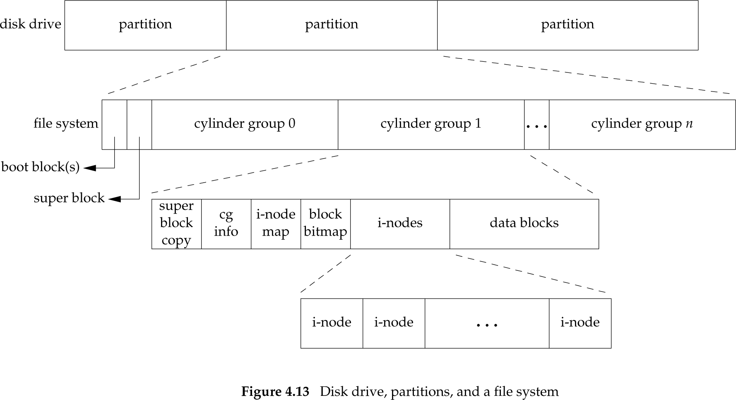
4.14 File Systems (Fig. 4.13)
Slides©2014 Pao-Ann Hsiung, Dept of CSIE, National Chung Cheng University, Taiwan

Slide 44
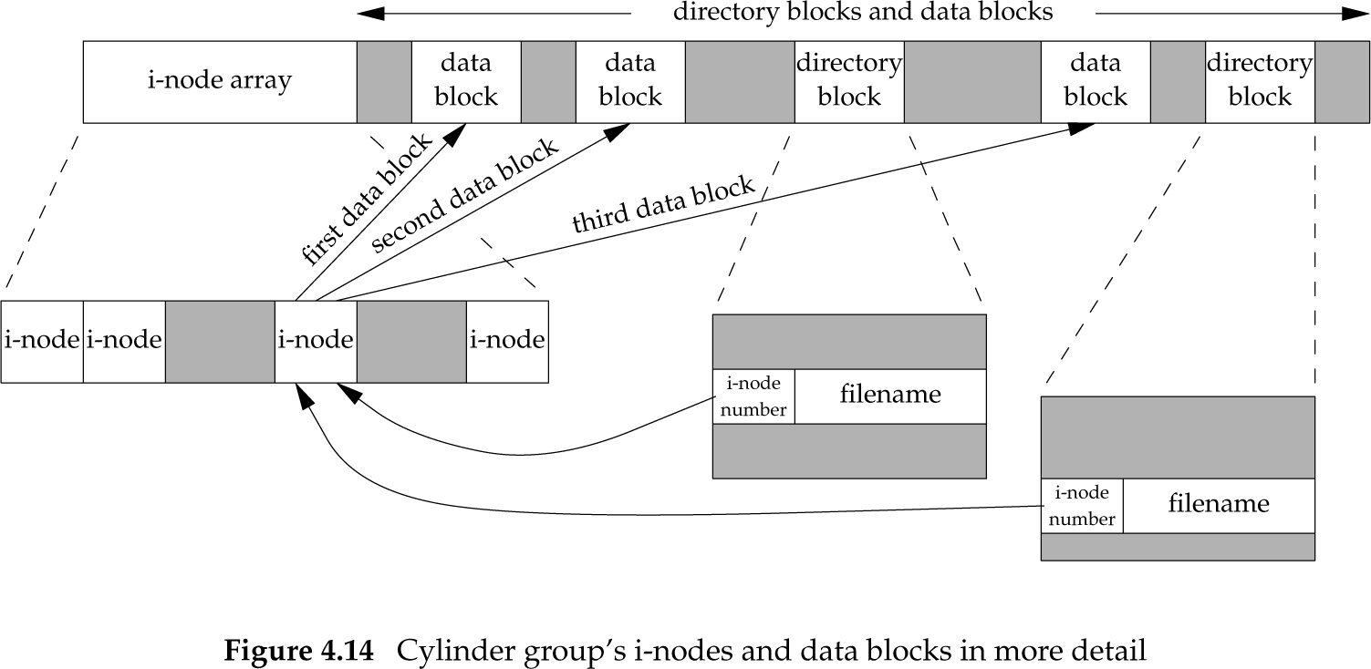
4.14 File Systems (Fig. 4.14)
Slides©2014 Pao-Ann Hsiung, Dept of CSIE, National Chung Cheng University, Taiwan

Slide 45
4.14 File Systems
i-node contains all info about file:
  file type
  file’s access permission bits
  file size
  pointers to data blocks for file
  …
Inode # in dir points to an i-node in the same filesystem
  Hence ln cannot link across filesystems
Slides©2014 Pao-Ann Hsiung, Dept of CSIE, National Chung Cheng University, Taiwan

Slide 46
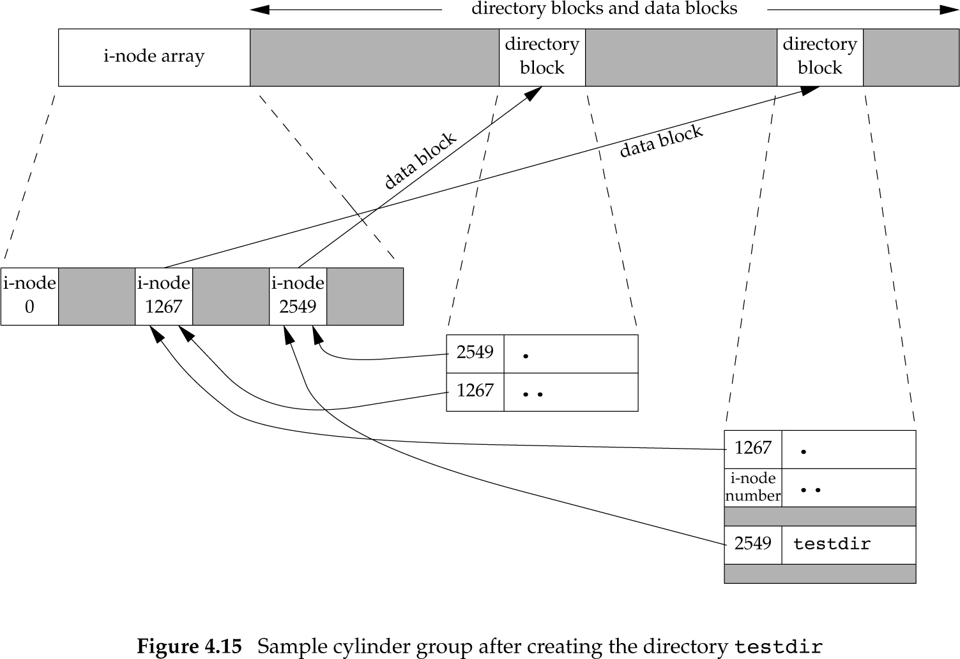
Filesystem (Fig. 4.15)
After creating testdir
Slides©2014 Pao-Ann Hsiung, Dept of CSIE, National Chung Cheng University, Taiwan

Slide 47
4.15 link, linkat, unlink, unlinkat, remove Functions
#include <unistd.h>
int link( const char *existingpath,
const char *newpath);
int linkat(int efd,
const char *existingpath,
const char *newpath, int flag);
Return: 0 if OK, -1 on error
Creation of a new directory entry and increment of link count must be ATOMIC!!!
Slides©2014 Pao-Ann Hsiung, Dept of CSIE, National Chung Cheng University, Taiwan

Slide 48
unlink, unlinkat Functions
#include <unistd.h>
int unlink(const char *pathname);
int unlinkat(int fd, const char *pathname, int flag);
Return: 0 if OK, -1 on error
Removes directory entry
Decrements link count
File deleted only when link count = 0 and open count = 0
Slides©2014 Pao-Ann Hsiung, Dept of CSIE, National Chung Cheng University, Taiwan

Slide 49
Figure 4.16: Open a file and unlink it
#include "apue.h"
#include <fcntl.h>
int
main(void)
{
if (open("tempfile", O_RDWR) < 0)
err_sys("open error");
if (unlink("tempfile") < 0)
err_sys("unlink error");
printf("file unlinked\n");
sleep(15);
printf("done\n");
exit(0);
}
Slides©2014 Pao-Ann Hsiung, Dept of CSIE, National Chung Cheng University, Taiwan

Slide 50
Figure 4.16: output
$ ls –l tempfile
-rw-r--r-- 1 sar 413265408 Jan 21 07:14 tempfile
$ df /home
Filesystem 1K-blocks Used Available Use% Mounted on
/dev/hda4 11021440 1956332 9065108 18% /home
$ a.out &
1364
file unlinked
$ ls –l tempfile
ls: tempfile: No such file or directory
$ df /home
Filesystem 1K-blocks Used Available Use% Mounted on
/dev/hda4 11021440 1956332 9065108 18% /home
$ done
df /home
Filesystem 1K-blocks Used Available Use% Mounted on
/dev/hda4 11021440 1552352 9469088 15% /home
No change in space
Slides©2014 Pao-Ann Hsiung, Dept of CSIE, National Chung Cheng University, Taiwan

Slide 51
Property of unlink Function
Property
  File deleted only when link count = 0 and open count = 0
This property is used for temporary files
  Won’t be left around if program crashes
open() or creat() temporary file
unlink() immediately
  File is not deleted, because still open
  File is deleted only when process terminates or closes it
Slides©2014 Pao-Ann Hsiung, Dept of CSIE, National Chung Cheng University, Taiwan

Slide 52
remove Function
#include <stdio.h>
int remove(const char *pathname);
Returns: 0 if OK, -1 on error
For files: Identical to unlink()
For directories: Identical to rmdir()
Slides©2014 Pao-Ann Hsiung, Dept of CSIE, National Chung Cheng University, Taiwan

Slide 53
4.16 rename and renameat Functions
#include <stdio.h>
int rename( const char *oldname,
const char *newname);
int renameat(int oldfd,
const char *oldname, int newfd,
const char *newname);
Return: 0 if OK, -1 on error
If newname exists:
If both are files,
  newname is deleted
  oldname is renamed as newname
If both are directories and newname is empty
  oldname is deleted
  oldname is renamed as newname
  (Cannot rename /usr/foo to /usr/foo/testdir)
Slides©2014 Pao-Ann Hsiung, Dept of CSIE, National Chung Cheng University, Taiwan

Slide 54
4.17 Symbolic Links
Hard link
  Points directly to an i-node of a file
  Must be in the same file system as the file
  Only superuser can create a hard link to a directory
  Used for file system construction
Symbolic link
  An indirect pointer to a file
  Can link across file systems
  Anyone can link to a directory
  Used to move a file or an entire directory hierarchy to somewhere else
Slides©2014 Pao-Ann Hsiung, Dept of CSIE, National Chung Cheng University, Taiwan

Slide 55
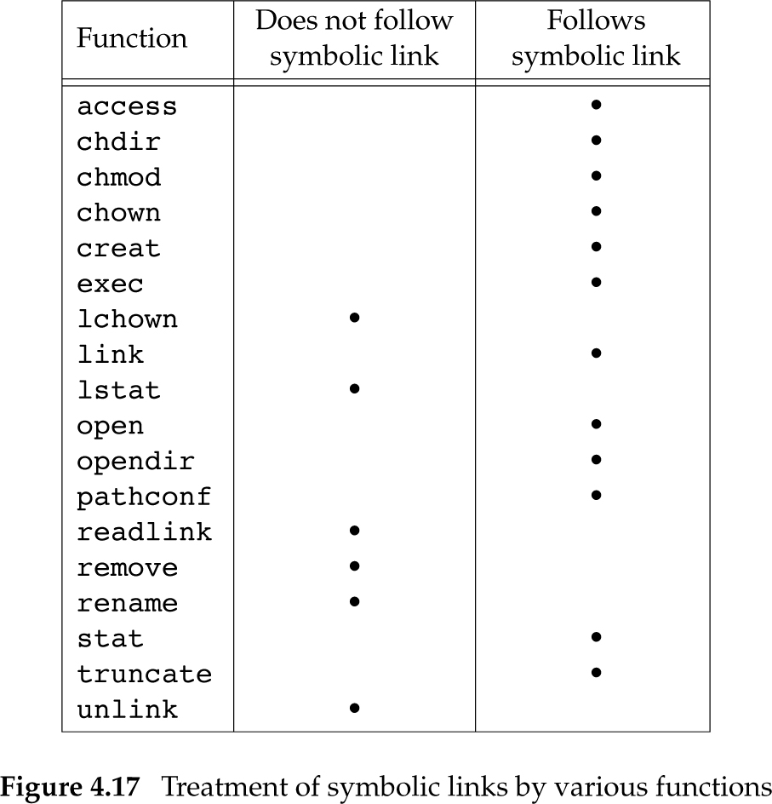
Symbolic Links (Fig. 4.17)
If function follows links, argument refers to the actual file
If function does not follow links, argument refers to the link
Slides©2014 Pao-Ann Hsiung, Dept of CSIE, National Chung Cheng University, Taiwan

Slide 56
Symbolic links create loops
$ mkdir foo
$ touch foo/a
$ ln –s ../foo foo/testdir
$ ls –l foo
total 0
-rw-r----- 1 sar 0 Jan 22 00:16 a
lrwxrwxrwx 1 sar 6 Jan 22 00:16 testdir→../foo
Slides©2014 Pao-Ann Hsiung, Dept of CSIE, National Chung Cheng University, Taiwan

Slide 57
Symbolic Links (loops)
write a program using ftw (walk fs)
RESULT:
foo
foo/a
foo/testdir
foo/testdir/a
foo/testdir/testdir
foo/testdir/testdir/a
foo/testdir/testdir/testdir
foo/testdir/testdir/testdir/a
ftw returned -1: Too many levels of symbolic links
Linux ftw, nftw: record all dirs seen
and avoid processing a directory
more than once.
Slides©2014 Pao-Ann Hsiung, Dept of CSIE, National Chung Cheng University, Taiwan

Slide 58
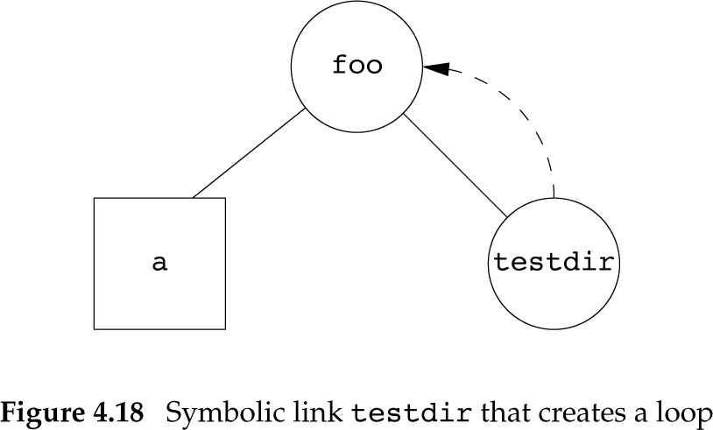
Symbolic Link (Fig. 4.18)
Slides©2014 Pao-Ann Hsiung, Dept of CSIE, National Chung Cheng University, Taiwan

Slide 59
Symbolic Link
open() follows symbolic links
$ ln –s /no/such/file myfile
$ ls myfile
myfile
$ cat myfile
cat: myfile: No such file or directory
$ ls –l myfile
lrwxrwxrwx 1 sar 13 Jan 22 00:26 myfile → /no/such/file
Slides©2014 Pao-Ann Hsiung, Dept of CSIE, National Chung Cheng University, Taiwan

Slide 60
4.18 Creating and Reading Symbolic Links
#include <unistd.h>
int symlink( const char *actualpath,
const char *sympath);
int symlinkat( const char *actualpath, int fd, const char *sympath);
Return: 0 if OK, -1 on error
Creates a symbolic link:
sympath → actualpath
open() cannot open a link, so what if we want to read a link?
Slides©2014 Pao-Ann Hsiung, Dept of CSIE, National Chung Cheng University, Taiwan

Slide 61
readlink, readlinkat Functions
#include <unistd.h>
int readlink(const char *restrict pathname,
char *restrict buf, size_t bufsize);
int readlinkat(int fd, const char *restrict pathname, char *restrict buf, size_t bufsize);
Return: #bytes read if OK, -1 on error
Combines open, read, & close
buf: name of link, not null terminated
Slides©2014 Pao-Ann Hsiung, Dept of CSIE, National Chung Cheng University, Taiwan

Slide 62

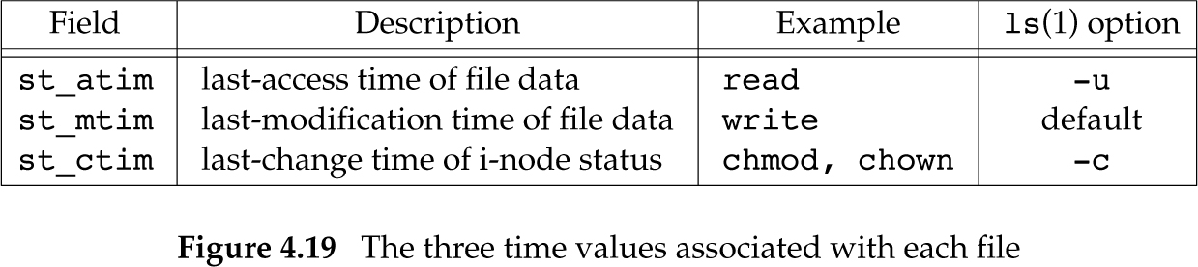
4.19 File Times
Slides©2014 Pao-Ann Hsiung, Dept of CSIE, National Chung Cheng University, Taiwan

Slide 63
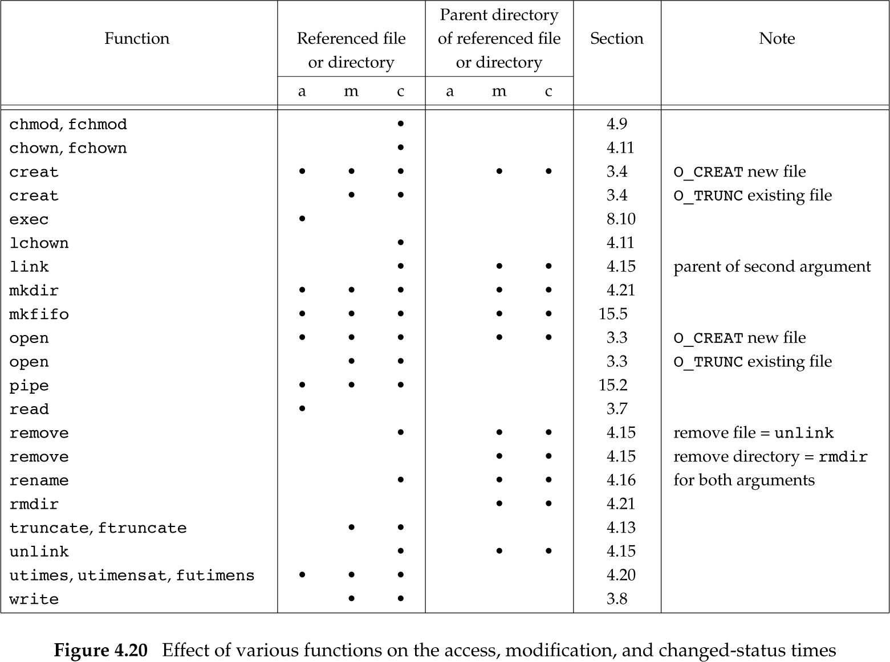
3 times of functions (Fig. 4.20)
access, stat
functions do not
change any of
the 3 times
Slides©2014 Pao-Ann Hsiung, Dept of CSIE, National Chung Cheng University, Taiwan

Slide 64
4.20 futimens, utimensat, and utimes Functions
#include <sys/stat.h>
int futimens(int fd,
const struct timespec times[2]);
int utimensat(int fd, const char *path, const struct timespec times[2],
int flag);
Return: 0 if OK, -1 on error
Slides©2014 Pao-Ann Hsiung, Dept of CSIE, National Chung Cheng University, Taiwan

Slide 65
4.20 futimens, utimensat, and utimes Functions
Depends on times pointer
NULL, set a and m times to current
If tv_nsec=UTIME_NOW, set to current
If tv_nsec=UTIME_OMIT, no change
Otherwise, set to the times pointer
Access permissions required:
To set to current time
  owner of file with write permission or superuser
To set to times
  owner of file or superuser
Slides©2014 Pao-Ann Hsiung, Dept of CSIE, National Chung Cheng University, Taiwan

Slide 66
4.20 futimens, utimensat, and utimes Functions
#include <sys/time.h>
int utimes( const char *pathname,
const struct timeval times[2]);
Returns: 0 if OK, -1 on error
struct timeval {
time_t tv_sec; /* seconds */
long tv_usec; /* microseconds */
}
Slides©2014 Pao-Ann Hsiung, Dept of CSIE, National Chung Cheng University, Taiwan

Slide 67
Figure 4.21: futimens
#include "apue.h"
#include <fcntl.h>
int
main(int argc, char *argv[])
{
int i, fd;
struct stat statbuf;
struct timespec times[2];
for (i = 1; i < argc; i++) {
if (stat(argv[i], &statbuf) < 0) { /* fetch current times */
err_ret("%s: stat error", argv[i]);
continue;
}
Slides©2014 Pao-Ann Hsiung, Dept of CSIE, National Chung Cheng University, Taiwan

Slide 68
Figure 4.21: utime()
if (fd=open(argv[i], O_RDWR | O_TRUNC) < 0) {/* truncate */
err_ret("%s: open error", argv[i]);
continue;
}
times[0] = statbuf.st_atim;
times[1] = statbuf.st_mtim;
if (futimens(fd, times) < 0) /* reset times */
err_ret("%s: futimens error", argv[i]);
close(fd);
}
exit(0);
}
Slides©2014 Pao-Ann Hsiung, Dept of CSIE, National Chung Cheng University, Taiwan

Slide 69
Figure 4.21: output
$ ls –l changemod times
-rwxr-xr-x 1 sar 13792 Jan 22 01:26 changemod
-rwxr-xr-x 1 sar 13824 Jan 22 01:26 times
$ ls –lu changemod times
-rwxr-xr-x 1 sar 13792 Jan 22 22:22 changemod
-rwxr-xr-x 1 sar 13824 Jan 22 22:22 times
$ date
Fri Jan 27 20:53:46 EST 2012
Slides©2014 Pao-Ann Hsiung, Dept of CSIE, National Chung Cheng University, Taiwan

Slide 70
Figure 4.21: output (contd)
$ ./a.out changemod times
$ ls –l changemod times
-rwxr-xr-x 1 sar 0 Jan 22 01:26 changemod
-rwxr-xr-x 1 sar 0 Jan 22 01:26 times
$ ls –lu changemod times
-rwxr-xr-x 1 sar 0 Jan 22 22:22 changemod
-rwxr-xr-x 1 sar 0 Jan 22 22:22 times
$ ls –lc changemod times
-rwxr-xr-x 1 sar 0 Jan 27 20:53 changemod
-rwxr-xr-x 1 sar 0 Jan 27 20:53 times
Slides©2014 Pao-Ann Hsiung, Dept of CSIE, National Chung Cheng University, Taiwan

Slide 71
4.21 mkdir, mkdirat and rmdir Functions
#include <sys/stat.h>
int mkdir(const char *pathname,
mode_t mode);
int mkdirat(int fd, const char *pathname,
mode_t mode);
Return: 0 if OK, -1 on error
Creates a new, empty directory
. and .. are automatically created
mode are modified by file mode creation mask of the process (umask)
Slides©2014 Pao-Ann Hsiung, Dept of CSIE, National Chung Cheng University, Taiwan

Slide 72
rmdir()
#include <unistd.h>
int rmdir(const char *pathname);
Returns: 0 if OK, -1 on error
Only when link count = 0 and Open count = 0 is the space of directory freed
Slides©2014 Pao-Ann Hsiung, Dept of CSIE, National Chung Cheng University, Taiwan

Slide 73
4.22 Reading Directories
Anyone can read a dir with permissions
Only kernel can write a directory
(diff from create/deleting files in a dir)
struct dirent {/*defined in <dirent.h>*/
ino_t d_ino; /* i-node # */
char d_name[NAME_MAX + 1];
/* NULL-terminated filename */
}
Slides©2014 Pao-Ann Hsiung, Dept of CSIE, National Chung Cheng University, Taiwan

Slide 74
opendir(), rewinddir(), closedir()
#include <dirent.h>
DIR *opendir(const char *pathname);
DIR *fdopendir(int fd);
struct dirent *readdir(DIR *dp);
void rewinddir(DIR *dp);
int closedir(DIR *dp);
long telldir(DIR *dp);
void seekdir(DIR *dp, long loc);
Slides©2014 Pao-Ann Hsiung, Dept of CSIE, National Chung Cheng University, Taiwan

Slide 75
Walking the filesystem
Similar to the nftw function in Solaris
Traverses a file hierarchy
  Gives the counts and percentages of different file types
Slides©2014 Pao-Ann Hsiung, Dept of CSIE, National Chung Cheng University, Taiwan

Slide 76
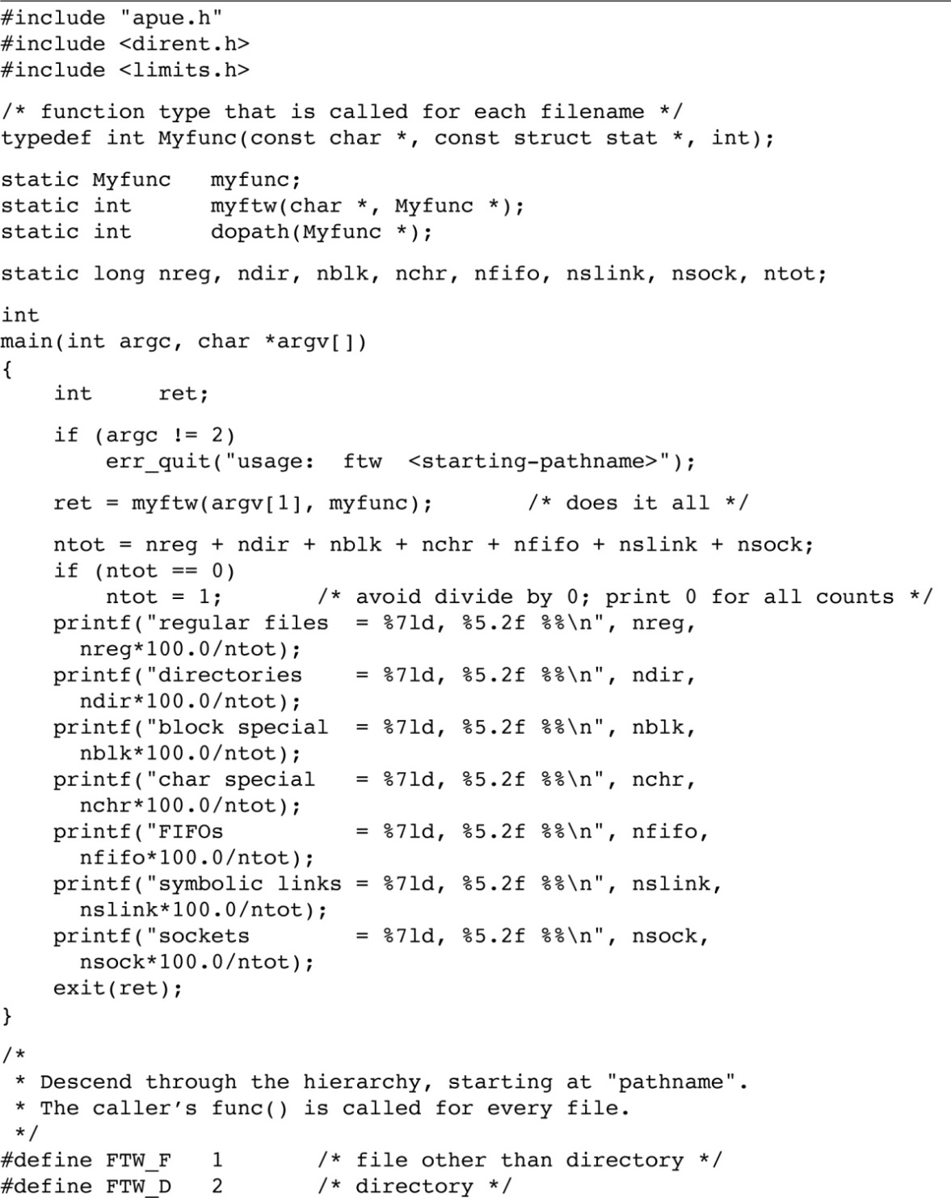
Slides©2014 Pao-Ann Hsiung, Dept of CSIE, National Chung Cheng University, Taiwan

Slide 77
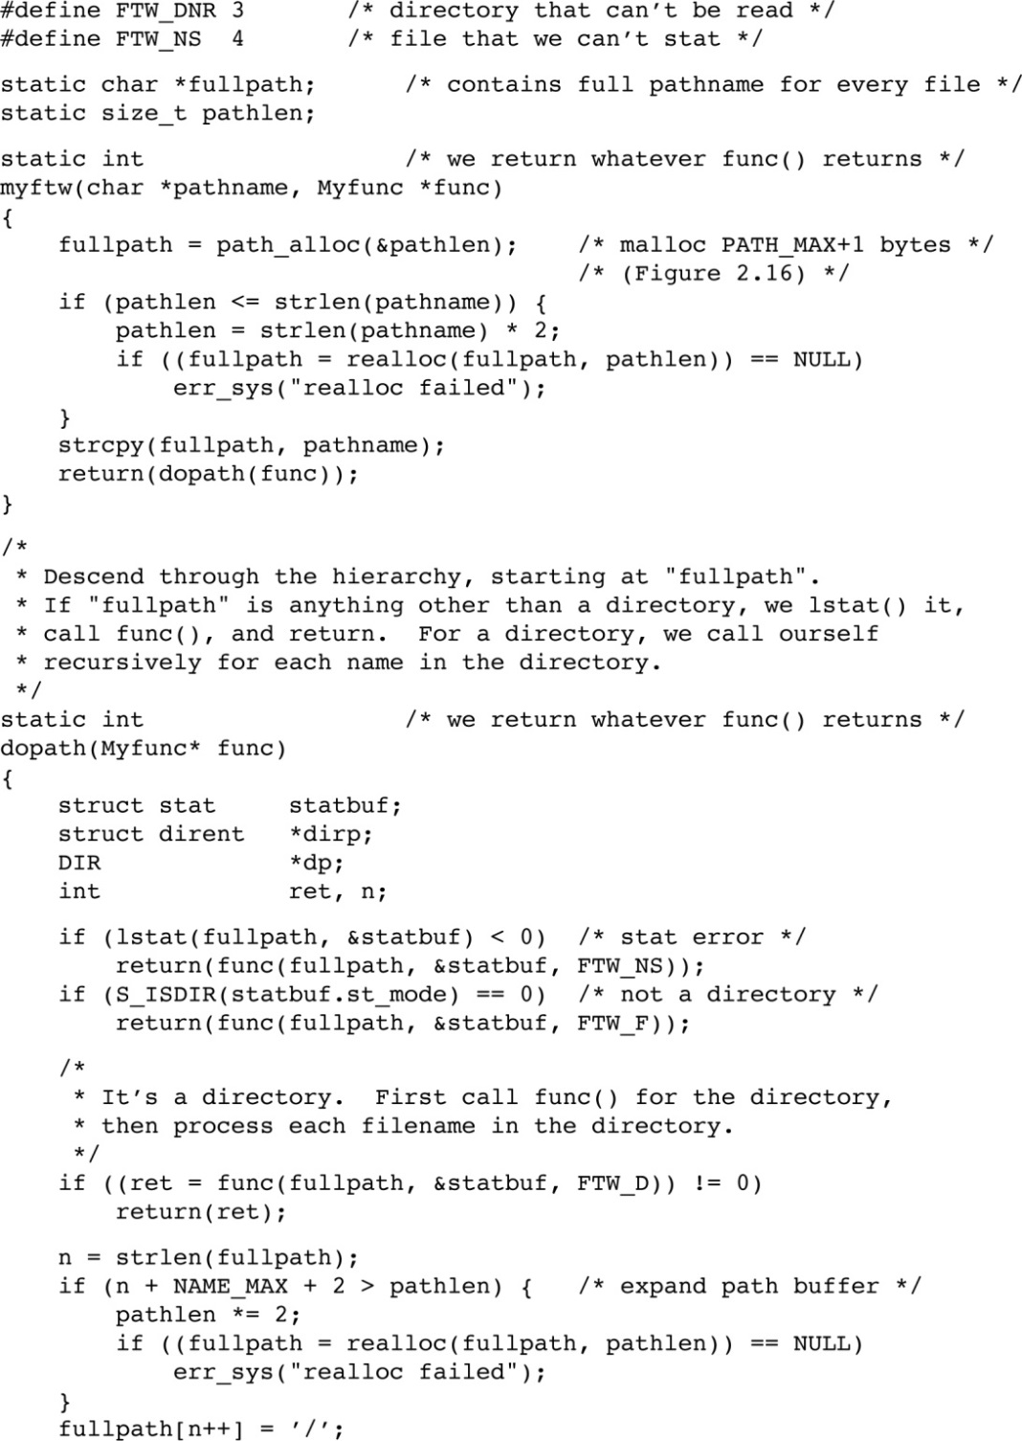
Slides©2014 Pao-Ann Hsiung, Dept of CSIE, National Chung Cheng University, Taiwan

Slide 78
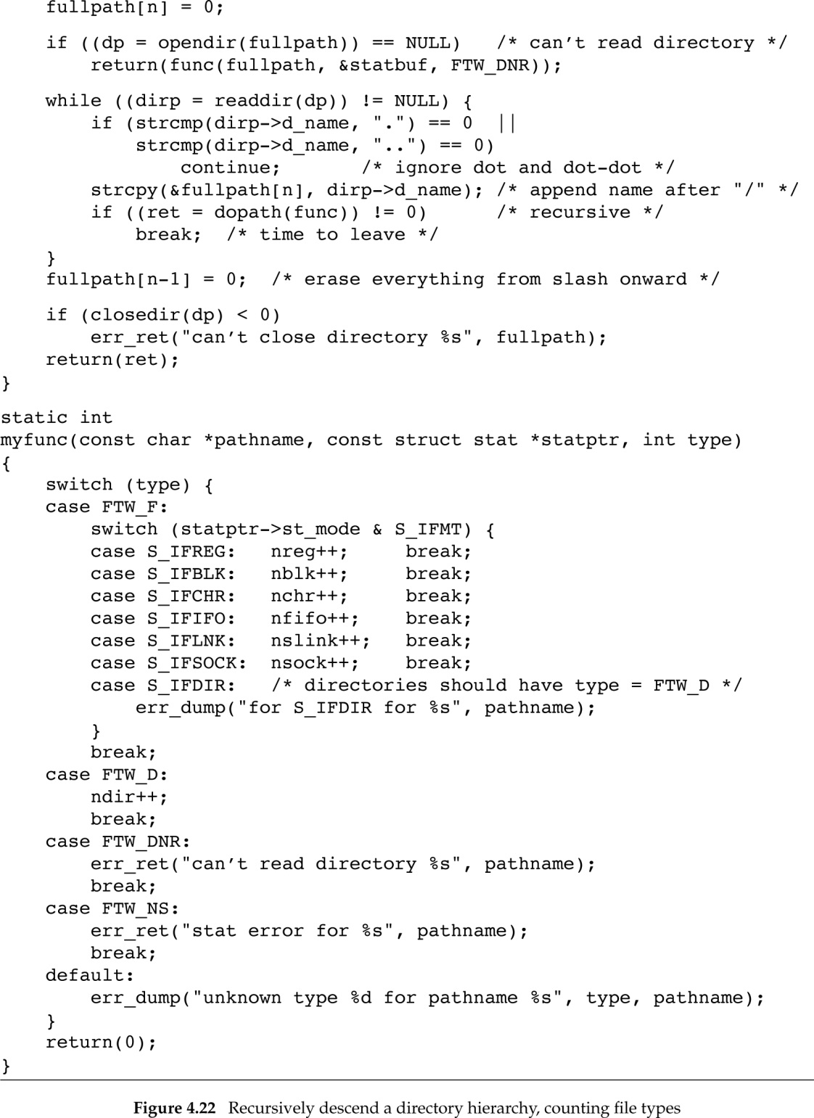
Slides©2014 Pao-Ann Hsiung, Dept of CSIE, National Chung Cheng University, Taiwan

Slide 79
4.23 chdir, fchdir, and getcwd Functions
#include <unistd.h>
int chdir(const char *pathname);
int fchdir(int fd);
Return: 0 if OK, -1 on error
Current working directory is an attribute of the process
Home directory is an attribute of a login name
Slides©2014 Pao-Ann Hsiung, Dept of CSIE, National Chung Cheng University, Taiwan

Slide 80
Figure 4.23
#include “apue.h"
int
main(void)
{
if (chdir("/tmp") < 0)
err_sys("chdir failed");
printf("chdir to /tmp succeeded\n");
exit(0);
}
Slides©2014 Pao-Ann Hsiung, Dept of CSIE, National Chung Cheng University, Taiwan

Slide 81
Figure 4.23: output
$ pwd
/usr/lib
$ mycd
chdir to /tmp succeeded
$ pwd
/usr/lib
Current working directory not changed
because it is an attribute of the process!
chdir must be built-in for shells to
successfully change directory.
Slides©2014 Pao-Ann Hsiung, Dept of CSIE, National Chung Cheng University, Taiwan

Slide 82
getcwd()
#include <unistd.h>
char *getcwd(char *buf, size_t size);
Returns: buf if OK, NULL on error
buf should be large enough to accommodate absolute pathnames plus a terminating null byte, or error.
Slides©2014 Pao-Ann Hsiung, Dept of CSIE, National Chung Cheng University, Taiwan

Slide 83
Figure 4.24: getcwd()
#include "apue.h"
int
main(void)
{
char *ptr;
size_t size;
if (chdir("/usr/spool/uucppublic") < 0)
err_sys("chdir failed");
ptr = path_alloc(&size); /* our own function */
if (getcwd(ptr, size) == NULL)
err_sys("getcwd failed");
printf("cwd = %s\n", ptr);
exit(0);
}
Slides©2014 Pao-Ann Hsiung, Dept of CSIE, National Chung Cheng University, Taiwan

Slide 84
Figure 4.24: output
$ ./a.out
cwd = /var/spool/uucppublic
$ ls –l /usr/spool
lrwxrwxrwx 1 root 12 Jan 31 07:57 /usr/spool → ../var/spool
Slides©2014 Pao-Ann Hsiung, Dept of CSIE, National Chung Cheng University, Taiwan

Slide 85
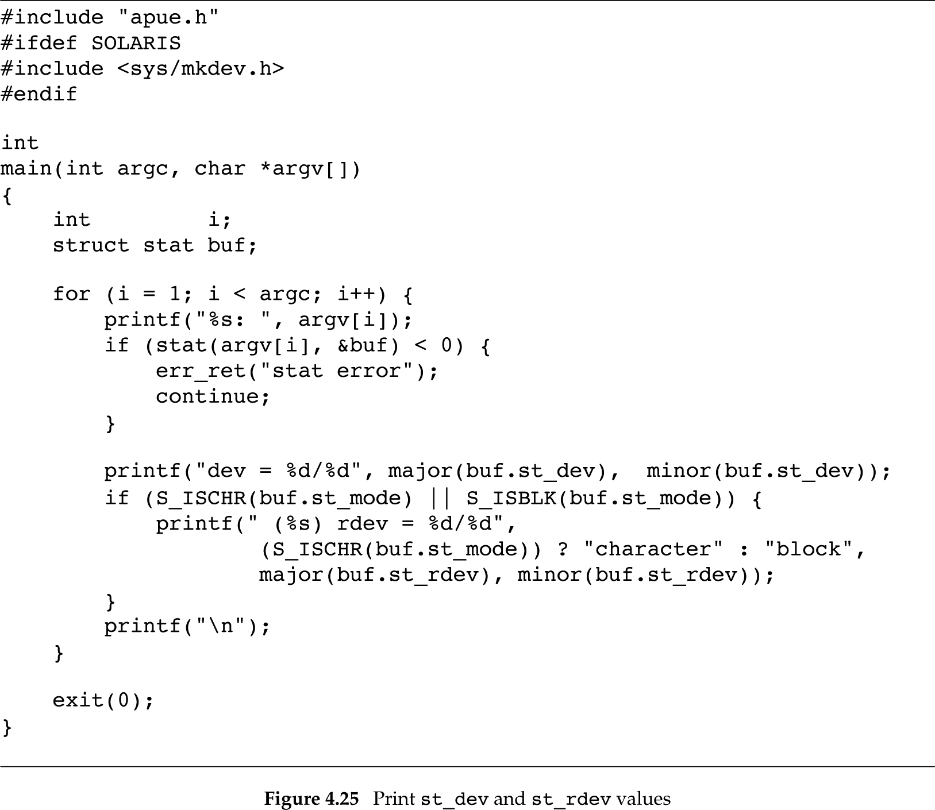
Figure 4.25: st_dev, st_rdev
Slides©2014 Pao-Ann Hsiung, Dept of CSIE, National Chung Cheng University, Taiwan

Slide 86
Figure 4.25: output
$ ./a.out / /home/sar /dev/tty[01]
/: dev = 8/3
/home/sar: dev = 8/4
/dev/tty0: dev = 0/5 (character) rdev=4/0
/dev/tty1: dev=0/5 (character) rdev=4/1
$ mount
/dev/sda3 on / type ext3 (rw,errors=remount,commit=0)
/dev/sda4 on /home type ext3 (rw,commit=0)
$ ls –l /dev/tty[01] /dev/sda[34]
brw-rw---- 1 root 8, 3 2011-07-01 11:08 /dev/sda3
brw-rw---- 1 root 8, 4 2011-07-01 11:08 /dev/sda4
crw--w---- 1 root 4, 0 2011-07-01 11:08 /dev/tty0
crw------- 1 root 4, 1 2011-07-01 11:08 /dev/tty1
Slides©2014 Pao-Ann Hsiung, Dept of CSIE, National Chung Cheng University, Taiwan

Slide 87
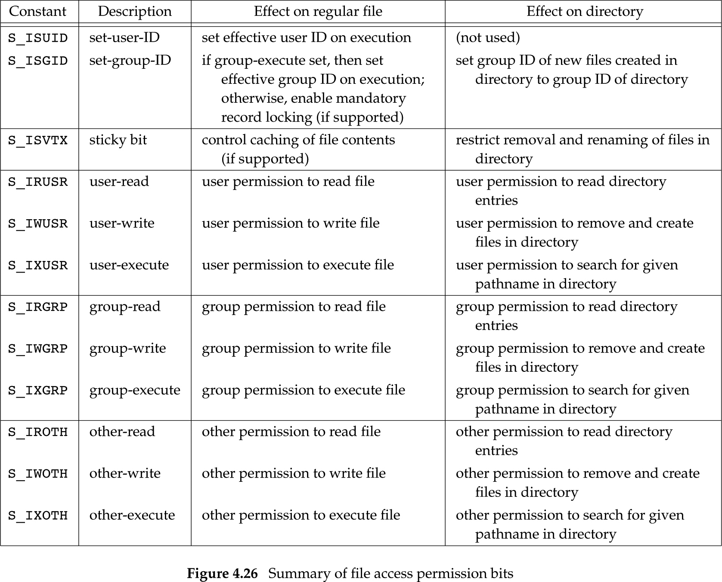
4.25 Summary of File Access Permission Bits
Slides©2006 Pao-Ann Hsiung, Dept of CSIE, National Chung Cheng University, Taiwan

