Slide 1
Chapter 5.
Standard I/O Library
System Programming
http://www.cs.ccu.edu.tw/~pahsiung/courses/sp/
熊博安
國立中正大學資訊工程學系
pahsiung@cs.ccu.edu.tw Class: EA-001
(05)2720411 ext. 23100, 33119 Office: EA108, EA-512
Textbook: Advanced Programming in the UNIX Environment, 3rd Edition, W. Richard Stevens and Stephen A. Rago
Notes:
115/11/07

Slide 2
Introduction
Standard I/O Library
Written by Dennis Ritchie in 1975
Implemented on many OS
ISO C standard
Buffer allocation
Perform I/O in optimal-sized chunks
Easy to use, but introduces other problems
Slides©2014 Pao-Ann Hsiung, Dept of CSIE, National Chung Cheng University, Taiwan

Slide 3
Streams and FILE objects
A stream is associated with a file when we open or create a file using std I/O lib
ASCII character set
  Single character represented by a byte
International character set
  Single character represented by one or more bytes (multibyte)
  “wide” character sets
Slides©2014 Pao-Ann Hsiung, Dept of CSIE, National Chung Cheng University, Taiwan

Slide 4
Streams and FILE objects
Initially
  A stream has no orientation
Multibyte I/O function
  Stream’s orientation = wide-oriented
A byte I/O function
  Stream’s orientation = byte-oriented
Change stream orientation
  freopen (to clear), fwide (to set)
Slides©2014 Pao-Ann Hsiung, Dept of CSIE, National Chung Cheng University, Taiwan

Slide 5
Streams and FILE objects
  +ve set stream wide-oriented,
  -ve set stream byte-oriented,
  0 no change in orientation
#include <stdio.h>
#include <wchar.h>
int fwide(FILE *fp, int mode);
Returns:
  +ve if stream is wide-oriented,
  -ve if stream is byte-oriented,
  0 if stream has no orientation
Slides©2014 Pao-Ann Hsiung, Dept of CSIE, National Chung Cheng University, Taiwan

Slide 6
Streams and FILE objects
fopen() returns a FILE object
  file descriptor
  pointer to stream buffer
  buffer size
  #chars in buffer
  error flag
  …
Slides©2014 Pao-Ann Hsiung, Dept of CSIE, National Chung Cheng University, Taiwan

Slide 7
Streams and FILE objects
Applications need not examine FILE obj
Pass FILE pointer as argument to standard I/O functions
FILE * is called file pointer
Slides©2014 Pao-Ann Hsiung, Dept of CSIE, National Chung Cheng University, Taiwan

Slide 8
Standard Input, Output, Error
3 streams are automatically created for a process
  stdin
  stdout
  stderr
  Defined in <stdio.h>
Slides©2014 Pao-Ann Hsiung, Dept of CSIE, National Chung Cheng University, Taiwan

Slide 9
Buffering
3 types of buffering
Fully Buffered
Line Buffered
Unbuffered
Slides©2014 Pao-Ann Hsiung, Dept of CSIE, National Chung Cheng University, Taiwan

Slide 10
Fully Buffered I/O
Actual I/O takes place when std I/O buffer is FILLED!
Disk files are fully buffered
A buffer can be flushed (write out contents of buffer to disk, …, etc.)
  fflush(): write out buffer contents (std I/O)
  tcflush(): discard buffer data (terminal driver)
Slides©2014 Pao-Ann Hsiung, Dept of CSIE, National Chung Cheng University, Taiwan

Slide 11
Line Buffered I/O
Actual I/O is performed only when a newline character is encountered
fputc(): can input/output a single char
Line buffering is used on a stream associated with a terminal
Fixed buffer size ➔ I/O takes place before newline when buffer is full
Slides©2014 Pao-Ann Hsiung, Dept of CSIE, National Chung Cheng University, Taiwan

Slide 12
Unbuffered I/O
Characters unbuffered
fputs()
stderr is unbuffered
(hence, error messages are always output very quickly!)
Slides©2014 Pao-Ann Hsiung, Dept of CSIE, National Chung Cheng University, Taiwan

Slide 13
Buffering
ISO C requirements on buffering:
  stdin and stdout are fully buffered (except in an interactive device)
  stderr is never fully buffered
Most implementations of buffering:
  stderr is always unbuffered
  All other streams are line buffered for terminal device; o/w fully buffered
Slides©2014 Pao-Ann Hsiung, Dept of CSIE, National Chung Cheng University, Taiwan

Slide 14
Buffering
Type of buffering can be changed:
#include <stdio.h>
void setbuf( FILE *fp, char *buf );
int setvbuf( FILE *fp, char *buf,
int mode, size_t size );
Returns 0 if OK, nonzero on error
Slides©2014 Pao-Ann Hsiung, Dept of CSIE, National Chung Cheng University, Taiwan

Slide 15
setbuf(): turns buffering on or off
char *buf:
  a buffer of length BUFSIZ (<stdio.h>)
  (Terminal device: line buffered
  otherwise: fully buffered)
  NULL (buffering turned off)
Slides©2014 Pao-Ann Hsiung, Dept of CSIE, National Chung Cheng University, Taiwan

Slide 16
setvbuf(): set buffering type
int mode
  _IOFBF: fully buffered
  _IOLBF: line buffered
  _IONBF: unbuffered
char *buf: buffer
( NULL➔ automatic buffer allocation
Files: buffer size = st_blksize in stat
Pipes: buffer size = BUFSIZ )
size_t size: buffer size
Slides©2014 Pao-Ann Hsiung, Dept of CSIE, National Chung Cheng University, Taiwan

Slide 17
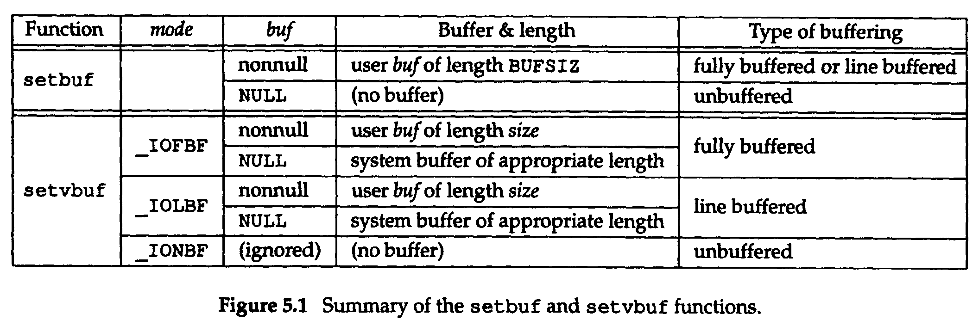
setbuf() v/s setvbuf() (Fig. 5.1)
Slides©2014 Pao-Ann Hsiung, Dept of CSIE, National Chung Cheng University, Taiwan

Slide 18
Stream Flushing
A stream can be flushed:
#include <stdio.h>
int fflush(FILE *fp);
Returns: 0 if OK, EOF on error
Unwritten data passed to kernel
fp = NULL ➔ ALL output streams flushed!
Slides©2014 Pao-Ann Hsiung, Dept of CSIE, National Chung Cheng University, Taiwan

Slide 19
Opening a Stream
#include <stdio.h>
FILE *fopen( const char *restrict pathname, const char *restrict type);
FILE *freopen(const char *restrict pathname, const char *restrict type, FILE *restrict fp);
FILE *fdopen( int fd, const char *type );
Return: file pointer if OK, NULL on error
Slides©2014 Pao-Ann Hsiung, Dept of CSIE, National Chung Cheng University, Taiwan

Slide 20
fopen, freopen, fdopen
fopen opens a specified file
freopen opens a specified file on a specified stream (to open a specified file as stdin, stdout, or stderr)
fdopen associates a stream with a file descriptor (for pipes, network comm channels, which cannot be opened by fopen)
ISO C
POSIX.1
Slides©2014 Pao-Ann Hsiung, Dept of CSIE, National Chung Cheng University, Taiwan

Slide 21
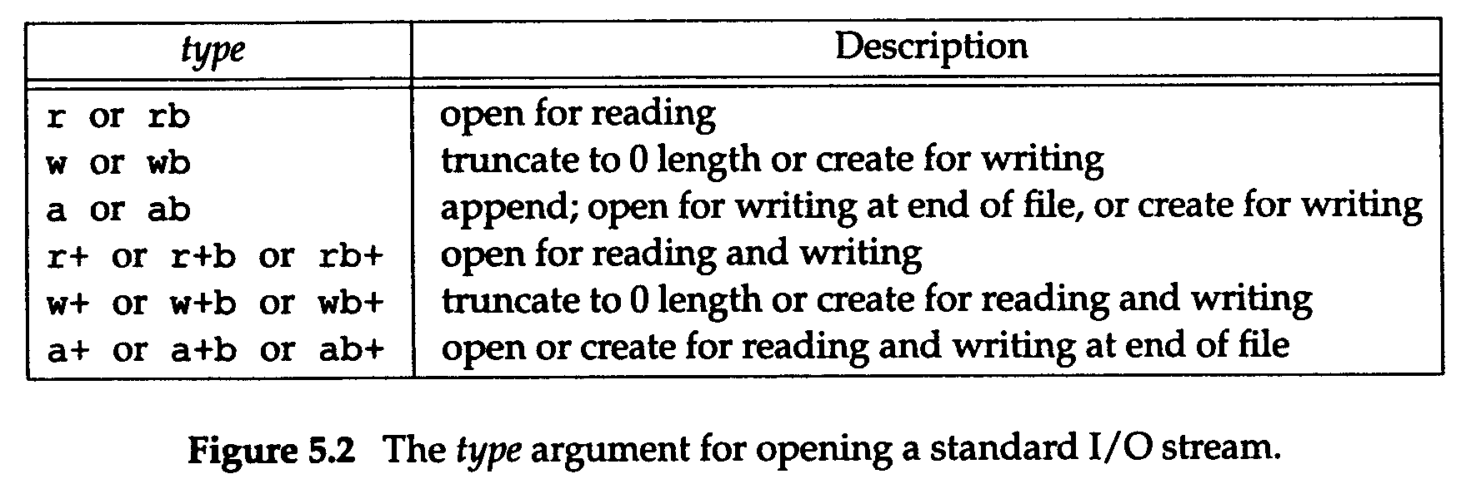
type argument (Fig. 5.2)
b ➔ binary (for some non-UNIX OS)
UNIX doesn’t distinguish between text and binary, so no difference in UNIX
Slides©2014 Pao-Ann Hsiung, Dept of CSIE, National Chung Cheng University, Taiwan

Slide 22
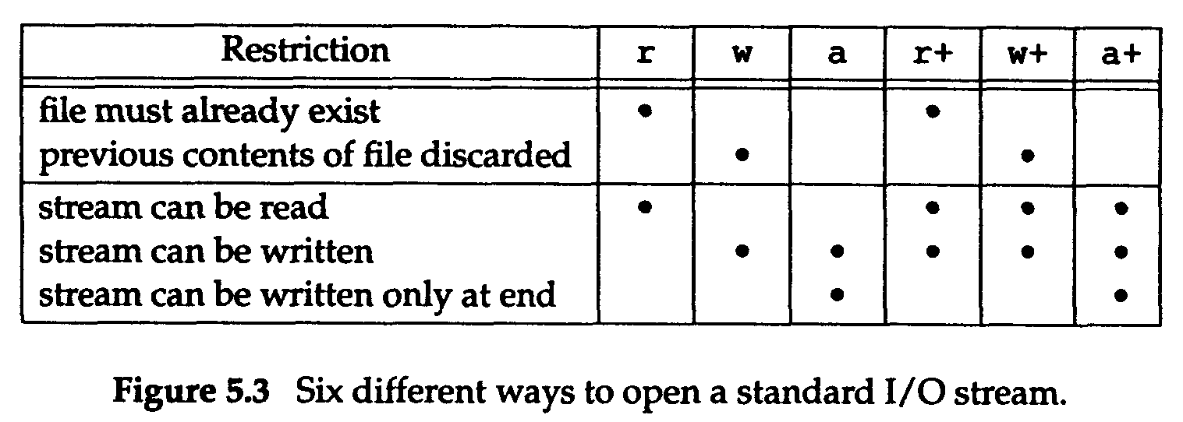
6 ways to open stream (Fig. 5.3)
Slides©2014 Pao-Ann Hsiung, Dept of CSIE, National Chung Cheng University, Taiwan

Slide 23
To close an open stream
#include <stdio.h>
int fclose(FILE *fp);
Returns: 0 if OK, EOF one error
Before closing:
  Output buffer data is flushed
  Input buffer data is discarded
  Automatically allocated buffer is released
Slides©2014 Pao-Ann Hsiung, Dept of CSIE, National Chung Cheng University, Taiwan

Slide 24
Reading / Writing a Stream
3 types of Unformatted I/O:
Character-at-a-time I/O:
getc(), fgetc(), getchar()
Line-at-a-time I/O:
fgets(), fputs()
Direct I/O: fread(), fwrite()
(read/write some number of objects)
Binary I/O
Object-at-a-time I/O
Record-oriented I/O
Structure-oriented I/O
Slides©2014 Pao-Ann Hsiung, Dept of CSIE, National Chung Cheng University, Taiwan

Slide 25
Char-at-a-time: Input Functions
#include <stdio.h>
int getc(FILE *fp);
int fgetc(FILE *fp);
int getchar(void); (== getc(stdin))
Return: next char if OK, EOF on EOF or error
Slides©2014 Pao-Ann Hsiung, Dept of CSIE, National Chung Cheng University, Taiwan

Slide 26
getc(), fgetc(), getchar()
getc() is a macro
  arguments without side effects
fgetc() is a function
  func addr can be passed as arguments
  It is slower than getc()
EOF=-1 ➔ int return value
No distinction between:
  file error
  end of file
Slides©2014 Pao-Ann Hsiung, Dept of CSIE, National Chung Cheng University, Taiwan

Slide 27
File Error or EOF?
#include <stdio.h>
int ferror(FILE *fp);
int feof(FILE *fp);
Return: nonzero if true, 0 otherwise
void clearerr(FILE *fp);
  Clears 2 flags in FILE object:
    an error flag
    an EOF flag
Slides©2014 Pao-Ann Hsiung, Dept of CSIE, National Chung Cheng University, Taiwan

Slide 28
ungetc()
#include <stdio.h>
int ungetc(int c, FILE *fp);
Returns: c if OK, EOF on error
Chars are pushed back into stream
  Need not push back same char as read
  Cannot push EOF
Slides©2014 Pao-Ann Hsiung, Dept of CSIE, National Chung Cheng University, Taiwan

Slide 29
ungetc()
At EOF, we can push back a character
  Because ungetc clears EOF indication for the stream
Generally, used for breaking input stream into words or tokens
  peek next char to determine how to handle current character
Slides©2014 Pao-Ann Hsiung, Dept of CSIE, National Chung Cheng University, Taiwan

Slide 30
Char-at-a-time: Output Functions
#include <stdio.h>
int putc(int c, FILE *fp);
int fputc(int c, FILE *fp);
int putchar(int c); (== putc(c, stdout)
Return: c if OK, EOF on error
macro
function
Slides©2014 Pao-Ann Hsiung, Dept of CSIE, National Chung Cheng University, Taiwan

Slide 31
Line-at-a-Time: Input Functions
#include <stdio.h>
char *fgets(char *buf, int n, FILE *fp);
(stores: line + \n + NULL)
char *gets(char *buf);
(stores line only, without \n and NULL)
Return: buf if OK, NULL on EOF or error
deprecated
Slides©2014 Pao-Ann Hsiung, Dept of CSIE, National Chung Cheng University, Taiwan

Slide 32
Line-at-a-Time: Input Functions
Never use gets()
  It doesn’t allow caller to specify buffer size
  Allows buffer to overflow
    writing over whatever happens to follow the buffer in memory
    flaw used as part of the Internet worm in 1988
      Communications of the ACM, Vol. 32, No. 6, 1989
Slides©2014 Pao-Ann Hsiung, Dept of CSIE, National Chung Cheng University, Taiwan

Slide 33
Line-at-at-time: Output Functions
#include <stdio.h>
int fputs(const char *str, FILE *fp);
int puts(const char *str);
Return: nonnegative value if OK,
EOF on error
puts an
extra \n
Slides©2014 Pao-Ann Hsiung, Dept of CSIE, National Chung Cheng University, Taiwan

Slide 34
Line-at-a-time I/O
Suggestion:
Use:
  fgets() and fputs()
Remember:
  we always have to deal with the newline character at the end of each line!
Slides©2014 Pao-Ann Hsiung, Dept of CSIE, National Chung Cheng University, Taiwan

Slide 35
Standard I/O Efficiency
How does the three types of unformatted I/O compare in efficiency?
How does unformatted I/O compare with direct read() and write()?
Are macros more efficient than functions? Why?
What about Program Text size?
Slides©2014 Pao-Ann Hsiung, Dept of CSIE, National Chung Cheng University, Taiwan

Slide 36
stdin → stdout (getc, putc) Figure 5.4
#include “apue.h"
int
main(void)
{
int c;
while ( (c = getc(stdin)) != EOF)
if (putc(c, stdout) == EOF)
err_sys("output error");
if (ferror(stdin))
err_sys("input error");
exit(0);
}
Slides©2014 Pao-Ann Hsiung, Dept of CSIE, National Chung Cheng University, Taiwan

Slide 37
stdin → stdout (fgets(), fputs) Figure 5.5
#include "ourhdr.h"
int
main(void)
{
char buf[MAXLINE];
while (fgets(buf, MAXLINE, stdin) != NULL)
if (fputs(buf, stdout) == EOF)
err_sys("output error");
if (ferror(stdin))
err_sys("input error");
exit(0);
}
flush data
close streams
Slides©2014 Pao-Ann Hsiung, Dept of CSIE, National Chung Cheng University, Taiwan

Slide 38
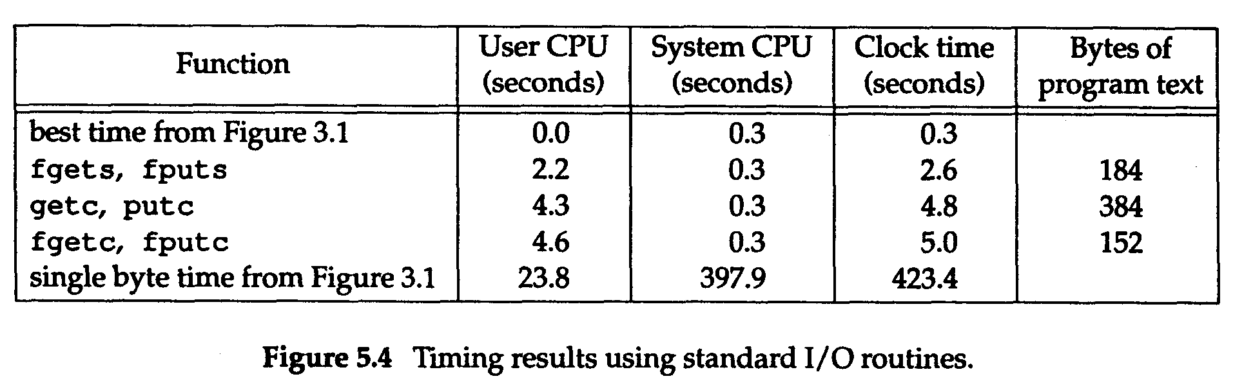
Timing Results using std I/O
(Fig. 5.4) (Edition I)
Slides©2014 Pao-Ann Hsiung, Dept of CSIE, National Chung Cheng University, Taiwan

Slide 39
Timing results using std I/O
(Fig. 5.6) (Edition II)
Function | User CPU (s) | System CPU (s) | Clock time (s) | Program text (byte)
best time (Fig. 3.5) | 0.01 | 0.18 | 6.67
fgets, fputs | 2.59 | 0.19 | 7.15 | 139
getc, putc | 10.84 | 0.27 | 12.07 | 120
fgetc, fputc | 10.44 | 0.27 | 11.42 | 120
single byte (Fig. 3.5) | 124.89 | 161.65 | 288.64 | 120
Slides©2014 Pao-Ann Hsiung, Dept of CSIE, National Chung Cheng University, Taiwan

Slide 40
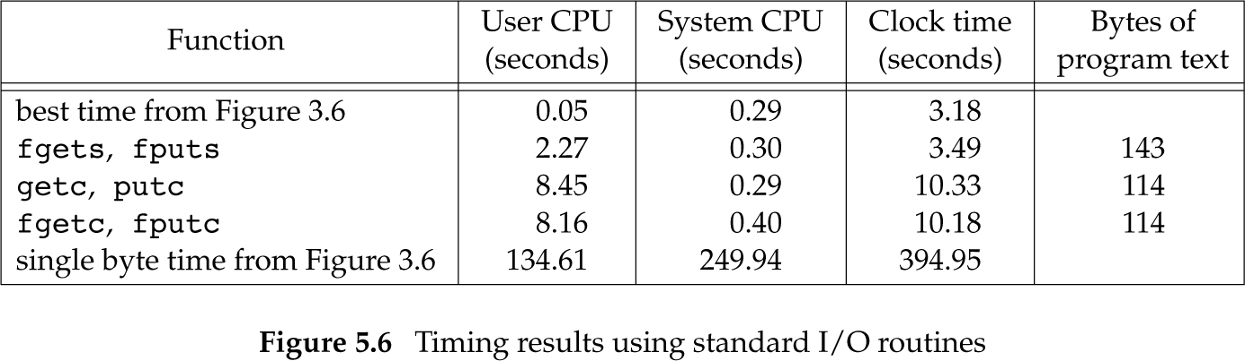
Timing results using std I/O (Fig. 5.6) (Edition III)
Slides©2014 Pao-Ann Hsiung, Dept of CSIE, National Chung Cheng University, Taiwan

Slide 41
Standard I/O Efficiency
# Loop Iterations:
Char-at-a-time: 100 million times
Line-at-a-time: 3,144,984 times
read() version: 25,224 times (BUFFSIZE=4,096)
Thus, different user CPU times!
Slides©2014 Pao-Ann Hsiung, Dept of CSIE, National Chung Cheng University, Taiwan

Slide 42
Program Text Size and
Execution Time
getc(), putc(): inline macros
➔ more instructions, larger text size
GNU C library: macro = function call
  program texts are all same size
Execution Time:
Char-at-a-time = 2 * (Line-at-a-time)
Line-at-a-time: implemented using memccpy(), which is in assembly.
Slides©2014 Pao-Ann Hsiung, Dept of CSIE, National Chung Cheng University, Taiwan

Slide 43
fgetc() and BUFFSIZE=1 prog
Compared to single-byte read, fgetc() is
  16 times faster in user CPU time
  39 times faster in clock time
fgetc() is much faster! Why?
Both: 200 million function calls
read(): 200 million system calls!!
fgetc(): 25,224 system calls!!
Slides©2014 Pao-Ann Hsiung, Dept of CSIE, National Chung Cheng University, Taiwan

Slide 44
Binary I/O
#include <stdio.h>
size_t fread(void *restrict ptr, size_t size, size_t nobj, FILE *restrict fp);
size_t fwrite(const void *restrict ptr, size_t size, size_t nobj, FILE *restrict fp);
Return: #objects read or written
Slides©2014 Pao-Ann Hsiung, Dept of CSIE, National Chung Cheng University, Taiwan

Slide 45
Binary I/O
Read or write an entire structure!
Cannot use fgets() or fputs()
  There may be NULLs or newlines in a structure
Hence, fread() and fwrite() are required!
Slides©2014 Pao-Ann Hsiung, Dept of CSIE, National Chung Cheng University, Taiwan

Slide 46
Binary I/O: (1/2)
Read/Write Binary Array
Write elements 2 through 5 of a floating point array:
float data[10]
if (fwrite(&data[2], sizeof(float), 4, fp)
!= 4)
err_sys(“fwrite error”);
Slides©2014 Pao-Ann Hsiung, Dept of CSIE, National Chung Cheng University, Taiwan

Slide 47
Binary I/O: (2/2)
Read/Write a Structure
struct {
short count;
long total;
char name[NAMESIZE];
} item;
if (fwrite(&item, sizeof(item), 1, fp) != 1) err_sys(“fwrite error”);
Slides©2014 Pao-Ann Hsiung, Dept of CSIE, National Chung Cheng University, Taiwan

Slide 48
Binary Data Exchange
May be incompatible among different machine architectures because:
Offset of a member in a structure can differ between compilers and systems
Binary formats of multibyte int and float may differ between different machines
So use a higher level protocol instead!
Slides©2014 Pao-Ann Hsiung, Dept of CSIE, National Chung Cheng University, Taiwan

Slide 49
Positioning a Stream
Three ways:
ftell and fseek (UNIX Version 7)
  assumes filepos as long integer data type
ftello and fseeko (Single UNIX Specification)
  assumes filepos as off_t data type
fgetpos and fsetpos (ISO C)
  assumes filepos as fpos_t data type
  more portable (UNIX, non-UNIX, …)
replace long int
as big as necessary
Slides©2014 Pao-Ann Hsiung, Dept of CSIE, National Chung Cheng University, Taiwan

Slide 50
ftell() and fseek()
#include <stdio.h>
long ftell (FILE *fp);
  Returns: curr filepos indicator if OK,
  -1L on error
int fseek (FILE *fp, long offset,
int whence);
  Returns: 0 if OK, nonzero on error
void rewind (FILE *fp);
Slides©2014 Pao-Ann Hsiung, Dept of CSIE, National Chung Cheng University, Taiwan

Slide 51
ftello() and fseeko()
#include <stdio.h>
off_t ftello(FILE *fp);
  Returns curr filepos indicator if OK,
  (off_t)-1 on error
int fseeko(FILE *fp, off_t offset,
int whence);
  Returns 0 if OK, nonzero on error
Slides©2014 Pao-Ann Hsiung, Dept of CSIE, National Chung Cheng University, Taiwan

Slide 52
fgetpos() and fsetpos()
#include <stdio.h>
int fgetpos(FILE *restrict fp, fpos_t *restrict pos);
int fsetpos(FILE *fp, const fpos_t *pos);
Return: 0 if OK, nonzero on error
Can reposition to a previous position obtained by fgetpos()
Slides©2014 Pao-Ann Hsiung, Dept of CSIE, National Chung Cheng University, Taiwan

Slide 53
Formatted Output
#include <stdio.h>
int printf(const char *restrict format, …);
int fprintf(FILE *restrict fp, const char *restrict format, …);
int dprintf(int fd, const char *restrict format, …);
  Return: #char output if OK, <0 on error
int sprintf(char *restrict buf, const char *restrict format, …);
int snprintf(char *restrict buf, size_t n,
const char *restrict format, …);
  Return: #char stored in array (without counting NULL)
  NULL appended to buf
Slides©2014 Pao-Ann Hsiung, Dept of CSIE, National Chung Cheng University, Taiwan

Slide 54
Formatted Output (variants)
#include <stdarg.h>
#include <stdio.h>
int vprintf(const char *restrict format, va_list arg);
int vfprintf(FILE *restrict fp, const char *restrict format, va_list arg);
int vdprintf(int fd, const char *restrict format, va_list arg);
  Return: #char output if OK, <0 on error
int vsprintf(char *buf, const char *format,
va_list arg);
int vsnprintf(char *buf, size_t n, const char *format,
va_list arg);
  Return: #char stored in array if OK, <0 if error
Slides©2014 Pao-Ann Hsiung, Dept of CSIE, National Chung Cheng University, Taiwan

Slide 55
Formatted Input
#include <stdio.h>
int scanf(const char *restrict format, …);
int fscanf(FILE *restrict fp, const char *restrict format, …);
int sscanf(const char *restrict buf,
const char *restrict format, …);
Return: #items assigned, EOF on error or on EOF
Slides©2014 Pao-Ann Hsiung, Dept of CSIE, National Chung Cheng University, Taiwan

Slide 56
Implementation Details
#include <stdio.h>
int fileno(FILE *fp);
Returns: file descriptor from stream
Needed by dup() and fcntl() functions
Slides©2014 Pao-Ann Hsiung, Dept of CSIE, National Chung Cheng University, Taiwan

Slide 57
Print stdio buffering (Fig. 5.11)
3 slides of program code
Slides©2014 Pao-Ann Hsiung, Dept of CSIE, National Chung Cheng University, Taiwan

Slide 58
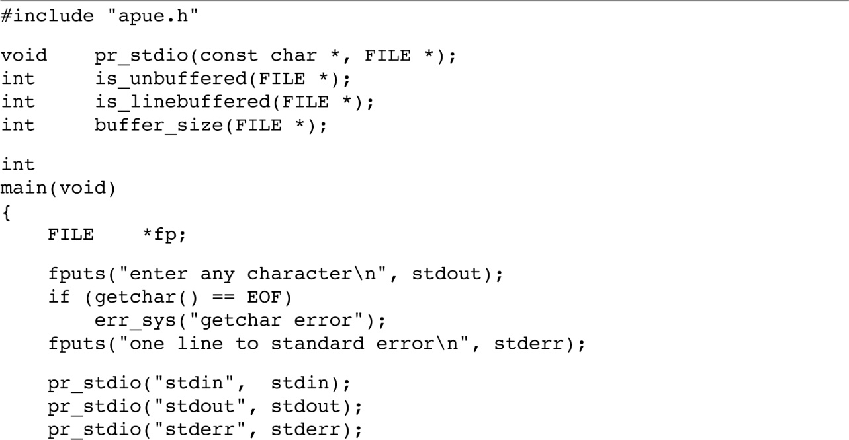
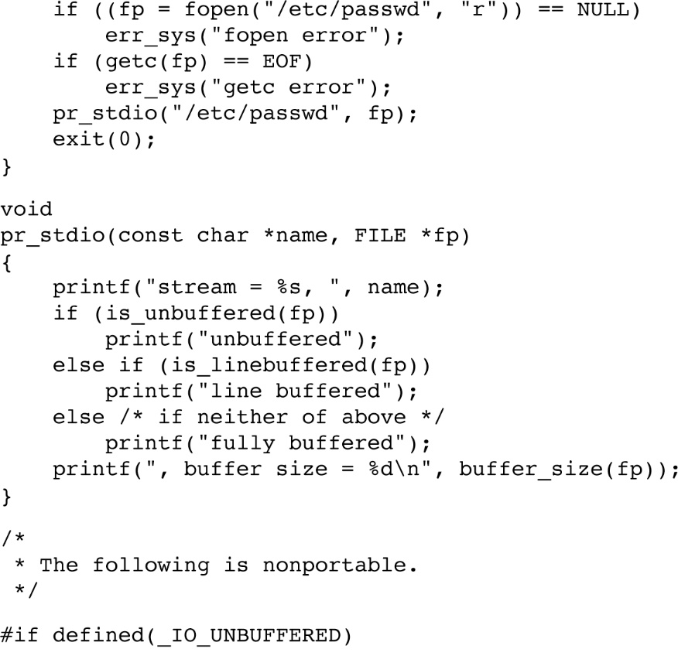
Slides©2014 Pao-Ann Hsiung, Dept of CSIE, National Chung Cheng University, Taiwan
Figure 5.11 (continues)

Slide 59

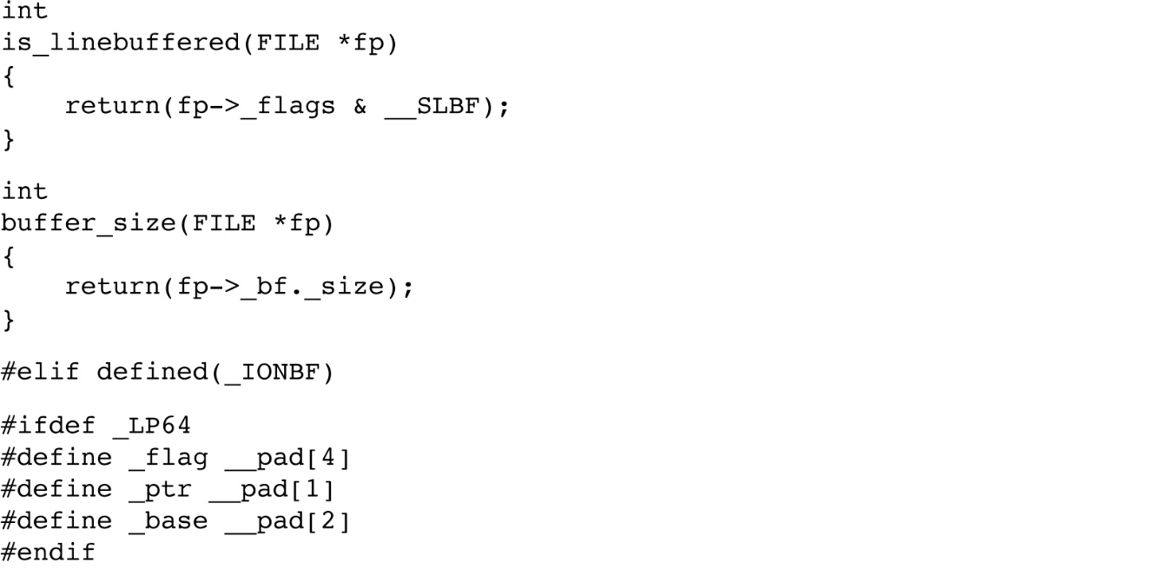
Slides©2014 Pao-Ann Hsiung, Dept of CSIE, National Chung Cheng University, Taiwan
Figure 5.11 (continues)

Slide 60
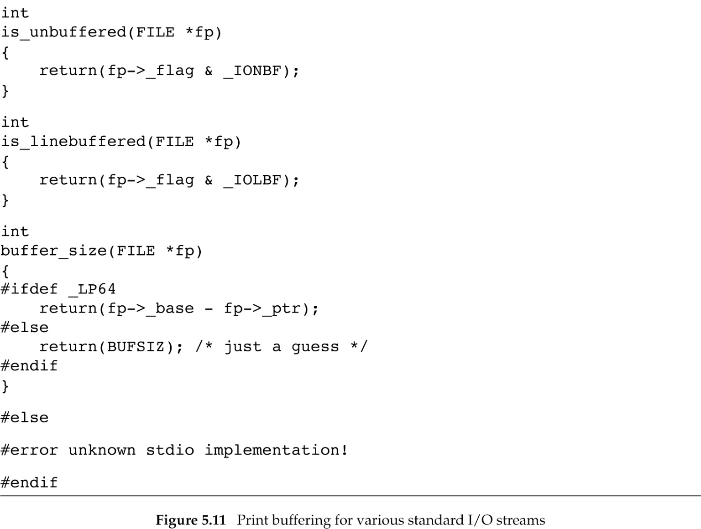
Slides©2014 Pao-Ann Hsiung, Dept of CSIE, National Chung Cheng University, Taiwan

Slide 61
Figure 5.11: Output (1)
$ a.out
enter any character
one line to standard error
stream = stdin, line buffered, buffer size = 1024
stream = stdout, line buffered, buffer size = 1024
stream = stderr, unbuffered, buffer size = 1
stream = /etc/passwd, fully buffered, buffer size = 4096
Slides©2014 Pao-Ann Hsiung, Dept of CSIE, National Chung Cheng University, Taiwan

Slide 62
Figure 5.11: Output (2)
$ a.out < /etc/group > std.out 2> std.err
$ cat std.err
one line to standard error
$ cat std.out
enter any character
stream=stdin, fully buffered, buffer size = 4096
stream=stdout, fully buffered, buffer size = 4096
stream=stderr, unbuffered, buffer size = 1
stream=/etc/passwd, fully buffered, buffer size = 4096
Slides©2014 Pao-Ann Hsiung, Dept of CSIE, National Chung Cheng University, Taiwan

Slide 63
Temporary Files
NULL→store in static area
O/W ptr = user- given buffer
#include <stdio.h>
char *tmpnam(char *ptr);
Returns: pointer to unique pathname
FILE *tmpfile(void);
Returns: file pointer if OK, NULL on error
wb+
(create for read/write)
Slides©2014 Pao-Ann Hsiung, Dept of CSIE, National Chung Cheng University, Taiwan

Slide 64
Fig. 5.12: tmpnam, tmpfile
#include “apue.h"
int main(void) {
char name[L_tmpnam], line[MAXLINE];
FILE *fp;
printf("%s\n", tmpnam(NULL)); /* first temp name */
tmpnam(name); /* second temp name */
printf("%s\n", name);
if ( (fp = tmpfile()) == NULL) /* create temp file */
err_sys("tmpfile error");
fputs("one line of output\n", fp); /* write to temp file */
rewind(fp); /* then read it back */
if (fgets(line, sizeof(line), fp) == NULL)
err_sys("fgets error");
fputs(line, stdout); /* print the line we wrote */
exit(0); }
Slides©2014 Pao-Ann Hsiung, Dept of CSIE, National Chung Cheng University, Taiwan

Slide 65
Fig. 5.12: Output
$ ./a.out
/tmp/fileC1Icwc
/tmp/fileemSkHSe
one line of output
Slides©2014 Pao-Ann Hsiung, Dept of CSIE, National Chung Cheng University, Taiwan

Slide 66
tmpfile()
UNIX technique for tmpfile():
Call tmpnam() to create a unique pathname
Create the file
Unlink it immediately
(unlinking is not deleting immediately)
Slides©2014 Pao-Ann Hsiung, Dept of CSIE, National Chung Cheng University, Taiwan

Slide 67
mkdtemp(), mkstemp()
To create a directory with a unique name
#include <stdlib.h>
char *mkdtemp(char *template);
  Returns: pointer to unique pathname
To create a file with a unique name
int mkstemp(char *template);
    Returns file descriptor if OK, -1 on error
Slides©2014 Pao-Ann Hsiung, Dept of CSIE, National Chung Cheng University, Taiwan

Slide 68
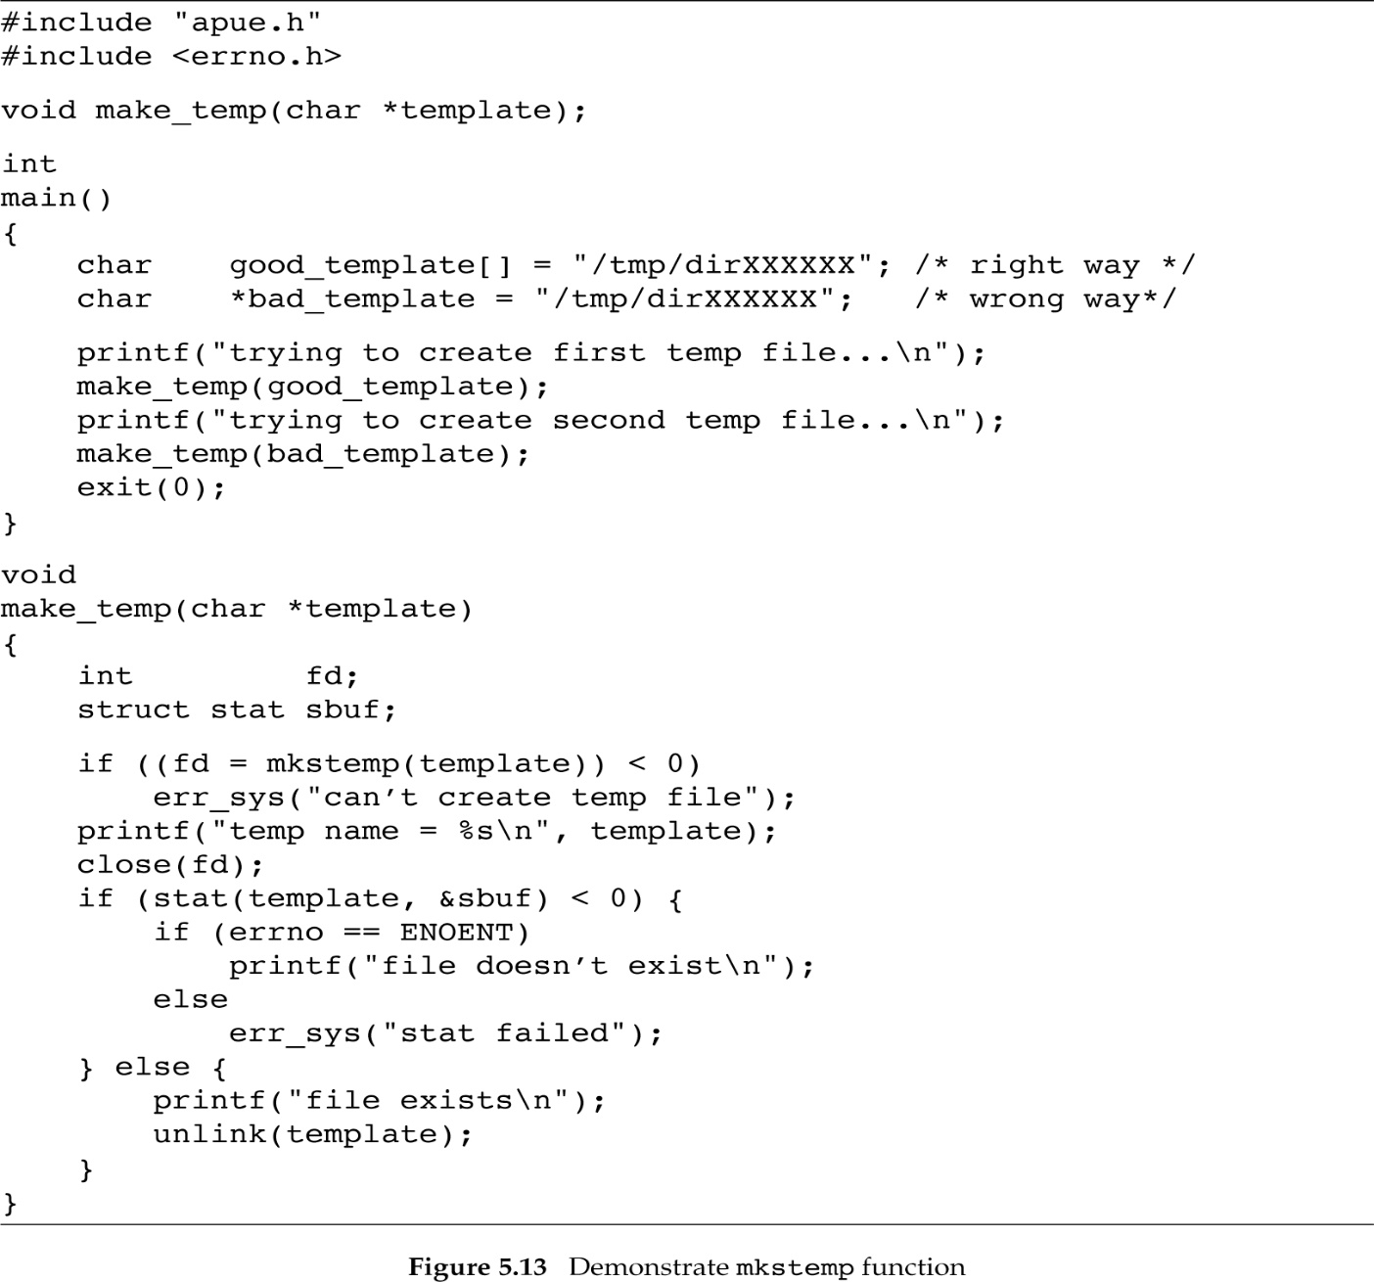
Fig. 5.13: how to use mkstemp()
Slides©2014 Pao-Ann Hsiung, Dept of CSIE, National Chung Cheng University, Taiwan

Slide 69
Fig. 5.13: Output
$ ./a.out
trying to create first temp file …
temp name = /tmp/dirUmBT7h
file exists
trying to create second temp file …
Segmentation fault
Slides©2014 Pao-Ann Hsiung, Dept of CSIE, National Chung Cheng University, Taiwan

Slide 70
Which to use?
tmpnam, tempnam
  Window between the unique pathname generation and actual file creation
    During this time window, another process can create a file of the same name
tmpfile, mkstemp
  No such time window
  Use these functions
Slides©2014 Pao-Ann Hsiung, Dept of CSIE, National Chung Cheng University, Taiwan

Slide 71
Memory Streams
Single UNIX Specification
No underlying files, accessed using FILE pointers
Slides©2014 Pao-Ann Hsiung, Dept of CSIE, National Chung Cheng University, Taiwan

Slide 72
fmemopen
#include <stdio.h>
FILE *fmemopen(void *restrict buf, size_t size, const char *restrict type);
Returns: stream pointer if OK, NULL on error.
Slides©2014 Pao-Ann Hsiung, Dept of CSIE, National Chung Cheng University, Taiwan

Slide 73

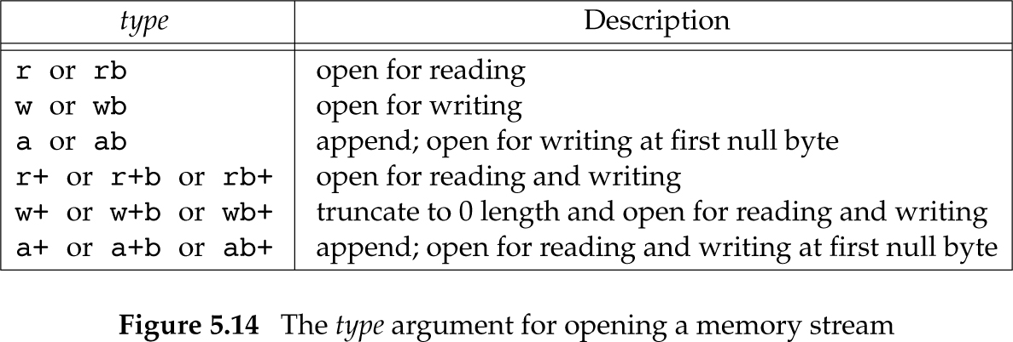
Argument for opening a memory stream
Slides©2014 Pao-Ann Hsiung, Dept of CSIE, National Chung Cheng University, Taiwan

Slide 74
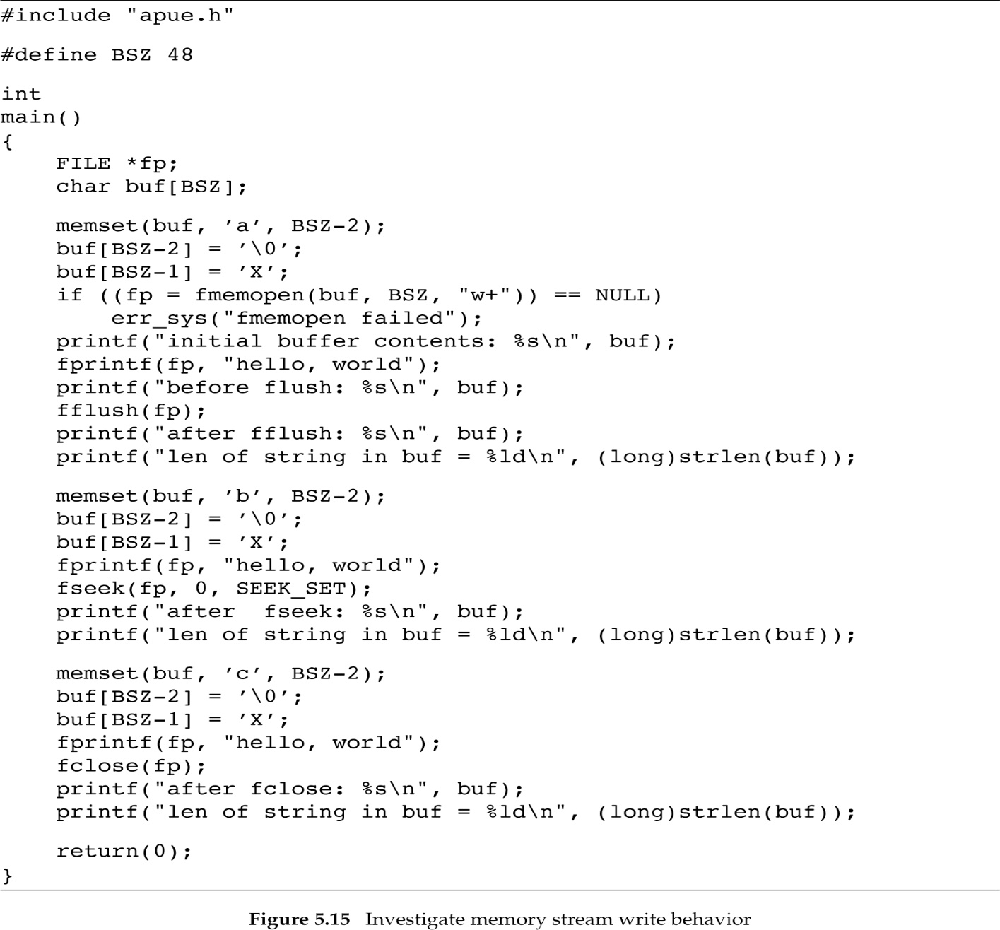
Fig. 5.15 (how to use memory streams)
Slides©2006 Pao-Ann Hsiung, Dept of CSIE, National Chung Cheng University, Taiwan

Slide 75
Fig. 5.15: Results
$ ./a.out
overwrite the buffer with a’s
initial buffer contents: fmemopen places a null byte at beginning of buffer
before flush: buffer is unchanged until stream is flushed
after fflush: hello, world
len of string in buf = 12 null byte added to end of string
now overwrite the buffer with b’s
after fseek: bbbbbbbbbbbbhello, world fseek causes flush
len of string in buf = 24 null byte appended again
now overwrite the buffer with c’s
after fclose: hello, worldcccccccccccccccccccccccccccccccccc
len of string in buf = 46 no null byte appended
Slides©2014 Pao-Ann Hsiung, Dept of CSIE, National Chung Cheng University, Taiwan

Slide 76
Current status
Currently only Linux 3.2.0 support memory streams
Other OS will follow the standard in the future
Slides©2006 Pao-Ann Hsiung, Dept of CSIE, National Chung Cheng University, Taiwan

Slide 77
Alternatives to Std I/O
Korn and Vo [1991]: list numerous defects
Inefficiency in standard I/O
  too much data copying
    Eg.: line-at-a-time functions (fgets, fputs)
      between kernel and std I/O buffer
      between std I/O buffer and line buffer
Slides©2014 Pao-Ann Hsiung, Dept of CSIE, National Chung Cheng University, Taiwan

Slide 78
Alternatives to Std I/O
Alternatives
  Fast I/O library (fio): returns pointer to the line
    grep 3 times faster
  sfio: generalized to files and memory regions, processing modules on stacked on I/O stream, better exception handling
  Alloc Stream Interface (ASI): uses mmap
  Embedded Systems
    uClibc C library (http://www.uclibc.org)
    newlibc C library (http://sources.redhat.com/newlib)
Slides©2014 Pao-Ann Hsiung, Dept of CSIE, National Chung Cheng University, Taiwan

