Slide 1
Chapter 7. Process Environment
System Programming
http://www.cs.ccu.edu.tw/~pahsiung/courses/sp
熊博安
國立中正大學資訊工程學系
pahsiung@cs.ccu.edu.tw Class: EA-104
(05)2720411 ext. 23100, 33119 Office: EA-108/512

Slide 2
Introduction
How is main() called?
How are arguments passed?
Memory layout and allocation?
Environment variables
Process termination
longjmp, setjmp functions

Slide 3
main Function
int main(int argc, char *argv[]);
argc = #arguments
argv[] = vector of arguments
Kernel executes a special START-UP routine before main()
Start-up routine sets things up before main() is called: stack, heap, etc.

Slide 4
Process Termination
8 ways
Normal termination:
return from main()
calling exit()
calling _exit() or _Exit()
Return of the last thread from its start routine
Calling pthread_exit from the last thread
Abnormal termination
calling abort()
Receipt of a signal
Response of the last thread to a cancellation request
Section 11.5
Section 10.17
Section 10.2
Sections 11.5, 12.7

Slide 5
exit(), _Exit, _exit()
#include <stdlib.h>
void exit(int status);
void _Exit(int status);
#include <unistd.h>
void _exit(int status);
fclose() all open streams
ISO C
return to kernel immediately
POSIX.1

Slide 6
Exit Status
All exit functions require a single integer as exit status of the process
Exit status is sometimes undefined if
Exit function called without an exit status
main returns without a return value
main function is not declared to return an integer

Slide 7
Exit Status Example
#include <stdio.h>
main() { printf(“hello, world\n”); }
$ gcc hello.c
$ ./a.out
hello world
$ echo $?
13 depends on stack / register contents when returning

Slide 8
Exit Status Example
$ gcc –std=c99 hello.c
hello.c:4: warning: return type defaults to ‘int’
$ ./a.out
hello, world
$ echo $?
0

Slide 9
atexit(): Exit Handler
#include <stdlib.h>
int atexit(void (*func) (void));
Returns: 0 if OK, nonzero on error
func is an exit handler, at most 32
exit() calls these exit handler functions in the reverse order of registration
#times called = #times registered

Slide 10
atexit(): Exit Handler
ISO C and POSIX.1
exit first calls the exit handlers
then closes (via fclose) all open streams
POSIX.1 extends ISO C standard
any installed exit handlers will be cleared on exec (a new process does not have the original exit handlers)

Slide 11
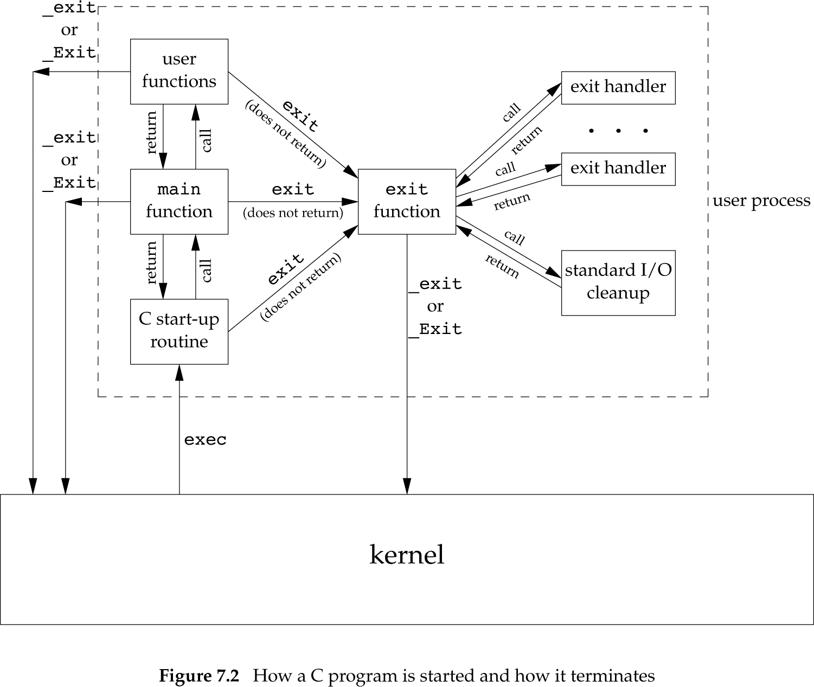
Program Start & Termination

Slide 12
Figure 7.3: Exit Handlers
#include “apue.h"
static void my_exit1(void), my_exit2(void);
int main(void) {
if (atexit(my_exit2) != 0)
err_sys("can't register my_exit2");
if (atexit(my_exit1) != 0)
err_sys("can't register my_exit1");
if (atexit(my_exit1) != 0)
err_sys("can't register my_exit1");
printf("main is done\n");
return(0);
}
static void my_exit1(void)
{ printf("first exit handler\n"); }
static void my_exit2(void)
{ printf("second exit handler\n"); }

Slide 13
Figure 7.3: results
$ a.out
main is done
first exit handler
first exit handler
second exit handler

Slide 14
Command-Line Arguments
exec() can pass command-line arguments to a new program
Part of normal operation of Unix shells
echo() does not echo 0th argument
argv[argc] is NULL (ISO C, POSIX.1)
for(i=0; argv[i] != NULL; i++) …

Slide 15
Figure 7.4: echo()
#include “apue.h"
int
main(int argc, char *argv[])
{
int i;
for (i = 0; i < argc; i++) /* echo all command-line args */
printf("argv[%d]: %s\n", i, argv[i]);
exit(0);
}

Slide 16
Figure 7.4: results
$ ./echoarg arg1 TEST foo
argv[0]: ./echoarg
argv[1]: arg1
argv[2]: TEST
argv[3]: foo

Slide 17
Environment List
An array of character pointers (addresses of null-terminated C strings)
Array address is in global variable environ
extern char **environ;
getenv(): get an environment string
putenv(): set an environment string

Slide 18
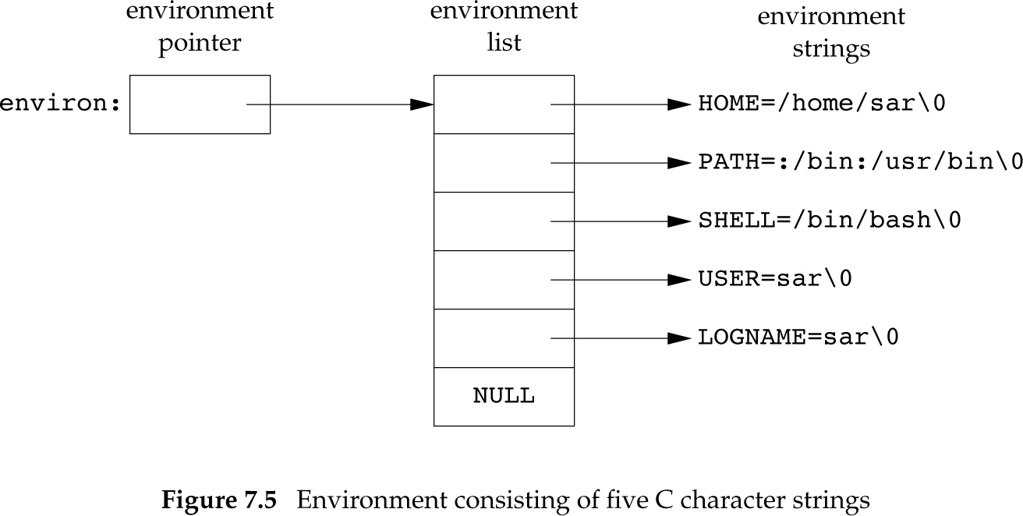
Environment List (Fig. 7.5)

Slide 19
Memory Layout of a C Program
Text segment: Machine instructions (read-only, sharable)
Initialized data segment: e.g. int maxcount = 99; (initialized!)
Uninitialized data segment: (bss: block started by symbol) e.g. long sum[1000];
Stack: automatic variables, function calling information, context-switch information, (recursive functions)
Heap: dynamic memory allocation

Slide 20
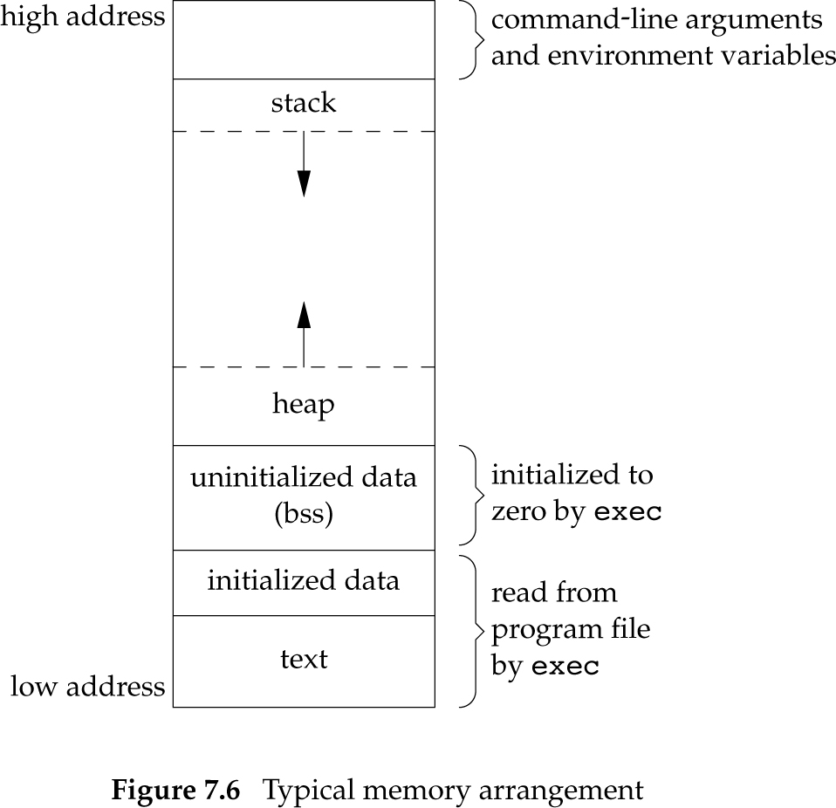
Memory Layout (Fig. 7.6)
More in a.out:
Symbol table
Debug info
Linkage tables for dynamic shared libs

Slide 21
size
$ size /bin/cc /bin/sh
text data bss dec hex
81920 16384 664 98968 18298 /bin/cc
90112 16384 0 106496 1a000 /bin/sh

Slide 22
Shared Libraries
Common library routines removed from executable files
Single copy of common library routines in memory is maintained
No need to re-link edit every program if a library is updated or changed
Size is smaller, some run-time overhead

Slide 23
Shared Libraries
Without Shared Libraries
$ ls –l a.out
-rwxrwxr-x 1 stevens 104859 Aug 2 14:25 a.out
$ size a.out
text data bss dec hex
49152 49152 0 98304 18000
$ ls –l a.out
-rwxrwxr-x 1 stevens 24576 Aug 2 14:26 a.out
$ size a.out
text data bss dec hex
8192 8192 0 16384 4000
With Shared Libraries

Slide 24
Shared Libraries
$ gcc –static hello1.c
$ ls –l a.out
-rwxrwxr-x 1 sar 475570 Feb 18 23:17 a.out
$ size a.out
text data bss dec hex filename
375657 3780 3220 382657 5d6c1 a.out

Slide 25
Shared Libraries
$ gcc hello1.c
$ ls –l a.out
-rwxrwxr-x 1 sar 11410 Feb 18 23:19 a.out
$ size a.out
text data bss dec hex filename
872 256 4 1132 46c a.out

Slide 26
Memory Allocation
malloc():
allocates specified #bytes,
initial value of memory is indeterminate
calloc():
allocates specified #objects of specified size,
initialized to all 0 bits
realloc():
changes size of previously allocated memory,
initial value of new area is indeterminate

Slide 27
Memory Allocation
#include <stdlib.h>
void *malloc(size_t size);
void *calloc(size_t nobj, size_t size);
void *realloc(void *ptr, size_t newsize);
Return: nonnull pointer if OK, NULL on error
void free(void *ptr);

Slide 28
Alternate Memory Allocators
libmalloc
SVR4-based systems, such as Solaris
API match ISO C functions
mallopt: to control memory allocation operations
mallinfo: provide info on memory allocator
Advantage: space-efficient
Disadvantage: poor performance

Slide 29
Alternate Memory Allocators
vmalloc
Allows processes to allocate memory using different techniques for different regions
Emulations of ISO C memory allocation functions
Specific functions
Author Kiem-Phong Vo’s Web Page (1996): http://www.research.att.com/~gsf/download/ref/vmalloc/vmalloc.html
Notes:
Vmalloc is a library for dynamic memory allocation. It enables applications to create and allocate from regions of memory. Each region has an application-defined discipline and a library-provided method. A Vmalloc discipline primarily defines the memory type to be used. This may include shared, memory mapped, heap memory or even memory obtained from another region. Other uses of disciplines are for handling various exceptions that may arise during allocation. A Vmalloc method defines the allocation policy in a region. An allocation policy would then define the memory lay-out as well as the data structures and algorithms used to efficiently allocate memory. The current set of methods include:
Vmbest: A general purpose allocator based on a best-fit strategy but enhanced with caching strategies to improve allocation efficiency.
Vmlast: A strategy for building structures that are only deleted whole. Thus, only the latest allocated block can be freed or resized. This means that after a block, say a is allocated, all previously allocated blocks are frozen and only a can ever be freed or resized.
Vmpool: A strategy for allocating blocks of the same size.
Vmdebug: A general purpose allocator with stringent checking and locking. It is useful for detecting memory overwrites, resizing or freeing of unallocated blocks, etc.
Vmprofile: A general purpose allocator that records and prints a summary of memory usage on program exit. This can be used to tune memory usage and to detect memory leakages.
Vmalloc provides a malloc interface for backward compatibility. This implementation of malloc is instrumented with the Vmalloc methods so that an application can select a particular allocation policy at program start-up time via environment variables. For example, to debug memory errors, an application can set the environment variable VMDEBUG=1 before invocation to use the method Vmdebuginstead of the default method Vmbest. Then, as memories are allocated and freed, allocation errors and memory corruptions will be reported. In this way, normal execution retains good performance but debugging is still possible when needed without recompilation or relinking.
The current distribution is Vmalloc2002. This version of library is portable to all C and C++ flavors. A number of new functions have been added including one to open a region based on memory mapping. Such regions are automatically backed up to secondary storage for data persistence. An example to build persistent containers based on the container data type library Cdt is given in the distribution.
Below are papers related to Vmalloc
Kiem-Phong Vo, "Vmalloc: A General and Efficient Memory Allocator", Software Practice & Experience, vol.26, pp.1-18, 1996.
Kiem-Phong Vo, ``The Discipline and Method Architecture for Reusable Libraries'', Software - Practice & Experience, v.30, pp.107-128, 2000.
Kiem-Phong Vo, "Cdt: A Container Data Type Library", Software Practice & Experience, vol.27, pp.163-172, 1997.
Glenn S. Fowler, David G. Korn and Kiem-Phong Vo, ``Feature-Based Portability'', Proceedings of the Usenix VHLL Conference, pp. 197-207, 1994.
Software Installation Notes
The package should be unpacked in a root installation directory, say ``Software'', to create the below directory tree: Software / NOTICE README include / [headers (ast_common.h, vmalloc.h)] lib / [libraries (libvmalloc.a)] bin / [commands (iffe)] man / man1 / [command manual pages (iffe.1)] / man3 / [library manual pages (vmalloc.3)] src / lib / vmalloc / [vmalloc source code] NOTICE README features / [feature probes] Vmalloc_t / [regression tests for Vmalloc] Vmalloc_ex / [example program(s)] The README file tells how to build Vmalloc.Comments/Questions/Problems
Contact Phong Vo at: kpv@research.att.com.Except for configuration problems in building the package, a bug report should be in the form of a small program that I can compile and run. Without such a program, I will likely ignore the report since it often takes too much time for me to tell if a reported bug is real or if it's just a misuse of the code.

Slide 30
Alternate Memory Allocators
quick-fit (Weinstock’s Ph.D. dissertation)
quick-fit memory allocation is faster than best-fit and first-fit (used by std malloc)
Splits memory info buffers of various sizes
Maintains unused buffers on different lists
Free implementations of malloc and free based on quick-fit available on FTP sites
About Memory Allocators:
http://www.flounder.com/memory_allocation.htm

Slide 31
Alternate Memory Allocators
alloca
Allocates memory from stack, instead of heap
Advantage: No need to free space, automatically freed after function returns
For example, after longjmp()
Disadvantage: Some systems do not support alloca()
However, all 4 platforms of textbook support it

Slide 32
Example of alloca()
A function that
opens a file name made from concatenating two argument strings, and
returns a file descriptor or minus one signifying failure
Source of Example:
http://www.gnu.org/software/libtool/manual/libc/Variable-Size-Automatic.html#Variable-Size-Automatic

Slide 33
Example of alloca()
int open2 (char *str1, char *str2, int flags, int mode) {
char *name = (char *) alloca ( strlen (str1) +
strlen (str2) + 1);
stpcpy (stpcpy (name, str1), str2);
return open (name, flags, mode);
}

Slide 34
Example of alloca()
Here is how you would get the same results with malloc and free:

Slide 35
int open2 (char *str1, char *str2, int flags, int mode) {
char *name = (char *)
malloc ( strlen (str1) +
strlen (str2) + 1);
int desc;
if (name == 0)
fatal ("virtual memory exceeded");
stpcpy (stpcpy (name, str1), str2);
desc = open (name, flags, mode);
free (name);
return desc;
}
As you can see, it is simpler with alloca. But alloca has other, more important advantages, and some disadvantages.

Slide 36
Food for thought!
Is there any problem with the following?
foo (x, alloca(4), y);
Notes:
Do not use alloca inside the arguments of a function call—you will get unpredictable results, because the stack space for the alloca would appear on the stack in the middle of the space for the function arguments. An example of what to avoid is foo (x, alloca (4), y).

Slide 37
Environment Variables
#include <stdlib.h>
char *getenv(const char *name);
Returns: pointer to value associated with name, NULL if not found
Some environment variables are set automatically by shell upon login
E.g.: HOME, USER, etc.

Slide 38
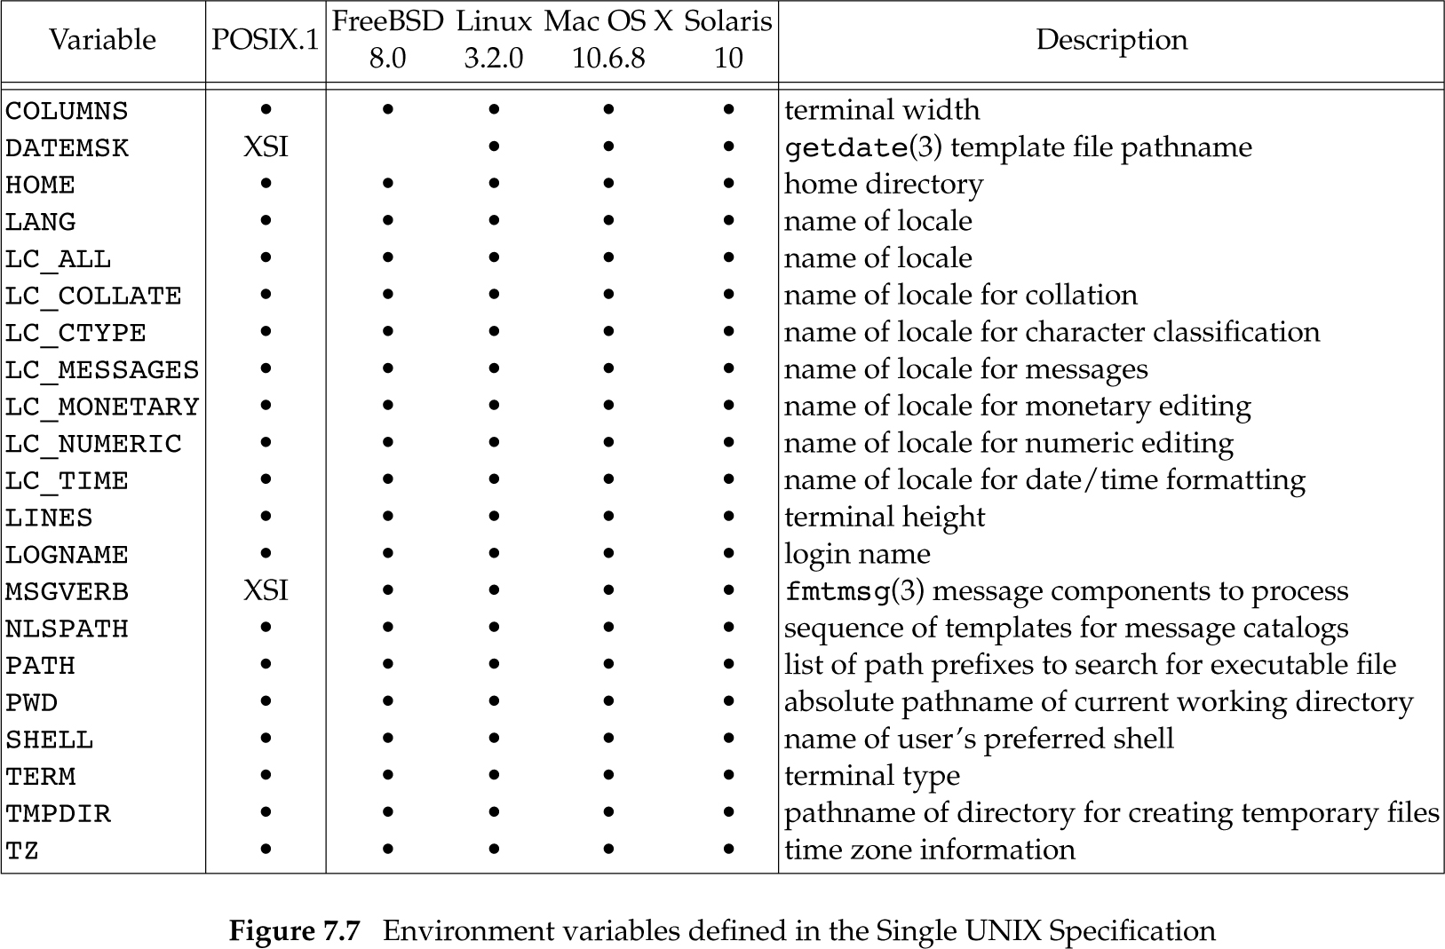
Environment Variables (Fig. 7.7)

Slide 39
Setting an environment variable
#include <stdlib.h>
int putenv(const char *str);
int setenv(const char *name, const char *value, int rewrite);
void unsetenv(const char *name);
Return: 0 if OK, nonzero on error

Slide 40
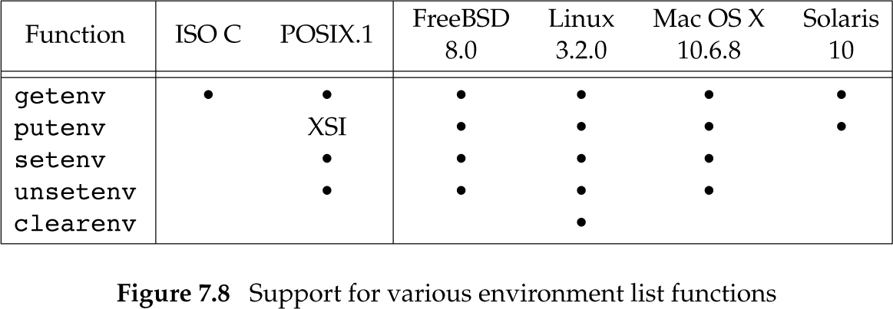
Environment Variables (Fig. 7.8)

Slide 41
setjmp(), longjmp() Functions
In C, we cannot goto a label in another function
setjmp() and longjmp() must be used
See Figure 7.9 (a skeleton) for command processing
read lines (main),
interpret commands (do_line)
process command (cmd_add, …)

Slide 42
Figure 7.9 (1/4: main)
#include "apue.h"
#define TOK_ADD 5
void do_line(char *);
void cmd_add(void);
int get_token(void);
int main(void)
{
char line[MAXLINE];
while (fgets(line, MAXLINE, stdin) != NULL)
do_line(line);
exit(0);
}

Slide 43
Figure 7.9 (2/4: do_line)
char *tok_ptr; /* global pointer for get_token() */
void
do_line(char *ptr) /* process one line of input */
{
int cmd;
tok_ptr = ptr;
while ((cmd = get_token()) > 0) {
switch (cmd) { /* one case for each command */
case TOK_ADD:
cmd_add();
break;
}
}
}

Slide 44
Figure 7.9 (3/4: cmd_add)
void
cmd_add(void)
{
int token;
token = get_token();
/* rest of processing for this command */
}

Slide 45
Figure 7.9 (4/4: get_token)
int
get_token(void)
{
/* fetch next token from line pointed to by tok_ptr */
}
What if error occurs here?

Slide 46
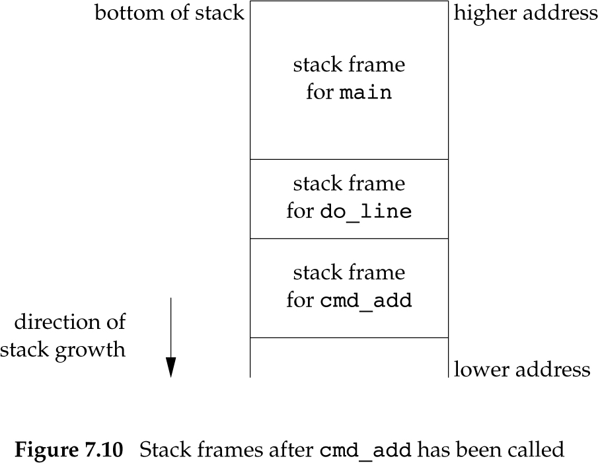
After cmd_add(): stack frame

Slide 47
setjmp() and longjmp()
Often we are deeply nested,
An error occurs,
We want to print an error, ignore rest of input, and return to main()
Large # of levels → handle return at each level for each error
Direct nonlocal goto: setjmp, longjmp

Slide 48
setjmp() and longjmp()
#include <setjmp.h>
int setjmp(jmp_buf env);
Returns: 0 if called directly, nonzero if returning from a call to longjmp
void longjmp(jmp_buf env, int val);

Slide 49
Figure 7.11
#include "apue.h"
#include <setjmp.h>
#define TOK_ADD 5
jmp_buf jmpbuffer;
int
main(void)
{
char line[MAXLINE];
if (setjmp(jmpbuffer) != 0)
printf("error");
while (fgets(line, MAXLINE, stdin) != NULL)
do_line(line);

Slide 50
Figure 7.11 (cont’d)
exit(0);
}
. . .
void
cmd_add(void)
{
int token;
token = get_token();
if (token < 0) /* an error has occurred */
longjmp(jmpbuffer, 1);
/* rest of processing for this command */
}

Slide 51
Figure 7.11
setjmp(jmpbuffer) stores current state of main at the start of program exec
longjmp(jmpbuffer, 1) unwounds the stacks of do_line() and cmd_add()
and causes setjmp() to return 1

Slide 52
Automatic, Register, Volatile Variables
After longjmp(), what are the values of the automatic and register variables?
Rolled back
Left alone
Standards: indeterminate
Volatile variables: don’t rollback values
Global, static variables: leave alone

Slide 53
Program 7.5: longjmp() …
#include "apue.h"
#include <setjmp.h>
static void f1(int, int, int, int);
static void f2(void);
static jmp_buf jmpbuffer;
static int globval;
int main(void)
{
int autoval;
register int regival;
volatile int volaval;
static int statval;

Slide 54
Program 7.5: longjmp() …
globval = 1; autoval = 2; regival = 3;
volaval = 4; statval = 5;
if (setjmp(jmpbuffer) != 0) {
printf("after longjmp:\n");
printf("globval = %d, autoval = %d, regival = %d,"
" volaval = %d, statval = %d\n",
globval, autoval, regival, volaval, statval);
exit(0);
}

Slide 55
Program 7.5: longjmp() …
/*
* Change variables after setjmp, but before longjmp.
*/
globval = 95; autoval = 96; regival = 97; volaval = 98; statval = 99;
f1(autoval, regival, volaval, statval);
/* never returns */
exit(0);
}

Slide 56
Program 7.5: longjmp() …
static void
f1(int i, int j, int k, int l)
{
printf("in f1():\n");
printf("globval = %d, autoval = %d, regival = %d,"
" volaval = %d, statval = %d\n", globval, i, j, k, l);
f2();
}
static void
f2(void)
{
longjmp(jmpbuffer, 1);
}

Slide 57
Figure 7.13: results
$ gcc testjmp.c // compile without any optimization
$ ./a.out
in f1(): globval = 95, autoval = 96, regival = 97, volaval = 98, statval = 99
after longjmp:
globval = 95, autoval = 96, regival = 97, volaval = 98, statval = 99
$ gcc –O testjmp.c // compile with full optimization
$ ./a.out
in f1(): globval = 95, autoval = 96, regival = 97, volaval = 98, statval = 99
after longjmp:
globval = 95, autoval = 2, regival = 3, volaval = 98, statval = 99

Slide 58
Figure 7.13: results
setjmp(3) manual
Variables stored in memory will have values as of the time of the longjmp,
Whereas variables in the CPU and floating-point registers are restored to their values when setjmp was called.

Slide 59
Figure 7.13: results
Without Optimization
All variables in memory
With Optimization
autoval and regival go into registers
Suggestion
Use “volatile” for portable code

Slide 60
Figure 7.14: Incorrect usage of automatic variables
#include <stdio.h>
#define DATAFILE "datafile"
FILE *open_data(void)
{
FILE *fp;
char databuf[BUFSIZ]; /* setvbuf makes this the stdio buffer */
if ( (fp = fopen(DATAFILE, "r")) == NULL)
return(NULL);
if (setvbuf(fp, databuf, _IOLBF, BUFSIZ) != 0)
return(NULL);
return(fp); /* error */
}
local automatic variable!

Slide 61
getrlimit(), setrlimit()
Every process has resource limits
#include <sys/resource.h>
int getrlimit( int resource, struct rlimit *rlptr );
int setrlimit( int resource, const struct rlimit *rlptr );
Return: 0 if OK, nonzero on error

Slide 62
Resource Limits
struct rlimit {
rlim_t rlim_cur; /* soft limit: curr limit */
rlim_t rlim_max; /* hard limit: max */
};
Soft limit: can be changed by any process to ≤ hard limit
Hard limit: can be lowered by any process to ≥ soft limit (irreversible!)
can be raised only by superuser process
2MB
>2MB
<20MB
20MB

Slide 63
Resource Limits
Infinite Limit = RLIM_INFINITY
RLIMIT_AS: #bytes for a process memory
RLIMIT_CORE: #bytes in core file
RLIMIT_CPU: #seconds of CPU time
RLIMIT_DATA: #bytes of data seg = init data + uninit data + heap
RLIMIT_FSIZE: #bytes of max file size
RLIMIT_LOCKS: #file locks by a process

Slide 64
Resource Limits
RLIMIT_MEMLOCK: #bytes locked by process in memory using mlock(2)
RLIMIT_NOFILE: Max # open files
RLIMIT_NPROC: Max # child processes
RLIMIT_RSS: Max resident set size (bytes)
RLIMIT_SBSIZE: #bytes of socket buffers
RLIMIT_STACK: #bytes of stack size
RLIMIT_VMEM: same as RLIMIT_AS

Slide 65
Resource Limits
Resource limits are inherited by child processes
For ALL processes to have same limits, shells has built-in commands:
ulimit (sh, bash, ksh, …)
limit (csh, tcsh, …)

Slide 66
Figure 7.16 (1/4)
#include "apue.h"
#if defined(BSD) || defined(MACOS)
#include <sys/time.h>
#define FMT "%10lld "
#else
#define FMT "%10ld "
#endif
#include <sys/resource.h>
#define doit(name) pr_limits(#name, name)
static void pr_limits(char *, int);
ISO C string creation operator

Slide 67
Figure 7.16 (2/4)
int main(void)
{
#ifdef RLIMIT_AS
doit(RLIMIT_AS);
#endif
doit(RLIMIT_CORE);
doit(RLIMIT_CPU);
doit(RLIMIT_DATA);
doit(RLIMIT_FSIZE);
#ifdef RLIMIT_LOCKS
doit(RLIMIT_LOCKS);
#endif
#ifdef RLIMIT_MEMLOCK
doit(RLIMIT_MEMLOCK);
#endif
doit(RLIMIT_NOFILE);

Slide 68
Figure 7.16 (3/4)
#ifdef RLIMIT_NPROC
doit(RLIMIT_NPROC);
#endif
#ifdef RLIMIT_RSS
doit(RLIMIT_RSS);
#endif
#ifdef RLIMIT_SBSIZE
doit(RLIMIT_SBSIZE);
#endif
doit(RLIMIT_STACK);
#ifdef RLIMIT_VMEM
doit(RLIMIT_VMEM);
#endif
exit(0);
}

Slide 69
Figure 7.16 (4/4)
static void pr_limits(char *name, int resource)
{
struct rlimit limit;
if (getrlimit(resource, &limit) < 0)
err_sys("getrlimit error for %s", name);
printf("%-14s ", name);
if (limit.rlim_cur == RLIM_INFINITY)
printf("(infinite) ");
else
printf(FMT, limit.rlim_cur);
if (limit.rlim_max == RLIM_INFINITY)
printf("(infinite)");
else
printf(FMT, limit.rlim_max);
putchar((int)'\n');
}

Slide 70
Figure 7.16: FreeBSD results
$ ./a.out
RLIMIT_CORE (infinite) (infinite)
RLIMIT_CPU (infinite) (infinite)
RLIMIT_DATA 536870912 536870912
RLIMIT_FSIZE (infinite) (infinite)
RLIMIT_MEMLOCK (infinite) (infinite)
RLIMIT_NOFILE 1735 1735
RLIMIT_NPROC 867 867
RLIMIT_RSS (infinite) (infinite)
RLIMIT_SBSIZE (infinite) (infinite)
RLIMIT_STACK 67108864 67108864
RLIMIT_VMEM (infinite) (infinite)

Slide 71
Figure 7.16: Solaris results
$ ./a.out
RLIMIT_AS (infinite) (infinite)
RLIMIT_CORE (infinite) (infinite)
RLIMIT_CPU (infinite) (infinite)
RLIMIT_DATA (infinite) (infinite)
RLIMIT_FSIZE (infinite) (infinite)
RLIMIT_NOFILE 256 65536
RLIMIT_STACK 8388608 (infinite)
RLIMIT_VMEM (infinite) (infinite)

