Slide 1
Chapter 8. Process Control
System Programming
http://www.cs.ccu.edu.tw/~pahsiung/courses/sp
熊博安
國立中正大學資訊工程學系
pahsiung@cs.ccu.edu.tw Class: EA-001
(05)2720411 ext. 23100, 33119 Office: EA-108,EA512

Slide 2
Introduction
Creation of new processes
Program execution & termination
IDs: real, effective, saved
Interpreter files, system()
Process accounting

Slide 3
Process Identifiers
Process ID = a nonnegative integer
PID | Process
0 | swapper (scheduler)
1 | init (/sbin/init)
2 | pagedaemon (virtual memory paging)
3, 4, … | other processes

Slide 4
Identifier functions
#include <unistd.h>
pid_t getpid(void); return PID
pid_t getppid(void); return parent PID
uid_t getuid(void); return real UID
uid_t geteuid(void); return effective UID
gid_t getgid(void); return real GID
gid_t getegid(void); return effective GID

Slide 5
fork Function
fork() is the ONLY way to create a process in Unix kernel by user
#include <unistd.h>
pid_t fork(void);
Returns: 0 in child, child PID in parent, -1 on error

Slide 6
Parent / Child Processes
Parent and child continue executing instructions following the fork() call
Child gets a copy of parent’s data space, heap, and stack
Often, read-only text segment is shared
Often, fork() is followed by exec()
Waste of space and time for setting up child’s program space!!!

Slide 7
Copy-On-Write (COW)
Memory regions are read-only and shared by parent and child
If either process wants to write, kernel makes a copy of that memory only for that process.
Saves space and time!

Slide 8
Variations of fork
All 4 platforms support vfork(2)
Linux 3.2.0
clone(2) system call
Can control what to share between parent and child processes
FreeBSD 8.0
rfork(2) system call: similar to clone()
Solaris 9
POSIX Thread (pthread): a new process with only the calling thread
Solaris Thread: a new process with all threads from the process of calling thread
Solaris 10
fork (fork1): a new process with only the calling thread
forkall: a new process with all threads duplicated

Slide 9
Figure 8.1: fork()
#include “apue.h"
int glob = 6; /* external variable in initialized data */
char buf[] = "a write to stdout\n";
int main(void) {
int var; /* automatic variable on the stack */
pid_t pid;
var = 88;
if (write(STDOUT_FILENO, buf, sizeof(buf)-1) != sizeof(buf)-1)
err_sys("write error");
printf("before fork\n"); /* we don't flush stdout */
if ( (pid = fork()) < 0) err_sys("fork error");
else if (pid == 0) { /* child */
glob++; var++; /* modify variables */
} else
sleep(2); /* parent */
printf("pid = %d, glob = %d, var = %d\n", getpid(), glob, var);
exit(0);
}

Slide 10
Figure 8.1: results
$ ./a.out
a write to stdout
before fork
pid = 430, glob = 7, var = 89
pid = 429, glob = 6, var = 88
$ ./a.out > temp.out
$ cat temp.out
a write to stdout
before fork
pid = 432, glob = 7, var = 89
before fork
pid = 431, glob = 6, var = 88

Slide 11
File Sharing
Parent and child share the same file descriptors
As if dup() had been called on all open file descriptors
Parent and child share the same file offset, o/w overwrite
Intermixed output from parent and child

Slide 12
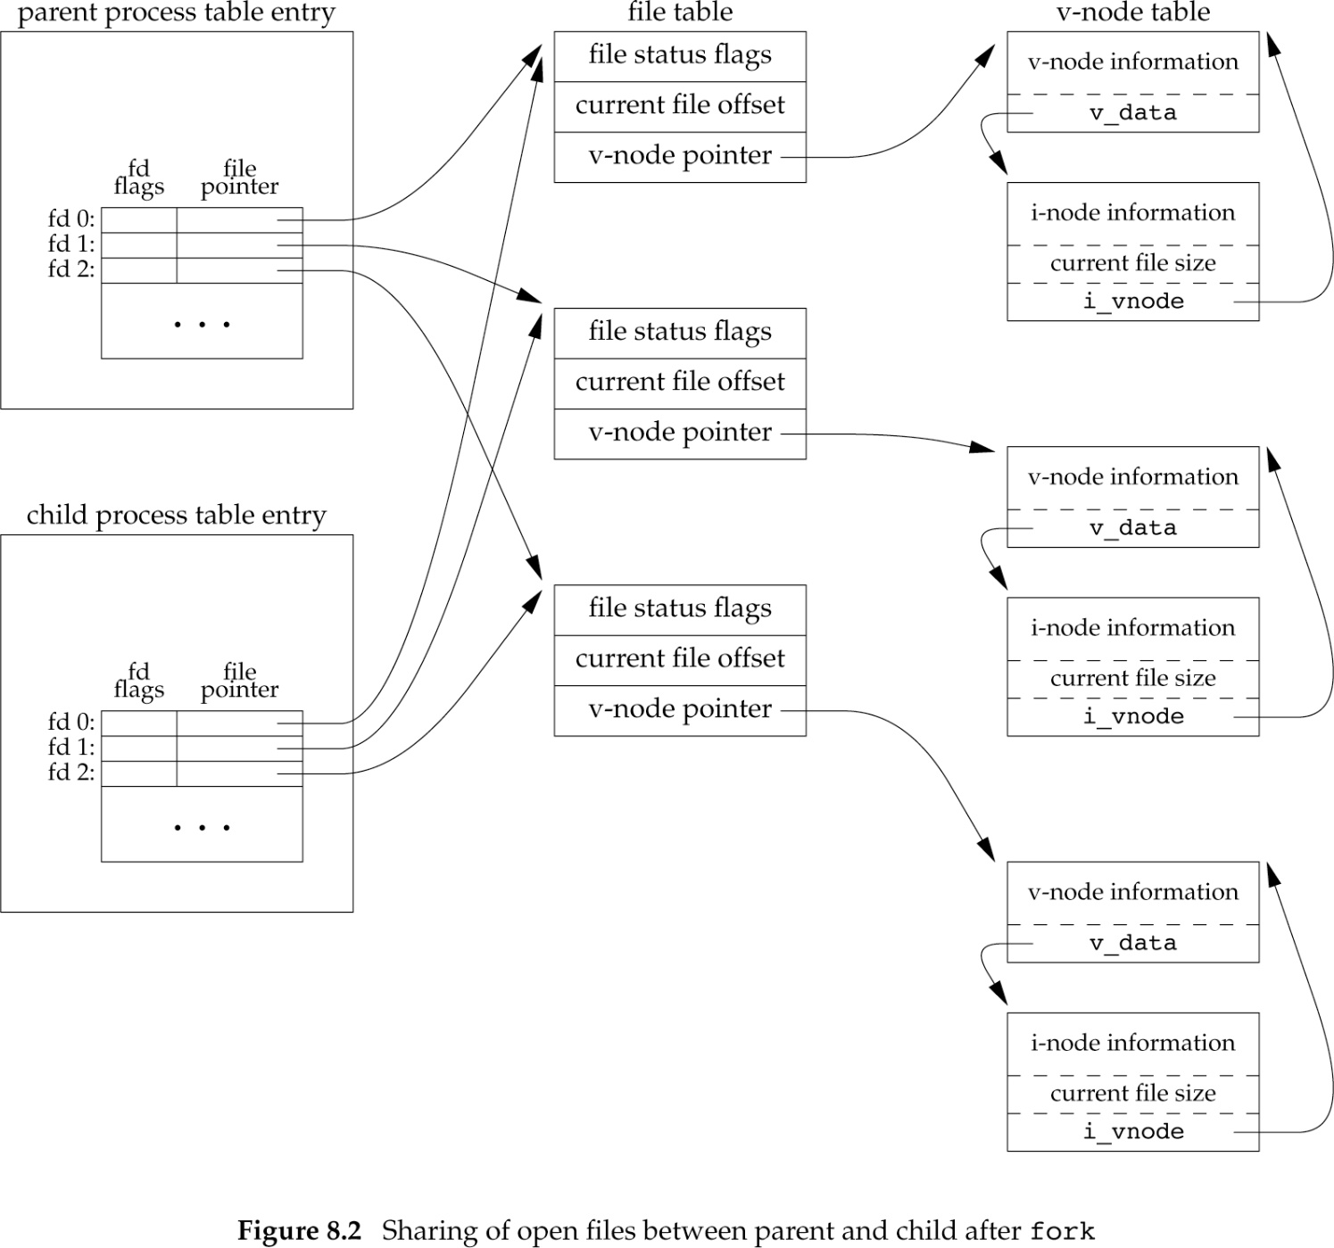
File Sharing between Parent and Child

Slide 13
Handle descriptors after fork
Parent waits for child to complete
File offsets updated by child
Parent and child go their own way
Parent closes unrequired file descriptors
Child closes unrequired file descriptors
(often found in network servers)

Slide 14
Fork
fork fails if:
too many processes in system
total #processes exceeded for a user (CHILD_MAX)
2 uses for fork
Duplicate of itself for executing different code sections, e.g. network servers
Execute a different program, e.g. shells

Slide 15
vfork Function (obsolete)
Creates a new process only to ‘exec’ a new program
No copy of parent’s address space for child (not needed!)
Before exec, child runs in “address space of parent”
Efficient in paged virtual memory
Child runs first
Parent waits until child ‘exec’ or ‘exit’

Slide 16
Figure 8.3: vfork()
#include “apue.h"
int globvar = 6; /* external variable in initialized data */
int main(void) {
int var; /* automatic variable on the stack */
pid_t pid;
var = 88;
printf("before vfork\n"); /* we don't flush stdio */
if ( (pid = vfork()) < 0)
err_sys("vfork error");
else if (pid == 0) { /* child */
globvar++; /* modify parent's variables */
var++;
_exit(0); /* child terminates */
}
/* parent */
printf("pid = %d, glob = %d, var = %d\n", (long)getpid(), globvar, var);
exit(0);
}

Slide 17
Figure 8.3: results
$ ./a.out
before vfork
pid = 29039, glob = 7, var = 89
(increments by child appear in parent address space)
Instead of _exit() → exit(), results in:
$ ./a.out
before vfork
stdio closed by child

Slide 18
Why exit() and _exit() are same for vfork and fork? Source: http://www.lslnet.com/linux/f/docs1/i22/big5202383.htm
law: 我看過Linux核了。vfork以後用戶空間的內存是和父進程共享的，但文件描述表卻是 和fork一樣重新複製一份給子進程的。所以子進程調用close不會影響父親進程。但 在用戶空間的一些操作比如fflush(stdout), fclose(stdout)卻會影響父進程。 ysqcn: 有道理, vfork比起fork來就是多了兩個標誌：CLONE_VFORK 和 CLONE_VM，它們都沒 有CLONE_FILES、CLONE_FS、CLONE_SIGHAND標誌，所以fork與vfork在文件表項、信號 處理等方面是一致的，但由於vfork有CLONE_VM標誌，所以它與父進程共享進程空間。 子進程通過內核文件表項的數據結構close(1)來關閉stdou並不影響父進程，但是通過 用戶空間的庫代碼fflush就不一樣了，此時父子是共享的。

Slide 19
exit Functions
A process can terminate in 8 ways:
Normal Termination (5 ways)
return from main
exit
_exit or _Exit
return from last thread in a process
calling pthread_exit from last thread in a process
Abnormal Termination (3 ways)
calling abort (SIGABRT signal) e.g. ÷0
process receives signals
last thread cancelled (deferred cancellation)

Slide 20
exit Function
exit status: argument of exit, _exit, _Exit
termination status:
normal: exit status
abnormal: kernel indicates reason
Child returns termination status to parent
What if parent terminates before child?

Slide 21
exit Function
Parent PID (of orphaned child) = 1 (init)
Suppose child terminates first
If child disappeared, parent would not be able to check child’s termination status
Zombie: minimal info of dead child process (pid, termination status, CPU time)
init’s inherited child processes do not become zombies (wait() fetches status)

Slide 22
Child Termination
Child terminates → Kernel sends SIGCHLD signal to parent
Default action for SIGCHLD signal: ignore it
Signal handlers can be defined by users
(Chapter 10)

Slide 23
wait(), waitpid()
block wait for any one child to terminate
#include <sys/wait.h>
pid_t wait(int *statloc);
pid_t waitpid( pid_t pid, int *statloc, int options);
Return: PID if OK, 0, -1 on error
depends on options
place for storing termination status
NULL→no need!

Slide 24
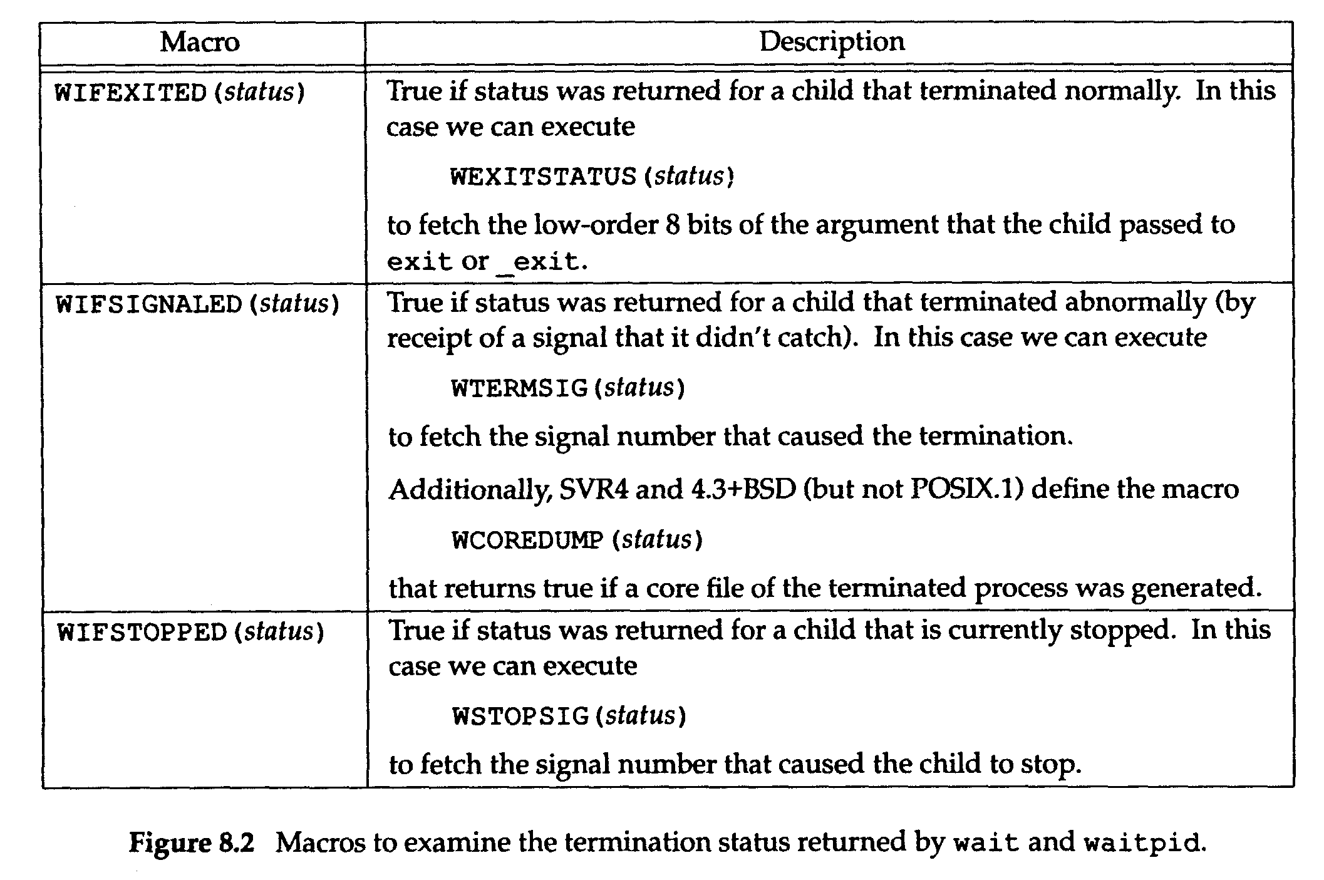
Termination Status Macros
WIFCONTINUED(status) True if status was returned for a child that has been continued after a job control stop (XSI extension to POSIX.1; waitpid only)

Slide 25
Figure 8.5: print exit status
#include <sys/wait.h>
#include “apue.h"
void pr_exit(int status)
{
if (WIFEXITED(status))
printf("normal termination, exit status = %d\n",
WEXITSTATUS(status));
else if (WIFSIGNALED(status))
printf("abnormal termination, signal number = %d%s\n",
WTERMSIG(status),
#ifdef WCOREDUMP
WCOREDUMP(status) ? " (core file generated)" : "");
#else
"");
#endif
else if (WIFSTOPPED(status))
printf("child stopped, signal number = %d\n",
WSTOPSIG(status));
}

Slide 26
Figure 8.6: demo exit status
#include <sys/wait.h>
#include “apue.h"
int main(void)
{
pid_t pid;
int status;
if ( (pid = fork()) < 0)
err_sys("fork error");
else if (pid == 0) /* child */
exit(7);
if (wait(&status) != pid) /* wait for child */
err_sys("wait error");
pr_exit(status); /* and print its status */

Slide 27
Program 8.4 (II Part)
if ( (pid = fork()) < 0)
err_sys("fork error");
else if (pid == 0) /* child */
abort(); /* generates SIGABRT */
if (wait(&status) != pid) /* wait for child */
err_sys("wait error");
pr_exit(status); /* and print its status */

Slide 28
Program 8.4 (III part)
if ( (pid = fork()) < 0)
err_sys("fork error");
else if (pid == 0) /* child */
status /= 0; /* divide by 0 generates SIGFPE */
if (wait(&status) != pid) /* wait for child */
err_sys("wait error");
pr_exit(status); /* and print its status */
exit(0);
}

Slide 29
Figure 8.6: results
$ ./a.out
normal termination, exit status = 7
abnormal termination, signal number = 6 (core file generated)
abnormal termination, signal number = 8 (core file generated)
SIGABRT
SIGFPE

Slide 30
pid argument of waitpid()
same as wait()
PID | Interpretation
== -1 | Wait for any child process
> 0 | Wait for child with PID
== 0 | Wait for child with GID==calling process GID
< -1 | Wait for child with |PID|

Slide 31
Avoiding zombie processes
A process forks a child
It does not wait for the child to complete
It does not want child to become zombie
How to do this?
Answer: fork twice! (Figure 8.8)

Slide 32
Figure 8.8: Avoid Zombie
#include <sys/wait.h>
#include “apue.h"
int
main(void)
{
pid_t pid;
if ( (pid = fork()) < 0)
err_sys("fork error");
else if (pid == 0) { /* first child */
if ( (pid = fork()) < 0)
err_sys("fork error");
else if (pid > 0) /* parent from second fork */
exit(0); /* == first child */
fork a 2nd time

Slide 33
Program 8.5: Avoid Zombie
/* We're the second child; our parent becomes init as soon as our real parent calls exit() in the statement above. Here's where we'd continue executing, knowing that when we're done, init will reap our status. */
sleep(2);
printf("second child, parent pid = %d\n", getppid());
exit(0);
}
if (waitpid(pid, NULL, 0) != pid)/* wait for first child */
err_sys("waitpid error");
/* We're the parent (the original process); we continue executing, knowing that we're not the parent of the second child. */
exit(0);
}
so that init becomes the new parent

Slide 34
Figure 8.8: results
$ ./a.out
$ second child, parent pid = 1

Slide 35
wait3 and wait4
#include <sys/types.h>
#include <sys/wait.h>
#include <sys/time.h>
#include <sys/resource.h>
pid_t wait3(int *statloc, int options, struct rusage *rusage);
pid_t wait4(pid_t pid, int *statloc, int options, struct rusage *rusage);
Return: PID if OK, 0 or -1 on error
resource information for terminated processes

Slide 36
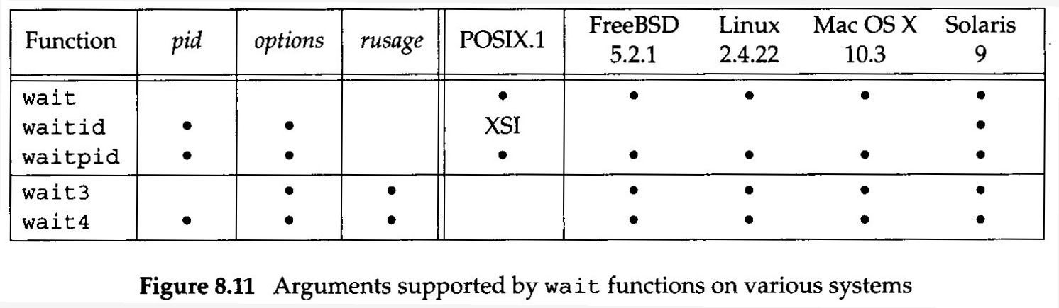
wait arguments support

Slide 37
Race Conditions
Multiple processes share some data
Outcome depends on the order of their execution (i.e. RACE)
After fork(), we cannot predict if the parent or the child runs first!
The order of execution depends on:
system load
kernel’s scheduling algorithm

Slide 38
Race Conditions
Race condition problems are hard to detect because they work “most of the time”!
For parent to wait for child
call wait, waitpid, wait3, wait4
For child to wait for parent
while (getppid() != 1) sleep(1);
polling! wastes CPU time!
use signals or other IPC methods

Slide 39
Race Conditions
After fork
parent and child both need to do something on its own
e.g. parent: write a record in a log file
e.g. child: creates a log file
Parent and child need to:
TELL each other when its initial set of operations are done, and
WAIT for each other to complete

Slide 40
TELL and WAIT
#include “apue.h”
TELL_WAIT(); /* setup for TELL_XXX and WAIT_XXX */
if ( (pid = fork()) < 0 )
err_sys(“fork error”);
else if (pid==0) { /* child */
/* child does whatever is necessary */
TELL_PARENT(getppid()); /* tell parent we’re done */
WAIT_PARENT(); /* & wait for parent */
/* and child continues on its way */
exit(0);
}
/* parent does whatever is necessary */
TELL_CHILD(pid); /*tell child we’re done */
WAIT_CHILD(); /* wait for child */
/* and parent continues on its way */
exit(0);
child
parent

Slide 41
Figure 8.12: Race Condition
#include “apue.h"
static void charatatime(char *);
int
main(void)
{
pid_t pid;
if ( (pid = fork()) < 0)
err_sys("fork error");
else if (pid == 0) {
charatatime("output from child\n");
} else {
charatatime("output from parent\n");
}
exit(0);
}

Slide 42
Figure 8.12 (continued)
static void
charatatime(char *str)
{
char *ptr;
int c;
setbuf(stdout, NULL); /* set unbuffered */
for (ptr = str; c = *ptr++; )
putc(c, stdout);
}

Slide 43
Figure 8.12: results
$ ./a.out
output from child
output from parent
$ ./a.out
oouuttppuutt ffrroomm pcahrielndt
$ ./a.out
ooutput from parent
utput from child

Slide 44
Figure 8.13: No race condition
#include “apue.h"
static void charatatime(char *);
int
main(void)
{
pid_t pid;
TELL_WAIT();
if ( (pid = fork()) < 0)
err_sys("fork error");
else if (pid == 0) {
WAIT_PARENT(); /* parent goes first */
charatatime("output from child\n");
} else {
charatatime("output from parent\n");
TELL_CHILD(pid);
}
exit(0);
}

Slide 45
Figure 8.13 (continued)
static void
charatatime(char *str)
{
char *ptr;
int c;
setbuf(stdout, NULL); /* set unbuffered */
for (ptr = str; c = *ptr++; )
putc(c, stdout);
}

Slide 46
exec Functions
#include <unistd.h>
int execl(const char *pathname, const char *arg0, … /* (char *)0 */);
int execv(const char *pathname, char *const argv[]);
int execle(const char *pathname, const char *arg0, … /* (char *)0, char *const envp[] */);
int execve(const char *pathname, char *const argv[], char *const envp[]);
int execlp(const char *filename, const char *arg0, … /* (char *)0 */);
int execvp(const char *filename, char *const argv[]);
All return -1 on error, no return on success.

Slide 47
Differences among exec functions
filename (execlp, execvp: uses PATH) v/s pathname (others: does not use PATH)
list (l) v/s vector (v)
list of arguments (execl, execle, execlp)
array of pointers to arguments (execv, execve, execvp)
pointer to an array of pointers to environment strings (execle, execve) v/s environ (others)

Slide 48
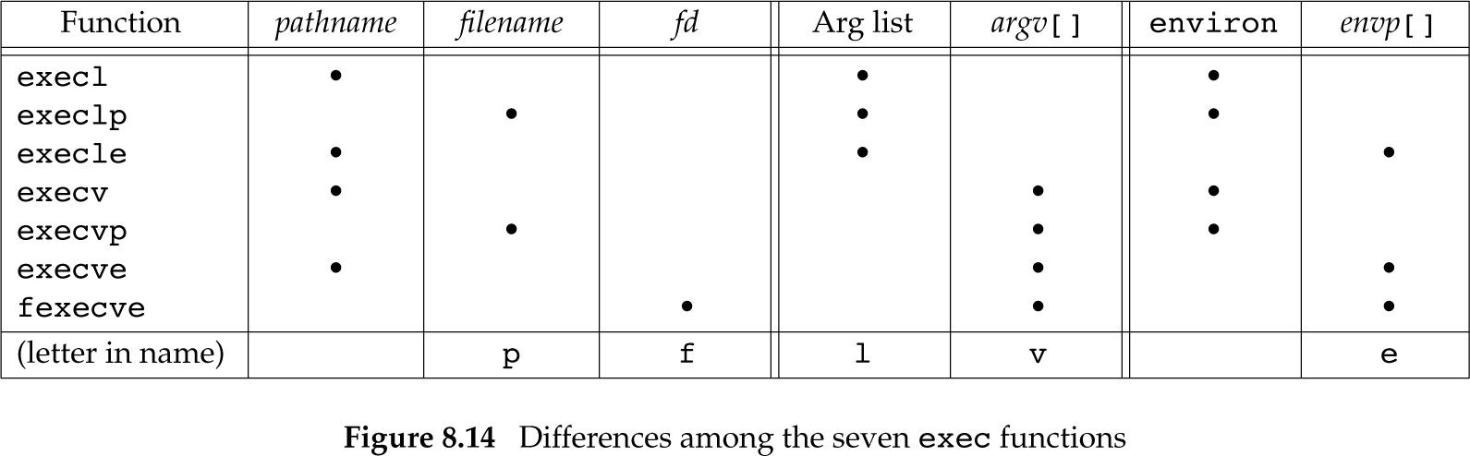
Differences among exec functions

Slide 49
Inheritance by child from parent
PID, Parent PID
Real UID, Real GID
Supplementary GIDs
Process GID
Session ID
Controlling Terminal
Time Left Until Alarm Clock
Current Working Directory

Slide 50
Inheritance by child from parent
Root Directory
File Mode Creation Mask
File Locks
Process Signal Mask
Pending Signals
Resource Limits
tms_utime, tms_stime, tms_cutime, tms_cstime values

Slide 51
Changes on exec()
FD_CLOEXEC flag for files
set ➔ close file descriptors on exec()
unset (default) ➔ open across exec()
FD_CLOEXEC flag for directories
closed across exec() (POSIX.1)
UIDs and GIDs
real ➔ same across exec()
effective ➔ may change (set-[U,G]ID)

Slide 52
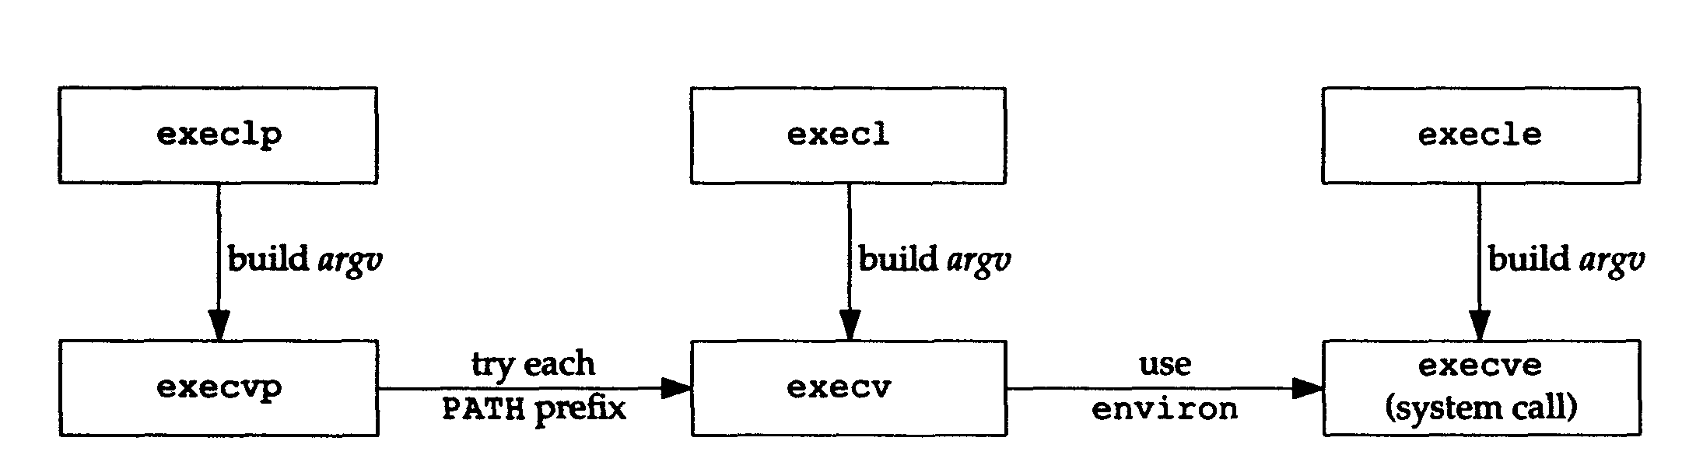
Relationship of 6 exec functions

Slide 53
Figure 8.16: exec functions
#include <sys/wait.h>
#include “apue.h"
char *env_init[] = { "USER=unknown", "PATH=/tmp", NULL };
int main(void) {
pid_t pid;
if ( (pid = fork()) < 0) err_sys("fork error");
else if (pid == 0) { /* specify pathname, specify environment */
if (execle("/home/sar/bin/echoall",
"echoall", "myarg1", "MY ARG2", (char *) 0, env_init) < 0)
err_sys("execle error");
}
if (waitpid(pid, NULL, 0) < 0)
err_sys("wait error");
if ( (pid = fork()) < 0)
err_sys("fork error");
else if (pid == 0) { /* specify filename, inherit environment */
if (execlp("echoall", "echoall", "only 1 arg", (char *) 0) < 0)
err_sys("execlp error"); }
exit(0); }

Slide 54
Figure 8.17: echoall
#include “apue.h"
int
main(int argc, char *argv[])
{
int i;
char **ptr;
extern char **environ;
for (i = 0; i < argc; i++) /* echo all command-line args */
printf("argv[%d]: %s\n", i, argv[i]);
for (ptr = environ; *ptr != 0; ptr++)/* and all env strings */
printf("%s\n", *ptr);
exit(0);
}

Slide 55
Figure 8.16: results
$ a.out
argv[0]: echoall
argv[1]: myarg1
argv[2]: MY ARG2
USER=unknown
PATH=/tmp
argv[0]: echoall
$ argv[1]: only 1 arg
USER=sar
LOGNAME=sar
SHELL=/bin/bash
… 47 more lines that aren’t shown
HOME=/home/sar

Slide 56
Changing UIDs and GIDs
#include <unistd.h>
int setuid(uid_t uid);
int setgid(gid_t gid);
Return: 0 if OK, -1 on error

Slide 57
Changing UIDs and GIDs
Rules:
Superuser ➔ real, effective, saved set-UID := uid
real, saved set-UID = uid ➔ effective := uid
errno := EPERM; return -1;

Slide 58
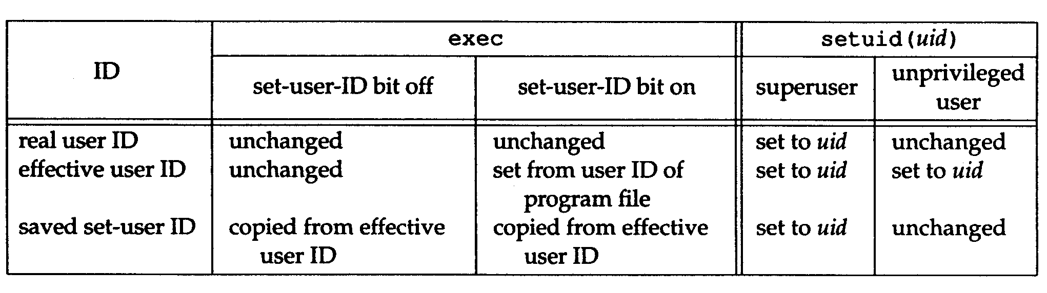
Changing 3 UIDs

Slide 59
What is “saved set-UID”?
Example: tip (Berkeley) or cu (System V)
tip: Program to remote connection through modem (exclusive access through lock files)
owned by uucp, set-UID bit is SET, on exec:
Real UID = our own UID
Effective UID = uucp
Saved set-UID = uucp
tip accesses lock files owned by uucp (allowed because e-UID == uucp)

Slide 60
What is “saved set-UID”?
tip executes setuid(getuid()), only e-UID is changed:
Real UID = our own UID (unchanged!)
Effective UID = our own UID
Saved set-UID = uucp (unchanged!)
tip runs with our own UID as effective UID, can access only our own normally accessed files. No additional permissions.

Slide 61
What is “saved set-UID”?
tip executes setuid(uucpuid), uucpuid was saved by calling geteuid() when tip started. This call is allowed because the saved set-UID == uucpuid! Thus, we have:
Real UID = our own UID (unchanged!)
Effective UID = uucp
Saved set-UID = uucp (unchanged!)
tip can now release lock files (because its effective UID == uucp!)

Slide 62
setreuid(), setregid()
#include <unistd.h>
int setreuid(uid_t ruid, uid_t euid);
int setregid(gid_t rgid, gid_t egid);
Return: 0 if OK, -1 on error
For swapping real ID ←→ effective ID
XSI extensions in the Single UNIX Specification (BSD supports it currently)

Slide 63
seteuid(), setegid()
#include <unistd.h>
int seteuid(uid_t uid);
int setegid(gid_t gid);
Return: 0 if OK, -1 on error
Only effective UID or GID is changed
Unpriviledged user:
EUID:=uid (== real UID or saved set-UID)
Priviledged user:
EUID:=uid (different from setuid: sets all 3 UIDs)

Slide 64
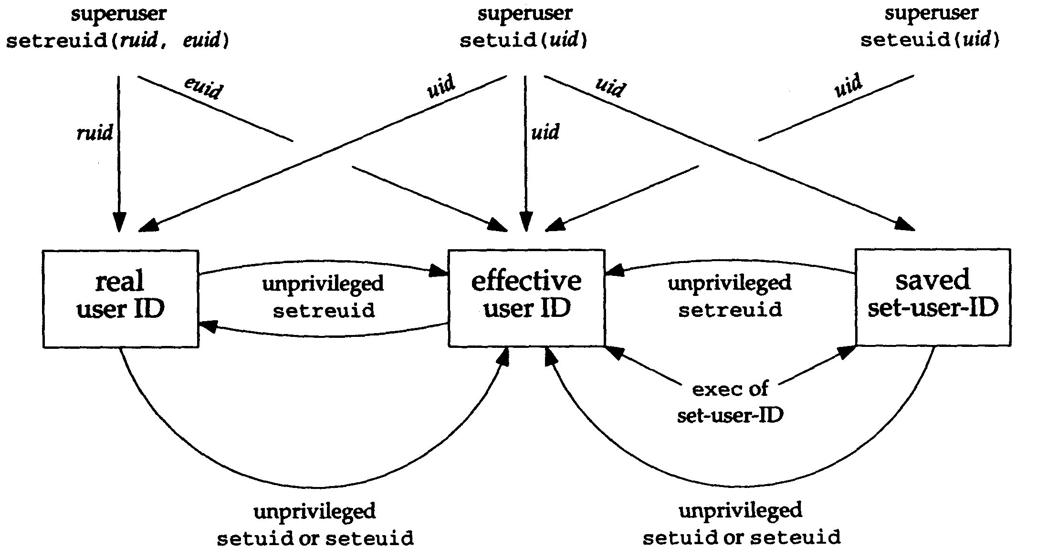
Summary of set ID functions

Slide 65
Interpreter Files
Interpreter (script) files that begin with:
#! pathname [optional-argument]
E.g.: #! /bin/sh
E.g.: #! /bin/csh
E.g.: #! /bin/awk –f
Allows users an easier and efficient way to execute some commands using scripts
Limit on 1st line of interpreter files
FreeBSD 8.0: 4,097 bytes,
Mac OS X 10.6.8: 513 bytes,
Linux 3.2.0: 128 bytes,
Solaris 10: 1024 bytes

Slide 66
Figure 8.20: exec an interpreter file
#include <sys/wait.h>
#include “apue.h"
int main(void) {
pid_t pid;
if ( (pid = fork()) < 0)
err_sys("fork error");
else if (pid == 0) { /* child */
if (execl("/home/sar/bin/testinterp",
"testinterp", "myarg1", "MY ARG2", (char *) 0) < 0)
err_sys("execl error");
}
if (waitpid(pid, NULL, 0) < 0) /* parent */
err_sys("waitpid error");
exit(0);
}

Slide 67
Figure 8.20: results
$ cat /home/sar/bin/testinterp
#! /home/sar/bin/echoarg foo
$ ./a.out
argv[0]: /home/sar/bin/echoarg
argv[1]: foo
argv[2]: /home/sar/bin/testinterp
argv[3]: myarg1
argv[4]: MY ARG2

Slide 68
Figure 8.21: awk interpreter file (/usr/local/bin/awkexample)
#!/bin/awk -f
BEGIN {
for (i = 0; i < ARGC; i++)
printf "ARGV[%d] = %s\n", i, ARGV[i]
exit
}

Slide 69
Figure 8.21: results
$ awkexample file1 FILENAME2 f3
ARGV[0]: /bin/awk
ARGV[1]: file1
ARGV[2]: FILENAME2
ARGV[3]: f3
Actually: /bin/awk –f /usr/local/bin/awkexample file1 FILENAME2 f3

Slide 70
system Function
#include <stdlib.h>
int system ( const char *cmdstring );
Return values:
-1 with errno set if fork or waitpid fails
127 as if shell exit(127) if exec fails
Termination status of shell if all 3 succeed

Slide 71
Figure 8.22: system
#include <sys/wait.h>
#include <errno.h>
#include <unistd.h>
int system(const char *cmdstring) /* version without signal handling */
{
pid_t pid;
int status;
if (cmdstring == NULL)
return(1); /* always a command processor with Unix */
if ( (pid = fork()) < 0) {
status = -1; /* probably out of processes */
}

Slide 72
Program 8.12: system
no need of breaking up cmdstring
else if (pid == 0) { /* child */
execl("/bin/sh", "sh", "-c", cmdstring, (char *) 0);
_exit(127); /* execl error */
} else { /* parent */
while (waitpid(pid, &status, 0) < 0)
if (errno != EINTR) {
status = -1; /* error other than EINTR */
break;
}
}
return(status);
}
to prevent child flushing buffer

Slide 73
Figure 8.23: calling system
#include <sys/wait.h>
#include “apue.h"
int main(void) {
int status;
if ( (status = system("date")) < 0)
err_sys("system() error");
pr_exit(status);
if ( (status = system("nosuchcommand")) < 0)
err_sys("system() error");
pr_exit(status);
if ( (status = system("who; exit 44")) < 0)
err_sys("system() error");
pr_exit(status);
exit(0);
}

Slide 74
Figure 8.23: results
$ ./a.out
Sun Mar 21 18:41:32 EST 2004
normal termination, exit status = 0 for date
sh: nosuchcommand: not found
normal termination, exit status = 127 for nosuchcommand
sar :0 Mar 18 19:45
sar pts/0 Mar 18 19:45 (:0)
sar pts/1 Mar 18 19:45 (:0)
sar pts/2 Mar 18 19:45 (:0)
normal termination, exit status = 44 for exit

Slide 75
Set User-ID Programs
What happens if we call system from a set-user-ID program?
A security hole!
Should never be done!

Slide 76
Figure 8.24: system from cmd
Compile into program tsys
#include “apue.h"
int
main(int argc, char *argv[])
{
int status;
if (argc < 2)
err_quit("command-line argument required");
if ( (status = system(argv[1])) < 0)
err_sys("system() error");
pr_exit(status);
exit(0);
}

Slide 77
Figure 8.25: print UIDs
Compile into program printuids
#include “apue.h"
int
main(void)
{
printf("real uid = %d, effective uid = %d\n", getuid(), geteuid());
exit(0);
}

Slide 78
Figures 8.24, 8.25: results
$ tsys printuids
real uid = 224, effective uid = 224
normal termination, exit status = 0
$ su
Password:
# chown root tsys
# chmod u+s tsys
# ls –l tsys
-rwsrwxr-x 1 root 16361 Mar 16 16:59 tsys
# exit
$ tsys printuids
real uid = 224, effective uid = 0 oops, this is a security hole
normal termination, exit status = 0
make tsys set-user-ID

Slide 79
User Identification
#include <unistd.h>
char *getlogin(void);
Returns: pointer to string giving login name if OK, NULL on error
Used when a user has more than one login name
User with getpwnam() to get the user information from passwd file.

Slide 80
Process Times
#include <sys/times.h>
clock_t times(struct tms *buf);
Returns: elapsed wall clock time in clock ticks if OK, -1 on error
struct tms {
clock_t tms_utime; /* user CPU time */
clock_t tms_stime; /* system CPU time */
clock_t tms_cutime; /* user time, term’d children */
clock_t tms_cstime; /* system time, term’d children*/
};

Slide 81
Figure 8.30 (main())
#include <sys/times.h>
#include “apue.h"
static void pr_times(clock_t, struct tms *, struct tms *);
static void do_cmd(char *);
int main(int argc, char *argv[]) {
int i;
setbuf(stdout, NULL);
for (i = 1; i < argc; i++)
do_cmd(argv[i]); /*once each command-line arg */
exit(0);
}

Slide 82
Figure 8.30 (do_cmd())
static void
do_cmd(char *cmd) /*execute and time the "cmd" */
{
struct tms tmsstart, tmsend;
clock_t start, end;
int status;
fprintf(stderr, "\ncommand: %s\n", cmd);
if ( (start = times(&tmsstart)) == -1) /* starting values */
err_sys("times error");
if ( (status = system(cmd)) < 0) /* execute command */
err_sys("system() error");
if ( (end = times(&tmsend)) == -1) /* ending values */
err_sys("times error");
pr_times(end-start, &tmsstart, &tmsend);
pr_exit(status);
}

Slide 83
Figure 8.30 (pr_times())
static void pr_times(clock_t real, struct tms *tmsstart, struct tms *tmsend)
{
static long clktck = 0;
if (clktck == 0) /* fetch clock ticks per second first time */
if ( (clktck = sysconf(_SC_CLK_TCK)) < 0)
err_sys("sysconf error");
fprintf(stderr, " real: %7.2f\n", real / (double) clktck);
fprintf(stderr, " user: %7.2f\n",
(tmsend->tms_utime - tmsstart->tms_utime) / (double) clktck);
fprintf(stderr, " sys: %7.2f\n",
(tmsend->tms_stime - tmsstart->tms_stime) / (double) clktck);
fprintf(stderr, " child user: %7.2f\n",
(tmsend->tms_cutime - tmsstart->tms_cutime) / (double) clktck);
fprintf(stderr, " child sys: %7.2f\n",
(tmsend->tms_cstime - tmsstart->tms_cstime) / (double) clktck);
}

Slide 84
Figure 8.30: results
$ ./a.out “sleep 5” “date”
command: sleep 5
real: 5.02
user: 0.00
sys: 0.00
child user: 0.01
child sys: 0.00
normal termination, exit status = 0
command: date
Mon Mar 22 00:43:58 EST 2004
real: 0.01
user: 0.00
sys: 0.00
child user: 0.01
child sys: 0.00
normal termination, exit status = 0

