Slide 1
CHAPTER 10
Efficient Binary Search Trees
All the programs in this file are selected from
Ellis Horowitz, Sartaj Sahni, and Susan Anderson-Freed
“Fundamentals of Data Structures in C”,

Slide 2
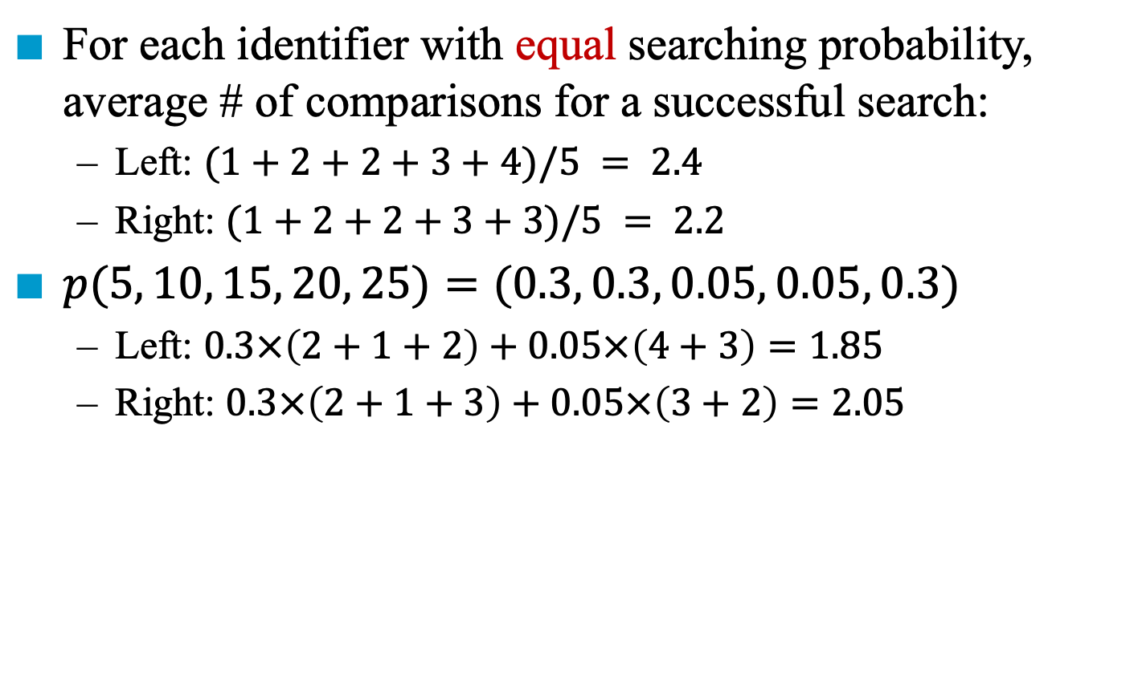
Two Binary Search Trees (BST)
For each identifier with equal searching probability, average # of comparisons for a successful search:
Left: $(1+2+2+3+4)/5 = 2.4$
Right: $(1+2+2+3+3)/5 = 2.2$
$p(5, 10, 15, 20, 25)=(0.3, 0.3, 0.05, 0.05, 0.3)$
Left: $0.3×\left(2+1+2\right)+0.05×\left(4+3\right)=1.85$
Right: $0.3×\left(2+1+3\right)+0.05×\left(3+2\right)=2.05$
10
1
10
1
2
2
2
2
5
25
5
20
3
3
3
20
15
25
4
15

Slide 3
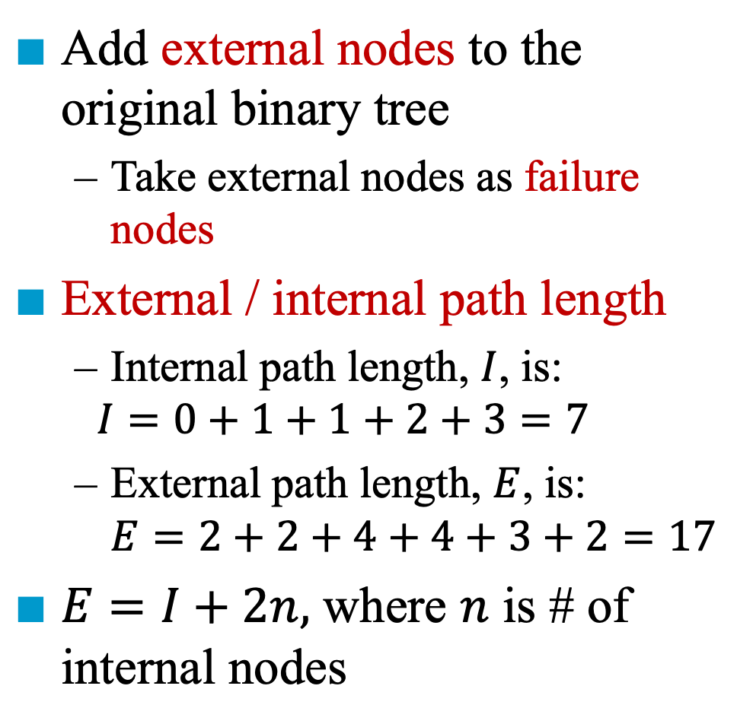
Extended Binary Trees
The length from the root
Add external nodes to the original binary tree
Take external nodes as failure nodes
External / internal path length
Internal path length, $I$, is:
$$I=0+1+1+2+3=7$$
External path length, $E$, is: $E=2+2+4+4+3+2=17$
$E=I+2n,$ where $n$ is # of internal nodes
0
10
1
1
5
25
2
2
2
2
20
3
3
15
4
4

Slide 4
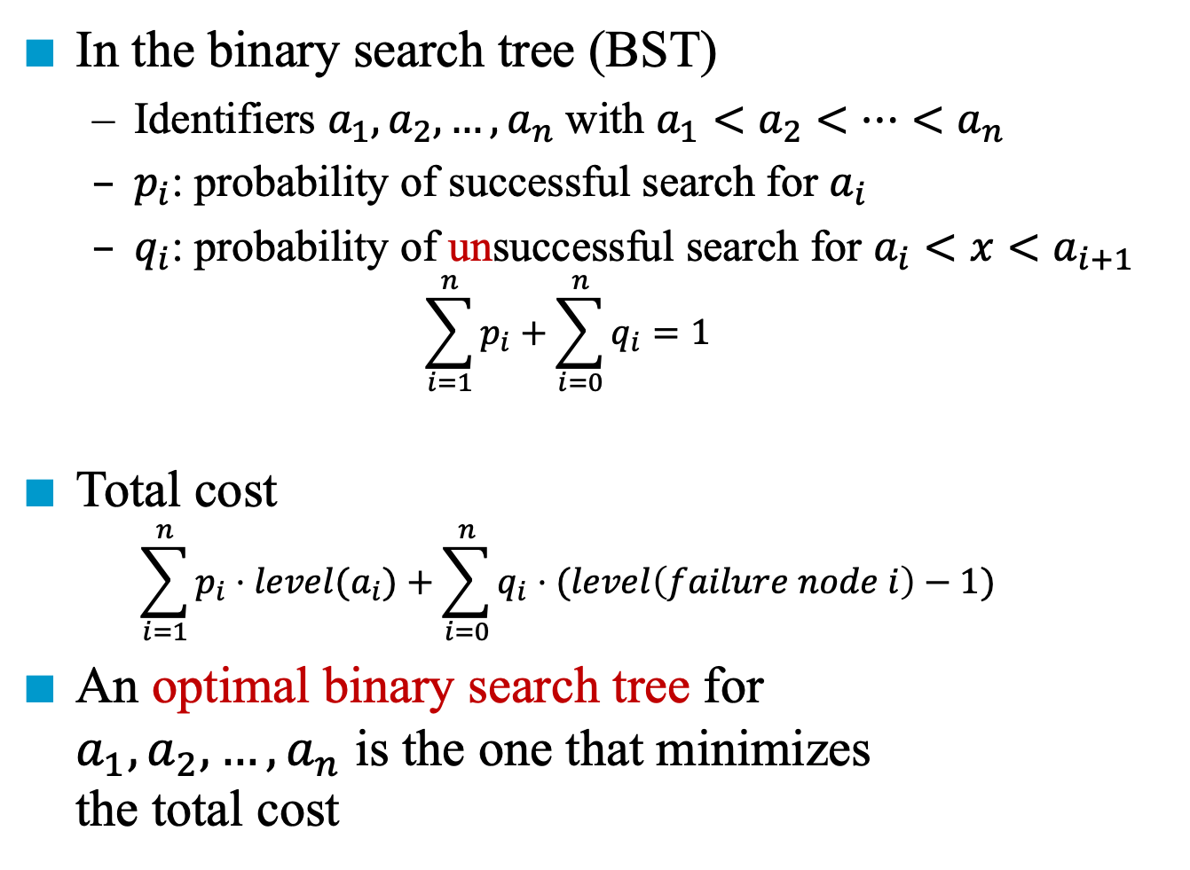
Search Cost in a BST
In the binary search tree (BST)
Identifiers $a_{1}, a_{2},…,a_{n}$ with $a_{1}<a_{2}<…<a_{n}$
$p_{i}$: probability of successful search for $a_{i}$
$q_{i}$: probability of unsuccessful search for $a_{i}<x<a_{i+1}$
$$\sum_{i=1}^{n}{p_{i}}+\sum_{i=0}^{n}{q_{i}}=1$$
Total cost
$$\sum_{i=1}^{n}{p_{i}⋅level(a_{i})}+\sum_{i=0}^{n}{q_{i}⋅(level\left(failure node i\right)−1)}$$
An optimal binary search tree for $a_{1}, a_{2},…,a_{n}$ is the one that minimizes the total cost
1
10
2
2
5
25
3
3
3
3
20
4
4
15
5
5

Slide 5









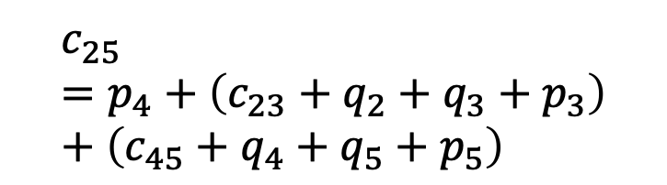

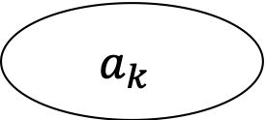


Algorithm for Constructing Optimal BST (1)
Solved by dynamic programming
$T_{ij}$: an optimal binary search tree for $a_{i+1}, …, a_{j}$, $i<j$
$T_{ii}$ is an empty tree for $0≤i<n$
$c_{ij}$: cost of $T_{ij}$, where $c_{ii}=0$
$r_{ij}$: root of $T_{ij}$
$w_{ij}$: weight of $T_{ij}$
$w_{ij}=q_{i}+\sum_{k=i+1}^{j}{(q_{k}+p_{k})}$
Goal: find $T_{0n}$ (i.e., optimal binary search tree for $a_{1}, …, a_{n}$)
Cost: $c_{0n}$ weight: $w_{0n}$ root: $r_{0n}$
$$a_{k}$$
$$T_{23}$$
1
$$a_{3}$$
$$T_{25}$$
1
2
2
$$a_{4}$$
$$L$$
$$R$$
2
2
$$a_{k+1},…,a_{j}$$
$$a_{3}$$
$$a_{5}$$
$$a_{i+1},…,a_{k−1}$$
$$c_{23}=q_{2}+q_{3}+p_{3}=w_{23}$$
3
3
3
3
$$c_{25}=p_{4}+\left(c_{23}+q_{2}+q_{3}+p_{3}\right)+\left(c_{45}+q_{4}+q_{5}+p_{5}\right)$$

Slide 6


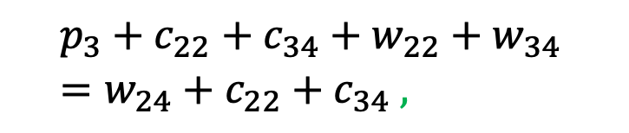


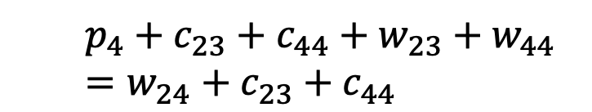



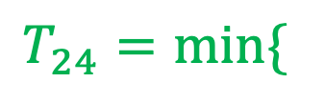
Algorithm for Constructing Optimal BST (1)
$$T_{24}=min⁡\{$$
$$p_{3}+c_{22}+c_{34}+w_{22}+w_{34} \\ =w_{24}+c_{22}+c_{34} ,$$
$$T_{23}$$
1
1
$$a_{3}$$
$$a_{3}$$
2
2
2
2
$$a_{4}$$
$$a_{k}$$
3
3
$$c_{23}=q_{2}+q_{3}+p_{3}=w_{23}$$
$$p_{4}+c_{23}+c_{44}+w_{23}+w_{44}=w_{24}+c_{23}+c_{44}$$
$$L$$
$$R$$
$$T_{34}$$
1
$$\}$$
1
$$a_{i+1},…,a_{k−1}$$
$$a_{k+1},…,a_{j}$$
$$a_{4}$$
$$a_{4}$$
2
2
2
2
$$a_{3}$$
$$c_{34}=q_{3}+q_{4}+p_{4}=w_{34}$$
3
3

Slide 7


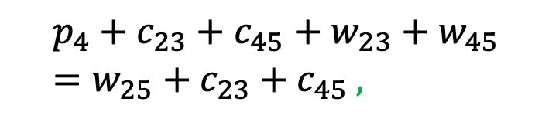


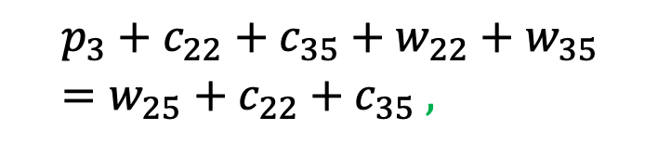



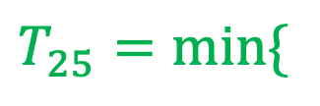

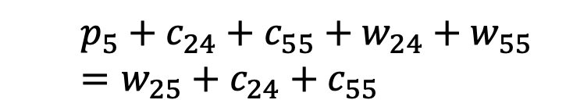
Algorithm for Constructing Optimal BST (1)
$$T_{25}=min⁡\{$$
$$p_{4}+c_{23}+c_{45}+w_{23}+w_{45} \\ =w_{25}+c_{23}+c_{45} ,$$
1
$$a_{3}$$
2
2
1
$$a_{4}$$
$$a_{k}$$
2
2
$$a_{3}$$
$$a_{5}$$
$$a_{4}$$
$$a_{5}$$
3
3
3
3
1
$$L$$
$$R$$
$$p_{3}+c_{22}+c_{35}+w_{22}+w_{35} \\ =w_{25}+c_{22}+c_{35} ,$$
$$a_{5}$$
$$a_{i+1},…,a_{k−1}$$
$$a_{k+1},…,a_{j}$$
2
2
$$p_{5}+c_{24}+c_{55}+w_{24}+w_{55}=w_{25}+c_{24}+c_{55}$$
$$\}$$
$$a_{4}$$
$$a_{3}$$

Slide 8

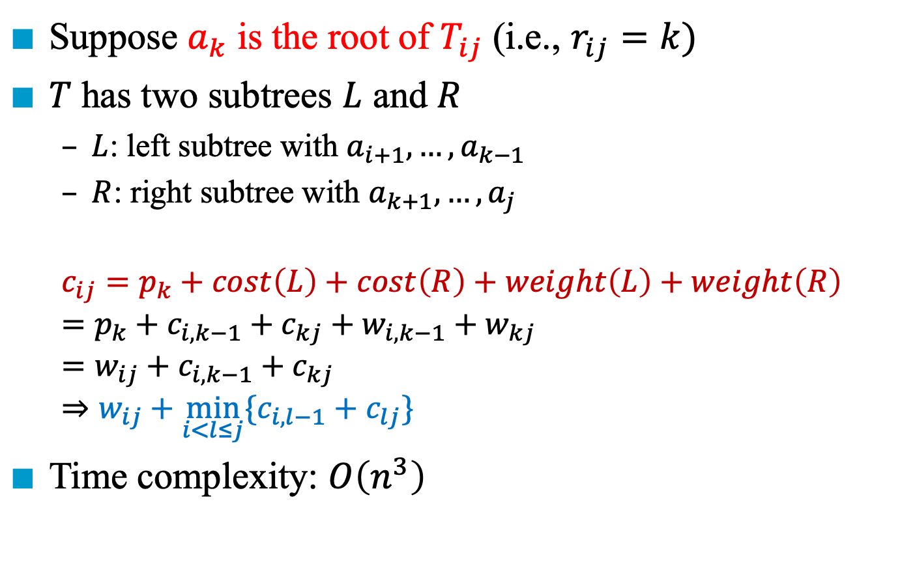




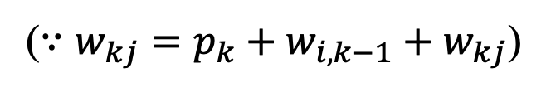
Algorithm for Constructing Optimal BST (2)
Suppose $a_{k}$ is the root of $T_{ij}$ (i.e., $r_{ij}=k)$
$T$ has two subtrees $L$ and $R$
$L$: left subtree with $a_{i+1},…, a_{k−1}$
$R$: right subtree with $a_{k+1},…, a_{j}$
$$c_{ij}=p_{k}+cost\left(L\right)+cost\left(R\right)+weight\left(L\right)+weight\left(R\right) \\ =p_{k}+c_{i, k−1}+c_{kj}+w_{i,k−1}+w_{kj} \\ =w_{ij}+c_{i,k−1}+c_{kj} \\ ⇒w_{ij}+\min_{i<l≤j}{\{c_{i,l−1}+c_{lj}\}}$$
Time complexity: $O\left(n^{3}\right)$
($∵w_{kj}=p_{k}+w_{i,k−1}+w_{kj}$)
$$a_{k}$$
$$L$$
$$R$$
$$a_{i+1},…,a_{k−1}$$
$$a_{k+1},…,a_{j}$$

Slide 9
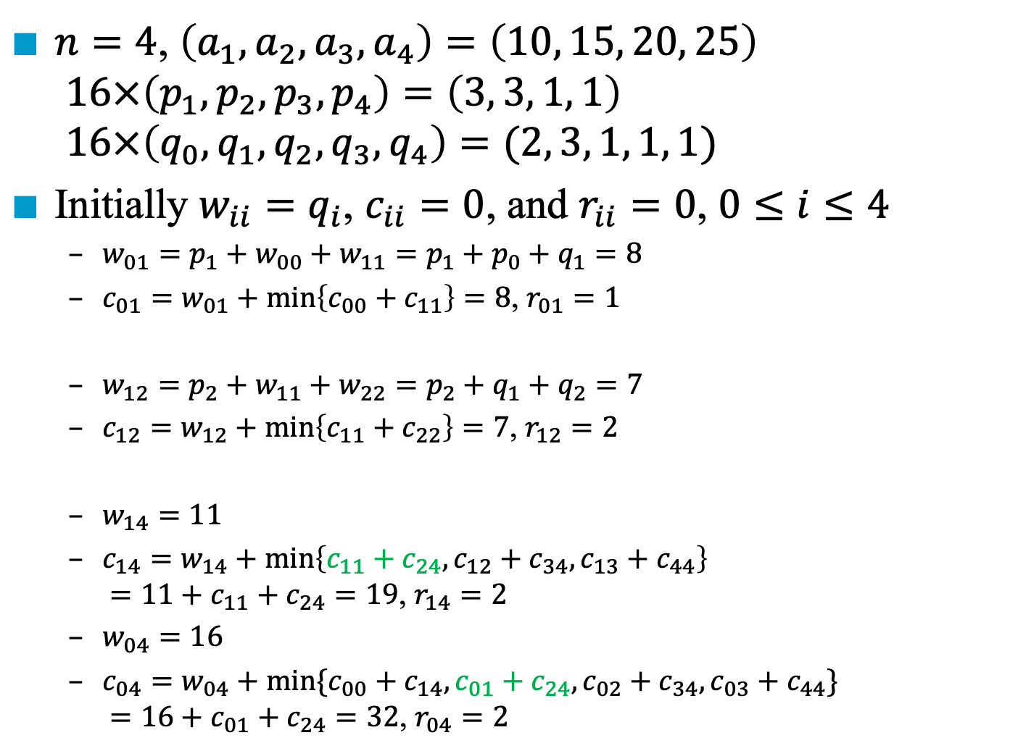
Example for Constructing Optimal BST (1)
$n=4$, $\left(a_{1},a_{2},a_{3},a_{4}\right)=\left(10, 15, 20, 25\right)$ $16×\left(p_{1},p_{2},p_{3}, p_{4}\right)=\left(3, 3, 1, 1\right)$ $16×\left(q_{0},q_{1}, q_{2}, q_{3}, q_{4}\right)=(2, 3, 1, 1, 1)$
Initially $w_{ii}=q_{i}$, $c_{ii}=0$, and $r_{ii}=0$, $0≤i≤4$
$w_{01}=p_{1}+w_{00}+w_{11}=p_{1}+p_{0}+q_{1}=8$
$c_{01}=w_{01}+\min\left\{c_{00}+c_{11}\right\}=8$, $r_{01}=1$
$w_{12}=p_{2}+w_{11}+w_{22}=p_{2}+q_{1}+q_{2}=7$
$c_{12}=w_{12}+\min\left\{c_{11}+c_{22}\right\}=7$, $r_{12}=2$
$w_{14}=11$
$c_{14}=w_{14}+\min\left\{c_{11}+c_{24},c_{12}+c_{34},c_{13}+c_{44}\right\}$ $=11+c_{11}+c_{24}=19$, $r_{14}=2$
$w_{04}=16$
$c_{04}=w_{04}+\min{\{c_{00}+c_{14},c_{01}+c_{24}, c_{02}+c_{34},c_{03}+c_{44}\}}$ $=16+c_{01}+c_{24}=32$, $r_{04}=2$
// root = 1
// root = 2
// root = 2, 3, or 4
// root = 1, 2, 3, or 4

Slide 10



Example for Constructing Optimal BST (2)
$w_{ii}=q_{i}$
$w_{ij}=p_{k}+w_{i,k−1}+w_{kj}$
$c_{ij}=w_{ij}+\min_{i<l≤j}\left\{c_{i,l−1}+c_{lj}\right\}$
$c_{ii}=0$
$r_{ii}=0$
$r_{ij}=l$
$$\left(a_{1},a_{2},a_{3},a_{4}\right)=\left(10, 15, 20, 25\right)$$
$$\left(p_{1},p_{2},p_{3},p_{4}\right)=\left(3, 3, 1, 1\right)$$
$$\left(q_{0},q_{1},q_{2},q_{3},q_{4}\right)=\left(2, 3, 1, 1, 1\right)$$
$$w_{00}=2$$ $$c_{00}=0$$ $$r_{00}=0$$ | $$w_{11}=3$$ $$c_{11}=0$$ $$r_{11}=0$$ | $$w_{22}=1$$ $$c_{22}=0$$ $$r_{22}=0$$ | $$w_{33}=1$$ $$c_{33}=0$$ $$r_{33}=0$$ | $$w_{44}=1$$ $$c_{44}=0$$ $$r_{44}=0$$
$$w_{01}=8$$ $$c_{01}=8$$ $$r_{01}=1$$ | $$w_{12}=7$$ $$c_{12}=7$$ $$r_{12}=2$$ | $$w_{23}=3$$ $$c_{23}=3$$ $$r_{23}=3$$ | $$w_{34}=3$$ $$c_{34}=3$$ $$r_{34}=4$$
$$w_{02}=12$$ $$c_{02}=19$$ $$r_{02}=1$$ | $$w_{13}=9$$ $$c_{13}=12$$ $$r_{13}=2$$ | $$w_{24}=5$$ $$c_{24}=8$$ $$r_{24}=3$$
$$w_{03}=14$$ $$c_{03}=25$$ $$r_{03}=2$$ | $$w_{14}=11$$ $$c_{14}=19$$ $$r_{14}=2$$
$$w_{04}=16$$ $$c_{04}=32$$ $$r_{04}=2$$
1
15
2
2
10
20
3
25
The optimal binary search tree

Slide 12
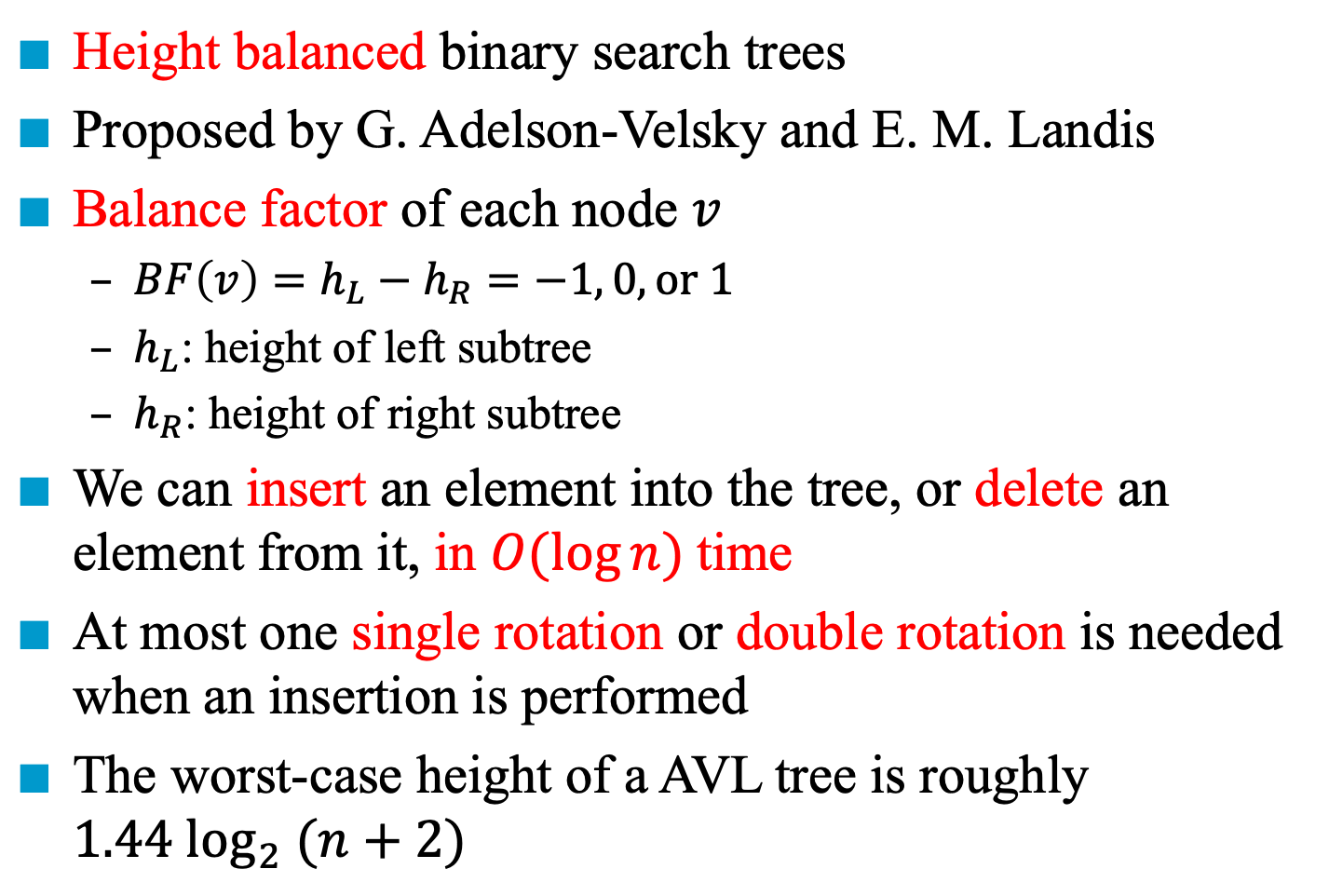
AVL Trees
Height balanced binary search trees
Proposed by G. Adelson-Velsky and E. M. Landis
Balance factor of each node $v$
$BF\left(v\right)=h_{L}−h_{R}=−1, 0, or 1$
$h_{L}$: height of left subtree
$h_{R}$: height of right subtree
We can insert an element into the tree, or delete an element from it, in $O(log⁡n)$time
At most one single rotation or double rotation is needed when an insertion is performed
The worst-case height of a AVL tree is roughly $1.44 \log_{2} (n+2)$

Slide 13
Example
Is this tree a AVL tree?
JAN
FEB
MAR
APR
JUNE
MAY
AUG
JULY
SEPT
DEC
OCT
NOV

Slide 14
Example
Is this tree a AVL tree?
JAN
-2
FEB
3
MAR
-2
-3
APR
JUNE
MAY
2
AUG
JULY
SEPT
DEC
OCT
NOV

Slide 15
Example
Is this tree a AVL tree?
JAN
DEC
MAR
AUG
FEB
JULY
NOV
APR
JUNE
MAY
OCT
SEPT

Slide 16
Example
Is this tree a AVL tree?
-1
JAN
1
-1
DEC
MAR
1
0
-1
-1
AUG
FEB
JULY
NOV
0
0
0
-1
APR
JUNE
MAY
OCT
0
SEPT

Slide 17
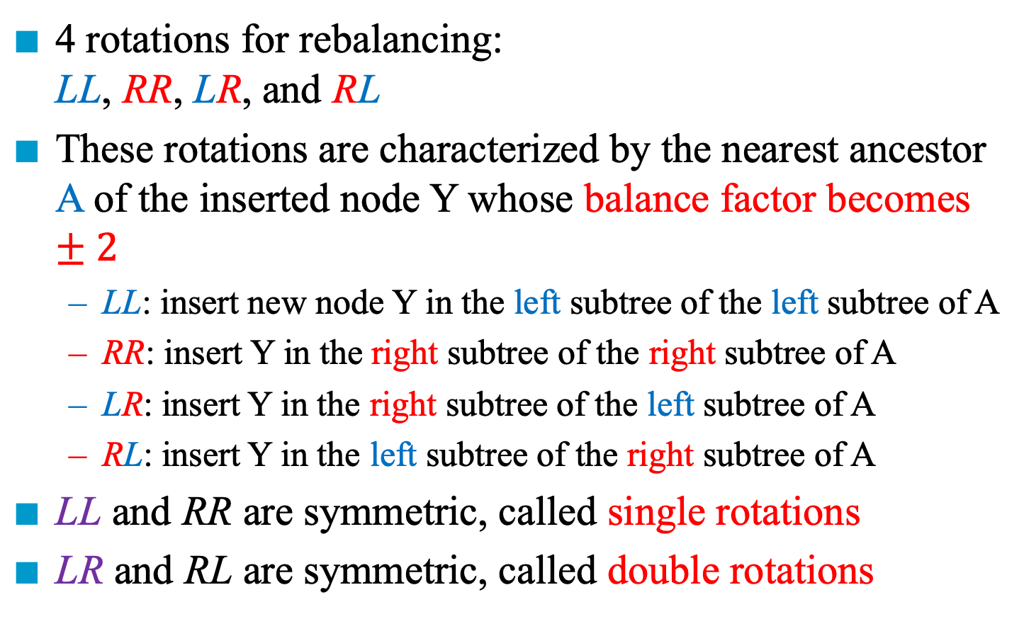
Four Kinds of Rotations in an AVL Tree
4 rotations for rebalancing: LL, RR, LR, and RL
These rotations are characterized by the nearest ancestor A of the inserted node Y whose balance factor becomes $±2$
LL: insert new node Y in the left subtree of the left subtree of A
RR: insert Y in the right subtree of the right subtree of A
LR: insert Y in the right subtree of the left subtree of A
RL: insert Y in the left subtree of the right subtree of A
LL and RR are symmetric, called single rotations
LR and RL are symmetric, called double rotations

Slide 18
LL Rebalancing Rotation
1
2
LL
0
A
A
B
0
1
0
B
A_{R}
h
B
A_{R}
h
A
h+2
B_{L}
h+1
h+2
B_{L}
h
B_{R}
h
B_{L}
h+1
B_{R}
h
B_{R}
h
A_{R}
h
Height of B_{L} increases to h+1, right rotation
2
1
MAY
LL
MAY
2
0
0
0
MAR
NOV
AUG
NOV
1
0
0
0
AUG
APR
MAR
APR
Notes:
記得特別強調 in-order traversal 會保持不變
並且點出更上面的 sub-tree root 不需要旋轉，因為對他來說 修改前是 h+2，修改後仍然是 h+2 沒變
強調一下 LL 是 node A 的左邊的左邊，而且修正的方法是 right rotation 向右旋轉

Slide 19
RR Rebalancing Rotation
RR
-1
-2
0
A
A
B
0
-1
0
B
A_{L}
h
B
A_{L}
h
A
h+2
B_{R}
h+1
h+2
B_{R}
h
B_{L}
h
B_{R}
h+1
B_{L}
h
B_{L}
h
A_{L}
h
Height of B_{R} increases to h+1, left rotation
-1
RR
-1
JAN
-1
1
JAN
0
1
1
DEC
0
-1
MAR
-2
1
DEC
0
-1
MAR
0
AUG
FEB
JULY
MAY
-1
0
AUG
FEB
JULY
NOV
0
0
0
AUG
0
JUNE
NOV
AUG
0
JUNE
MAY
OCT
0
OCT

Slide 20
LR Rebalancing Rotation
1
2
LR
0
A
A
C
0
-1
0
-1
B
A_{R}
h
B
A_{R}
h
B
A
0
h+2
1
h+2
B_{L}
h
C
B_{L}
h
C
B_{L}
h
A_{R}
h
C_{L}
h
C_{R}
h-1
C_{L}
h-1
C_{R}
h-1
C_{L}
h
C_{R}
h-1
LR needs double rotations:
Perform left rotation on the tree rooted at B
Perform right rotation on the tree rooted at A
Notes:
把旋轉過程的圖寫在黑板上

Slide 21
Example of LR
2
0
MAY
LR
MAR
-1
0
0
-1
AUG
NOV
AUG
MAY
0
1
0
0
0
APR
MAR
APR
JAN
NOV
0
JAN
Insert JAN

Slide 22
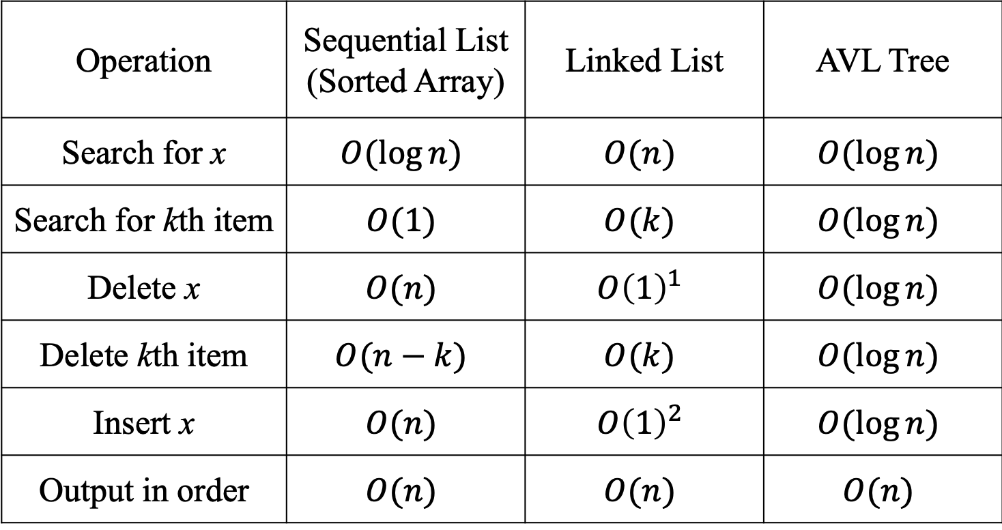
Complexity Comparison of Various Structures
Operation | Sequential List (Sorted Array) | Linked List | AVL Tree
Search for x | $$O(\log{n})$$ | $$O(n)$$ | $$O(\log{n})$$
Search for kth item | $$O(1)$$ | $$O(k)$$ | $$O(\log{n})$$
Delete x | $$O(n)$$ | $$O{\left(1\right)}^{1}$$ | $$O(\log{n})$$
Delete kth item | $$O(n−k)$$ | $$O(k)$$ | $$O(\log{n})$$
Insert x | $$O(n)$$ | $$O{\left(1\right)}^{2}$$ | $$O(\log{n})$$
Output in order | $$O(n)$$ | $$O(n)$$ | $$O(n)$$
1. Doubly linked list and position of x known
2. Position for insertion known

Slide 24
Red-Black Trees
A red-black tree is an extended binary search tree
Each node/pointer (edge) is colored by red or black
Colored node definition
Equivalent colored edges definition
6
4
9
2
5
8
11
Internal nodes
1
3
7
10
External nodes

Slide 25
Colored Node Definition
Colored node definition:
RB1: the root and all external nodes are black
RB2: no root-to-external-node path has two consecutive red nodes
RB3: all root-to-external-node paths have the same number of black nodes
65
50
80
10
60
70
5
62
Notes:
注意紅色不會比黑色多

Slide 26
Colored Pointer (Edge) Definition
Equivalent colored pointer (edge) definition:
RB1’: pointers to an external node are black
RB2’: no root-to-external-node path has two consecutive red pointers (edges)
RB3’: all root-to-external-node paths have the same number of black pointers
65
50
80
10
60
70
5
62

Slide 27
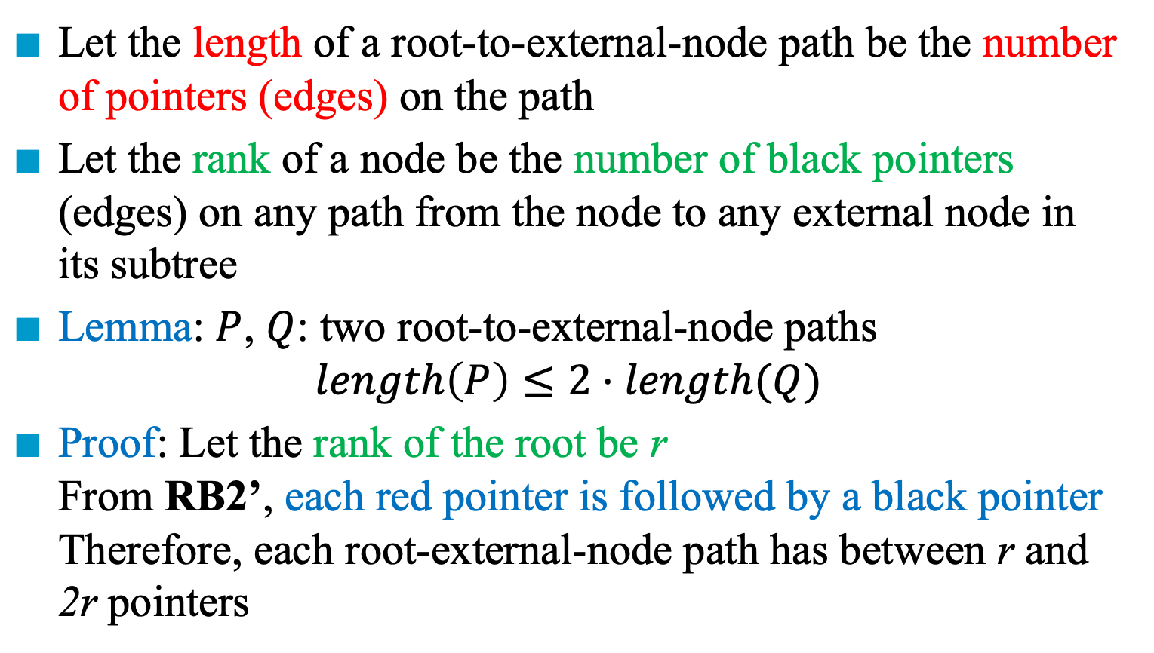
Length and Rank in a Red-Black Tree
Let the length of a root-to-external-node path be the number of pointers (edges) on the path
Let the rank of a node be the number of black pointers (edges) on any path from the node to any external node in its subtree
Lemma: $P$, $Q$: two root-to-external-node paths $length\left(P\right)≤2⋅length(Q)$
Proof: Let the rank of the root be r From RB2’, each red pointer is followed by a black pointer Therefore, each root-external-node path has between r and 2r pointers

Slide 28
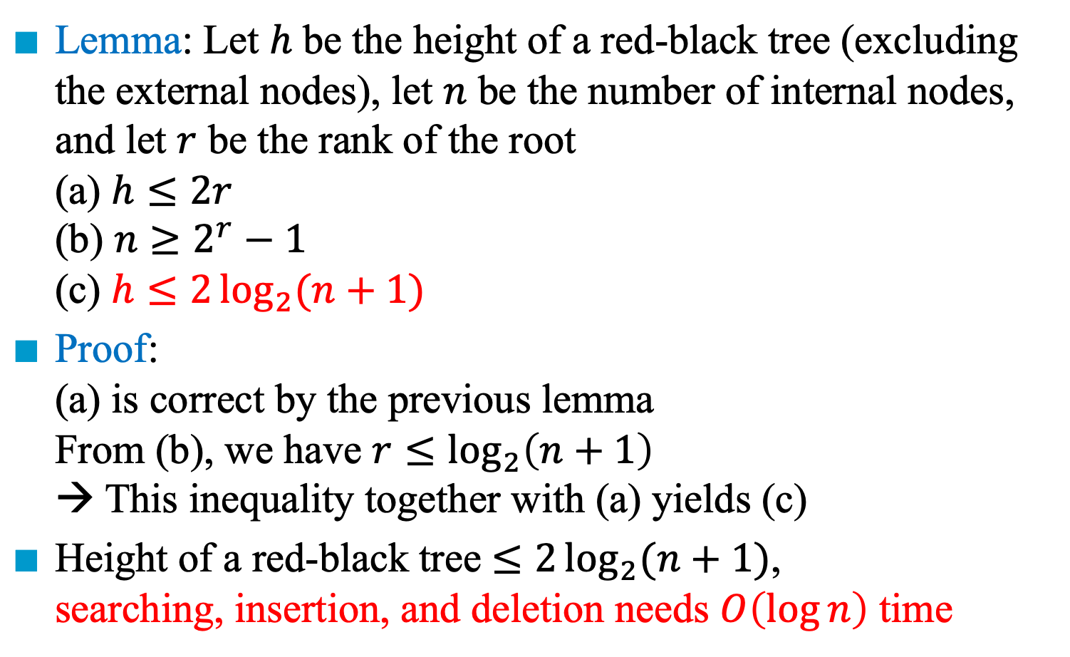
Properties of a Red-Black Tree
Lemma: Let $h$ be the height of a red-black tree (excluding the external nodes), let $n$ be the number of internal nodes, and let $r$ be the rank of the root (a) $h≤2r$ (b) $n≥2^{r}−1$ (c) $h≤2\log_{2}{(n+1)}$
Proof: (a) is correct by the previous lemma From (b), we have $r≤\log_{2}\left(n+1\right)$ → This inequality together with (a) yields (c)
Height of a red-black tree $≤2\log_{2}{(n+1)}$, searching, insertion, and deletion needs $O\left(\log{n}\right)$ time

Slide 29

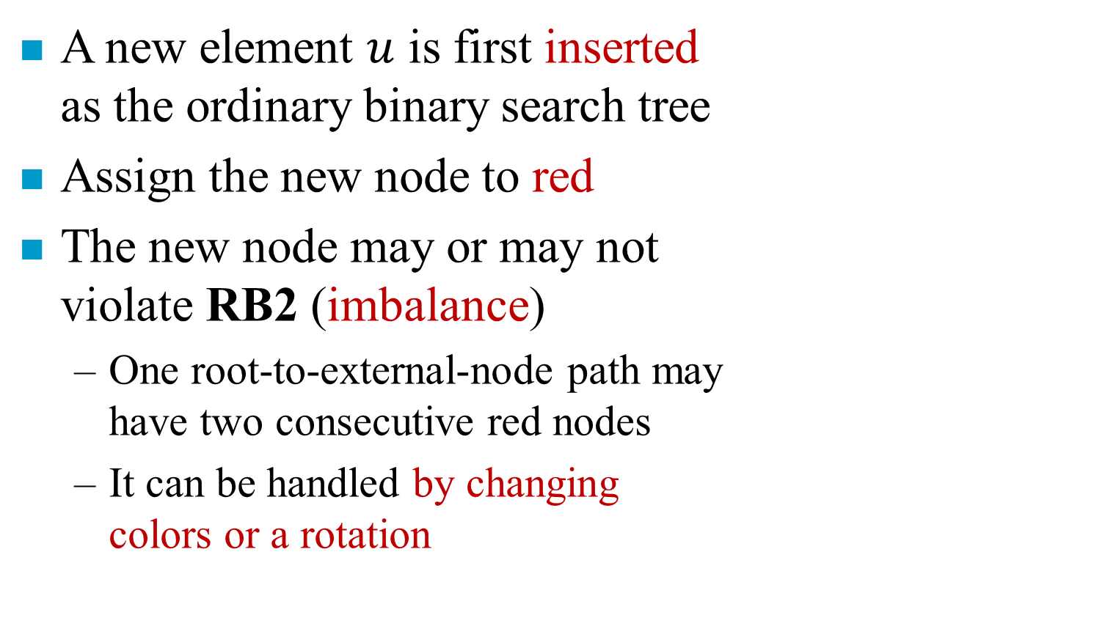


Inserting into a Red-Black Tree
A new element $u$ is first inserted as the ordinary binary search tree
Assign the new node to red
The new node may or may not violate RB2 (imbalance)
One root-to-external-node path may have two consecutive red nodes
It can be handled by changing colors or a rotation
$$gu$$
$$pu$$
d
$$u$$
c
a
b

Slide 30

Two Consecutive Red Nodes
$u$: new node, red
$pu$: parent of $u$, red
g$u$: grandparent of $u$, black
LLb, LLr
Left child, then left child
LLb: the other child of g$u$, $d$, is black
LLr: the other child of g$u$, $d$, is red
LRb, LRr
Left child, then right child, black or red
RRb, RRr
Right child, then right child, black or red
RLb, RLr
Right child, then left child, black or red
$$gu$$
$$pu$$
d
$$u$$
c
a
b

Slide 31







Color Change of LLr, LRr, RRr, RLr
$$gu$$
Change Color
Move $u$, $pu$, and $gu$ up two levels
g$u$ becomes new $u$
Continue rebalancing if necessary
If RB2 is satisfied, stop propagation
If $gu$ is the root, force $gu$ to be black (the number of black nodes on all root-to-external-node paths increases by 1)
Otherwise, continue color change or rotation
$$gu$$
$$pu$$
$$pu$$
LLr
d
d
$$u$$
$$u$$
red
black
c
c
a
b
a
b

Slide 32








Rotation and Color Change of LLb, LRb, RRb, RLb
Same as the rotation schemes taken for an AVL tree
LLb rotation: LL rotation of AVL tree
LRb rotation: LR rotation of AVL tree
RRb is symmetric to LLb
RLb is symmetric to LRb
$$gu$$
LLb
z
y
$$u$$
$$pu$$
$$u$$
y
d
x
z
x
c
a
b
c
d
a
b
$$gu$$
LRb
z
y
$$u$$
$$pu$$
x
d
x
z
a
$$u$$
y
a
b
c
d
b
c

Slide 33












Insertion 50, 10, 80, 90, 70, 60, 65, 62
50
50
50
10
10
80
$$gu$$
$$gu$$
$$gu$$
RRr
root
50
50
50
$$d$$
$$pu$$
$$pu$$
$$pu$$
$$d$$
10
$$d$$
10
80
10
80
80
$$u$$
$$u$$
$$u$$
90
90
90
Violate RB2
Violate RB1

Slide 34






Insertion 50, 10, 80, 90, 70, 60, 65, 62
50
50
10
80
10
80
90
70
90
50
50
$$pu$$
$$gu$$
$$u$$
10
80
10
80
$$pu$$
LLr
$$d$$
70
90
70
90
$$u$$
60
60
Violate RB2

Slide 35








Insertion 50, 10, 80, 90, 70, 60, 65, 62
$$gu$$
50
50
$$d$$
$$pu$$
10
80
10
80
$$gu$$
$$u$$
70
90
65
90
LRb
$$d$$
$$pu$$
60
60
70
65
$$u$$
Violate RB2

Slide 36








Insertion 50, 10, 80, 90, 70, 60, 65, 62
$$gu$$
50
50
$$pu$$
$$d$$
10
80
10
80
$$u$$
$$gu$$
65
90
65
90
LRr
$$d$$
$$pu$$
60
70
60
70
$$u$$
62
62
Violate RB2
Violate RB2

Slide 37




Insertion 50, 10, 80, 90, 70, 60, 65, 62
$$gu$$
65
50
$$pu$$
$$d$$
50
80
10
80
$$u$$
10
60
70
90
65
90
RLb
62
60
70
62
Violate RB2

Slide 38
Comparison of AVL Tree and RB Tree
Criteria | AVL Tree | RB Tree
Search | Faster (more balanced) | -
Insertion | - | Faster (fewer rotations)
Deletion | - | Faster
Storage | - (an integer) | Smaller (one bit for color)
Application | Database (for fast retrievals) | map, multimap, multiset in C++

Slide 40
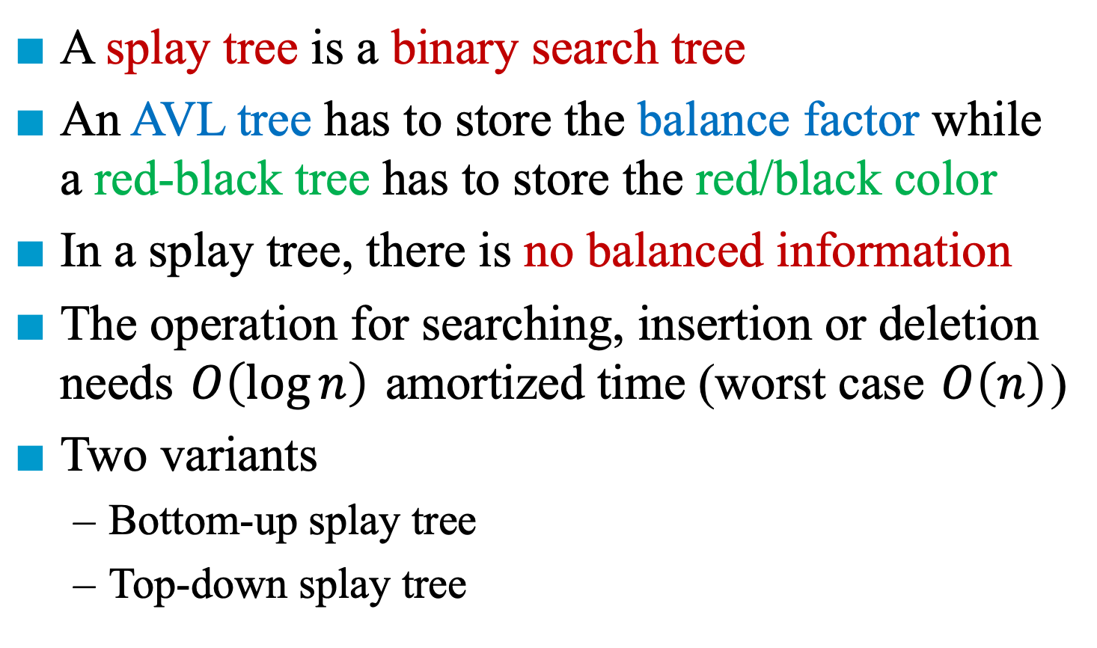
Splay Trees (斜張樹)
A splay tree is a binary search tree
An AVL tree has to store the balance factor while a red-black tree has to store the red/black color
In a splay tree, there is no balanced information
The operation for searching, insertion or deletion needs $O\left(\log{n}\right)$ amortized time (worst case $O\left(n\right)$)
Two variants
Bottom-up splay tree
Top-down splay tree

Slide 41
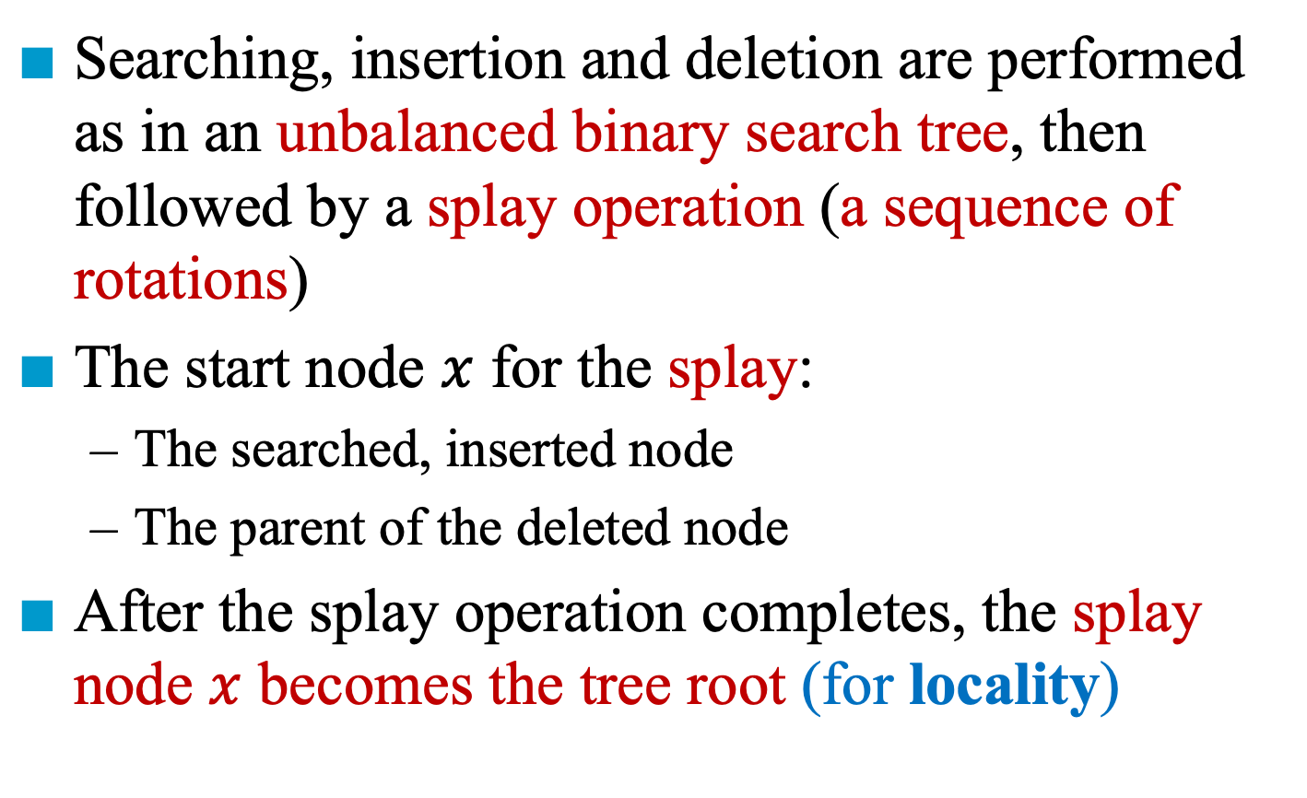
Bottom-Up Splay Trees
Searching, insertion and deletion are performed as in an unbalanced binary search tree, then followed by a splay operation (a sequence of rotations)
The start node $x$ for the splay:
The searched, inserted node
The parent of the deleted node
After the splay operation completes, the splay node $x$ becomes the tree root (for locality)

Slide 42





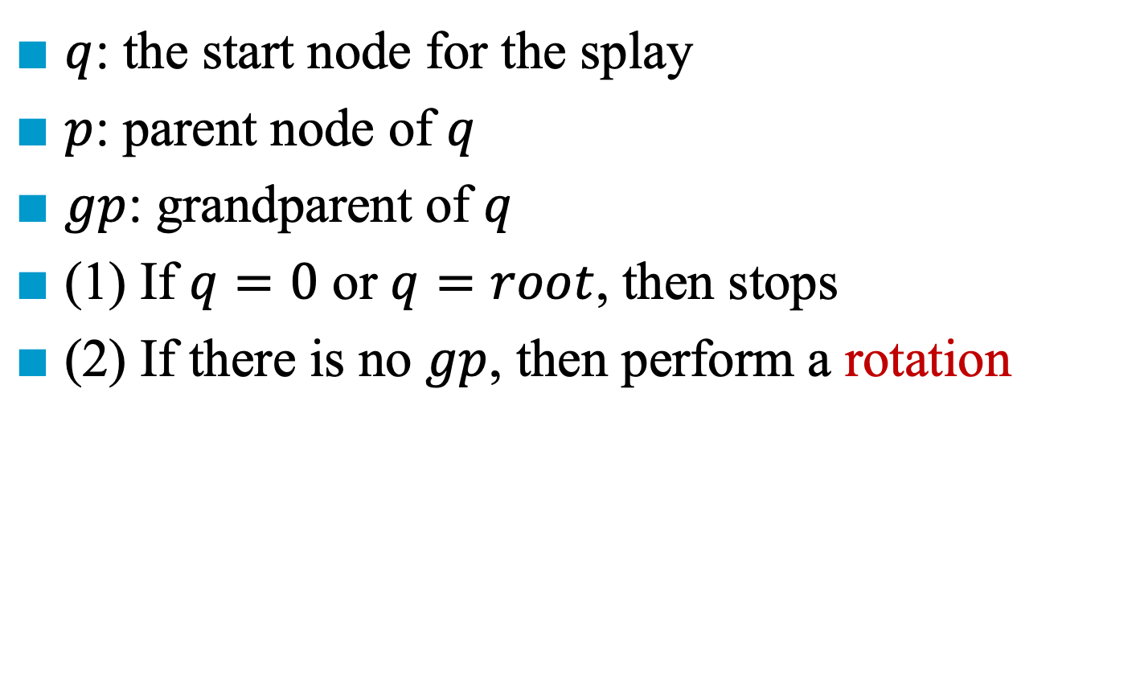






The Splay Operation
$q$: the start node for the splay
$p$: parent node of $q$
$gp$: grandparent of $q$
(1) If $q=0$ or $q=root$, then stops
(2) If there is no $gp$, then perform a rotation
$$p$$
$$q$$
rotation
x
$$q$$
$$p$$
x
$$a$$
$$c$$
$$b$$
$$c$$
$$a$$
$$b$$
$a,b,$ and $c$ are subtrees

Slide 43



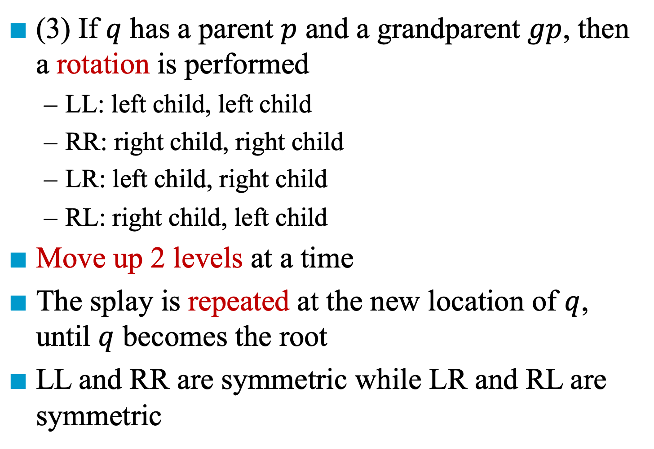






Rotations in the Splay Operation
(3) If $q$ has a parent $p$ and a grandparent $gp$, then a rotation is performed
LL: left child, left child
RR: right child, right child
LR: left child, right child
RL: right child, left child
Move up 2 levels at a time
The splay is repeated at the new location of $q$, until $q$ becomes the root
LL and RR are symmetric while LR and RL are symmetric
$$p$$
$$q$$
rotation
x
$$q$$
$$p$$
x
$$a$$
$$c$$
$$b$$
$$c$$
$$a$$
$$b$$

Slide 44






















RR and RL Rotations
$$gp$$
$$q$$
x
RR rotation
Keep inorder sequence unchanged
RL rotation
Keep inorder sequence unchanged
$$p$$
$$p$$
$$a$$
$$d$$
$$q$$
$$gp$$
x
$$c$$
$$b$$
$$p$$
$$q$$
$$a$$
rotation
$$c$$
$$d$$
$$b$$
x
$$gp$$
$$q$$
$$q$$
$$p$$
x
x
$$a$$
$$c$$
$$p$$
$$p$$
$$a$$
$$gp$$
$$b$$
$$c$$
$$a$$
$$b$$
$$q$$
x
$$d$$
$$a$$
$$b$$
$$c$$
$$d$$
$$b$$
$$c$$

Slide 45


















Example for the Splay Operation (1)
1
1
$$a$$
9
$$a$$
9
8
8
$$j$$
$$j$$
2
2
$$i$$
$$i$$
$$b$$
7
$$b$$
7
6
6
$$h$$
$$h$$
3
5
$$g$$
$$g$$
Initial: RR
$$c$$
4
4
$$f$$
5
3
$$e$$
$$d$$
$$e$$
After RR rotation: LL
$$f$$
$$c$$
$$d$$

Slide 46












Example for the Splay Operation (2)
1
1
$$a$$
9
$$a$$
9
8
$$j$$
8
$$j$$
2
$$i$$
2
$$i$$
$$b$$
7
$$b$$
5
6
$$h$$
4
6
5
$$g$$
3
$$e$$
$$f$$
7
4
$$f$$
$$c$$
$$d$$
$$g$$
$$h$$
3
$$e$$
After LL rotation: LR
After RR rotation: LL
$$c$$
$$d$$

Slide 47












Example for the Splay Operation (3)
1
1
$$a$$
9
$$a$$
9
8
5
$$j$$
$$j$$
2
2
8
$$i$$
$$b$$
5
$$b$$
4
6
$$i$$
4
6
3
$$e$$
$$f$$
7
3
$$e$$
$$f$$
7
$$c$$
$$d$$
$$g$$
$$h$$
$$c$$
$$d$$
$$g$$
$$h$$
After LL rotation: LR
After LR rotation: RL

Slide 48













Example for the Splay Operation (4)
1
5
$$a$$
9
1
9
5
$$j$$
$$a$$
2
8
$$j$$
2
8
$$b$$
4
6
$$i$$
$$b$$
4
6
$$i$$
3
$$e$$
$$f$$
7
3
$$e$$
$$f$$
7
$$c$$
$$d$$
$$g$$
$$h$$
$$c$$
$$d$$
$$g$$
$$h$$
After RL rotation
After LR rotation: RL

Slide 50
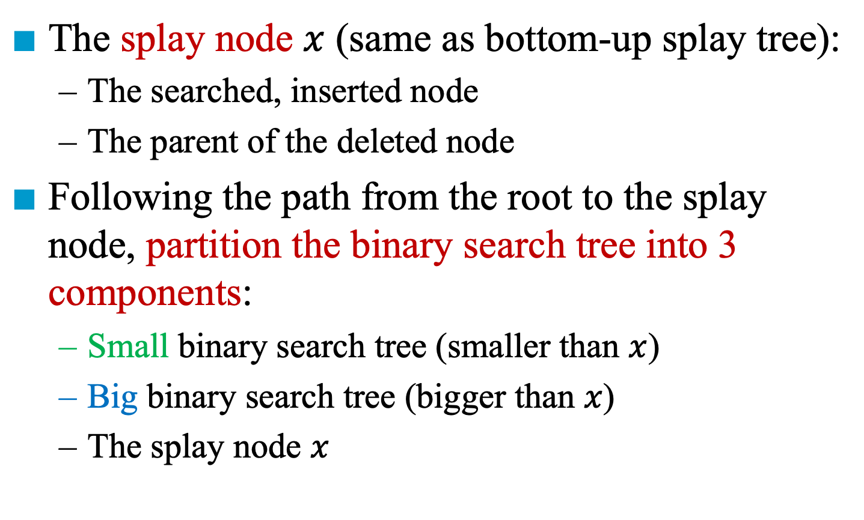
Top-Down Splay Trees (1)
The splay node $x$ (same as bottom-up splay tree):
The searched, inserted node
The parent of the deleted node
Following the path from the root to the splay node, partition the binary search tree into 3 components:
Small binary search tree (smaller than $x$)
Big binary search tree (bigger than $x$)
The splay node $x$

Slide 51
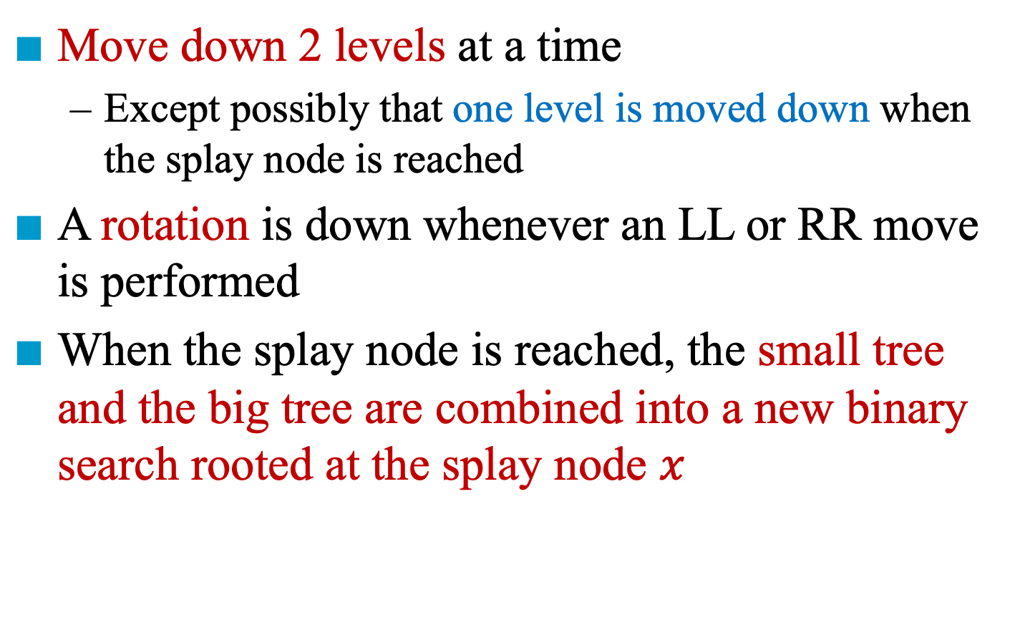
Top-Down Splay Trees (2)
Move down 2 levels at a time
Except possibly that one level is moved down when the splay node is reached
A rotation is down whenever an LL or RR move is performed
When the splay node is reached, the small tree and the big tree are combined into a new binary search rooted at the splay node $x$

Slide 52





An Example for Top-Down Splay Tree (1/7)
$$x$$
$$s$$
$$b$$
big
1
small
$$a$$
9
1
9
8
$$a$$
$$j$$
$$j$$
2
$$i$$
$$b$$
7
6
$$h$$
3
$$g$$
$$c$$
4
5
$$d$$
Initial: RL
$$e$$
$$f$$

Slide 53





An Example for Top-Down Splay Tree (2/7)
small
$$s$$
$$b$$
big
1
9
$$x$$
8
$$a$$
$$j$$
2
$$i$$
$$b$$
7
6
$$h$$
3
$$g$$
$$c$$
4
5
$$d$$
After RL transformation: LR
$$e$$
$$f$$

Slide 54


An Example for Top-Down Splay Tree (2/7)
small
$$s$$
$$b$$
big
1
9
$$x$$
8
$$a$$
2
8
$$j$$
2
$$b$$
$$i$$
$$i$$
$$b$$
7
6
$$h$$
3
$$g$$
$$c$$
4
5
$$d$$
After RL transformation: LR
$$e$$
$$f$$

Slide 55

An Example for Top-Down Splay Tree (3/7)
small
$$s$$
$$b$$
big
1
9
$$a$$
2
8
$$j$$
$$x$$
$$b$$
$$i$$
7
6
$$h$$
3
$$g$$
$$c$$
4
5
$$d$$
After LR transformation: LL
$$e$$
$$f$$

Slide 56



An Example for Top-Down Splay Tree (3/7)
small
$$s$$
$$b$$
big
1
9
$$a$$
2
8
$$j$$
$$x$$
$$b$$
6
$$i$$
7
7
6
$$h$$
$$g$$
$$h$$
3
$$g$$
$$c$$
4
5
$$d$$
After LR transformation: LL
$$e$$
$$f$$

Slide 57



An Example for Top-Down Splay Tree (4/7)
small
$$s$$
$$b$$
big
1
9
$$a$$
2
8
$$j$$
$$b$$
6
$$i$$
$$x$$
7
$$g$$
$$h$$
3
$$c$$
4
5
$$d$$
After LL transformation: RR
$$e$$
$$f$$

Slide 58



An Example for Top-Down Splay Tree (4/7)
small
$$s$$
$$b$$
big
1
9
$$a$$
2
8
$$j$$
$$b$$
4
6
$$i$$
$$x$$
3
7
$$g$$
$$h$$
$$c$$
$$d$$
3
$$c$$
4
5
$$d$$
After LL transformation: RR
$$e$$
$$f$$

Slide 59
An Example for Top-Down Splay Tree (5/7)
small
$$s$$
$$b$$
big
1
9
$$a$$
2
8
$$j$$
$$b$$
4
6
$$i$$
3
7
$$g$$
$$h$$
$$c$$
$$d$$
$$x$$
5
After RR transformation: moving subtrees of the splay node
$$e$$
$$f$$

Slide 60


An Example for Top-Down Splay Tree (5/7)
small
$$s$$
$$b$$
big
1
9
$$a$$
2
8
$$j$$
$$b$$
4
6
$$i$$
3
$$e$$
$$f$$
7
$$g$$
$$h$$
$$c$$
$$d$$
$$x$$
5
After RR transformation: moving subtrees of the splay node
$$e$$
$$f$$

Slide 61


An Example for Top-Down Splay Tree (6/7)
small
$$s$$
$$b$$
big
1
9
$$a$$
2
8
$$j$$
$$b$$
4
6
$$i$$
3
$$e$$
$$f$$
7
$$g$$
$$h$$
$$c$$
$$d$$
$$x$$
5
After RR transformation: moving subtrees of the splay node

Slide 62






An Example for Top-Down Splay Tree (7/7)
5
1
9
$$a$$
2
8
$$j$$
$$b$$
4
6
$$i$$
3
$$e$$
$$f$$
7
$$c$$
$$d$$
$$g$$
$$h$$
Bottom-Up v.s. Top-Down
Top-down splay trees are faster than bottom-up splay trees by experiments

