Slide 1
CHAPTER 11
Multiway Search Trees
All the programs in this file are selected from
Ellis Horowitz, Sartaj Sahni, and Susan Anderson-Freed
“Fundamentals of Data Structures in C”,

Slide 2
A Three-Way Search Tree
T
a
20, 40
b
d
c
10, 15
25, 30
45,. 50
e
28
Node | Schematic format
a b c d e | 2, b, (20, c), (40, d) 2, 0, (10, 0), (15, 0) 2, 0, (25, e), (30, 0) 2, 0, (45, 0), (50, 0) 1, 0, (28, 0)
Notes:
表上的 a 的 2 表示 node a 有兩筆資料，b表示比20小的數字放b，比20大但比40小的數字放c，比40大的數字放d

Slide 3
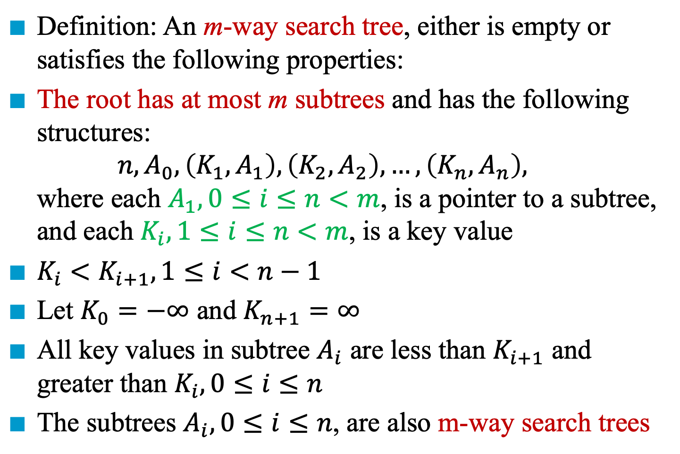
m-Way Search Trees
Definition: An m-way search tree, either is empty or satisfies the following properties:
The root has at most m subtrees and has the following structures: $n, A_{0},\left(K_{1},A_{1}\right),\left(K_{2},A_{2}\right),…,\left(K_{n},A_{n}\right),$ where each $A_{1}, 0≤i≤n<m$, is a pointer to a subtree, and each $K_{i}, 1≤i≤n<m$, is a key value
$K_{i}<K_{i+1}, 1≤i<n−1$
Let $K_{0}=−∞$ and $K_{n+1}=∞$
All key values in subtree $A_{i}$ are less than $K_{i+1}$ and greater than $K_{i}, 0≤i≤n$
The subtrees $A_{i}, 0≤i≤n$, are also m-way search trees

Slide 4
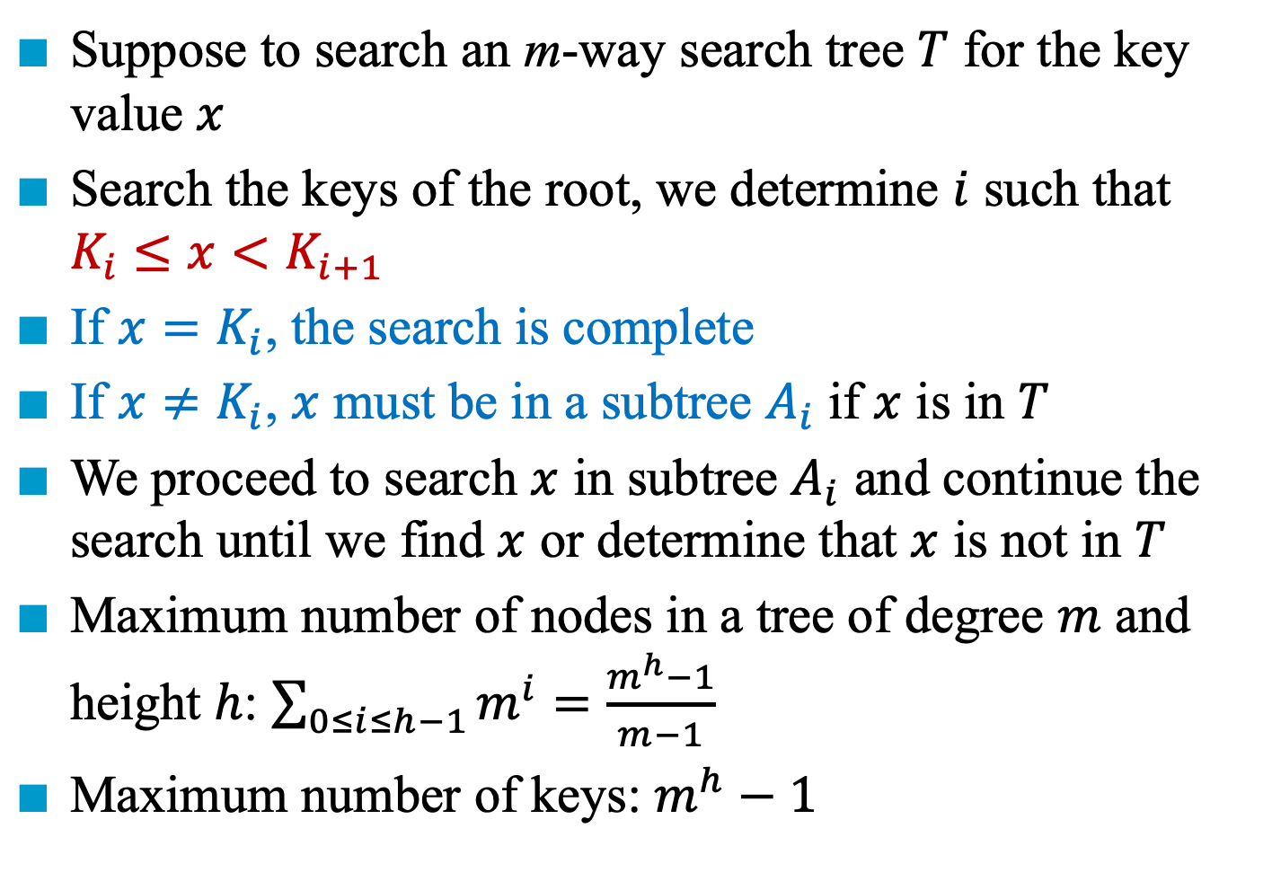
Searching an m-Way Search Trees
Suppose to search an m-way search tree $T$ for the key value $x$
Search the keys of the root, we determine $i$ such that $K_{i}≤x<K_{i+1}$
If $x=K_{i}$, the search is complete
If $x≠K_{i}$, $x$ must be in a subtree $A_{i}$ if $x$ is in $T$
We proceed to search $x$ in subtree $A_{i}$ and continue the search until we find $x$ or determine that $x$ is not in $T$
Maximum number of nodes in a tree of degree $m$ and height $h$: $\sum_{0≤i≤h−1}{m^{i}}=\frac{m^{h}−1}{m−1}$
Maximum number of keys: $m^{h}−1$

Slide 5
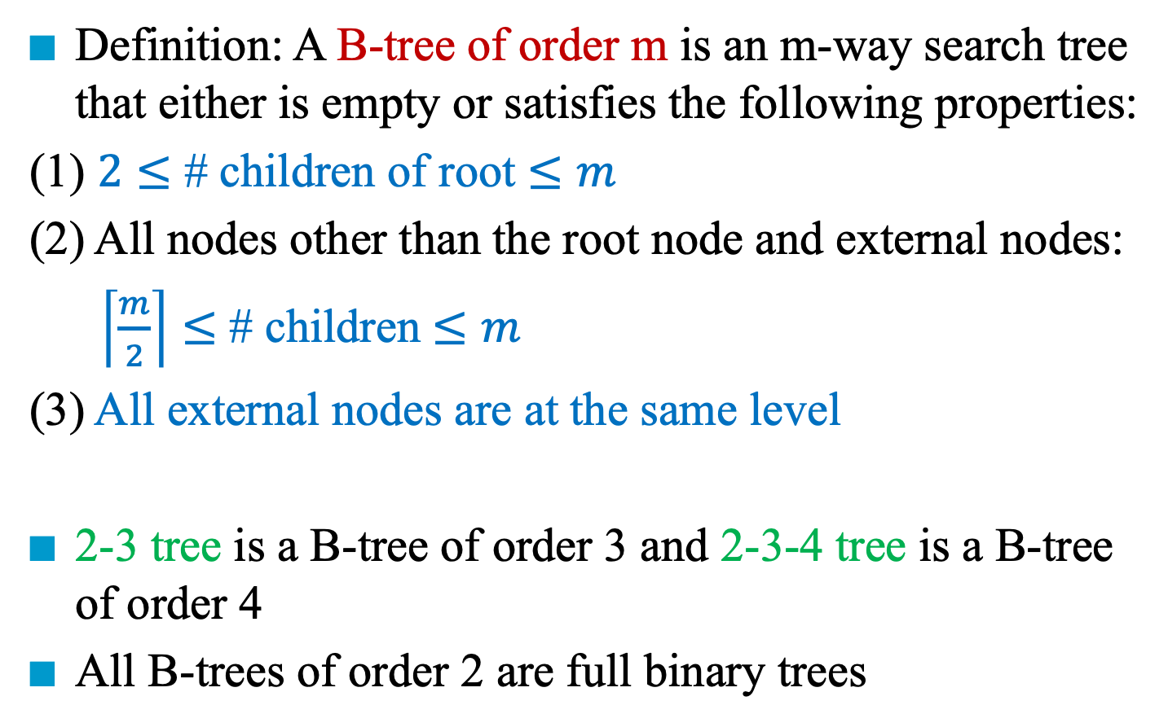
B-trees
Definition: A B-tree of order m is an m-way search tree that either is empty or satisfies the following properties:
(1) $2≤$ # children of root $≤m$
(2) All nodes other than the root node and external nodes:
$\left\lceil \frac{m}{2}\right\rceil ≤$ # children $≤m$
(3) All external nodes are at the same level
2-3 tree is a B-tree of order 3 and 2-3-4 tree is a B-tree of order 4
All B-trees of order 2 are full binary trees

Slide 6
Example
A
40
2-3 tree: B-tree of order 3
B
C
10 | 20
80
2-3-4 tree: B-tree
of order 4
50
10
70 | 80
5 | 7 | 9
30 | 40
60
75
85 | 90 | 92

Slide 7
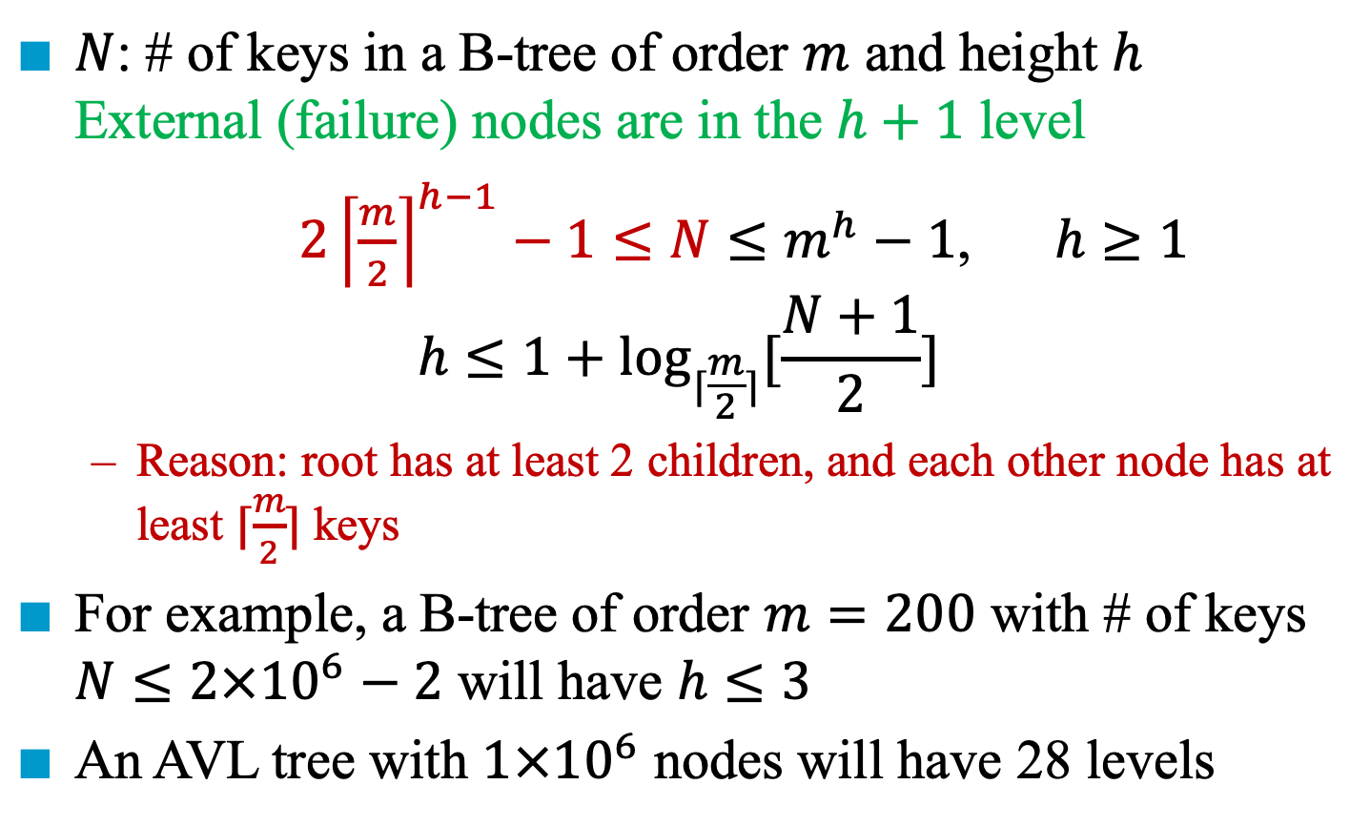
Number of Elements in B-trees
$N$: # of keys in a B-tree of order $m$ and height $h$ External (failure) nodes are in the $h+1$ level
$2{\left\lceil \frac{m}{2}\right\rceil }^{h−1}−1≤N≤m^{h}−1$, $h≥1$
$$h≤1+\log_{⌈\frac{m}{2}⌉}{[\frac{N+1}{2}]}$$
Reason: root has at least 2 children, and each other node has at least $⌈\frac{m}{2}⌉$ keys
For example, a B-tree of order $m=200$ with # of keys $N≤2×{10}^{6}−2$ will have $h≤3$
An AVL tree with $1×{10}^{6}$ nodes will have 28 levels
Notes:
第一層的 root 至少存一個 key，且有兩個 children
第二層的 2 個 node，每個要存 ceil (m/2) 個 children，也就是至少 ceil(m/2) keys
第三層有 ceil(m/2) 個 node，且每個存 ceil(m/2) 個以上，也就是至少 ceil(m/2) keys
第四層有 ceil(m/2)^2 個 node，且每個存 ceil(m/2) 個以上，也就是至少 ceil(m/2) keys
第 h 層有 ceil(m/2)^{h-1} 個 node，且每個存 ceil(m/2) 個以上，也就是至少 ceil(m/2) keys

Slide 8
Insertion into a B-tree of Order 5
320 540
430 480
380 395 406 412
451 472
493 506 511
Insert 382 ➔ # of children > 5
Initially, insert 382
Notes:
Ceil (5/2) = 3
Way = 3~5
Data = 2~4

Slide 9
Insertion into a B-tree of Order 5
320 540
395 430 480
380 382
406 412
451 472
493 506 511
After inserting 382 (Split the full node), insert 518 and 508

Slide 10
Insertion into a B-tree of Order 5
320 540
395 430 480 508
380 382
406 412
451 472
493 506
511 518
After inserting 518 and 508 (Split the full node)

Slide 11
Insertion into a B-tree of Order 4 (2-3-4 Tree)
87 140
23 61 74
90 100 106
152 186 194
Initially, insert 102
Notes:
Ceil(4/2) = 2
Way = 2 ~ 4
Data = 1 ~ 3

Slide 12
Insertion into a B-tree of Order 4 (2-3-4 Tree)
87 102 140
23 61 74
90 100
106
152 186 194
After inserting 102 with a left bias

Slide 13
Insertion into a B-tree of Order 4 (2-3-4 Tree)
87 100 140
23 61 74
90
102 106
152 186 194
After inserting 102 with a right bias

Slide 14
Deletion from a B-tree of Order 5
Rotation: Shift a key from its parent and its sibling
87 120 150
90 113
126 135 142
Delete 113 ➔ # of children < 3
Initially, delete 113
Notes:
Ceil(m/2) = 3
Data = 2 ~ 4
因此如果是刪掉 126 則無所謂

Slide 15
Deletion from a B-tree of Order 5
Rotation: Shift a key from its parent and its sibling
87 120 150
90 113
126 135 142
Delete 113 ➔ # of children < 3
Initially, delete 113

Slide 16
Deletion from a B-tree of Order 5
Rotation: Shift a key from its parent and its sibling
87 126 150
90 120
135 142
After deletion of 113

Slide 17
Deletion from a B-tree of Order 5
Combination: Take a key from its parent and combine with its sibling
87 126 150
90 120
135 142
Delete 120 ➔ # of children < 3
Initially, delete 120
Notes:
左右 subtree 都不能旋轉

Slide 18
Deletion from a B-tree of Order 5
Combination: Take a key from its parent and combine with its sibling
87 150
90 126 135 142
After deletion of 120

Slide 19
Deletion from a B-tree of Order 5
Combine, then rotate for its parent
60 170
35 50
80 150
180 220 280
C
D
E
A
B
65 72
87 96
153 162
173 178
187 202
Initially, delete 65
Notes:
Ceil(5/2) = 3
Data = 2 ~ 4

Slide 20
Deletion from a B-tree of Order 5
Combine, then rotate for its parent
60 170
35 50
80 150
180 220 280
C
D
E
A
B
65 72
87 96
153 162
173 178
187 202
Initially, delete 65
Notes:
Ceil(5/2) = 3
Data = 2 ~ 4

Slide 21
Deletion from a B-tree of Order 5
Combine, then rotate for its parent
60 170
35 50
80 150
180 220 280
C
D
E
A
B
65 72
87 96
153 162
173 178
187 202
Initially, delete 65
Notes:
Ceil(5/2) = 3
Data = 2 ~ 4

Slide 22
Deletion from a B-tree of Order 5
Combine, then rotate for its parent
60 170
35 50
80 150
180 220 280
C
D
E
A
B
65 72
87 96
153 162
173 178
187 202
Initially, delete 65
Notes:
Ceil(5/2) = 3
Data = 2 ~ 4

Slide 23
Deletion from a B-tree of Order 5
Combine, then rotate for its parent
60 180
35 50
150 170
220 280
C
D
E
A
B
72 80 87 96
153 162
173 178
187 202
After deletion of 65

Slide 24
Deletion from a B-tree of Order 5
Combine, then combine for its parent
60 180 300
G
35 50
150 170
220 280
C
D
E
F
A
B
153 162
173 178
187 202
Initially, delete 173

Slide 25
Deletion from a B-tree of Order 5
Combine, then combine for its parent
60 180 300
G
35 50
150 170
220 280
C
D
E
F
A
B
153 162
173 178
187 202
Initially, delete 173

Slide 26
Deletion from a B-tree of Order 5
Combine, then combine for its parent
60 180 300
G
35 50
150 170
220 280
C
D
E
F
A
B
153 162
173 178
187 202
Initially, delete 173

Slide 27
Deletion from a B-tree of Order 5
Combine, then combine for its parent
60 300
G
35 50
150 180 220 280
C
D
E
F
A
B
153 162 170 178
187 202
After deletion of 173

Slide 28
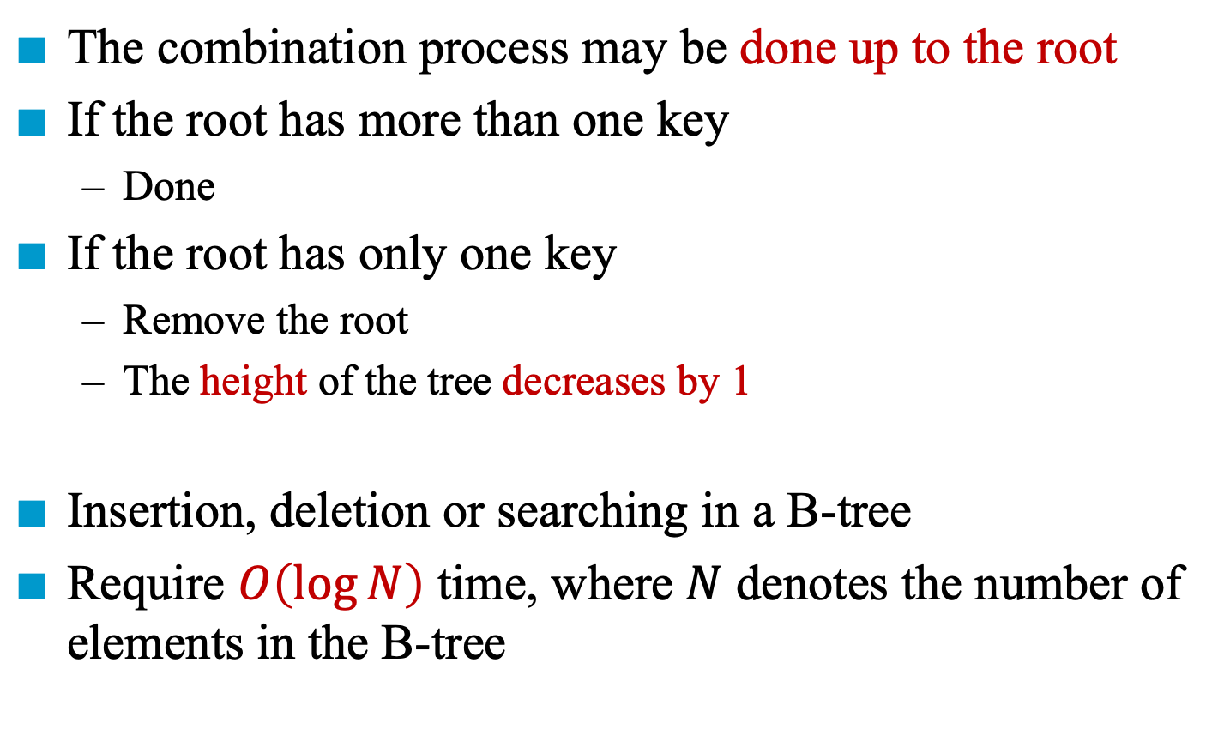
Deletion in a B-tree
The combination process may be done up to the root
If the root has more than one key
Done
If the root has only one key
Remove the root
The height of the tree decreases by 1
Insertion, deletion or searching in a B-tree
Require $O\left(\log{N}\right)$ time, where $N$ denotes the number of elements in the B-tree

Slide 30
B⁺-trees
Index node: internal node, storing keys (not elements) and pointers
Data node: external node, storing elements (with their keys)
Data nodes are linked together to form a doubly linked list
A
index
20 | 40
D
B
C
data
10
30
70 | 80
2
4
6
12
16
18
20
25
32
36
40
50
60
71
72
80
82
84

Slide 31
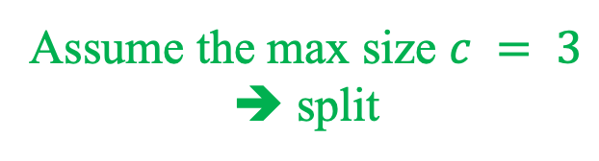
Insertion into a B⁺-trees
A
20 | 40
D
B
C
10
30
70 | 80
2
4
6
12
16
18
20
25
32
36
40
50
60
71
72
80
82
84
Assume the max size $c = 3$
➔ split
Initially, insert 14

Slide 32
Insertion into a B⁺-trees
A
20 | 40
D
B
C
10 | 16
30
70 | 80
2
4
6
12
14
16
18
20
25
32
36
40
50
60
71
72
80
82
84
After 14 is inserted, insert 86

Slide 33
Insertion into a B⁺-trees
A
The parent node is full
20 | 40
D
B
C
10 | 16
30
70 | 80
2
4
6
12
14
16
18
20
25
32
36
40
50
60
71
72
80
82
84
After 14 is inserted, insert 86

Slide 34
Insertion into a B⁺-trees
G
40
F
A
20
80
C
D
E
B
10 | 16
30
70
84
2
4
6
12
14
16
18
20
25
32
36
40
50
60
71
72
80
82
84
86
After 86 is inserted

Slide 35
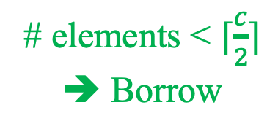
Deletion from a B⁺-trees (Case 1)
A
20 | 40
D
B
C
10
30
70 | 80
2
4
6
12
16
18
20
25
32
36
40
50
60
71
72
80
82
84
# elements < $⌈\frac{c}{2}⌉$
➔ Borrow
Initially, delete 71

Slide 36
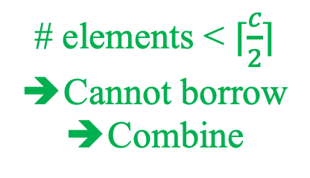
Deletion from a B⁺-trees (Case 1)
A
20 | 40
D
B
C
10
30
70 | 82
2
4
6
12
16
18
20
25
32
36
40
50
60
72
80
82
84
# elements < $⌈\frac{c}{2}⌉$
Cannot borrow
Combine
After deletion of 71 (borrow), delete 80

Slide 37
Deletion from a B⁺-trees (Case 1)
A
20 | 40
D
B
C
10
30
70
2
4
6
12
16
18
20
25
32
36
40
50
60
72
82
84
After deletion of 80 (combine)

Slide 38
Deletion into a B⁺-trees (Case 2)
G
40
F
A
20
80
C
D
E
B
10 | 16
30
70
84
2
4
6
12
14
16
18
20
25
32
36
40
50
60
71
72
80
82
84
86
Initially, delete 32

Slide 39
Deletion into a B⁺-trees (Case 2)
G
40
F
A
20
80
C
D
E
B
10 | 16
70
84
2
4
6
12
14
16
18
20
25
36
40
50
60
71
72
80
82
84
86
After deletion of 32, C is deficient

Slide 40
Deletion into a B⁺-trees (Case 2)
G
40
F
A
20
80
C
D
E
B
10 | 16
70
84
2
4
6
12
14
16
18
20
25
36
40
50
60
71
72
80
82
84
86
After deletion of 32, C is deficient
➔ Borrow

Slide 41
Deletion into a B⁺-trees (Case 2)
G
40
F
A
16
80
C
D
E
B
10
20
70
84
2
4
6
12
14
16
18
20
25
36
40
50
60
71
72
80
82
84
86
After borrowing from B

Slide 42
Deletion into a B⁺-trees (Case 3)
G
40
F
A
20
80
C
D
E
B
10 | 16
30
70
84
2
4
6
12
14
16
18
20
25
32
36
40
50
60
71
72
80
82
84
86
Initially, delete 86

Slide 43
Deletion into a B⁺-trees (Case 3)
G
40
F
A
20
80
C
D
E
B
10 | 16
30
70
2
4
6
12
14
16
18
20
25
32
36
40
50
60
71
72
80
82
84
After deletion of 86, E is deficient
➔ Borrow

Slide 44
Deletion into a B⁺-trees (Case 3)
G
40
F
A
20
80
C
D
E
B
10 | 16
30
70
2
4
6
12
14
16
18
20
25
32
36
40
50
60
71
72
80
82
84
After deletion of 86, E is deficient
➔ We cannot borrow ➔ Combine

Slide 45
Deletion into a B⁺-trees (Case 3)
G
40
F
A
20
C
D
B
10 | 16
30
70 | 80
2
4
6
12
14
16
18
20
25
32
36
40
50
60
71
72
80
82
84
After deletion of 86, F is deficient
➔ We cannot borrow ➔ Combine again

Slide 46
Deletion into a B⁺-trees (Case 3)
A
20 | 40
C
D
B
10 | 16
30
70 | 80
2
4
6
12
14
16
18
20
25
32
36
40
50
60
71
72
80
82
84
After deletion of 86

Slide 47
The End

