Slide 1
Data Structure
Programming Project #1
郭建志

Slide 2
Background
Large-scale sensor networks
Every node collect the environment information
How to obtain the average data? Such as temperature

Slide 3
Background
A sink averages all data
The nodes near the sink may send more packets
→ exhaust energy → node failure → network partition

Slide 4
Background
A sink averages all data
Centralized algorithms are not suitable for large-scale networks
How will you design a distributed algorithm to obtain the average?

Slide 5
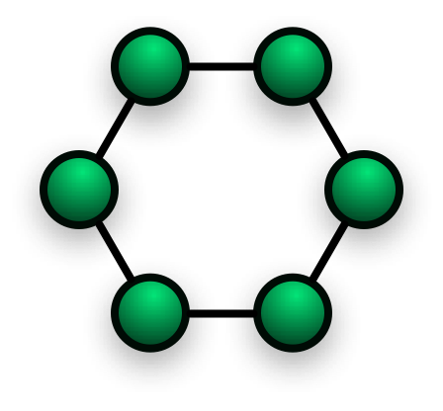
Distributed Consensus Algorithm
Every node acts a sensor and a sink at the same time
At each iteration,
each node sends the data to its neighbors
each node aggregate the data from its neighbors

Slide 6
Programming Project #1: Convergence Matrix
Input:
Number of nodes
Nodes with non-negative coordinates (x, y) (the input graph is connected when we add links if dist(u,v) < 1)
Procedure:
Add a link between any two nodes u, v as dist(u,v) < 1
Average the data from the neighbors
Output:
The data of nodes at each iteration
The grade is inversely proportional to the number of iterations for convergence

Slide 7
Programming Project #1: Convergence Matrix
Input:
Number of nodes
Nodes with non-negative coordinates (x, y) (the input graph is connected when we add links if dist(u,v) < 1)
Procedure:
Add a link between any two nodes u, v as dist(u,v) < 1
Average the data from the neighbors
Output:
The data of nodes at each iteration
The grade is inversely proportional to the number of iterations for convergence
…

Slide 8
Programming Project #1: Convergence Matrix
Input:
Number of nodes
Nodes with non-negative coordinates (x, y) (the input graph is connected when we add links if dist(u,v) < 1)
Procedure:
Add a link between any two nodes u, v as dist(u,v) < 1
Average the data from the neighbors
Output:
The data of nodes at each iteration
The grade is inversely proportional to the number of iterations for convergence
棄選了

Slide 9
Programming Project #1: Convergence Matrix
Input:
Number of nodes
Nodes with non-negative coordinates (x, y) (the input graph is connected when we add links if dist(u,v) < 1)
Procedure:
Add a link between any two nodes u, v as dist(u,v) < 1
Average the data from the neighbors
Output:
The data of nodes at each iteration
The grade is inversely proportional to the number of iterations for convergence
下週二 公布

Slide 10
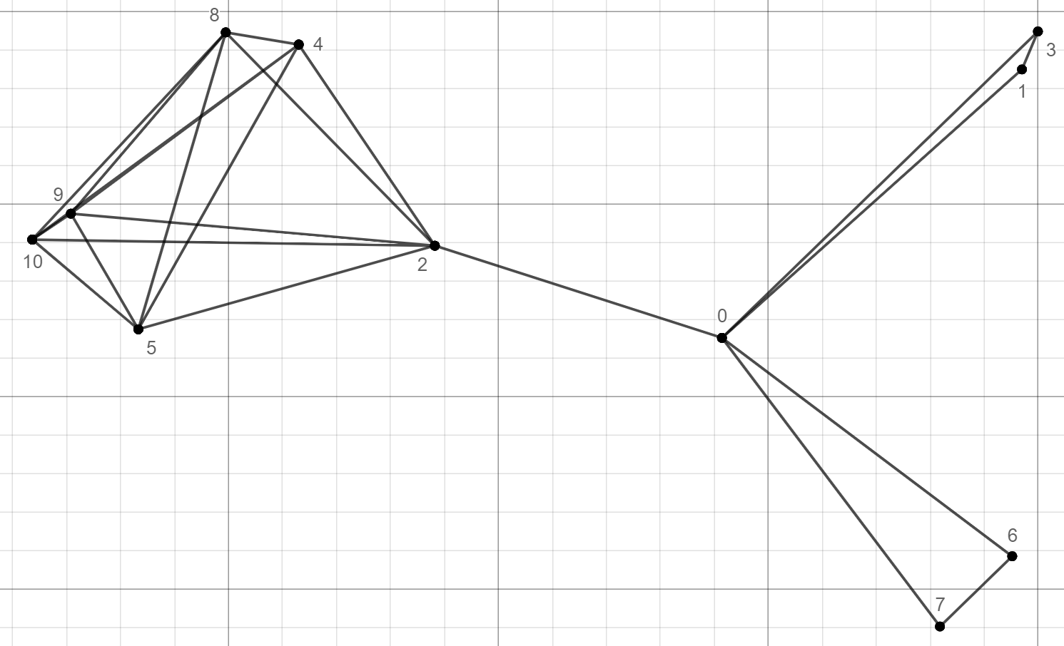
Programming Project #1: Convergence Matrix
At each iteration,
each node sends the data to its neighbors
each node aggregate the data from its neighbors
3
1
2
0
6
7

Slide 11

Programming Project #1: Convergence Matrix
$w_{i}^{′}=\sum_{j∈V}{a_{ij}⋅w_{i}}$
e.g., $w_{0}^{′}=a_{00}⋅w_{0}+a_{01}⋅w_{1}+a_{02}⋅w_{2}+a_{03}⋅w_{3}+a_{06}⋅w_{6}+a_{07}⋅w_{7}$
3
1
2
0
6
7

Slide 12
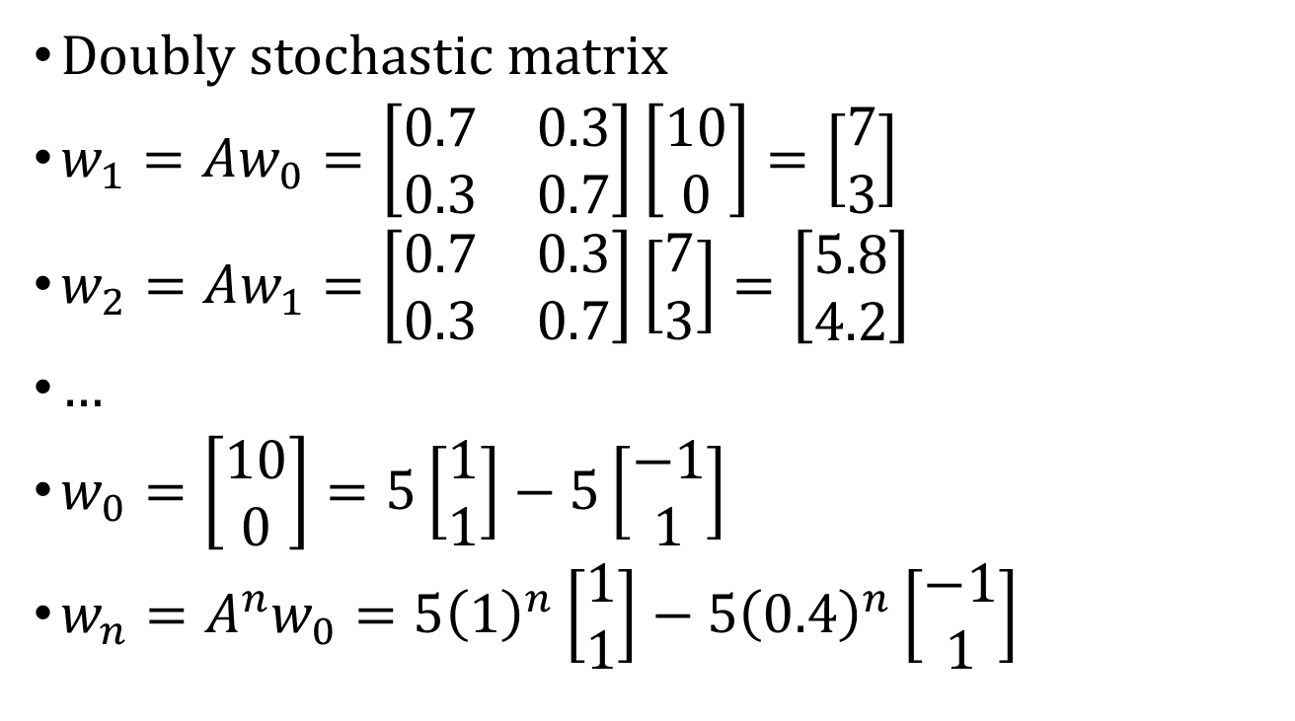


Review
$\left[\begin{matrix}0.7 & 0.3 \\ 0.3 & 0.7\end{matrix}\right]$
Eigenvector $\left[\begin{matrix}1 \\ 1\end{matrix}\right]$ with eigenvalue 1
Eigenvector $\left[\begin{matrix}−1 \\ 1\end{matrix}\right]$ with eigenvalue 0.4
$Ax=λx$
Doubly stochastic matrix
$w_{1}=Aw_{0}=\left[\begin{matrix}0.7 & 0.3 \\ 0.3 & 0.7\end{matrix}\right]\left[\begin{matrix}10 \\ 0\end{matrix}\right]=\left[\begin{matrix}7 \\ 3\end{matrix}\right]$
$w_{2}=Aw_{1}=\left[\begin{matrix}0.7 & 0.3 \\ 0.3 & 0.7\end{matrix}\right]\left[\begin{matrix}7 \\ 3\end{matrix}\right]=\left[\begin{matrix}5.8 \\ 4.2\end{matrix}\right]$
…
$w_{0}=\left[\begin{matrix}10 \\ 0\end{matrix}\right]=5\left[\begin{matrix}1 \\ 1\end{matrix}\right]−5\left[\begin{matrix}−1 \\ 1\end{matrix}\right]$
$w_{n}=A^{n}w_{0}=5{\left(1\right)}^{n}\left[\begin{matrix}1 \\ 1\end{matrix}\right]−5{\left(0.4\right)}^{n}\left[\begin{matrix}−1 \\ 1\end{matrix}\right]$
When $n$ is $∞$ ➔ 0

Slide 13
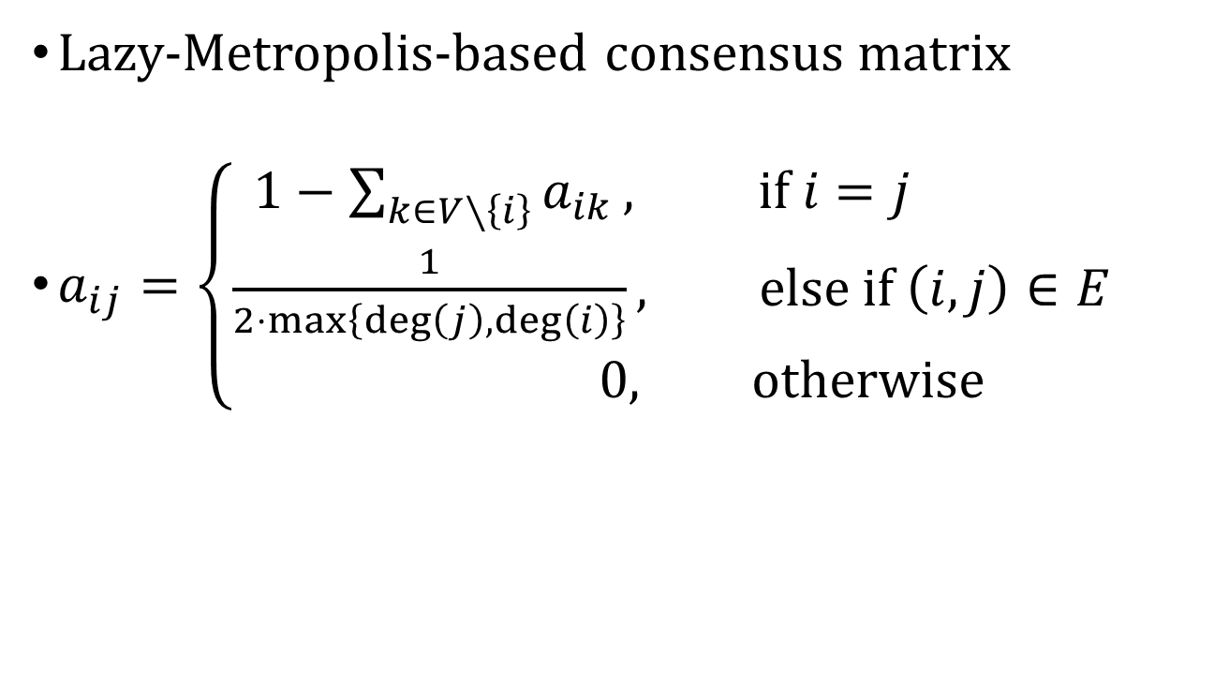
Convergence Matrix
Lazy-Metropolis-based consensus matrix
$a_{ij}=\left\{\begin{aligned}1−\sum_{k∈V∖\left\{i\right\}}{a_{ik}}, if i=j \\ \frac{1}{2⋅max\left\{\deg\left(j\right),\deg\left(i\right)\right\}}, else if \left(i,j\right)∈E \\ 0, otherwise\end{aligned}\right.$

Slide 14
Input Sample
#nodes #rounds
nodeID x y value
…
2: 50
1: 0
3 3
0 1.4142 1.1534 100
1 1.97 1.85 0
2 1.9996 1.9484 50
0: 100

Slide 15

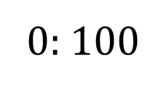


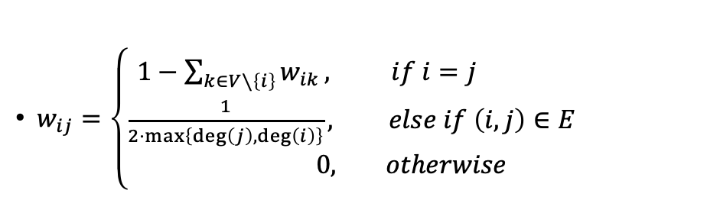
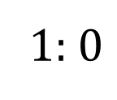
Out Sample
$w_{ij}=\left\{\begin{aligned}1−\sum_{k∈V∖\left\{i\right\}}{w_{ik}}, if i=j \\ \frac{1}{2⋅max\left\{\deg\left(j\right),\deg\left(i\right)\right\}}, else if \left(i,j\right)∈E \\ 0, otherwise\end{aligned}\right.$
2: 50
$$\frac{1}{4}$$
1: $0$
3 3
100 0 50
$$\frac{1}{4}$$
$$\frac{1}{4}$$
0: $100$

Slide 16
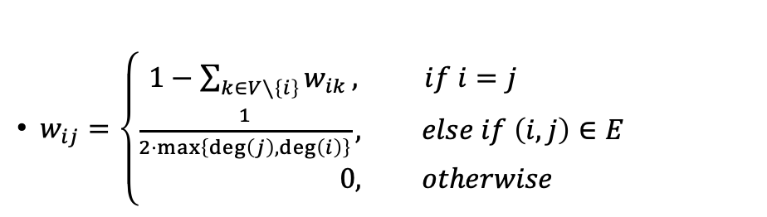
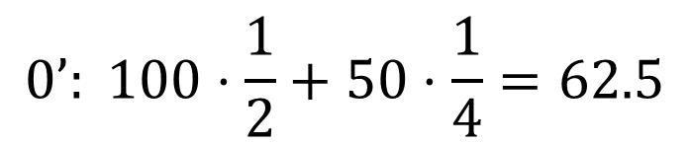
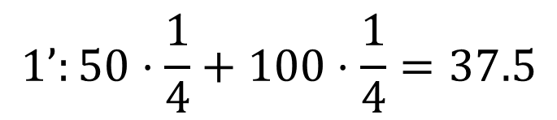
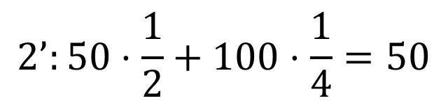
Out Sample
$w_{ij}=\left\{\begin{aligned}1−\sum_{k∈V∖\left\{i\right\}}{w_{ik}}, if i=j \\ \frac{1}{2⋅max\left\{\deg\left(j\right),\deg\left(i\right)\right\}}, else if \left(i,j\right)∈E \\ 0, otherwise\end{aligned}\right.$
2: 50
$$\frac{1}{4}$$
1: $0$
3 3
100 0 50
62.5 37.5 50
$$\frac{1}{4}$$
$$\frac{1}{4}$$
$$0’: 100⋅\frac{1}{2}+50⋅\frac{1}{4}=62.5$$
0: $100$
$$1’:50⋅\frac{1}{4}+100⋅\frac{1}{4}=37.5$$
$$2’:50⋅\frac{1}{2}+100⋅\frac{1}{4}=50$$

Slide 17
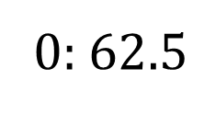
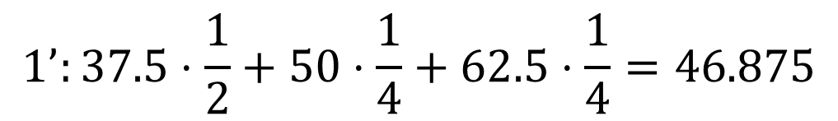
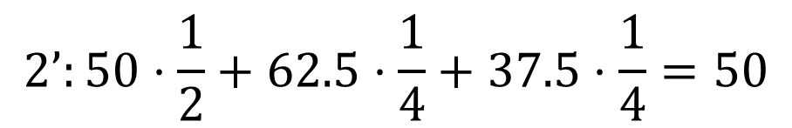
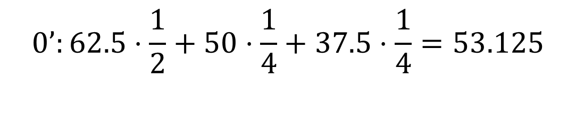
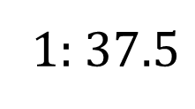
Out Sample
$w_{ij}=\left\{\begin{aligned}1−\sum_{k∈V∖\left\{i\right\}}{w_{ik}}, if i=j \\ \frac{1}{2⋅max\left\{\deg\left(j\right),\deg\left(i\right)\right\}}, else if \left(i,j\right)∈E \\ 0, otherwise\end{aligned}\right.$
2: 50
$$\frac{1}{4}$$
3 3
100 0 50
62.5 37.5 50
53.125 46.875 50
1: $37.5$
$$\frac{1}{4}$$
$$\frac{1}{4}$$
0: $62.5$
$$0’:62.5⋅\frac{1}{2}+50⋅\frac{1}{4}+37.5⋅\frac{1}{4}=53.125$$
$$1’:37.5⋅\frac{1}{2}+50⋅\frac{1}{4}+62.5⋅\frac{1}{4}=46.875$$
$$2’:50⋅\frac{1}{2}+62.5⋅\frac{1}{4}+37.5⋅\frac{1}{4}=50$$

Slide 18
Out Sample
#nodes #rounds
value1 value2 value3…
…
3 3
100.00 0.00 50.00
62.50 37.50 50.00
53.125 46.875 50.00
Note that the precision is set to 2
注意每個數字僅需列印出小數點下兩位
不需要另外處理四捨五入 (使用%.2f 輸出即可)

Slide 19
Further reading
Eigenvalue and eigenvector
Metropolis-based consensus matrix
Doubly stochastic matrix

Slide 20
Note
Superb deadline: 9/29 Tue
Deadline: 10/6 Tue
Submit your code to E-course2
Demonstrate your code in 工院1館 401B
C Source code
Show a good programming style

