Slide 1
CHAPTER 3
STACKS AND QUEUES
All the programs in this file are selected from
Ellis Horowitz, Sartaj Sahni, and Susan Anderson-Freed
“Fundamentals of Data Structures in C”,

Slide 2
A
Stack: a Last-In-First-Out (LIFO) list
B
A
C
B
A
D
C
B
A
E
D
C
B
A
top
D
C
B
A
top
top
top
top
top
*Figure 3.1: Inserting and deleting elements in a stack (p.108)

Slide 3
An application of stack: stack frame of function call
(activation record)
fp: a pointer to current stack frame
fp
al
fp
main
stack frame of invoking function
system stack before a1 is invoked
system stack after a1 is invoked
(a) (b)
*Figure 3.2: System stack after function call a1 (p.109)

Slide 4
ADT Stack is objects: a finite ordered list with zero or more elements. functions: for all stack ∈ Stack, item ∈ element, maxStackSize ∈ positive integer Stack CreateS(maxStackSize) ::= create an empty stack whose maximum size is maxStackSize Boolean IsFull(stack, maxStackSize) ::= if (number of elements in stack == maxStackSize) return TRUE else return FALSE Stack Push(stack, item) ::= if (IsFull(stack)) stackFull else insert item into top of stack and return
Abstract Data Type for Stack

Slide 5
Boolean IsEmpty(stack) ::= if(stack == CreateS(maxStackSize)) return TRUE else return FALSE Element Pop(stack) ::= if(IsEmpty(stack)) return else remove and return the item on the top of the stack.
*ADT 3.1: Abstract data type Stack (p.110)

Slide 6
Stack CreateS(maxStackSize) ::= #define MAX_STACK_SIZE 100 /* maximum stack size */ typedef struct { int key; /* other fields */ } element; element stack[MAX_STACK_SIZE]; int top = -1; Boolean IsEmpty(Stack) ::= top< 0; Boolean IsFull(Stack) ::= top >= MAX_STACK_SIZE-1;
Implementation: using array

Slide 7
void push(element item) { /* add an item to the global stack */ if (top >= MAX_STACK_SIZE-1) { stackFull( ); return; } stack[++top] = item; } *program 3.1: Add an item to a stack (p.111)
Add an item to a stack

Slide 8
element pop () { /* return the top element from the stack */ if (top == -1) return stackEmpty( ); /* returns and error key */ return stack[top--]; } *Program 3.2: Delete an item from a stack (p.111)
Delete an item from a stack

Slide 9
element *stack = malloc ( sizeof (*stack) ); int capacity = 1; void stackFull () { realloc (stack, 2*capacity*sizeof(*stack)); capacity *= 2; } *Program 3.4: Stack full with array doubling (p.113)
How to handle stackFull → Dynamic array
void stackFull () { realloc (stack, (capacity+1)*sizeof(*stack)); capacity +=1; }

Slide 10
element *stack = malloc ( sizeof (*stack) ); int capacity = 1; void stackFull () { realloc (stack, 2*capacity*sizeof(*stack)); capacity *= 2; } *Program 3.4: Stack full with array doubling (p.113)
How to handle stackFull → Dynamic array
Allocate and copy the O(capacity) memory for each time
void stackFull () { realloc (stack, (capacity+1)*sizeof(*stack)); capacity +=1; }

Slide 11
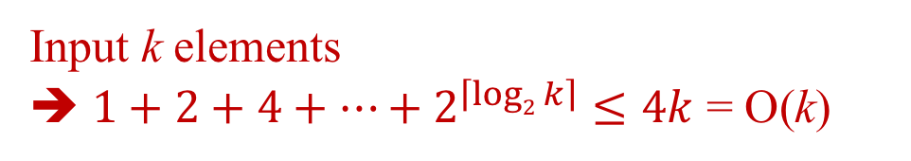
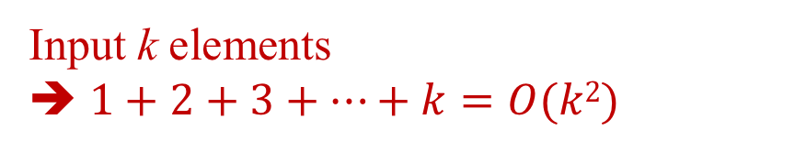
element *stack = malloc ( sizeof (*stack) ); int capacity = 1; void stackFull () { realloc (stack, 2*capacity*sizeof(*stack)); capacity *= 2; } *Program 3.4: Stack full with array doubling (p.113)
How to handle stackFull → Dynamic array
Allocate and copy the O(capacity) memory for each time
void stackFull () { realloc (stack, (capacity+1)*sizeof(*stack)); capacity +=1; }
Input k elements
➔ $1+2+3+…+k=O(k2)$
Input k elements
➔ $1+2+4+…+2^{\left\lceil log2 k\right\rceil }≤4k$ = O(k)

Slide 12
Queue: a First-In-First-Out (FIFO) list
A
B
A
C
B
A
D
C
B
A
rear
front
D
C
B
rear
front
rear
front
rear
front
rear
front
*Figure 3.4: Inserting and deleting elements in a queue (p.114)

Slide 13
Application: Packet switching

Slide 14
ADT Queue is objects: a finite ordered list with zero or more elements. functions: for all queue ∈ Queue, item ∈ element, maxQueueSize ∈ positive integer Queue CreateQ(maxQueueSize) ::= create an empty queue whose maximum size is maxQueueSize Boolean IsFullQ(queue, maxQueueSize) ::= if(number of elements in queue == maxQueueSize) return TRUE else return FALSE Queue AddQ(queue, item) ::= if (IsFullQ(queue)) queueFull else insert item at rear of queue and return queue
Abstract data type of queue

Slide 15
Boolean IsEmptyQ(queue) ::= if (queue ==CreateQ(maxQueueSize)) return TRUE else return FALSE Element DeleteQ(queue) ::= if (IsEmptyQ(queue)) return else remove and return the item at front of queue. *ADT 3.2: Abstract data type Queue (p.115)

Slide 16
Queue CreateQ(maxQueueSize) ::= # define MAX_QUEUE_SIZE 100/* Maximum queue size */ typedef struct { int key; /* other fields */ } element; element queue[MAX_QUEUE_SIZE]; int rear = -1; int front = -1; Boolean IsEmpty(queue) ::= front == rear Boolean IsFullQ(queue) ::= rear == MAX_QUEUE_SIZE-1
Implementation 1: using array (naïve version)

Slide 17
void addq (element item) { /* add an item to the queue */ if (rear == MAX_QUEUE_SIZE-1) queueFull( ); queue [++rear] = item; } *Program 3.5: Add an item to a queue (p. 116)
Add to a queue

Slide 18
element deleteq(int rear) { /* remove element at the front of the queue */ if ( front == rear) return queueEmpty( ); /* return an error key */ return queue [++front]; } *Program 3.6: Delete an item from a queue(p.116)
Delete from a queue
problem: there may be available space when IsFullQ is true ➔ movement is required.

Slide 19
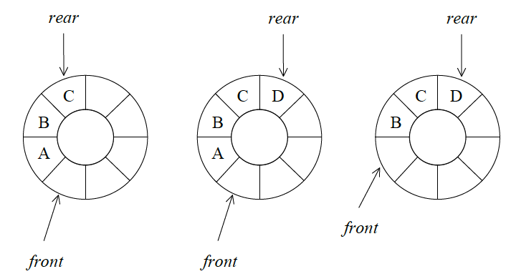
Implementation 2: regard an array as a circular queue
front: one position counterclockwise from the first element
rear: current end
*Figure 3.6: Circular queue (p. 117)

Slide 20
Add to a queue → circular queue?
void addq (element item) { /* add an item to the queue */ if (rear == MAX_QUEUE_SIZE-1) queueFull( ); queue [++rear] = item; } *Program 3.5: Add an item to a queue (p. 116)

Slide 21
Add to a circular queue?
void addq (element item) { /* add an item to the queue */ if (rear == front) queueFull();
rear = (rear+1) % MAX_QUEUE_SIZE; queue[rear] = item;
} *Program: Add an item to a circular queue

Slide 22
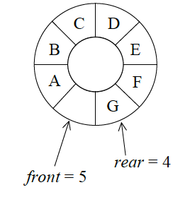
Add to a circular queue?
void addq (element item) { /* add an item to the queue */ if (rear == front) queueFull();
rear = (rear+1) % MAX_QUEUE_SIZE; queue[rear] = item;
} *Program: Add an item to a circular queue
H
rear = 5

Slide 23
Add to a circular queue?
void addq (element item) { /* add an item to the queue */ if (rear == front) queueFull(); rear = (rear+1) % MAX_QUEUE_SIZE; queue[rear] = item;
} *Program: Add an item to a circular queue
H
rear = 5
Problem: we cannot distinguish between an empty queue and a full queue

Slide 24
void addq(element item) { /* add an item to the queue */ rear = (rear +1) % MAX_QUEUE_SIZE; if (front == rear) queueFull ( ); /* print error and exit */ queue[rear] = item; } *Program 3.7: Add to a circular queue (p.118)
Add to a circular queue
Solution: front == rear if and only if the queue is empty

Slide 25
element deleteq ( ) { element item; /* remove front element from the queue and put it in item */ if (front == rear) return queueEmpty( ); /* queue_empty returns an error key */ front = (front+1) % MAX_QUEUE_SIZE; return queue[front]; } *Program 3.8: Delete from a circular queue (p.119)
Delete from a circular queue

Slide 26
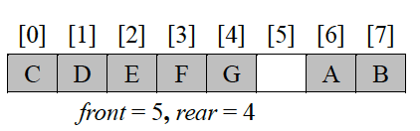
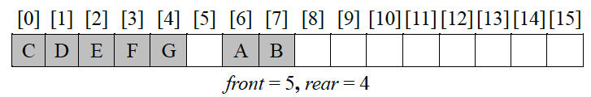
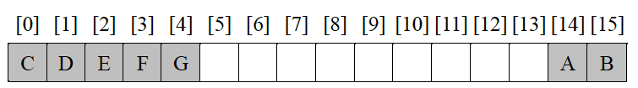
1. Use realloc ( ) to double the array size 2. Slide the elements
How to handle queueFull
front = 13, rear = 4

Slide 27
1. Use realloc ( ) to double the array size 2. Slide the elements
How to handle queueFull
#copy in realloc ( ) ➔ capacity
front = 13, rear = 4
G
A
B
C
D
E
F
#copy for sliding ➔ capacity-2

Slide 28
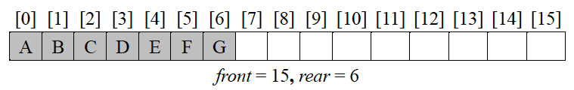
Alternative: 1. Create a new circular queue of twice the capacity using malloc ( ) 2. Copy the second segment queue [front+1: capacity-1] 3. Copy the first segment queue [0: rear]
How to handle queueFull
#copy ➔ capacity-1

Slide 30
Application of stacks: A Mazing Problem
entrance
0 1 0 0 0 1 1 0 0 0 1 1 1 1 1
1 0 0 0 1 1 0 1 1 1 0 0 1 1 1
0 1 1 0 0 0 0 1 1 1 1 0 0 1 1
1 1 0 1 1 1 1 0 1 1 0 1 1 0 0
1 1 0 1 0 0 1 0 1 1 1 1 1 1 1
0 0 1 1 0 1 1 1 0 1 0 0 1 0 1
0 1 1 1 1 0 0 1 1 1 1 1 1 1 1
0 0 1 1 0 1 1 0 1 1 1 1 1 0 1
1 1 0 0 0 1 1 0 1 1 0 0 0 0 0
0 0 1 1 1 1 1 0 0 0 1 1 1 1 0
0 1 0 0 1 1 1 1 1 0 1 1 1 1 0
exit
1: blocked path 0: through path
*Figure 3.8: An example maze (p.123)

Slide 31
Directions of Movement
*Figure 3.9: Allowable moves (p.124)

Slide 32
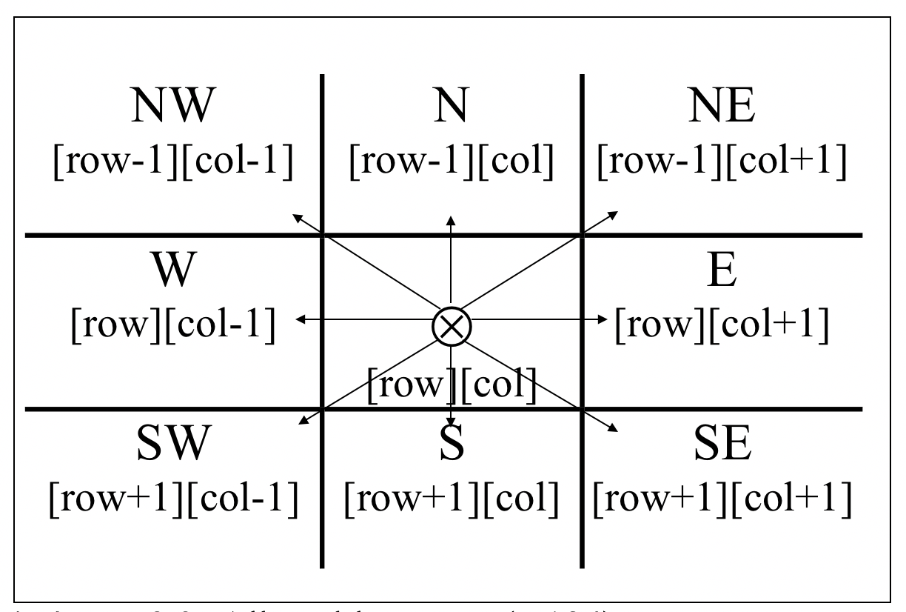
Not every position has 8 directions: At a border, there could be 5 or 3 neighbors
Number of Directions of Movement = 8?
Surround the maze by a border of ones
An m x p maze will require (m+2)(p+2) array
Entrance is at [1][1], and exit is at [m][p]

Slide 33
typedef struct { short int vert; short int horiz; } offsets; offsets move[8]; /*array of moves for each direction*/
A Possible Implementation
The position of the next move is set:
nextRow = row + move[dir].vert; nextCol = col + move[dir].horiz;
0
7 N 1
6 W E 2
5 S 3
4

Slide 34
#define MAX_STACK_SIZE ?? /*maximum stack size*/ typedef struct { short int row; short int col; short int dir; } element; element stack[MAX_STACK_SIZE];
Use stack to keep pass history

Slide 35
void path(void) {/* output a path through the maze if such a path exists*/ int i, row, col, nextRow, nextCol, dir, found = FALSE; element position; mark[1][1] = 1; top = 0; stack[0].row = 1; stack[0].col = 1; stack[0].dir = 1; while(top > -1 && !found) { position = pop(); row = position.row; col = position.col; dir = position.dir; while (dir < 8 && !found) { /* move in direction dir*/ nextRow = row + move[dir].vert; nextCol = col + move[dir].horiz; if (nextRow == EXIT_ROW && nextCol == EXIT_COL) found = true; else if (!maze[nextRow][nextCol] && !mark[nextRow][nextCol]) { mark[nextRow][nextCol]=1; position.row = row; position.col = col; position.dir = ++dir; push(position); row = nextRow; col = nextCol; dir = 0; } else ++dir; } }
Try all possible directions
Compute the next direction
Open path
&&
Unvisited
Push the current position
Move to the next position

Slide 36
if (found) { printf("The path is:\n”); printf(“row col\n”); for(i = 0; i <= top; i++) printf(“%2d%5d”,stack[i].row, stack[i].col); printf(“%2d%5d\n”,row,col); printf(“%2d%5d\n”,EXIT_ROW,EXIT_COL); } else printf(“The maze does not have a path\n”); } } *Program 3.12: Maze search function (p. 128)
For an m x p maze,
Memory size of the stack?
Time complexity?

Slide 37
if (found) { printf("The path is:\n”); printf(“row col\n”); for(i = 0; i <= top; i++) printf(“%2d%5d”,stack[i].row, stack[i].col); printf(“%2d%5d\n”,row,col); printf(“%2d%5d\n”,EXIT_ROW,EXIT_COL); } else printf(“The maze does not have a path\n”); } } *Program 3.12: Maze search function (p. 128)
For an m x p maze,
Memory size of the stack?
O(mp)
Time complexity?

Slide 39
X = a / b - c + d * e - a * c a = 4, b = c = 2, d = e = 3 Interpretation 1: ((4/2)-2)+(3*3)-(4*2) = 0 + 9 - 8=1 Interpretation 2: (4/(2-2+3))*(3-4)*2=(4/3)*(-1)*2=-2.66666… How to generate the machine instructions corresponding to a given expression? Precedence Hierarchy + Associative Rule
Evaluation of Expressions

Slide 40
X = a / b - c + d * e - a * c a = 4, b = c = 2, d = e = 3 Interpretation 1: ((4/2)-2)+(3*3)-(4*2) = 0 + 9 - 8=1 Interpretation 2: (4/(2-2+3))*(3-4)*2=(4/3)*(-1)*2=-2.66666… How to generate the machine instructions corresponding to a given expression? Precedence Hierarchy + Associative Rule
Evaluation of Expressions
Use parentheses to change the order

Slide 41
X = a / b - c + d * e - a * c a = 4, b = c = 2, d = e = 3 Interpretation 1: ((4/2)-2)+(3*3)-(4*2) = 0 + 9 - 8=1 Interpretation 2: (4/(2-2+3))*(3-4)*2=(4/3)*(-1)*2=-2.66666… How to generate the machine instructions corresponding to a given expression? Precedence Hierarchy + Associative Rule
Evaluation of Expressions
Use parentheses to change the order
order of operators
the same precedence

Slide 42
X = a / b - c + d * e - a * c a = 4, b = c = 2, d = e = 3 Interpretation 1: ((4/2)-2)+(3*3)-(4*2) = 0 + 9 - 8=1 Interpretation 2: (4/(2-2+3))*(3-4)*2=(4/3)*(-1)*2=-2.66666… How to generate the machine instructions corresponding to a given expression? Precedence Hierarchy + Associative Rule
Evaluation of Expressions
Use parentheses to change the order
order of operators
the same precedence

Slide 45
1. The precedence column is taken from Harbison and Steele.
2. Postfix form
3. Prefix form
*Figure 3.12: Precedence hierarchy for C (p. 130)

Slide 46
user
compiler
*Figure 3.13: Infix and postfix notation (p. 131)
Postfix: no parentheses, no precedence

Slide 47
6 2 / 3 - 4 2 * +
6/2 - 3 + 4*2 = 8
*Figure 3.14: Postfix evaluation (p. 131)

Slide 48
#define MAX_STACK_SIZE 100 /* maximum stack size */ #define MAX_EXPR_SIZE 100 /* max size of expression */ typedef enum{1paren, rparen, plus, minus, times, divide, mod, eos, operand} precedence; /* eos: end-of-string */ int stack[MAX_STACK_SIZE]; /* global stack */ char expr[MAX_EXPR_SIZE]; /* input string */
Goal: evaluate infix
infix → postfix and evaluate postfix
Assumptions:
operators: +, -, *, /, %
operands: single digit integer

Slide 49
int eval(void) { /* evaluate a postfix expression, expr, maintained as a global variable, ‘\0’ is the the end of the expression. The stack and top of the stack are global variables. get_token is used to return the token type and the character symbol. Operands are assumed to be single character digits */ precedence token; char symbol; int op1, op2; int n = 0; /* counter for the expression string */ int top = -1; token = getToken(&symbol, &n); while (token != eos) { if (token == operand) push (symbol-’0’); /* stack insert */
Retrieve the first token
expr: character array

Slide 50
else { /* remove two operands, perform operation, and return result to the stack */ op2 = pop ( ); /* stack delete */ op1 = pop ( ); switch(token) { case plus: push (op1+op2); break; case minus: push (op1-op2); break; case times: push (op1*op2); break; case divide: push (op1/op2); break; case mod: push (op1%op2); } } token = getToken (&symbol, &n); } return pop ( ); /* return result */ } *Program 3.13: Function to evaluate a postfix expression (p. 133)
Retrieve the next token

Slide 51
precedence getToken(char *symbol, int *n) { /* get the next token, symbol is the character representation, which is returned, the token is represented by its enumerated value, which is returned in the function name */ *symbol =expr[(*n)++]; switch (*symbol) { case ‘(‘ : return lparen; case ’)’ : return rparen; case ‘+’: return plus; case ‘-’ : return minus;
Retrieve the token from expr

Slide 52
case ‘/’ : return divide; case ‘*’ : return times; case ‘%’ : return mod; case ‘\0‘ : return eos; default : return operand; /* no error checking, default is operand */ } } *Program 3.14: Function to get a token from the input string (p. 134)

Slide 53
Infix to Postfix Conversion (Intuitive Method)
(1) Fully parenthesize expression
a / b - c + d * e - a * c -->
((((a / b) - c) + (d * e)) - a * c))
(2) All operators replace their corresponding right
parentheses.
((((a / b) - c) + (d * e)) - a * c))
(3) Delete all parentheses.
ab/c-de*+ac*-
*
*
/
-
-
+
Inefficient on a computer
1. Read the expression and parenthesize
2. Move operators

Slide 54
Example [Simple expression]
a + b * c → a b c * +
*Figure 3.15: Translation of a+b*c to postfix (p. 135)
Operator with higher precedence must be output before those with lower precedence
Stack an incoming operator only if its precedence is larger than the precedence of the operator at the top of the stack

Slide 55
Example [Parenthesized expression] a *₁ (b +c) *₂ d
match ‘)’
*₁ = *₂
Stack operators until we reach ‘)‘
Unstack operators until we reach the corresponding ‘(’
*Figure 3.16: Translation of a*(b+c)*d to postfix (p.135)

Slide 56
Rules
Incoming
 | + (or -) | * (or /) | ( | )
+₁ (or -) | pop +₁ push + | push * | push ( | pop until (
*₁ (or /) | pop *₁ push + | pop *₁ push * | push ( | pop until (
( | push + | push * | push (
In stack
Issue: “(‘ has two precedencies
Notes:
要進入 stack 時，乘比加還要優先
在 stack 中準備離開 stack 時，乘也比加還要優先

Slide 57
Rules
(1) Operators are taken out of the stack as long as their
in-stack precedence is higher than or equal to the
incoming precedence of the new operator.
(2) ( has low in-stack precedence, and high incoming
precedence.
( ) + - * / % eos
isp 0 19 12 12 13 13 13 0
icp 20 19 12 12 13 13 13 0

Slide 58
typedef enum{1paren, rparen, plus, minus, times, divide, mod, eos, operand} precedence; /* eos: end-of-string */ precedence stack[MAX_STACK_SIZE]; /* isp and icp arrays -- index is value of precedence lparen, rparen, plus, minus, times, divide, mod, eos */ int isp [ ] = {0, 19, 12, 12, 13, 13, 13, 0}; int icp [ ] = {20, 19, 12, 12, 13, 13, 13, 0};
isp: in-stack precedence
icp: incoming precedence

Slide 59
void postfix(void) { /* output the postfix of the expression. The expression string, the stack, and top are global */ char symbol; precedence token; int n = 0; int top = 0; /* place eos on stack */ stack[0] = eos; for (token = getToken(&symbol, &n); token != eos; token = get_token(&symbol, &n)) { if (token == operand) printf (“%c”, symbol); else if (token == rparen ){
Unstack the stack until reach ‘(‘

Slide 60
/*unstack tokens until left parenthesis */ while (stack[top] != lparen) printToken(pop( )); pop( ); /*discard the left parenthesis */ } else{ /* remove and print symbols whose isp is greater than or equal to the current token’s icp */ while( isp[stack[top]] >= icp[token] ) printToken( pop ( )); push (token); } } while ((token = pop ( )) != eos) printToken(token); print(“\n”); } *Program 3.11: Function to convert from infix to postfix (p.126)
f(n)=θ(g(n)) iff there exist positive
constants c₁, c₂, and n₀ such
that c₁g(n)≤f(n)≤c₂g(n) for all
n, n≥n₀.
f(n)=θ(g(n)) iff g(n) is both an
upper and lower bound on f(n).
θ(n)

Slide 62
Single Stack → Multiple Stacks
If only two stacks,
m[0], m[1], …, m[n-2], m[n-1]
Bottom Bottom
stack 1 stack 2
More than two stacks (n)
memory is divided into equal segments
boundary[stack_no]
0 ≤ stack_no < MAX_STACKS
top[stack_no]
0 ≤ stack_no < MAX_STACKS

Slide 63
Initially, boundary[i]=top[i].
0 1 $⌊\text{m}\text{/}\text{n}⌋$ 2 $⌊\text{m}\text{/}\text{n}⌋$ m-1
-1
boundary[ 0] boundary[1] boundary[ 2] boundary[n]
top[ 0] top[ 1] top[ 2]
All stacks are empty and divided into roughly equal segments.
*Figure 3.18: Initial configuration for n stacks in memory [m]. (p. 140)

Slide 64
#define MEMORY_SIZE 100 /* size of memory */ #define MAX_STACK_SIZE 100 /* max number of stacks plus 1 */ /* global memory declaration */ element memory[MEMORY_SIZE]; int top[MAX_STACKS]; int boundary[MAX_STACKS]; int n; /* number of stacks entered by the user */ *(p.139) top[0] = boundary[0] = -1; for (i = 1; i < n; i++) top[i] =boundary[i] =(MEMORY_SIZE/n)*i; boundary[n] = MEMORY_SIZE-1; *(p.139)

Slide 65
void push (int i, element item) { /* add an item to the ith stack */ if (top[i] == boundary [i+1]) stackFull(i); may have unused storage memory[++top[i]] = item; } *Program 3.16: Add an item to the ith stack (p. 140) element pop (int i) { /* remove top element from the ith stack */ if (top[i] == boundary[i]) return stackEmpty(i); return memory[top[i]--]; } *Program 3.17: Delete an item from the ithstack (p.141)

Slide 66
(往右)
Find j, stack_no < j < n
such that top[j] < boundary[j+1]
or, 0 ≤ j < stack_no
(往左)
b[0] t[0] b[1] t[1] b[i] t[i] t[i+1] t[j] b[j+1] b[n]
b[i+1] b[i+2]
b=boundary, t=top
*Figure 3.19: Configuration when stack i meets stack i+1,
but the memory is not full (p. 141)
meet
往左或右找一個空間

