Slide 1
Store item demand Forecasting
Chan Dat thai

Slide 2
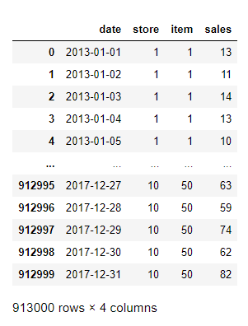
Dataset
Training
50 items
10 stores
5 years
913K instances
Predict 3 months

Slide 3
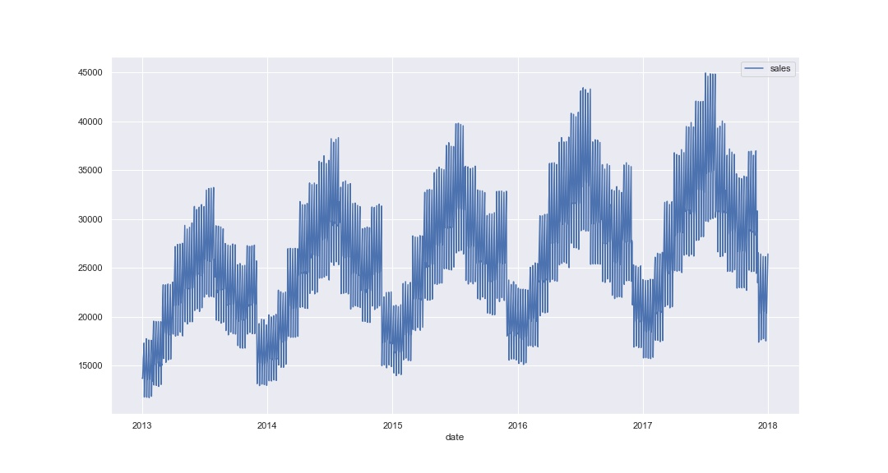
Generic plots

Slide 4
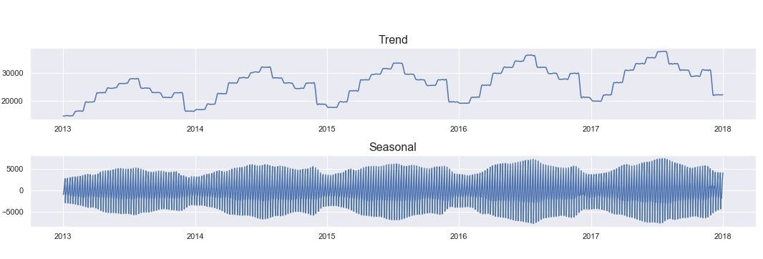
Trend and seasonality

Slide 5
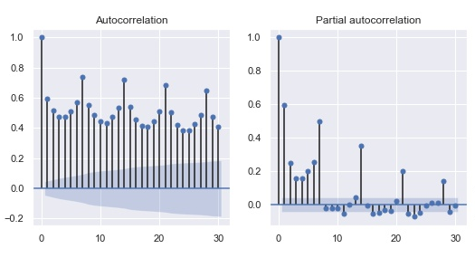
ACF and PACF

Slide 6
Methods
SARIMA
SARIMAX with Fourier terms
TBATS
XGBoost

Slide 7
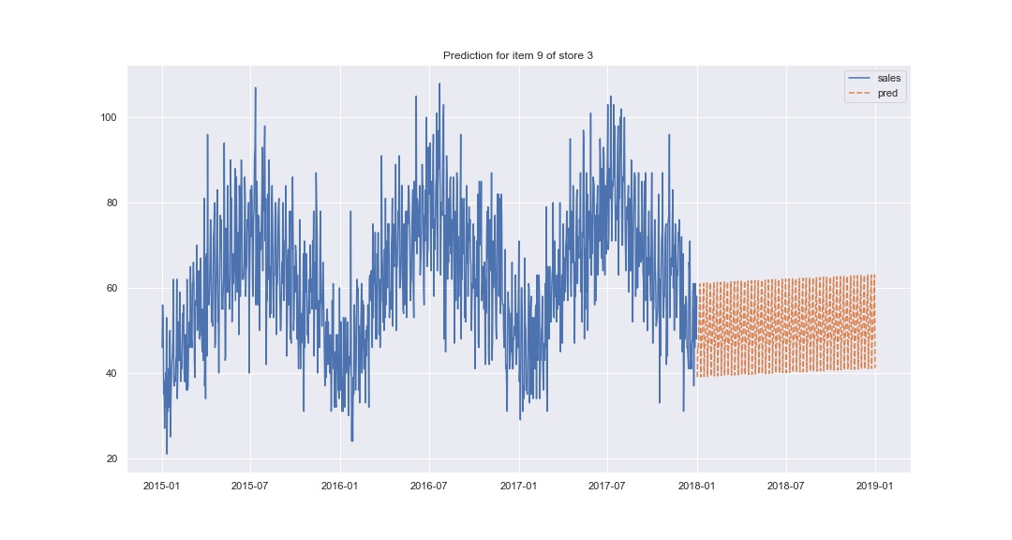
SARIMA (0,1,1)(3,0,1,7)

Slide 8
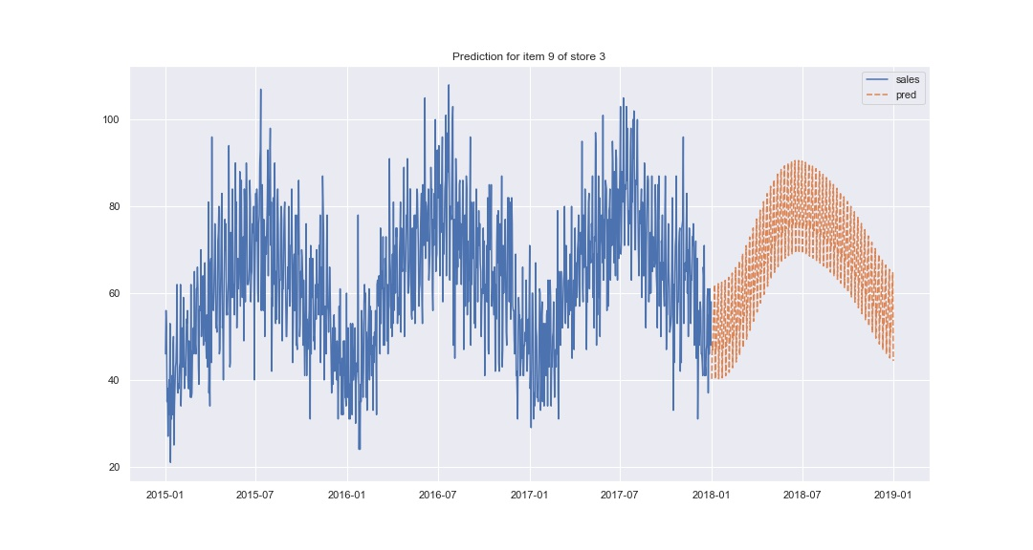
SARIMAX (2,1,3)(3,0,1,7) w/ exog = Fourier terms

Slide 9
TBATS
Consider models
Box-Cox transformation
Trend
Trend Damping
ARMA(p,q) process used to model residuals
non-seasonal model
various amounts of harmonics used to model seasonal effects
Final model chosen using AIC
Pros
Simple
Support multiple seasonality
Cons
Generic and slow
No exogenous variables

Slide 10
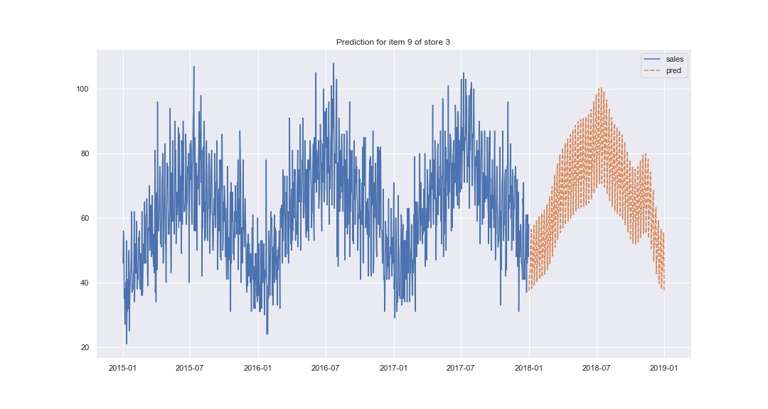
TBATS

Slide 11
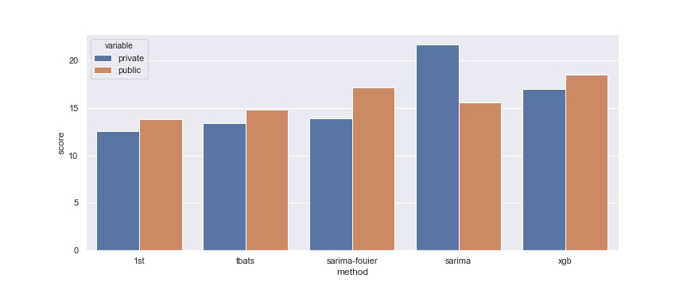
Evaluation

Slide 12
Thank you
Chan Dat thai

