Slide 1
Widget Title: Find The DNA Lengths
TP Details:
CBSE Chapter 9: Biotechnology: Principles and Processes
Science Level 6:
TP id: tp-04e8e005-cac7-41d2-9717-d9220252351f
TP title: Tools of Recombinant DNA Technology: Restriction Enzymes

Slide 2
Objective:
To determine sample DNA fragment sizes by comparing their band positions with a standard DNA ladder on agarose gel electrophoresis.
Use Case and User Interaction:
Users can observe DNA band positions of four samples alongside a DNA ladder on simulated gel electrophoresis results.
Users can estimate and enter fragment sizes in base pairs (bps) by comparing sample band positions with ladder markers.
Immediate validation shows correct answers, helping users refine their measurement accuracy.
Five different sample sets provide varied practice scenarios for developing gel interpretation skills.

Slide 3
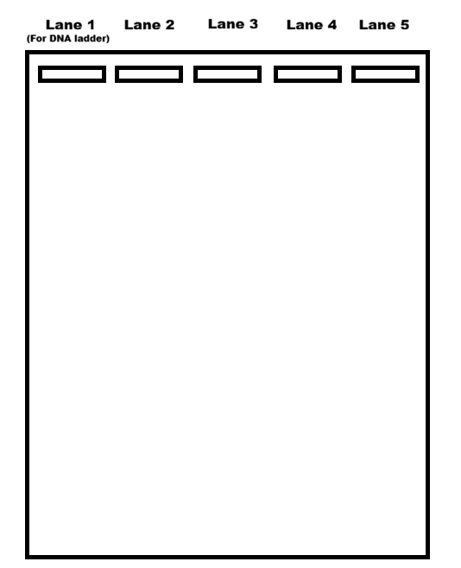
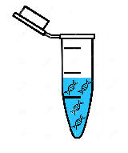
Find The DNA Lengths
DNA samples in loading mixtures
Sample 1
Sample 2
DNA ladder
Sample 3
Sample 4
Agarose Gel Electrophoresis
Tap the Eppendorf tubes (in any order) to load DNA samples.
Insights
Notes:
The user can select any of the five tubes in any order.
The user can press “Insight” button for having an insight about the widget’s topic.

Slide 4

Find The DNA Lengths
DNA samples in loading mixtures
Basis of Agarose Gel Electrophoresis:
Separation by size - DNA fragments are separated based on their molecular weight, with smaller fragments migrating faster through the gel matrix than larger ones
Negative charge movement - DNA molecules are negatively charged due to their phosphate backbone, so they migrate toward the positive electrode (anode) when an electric field is applied
DNA ladder as reference - A DNA ladder (molecular weight marker) containing fragments of known sizes runs alongside samples, allowing accurate size determination by comparison
Sample 1
Sample 2
DNA ladder
Sample 3
Sample 4
Agarose Gel Electrophoresis
Tap the Eppendorf tubes (in any order) to load DNA samples.
Insights
Notes:
If the user presses the “Insights” button, then the given information pops up.
The user can close it by tapping on the cross button.

Slide 5
Find The DNA Lengths
DNA samples in loading mixtures
(-)
Sample 1
Sample 2
DNA ladder
Sample 3
Sample 4
Agarose Gel Electrophoresis
Tap the Eppendorf tubes (in any order) to load DNA samples.
(+)
Insights
Notes:
1. When the user selects any tube. It gets highlighted.

Slide 6
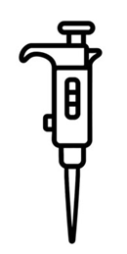
Find The DNA Lengths
DNA samples in loading mixtures
(-)
Sample 1
Sample 2
DNA ladder
Sample 3
Sample 4
Agarose Gel Electrophoresis
Tap the Eppendorf tubes (in any order) to load DNA samples.
(+)
Insights
Notes:
1. After selecting the tube, automatically a micropipette appears.

Slide 7
Find The DNA Lengths
DNA samples in loading mixtures
(-)
Sample 1
Sample 2
DNA ladder
Sample 3
Sample 4
Agarose Gel Electrophoresis
Tap the Eppendorf tubes (in any order) to load DNA samples.
(+)
Insights
Notes:
1. The mixture is sucked in the micropipette.

Slide 8
Find The DNA Lengths
DNA samples in loading mixtures
(-)
Sample 1
Sample 2
DNA ladder
Sample 3
Sample 4
Agarose Gel Electrophoresis
Tap the Eppendorf tubes (in any order) to load DNA samples.
(+)
Insights
Notes:
1. The micropipette goes to the Lane 1 for DNA ladder. (Note for DNA ladder the animation should always show the micropipette going to the Lane 1).

Slide 9
Find The DNA Lengths
DNA samples in loading mixtures
(-)
Sample 1
Sample 2
DNA ladder
Sample 3
Sample 4
Agarose Gel Electrophoresis
Tap the Eppendorf tubes (in any order) to load DNA samples.
(+)
Insights
Notes:
1. The sample is loaded in the Lane 1 through animation.

Slide 10
Find The DNA Lengths
DNA samples in loading mixtures
(-)
Sample 1
Sample 2
DNA ladder
Sample 3
Sample 4
Agarose Gel Electrophoresis
Tap the Eppendorf tubes (in any order) to load DNA samples.
(+)
Insights
Notes:
After the first sample is loaded it is marked with a different colour.
The user can then select the second sample.

Slide 11
Find The DNA Lengths
DNA samples in loading mixtures
(-)
Sample 1
Sample 2
DNA ladder
Sample 3
Sample 4
Agarose Gel Electrophoresis
Tap the Eppendorf tubes (in any order) to load DNA samples.
(+)
Insights
Notes:
1. Repeat the animation of slide 6.

Slide 12
Find The DNA Lengths
DNA samples in loading mixtures
(-)
Sample 1
Sample 2
DNA ladder
Sample 3
Sample 4
Agarose Gel Electrophoresis
Tap the Eppendorf tubes (in any order) to load DNA samples.
(+)
Insights
Notes:
1. Repeat the animation of slide 7.

Slide 13
Find The DNA Lengths
DNA samples in loading mixtures
(-)
Sample 1
Sample 2
DNA ladder
Sample 3
Sample 4
Agarose Gel Electrophoresis
Tap the Eppendorf tubes (in any order) to load DNA samples.
(+)
Insights
Notes:
For samples other than the DNA ladder, the animation should show that the micropipette going to the next lane of Ladder.
NOTE: Although the samples (1 to 4) can be selected in any order, they should be loaded in the order from Lane 2 to Lane 5.

Slide 14
Find The DNA Lengths
DNA samples in loading mixtures
(-)
Sample 1
Sample 2
DNA ladder
Sample 3
Sample 4
Agarose Gel Electrophoresis
Tap the Eppendorf tubes (in any order) to load DNA samples.
(+)
Insights
Notes:
1. The sample is loaded in the Lane 2 through animation.

Slide 15
Find The DNA Lengths
DNA samples in loading mixtures
(-)
(Sample 3)
Sample 1
Sample 2
DNA ladder
Sample 3
Sample 4
Agarose Gel Electrophoresis
Tap the Eppendorf tubes (in any order) to load DNA samples.
(+)
Insights
Notes:
1. After the second sample is loaded it is marked with a different colour.

Slide 16
Find The DNA Lengths
DNA samples in loading mixtures
(-)
(Sample 3)
(Sample 1)
(Sample 4)
(Sample 1)
Sample 1
Sample 2
DNA ladder
Sample 3
Sample 4
Agarose Gel Electrophoresis
(+)
Insights
Notes:
This way all the lanes are loaded with the sample.
All the sample tubes are marked with a different color.

Slide 17
Find The DNA Lengths
DNA samples in loading mixtures
(-)
(Sample 3)
(Sample 1)
(Sample 4)
(Sample 1)
Sample 1
Sample 2
DNA ladder
Sample 3
Sample 4
Agarose Gel Electrophoresis
(+)
Tap Start to run the DNA samples through Agarose Gel Electrophoresis
Insights
Start
Reload
Notes:
After all the lanes are loaded, the Start and Reset button appear.
If the user presses “Reset” button the user can again reload all the samples from slide 5 to slide 16.

Slide 18
Find The DNA Lengths
DNA samples in loading mixtures
(-)
(Sample 3)
(Sample 1)
(Sample 4)
(Sample 1)
Base pairs (bps)
2100 bps
2000 bps
1900 bps
1800 bps
1700 bps
1600 bps
Sample 1
Sample 2
1500 bps
1400 bps
1300 bps
1200 bps
1100 bps
1000 bps
900 bps
800 bps
DNA ladder
700 bps
600 bps
500 bps
400 bps
300 bps
200 bps
Sample 3
Sample 4
100 bps
Agarose Gel Electrophoresis
(+)
Insights
Notes:
If the user presses “Start” button, the DNA samples start running and bands form. (Refer to the last slide [23] for the reference of animation).
Then the bands form.

Slide 19
Find The DNA Lengths
DNA samples in loading mixtures
(-)
(Sample 3)
(Sample 1)
(Sample 4)
(Sample 1)
Base pairs (bps)
2100 bps
2000 bps
1900 bps
1800 bps
1700 bps
1600 bps
Sample 1
Sample 2
1500 bps
1400 bps
bps
1300 bps
bps
1200 bps
1100 bps
1000 bps
900 bps
800 bps
DNA ladder
700 bps
600 bps
500 bps
400 bps
300 bps
200 bps
Sample 3
Sample 4
100 bps
Agarose Gel Electrophoresis
bps
bps
(+)
Enter the DNA sample length (bps) for each loading mixture in the boxes below the samples.
Insights
Notes:
1.After the DNA bands form text boxes appear below the sample tubes, where the user has to manually enter the correct values.

Slide 20
Find The DNA Lengths
DNA samples in loading mixtures
(-)
(Sample 3)
(Sample 1)
(Sample 4)
(Sample 1)
Base pairs (bps)
2100 bps
2000 bps
1900 bps
1800 bps
1700 bps
1600 bps
Sample 1
Sample 2
1500 bps
1400 bps
1400 bps
1300 bps
1000 bps
1200 bps
Very good!
Very good!
1100 bps
1000 bps
900 bps
800 bps
DNA ladder
700 bps
600 bps
500 bps
400 bps
300 bps
200 bps
Sample 3
Sample 4
100 bps
V
Agarose Gel Electrophoresis
1900 bps
500 bps
(+)
Not really! Enter the correct length.
Very good!
Enter the DNA sample length (bps) for each loading mixture in the boxes below the samples.
Insights
Notes:
For correct values the text boxes will appear green with a feedback message.
For wrong values the text boxes will appear red with a feedback message.

Slide 21
Find The DNA Lengths
DNA samples in loading mixtures
(-)
(Sample 3)
(Sample 1)
(Sample 4)
(Sample 1)
Base pairs (bps)
2100 bps
2000 bps
1900 bps
1800 bps
1700 bps
1600 bps
Sample 1
Sample 2
1500 bps
1400 bps
1400 bps
1300 bps
1000 bps
1200 bps
Very good!
Very good!
1100 bps
1000 bps
900 bps
800 bps
700 bps
600 bps
500 bps
400 bps
300 bps
200 bps
Sample 3
V
100 bps
Agarose Gel Electrophoresis
1700 bps
500 bps
(+)
Very good!
Very good!
Excellent! You have successfully found the length of all the DNA samples.
Insights
Reset
Notes:
After all the correct values are entered a success feedback message appears.
The “Reset” button also appears
Pressing the “Reset” button restarts the entire widget from slide 3, but with a new set of four samples, having completely different lengths of DNA.
There are total 5 different sets of DNA samples which randomly appear.

Slide 22
Instruction for creation of sample Sets
Set 1:
Sample lengths: 500, 1000, 1400, 1700
Set 2:
Sample lengths: 300, 700, 1200, 2000
Set 3:
Sample lengths: 600, 800, 1900, 2100
Set 4:
Sample lengths: 100, 900, 1300, 1800
Set 5:
Sample lengths: 200, 600, 1100, 1500
The sets should appear randomly in the widget.

Slide 23
Reference for Slide 18
Please refer to the following video for the animation of the DNA bands running and appearing in Agarose Gel Electrophoresis
TP ID: tp-04e8e005-cac7-41d2-9717-d9220252351f
Level: 6
Subject: Biology
MM ID: d5cbf169-1238-4b6d-9e82-6ed40f0d46bd
MM Name: How do restriction enzymes help cut the DNA?
MM duration: 03:18-03:47

