Slide 1
Widget – Addition of Integers

Slide 2
Addition of Integers
Class 6 Addition of Integers tp-8278baad-c9b3-4533-9db6-1f32701d5418
The teacher uses chip method to show how integers can be added. She/he establishes that the sum of+1 and -1 is 0 through the cancellation of chips.
The teacher reinforces the concept of addition as moving forward or backward depending on the integer to be added using the number line

Slide 3
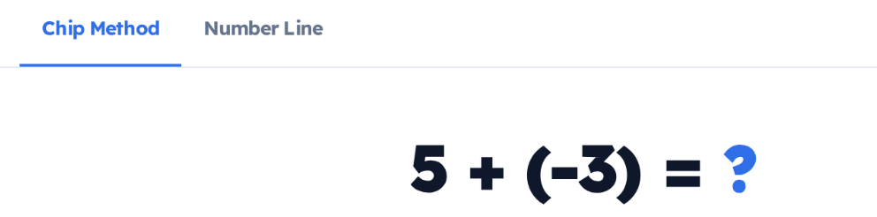

+
+
+
+
+
-
-
-
Playground Mode
Tap each pair of positive and negative chips.
Show Answer
Type your addition problem

Slide 4

+
+
+
+
+
-
-
-
Playground Mode
Show Answer
Type your addition problem
Notes:
The user taps each pair and makes it disappear

Slide 5
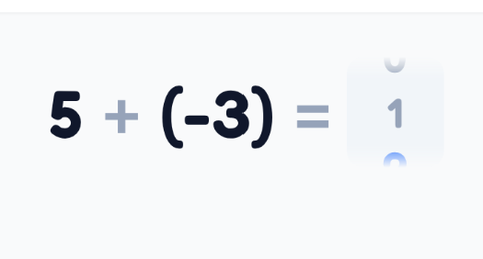
Note to developer Use numpad or let the user annotate to write the answrer
+
+
+
+
+
-
-
-
Playground Mode
Show Answer
Type your addition problem
Notes:
The user scrolls the ? Mark to type the answer or let the user use annotation tools to write the answer

Slide 6
+
+
+
+
+
-
-
-
Playground Mode
Show Answer
Type your addition problem
Notes:
When the user clicks on Show Answer, Group the pair of red and blue buttons and make them disappear by a pop effect (sound)

Slide 7
2
+
+
Playground Mode
Show Answer
Type your addition problem
Notes:
When the user clicks on Show Answer, Group the pair of red and blue buttons and make them disappear by a pop effect and the ? mark is replaced by the number

Slide 8
2
+
-
Playground Mode
Type your addition problem
Tap the chips to add them.
Notes:
When the user clicks on Playground mode, the user will have to add the chips. Tap the chips to add them. The user can type the problem in the box

Slide 9
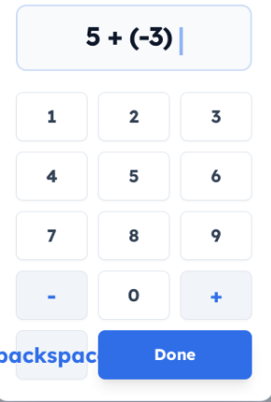
+
+
+
+
+
-
-
-
Type your addition problem
Show Answer
Type your addition problem
Notes:
When the user clicks on Type your addition problem button, a keypad opens up and the user can type the question. When the question is typed and clicked Done it shows the initial screen

Slide 10
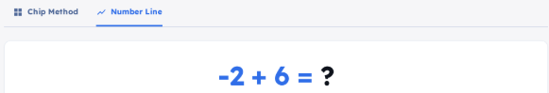

Tap the answer on the number line
Start
Hint
Show Answer
Type your addition problem
Notes:
When the user clicks on the number line, a feedback Lottie animation is shown for the correct and incorrect answer and the correct number of jumps are shown

Slide 11

That’s correct!
4
Tap the answer on the number line
Start
Hint
Show Answer
Type your addition problem
Notes:
When the user clicks on the number line, a feedback Lottie animation is shown for the correct and incorrect answer and the correct number of jumps are shown

Slide 12
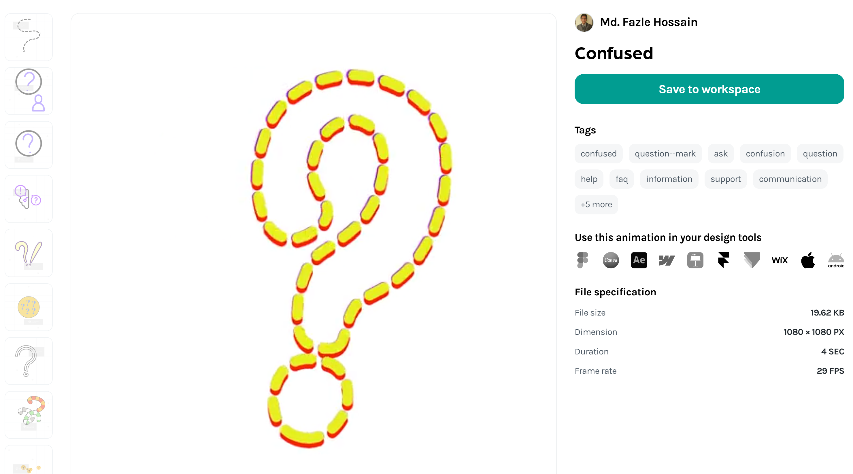
Not quite!
?
Tap the answer on the number line
Start
Hint
Show Answer
Type your addition problem
Notes:
When the user clicks on the number line, a feedback Lottie animation is shown for the incorrect answer. When the Show Answer button is clicked, show the right answer with the correct number of jumps.

Slide 13
Start at the first number on the number line
The second number tells you how many steps to move
Move forward (right) when adding a positive integer
E.g., -5 + 2 → start at -5, move 2 steps right → land on -3
4. Move backward (left) when adding a negative integer
E.g., -5 + (-2) → start at -5, move 2 steps left → land on -7
Tap the answer on the number line
Start
Hint
Show Answer
Type your addition problem
Notes:
When the user clicks on Hint, show the Hint

Slide 14
Rules for the developer
Red chip shows positive number whereas black chip shows negative number. Limit the number from -10 to 10. The answer can be from -20 to 2
Use sound effects (pop sound) for disappearing chips
Number line method:
Move forward (right) when adding a positive integer E.g., -5 + 2 → start at -5, move 2 steps right → land on -3
Move backward (left) when adding a negative integerE.g., 5 + (-2) → start at 5, move 2 steps left → land on 3

