Slide 1
Widget Title: Tests of Divisibility
TP Details:
CBSE Chapter 5: Prime Time
Divisibility
Math Level 3
TP id: tp-84193065-6c41-493a-8fdf-7271bcc2a516
TP title: Tests of Divisibility

Slide 2
Objective
The Factor Flask Game is an educational math game designed to help users understand and practice the concept of factors through an engaging, interactive experience.
Use case and user interaction
By playing this game, users will:
Understand what factors are (numbers that divide evenly into another number)
Develop pattern recognition skills with multiples and divisibility
Practice mental division with numbers up to 4 digits
Improve problem-solving speed and accuracy
Learn divisibility rules naturally through practice
Teachers assign the game as homework or in-class activity
Students practice identifying factors in an engaging, self-paced environment
Teachers can use it during math centers or as a reward activity
Progress tracking through scores helps assess student understanding
Interactive factor collection game - Claude

Slide 3
How to Play:
• Click on balls that are factors of the target number on the flask
• A factor divides the target number evenly (no remainder)
• Correct answers: +10 points
• Wrong answers: -5 points
• Try to collect all the factors and maximize your score!
• Once score of 200 is attained the user will progress to next level.
Interactive bar graph creation - Claude

Slide 4
Feedback
For Number 2: ✗ Wrong! Test for 2: A number is divisible by 2 if it ends in 0, 2, 4, 6, or 8. [target number] ends in [last digit].
For Number 3: ✗ Wrong! Test for 3: Sum the digits. [digit] + [digit] + [digit] + [digit] = [sum]. Since [sum] ÷ 3 has a remainder, [target number] is not divisible by 3.
For Number 4: ✗ Wrong! Test for 4: Check if the last 2 digits form a number divisible by 4. The last two digits are [last two digits], and [last two digits] ÷ 4 has a remainder.
For Number 5: ✗ Wrong! Test for 5: A number is divisible by 5 if it ends in 0 or 5. [target number] ends in [last digit].
For Number 6: ✗ Wrong! Test for 6: Must be divisible by both 2 and 3. [target number] is odd, so not divisible by 2.
OR
✗ Wrong! Test for 6: Must be divisible by both 2 and 3. [target number] is even, but digit sum ([sum]) is not divisible by 3.
For Number 9: ✗ Wrong! Test for 9: Sum the digits. [digit] + [digit] + [digit] + [digit] = [sum]. Since [sum] ÷ 9 has a remainder, [target number] is not divisible by 9.
For Number 10: ✗ Wrong! Test for 10: A number is divisible by 10 if it ends in 0. [target number] ends in [last digit].
For Number 11: ✗ Wrong! Test for 11: Alternating sum of digits. +[digit] -[digit] +[digit] -[digit] = [alternating sum]. Not divisible by 11.
Example with target number 3690:
2: ✗ Wrong! Test for 2: A number is divisible by 2 if it ends in 0, 2, 4, 6, or 8. 3690 ends in 0. (This would actually be correct!)
3: ✗ Wrong! Test for 3: Sum the digits. 3 + 6 + 9 + 0 = 18. Since 18 ÷ 3 has a remainder, 3690 is not divisible by 3. (This would actually be correct!)
4: ✗ Wrong! Test for 4: Check if the last 2 digits form a number divisible by 4. The last two digits are 90, and 90 ÷ 4 has a remainder.
11: ✗ Wrong! Test for 11: Alternating sum of digits. +3 -6 +9 -0 = 6. Not divisible by 11.

Slide 5
Feedback
For Number 2: ✗ Wrong! Test for 2: A number is divisible by 2 if it ends in 0, 2, 4, 6, or 8. [target number] ends in [last digit].
For Number 3: ✗ Wrong! Test for 3: Sum the digits. [digit] + [digit] + [digit] + [digit] = [sum]. Since [sum] ÷ 3 has a remainder, [target number] is not divisible by 3.
For Number 4: ✗ Wrong! Test for 4: Check if the last 2 digits form a number divisible by 4. The last two digits are [last two digits], and [last two digits] ÷ 4 has a remainder.
For Number 5: ✗ Wrong! Test for 5: A number is divisible by 5 if it ends in 0 or 5. [target number] ends in [last digit].
For Number 6: ✗ Wrong! Test for 6: Must be divisible by both 2 and 3. [target number] is odd, so not divisible by 2.
OR
✗ Wrong! Test for 6: Must be divisible by both 2 and 3. [target number] is even, but digit sum ([sum]) is not divisible by 3.
For Number 9: ✗ Wrong! Test for 9: Sum the digits. [digit] + [digit] + [digit] + [digit] = [sum]. Since [sum] ÷ 9 has a remainder, [target number] is not divisible by 9.
For Number 10: ✗ Wrong! Test for 10: A number is divisible by 10 if it ends in 0. [target number] ends in [last digit].
For Number 11: ✗ Wrong! Test for 11: Alternating sum of digits. +[digit] -[digit] +[digit] -[digit] = [alternating sum]. Not divisible by 11.
Example with target number 3690:
2: ✗ Wrong! Test for 2: A number is divisible by 2 if it ends in 0, 2, 4, 6, or 8. 3690 ends in 0. (This would actually be correct!)
3: ✗ Wrong! Test for 3: Sum the digits. 3 + 6 + 9 + 0 = 18. Since 18 ÷ 3 has a remainder, 3690 is not divisible by 3. (This would actually be correct!)
4: ✗ Wrong! Test for 4: Check if the last 2 digits form a number divisible by 4. The last two digits are 90, and 90 ÷ 4 has a remainder.
11: ✗ Wrong! Test for 11: Alternating sum of digits. +3 -6 +9 -0 = 6. Not divisible by 11.

Slide 6
Feedback
For Number 2: ✗ Wrong! Test for 2: A number is divisible by 2 if it ends in 0, 2, 4, 6, or 8. [target number] ends in [last digit].
✓ Correct! 2 is a factor: A number is divisible by 2 if it ends in 0, 2, 4, 6, or 8 . [target number] ends in [last digit].
For Number 3: ✗ Wrong! Test for 3: Sum the digits. [digit] + [digit] + [digit] + [digit] = [sum]. Since [sum] ÷ 3 has a remainder, [target number] is not divisible by 3.
✓ Correct! 3 is a factor : Sum the digits. [digit] + [digit] + [digit] + [digit] = [sum]. Since [sum] ÷ 3 has no remainder, [target number] is divisible by 3.
For Number 4: ✗ Wrong! Test for 4: Check if the last 2 digits form a number divisible by 4. The last two digits are [last two digits], and [last two digits] ÷ 4 has a remainder.
✓ Correct! 3 is a factor : The last two digits of [target number] are [last two digits], and [last two digits] ÷ 4 has no remainder.
For Number 5: ✗ Wrong! Test for 5: A number is divisible by 5 if it ends in 0 or 5. [target number] ends in [last digit].
✓ Correct! 5 is a factor: A number is divisible by 5 if it ends in 0 or 5. [target number] ends in [last digit].
For Number 6: ✗ Wrong! Test for 6: Must be divisible by both 2 and 3. [target number] is odd, so not divisible by 2.
OR
✗ Wrong! Test for 6: Must be divisible by both 2 and 3. [target number] is even, but digit sum ([sum]) is not divisible by 3.
✓ Correct! 6 is a factor: Must be divisible by both 2 and 3. [target number] is even, and the digit sum ([sum]) is divisible by 3.
For Number 9: ✗ Wrong! Test for 9: Sum the digits. [digit] + [digit] + [digit] + [digit] = [sum]. Since [sum] ÷ 9 has a remainder, [target number] is not divisible by 9.
✓ Correct! 9 is a factor: Sum the digits. [digit] + [digit] + [digit] + [digit] = [sum]. Since [sum] ÷ 9 has no remainder, [target number] is divisible by 9.
For Number 10: ✗ Wrong! Test for 10: A number is divisible by 10 if it ends in 0. [target number] ends in [last digit].
✓ Correct! 5 is a factor: A number is divisible by 10 if it ends in 0. [target number] ends in [last digit].
For Number 11: ✗ Wrong! Test for 11: Alternating sum of digits. +[digit] -[digit] +[digit] -[digit] = [alternating sum]. Not divisible by 11.
✓ Correct! 11 is a factor: Alternating sum of digits. +[digit] -[digit] +[digit] -[digit] = [alternating sum] is 0.
OR
✓ Correct! 11 is a factor: Alternating sum of digits. +[digit] -[digit] +[digit] -[digit] = [alternating sum] is divisible by 11.

Slide 7
Feedback
Example with target number 3690:
2: ✓ Correct! 2 is a factor: A number is divisible by 2 if it ends in 0, 2, 4, 6, or 8. 3690 ends in 0.
3: ✓ Correct! 3 is a factor : Sum the digits. 3 + 6 + 9 + 0 = 18. Since 18 ÷ 3 has no remainder, 3690 is divisible by 3.
4: ✗ Wrong! Test for 4: Check if the last 2 digits form a number divisible by 4. The last two digits are 90, and 90 ÷ 4 has a remainder.
5: ✓ Correct! 5 is a factor: A number is divisible by 5 if it ends in 0 or 5. 3690 ends in 0.
6: ✓ Correct! 6 is a factor: Must be divisible by both 2 and 3. 3690 is even, and digit sum (3 + 6 + 9 + 0 = 18) is divisible by 3.
9: ✓ Correct! 3 is a factor : Sum the digits. 3 + 6 + 9 + 0 = 18. Since 18 ÷ 9 has no remainder, 3690 is divisible by 9.
10: ✓ Correct! 3 is a factor : A number is divisible by 10 if it ends in 0. 3690 ends in 0.
11: ✗ Wrong! Test for 11: Alternating sum of digits. +3 -6 +9 -0 = 6. Not divisible by 11.

Slide 8
Graphic instructions
User reads the target number displayed in the flask (e.g., 3690)
User reviews available numbered balls (2,3,4,5,6,9,10 and 11)
User's goal: Identify which balls contain factors of the target number
User hovers over a ball → Ball enlarges slightly (visual feedback)
User clicks on a ball they believe is a factor
If Correct:
Ball becomes semi-transparent and displays a checkmark ✓
Flask fills with the same colour ball with the number on it visible on the flask.
Green success message appears: "✓ Correct! [number] is a factor!"
Score increases by +10 points
If Incorrect:
The ball falls outside the flask
Red error message appears: "✗ Wrong! [number] is NOT a factor!“ Along with feedback
Score decreases by -5 points (minimum 0)
Continuing Play
User continues selecting balls until they've found all factors
Already selected balls cannot be clicked again
User can strategize to maximize score (avoiding wrong guesses)
Game Completion
User has attempted most or all balls.
User can review which factors they collected
User clicks "New Number" button
Once score is above 100 progress to next level.
Step 6: Starting New Round
User clicks "New Game" button
New random target number generates (1000-9999)
New set of balls appears
Level 1: use numbers upto 999
Level 2: use numbers upto 9999
Level 3: use numbers upto 99999
Leve; 4: use numbers upto 999999

Slide 9
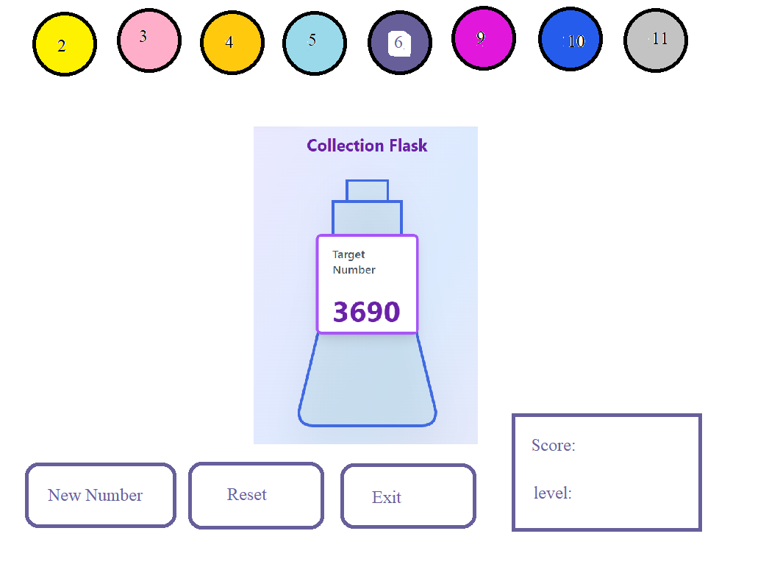
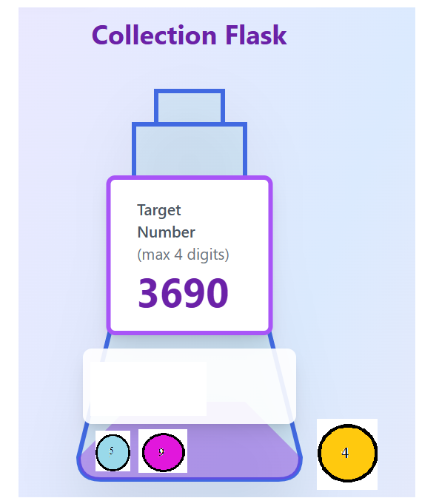

Slide 10
