Slide 1
Java Architecture for XML Binding(JAXB)

Slide 2
Need for Jaxb
JAXB annotation to convert Java object to / from XML file
Handlers
Marshalling – Convert a Java object into a XML file
Unmarshalling – Convert XML content into a Java Object.

Slide 3
Important Annotations
@XmlRootElement specifies the root element for the xml document.
@XmlAttribute specifies the attribute for the root element.
@XmlElement specifies the sub element for the root element.

Slide 4
Marshalling
Create POJO or bind the schema and generate the classes
Create the JAXBContext object
Create the Marshaller objects
Create the content tree by using set methods
Call the marshal method

Slide 5
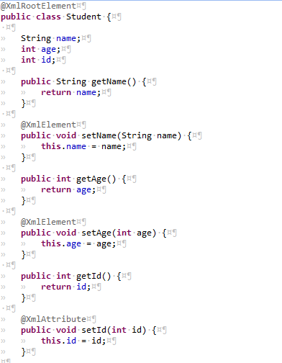
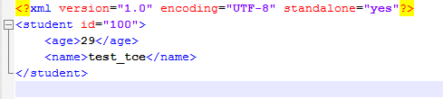
XML File and POJO

Slide 6
UnMarshalling
Create POJO or bind the schema and generate the classes
Create the JAXBContext object
Create the Unmarshaller objects
Call the unmarshal method
Use getter methods of POJO to access the data

