Slide 1


Slide 2
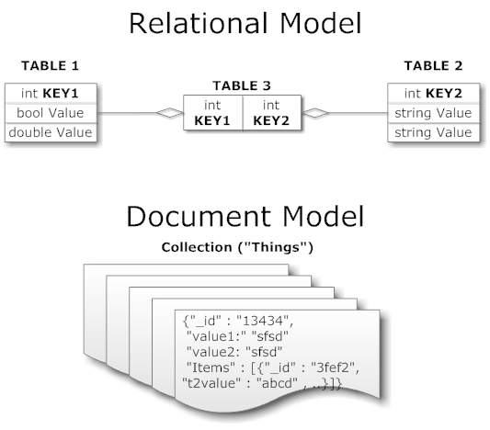
Four Categories
Key-value: Amazon’s Dynamo paper, Voldemort project by LinkedIn
BigTable: Google’s BigTable paper, Cassandra developed by Facebook, now Apache project
Graph: Mathematical Graph Theorys, FlockDB twitter
Document Store: JSON, XML format, CouchDB , MongoDB

Slide 3
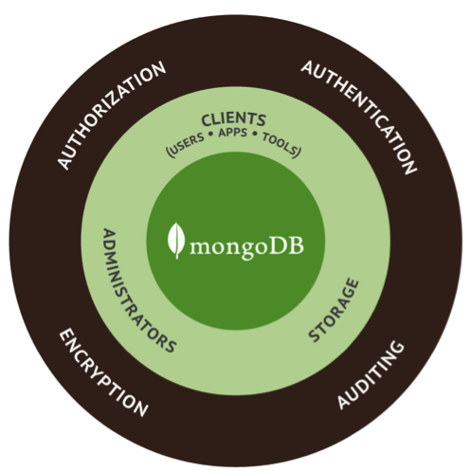
What is MongoDB
mongoDB = “Humongous DB”
Open-source
Document-based
“High performance, high availability”
Automatic scaling

Slide 4
What is MongoDB
Definition: MongoDB is an open source, document-oriented database designed with both scalability and developer agility in mind. Instead of storing your data in tables and rows as you would with a relational database, in MongoDB you store JSON-like documents with dynamic schemas(schema-free, schemaless)

Slide 5
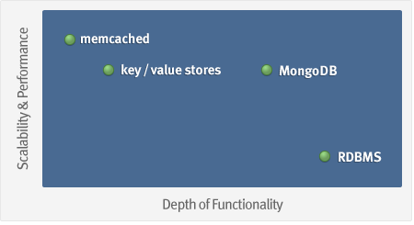
What is MongoDB
Goal: bridge the gap between key-value stores (which are fast and scalable) and relational databases (which have rich functionality).

Slide 6
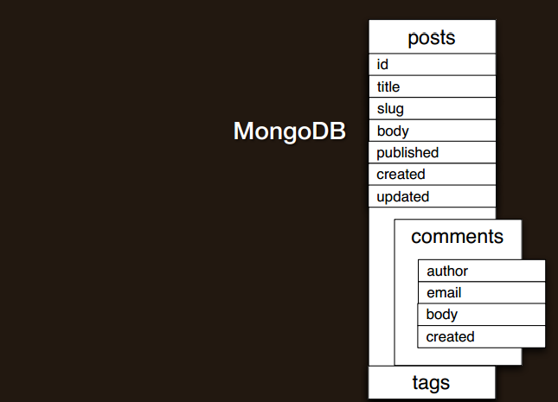
Schema Design
MongoDB: embed and link
Embedding is the nesting of objects and arrays inside a BSON document(prejoined). Links are references between documents(client-side follow-up query).
"contains" relationships, one to many; duplication of data, many to many

Slide 7
Data Model
Document-Based (max 16 MB)
Documents are in BSON format, consisting of field-value pairs
Each document stored in a collection
Collections
Have index set in common
Like tables of relational db’s.
Documents do not have to have uniform structure

Slide 8
JSON
“JavaScript Object Notation”
Easy for humans to write/read, easy for computers to parse/generate
Objects can be nested
Built on
name/value pairs
Ordered list of values

Slide 9
BSON
“Binary JSON”
Binary-encoded serialization of JSON-like docs
Also allows “referencing”
Embedded structure reduces need for joins
Goals
Lightweight
Traversable
Efficient (decoding and encoding)

Slide 10
BSON Types
Type | Number
Double | 1
String | 2
Object | 3
Array | 4
Binary data | 5
Object id | 7
Boolean | 8
Date | 9
Null | 10
Regular Expression | 11
JavaScript | 13
Symbol | 14
JavaScript (with scope) | 15
32-bit integer | 16
Timestamp | 17
64-bit integer | 18
Min key | 255
Max key | 127

Slide 11
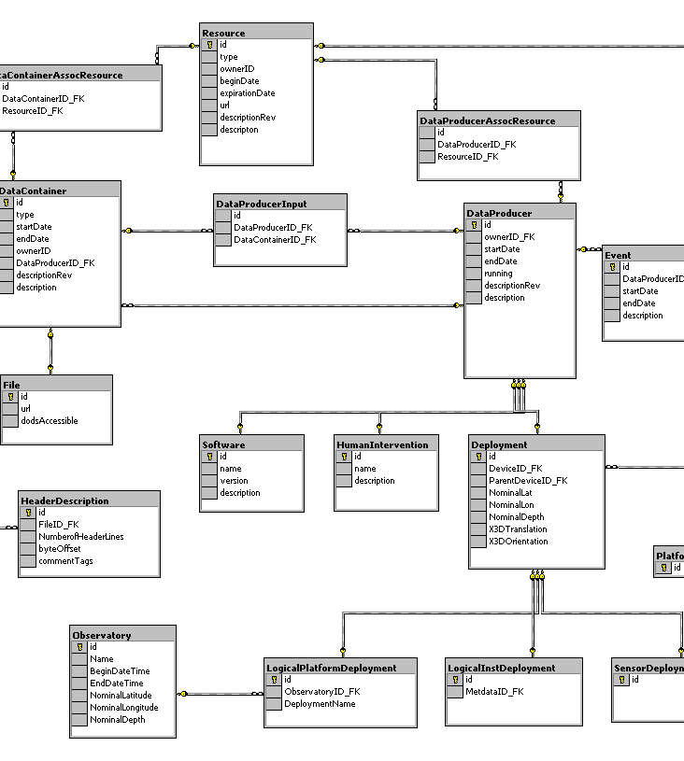
MongoDB is Easy to Use
{
title: ‘MongoDB’,
contributors: [
{ name: ‘Eliot Horowitz’,
email: ‘eliot@10gen.com’ },
{ name: ‘Dwight Merriman’,
email: ‘dwight@10gen.com’ }
],
model: {
relational: false,
awesome: true
}
}

Slide 12

MongoDB is easy to use
MySQL
MongoDB
START TRANSACTION;
INSERT INTO contacts VALUES
(NULL, ‘joeblow’);
INSERT INTO contact_emails VALUES
( NULL, ”joe@blow.com”,
LAST_INSERT_ID() ),
( NULL, “joseph@blow.com”,
LAST_INSERT_ID() );
COMMIT;
db.contacts.save( {
userName: “joeblow”,
emailAddresses: [
“joe@blow.com”,
“joseph@blow.com” ] } );

Slide 13
Sample BSON File
{
"_id" : "37010"
"city" : "ADAMS",
"pop" : 2660,
"state" : "TN",
“councilman” : {
name: “John Smith”
address: “13 Scenic Way”
}
}

Slide 14
Significance of ID
By default, each document contains an _id field. This field has a number of special characteristics:
Value serves as primary key for collection.
Value is unique, immutable, and may be any non-array type.
Default data type is ObjectId, which is “small, likely unique, fast to generate, and ordered.” Sorting on an ObjectId value is roughly equivalent to sorting on creation time

Slide 15
Comparison of RDBMS and MongoDB
mongoDB | SQL
Document | Tuple
Collection | Table/View
PK: _id Field | PK: Any Attribute(s)
Uniformity not Required | Uniform Relation Schema
Index | Index
Embedded Structure | Joins
Shard | Partition

Slide 16
Table level Comparison
RDBMS |  | MongoDB
Database | ➜ | Database
Table | ➜ | Collection
Row | ➜ | Document
Index | ➜ | Index
Join | ➜ | Embedded Document
Foreign Key | ➜ | Reference

Slide 17


MongoDB is fast and scalable
Better data locality
In-Memory
Caching
Distributed Architecture
Replication /HA
Relational
MongoDB
Horizontal Scaling

Slide 18
Getting Started with mongoDB
To install mongoDB, go to this link and click on the appropriate OS and architecture: http://www.mongodb.org/downloads
First, extract the files (preferrably to the C drive).
Finally, create a data directory on C:\ for mongoDB to use
i.e. “md data” followed by “md data\db”
http://docs.mongodb.org/manual/tutorial/install-mongodb-on-windows/

Slide 19
Getting Started with mongoDB
Open your mongodb/bin directory and run mongod.exe to start the database server.
To establish a connection to the server, open another command prompt window and go to the same directory, entering in mongo.exe. This engages the mongodb shell—it’s that easy!
http://docs.mongodb.org/manual/tutorial/getting-started/

Slide 20
CRUD: Using the Shell
To check which db you’re using
db
Show all databases
show dbs
Switch db’s/make a new one
use <name>
See what collections exist
show collections
Note: db’s are not actually created until you insert data!

Slide 21
CRUD: Using the Shell (cont.)
To insert documents into a collection/make a new collection:
db.<collection>.insert(<document>)
<=>
INSERT INTO <table> VALUES(<attributevalues>);

Slide 22
CRUD: Inserting Data
Insert one document
db.<collection>.insert({<field>:<value>})
Inserting a document with a field name new to the collection is inherently supported by the BSON model.
To insert multiple documents, use an array.

Slide 23
CRUD: Querying
Done on collections.
Get all docs: db.<collection>.find()
Returns a cursor, which is iterated over shell to display first 20 results.
Add .limit(<number>) to limit results
SELECT * FROM <table>;
Get one doc: db.<collection>.findOne()

Slide 24
CRUD: Querying
To match a specific value:
db.<collection>.find({<field>:<value>})
“AND”
db.<collection>.find({<field1>:<value1>,
<field2>:<value2>
})
SELECT *
FROM <table>
WHERE <field1> = <value1> AND <field2> = <value2>;

Slide 25
CRUD: Querying
OR
db.<collection>.find({ $or: [
<field>:<value1>
<field>:<value2> ]
})
SELECT *
FROM <table> WHERE <field> = <value1> OR <field> = <value2>;
Checking for multiple values of same field
db.<collection>.find({<field>: {$in [<value>, <value>]}})

Slide 26
CRUD: Querying
Including/excluding document fields
db.<collection>.find({<field1>:<value>}, {<field2>: 0})
SELECT field1
FROM <table>;
db.<collection>.find({<field>:<value>}, {<field2>: 1})
Find documents with or w/o field
db.<collection>.find({<field>: { $exists: true}})

Slide 27
CRUD: Updating
db.<collection>.update(
{<field1>:<value1>}, //all docs in which field = value
{$set: {<field2>:<value2>}}, //set field to value
{multi:true} ) //update multiple docs
upsert: if true, creates a new doc when none matches search criteria.
UPDATE <table> SET <field2> = <value2>
WHERE <field1> = <value1>;

Slide 28
CRUD: Updating
To remove a field
db.<collection>.update({<field>:<value>},
{ $unset: { <field>: 1}})
Replace all field-value pairs
db.<collection>.update({<field>:<value>},
{ <field>:<value>, <field>:<value>})
*NOTE: This overwrites ALL the contents of a document, even removing fields.

Slide 29
CRUD: Removal
Remove all records where field = value
db.<collection>.remove({<field>:<value>})
DELETE FROM <table>
WHERE <field> = <value>;
As above, but only remove first document
db.<collection>.remove({<field>:<value>}, true)

Slide 30
CRUD: Isolation
By default, all writes are atomic only on the level of a single document.
This means that, by default, all writes can be interleaved with other operations.
You can isolate writes on an unsharded collection by adding $isolated:1 in the query area:
db.<collection>.remove({<field>:<value>, $isolated: 1})

Slide 31
MongoImport
bin>mongoimport --host localhost --db local --collection student < d:\temp\test.json

Slide 32
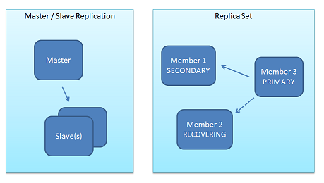
Replication
Replica Sets and Master-Slave
replica sets are a functional superset of master/slave and are handled by much newer, more robust code.

Slide 33
Replication…
Data Redundancy
Automated Failover
Read Scaling
Maintenance
Disaster Recovery(delayed secondary)

Slide 34
How to view the Replication
bin/mongod --dbpath data/db --logpath data/log/hengtian.log --logappend --rest --replSet hengtian
rs.initiate({
_id : "hengtian",
members : [
{_id : 0, host : "lab3:27017"},
{_id : 1, host : "cms1:27017"},
{_id : 2, host : "cms2:27017"}
]
})

Slide 35
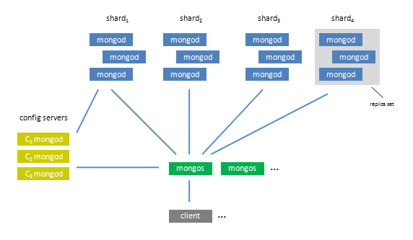
Sharding
The set of servers/mongod process within the shard comprise a replica set

Slide 36
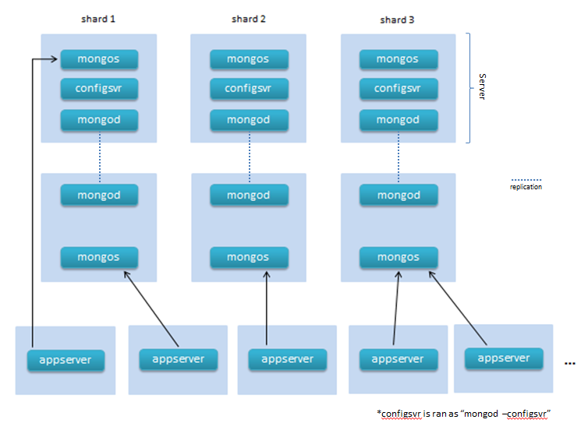
Sharding

Slide 37
Sharding
Sharding is the partitioning of data among multiple machines in an order-preserving manner.(horizontal scaling )
Machine 1 | Machine 2 | Machine 3
Alabama → Arizona | Colorado → Florida | Arkansas → California
Indiana → Kansas | Idaho → Illinois | Georgia → Hawaii
Maryland → Michigan | Kentucky → Maine | Minnesota → Missouri
Montana → Montana | Nebraska → New Jersey | Ohio → Pennsylvania
New Mexico → North Dakota | Rhode Island → South Dakota | Tennessee → Utah
 | Vermont → West Virgina | Wisconsin → Wyoming

Slide 38
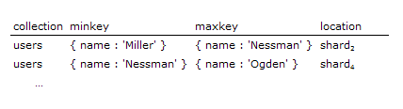
Shard Keys
Key patern: { state : 1 }, { name : 1 }
must be of high enough cardinality (granular enough) that data can be broken into many chunks, and thus distribute-able.
A BSON document (which may have significant amounts of embedding) resides on one and only one shard.

Slide 39
Sharding and Replication
sharding is the tool for scaling a system, and replication is the tool for data safety, high availability, and disaster recovery. The two work in tandem yet are orthogonal concepts in the design.

Slide 40
MongoDB Security
SSL
between client and server
Intra-cluster communication
Authorization at the database level
Read Only/Read+Write/Administrator
Security Roadmap (tentative)
Pluggable authentication (PAM) 2.4
Auditing 2.4
Cell level security 2.6
Common Criteria certifica

