Slide 1
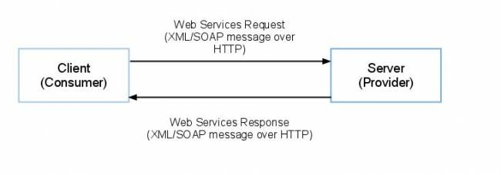
Web Services and Service Oriented Architecture
Saravanan Manoharan, M.E.
Software Engineer,
GT Nexus Inc(an Infor Company),Bangalore

Slide 2
SOA

Slide 3
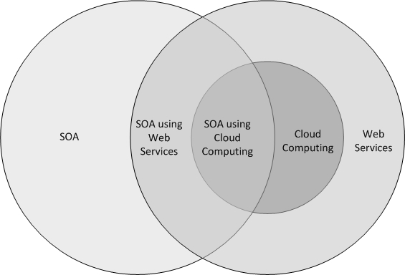
Web Services and Cloud Computing

Slide 4
Directions of System Architecture
1960 - 1980
1990 - 2000
2010 - 2050
Organization Focus
Mainframe Centric
Internal Use
Unique Data
Process Focus
Client Server
Partial Connectivity
EDI File Transfer
Distributed Functions
Data Centric
Universal Interoperability
Real-time Connectivity

Slide 5
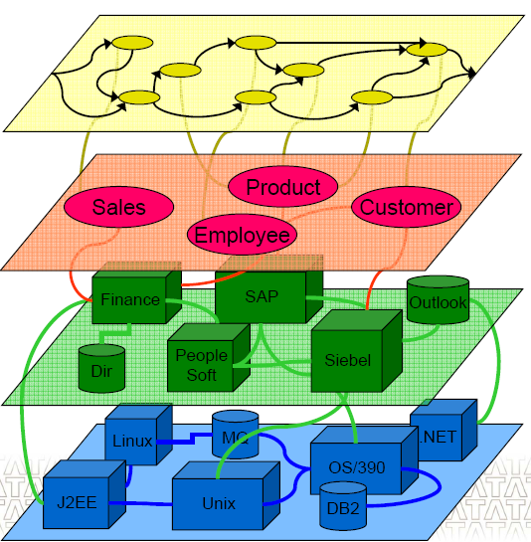
Layered view of an Application
Business Process
Composed of
Task
Fulfilled by
Applications/Packages
Supported by
Infrastructure

Slide 6
SOA
Service-oriented architecture is a client/server design approach in which an application consists of software services and software service consumers (also known as clients or service requesters). SOA differs from the more general client/server model in its definitive emphasis on loose coupling between software components, and in its use of separately standing interfaces (Gartner)
A set of components which can be invoked, and whose interface description can be published and discovered (W3C).

Slide 7
Definition
SOA is a architectural style that supports loosely coupled services to enable business flexibility in an interoperable, technology agnostic manner.
SOA consists of
composite set of business-aligned services that support a flexible and
dynamically re-configurable end-to-end business process realization using interface-based service descriptions

Slide 8
SOA Integration

Slide 9
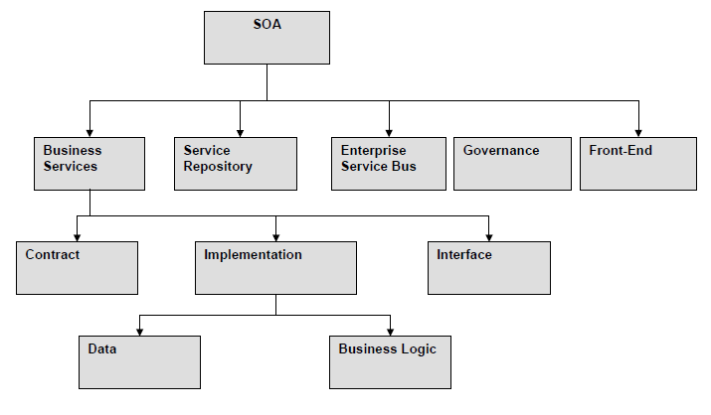
Components of SOA

Slide 10
What is an Enterprise Service Bus (ESB)?
An enterprise service bus is an infrastructure used for building compound applications
The enterprise service bus is the glue that holds the compound application together
The enterprise service bus is an emerging style for integrating enterprise applications in an implementation-independent fashion
An enterprise service bus can be thought of as an abstraction layer on top of an Enterprise Messaging System

Slide 11
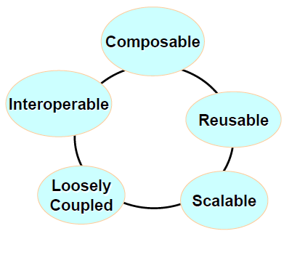
Key Characteristics of an ESB
Streamlines development
Supports multiple binding strategies
Performs data transformation
Intelligent routing
Real time monitoring
Exception handling
Service security

Slide 12
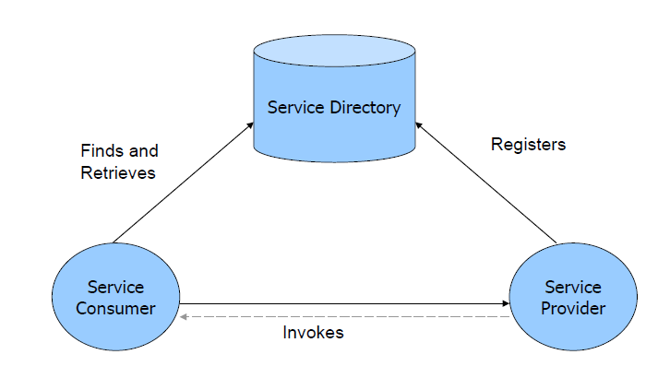
SOA Arch

Slide 13
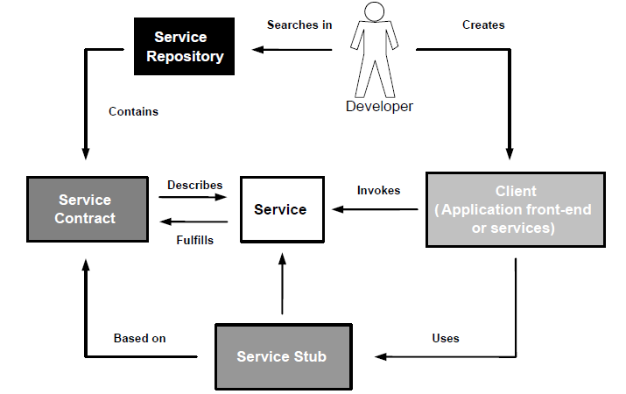
Generic SOA Working

Slide 14
WebServices

Slide 15
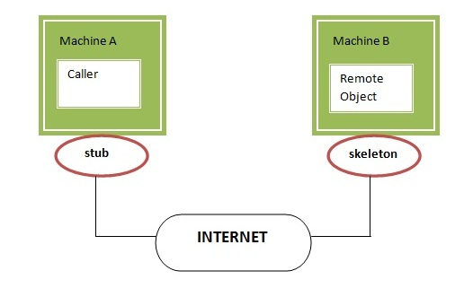
RMI
stub
The stub object, acts as a gateway for the client side. All the outgoing requests are routed through it. It resides at the client side and represents the remote object. When the caller invokes method on the stub object, it does the following tasks:
It initiates a connection with remote Virtual Machine (JVM),
It writes and transmits (marshals) the parameters to the remote Virtual Machine (JVM),
It waits for the result
It reads (unmarshals) the return value or exception, and
It finally, returns the value to the caller.
Skeleton
The skeleton is an object, acts as a gateway for the server side object. All the incoming requests are routed through it. When the skeleton receives the incoming request, it does the following tasks:
It reads the parameter for the remote method
It invokes the method on the actual remote object
It writes and transmits (marshals) the result to the caller.

Slide 16
Introduction
Web services are application programming interfaces (API) or Web APIs that are accessed via Hypertext Transfer Protocol (HTTP). Web service is way to expose business logic of a system over web.
For example,
today we use Facebook APIs or Google APIs to retrieve required data from respective server but practically can we directly access their data store?
No we can’t. Web services makes it easy for Facebook or Google to provide specific data rather than giving access to their database.
Web services are nothing but java/any language program running on the web which acts as a communicator between server and client.

Slide 17
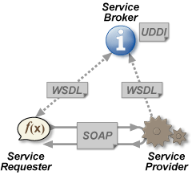
Web Service in General
SOAP
Simple Object Access Protocol
WSDL
Web service description language
UDDI
Universal Definition, Description & Integeration
SEI
Service End point Interface

Slide 18
Types
JAX-WS
SOAP
JAX-RS
REST

Slide 19
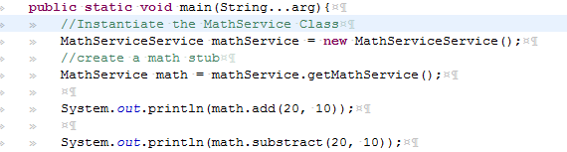
Soap Client
wsimport –keep <URL>
Import resultant into your project
In the wsdl file look for
wsdl:service
And then wsdl:port
Invoke the Contract into your code

Slide 20
Rest
REpresentational State Transfer (REST)
stateless client-server architecture in which the web services are viewed as resources and can be identified by their URIs
Web service clients that want to use these resources access via globally defined set of remote methods that describe the action to be performed on the resource

Slide 21
Rest…
REST server
which provides access to the resources
REST client
which accesses and modify the REST resources
Represented as xml, json, flatfile, CSV etc

Slide 22
Rest | HTTP methods
RESTful web services use HTTP protocol methods for the operations they perform.Methods are:
GET: It defines a reading access of the resource without side-effects.This operation is idempotent i.e.they can be applied multiple times without changing the result
PUT : It is generally used for updating resouce.It must also be idempotent.
DELETE : It removes the resources. The operations are idempotent i.e. they can get repeated without leading to different results.
POST :It is used for creating a new resource

Slide 23
Cont…
Idempotent means result of multiple successful request will not change state of resource after initial application
For example :
Delete is idempotent method because when you first time use delete, it will delete the resource (initial application) but after that, all other request will have no result because resource is already deleted.

Slide 24
Features of RESTful web services
Resource identification through URI
Uniform interface
Client-Server
Stateless
Cache
Named resources
Interconnected resource representations
Layered components
Self-descriptive messages

Slide 25
DEMO

