Slide 1
Single Sign On
SSO solution enables users to authenticate once yet access multiple resources

Slide 2
Single sign-on (SSO) method of access control of multiple related, but independent software systems.
example: google accounts once sign in, Mail,Drive,Photos...
With this property a user logs in with a single ID and password to gain access to a connected system or systems without using different usernames or passwords, or in some configurations seamlessly sign on at each system.
A simple version of single sign-on can be achieved over IP networks using cookies but only if the sites share a common DNS parent domain.
single authentication provides access to multiple applications by passing the authentication token seamlessly to configured applications as Single Sign-On.
Conversely, single sign-off is the property whereby a single action of signing out terminates access to multiple software systems.
As different applications and resources support different authentication mechanisms, single sign-on must internally store the credentials used for initial authentication and translate them to the credentials required for the different mechanisms.
To be precise, OAuth is not strictly an authentication scheme but an authorization protocol: it provides a way for the users to grant access on their own behalf to websites or applications to other websites or applications using some access keys.
The main purpose of the protocol is to exchange the access credentials required for the authentication and not the authentication itself.
Other shared authentication schemes include OAuth, OpenID, OpenID Connect and Facebook Connect. However, these authentication schemes require the user to enter their login credentials each time they access a different site or application so they are not to be confused with SSO.

Slide 3
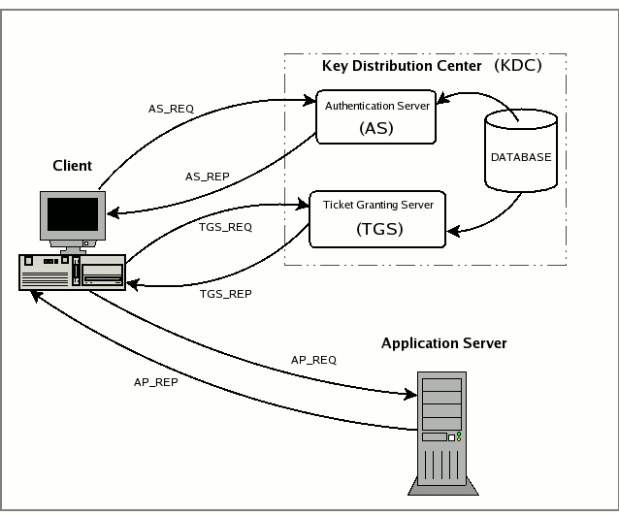
Kerberos based
AS_REQ is the initial user authentication request (i.e. made with kinit)
This message is directed to the KDC component known as Authentication Server (AS);
kinit command obtains or renews a Kerberos ticket-granting ticket
AS_REP is the reply of the Authentication Server to the previous request.
Basically it contains the TGT (encrypted using the TGS secret key) and the session key (encrypted using the secret key of the requesting user);
TGS_REQ is the request from the client to the Ticket Granting Server (TGS) for a service ticket.
This packet includes the TGT obtained from the previous message and an authenticator generated by the client and encrypted with the session key;

Slide 4
Kerberos based…
TGS_REP is the reply of the Ticket Granting Server to the previous request.
Located inside is the requested service ticket (encrypted with the secret key of the service) and a service session key generated by TGS and encrypted using the previous session key generated by the AS;
AP_REQ is the request that the client sends to an application server to access a service.
The components are the service ticket obtained from TGS with the previous reply and an authenticator again generated by the client, but this time encrypted using the service session key (generated by TGS);
AP_REP is the reply that the application server gives to the client to prove it really is the server the client is expecting.
This packet is not always requested. The client requests the server for it only when mutual authentication is necessary.
ref. http://kerberos.org/software/tutorial.html

Slide 5
Smart card based
Initial sign-on prompts the user for the smart card.
Additional software applications also use the smart card, without prompting the user to re-enter credentials.
Smart card-based single sign-on can either use certificates or passwords stored on the smart card

Slide 6
Security Assertion Markup Language
SAML is a product of the OASIS
open-standard data format for exchanging authentication and authorization data between an identity provider and a service provider
Actors and Actions
Principal (typically a user)
the principal requests a service from the service provider
Service provider (SP)
The service provider requests and obtains an identity assertion from the identity provider, it can decide whether to perform some service for the connected principal
Identity provider (IdP)
Before delivering the identity assertion to the SP, the IdP may request some information from the principal – such as a user name and password – in order to authenticate the principal

Slide 7
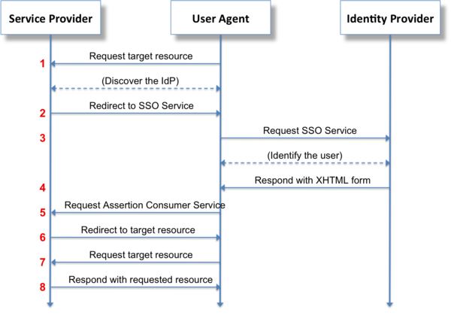

Slide 8
OKTA
Add Application
Step 1 “General Settings”, enter “Spring Security SAML” in the “App name” field
Step 2 “Configure SAML”, Paste the URL below into the “Single sign on URL” field:
http://localhost:8080/spring-security-saml2-sample/saml/SSO
Audience URI (SP Entity ID)” field:
http://localhost:8080/spring-security-saml2-sample/saml/metadata

Slide 9
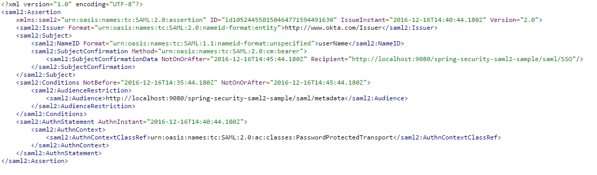
Sample SAML

