Slide 1
Web Application

Slide 2
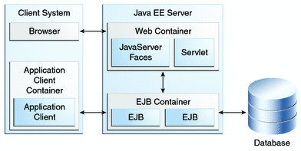
Components of a Web App
Web Server
Typically, a Web server refers to an execution infrastructure that handles HTTP requests and responses;
Servlet Container
A servlet container refers to a component that handles the lifecycle for servlets;
Application Server
An application server refers to a framework (servlet container, EJB container, JSP engine, MQ container, etc.) for handling Web applications.
Web container has a couple of meanings depending on the source.
Most refer to a Web container(also known as a servlet container; and compare "webtainer") as the part of an application server that manages servlets, JavaServer Pages (JSP) files, and other Web-tier components.
Some refer to a Web container as the infrastructure for managing the lifecycle for Web services.
A web container is responsible for managing the lifecycle of servlets, mapping a URL to a particular servlet and ensuring that the URL requester has the correct access-rights.

Slide 3
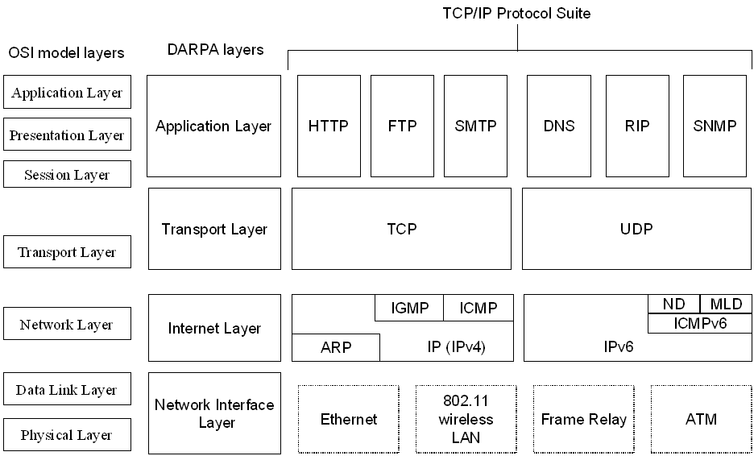
OSI-TCP/IP Networking Layers

Slide 4
History of HTTP(abstract)
Development of HTTP was initiated by Tim Berners-Lee at CERN in 1989.
Standards development of HTTP was coordinated by the Internet Engineering Task Force (IETF) and the World Wide Web Consortium (W3C)
The first definition of HTTP/1.1(the version of HTTP in common use) occurred in RFC 2068 in 1997, although this was obsoleted by RFC 2616 in 1999
Latest version HTTP/2, was standardized in 2015. And is now supported by major web servers

Slide 5
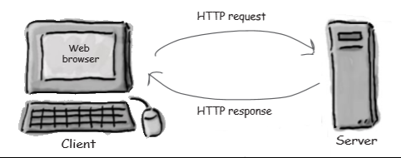
Web Client Server Interaction
Key elements of the request stream:
HTTP method (the action to be performed)
The page to access (a URL)
Form parameters (like arguments to a method)
Key elements of the response stream:
A status code (for whether the request was successful)
Content-type (text, picture, HTML, etc.)
The content (the actual HTML, image, etc.)

Slide 6
HTTP Request Methods: GET and POST
GET - Requests data from a specified resource
The query string (name/value pairs) is sent in the URL of a GET request
The GET method has size limtation: only 1024 characters
GET /FirstServletProject/jsps/hello.jsp /?name1=value1&name2=value2 HTTP/1.1
Cache-Control: no-cache
POST - Submits data to be processed to a specified resource
The query string (name/value pairs) is sent in the HTTP message body of a POST request
POST /FirstServletProject/jsps/hello.jsp
Host: localhost:8080
name1=value1&name2=value2

Slide 7
Get and Post
 | GET | POST
BACK button/Reload | Harmless | Data will be re-submitted (the browser should alert the user that the data are about to be re-submitted)
Bookmarked | Can be bookmarked | Cannot be bookmarked
Cached | Can be cached | Not cached
Encoding type | application/x-www-form-urlencoded | application/x-www-form-urlencoded or multipart/form-data. Use multipart encoding for binary data
History | Parameters remain in browser history | Parameters are not saved in browser history
Restrictions on data length | Yes, when sending data, the GET method adds the data to the URL; and the length of a URL is limited (maximum URL length is 2048 characters) | No restrictions
Restrictions on data type | Only ASCII characters allowed | No restrictions. Binary data is also allowed
Security | GET is less secure compared to POST because data sent is part of the URL Never use GET when sending passwords or other sensitive information! | POST is a little safer than GET because the parameters are not stored in browser history or in web server logs
Visibility | Data is visible to everyone in the URL | Data is not displayed in the URL

Slide 8
HTTP Response
200 OK
Date: Wed, 07 Aug 2013 19:55:50 GMT
Server: Apache-Coyote/1.1
Content-Length: 309
Content-Type: text/html;charset=US-ASCII
<!DOCTYPE html PUBLIC "-//W3C//DTD HTML 4.01 Transitional//EN" "http://www.w3.org/TR/html4/loose.dtd">
<html>
<head>
<meta http-equiv="Content-Type" content="text/html; charset=US-ASCII">
<title>Hello</title>
</head>
<body>
<h2>Hi There!</h2>
<br>
<h3>Date=Wed Aug 07 12:57:55 PDT 2013
</h3>
</body>
</html>

Slide 9
Other methods present in a request
Method | Description
HEAD | Same as GET but returns only HTTP headers and no document body
PUT | Uploads a representation of the specified URI
DELETE | Deletes the specified resource
OPTIONS | Returns the HTTP methods that the server supports
CONNECT | Converts the request connection to a transparent TCP/IP tunnel

Slide 10
Servlet

Slide 11
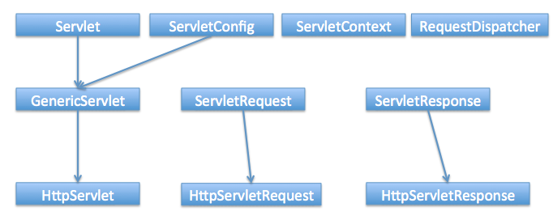
Why to use a Servlet
Servlets are programs that run on a Web or Application server and act as a middle layer
Using Servlets you can create web pages dynamically which includes
you can collect input from users through web page forms
present records from a database or another source

Slide 12
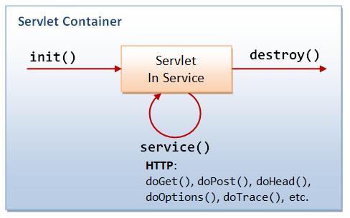
Servlet life cycle
A servlet life cycle can be defined as the entire process from its creation till the destruction.
Following are the paths followed by a servlet
The servlet is initialized by calling the init () method.
The servlet calls service() method to process a client's request.
The servlet is terminated by calling the destroy() method.
Finally, servlet is garbage collected by the garbage collector of the JVM.

Slide 13
Servlet life cycle…
init() method
The init method is designed to be called only once when the servlet is first created, and not called again for each user request.
For each user request a new thread that is handed off to doGet or doPost as appropriate.
The init() method simply creates or loads some data that will be used throughout the life of the servlet
service() method
The servlet container (i.e. web server) calls the service() method to handle requests coming from the client( browsers) and to write the formatted response back to the client.
Each time the server receives a request for a servlet the server spawns a new thread and calls service.
The service() method checks the HTTP request type (GET, POST, PUT, DELETE, etc.) and calls doGet, doPost, doPut, doDelete, etc. methods as appropriate.
destroy() method
The destroy() method is called only once at the end of the life cycle of a servlet.
This method gives your servlet a chance to close database connections, halt background threads, write cookie lists or hit counts to disk, and perform other such cleanup activities.
After the destroy() method is called, the servlet object is marked for garbage collection

Slide 14
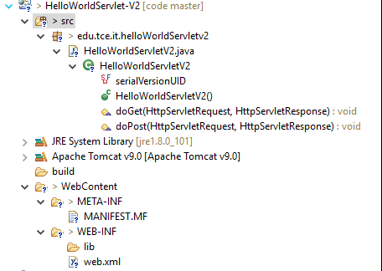
Web App Architecture-Servlet 2.x
Place to hold, JSP, Resources files
Project archive details, build version, POM file
Project dependent library
class – compiled files of an application
Deployment Descriptor

Slide 15
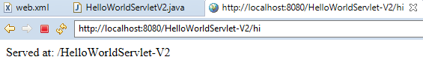
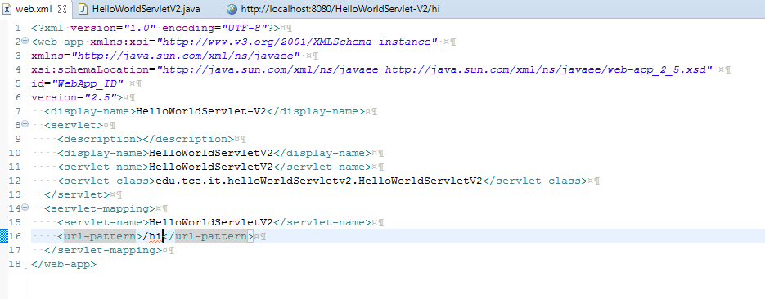
Servlet 2.x

Slide 16
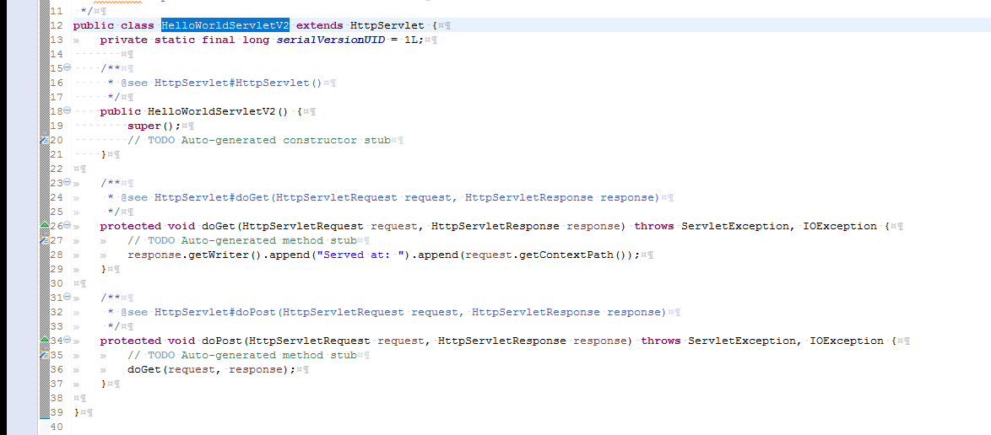
HelloWorld Servlet 2.x

Slide 17
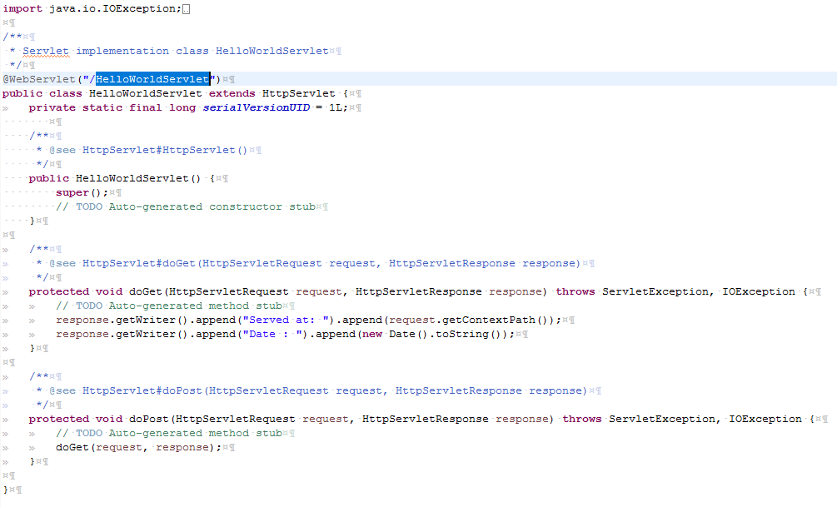
Servlet 3.x

Slide 18
Reading Form Data using Servlet
Servlets handles form data parsing automatically using the following methods depending on the situation:
getParameter():
request.getParameter() method to get the value of a form parameter.
getParameterValues():
Use this method if the parameter appears more than once and returns multiple values, for example checkbox.
getParameterNames():
This method will give a complete list of parameters in the current request.

Slide 19
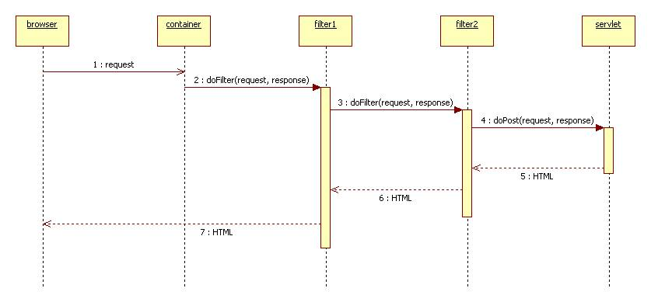
Servlet Filters
Servlet Filters are Java classes that can be used in Servlet Programming for the following purposes:
To intercept requests from a client before they access a resource at back end.
To manipulate responses from server before they are sent back to the client.
There are various types of filters suggested by the specifications:
Clickjack Filter.
CSRF Filter.
Encryption Filters.
Encoding Filters
Filters that trigger resource access events.
Tokenizing Filters
XSL/T Filters That Transform XML Content.
Filters are deployed in the deployment descriptor file web.xml
They are mapped either to servlet names or URL patterns in your application's deployment descriptor.
When the web container starts the web application, it creates an instance of each filter that are declared in the deployment descriptor.
The filters execute in the order that they are declared in the deployment descriptor.

Slide 20
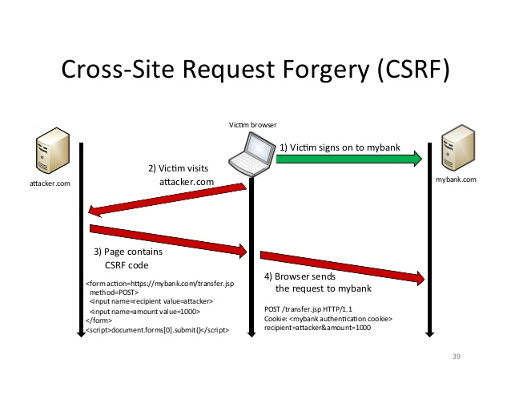
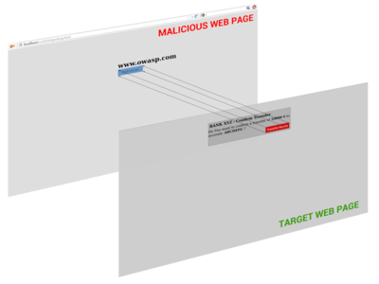
Servlet - Filters
Click Jacking Attack

Slide 21
Filter Life Cycle
A filter is simply a Java class that implements the javax.servlet.Filter interface.
The javax.servlet.Filter interface defines three methods:
public void init(FilterConfig filterConfig)
This method is called by the web container to indicate to a filter that it is being placed into service.
public void doFilter (ServletRequest, ServletResponse, FilterChain)
This method is called by the container each time a request/response pair is passed through the chain due to a client request for a resource at the end of the chain.
public void destroy()
This method is called by the web container to indicate to a filter that it is being taken out of service.

Slide 22
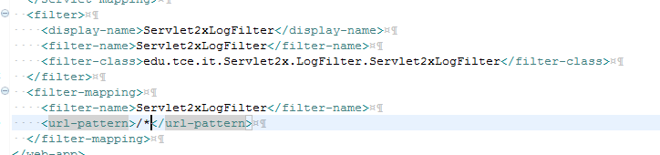
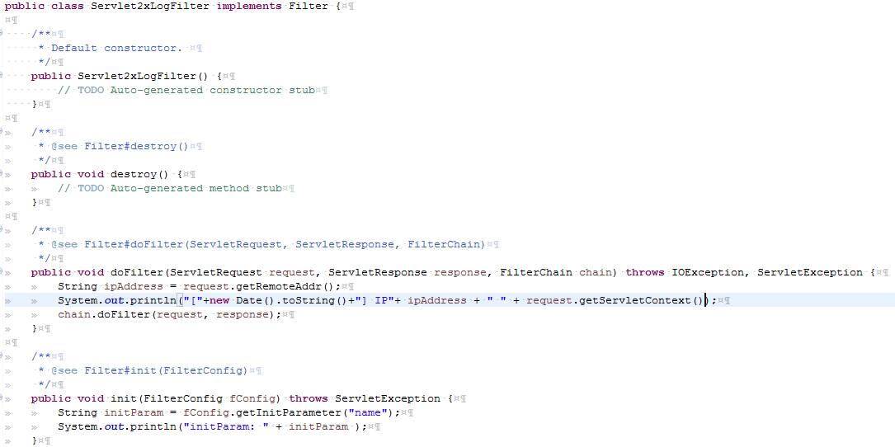
Writing a Filter

Slide 23
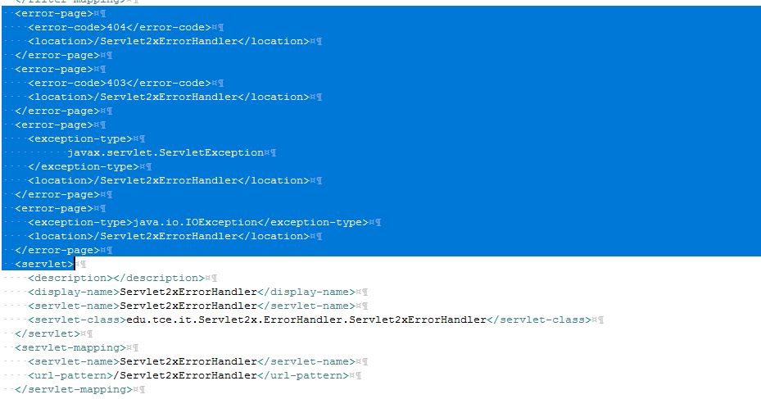
Generic Servlet Error –web.xml

Slide 24
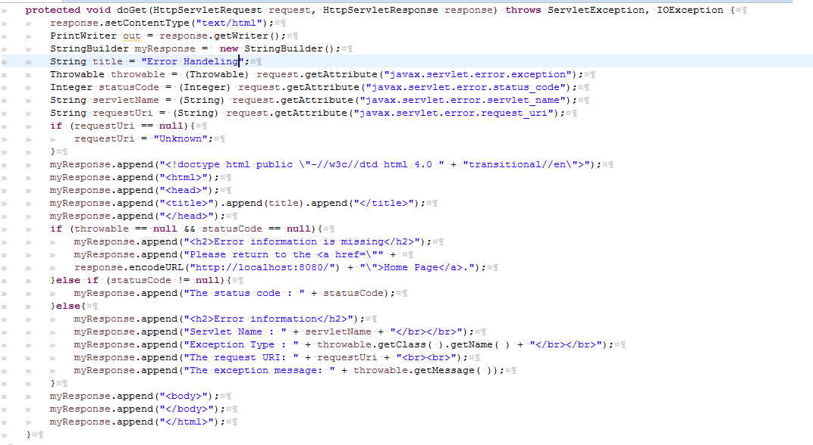
Servlet –Error Handler

Slide 25
Cookies
Cookies are text files stored on the client computer for various information and tracking purpose.
Java Servlets transparently supports HTTP cookies.
Cookies are usually set in an HTTP header (although JavaScript can also set a cookie directly on a browser)
It’s a name value pair
Web Browser
Sent a Http Request
Web Server
Sent a Response with Cookies
Store it in local system
Ask the Cookies
Sent a Http Request with cookies

Slide 26

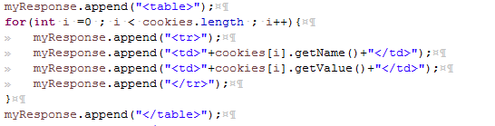
Writing Cookie
Setting a cookie
Reading a cookie value
Getting values from cookie

Slide 27
Session Management
HTTP is a "stateless" protocol, each time a client retrieves a Web page, the client opens a separate connection to the Web server
And the server does not keep any record of previous client request.
Ways to maintain session
Cookies
A webserver can assign a unique session ID as a cookie to each web client.
For subsequent requests from the client can be recognized using the recieved cookie.
This may not be an effective way because many time browser does not support a cookie.
Hidden Fields
A hidden HTML form field along with a unique session ID
When the form is submitted, the specified name and value are automatically included in the GET or POST data.
Each time when web browser sends request back, then session_id value can be used to keep the track of different web browsers.
This could be an effective way of keeping track of the session but clicking on a regular (<A HREF...>) hypertext link does not result in a form submission
URL Rewriting
We can append some extra data on the end of each URL that identifies the session
For example, http://localhost8080.com/file.htm;sessionid=12345 , the session identifier is attached as sessionid=12345 which can be accessed at the web server to identify the client.
URL rewriting is a better way to maintain sessions and works for the browsers when they don't support cookies but here drawback, you would have generate every URL dynamically to assign a session ID though page is simple static HTML page.

Slide 28
HttpSession
HttpSession Interface provides a way to identify a user across more than one page request or visits a Web site and store information about that user
The servlet container uses this interface to create a session between an HTTP client and an HTTP server.
The session is persisted for a specified time period, across more than one connection or page request from the user

Slide 29
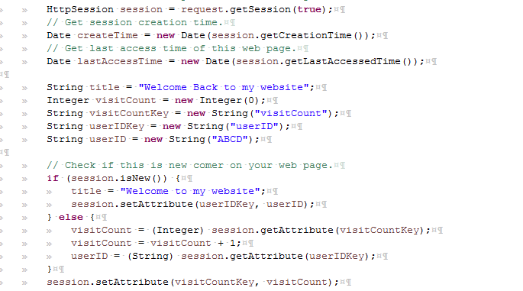
Session Management

Slide 30

Deleting Session Data:
public void removeAttribute(String name)
Remove a particular attribute: method deletes the value associated with a particular key.
public void invalidate()
Delete the whole session: method to discard an entire session.
public void setMaxInactiveInterval(int interval)
Setting Session timeout: method to set the timeout for a session individually.
logout
Log the user out: The servers that support servlets 2.4, call logout to log the client out of the Web server and invalidate all sessions belonging to all the users.
web.xml Configuration:
If you are using Tomcat, apart from the above mentioned methods, you can configure session time out in web.xml file as follows.

Slide 31
Questions
What is a URI and URL
HTTP/2
Examine how POST request is sent to a Application Server
What is the max, bytes allowed in a cookie
What is the max, life time of a cookie, if not specfied
Can a hidden value be stored in a cookie

