Slide 1
WebServices

Slide 2
Introduction
Web services are application programming interfaces (API) or Web APIs that are accessed via Hypertext Transfer Protocol (HTTP). Web service is way to expose business logic of a system over web.
For example,
today we use Facebook APIs or Google APIs to retrieve required data from respective server but practically can we directly access their data store?
No we can’t. Web services makes it easy for Facebook or Google to provide specific data rather than giving access to their database.
Web services are nothing but java/any language program running on the web which acts as a communicator between server and client.

Slide 3
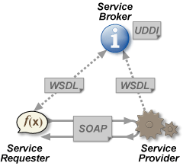
Web Service in General
SOAP
Simple Object Access Protocol
WSDL
Web service description language
UDDI
Universal Definition, Description & Integeration
SEI
Service End point Interface

Slide 4
Types
JAX-WS
SOAP
JAX-RS
REST

Slide 5
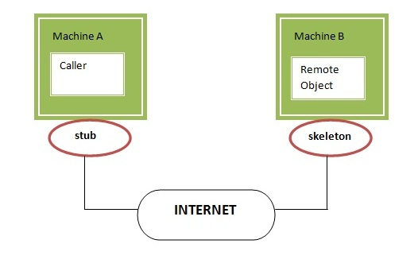
RMI
stub
The stub object, acts as a gateway for the client side. All the outgoing requests are routed through it. It resides at the client side and represents the remote object. When the caller invokes method on the stub object, it does the following tasks:
It initiates a connection with remote Virtual Machine (JVM),
It writes and transmits (marshals) the parameters to the remote Virtual Machine (JVM),
It waits for the result
It reads (unmarshals) the return value or exception, and
It finally, returns the value to the caller.
Skeleton
The skeleton is an object, acts as a gateway for the server side object. All the incoming requests are routed through it. When the skeleton receives the incoming request, it does the following tasks:
It reads the parameter for the remote method
It invokes the method on the actual remote object
It writes and transmits (marshals) the result to the caller.

Slide 6
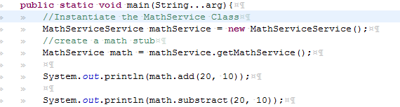
Soap Client
wsimport –keep <URL>
Import resultant into your project
In the wsdl file look for
wsdl:service
And then wsdl:port
Invoke the Contract into your code

Slide 7
DEMO

