Slide 1
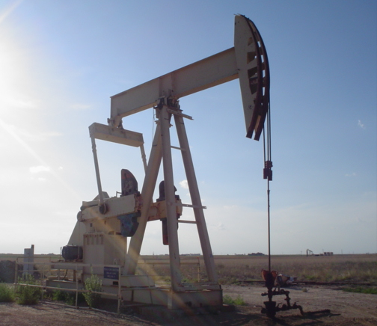
Predicting Deferments
Jared Turner, Steven Sun, Ryan Leveille, Jaime Flores, Andy Barnes

Slide 2
Scope
Data:
Candy Cane Well
Time Series
Unbalanced
Predict deferment 24 hours in advance
Identify human shutdowns vs. system failures
Anomaly detection algorithm
KPIS:
Confusion Matrix
Validation Test
Visualization
Goals:

Slide 3
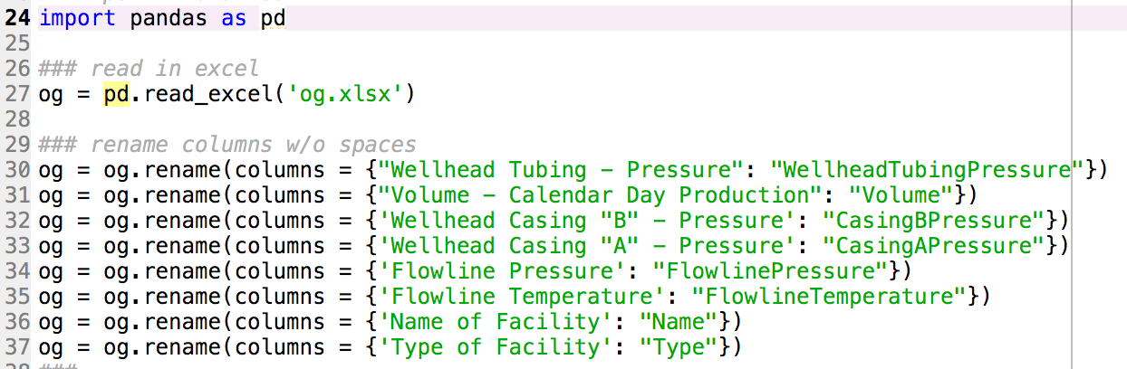
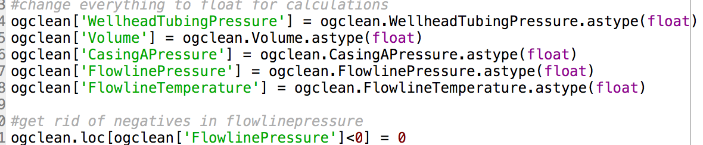
Preprocessing
Import data
Explore data
Check for NA’s
Rename columns
Drop columns
Convert data
Replace negatives
Statistical analysis
Visualize data
Correlation matrix

Slide 4
Observation
This python visualization sucks
Steven perhaps add some badass R stuff here ☺

Slide 5
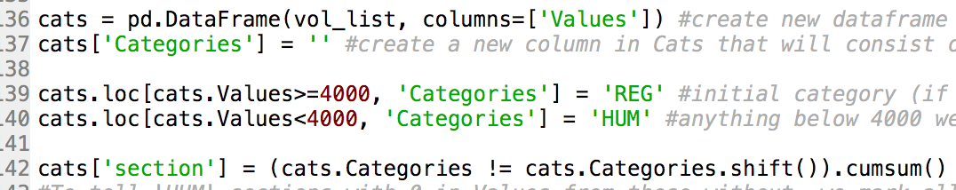
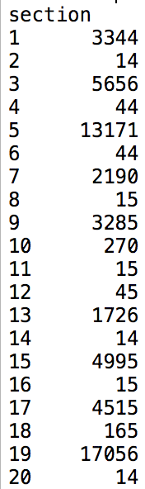

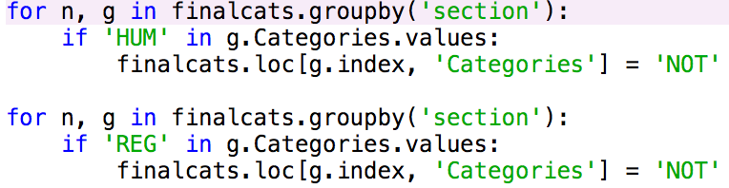
Categorization
3 Categories: (DEF,REG,HUM)
Volume[i] >= 4000 = REG
Volume[i] < 4000 = HUM
Volume[i] != 0 in section. section = DEF
Sections: 136 (DEF,REG,HUM)
3 to 2 Categories: (DEF or NOT)
If HUM or REG == NOT
Sections: 52 (DEF, NOT)

Slide 6
Histogram/Probability/Logistic Regression/Classification Tree

Slide 7
Nuerals

Slide 8
Clustering

Slide 9
Visualization

Slide 10
KPI

