Slide 1
Drug related deaths in Chicago
Capstone Project Final

Slide 2
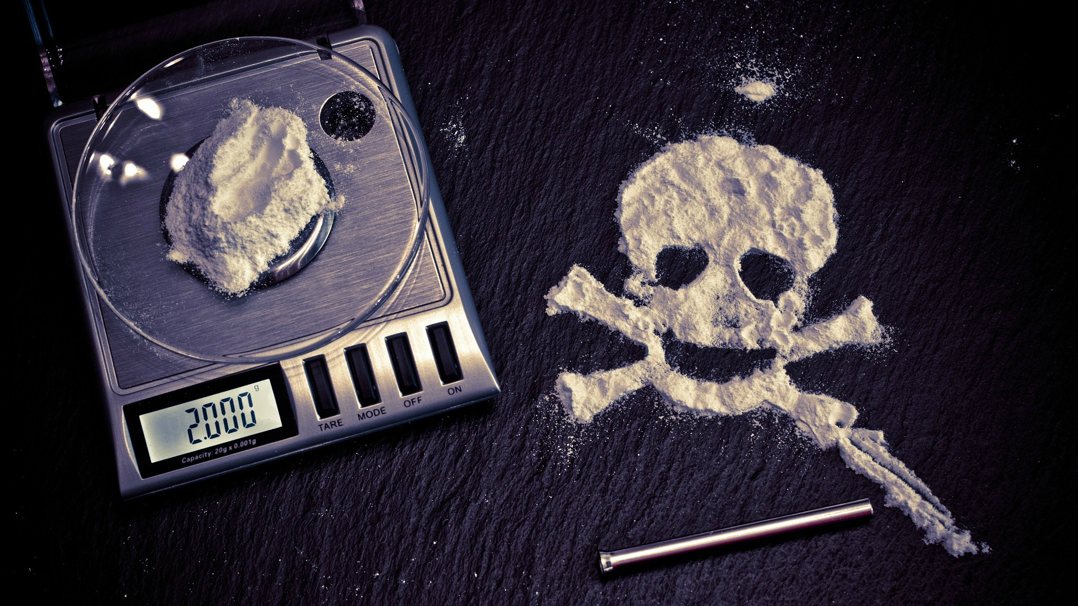
Introduction
In Chicago, there's a drug problem that's hampering state security, so we're going to study data on drug victims in Chicago in order to group drug users.
Insérez votre texte ici Insérez votre texte ici Insérez votre texte ici.

Slide 3
Methodology
Our analysis consists of identifying the people who died as a result of drug abuse in the state of Chicago in the United States, to do this we use the data described, where we use pandas and numpy to treat and clean up after we use seaborn to explore the data and statistical tools to understand the data and finally we use clustering to group the deceased according to their cities in relation to their age, the places where they use drugs and the city where they were found dead.
Élément 3

Slide 4
Interested parties:
This will allow institutions fighting drug use in the U.S. such as federal and state and local government and the police

Slide 5
Result

Slide 6
Young and old killed by drugs.
We know that our study was conducted on a sample of about 3,000 individuals, which tells us that the average age of a drug addict in Chicago is 42 years old, but half of these drug addicts are under 42 years old, with 25% of the drug addicts between 15 and 32 years old, 25% between 52 and 84 years old.

Slide 7
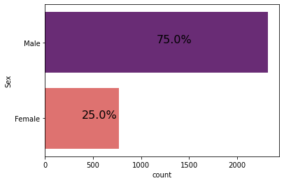
Men take more drugs than women.
The people who died as a result of drug abuse are generally men, as the graph below shows, ¾ of these people are men.

Slide 8
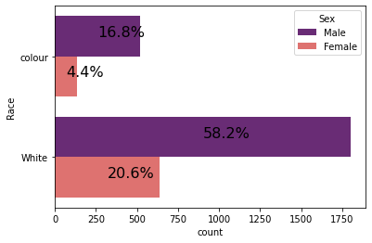
White people do more drugs than colored people.
If we continue to look by gender, we go by race, and we notice that out of every 100 drug addicts found dead in the city of Chicago, 80 are white and the other 20 are people of colour, a ratio that is not too different if we analyze by gender.

Slide 9
Recommendations
So we recommend to take care of the spread of drugs among young people, especially those in their thirties, and to open more detoxification centers for people over 50 years old.

Slide 10
Conclusion
This shows that in all the cities of Chicago, drug-related death by overdose is more common among older people while the increase in young people is growing with half of these victims.

Slide 11
END
Thank you for your precious time.

