Slide 1

Tchalins JEUDY
Customer Churn Analysis

Slide 2
Problem
Describe the business problem and define the analytic approach to solving the problem.
What is the business problem?
Rep:
Unsubscribing is a crucial problem for the Telco company, a large part of the clientele leaves us for other companies..
Who are the stakeholders impacted by the problem?
Rep:
The company is the main deficit in this problem.

Slide 3
Problem
Why is this problem important to the organization?
Rep:
it is a big problem for the business if customers start unsubscribing it will cause it to go bankrupt which could cause damage to the business.

Slide 4
Methodology
We performed a univariate analysis of the Churn variable, and a bivariate analysis of the latter by each of the other variables.using python language tools for data Scientist which does statistical analysis and visualization.

Slide 5
Results
1.1-How much is churn affecting the business?
1.2-How big is churn compared to the existing customer base?
2.-Explain churn by the below categories. Are there any factors that combine to be especially impactful?
Customer demographics like age and gender
Services used
Billing information.
3.1-What services are typically purchased by customers who churned?
3.2- Are any services especially helpful in retaining customers?

Slide 6
Results
4. Are there types of people who churn at higher rates?
5. A case study for one of a customer profiles. How much additional revenue we could make by increasing sales by 10% in that profile.

Slide 7
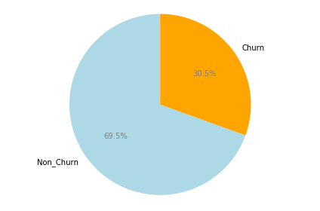
1.1-How much is churn affecting the business?
The business is affected by a 30.5% loss of incomes this month
based on the proportion of total charges represented by the churners.

Slide 8
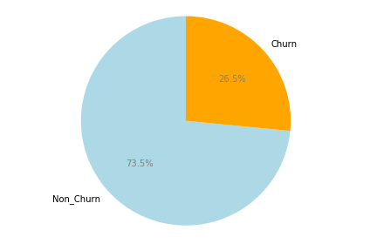
1.2-How big is churn compared to the existing customer base?
Compared to the existing consumer base, churners represent 26.5%,

Slide 9
2.-Explain churn by the below categories.
(Demographics)
The unsubscriber appears not to be greatly influenced by gender
and don't have a partner but more with to be a senior citizen and be dependent.

Slide 10
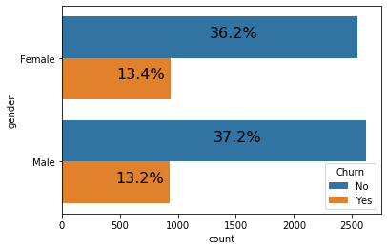
Explain churn by gender
The gender of the clients which is binary, i.e. Male and Female
is not significant for churners
as it is approximately equal for churners and loyal clients.

Slide 11
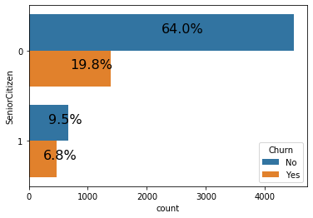
Explain churn by Senior Citizen
Senior Citizen is binary and really significant.
Minor are proportionally more loyal than senior
because in relation to our database of 7000 clients,
we have a rate of 19.8% minor churn for 64%minor no-churn
versus 6.8% senior churn for 9.5% senior no-churn.

Slide 12
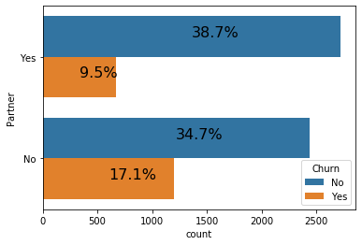
Have a partner is also binary, i.e.
it is not significant for churners
as it is also approximately equal for churners and loyal clients.

Slide 13
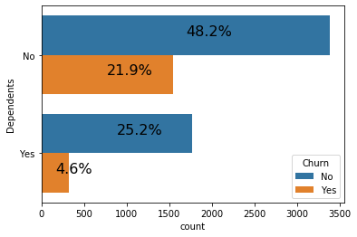
Explain churn by Dependents
Being dependent is binary and significant.
Dependent customers are more loyal than non-dependent customers
because we have a higher probability for dependents to be more loyal
and also by analyzing the proportions in our database of 7000 customers,
we have a rate of 4.6% churn for 25.2% of no-churn dependents
versus 21.9% of churn for 48.2% of no-churn of no-dependent.

Slide 14
2.-Explain churn by the below categories.
(Service Used)
The unsubscriber seems to be greatly influenced by what type of service for all types of services.

Slide 15
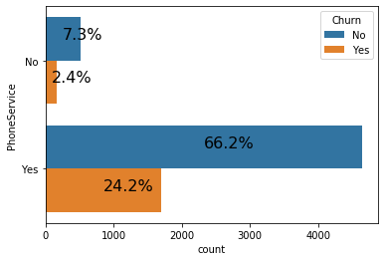
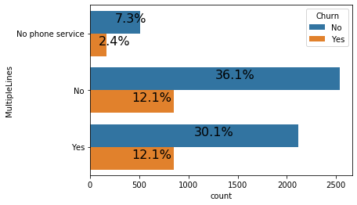
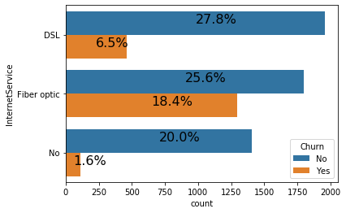
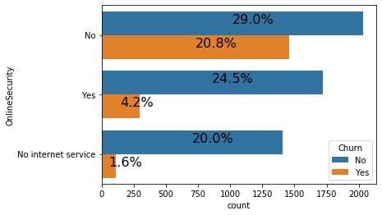
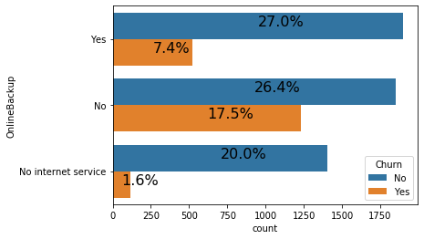
2.-Explain churn by the below categories.(Service Used 1)
.

Slide 17
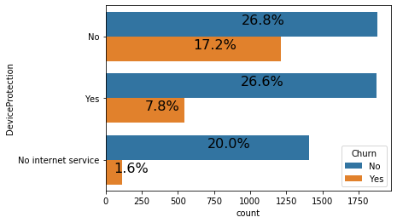

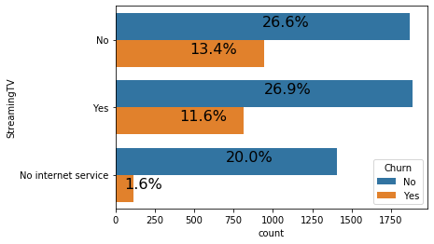
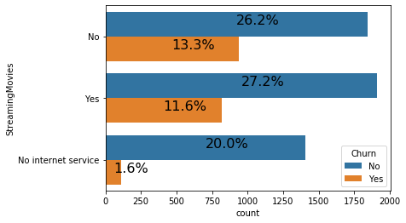
2.-Explain churn by the below categories.(Service Used 2)
The unsubscriber seems to be greatly influenced by what type of service for all types of services.

Slide 18
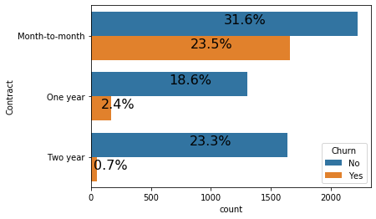
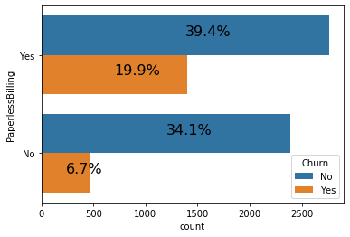
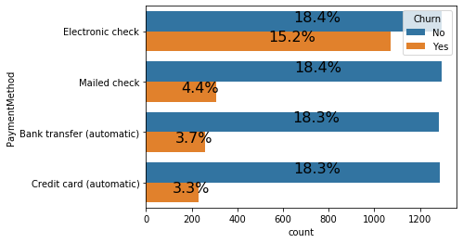
2.-Explain churn by the below categories.(Billing Information)
The unsubscriber seems to be greatly influenced by billing information.

Slide 19
3.1- Services are typically purchased by customers who churned
Services most used by churn customers are Internet and Phone

Slide 20
Internet Service is typically purchased by customers who churned
The internet service is one of the services that churners buy the most,
it has two types: DSL and the Fiber optic service,
the Fiber optic service is a service that does not work well
because on our database of 7000 customers,
20 % did not have the internet service and stayed,
1.6% did not have it and left
but 25.6% had fiber optic and remained loyal against
18. 4% who had it and are gone,
27.8% had the DNL and stayed
6.5% had it and are gone

Slide 21
Phone Service is typically purchased by customers who churned
Online Backup is also one of the services that churners buy the most,
it has one of the highest churn rates and the most used
compared to our database of almost 7000 customers,
7.3% did not have this service and stayed,
2.4% did not have it and left
and 66.2% got it and stayed loyal compared to
but 24.2% who got it and left.

Slide 22
3.2- Services especially helpful in retaining customers
Online Support, online security, online protection and tech support fidelize client.

Slide 23
Fidelize Client with Tech Support
Technical support is a service derived from internet service,
but internet service is one of the services that churners buy the most
or technical support has on our database of nearly 7000 customers
28.8% have not had this service and stayed,
20.6% did not have it and left
but 24.6% had it and remained faithful against
only 4.4% who had it and left.

Slide 24
Fidelize Client with Online Backup
Online Backup is also a service derived from internet service,
he is very important and helps to retain customers
because on our database of almost 7000 customers
26.4% did not have this service and stayed,
17.5% did not have it and left
but 27% got it and stayed loyal compared to
only 7.4% who got it and left.

Slide 25
Fidelize Client with Online Security
Online Security is also a service derived from internet service,
he is very important and helps to retain customers
because on our database of almost 7000 customers
29 % did not have this service and stayed,
20.5% did not have it and left
but 24.5% got it and stayed loyal compared to
only 4.2% who got it and left.

Slide 26
Fidelize Client with Device Protection
Device Protection is also a service derived from internet service,
he is very important and helps to retain customers
because on our database of almost 7000 customers
26.8% did not have this service and stayed,
17.2% did not have it and left
but 26.6% got it and stayed loyal compared to
only 7.8% who got it and left.

Slide 27
Types of people who churn at higher rates

Slide 28
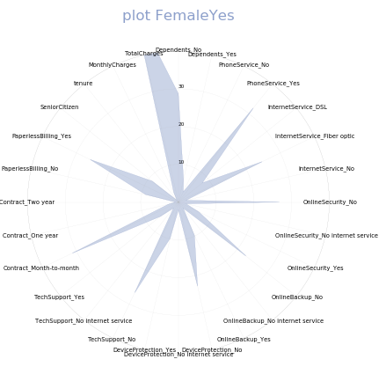

Slide 29
Discussion & Recommendations
Communicate your recommendations to your audience. Based on your results, how might you propose solving the business problem? (June 15, 2020)
What is your proposed solution?
What are strengths of the organization that you have leveraged in your solution?
What are weaknesses of the organization that could undermine your solution?
What are challenges that you might encounter? How can you mitigate them?

Slide 30
References & Appendices
Provide citations for your work and provide resources for your audience to learn more about the technical aspects of your project. Share links to your GitHub repository or accompanying spreadsheets.

