Slide 1
Lithuania PV Production Financial Plan
Market-Scaled Strategic Investment Evaluation (250 MW)
March 2026

Slide 2
1. Baseline vs With-Project summary
Metric | Baseline (Outsource) | With-Project (Local)
Supply Chain Risk | High (Long lead times) | Low (Local control)
Production Cost | Market Price + Margin | Internal Variable Cost
Strategic Value | Dependency on Imports | EU "Made in EU" Premium
CIT Rate | 15% | 0% (Klaipeda FEZ)

Slide 3
TABLE TEMPLATE 1 — Capacity & ramp-up plan
Year | Max capacity | Utilization % | Scrap % | Effective capacity
Year 1 | 250 | 50.0% | 5.0% | 118.75
Year 2 | 250 | 75.0% | 4.0% | 180.00
Year 3 | 250 | 90.0% | 3.0% | 218.25
Year 4 | 250 | 95.0% | 2.0% | 232.75
Year 5 | 250 | 100.0% | 2.0% | 245.00

Slide 4
TABLE TEMPLATE 2 — Sales forecast
Year | Units sold | Price (EUR/unit) | Revenue (EUR) | Justification (short)
Year 1 | 118.75 | 126,000 | 14,962,500 | Market entry
Year 2 | 180.00 | 123,480 | 22,226,400 | Growth phase
Year 3 | 218.25 | 121,010 | 26,410,520 | Scale reach
Year 4 | 232.75 | 118,590 | 27,601,867 | Maturity
Year 5 | 245.00 | 116,218 | 28,473,505 | Full capacity

Slide 5
TABLE TEMPLATE 3 — Variable cost per unit breakdown
Component | Driver | Formula | EUR/unit | Source
Materials/ingredients | LONGi HPBC 2.0 | Direct | 80,700 | LONGi 2025 Spec
Packaging | Export grade | Fixed | 1,500 | Logistics Spec
Direct labor | Lithuania Min | 800h * 16.5 | 13,200 | VDI 2026 Std
Energy (if relevant) | Industrial rate | 0.18/kWh | 2,500 | Eurostat
Platform fee / other | Scrap Effect | Cost/(1-S)-C | 1,998 | Industry Std

Slide 6
TABLE TEMPLATE 4 — Incremental fixed costs
Year | Maintenance | Extra staff | Rent/overhead | Other | Total fixed
Year 1 | 432,000 | 288,000 | 96,000 | 384,000 | 1,200,000
Year 2 | 432,000 | 288,000 | 96,000 | 384,000 | 1,200,000
Year 3 | 432,000 | 288,000 | 96,000 | 384,000 | 1,200,000
Year 4 | 432,000 | 288,000 | 96,000 | 384,000 | 1,200,000
Year 5 | 432,000 | 288,000 | 96,000 | 384,000 | 1,200,000

Slide 7
TABLE TEMPLATE 5 — Project operating statement
Year | Units | Revenue | Variable costs | Contribution | Fixed costs | EBITDA
Year 1 | 118.8 | 14,962,500 | 12,237,500 | 2,725,000 | 1,200,000 | 1,525,000
Year 2 | 180.0 | 22,226,400 | 18,356,250 | 3,870,150 | 1,200,000 | 2,670,150
Year 3 | 218.2 | 26,410,520 | 22,027,500 | 4,383,020 | 1,200,000 | 3,183,020
Year 4 | 232.8 | 27,601,867 | 23,251,250 | 4,350,617 | 1,200,000 | 3,150,617
Year 5 | 245.0 | 28,473,505 | 24,475,000 | 3,998,505 | 1,200,000 | 2,798,505

Slide 8
TABLE TEMPLATE 6 — Break-even
Item | Value | Notes
Price (EUR/unit) | 116,218 | EUR/MW
Variable cost (EUR/unit) | 99,898 | EUR/MW
Contribution (EUR/unit) | 16,320 | Price - Var cost
Fixed costs (EUR/period) | 1,200,000 | Annual burden
Break-even units (Q_BE) | 73.53 | Fixed / Contrib unit
Break-even revenue | 8,545,245 | Q_BE x Price
Margin of safety | 70.0% | (Exp - Q_BE)/Exp

Slide 9
TABLE TEMPLATE 7 — Assumptions & Sources
Assumption | Value | Unit | Source | Why reasonable | Low/Base/High
Price | 126,000 | EUR/MW | LONGi 2025 | HPBC 2.0 premium | Base
Volume / demand | 250 | MW | Market study | Realistic domestic share | Base
Ramp-up (utilization) | 50%-100% | % | Project plan | Staged growth | Base
Wage rate | 16.50 | EUR/h | VDI 2026 | Lithuanian standard | Base
Energy price | 0.18 | EUR/kWh | Eurostat | Baltic industrial | Base
Scrap / yield | 2% - 5% | % | Industry Std | Improving ramp-up | Base
Maintenance | 432,000 | EUR/yr | Vendor spec | Scaled for 250MW | Base

Slide 10
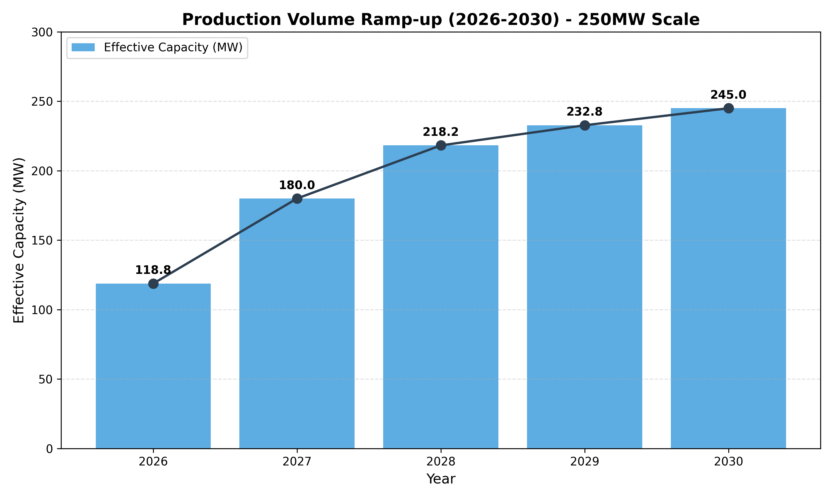
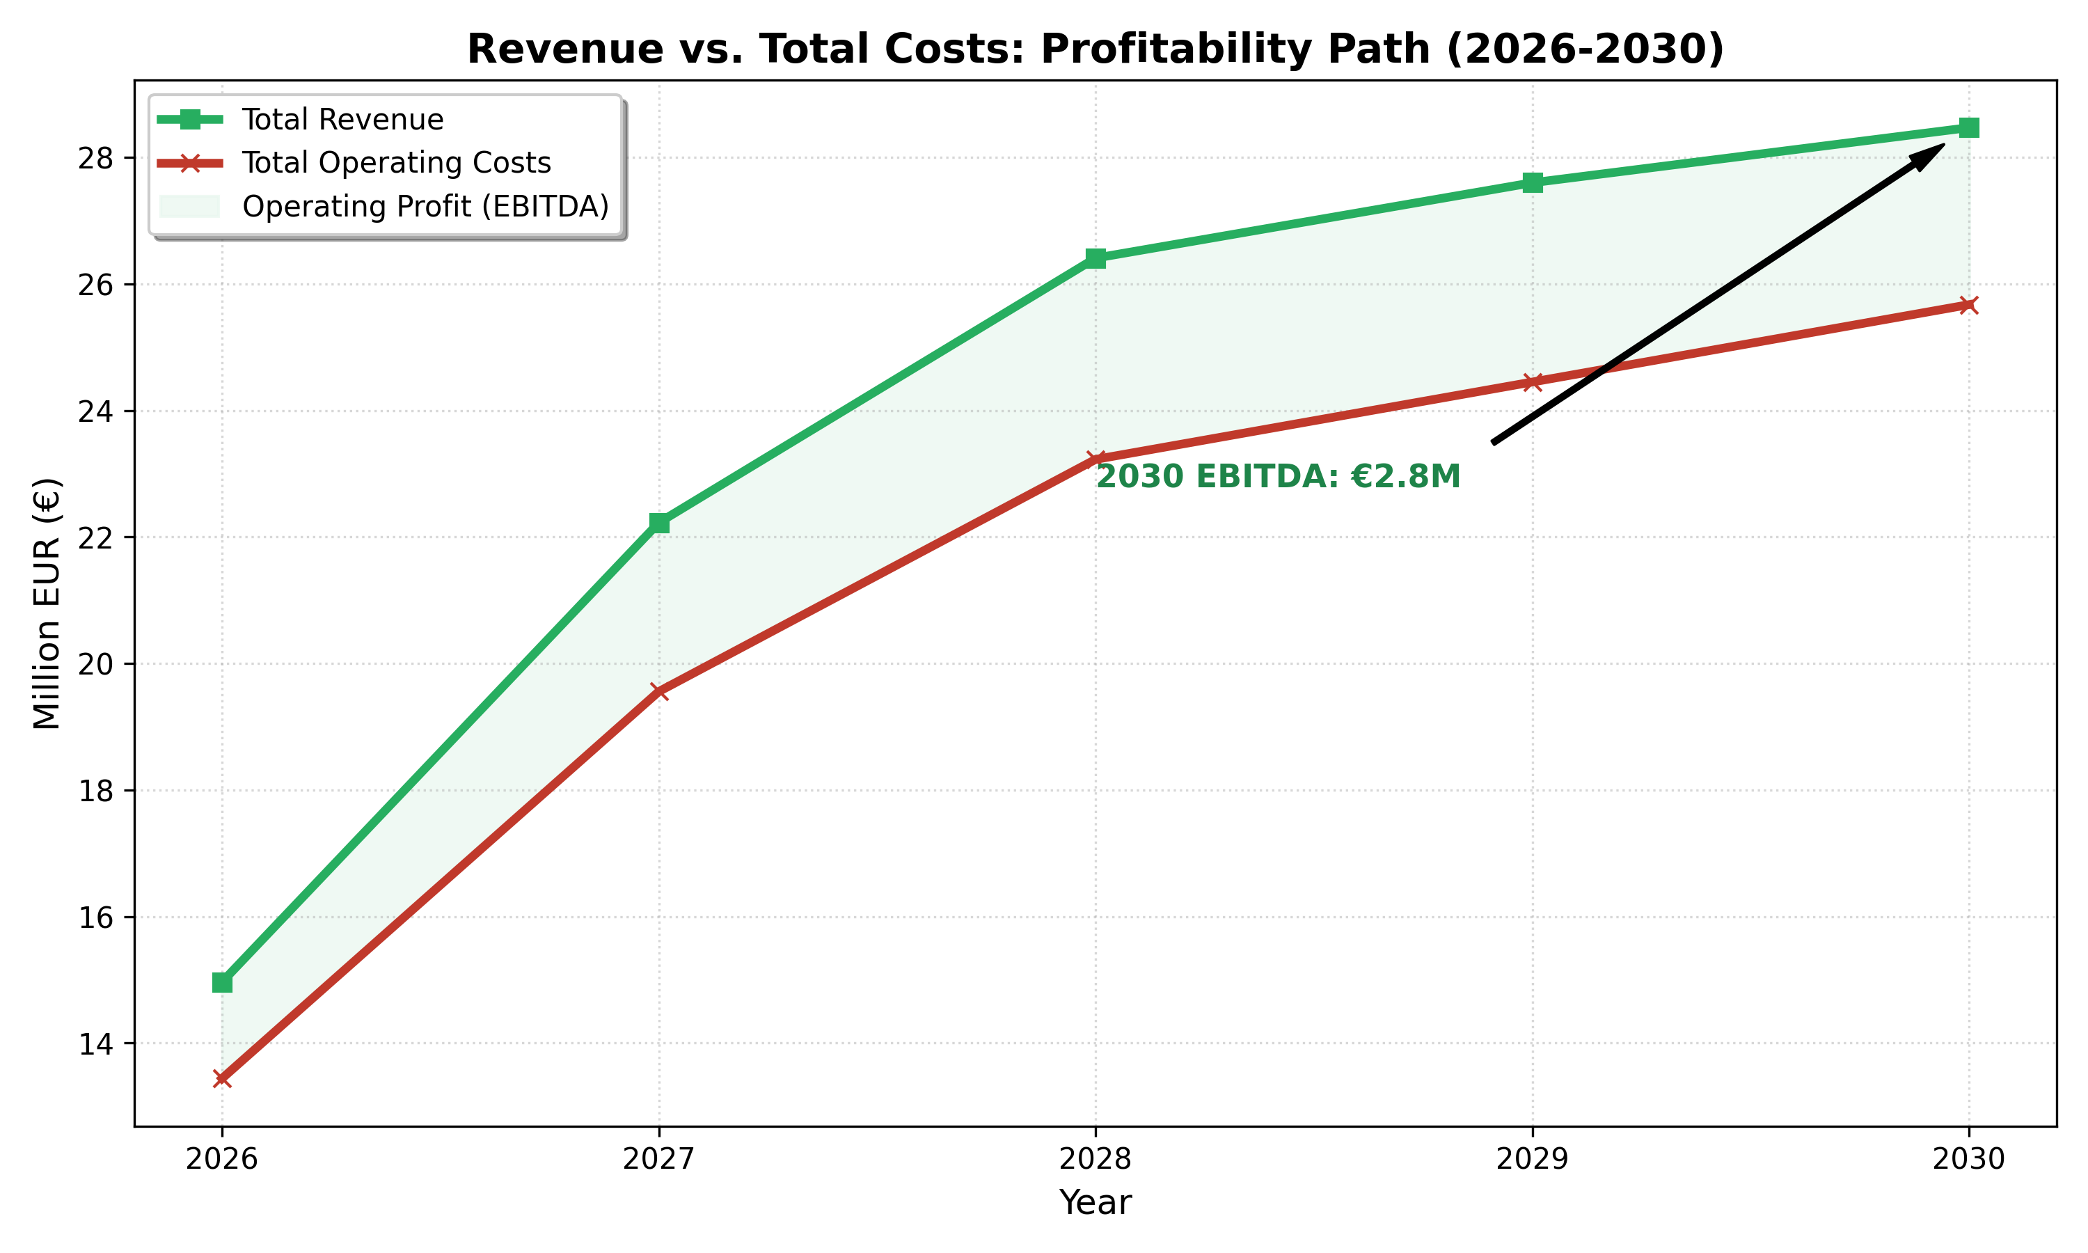
Financial Performance Visualizations

