Slide 1
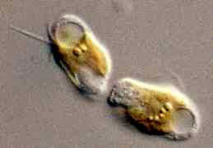
Haptophytes
Little aliens (not) from mars.

Slide 2
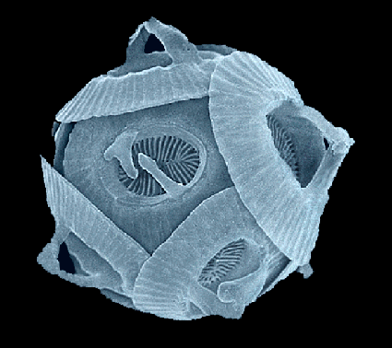
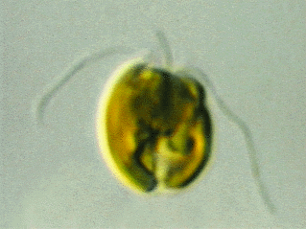
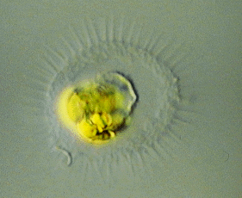
Classification and
Behavior
300 species in 80 genera in the phylum.
Consists of unicellular flagellates, colonial flagellates, as well as nonmotile single cells and colonies.
Hapto- “bind to, attach to” comes from the greek “hapsis” - touch. A reflection of their use of the haptonema.
They use their Haptonema as
a fishing rod, or a lasso.

Slide 3
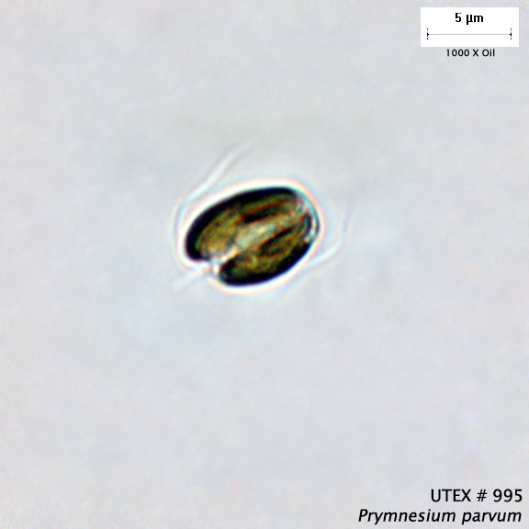
Visual Characteristics
Size: 3-15 micrometers
Often have two smooth,
equal flagella.
A unique organelle called a haptonema, which has modified behavior.
Strange outer scales.
http://tolweb.org
Notes:
http://tolweb.org/accessory/Algae:_Protists_with_Chloroplasts?acc_id=52

Slide 4
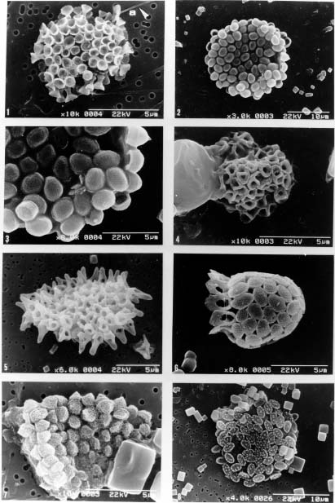
Biochemistry
Chlorophyll types A and C.
Use uncommon polysaccharide Chrysolaminarin for energy storage.
Scales are made of cellulose, or in some, calcium-containing deposits.
Some have the yellow-brown accessory pigment Fucoxanthin.

Slide 5
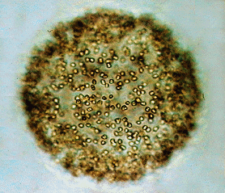
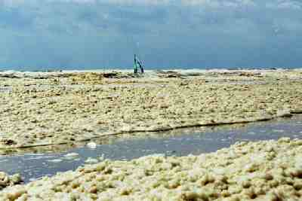
Impact
Mostly marine, a few freshwater and terrestrial.
Broad chemical manipulation:
As Phytoplankton, they help hold up
the marine food chain.
Sink organic carbon and two-thirds of the oceanic calcium carbonate to the ocean floor.
They produce sulfur oxides that
contribute to acid rain.
Two genera, Chrysochromulina
and Prymnesium, form toxic
marine blooms that kill pretty
much everything in the area.
Colony of Phaeocystis (Prymnesiales)
More colonies of Phaeocystis (Prymnesiales

Slide 6
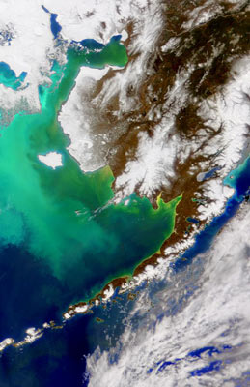
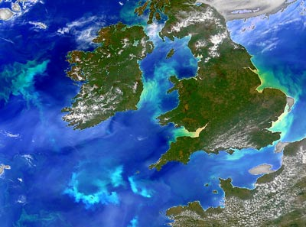
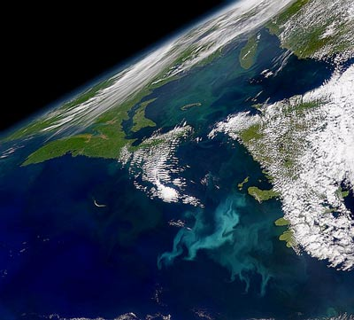
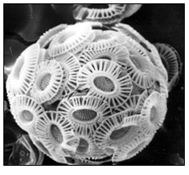
Coccolithophore blooms
Notes:
http://www.genomenewsnetwork.org/articles/02_02/bloom_art.shtml

Slide 7
Sources
Biology of Plants text
http://www.freearchive.info/ha/haptophyte.html for haptophyte classification methods.
http://www.genomenewsnetwork.org/articles for coccolithophore blooms.
http://www.biol.tsukuba.ac.jp/ for phaeocystis information and images.
…and a few other sites for images.
Questions?

