Slide 1
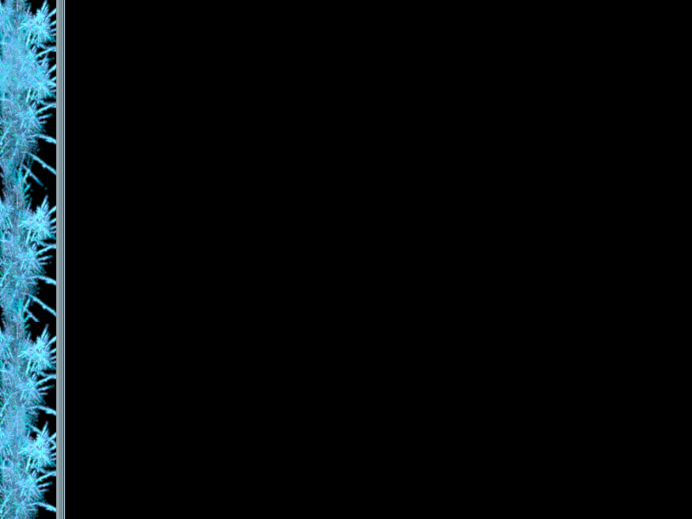
RNAi Overview
Intro to RNAi
Abstract of Experiment
Materials and Methods used
Results and Discussion
Labelling of dying proteins
  Focus on Ubiquitin
Degredation of dying proteins
  Focus on the Ubiquitin-Proteasome System

Slide 2
How do proteins die?
Immortality and you

Slide 3
An Overview of Protein Death
Protein Damage
  Focus on Free Radicals
Labelling of dying proteins
  Focus on Ubiquitin
Degredation of dying proteins
  Focus on the Ubiquitin-Proteasome System

Slide 4
1. Protein Damage
Denaturization
  Heat shock
  pH
  Ion Concentration
Chemical Bonding to the Protein
  Carbonyl group bonding
  Free Radicals

Slide 5
Free Radicals
Uncharged atoms or molecules with an unpaired electron shell that makes them very reactive.
Free radicals result from ionizing radiation during redox reactions.
The oxygen radicals •OH (the hydroxyl radical) and O²•¯ (the superoxide anion) arise from oxidations involving water, and are the most common free radicals in living things.
Only combining with another free radical or antioxidants like vitamin C can halt the destructive cycle that free radicals introduce
Free radicals can react powerfully with proteins
Notes:
Mitochondria,

Slide 6
The effects of Free Oxygen Radicals
Destroying the structure of the protein
  By denaturing secondary and tertiary structure
  By cleaving proteins into modified, nonstandard peptides
Aggregation of proteins
  Due to formation of protein-protein cross-links
  Due to hydrophobic domains becoming exposed

Slide 7
2. The need to remove dying proteins
Conservation of the raw material of amino acids and the energy that they contain
Regulation of Cell Cycles like division, and transcription
Removal of incorrectly functioning protein due to free radical oxidative stress
Prevention of protein aggregates (the buildup of which is often seen in diseases like Alzheimer’s and Parkinson’s)

Slide 8
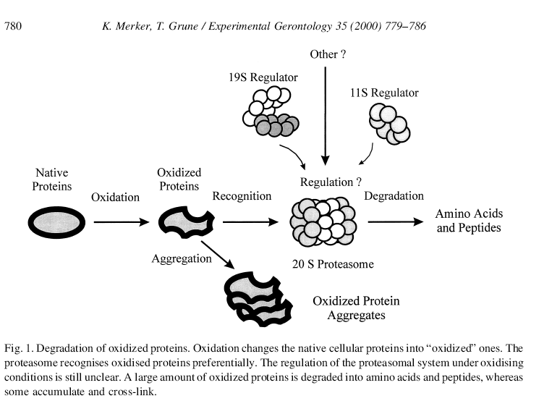
Protein Aggregation
Bullets

Slide 9
Types of ProteinDegredation
Mass digestion by proteases in the Lysosome
Refolding of salvageable denatured proteins by Chaperone proteins
Selective degredation by the Ubiquitin-Proteasome system

Slide 10
Ubiquitin
Ubiquitin (a relatively small, 76 Amino Acid long protein)
  Used as a label for proteins that need to be degraded, it binds covalently to lysine residues of target proteins
Ubiquitin uses three protein groups to attach to its target
  Ubiquitin-activating enzyme E1
  Ubiquitin-conjugating enzyme E2
  Ubiquiting-protein ligases E3

Slide 11
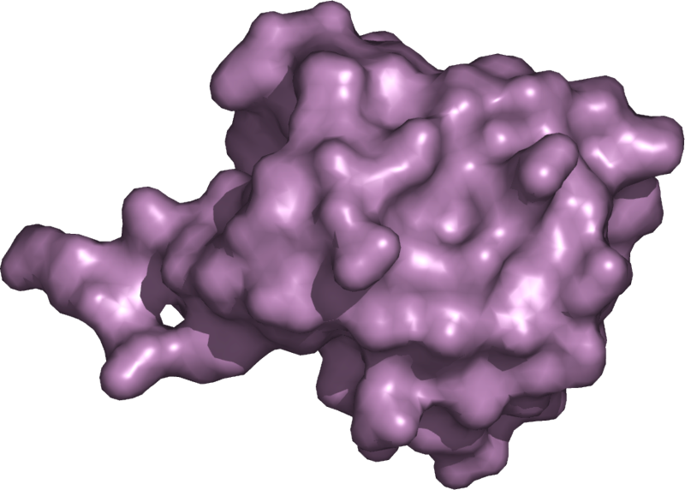
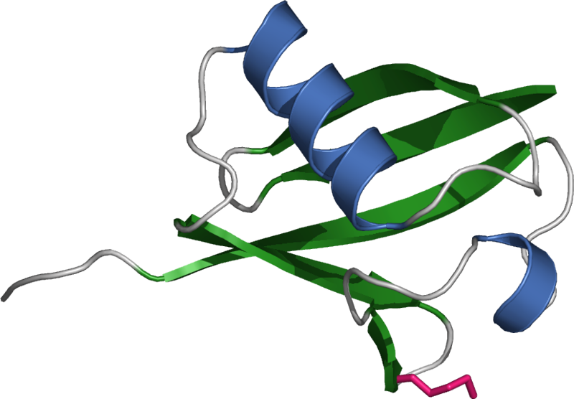
Imagery of Ubiquitin
Molecular Surface Ribbon Representation

Slide 12
Ubiquitin Attachment
Activation-
  Carboxyl group of Ubiquitin binds to the sulfhydryl group of E1, using ATP
Transfer-
  Transfer of Ubiquitin’s thioester bond from E1 to E2
Labelling-
  Either a transfer from E2 directly to an already ubiquinated protein,
  Or by the attachment of the Ubiquitin-E2 complex to E3, which attaches in turn to the target protein, and then the binding of Ubiquitin to a lysine residue of the target protein

Slide 13
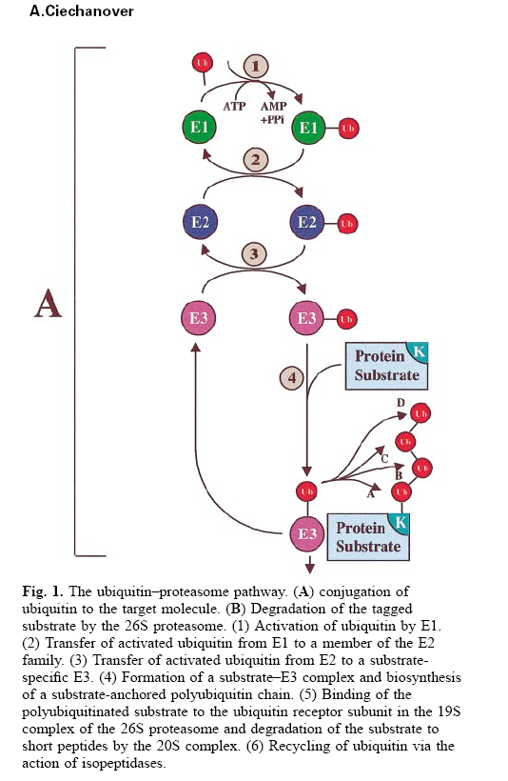
123
Ubiquitin
Attachment
System

Slide 14
Ubiquitin labelling cues
The Ubiquitin system (and more specifically E3) makes use of the following general factors to find a target protein
  Hydrophobic domains on the outside of the proteins
  N-terminus type

Slide 15
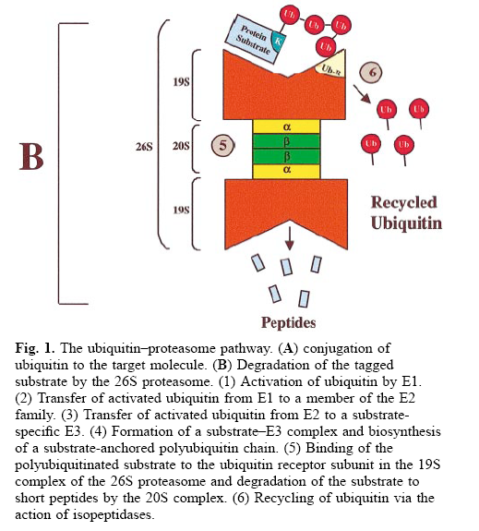
Material
Proteosome
System

Slide 16
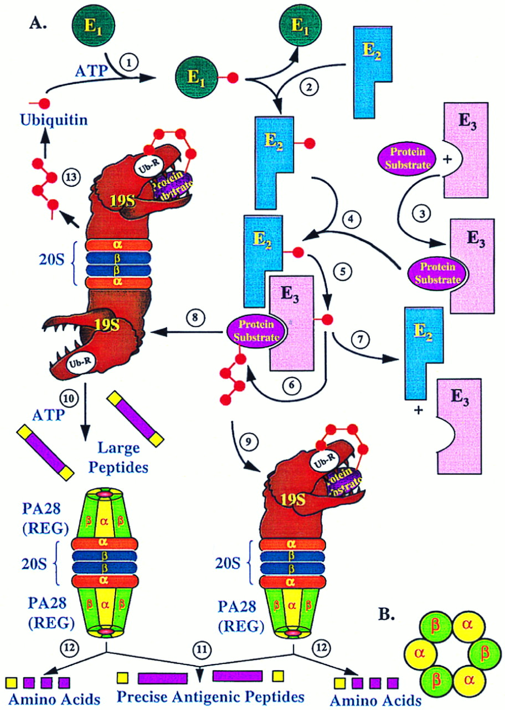
Full
The full
Ubiquitin-
Proteasome
System
(+ tyrannosaur)

Slide 17
Ubiquitin in Disease
HIV and the Ebola virus
Alzheimer’s

Slide 18
Conclusion
The implications for immortality.

Slide 19
Questions?
Hershko, A., and Ciechanover, A., The Ubiquitin System, Annu. Rev. Biochem. 67:425-79, 1998
Merker, K., and Grune, T., Proteolysis of oxidised proteins and cellular senescence, Experimental Gerontology, 35:779-786, 2000
Beckman, K. B., and Ames, B. N., The Free Radical Theory of Aging Matures, Physiological Reviews, 78, No. 2:547-572, 1998
Berlett, B. S., and Stadtman, E. R., Protein Oxidation in Aging, Disease, and Oxidative Stress, The Journal of Biological Chemistry, 272:20313-20316, 1997

Slide 20
Conclusion

Slide 21
Imagery of Ubiquitin
Molecular Surface Ribbon Representation
The implications for immortality.

