Slide 1
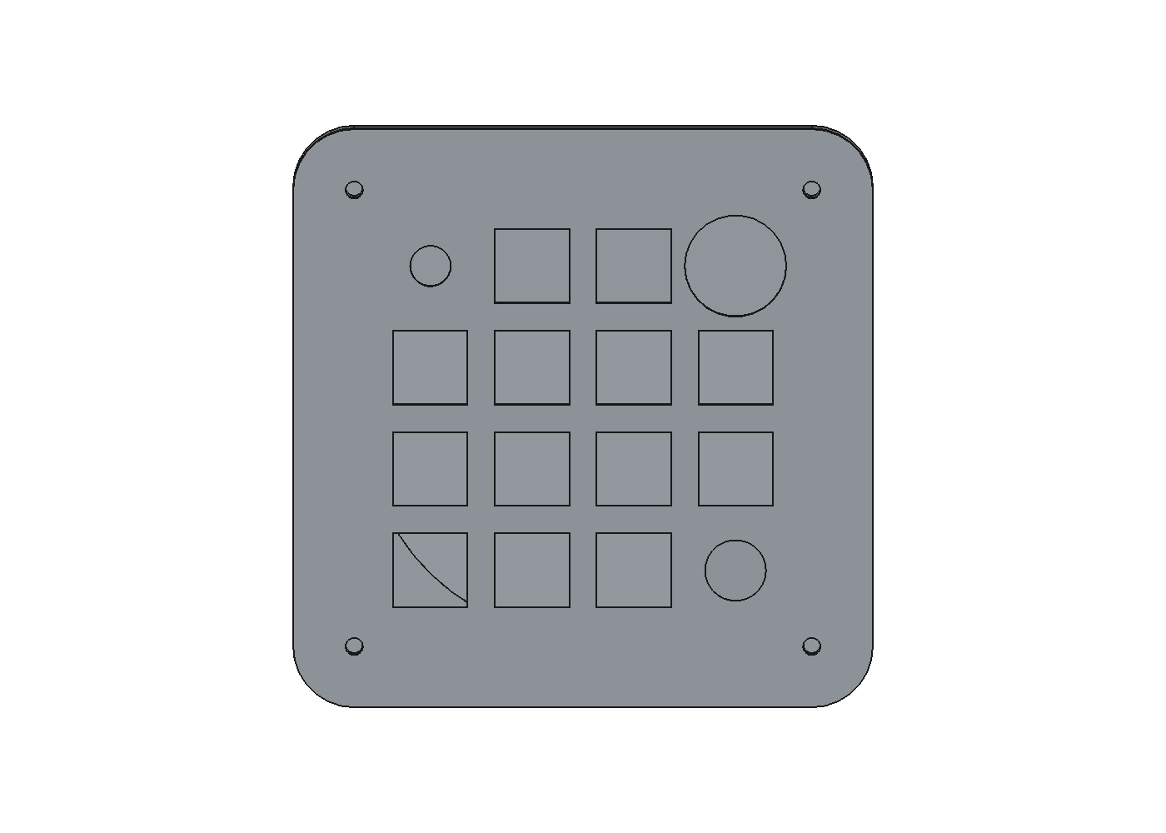
FocalPoint Rev A
Two-device bill of materials
16 dynamically mapped inputs
Wireless + USB-C • 1,000 mAh • per-key RGB
Prototype procurement decision — 28 July 2026

Slide 2
What we are building
The BOM follows the current square enclosure and 16-input architecture
Controls
Industrial design
User experience
13 tactile MX keys 1 analog joystick + push 1 rotary encoder + push 1 capacitive touch region
114 × 114 mm square shell 6 mm corner radius 4° key-plane slope 86 mm circular bottom puck
Every input remappable BLE and wired USB 13 individually addressed RGB keys Clear caps + one ceramic accent
The supplied visual sketch is an aesthetic reference; the electrical count remains the previously specified 4×4 set of sixteen logical inputs.
2

Slide 3
Electronics selection
Exact primary components for each of the two devices
Compute + radio
Power path
RGB power
Raytac MDBT50Q-1MV2 nRF52840 certified module
TI BQ24074 charger TPS63031 3.3 V buck-boost
TPS61023 5 V boost TPS22918 switch + AHCT buffer
Sensors
Connectivity
Battery
Alps RKJX21224001 joystick AT42QT1010 touch MAX17048 fuel gauge
GCT USB4105 USB-C TI USB ESD + Nexperia VBUS TVS
TinyCircuits ASR00012 Protected 1,000 mAh; 1 A max
3

Slide 4
Exactly two devices
No third assembled unit and no discretionary spare quantities
26 each
2 each
Pack minimums
Kailh Polia switches Kailh hot-swap sockets 1N4148W matrix diodes 12 mA SK6812MINI-E LEDs
Radio modules • batteries USB-C • joystick • encoder Every power and sensor IC JST-SH battery connectors
2 × Adafruit 5068 12-cap packs 1 × Cerakey four-cap pack 1 silicone sheet + adhesive 5 bare PCBs may be fab minimum
57 frozen BOM lines include per-board reference designators, fabricated parts, and reusable programming tools.
JLC attrition quantities are manufacturing consumables—not parts for a third device.
The machine-readable CSV is the purchasing authority for quantities.
4

Slide 5
Who assembles what
Designed around no at-home reflow
JLCPCB / contract manufacturer
Hand assembly
All SMT passives and ICs Raytac radio module BQ24074 QFN charger Power converters and protection 13 reverse-mounted RGB LEDs 13 hot-swap sockets + diodes USB-C hybrid assembly preferred
Install encoder and joystick Insert MX switches and keycaps Connect protected battery Install heat-set inserts and screws Fit printed enclosure parts Cut/apply circular silicone pad Program and run acceptance test
5

Slide 6
Power budget and non-negotiable limits
RGB budget
Battery + charging
Thermal constraint
13 × 12 mA channels ≈169 mA total at 5 V incl. static ≈313 mA battery draw at 3.0 V Firmware cap: 156 mA channels
1,000 mAh protected cell 1 A maximum discharge Target total draw <0.45 A Charge limited to ≈0.4 A
BQ24074 may dissipate ≈0.8 W Thermal copper/vias required Closed-case charge test mandatory No USB-PD claim
Do not substitute generic 60 mA-per-pixel LEDs.
The RGB rail defaults off and is enabled only after controlled startup.
6

Slide 7
Two-device prototype budget
Planning allowance; final price comes from live JLC and distributor carts
PCBs + assembly
Controls + mechanics
Shipping + contingency
$110–190 Five bare boards may be the fabrication minimum; populate only two. Includes double-sided setup and ordinary SMT labor.
$90–170 Switches, caps, joysticks, encoders, batteries, hardware, printed parts, and foot material.
$50–100 Multiple vendors, taxes, rare-part loading, and first-article rework allowance.
$250–460 total • $125–230 per working prototype
7

Slide 8
Before placing the complete order
The BOM is selected; product validation still depends on the PCB and physical prototype
Complete schematic and four-layer routing; pass ERC/DRC and independent review.
Replace every placeholder with its exact manufacturer footprint and STEP model.
Redesign battery pocket, joystick opening/tail path, USB opening, and insert bosses.
Verify radio antenna keep-out against copper, battery, screws, and circular base.
Validate every JLC MPN, side, rotation, and package in the live order preview.
Build two units; test power, charging temperature, USB, BLE range, RGB, touch, all controls, and enclosure fit.
8

Slide 9
Recommendation
Buy now
Hold until layout validation
Two batteries for fit checks Two joysticks and encoders Two keycap packs + ceramic pack Switches and mechanical samples Programming cable / nRF52840-DK if needed
JLC assembled PCB order Final printed enclosure batch Custom-cut production foot pads Any volume purchase beyond the two devices
Procurement source: hardware/bom.csv
Engineering rationale and gates: hardware/BOM.md
9

