Slide 1
Scheme for 1 DSB by hguide 3.9 (Yellow line indicates possible positions of microhomology for each groups)
Group 1 (Exon1-Exon2)
Group 2 (Exon1-Intron all)
R1
DSB by
hguide 3.9
DSB by
hguide 3.9
R1
Spliced CMV∆
Ds
Red
Spliced CMV∆
Ds
Red
Intron
Intron
R2
R2
DSB by
hguide 3.9
R1
branch∆
Ds
Intron
Red
R2
Group 3 (Exon1-Intron w/o branch)
Group 4 (Exon1-branch site)
R1
DSB by
hguide 3.9
DSB by
hguide 3.9
R1
Spliced CMV∆
Ds
Intron
Red
Spliced CMV∆
Ds
Intron
Red
R2
R2
R1
DSB by
hguide 3.9
branch∆
Ds
Intron
Red
R2

Slide 2
Scheme for 1 DSB by hguide 4.2 (Yellow line indicates possible positions of microhomology for each groups)
Group 1 (Exon2-Exon1)
Group 2 (Exon2-Intron all)
R1
DSB by
hguide 4.2
R1
DSB by
hguide 4.2
Spliced CMV∆
Ds
Red
Spliced CMV∆
Ds
Red
Intron
Intron
DSB by
hguide 4.2
R2
R2
R1
branch∆
Ds
Intron
Red
R2
Group 3 (Exon2-Intron w/o branch)
Group 4 (Exon2-branch site)
DSB by
hguide 4.2
DSB by
hguide 4.2
R1
R1
Spliced CMV∆
Ds
Intron
Red
Spliced CMV∆
Ds
Intron
Red
R2
R2
DSB by
hguide 4.2
R1
branch∆
Ds
Intron
Red
R2

Slide 3
1 DSB by hguide 3.9

Slide 4
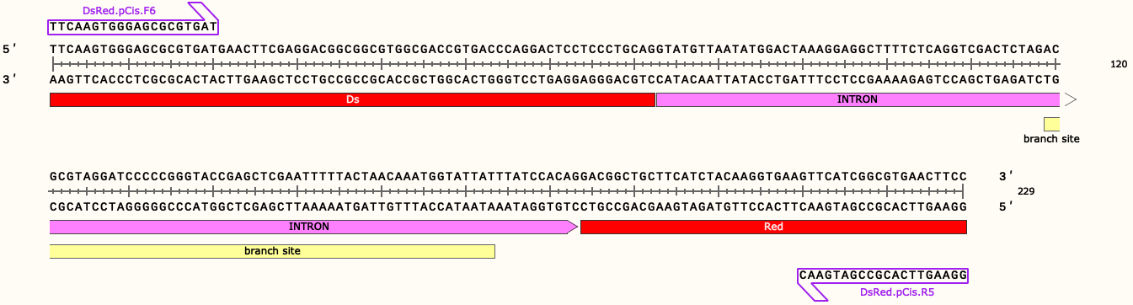
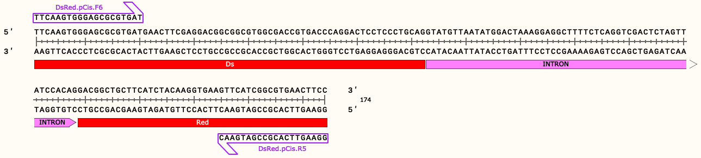
R1, Group 1, Exon1-Exon2
DSB by hguide 3.9
R1
Exon1 (21-67)
PAM
hguide 3.9
Spliced trarnscript Library
Exon2 (184-209)
DSB by hguide 3.9
R2
R1
Exon1 (21-67)
PAM
∆branch
hguide 3.9
Exon2 (129-154)
R2

Slide 5
R1, Group 3, Exon1-Intron (w/o branch site)
R1
DSB by hguide 3.9
Exon1 (21-67)
Intron 1 (73-118)
PAM
hguide 3.9
Intron 2 (174-183)
DSB by hguide 3.9
R2
R1
Exon1 (21-67)
Intron (73-128)
PAM
hguide 3.9
R2

Slide 6
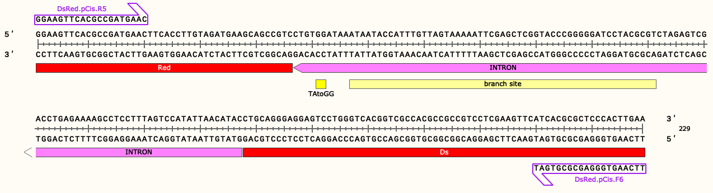
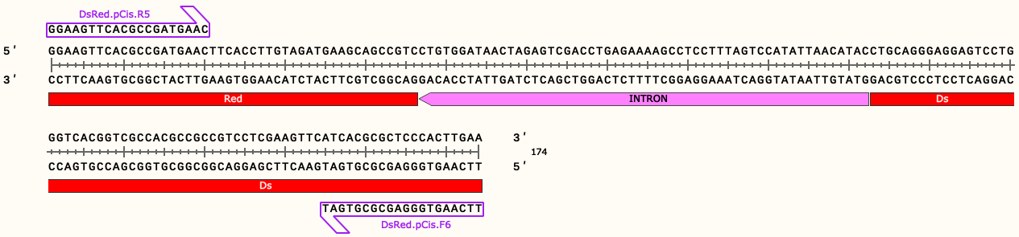
R2, Group1, Exon1-Exon2
R2
Exon2 (21-46)
Spliced trarnscript Library
hguide 3.9
PAM
Exon1 (163-209)
DSB by hguide 3.9
R1
R2
Exon2 (21-46)
hguide 3.9
PAM
∆branch
DSB by hguide 3.9
Exon1 (108-154)
R1

Slide 7
R2, Group 3, Exon1-Intron (w/o branch site)
R2
Intron 1 (47-56)
Spliced trarnscript Library
hguide 3.9
PAM
Intron 2 (112-157)
Exon1 (163-209)
DSB by hguide 3.9
R1
R2
Intron (47-102)
hguide 3.9
PAM
∆branch
DSB by hguide 3.9
Exon1 (108-154)
R1

Slide 8
1 DSB by hguide 4.2

Slide 9
R1, Group 1, Exon2-Exon1
R1
Exon1 (21-72)
Spliced trarnscript Library
PAM
hguide 4.2
Exon2 (184-209)
R1
DSB by hguide 4.2
R2
Exon1 (21-72)
∆branch
PAM
hguide 4.2
DSB by hguide 4.2
Exon2 (129-154)
R2

Slide 10
R1, Group 3, Exon2-Intron (w/o branch site)
R1
Intron 1 (73-118)
PAM
hguide 4.2
Intron 2 (174-183)
Exon2 (184-209)
DSB by hguide 4.2
R2
R1
Intron (73-128)
PAM
hguide 4.2
DSB by hguide 4.2
Exon2 (129-154)
R2

Slide 11
R2, Group1, Exon2-Exon1
DSB by hguide 4.2
R2
Exon2 (21-46)
hguide 4.2
PAM
Spliced trarnscript Library
Exon1 (158-209)
DSB by hguide 4.2
R1
R2
Exon2 (21-46)
hguide 4.2
PAM
∆branch
Exon1 (103-154)
R1

Slide 12
R2, Group 3, Exon2-Intron (w/o branch site)
DSB by hguide 4.2
R2
Exon2 (21-46)
Intron 1 (47-56)
hguide 4.2
PAM
Spliced trarnscript Library
Intron 2 (112-157)
R2
R1
Exon2 (21-46)
Intron (47-102)
hguide 4.2
PAM
∆branch
R1

Slide 13
2 DSBs by hguide 3.9 + 4.2

Slide 14
R1, Group 1, Exon1-Exon2
DSB by hguide 3.9
R1
Exon1 (21-67)
PAM
hguide 3.9
Spliced trarnscript Library
DSB by hguide 4.2
Exon2 (184-209)
R1
R2
Exon1 (21-67)
DSB by hguide 3.9
PAM
∆branch
hguide 3.9
DSB by hguide 4.2
Exon2 (129-154)
R2

Slide 15
R2, Group 1, Exon1-Exon2
DSB by hguide 4.2
R2
Exon2 (21-46)
Spliced transcript Library
hguide 3.9
PAM
DSB by hguide 3.9
Exon1 (163-209)
R1
R2
Exon2 (21-46)
DSB by hguide 4.2
hguide 3.9
PAM
∆branch
DSB by hguide 3.9
Exon1 (108-154)
R1

Slide 16
Antisense plasmids
2 DSBs

Slide 17
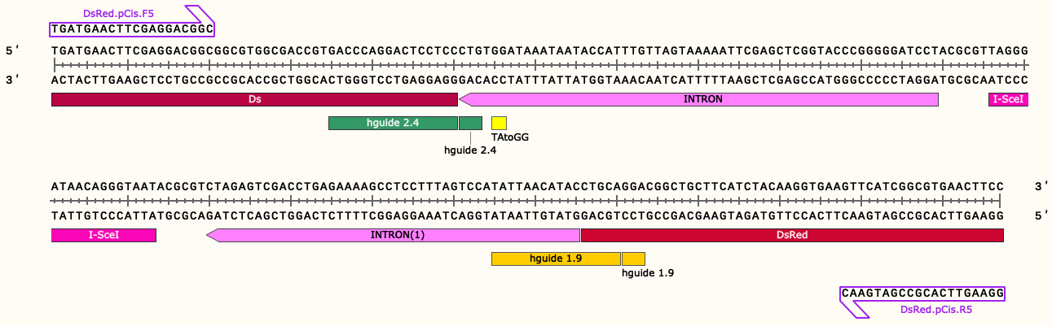
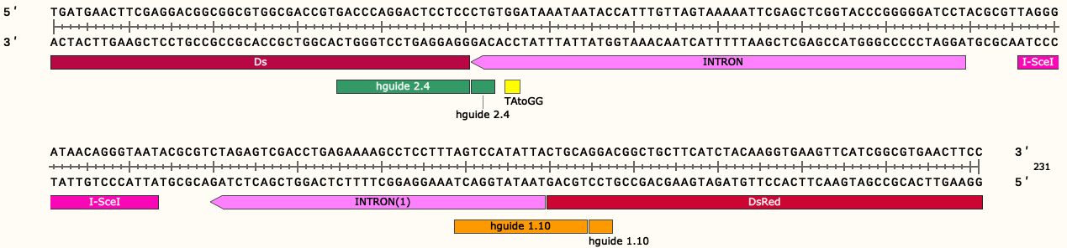
R1, Group 1, Exon1-Exon2
DSB by hguide 2.4
Exon1 (21-50)
DSB by hguide 1.9
Spliced transcript Library
Exon2 (191-217)
DSB by hguide 2.4
Exon1 (21-50)
DSB by hguide 1.10
5’ splicing site∆
Exon2 (185-211)

Slide 18
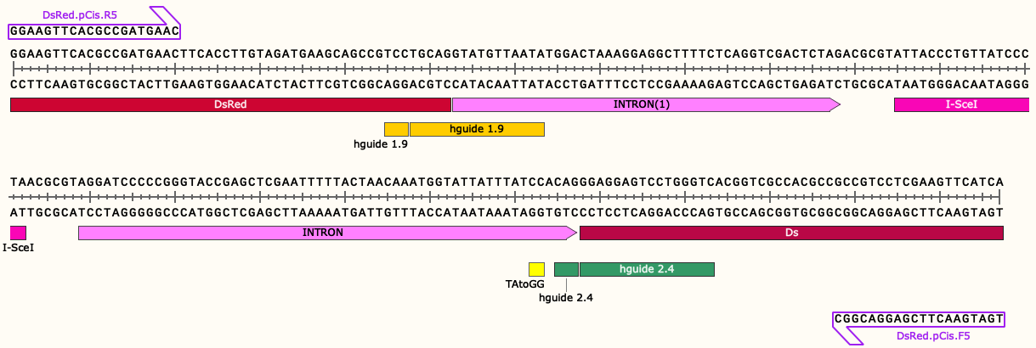
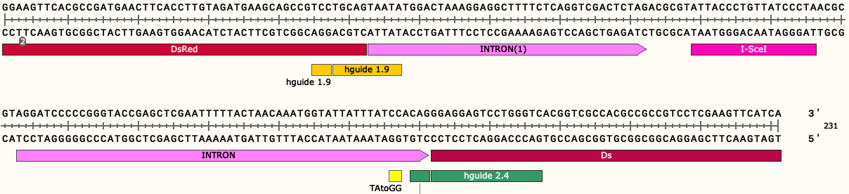
R2, Group 1, Exon1-Exon2
DSB by hguide 1.9
Exon2 (21-47)
Spliced transcript Library
Exon1 (188-217)
DSB by hguide 1.9
Exon2 (21-47)
DSB by hguide 2.4
5’ splicing site∆
Exon1 (182-211)

