Slide 1

ANDREW PARKER
TUCKER HARDIE
BENJAMIN MCPHERSON

Slide 2




What is Signal Seeker?
Signal Seeker is a location based service that allows users to view and submit visual signal strength data on a map.
Signal Seeker utilizes Wi-Fi, GPS, and Google Maps for its Ruby on Rails and Android applications.

Slide 3
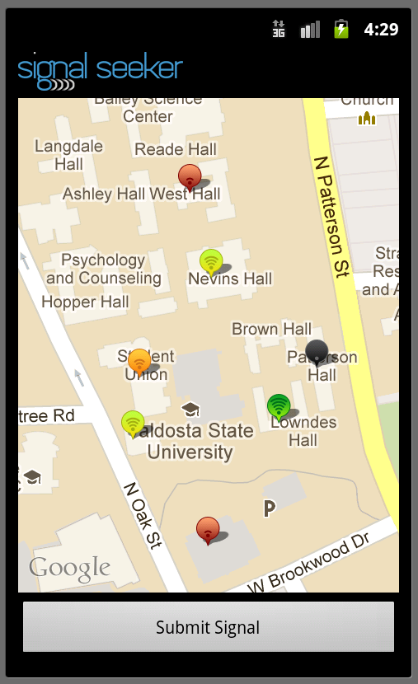
Signal Seeker on Android
The Signal Seeker Android application was built with the Android 2.3.3 SDK platform.
Serves as the main environment for viewing and submitting signal strength data.

Slide 4
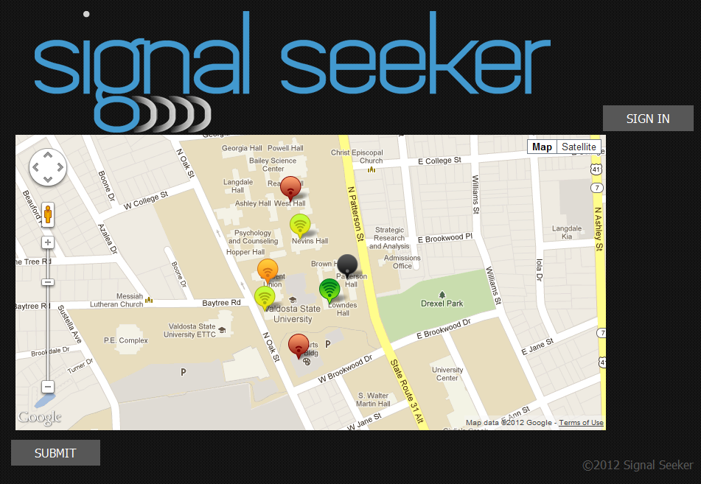
signalseeker.herokuapp.com
The Signal Seeker web application was built with the Ruby on Rails framework.
It functions as the server to the Signal Seeker Android app.
Provides administrator privileges.

Slide 5
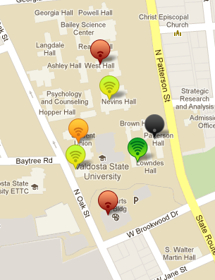
The Signal Seeker Map
On both the web app and Android version of Signal Seeker, the “Signal Seeker Map” populated with signal map markers is the main focus.
Each map marker denotes the location and signal, represented by the appropriate signal icon, for a submitted point.

Slide 6
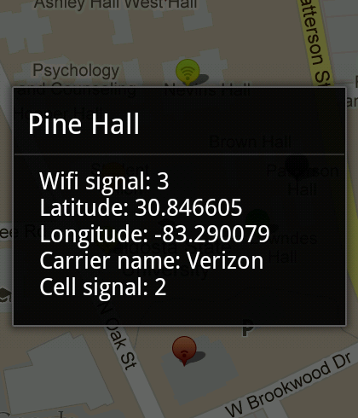
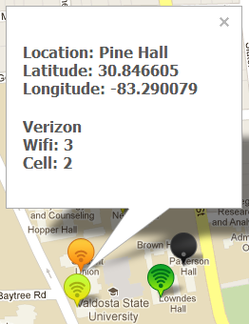
The Signal Seeker Map Markers
Clicking on a map marker will reveal information such as location name, latitude, longitude, Wi-Fi signal strength, carrier name, and cell signal strength.

Slide 7
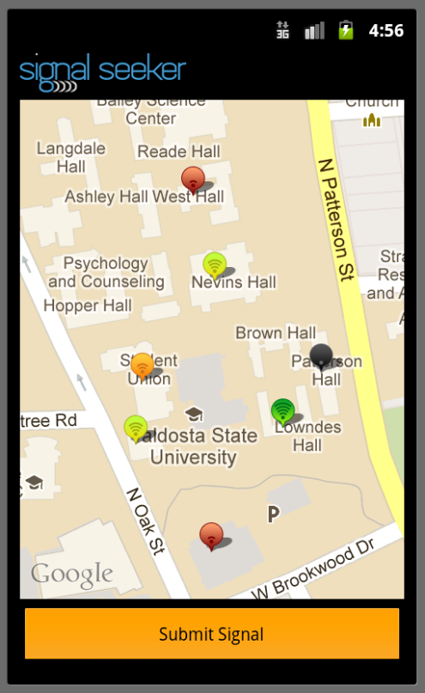
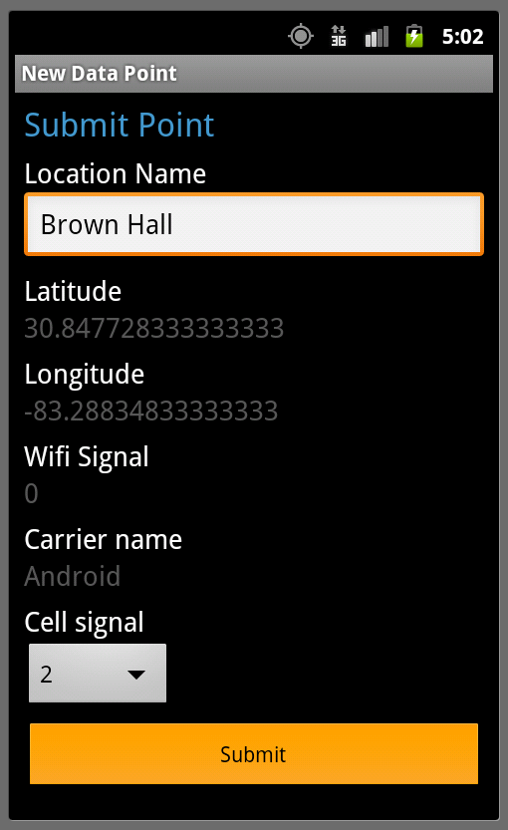
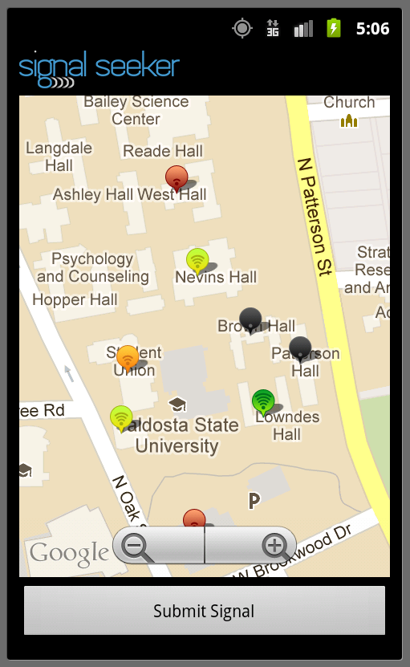
Submitting a Signal on Android
Submitting a signal on the Signal Seeker Android app is extremely simple.

Slide 8
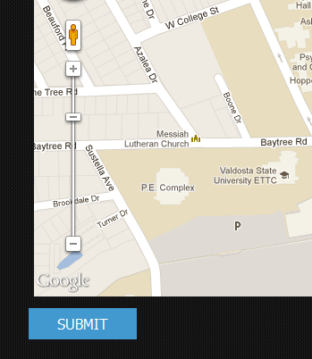
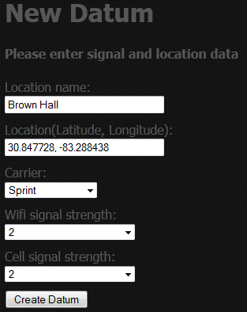
Submitting a Signal on the Web
Submitting a signal on the Signal Seeker web app is as simple as on Android

Slide 9
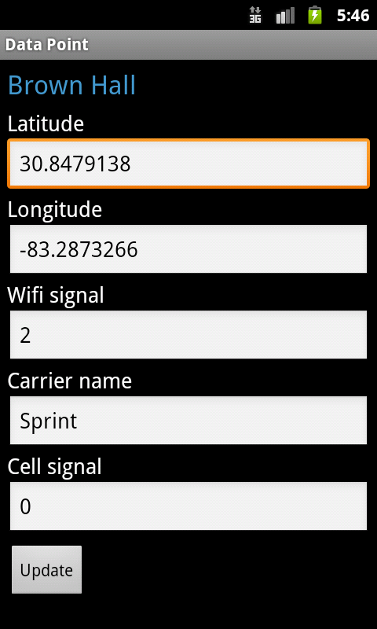
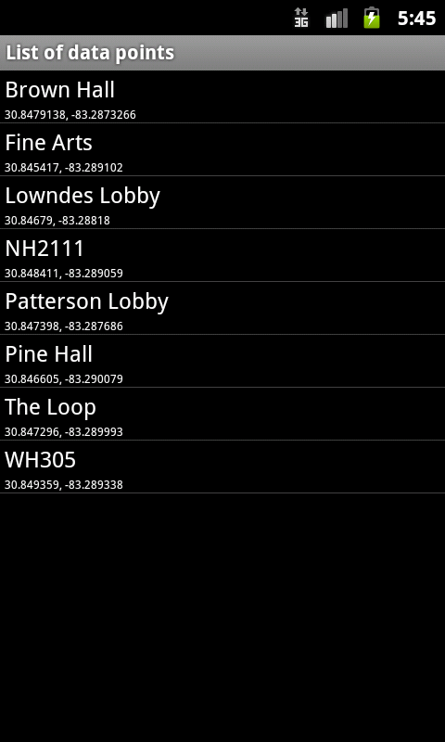
Administrative Privileges on Android
Privileges for Administrators include viewing, editing, and deleting signal data.

Slide 10
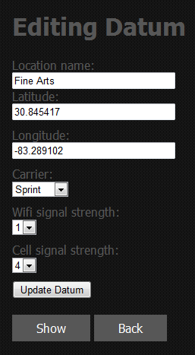
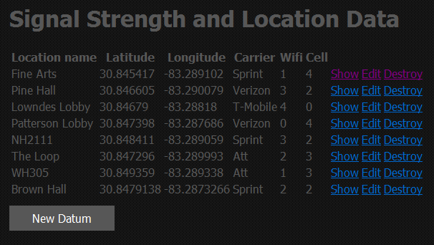
Administrative Privileges on the Web
Similar administrative privileges exists for the Signal Seeker web app.

Slide 11
The Signal Seeker Algorithm
Signal Seeker’s key algorithm populates the signal map and determines which signal icon to display for the appropriate Wi-Fi signal strength.

Slide 12
Design & Implementation Trade-Offs
Relies heavily on internet and GPS connectivity.
No map data caching.
Designed with only HallNet in mind.

Slide 13
Desired Features
User accounts for Signal Seeker.
Distinguishable super-users.
Data point tracking, range finding and nearest neighbor queries.
More user friendly features include automatic cell signal detection.
Be applicable to networks beyond HallNet.

Slide 14
Project Collaboration
Collaboration through team meetings and GitHub.
Group learning of new technologies.
Past experience with teammates.

