Slide 1
Currently:
One general purpose execute unit
No branch prediction
No register renaming
No pipelining
Working processor
Instruction Buffer
:
:
Fetch Unit
Memory
Decode Unit
Register File
Execute Unit
:
:
Scoreboard

Slide 2
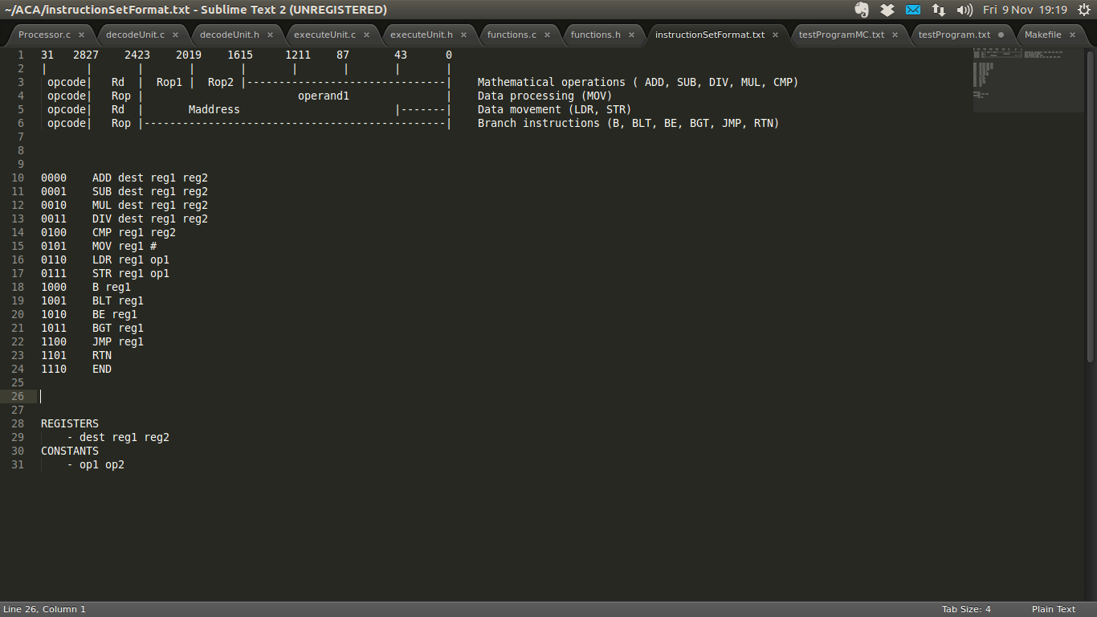
Features
0000 ADD dest reg1 reg2
0001 SUB dest reg1 reg2
0010 MUL dest reg1 reg2
0011 DIV dest reg1 reg2
0100 CMP reg1 reg2
0101 MOV reg1 #
0110 LDR reg1 op1
0111 STR reg1 op1
1000 B reg1
1001 BLT reg1
1010 BE reg1
1011 BGT reg1
1110 END
Fetch Unit
Fetches machine code
Decodes the machine
code, putting instructions
into a form which can be
executed
Takes decoded instructions,
populates the register
names with their values,
then executes
Decode Unit
Execute Unit

Slide 3
Experiments
a. Accumulator
  Test branching, basic mathematical functions and basic processor function.
  Takes 762 clock cycles to add all the numbers 1 .. 50

Slide 4
Experiments
b. Plan to do:
Livermore loops
Sorting algorithms

Slide 5
Experiments
c. Other features to implement (in this order):
Pipelined
Branch prediction
Super-scaler
Register renaming unit
Other features (Rob...)
Hypothesis'

