Slide 1
Thodoris Charos mscaidl-0077 AIDL_B_02 – Advanced Topics in Deep Learning

Slide 2
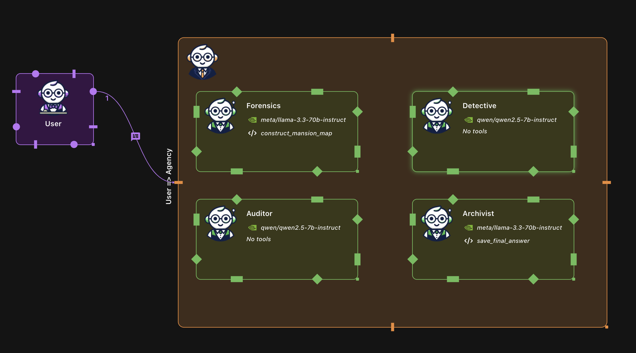
Waldiez flow – Agent’s specific missions

Slide 3
Waldiez flow – Agent’s specific missions
The Flow consists of four Agents.
The Group Manager uses Speaker Selection Method: Default and every agent uses a Termination Method where a specific message is checked in the log.
Forensics (meta/llama-3.3-70b-instruct): Responsible for initializing the crime scene. Uses construct_mansion_map tool to print and save in a file the map in json format for the other agents. Also lists the suspects, weapons and the status/last known location of the victim.
Detective (qwen/qwen2.5-7b-instruct): Conducts the main investigation and provides a solution along with the reasoning for every choice.
Archivist (meta/llama-3.3-70b-instruct): Responsible to save the final answer to a file using the desired format.
Auditor (qwen/qwen2.5-7b-instruct): Responsible to check, verify and correct (or not) the answer from the Detective agent.

Slide 4
Tools that were created
construct_mansion_map: Used for movement verification from Detective/Auditor.
save_final_answer: Used to save the final answer to a file in the desired format.
verify_and_log (not used): Save the facts that derive from the analysis of the clues and based on that either verify or exclude suspects etc.
audit_and_finalize_case (not used): Save both the answer of the Detective and the Auditor.

Slide 5
Metrics and Analysis of the cases
I executed each case 10 times and stored the best result.
To better analyze the results (with what the Agents struggle and why) I stored the questions that consistently failed across all the runs of each case.
In general, these apply to all cases:
The re-evaluation from the Auditor was weak and, in most cases, just repeated the answer from the Detective.
The agents struggle with clues that include “if and only if” and “OR” cases. They couldn’t follow both paths and eliminate one of these.
case_id | best_score | best_accuracy_percent | persistent_fails | min_score | max_score
1052 | 3/7 | 42,86 | C, D, E | 2 | 3
1182 | 3/6 | 50,00 | A, D | 0 | 3
1230 | 3/8 | 37,50 | A, D, E, F | 0 | 3
2145 | 4/8 | 50,00 | C, D, E, F | 0 | 4
2176 | 2/6 | 33,33 | A, C, D | 0 | 2
2279 | 3/7 | 42,86 | B, D | 1 | 3
2372 | 3/8 | 37,50 | C, F, H | 0 | 3
2680 | 3/7 | 42,86 | None | 0 | 3
2799 | 4/6 | 66,67 | None | 1 | 4
2973 | 4/8 | 50,00 | C, F | 0 | 4
Question | Correct Results
A (SUSPECT) | 7/10
B (WEAPON) | 5/6
C (MURDER ROOM) | 6/10
D (TIME) | 4/7
E (MOTIVE) | 4/10

Slide 6
What I tried to mitigate
What worked and what not
The initial setup had 3 agents, one to do the heavy lifting.
I added a fourth agent (Auditor) to check and validate the answer in order to have better results.
In most cases the Auditor just reproduced the Detective answer.
We also had updates to the final answer, some of them were correct.
The Agents had problem to follow clues that have “if and only if” and “OR” that resulted to poor performance.
I tried to create a tool to create and keep a deduction ledger.
The result was the agent to not print reasoning but just output a result so no manual analysis could be done.
Based on the result it didn’t work as expected.

Slide 7

Thank You!
Q & A

