Slide 1
Brain Cancer MRI classification
Thodoris Charos mscaidl-0077
AIDL_A_02 - Neural Networks and Deep Learning

Slide 2
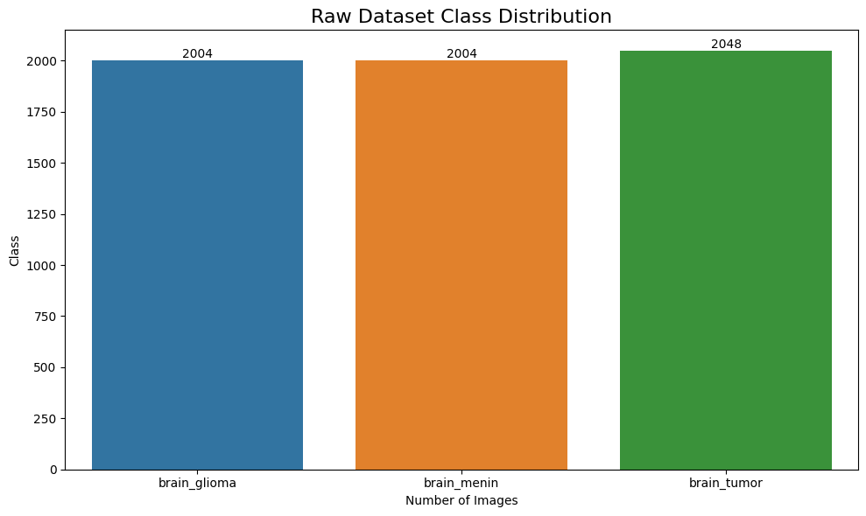
Dataset details
Dataset comes from Kaggle and is free to use https://www.kaggle.com/datasets/orvile/brain-cancer-mri-dataset
It includes 6056 images, with size 512*512 pixels and it consists of 3 classes distributed as shown below: brain_glioma 2004 (33,1%) brain_menin 2004 (33,1%) brain_tumor 2048 (33,8%)
Dataset owner
Rahman, Md Mizanur (2024), “Brain Cancer - MRI dataset”, Mendeley Data, V1, doi: 10.17632/mk56jw9rns.1

Slide 3
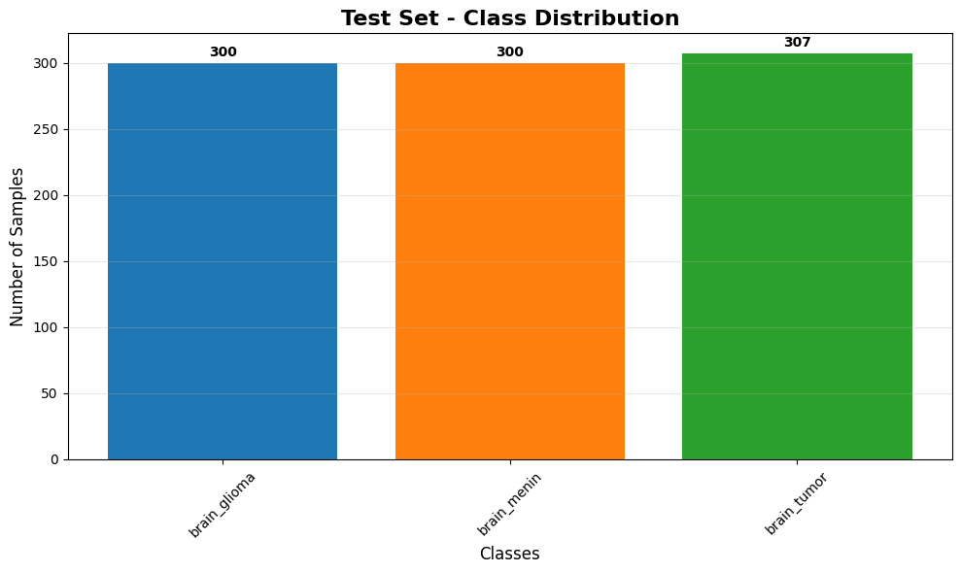
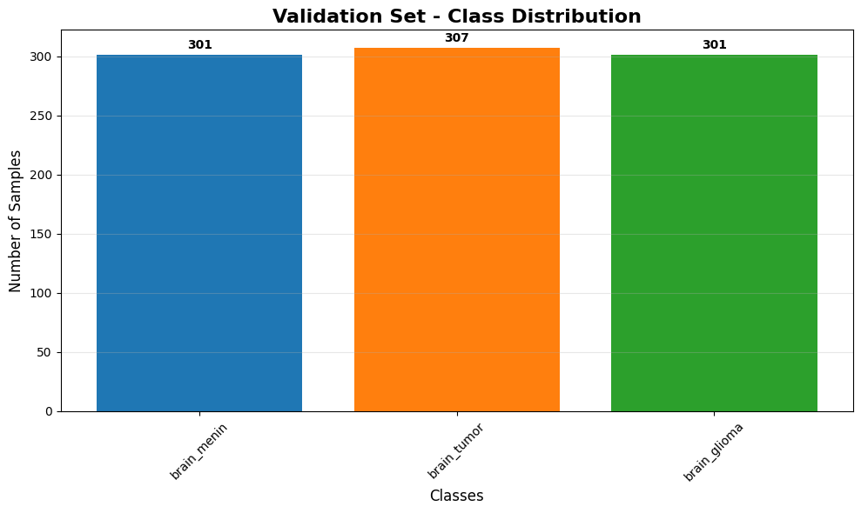
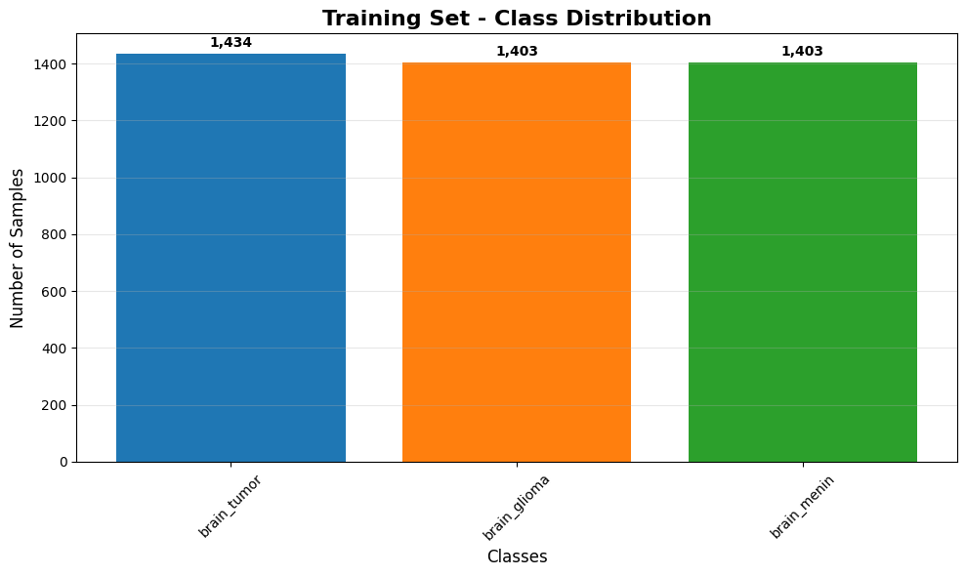
Data pre-processing
The dataset is split to Training (0.7)/Validation (0.15)/Testing (0.15) datasets respecting the initial class distribution
Images are resized to 224*224 for faster training and less resource consumption
Pixel normalization is performed (from [0,255] to [0,1] → stable training, faster convergence), expect for transfer learning models that require [0,255] and I applied keras.applications.inception_v3.preprocess_input, keras.applications.vgg16.preprocess_input, which scales to the expected input
Shuffle train/val datasets on loading for better training

Slide 4
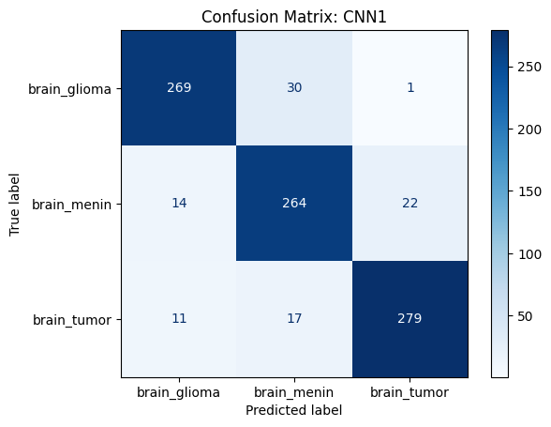
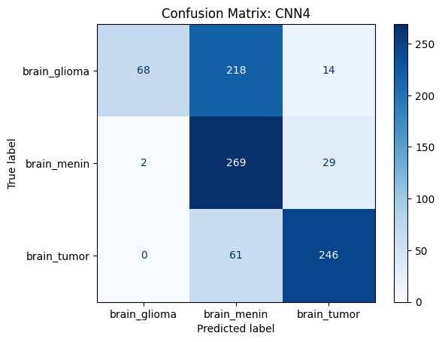
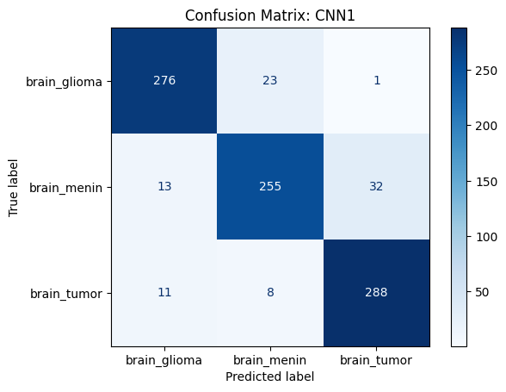
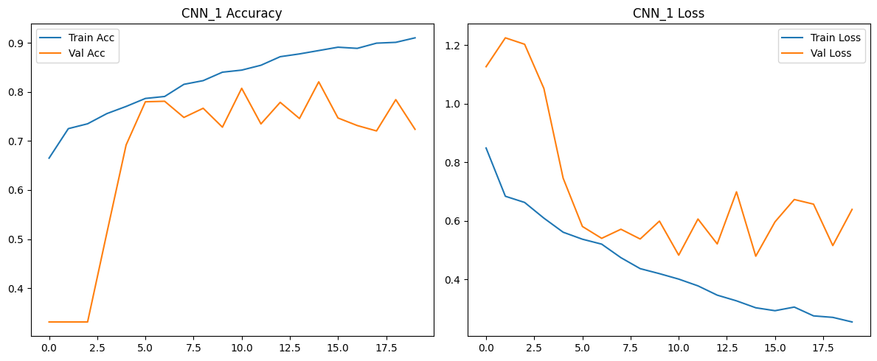
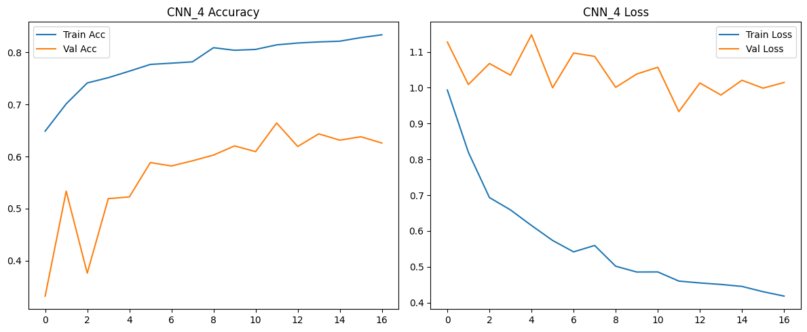
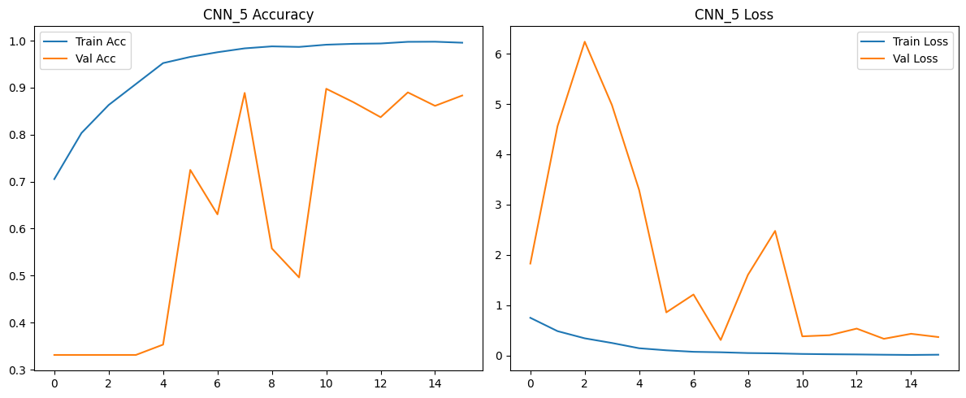
CNN1
(294 MB)
Accuracy : 0.895
F1 Score : 0.896
Precision: 0.896
Recall : 0.895 epochs = 30 lr = 1e-4 early_stop_cb = callbacks.EarlyStopping(monitor="val_accuracy", patience=5, mode="max", restore_best_weights=True) reduce_lr_cb = callbacks.ReduceLROnPlateau(monitor='val_loss',factor=0.5, patience=3, min_lr=1e-6, verbose=1)
CNN4 (same architecture with CNN1)
(294 MB)
Accuracy : 0.643
F1 Score : 0.611
Precision: 0.772
Recall : 0.643
epochs = 40
lr = 1e-5
early_stop_cb = callbacks.EarlyStopping(
monitor="val_accuracy",
patience=5,
mode="max",
restore_best_weights=True)
reduce_lr_cb = callbacks.ReduceLROnPlateau(
monitor='val_loss',
factor=0.5,
patience=3,
min_lr=1e-6,
verbose=1)
CNN5 (same architecture with CNN1)
(294 MB)
Accuracy : 0.903
F1 Score : 0.903
Precision: 0.903
Recall : 0.903
epochs = 40
lr = 1e-3
early_stop_cb = callbacks.EarlyStopping(
monitor="val_accuracy",
patience=5,
mode="max",
restore_best_weights=True)
reduce_lr_cb = callbacks.ReduceLROnPlateau(
monitor='val_loss',
factor=0.5,
patience=3,
min_lr=1e-6,
verbose=1)

Slide 5
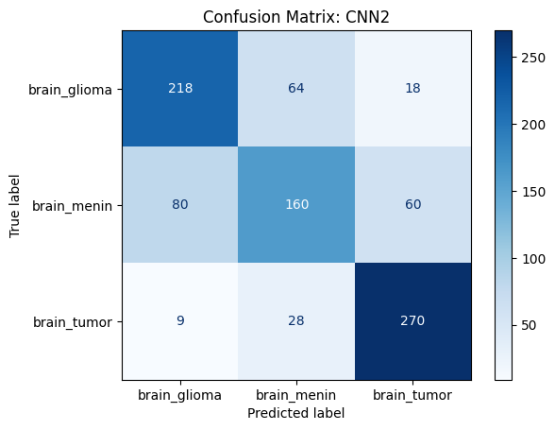
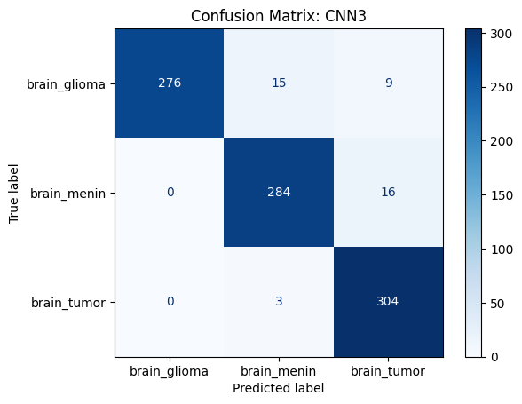
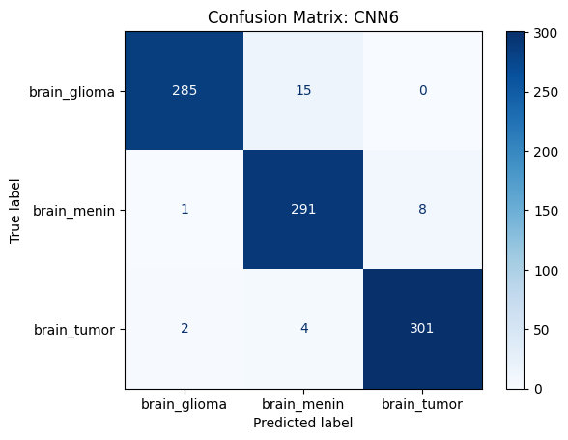
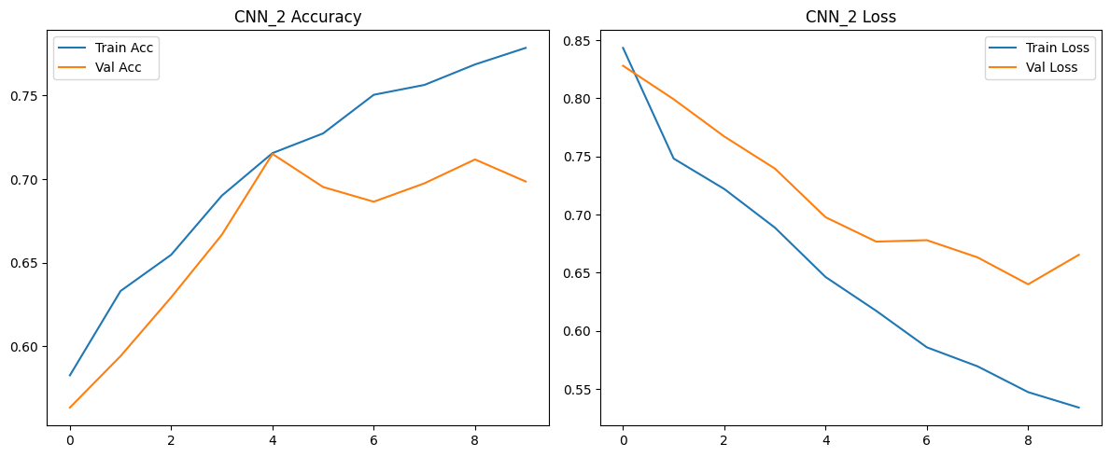
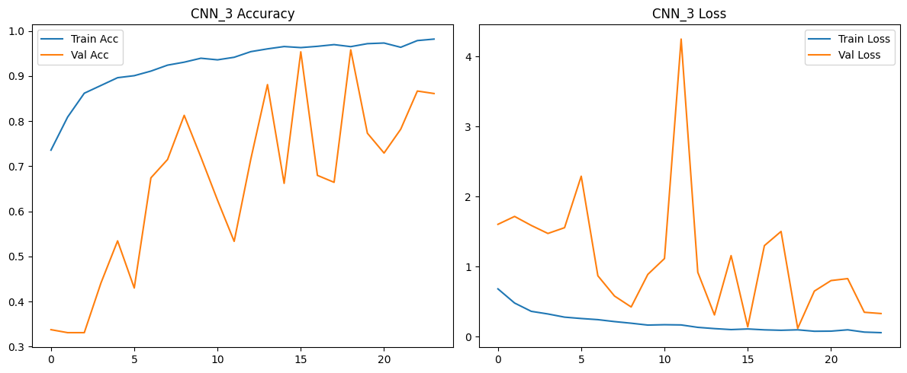
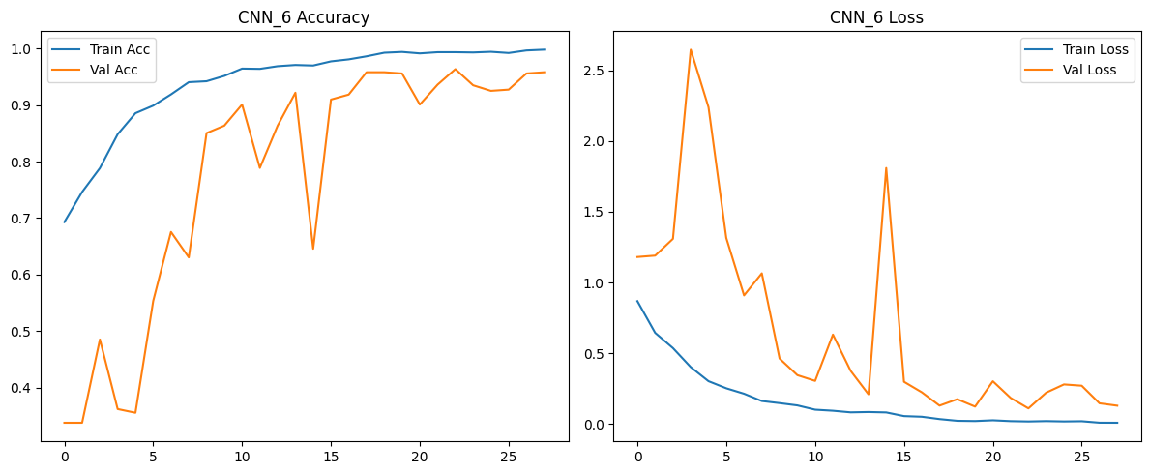
CNN6 (2,31 GB)
Accuracy : 0.967
F1 Score : 0.967
Precision: 0.968
Recall : 0.967 epochs = 30 lr = 1e-3 early_stop_cb = callbacks.EarlyStopping(monitor="val_accuracy", patience=5, mode="max", restore_best_weights=True) reduce_lr_cb = callbacks.ReduceLROnPlateau(monitor='val_loss', factor=0.5, patience=3, min_lr=1e-6, verbose=1)
CNN2 (589 MB)
Accuracy : 0.714
F1 Score : 0.708
Precision: 0.707
Recall : 0.714
epochs = 30
lr = 1e-5
EarlyStopping(monitor="val_accuracy", patience=5,mode="max", restore_best_weights=True
ReduceLROnPlateau(monitor='val_loss', factor=0.2, patience=5,min_lr=1e-6, verbose=1)
CNN3 (1,9 MB)
Accuracy : 0.953
F1 Score : 0.953
Precision: 0.955
Recall : 0.953
epochs = 30
lr = 1e-3
EarlyStopping(monitor="val_accuracy", patience=5,mode="max", restore_best_weights=True
ReduceLROnPlateau(monitor='val_loss', factor=0.2, patience=5,min_lr=1e-6, verbose=1)

Slide 6
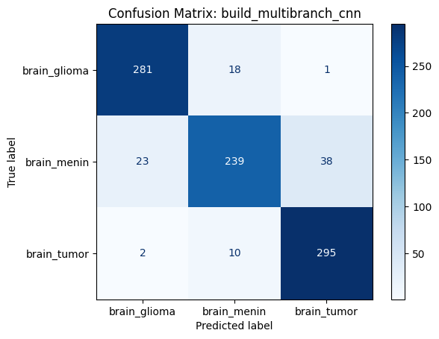
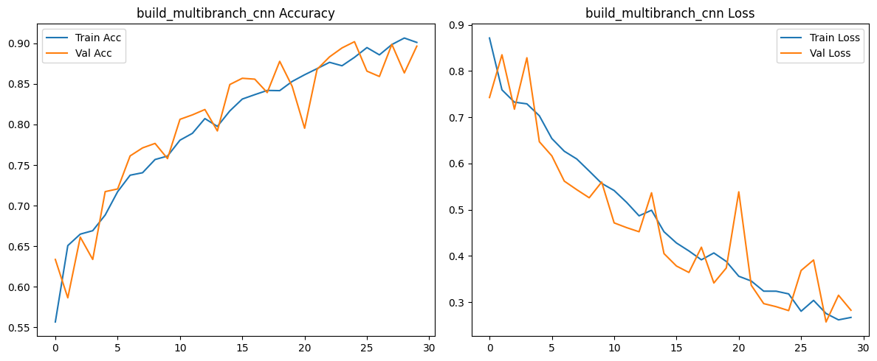
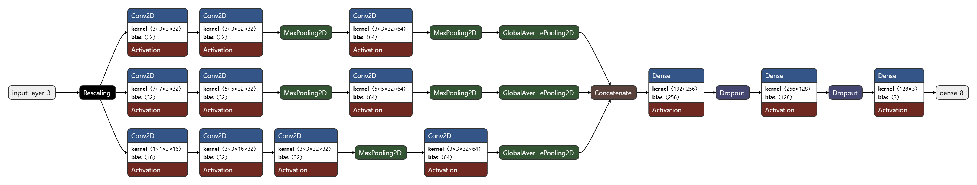
multibranch_cnn (2,7 MB)
Accuracy : 0.775
F1 Score : 0.776
Precision: 0.780
Recall : 0.775
epochs = 30
lr = 1e-4

Slide 7

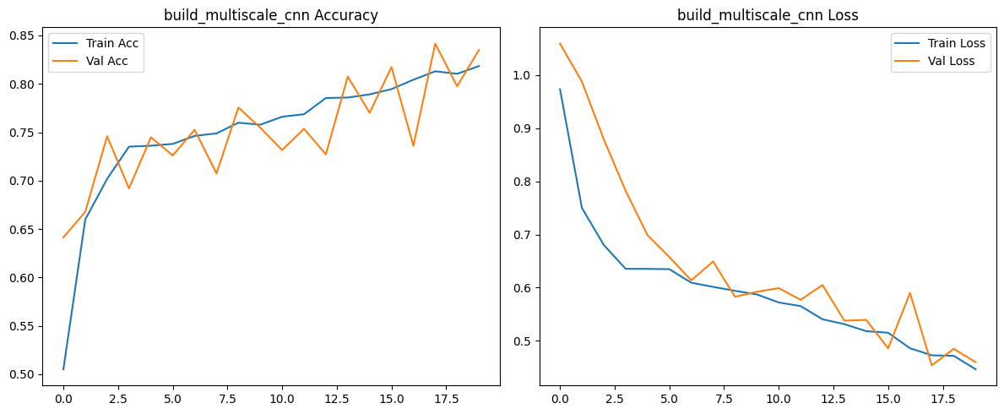
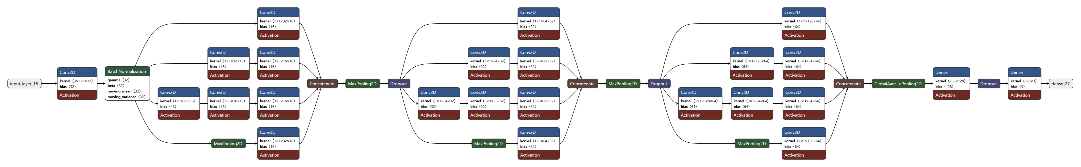
multiscale_cnn (3,2 MB)
Accuracy : 0.837
F1 Score : 0.836
Precision: 0.837
Recall : 0.837 epochs = 20 lr = 1e-4

Slide 8
Transfer Learning Models
The below models are selected
VGG16
ResNet-50
InceptionV3

Slide 9
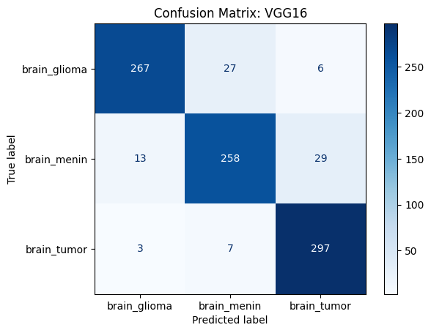
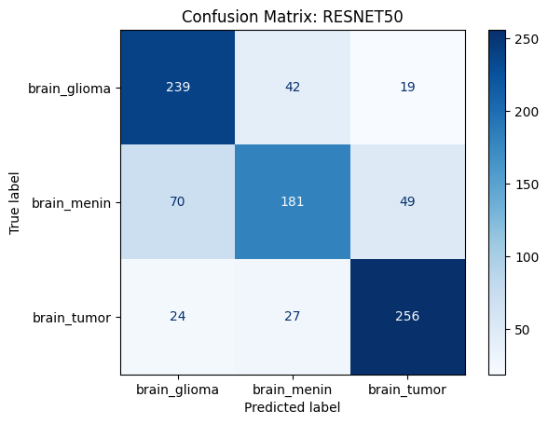

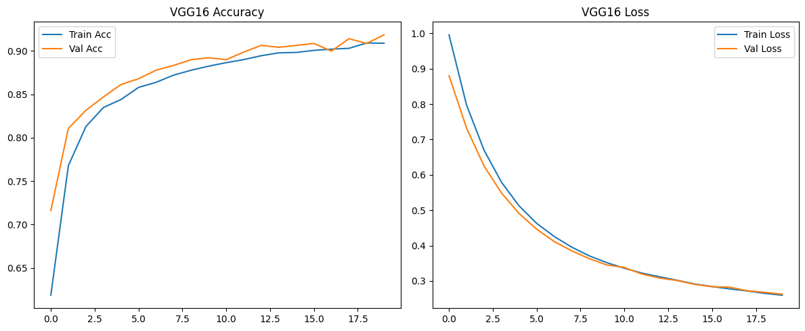
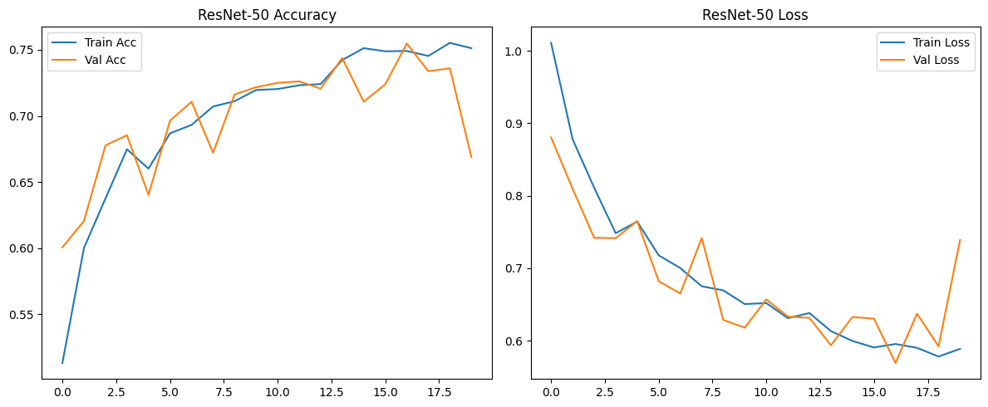
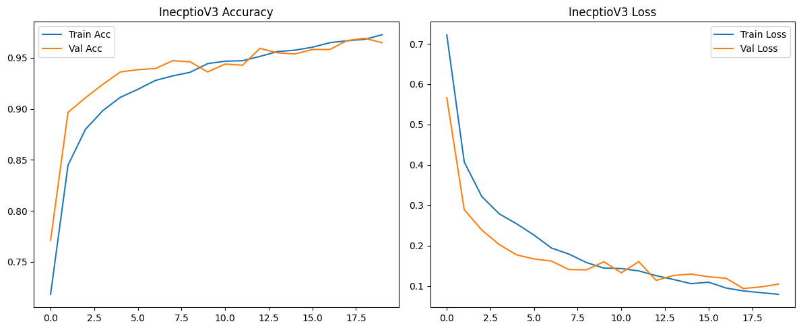
VGG16 (57 MB)
Accuracy : 0.906
F1 Score : 0.906
Precision: 0.907
Recall : 0.906 epochs = 20 lr = 1e-4
ResNet-50 (96 MB)
Accuracy : 0.745
F1 Score : 0.745
Precision: 0.745
Recall : 0.745
epochs = 20
lr = 1e-4
InceptionV3 (86 MB)
Accuracy : 0.968
F1 Score : 0.968
Precision: 0.968
Recall : 0.968
epochs = 20
lr = 1e-4

Slide 10
Data Augmentation
The following techniques were used, in two different tests:
Configuration A
Random horizontal flip
Random rotation 0.05 radians (~2.8 degrees)
Random zoom 0.05 or 10%
Configuration B
Random Brightness 0.05
Random Contrast 0.05

Slide 11

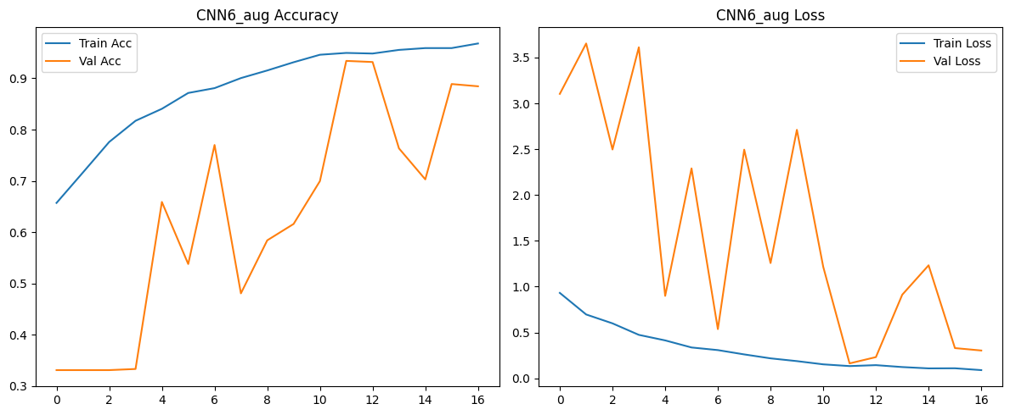
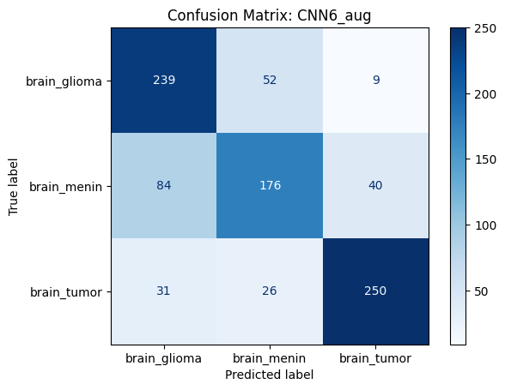
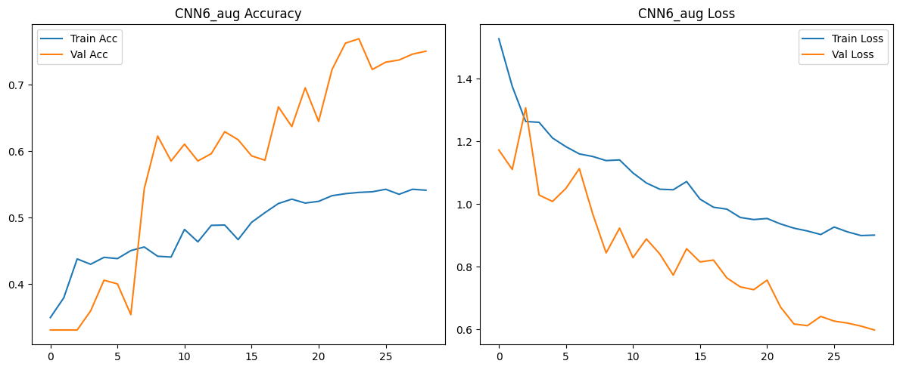
CNN6 Augmented
Accuracy : 0.937
F1 Score : 0.936
Precision: 0.939
Recall : 0.937 epochs = 30 lr = 1e-3
Configuration A
Configuration B
Accuracy : 0.733
F1 Score : 0.731
Precision: 0.736
Recall : 0.733

Slide 12
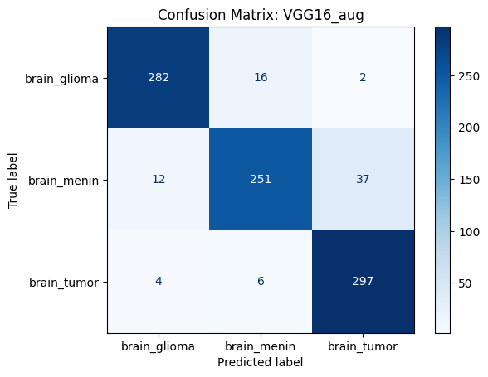
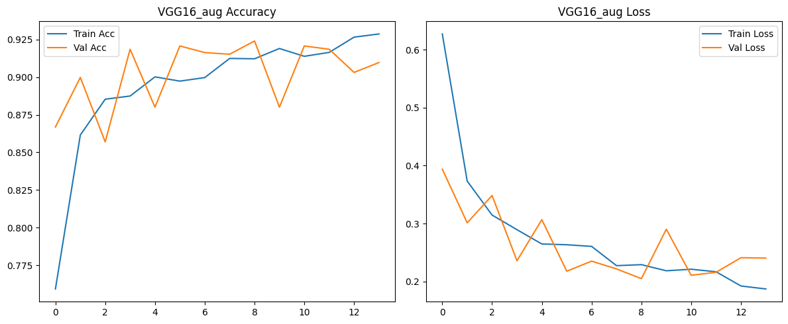

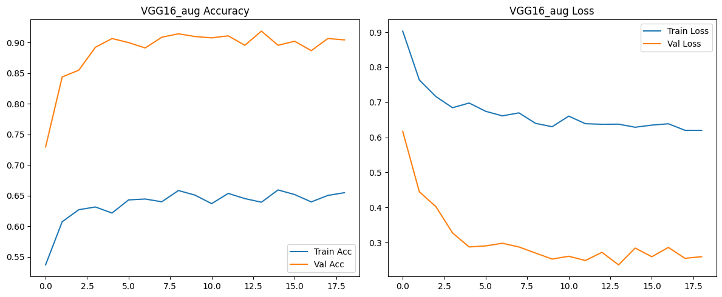
VGG16 Augmented
Accuracy : 0.915
F1 Score : 0.914
Precision: 0.916
Recall : 0.915 epochs = 20 lr = 1e-4
Configuration A
Configuration B
Accuracy : 0.910
F1 Score : 0.910
Precision: 0.911
Recall : 0.910

Slide 13
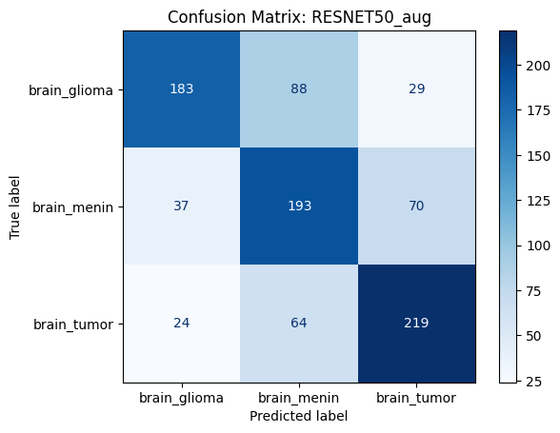
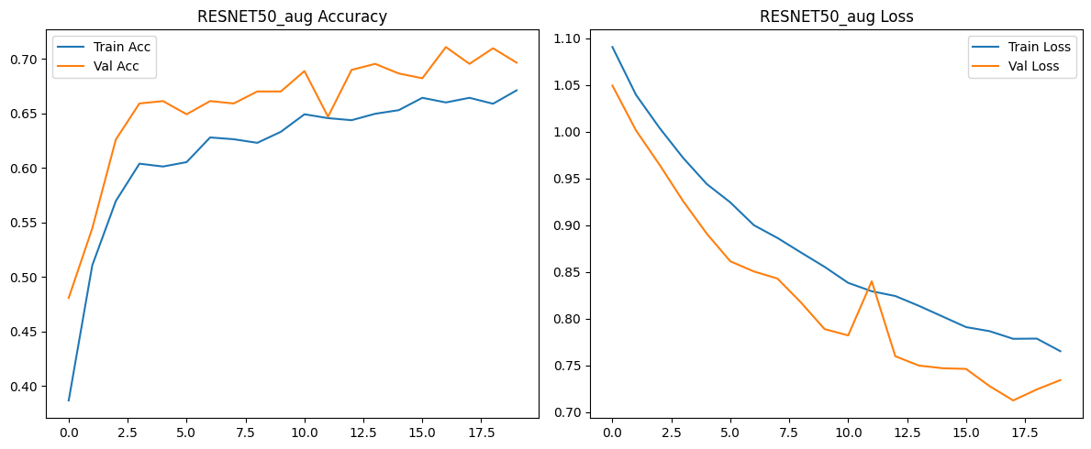
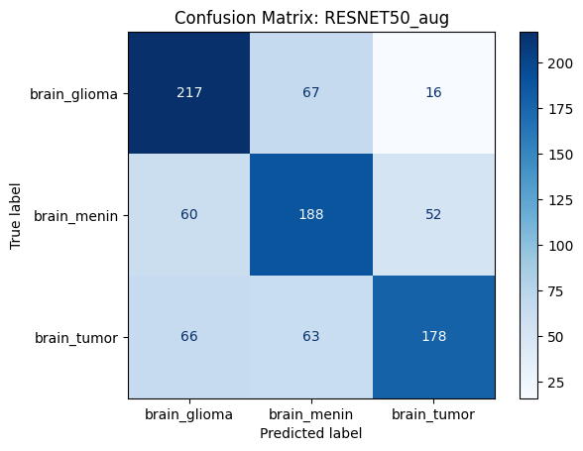
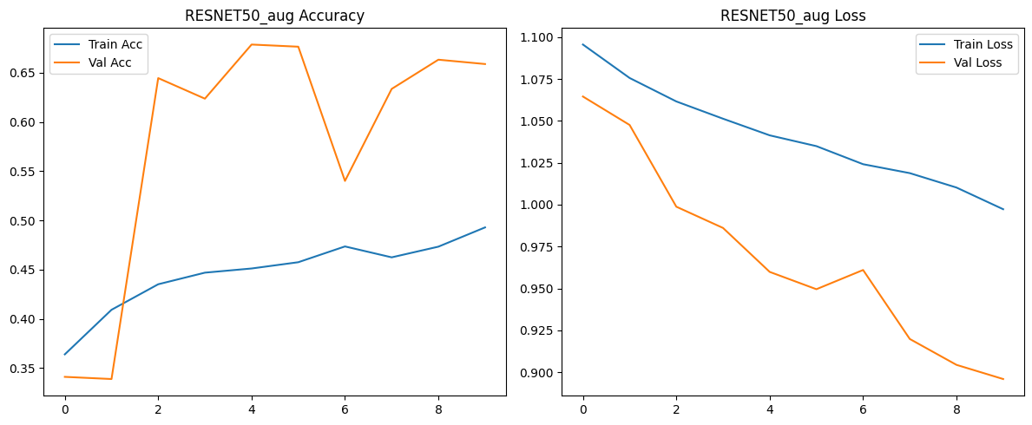
ResNet-50 Augmented
Accuracy : 0.656
F1 Score : 0.658
Precision: 0.666
Recall : 0.656 epochs = 20 lr = 1e-4
Configuration A
Configuration B
Accuracy : 0.643
F1 Score : 0.642
Precision: 0.650
Recall : 0.643

Slide 14
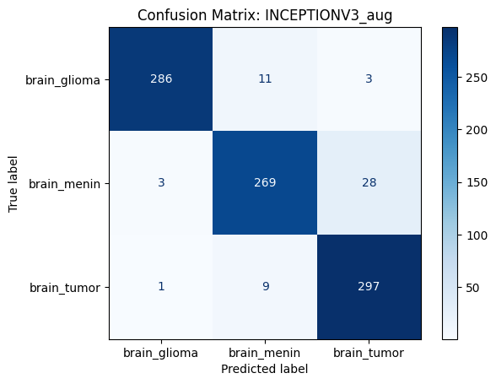
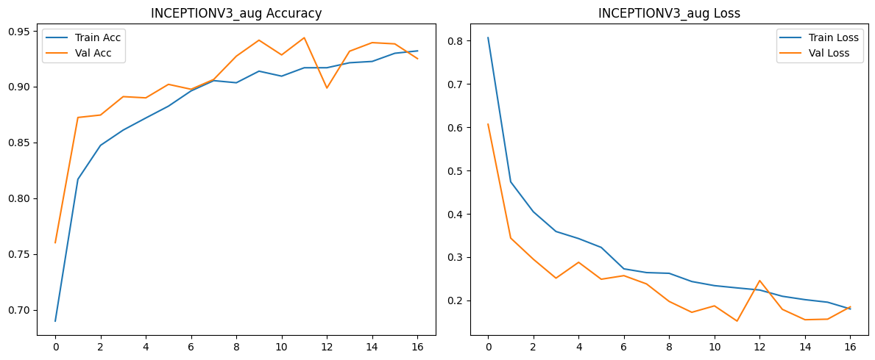
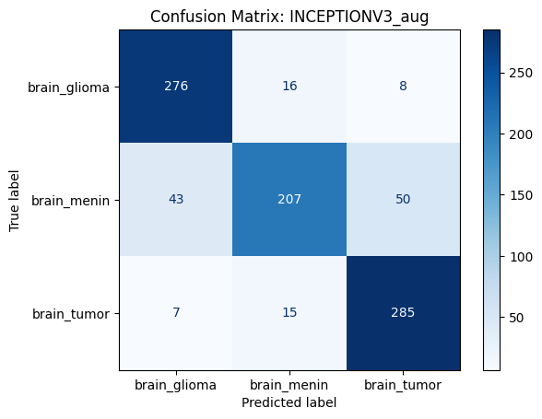
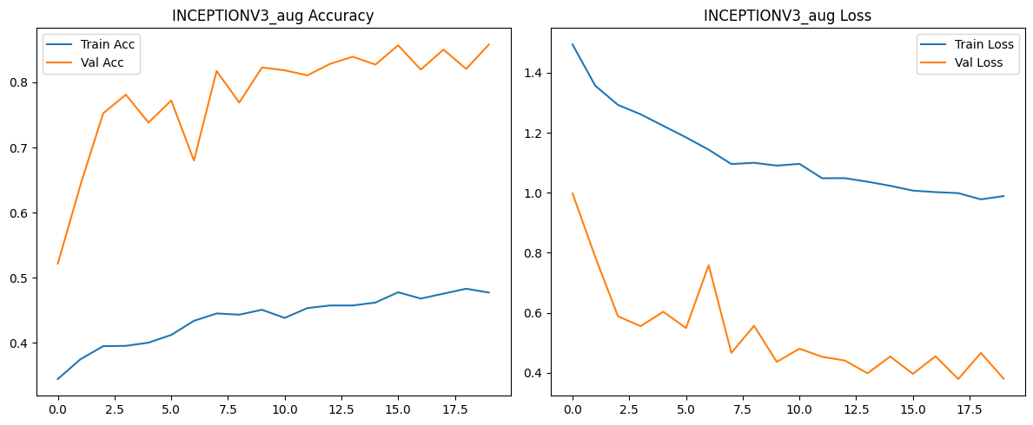
InceptionV3 Augmented
Accuracy : 0.939
F1 Score : 0.939
Precision: 0.941
Recall : 0.939 epochs = 20 lr = 1e-4
Configuration A
Configuration B
Accuracy : 0.847
F1 Score : 0.843
Precision: 0.849
Recall : 0.847

Slide 15
Conclusion
In this project, we implemented and compared multiple custom CNN architectures and transfer learning models for brain tumor classification using MRI scans.
The results demonstrate that:
Transfer learning outperforms most custom CNNs, with InceptionV3 achieving the highest performance (96% accuracy) even without augmentation. Moreover, transfer learning models have more stable train/val loss diagram, which results to better generalization. From the custom models multibranch_cnn and multiscale_cnn have also stable train/val loss diagrams. VGG16 performed well overall (90%), while ResNet-50 underperformed both in original and augmented versions, suggesting that this transfer model is not a good choice for this dataset or requires further fine-tuning.
Among the custom models, CNN6, achieved good results (92.4% accuracy) and improved with data augmentation (93.7%). In the majority of the custom models we see a minor overfitting issue (the “gap” in the accuracy plot), which means worst performance on unseen data.
Data augmentation techniques were expected to improve the results. Although the metrics remained high, they were slightly lower in comparison with the run on the initial data, with the exception of custom model CNN6. Moreover, due to the nature of the data, we can see that different data augmentation techniques affect the performance of the models. For example, with Configuration B all models have Training loss much higher than Validation loss which means that the models don’t learn from the training data.
The class that most models had difficulty to predict was brain_menin and the easiest was brain_tumor (based on confusion matrices).
When selecting a model for production usage several factors have to be taken into account, one of them is the model size. We might select a model with slightly “worse” metrics but with a significant smaller size. In our case InceptionV3 and CNN 6, which have similar metrics and confusion matrix results, but the size difference is huge.
 |  | Initial Data |  |  |  | Augmented Data (Configuration A) |  |  |  | Augmented Data (Configuration B)
 | Model Size | Accuracy | F1 | Precision | Recall | Accuracy | F1 | Precision | Recall | Accuracy | F1 | Precision | Recall
CNN 1 | 294 MB | 0,895 | 0,896 | 0,896 | 0,895
CNN 2 | 589 MB | 0,677 | 0,655 | 0,681 | 0,677
CNN 3 | 1,9 MB | 0,796 | 0,779 | 0,836 | 0,796
CNN 4 | 294 MB | 0,83 | 0,83 | 0,83 | 0,83
CNN 5 | 294 MB | 0,859 | 0,856 | 0,861 | 0,859
CNN 6 | 2,31 GB | 0,924 | 0,924 | 0,925 | 0,924 | 0,937 | 0,936 | 0,939 | 0,937 | 0,733 | 0,731 | 0,736 | 0,733
Multibranch CNN | 3,2 MB | 0,775 | 0,776 | 0,780 | 0,775
Multiscale CNN | 2,7 MB | 0,837 | 0,836 | 0,837 | 0,837
VGG16 | 57 MB | 0,906 | 0,906 | 0,907 | 0,906 | 0,916 | 0,914 | 0,916 | 0,915 | 0,910 | 0,910 | 0,911 | 0,910
ResNet-50 | 96 MB | 0,745 | 0,745 | 0,745 | 0,745 | 0,656 | 0,658 | 0,666 | 0,656 | 0,643 | 0,642 | 0,650 | 0,643
InceptionV3 | 86 MB | 0,968 | 0,968 | 0,968 | 0,968 | 0,939 | 0,939 | 0,941 | 0,939 | 0,847 | 0,843 | 0,849 | 0,847

Slide 16

Thank You!
Q & A

