Slide 1
RESEARCH PROJECT
Digital Twin of Indian Fisheries
Export Cold Chain for
Spoilage Risk Prediction
Testing where a chilled-fish export journey picks up heat.
RESEARCH PROTOTYPE · INDIA → EUROPE · OCTOBER 2026
INDIAN FISHERIES / COLD-CHAIN RESEARCH
01 / 12
Notes:
The title is the original research objective. What has been delivered is a thermal-exposure research prototype, not a calibrated fish-spoilage predictor. The examples are hypothetical configured routes. This distinction will be explained on slide 11.
Evidence / sources:
COMPLETE_README.MD
reports/integration/final_handoff.md

Slide 2
THE PROBLEM
Fish passes through many hands.
The cold chain must stay connected.
An illustrative export journey from India to Europe
Landing
and icing
Processing
and packing
Cold
storage
Road
transfer
Airport
handling
Air
transport
Arrival
inspection
Each handover can change the time spent in warm conditions.
INDIAN FISHERIES / COLD-CHAIN RESEARCH
02 / 12
Notes:
Walk through a shipment in everyday language: landing and icing, packing, chilled holding, road transfer, airport handling, international transit and arrival inspection. These are stages of the configured example, not a reconstructed observed shipment. The system also includes a conditional hypothetical sea stress configuration. MPEDA supports Indian export context but its item, market and port tables are separate marginals; they do not prove this specific route.
Evidence / sources:
configs/digital_twin/experiment.yaml
reports/digital_twin/final_handoff.md
https://mpeda.gov.in/?page_id=438

Slide 3
THE PROBLEM
Small disruptions can add heat.
Temperature and time both matter across the journey.
Cooling stops
Handling takes longer
A refrigerated vehicle loses cooling.
Fish waits during loading or inspection.
Doors stay open
Setpoints rise
Warm air enters a chilled space.
Storage or transport runs warmer.
INDIAN FISHERIES / COLD-CHAIN RESEARCH
03 / 12
Notes:
Warmer conditions and longer exposure can affect fish quality, but the effect depends on species, product state, initial quality and biological response. This project tests thermal consequences of plausible disruptions. It has not measured these failure frequencies on Indian shipments or quantified resulting spoilage/safety outcomes.
Evidence / sources:
reports/digital_twin/final_handoff.md
configs/digital_twin/experiment.yaml

Slide 4
RESEARCH QUESTION
Where does a disruption add
the most temperature exposure
to an export journey?
LONGER-TERM AIM
Use paired fish-quality measurements to turn exposure into a tested spoilage forecast.
INDIAN FISHERIES / COLD-CHAIN RESEARCH
04 / 12
Notes:
The current answerable research question is about modeled thermal exposure and stage sensitivity. The longer-term objective is biological prediction. A sensor model alone cannot learn a new temperature response, and thermal exposure alone cannot be presented as spoilage probability.
Evidence / sources:
reports/digital_twin/final_handoff.md
reports/integration/final_handoff.md

Slide 5
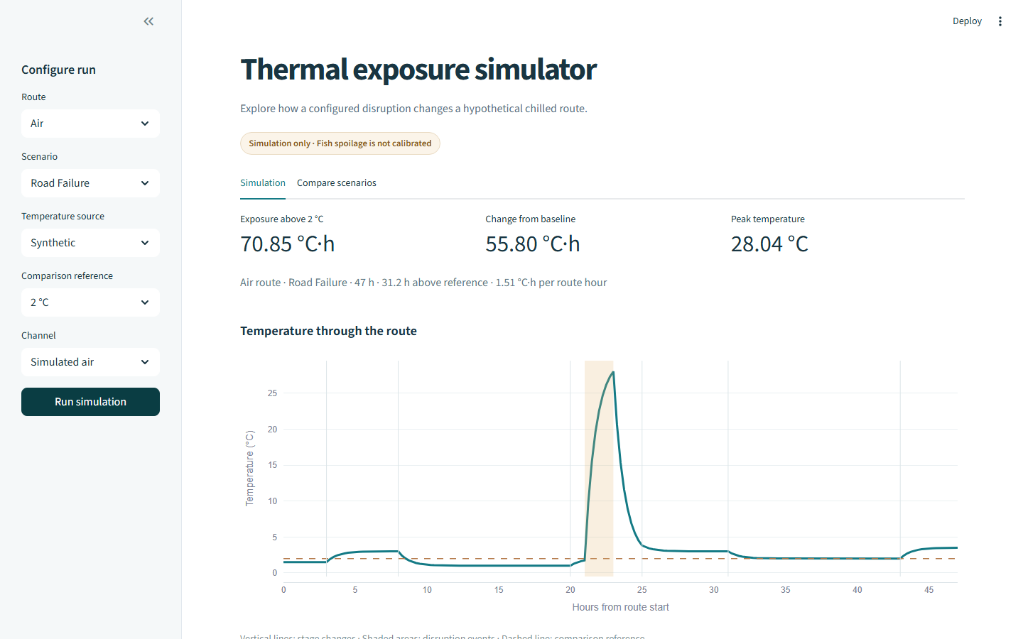
WHAT WE BUILT
A virtual cold chain we can experiment with.
Change the cooling.
See the effect.
A computer model follows the journey and compares normal cooling with disruptions.
Working local dashboard
INDIAN FISHERIES / COLD-CHAIN RESEARCH
05 / 12
Notes:
This is an actual saved screenshot of the implemented Streamlit dashboard, not a mock-up. Users choose route, scenario, temperature source, reference and channel, run a simulation, compare saved scenarios and download results. The simulator is a configured digital-twin prototype, not a live data-connected replica of an observed shipment. The visible product-lag option is assumed, not measured fish-core temperature.
Evidence / sources:
app.py
reports/dashboard/final_handoff.md
figures/dashboard/redesign/02_road_failure_desktop.png

Slide 6
WHAT WE BUILT
Real measurements, used within their limits.
The sources play different roles in the system.
Fish sensors
DaFiF and rainbow-trout sensor readings
Study fish measurements; no matched quality labels
Trout quality
21 measured microbial-count assays
A small, separate study at nominal 4 °C
Export statistics
Official MPEDA records
Indian trade context; not shipment tracking
Thermal records
Citrus reefer and cold-room measurements
Nonfish proxy patterns; not seafood route logs
INDIAN FISHERIES / COLD-CHAIN RESEARCH
06 / 12
Notes:
Phase 1 curated 27,120 DaFiF readings from 63 workbooks, 774 separate sensory criterion scores, 25,200 trout sensor readings and 21 individual trout TVC assays. Sensor and quality cohorts are different fish; repeated readings are not independent fish. MPEDA has 10,788 annual marginal statistics rows. Proxy tables have 31,140 citrus and 1,411,515 cold-room rows. A separate smoked-catfish study supplies 336 long-format measured endpoint rows; it supports only within-study treatment curves, not fresh-fish kinetics. The model branches are deliberately not fused into a biologically invalid target table. DaFiF source counts and 2,298 local session-label conflicts are documented in the data-quality report; use counted workbook rows, not published descriptions, for totals.
Evidence / sources:
reports/data/data_quality_report.md
reports/data/scientific_sufficiency_report.md
https://data.mendeley.com/datasets/vx4ptwk3pb/1
https://zenodo.org/records/23600663
https://mpeda.gov.in/?page_id=438
https://data.mendeley.com/datasets/mvr7m6mcgp/2
https://zenodo.org/records/15130001

Slide 7
WHAT WE BUILT
From a route choice to a stage comparison.
01
02
03
04
05
Choose
a route
→
Set normal
cooling
→
Introduce
a disruption
→
Calculate
exposure
→
Compare
the stages
Example: temperature stays at 5 °C for 2 hours
3 °C
×
2 h
=
6 °C·h
Above 2 °C reference
Duration
Thermal exposure
This is a comparison measure, not a universal spoilage threshold.
INDIAN FISHERIES / COLD-CHAIN RESEARCH
07 / 12
Notes:
The simulator carries temperature state through stages using an illustrative first-order response: nominal air lag 0.75 h and assumed product lag 1.5 h. The degree-hour indicator integrates max(temperature minus reference, 0) over time. The simple constant-temperature example gives (5 minus 2) °C × 2 hours = 6 °C·h. This is a teaching example, not a measured shipment or a spoilage threshold. References 2 °C and 4 °C are comparisons, not universal legal or spoilage cutoffs. The current model does not translate degree-hours to biological deterioration. The stable Python API is src.integration.execute; the UI delegates to it rather than implementing separate calculations.
Evidence / sources:
reports/digital_twin/final_handoff.md
reports/integration/architecture_and_contracts.md
src/digital_twin/exposure.py

Slide 8
WHAT WE TESTED
What if the journey does not go to plan?
Each disruption is compared with the same route under normal cooling.
Normal cooling
Road cooling failure
Airport delay
The reference journey
Cooling stops for 2 hours
Extra waiting and an open door
Warmer storage
Flight excursion
Combined failures
Setpoint rises by 3 °C
Setpoint rises for 4 hours
Road, airport and flight together
Processing and arrival delays were also tested. All routes and disruptions are hypothetical.
INDIAN FISHERIES / COLD-CHAIN RESEARCH
08 / 12
Notes:
The configured air baseline lasts 47 h: landing/icing 3, processing 5, storage 12, road 5, airport 6, flight 12 and destination 4 h. Eight scenarios include baseline, processing delay, storage setpoint, road failure, airport delay/door, flight excursion, destination delay and combined. Combined is 50 h because the airport stage gains 3 h. The sea configuration is a conditional 375 h software stress case with a 14-day voyage and no evidence that chilled fish remains viable. Phase 4 ran 48 route/mode/scenario simulations: 2 routes × 3 modes × 8 scenarios. Only the air synthetic example is foregrounded here to avoid conflating distinct domains.
Evidence / sources:
configs/digital_twin/experiment.yaml
configs/digital_twin/sea_route.yaml
reports/integration/final_handoff.md

Slide 9
WHAT WE FOUND
Road cooling failure added the most exposure.
Among the configured single-disruption air-route scenarios
ADDED EXPOSURE VS NORMAL COOLING · °C·h ABOVE 2 °C
Road cooling failure
55.8
55.8
Airport delay / door
37.3
Warmer storage
24.5
Flight excursion
20.0
additional °C·h
Arrival delay
4.5
from a 2-hour
road cooling failure
Processing delay
3.0
Simulated air · Hypothetical 47 h route · Disruption sizes differ, so this is a conditional ranking.
INDIAN FISHERIES / COLD-CHAIN RESEARCH
09 / 12
Notes:
All plotted values are additional simulated-air degree-hours above 2 °C relative to the same synthetic-air route baseline. Road 55.8025, airport 37.3003, storage 24.5202, flight 19.9999, destination 4.4946, processing 2.9993. Baseline total is 15.0455 °C·h; road-failure total is 70.8480. The combined case adds 113.0374 and totals 128.0829 but is excluded from this single-disruption chart. Airport and delay cases have longer durations; differences include added hours. This ranks intervention effects, not exposure physically occurring inside each stage. These indicators are neither spoilage percentages nor causal field estimates.
Evidence / sources:
results/integration/scenario_comparison.parquet
reports/integration/scenario_experiments.md

Slide 10
HOW WE CHECKED IT
The road result held across most tested assumptions.
197 / 200
The ranking is not universal.
When we changed our simulation assumptions 200 times, road cooling failure was the biggest contributor in 197 cases.
It changed when we used equal-sized disruptions or changed the comparison temperature.
These are hypothetical assumption tests, not validation against real fish shipments.
Air route · 2 °C comparison reference
INDIAN FISHERIES / COLD-CHAIN RESEARCH
10 / 12
Notes:
The paired assumption exercise varies stage durations ×0.85–1.15, setpoints ±0.5 °C, ambient ±3 °C, air response 0.4–1.2 h, assumed product response 0.75–3 h and event duration ×0.75–1.25. Road is the largest single intervention in 197/200 air draws at 2 °C, 193/200 at 4 °C, and 100/100 sea draws for either reference. Those counts are sensitivity within assumed ranges, not confidence levels or real-world probabilities. Under equal 2 h/+3 °C events, airport and flight each add 6.0 °C·h above 2 °C, while storage adds 2.9018. At 4 °C, the dominant standardized stage changes to destination. The engineering suite also checked deterministic replay, stage-to-route conservation, trace reload, Shapley conservation and numerical step-size sensitivity; the full rebuild passed 41 tests. None of this validates fish biology or field performance.
Evidence / sources:
reports/integration/robustness_and_uncertainty.md
reports/integration/stage_ranking_and_attribution.md
reports/setup/final_handoff.md

Slide 11
WHAT IT MEANS
We can compare heat exposure.
Spoilage prediction needs more evidence.
AVAILABLE NOW
NEEDED FOR SPOILAGE PREDICTION
Simulate a configured journey
Compare disruption effects
Inspect and download results
Fish temperature and quality measured together
Independent shipment tests
The planned spoilage classifier has not been trained: specimen-matched labels are missing.
INDIAN FISHERIES / COLD-CHAIN RESEARCH
11 / 12
Notes:
There is no validated freshness classifier, fish-specific variable-temperature deterioration model, spoilage probability, shelf-life forecast, food-safety decision or regulatory-compliance engine. The planned Gradient Boosting classifier was not trained because the specimen-level labels are unavailable; saying only “unvalidated” could imply a fitted classifier exists. Phase 2 did produce a separate age-only trout TVC linear model (17 development assays, grouped-CV MAE 0.539 log10 CFU/g). Its three-assay temporal check is post-hoc after a candidate fish overlap was discovered, so no untouched final test exists. Smoked-catfish treatment curves and DaFiF unsupervised clusters also remain separate diagnostics. These are not coupled into the route to claim fish spoilage. The API returns prediction null/NOT_CALIBRATED and explicitly refuses unsupported biological targets.
Evidence / sources:
reports/modeling/PHASE_2_FINAL_RESULTS.md
reports/integration/model_capabilities_and_blockers.md
reports/data/scientific_sufficiency_report.md

Slide 12
CONCLUSION
We built a working
virtual cold chain.
It identifies where simulated temperature exposure increases.
The next step is connecting those simulations with real fish-quality measurements to predict spoilage.
01
02
03
Measure
Validate
Prepare research paper
Collect paired fish-temperature and quality data.
Test on independent Indian export shipments.
Document findings and evidence limits.
INDIAN FISHERIES / COLD-CHAIN RESEARCH
12 / 12
Notes:
The delivered contribution is an auditable data pipeline, evidence-scoped study diagnostics, configurable thermal simulation, integrated experiment service and actual dashboard. The immediate research upgrade is linked specimen/lot/logger/assay data at multiple product temperatures and independent exporter/route/later-shipment holdouts. A pilot must determine sample size by independent biological lots and outcome rate, not sensor-row count. The dashboard is already delivered; the next task is biological calibration and field evaluation. Publication is a future research step, not an accepted or submitted paper claim. Full information, provenance, metrics, run commands and limitations are in COMPLETE_README.MD.
Evidence / sources:
COMPLETE_README.MD
configs/integration/field_linkage_schema.yaml
reports/data/blocked_data_requests.md

