Slide 1
Controlling a Surveillance Camera with Python
Douglas Schilling Landgraf
dougsland@gmail.com
Twitter: @dougsland
December 18th 2017

Slide 2
About me
Member of Boston Python Group! :-)
Contributor in open source projects
Software Engineer
Progressive talk

Slide 3
Disclaimer
This is hobby project, not related to my employer
I don’t have any relationship or advanced on the vendor of hardware presented here

Slide 4
How it get started?
Home monitoring
Watch dogs
Watch newborn *
* BOSS REQUIREMENT (WIFE)

Slide 5
We decided some requirements
Wifi support
High Definition
Pan Tilt Zoom (PTZ)
Motion Detection
Linux support
Not expensive hardware

Slide 6
The hardware acquired
Amcrest HDSeries 720P, model IPM-721S

Slide 7

Running on Linux (browser)

Slide 8

Running on Linux

Slide 9
Running on Linux
Graphical User Interface? Not that I have found
Command Line Interface? Not that I have found
Software Developer Kit (SDK)? Yes
BTW, What’s SDK?

Slide 10
SDK Model
Amcrest Firmware
(Proprietary Software)
Communication Protocol
Camera
SDK
Program
based on SDK
Can you extract the plugin from firmware to make firefox work?
Time to create a project?

Slide 11
Running on Linux
But I was lazy to start a project…
Few days later, got a call from Marcelo (tchellomello)...

Slide 12
Project started
First steps, read the docs
How can we communicate with the camera?
Which python module can we use to handle such communication?

Slide 13
Make the auth
import requests
<snip>
try:
# try old firmware first (http basic, user/pass base64 encoded)
self._authentication = 'basic'
auth = requests.auth.HTTPBasicAuth(self._user, self._password)
req = requests.get(url, auth=auth)
</snip>

Slide 14
Make the auth
<snip>
except requests.exceptions.HTTPError:
self._authentication = 'digest'
auth = requests.auth.HTTPDigestAuth(self._user, self._password)
req = requests.get(url, auth=auth)
req.raise_for_status()
</snip>

Slide 15
Sending a command
Format:
http://<server>/cgi-bin/${TOPIC}.cgi[parameters]
Example,snapshot url: http://192.168.1.108/cgi-bin/snapshot.cgi

Slide 16
Sending a command
<snip>
resp = requests.get(url_command, auth=auth, stream=True)
resp.raise_for_status()
except:
raise

Slide 17
Basic is gone, next challenges...

Slide 18
Let’s avoid duplicate code
We want to create multiple tools
Single way to communicate
Inheritance
Welcome to python-amcrest module!

Slide 19
Simple view
amcrest-cli
Amcrest Camera/SDK
python-amcrest
amcrest-tui
homeassitant

Slide 20
Strong code
Coding style, which tool to validate ? flake8 (Hey Ned!)
We need a continuous integration flow… Travis
Uh-oh, we need to support Python3 too, how? 2to3

Slide 21
Document everything
<snip>
def upnp_config(self, upnp_opt):
"""
Note 2:
-------
In firmware Amcrest_IPC-AWXX_Eng_N_V2.420.AC00.15.R.20160908.bin
InnerPort was not able to be changed as API SDK 2.10 suggests.
</snip>

Slide 22
Document everything
<snip>
11/05/2016
Looks like the mjpeg support was removed from the mainstream in
one of the firmware updates, so subtype=0 is not working.
I have tested with the below firmware and still not working
in the mainstream:
Amcrest_IPC-AWXX_Eng_N_V2.420.AC00.15.R.20160908.bin
Users complaining here too:
https://amcrest.com/forum/technical-discussion-f3/lost-mjpeg-encode-for-main-stream-after-firmware-u-t1516.html
</snip>

Slide 23
Getters and Setters
<snip>
@property
def telnet_config(self):
ret = self.command(
'configManager.cgi?action=getConfig&name=Telnet'
)
return ret.content.decode('utf-8')
</snip>

Slide 24
Getters and Setters
<snip>
@telnet_config.setter
def telnet_config(self, status):
ret = self.command(
'configManager.cgi?action=setConfig&Telnet.Enable={0}'.format(
status)
)
return ret.content.decode('utf-8')
</snip>

Slide 25
Split the cmds
src/amcrest/
audio.py nas.py
config.py network.py
event.py record.py
http.py snapshot.py
__init__.py special.py
log.py storage.py
motion_detection.py system.py
user_management.py video.py
utils.py

Slide 26
Improved view
from amcrest import AmcrestCamera
snapshot.py
audio.py
AmcrestCamera Object
network.py
ptz.py
Amcrest
Camera/SDK
Python requests module
http.py
motion_detection.py
Inheritance
….

Slide 27
Simple Examples (snapshot)
from amcrest import AmcrestCamera
amcrest = AmcrestCamera('192.168.1.50', 80, 'admin', 'super_password')
amcrest.camera.snapshot(path_file="/tmp/snapshot.jpg")

Slide 28
Command Line
$ amcrest-cli --camera babyroom --software-information
version=2.420.AC00.15.R
BuildDate=2016-09-08

Slide 29
Command Line
$ vi ~/.config/amcrest.conf
[babyroom] [livingroom]
hostname: 192.168.1.20 hostname: 192.168.1.30
username: admin username: admin
password: 123456 password: 123456
port: 80 port: 80

Slide 30
Sending Audio
$ amcrest-cli -H 192.168.1.10 -u admin -p password --play-wav /path/file.wav

Slide 31
Text User Interface
$ amcrest-tui
Why?
Based on Framebuffer client ‘fbi’
Do not execute in Xwindow or pseudo-terminais, only console /dev/tty

Slide 32
Extending the SDK
<snip>
def scan_devices(self, subnet, timeout=None):
"""
Scan cameras in a range of ips
Params:
subnet - subnet, i.e: 192.168.1.0/24
if mask not used, assuming mask 24
timeout_sec - timeout in sec
</snip>

Slide 33
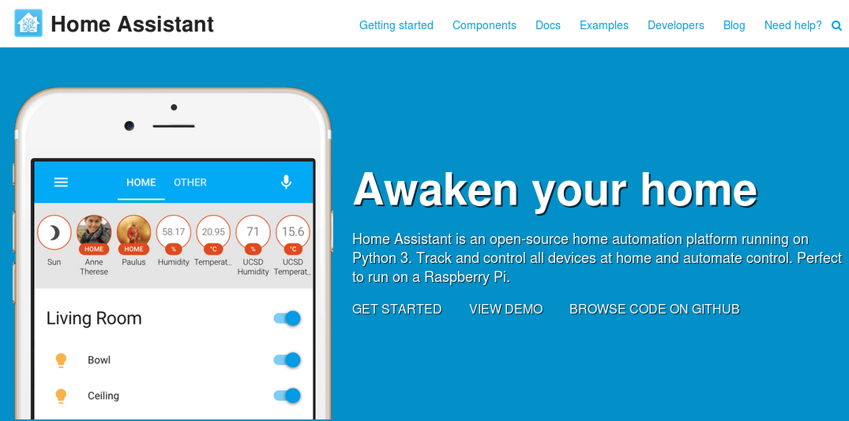
Home Assistant (HA)

Slide 34
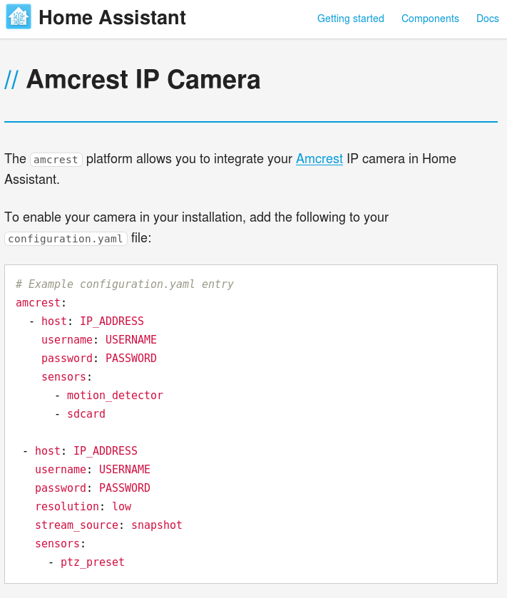
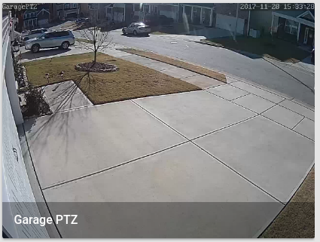
HA - Amcrest

Slide 35
How to run HA?
Virtual Machine
Container
Raspberry Image
Intel NUC Image

Slide 36
Demo
Demo time!

Slide 37
Future
Make sure the module users are happy! :-)
Keep improving the code
Open source firmware?

Slide 38
Thanks
Questions?
We are looking forward for your contribution!
https://github.com/tchellomello/python-amcrest
http://python-amcrest.readthedocs.io/
https://home-assistant.io/
Douglas Schilling Landgraf
<dougsland@gmail.com>
Twitter: @dougsland

