Slide 1
AutoAgument

Slide 2
1
Introduce
简介

Slide 3
search for augmentation policies
Faster
Fast AutoAgument
AutoAugment
based on density matching

Slide 4
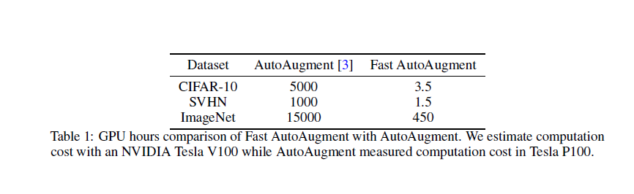

Slide 5
2
Search Space
整体策略

Slide 6
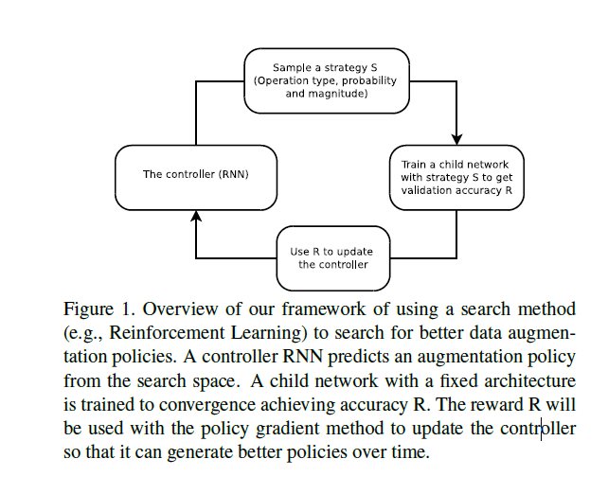
- A search algorithm
- a search space.

Slide 7
3
Search Strategy
搜索策略

Slide 8
search algorithm
samples a data augmentation policy S （RNN）
image processing operation
the probability of using the operation in each batch
the magnitude of the operation
Since R is not differentiable, the controller will be updated by policy gradient methods.

Slide 9
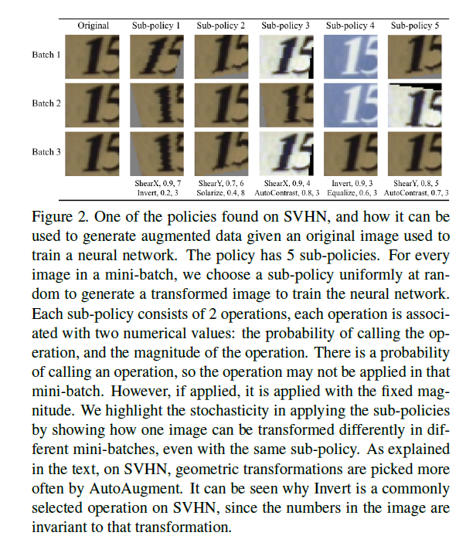
Search Space Detail
(16*10*11)^2
(16*10*11)^10≈2*10^91032
a policy consists (S) of 5 sub-policies
sub-policy consisting of two image operations to be applied in sequence.
each operation is also associated with two hyperparameters:
1) the probability of applying the operation
2) the magnitude of the operation.
PIL
10 values(1,2,….,10)
11 values(0.1,0.2,….,1)

Slide 10
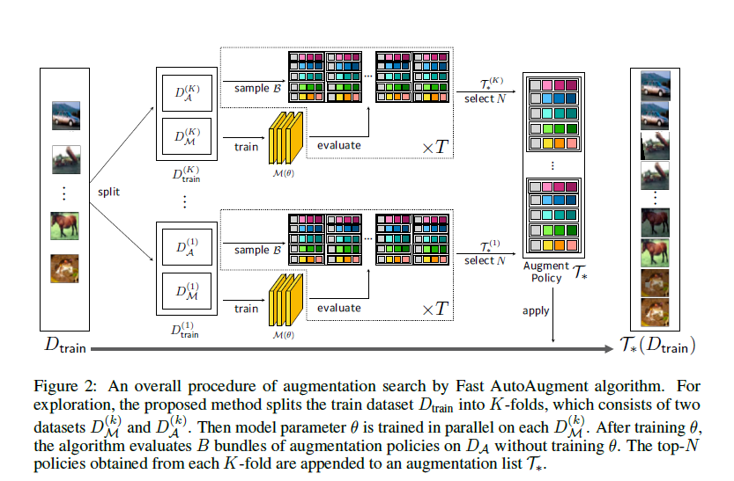

Slide 11
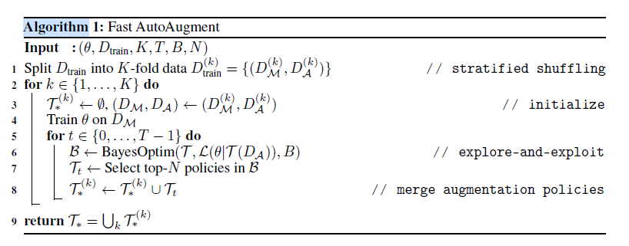
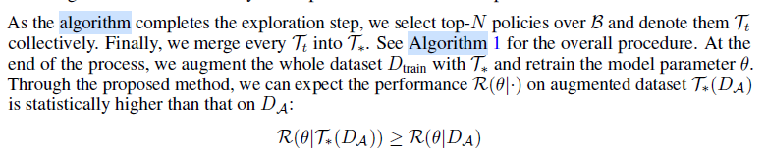

Slide 12

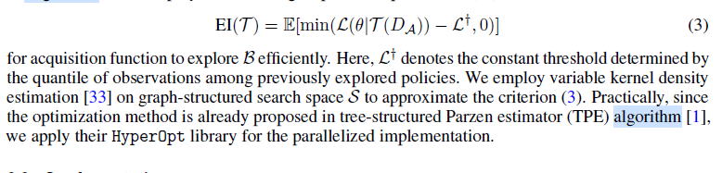
贝叶斯优化
Expected improvement
Notes:
模板来自 http://docer.mysoeasy.com/

Slide 13
THANKS
谢谢聆听

