Slide 1
Fast AutoAgument

Slide 2
1
Introduce
简介

Slide 3
search for augmentation policies
Faster
Fast AutoAgument
AutoAugment
based on density matching

Slide 4
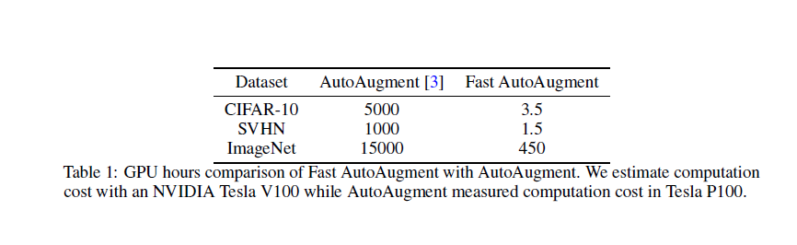

Slide 5
2
Search Space
搜索空间

Slide 6


：a set of O
O ：augmentation (image transformation) operations
O → two parameters→ the calling probability p
→ the magnitude λ
determines the variability of operation.
S： the set of sub-policies
τ ：a sub-policies
consists of N consecutive operations

Slide 7
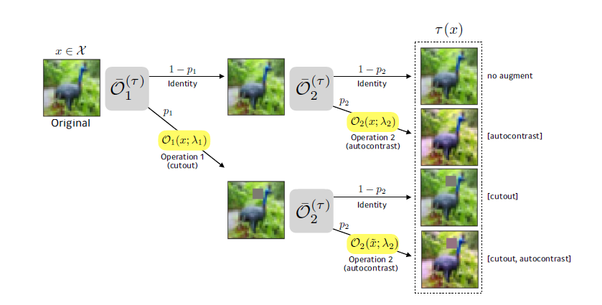

Slide 8
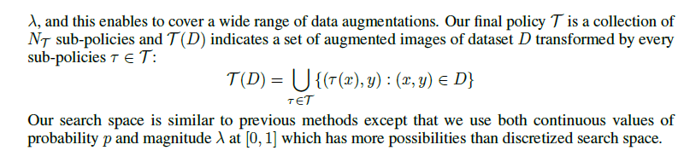

Slide 9
3
Search Strategy
搜索策略

Slide 10

命名
Let be a probability distribution on and assume dataset D is sampledfrom this distribution.
parameterized by θ
accuracy
loss

Slide 11

定义策略
augmentation policies
match
D_{train} → D_{valid}
D_{train} → D_{M} → learn θ； classify model
→ D_{A} → exploring the augmentation policy T
θ* is trained on D_{M} , T* minimizes the distance between density of D_{M} and density of T (D_{A})

Slide 12
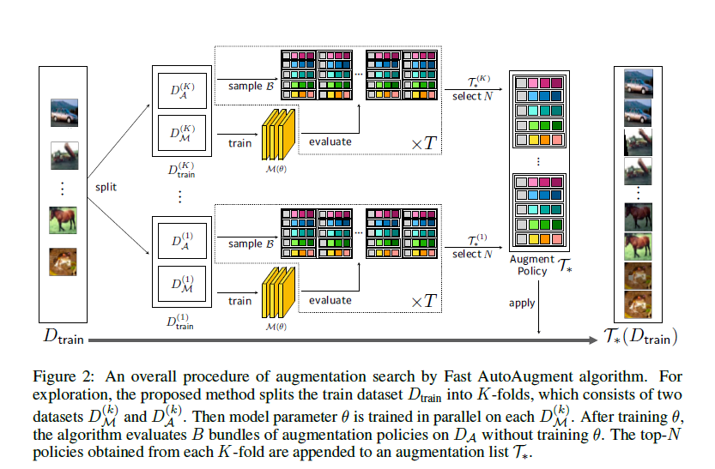

Slide 13
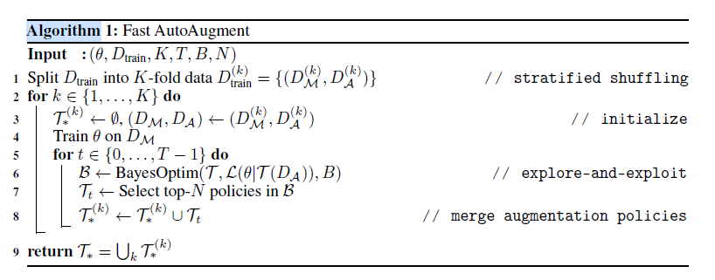
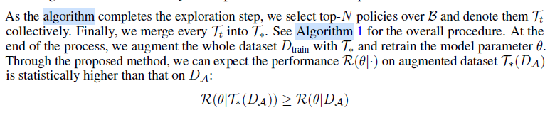

Slide 14

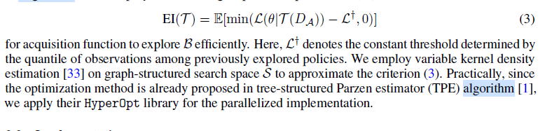
贝叶斯优化
Expected improvement
Notes:
模板来自 http://docer.mysoeasy.com/

Slide 15
THANKS
谢谢聆听

