Slide 1





Agent Assist Algorithm Enhancement
Query
Docs
Embedding Model
Vector Store
Retrieved Docs
Rerank Model
Reranked Docs
Fig. Architecture of the Agent Assist Enhancement Algorithm

Slide 2
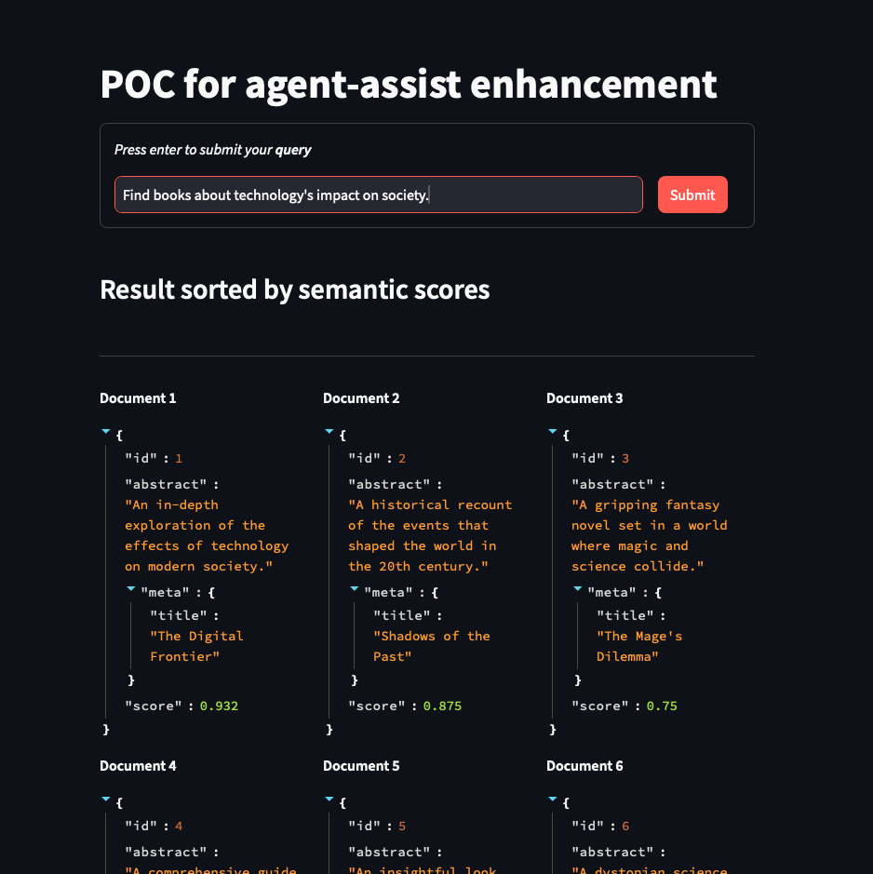
Proof of Concept
Created POC on retrieval using semantic search using open-source data from Kaggle.
Used Elasticsearch as a vector store and base retriever.
Used HF’s “stsb-roberta-large” for embedding the documents and “ms-marco-MiniLM-L-12-v2” for ranking the retrieved results from Elasticsearch.
GitHub: https://github.com/tchoudharycomm100/agent-assist-enhancement/
Note: Need to setup an evaluation strategy

