Slide 1
Timeseries Analysis COVID-19: Death Rates in the US and the Influence of other factors SMU MSDS- 6373 – Time Series Submitted by: Simerpreet Reddy & Tai Chowdhury Date: April- 10th - 2021

Slide 2
Introduction
COVID-19 :
Contagious disease caused by severe acute respiratory syndrome coronavirus 2 (SARS-CoV-2).
Has led to an ongoing pandemic.
Vaccination introduced in the US in Dec. 2020.
Objective of the Analyses: Analyze influence of Covid-19 Vaccination Rates on the Death Rates in the US. Additional details such as ‘New cases per day’, ‘# of Hospitalizations’ and ‘# of ICU patients’ will also be analyzed as part of the multivariate analysis.
Data set*: Daily data since the first vaccine got administered in the US i.e., 12/21/20 through 03/26/2021.
Columns: 96 observations with the following attributes: Date, New Cases per million, New Deaths per million, New ICU patients per million, New Hospitalizations per million, New Vaccinations per million
Source: Coronavirus (COVID-19) Vaccinations - Statistics and Research - Our World in Data. It is updated daily and includes data on confirmed cases, deaths, hospitalizations, testing, and vaccinations as well as other variables of potential interest.
* We have full data set as well beginning 1/23/2020 for initial visualization.
 | Worldwide | United States
Confirmed Cases | 124M | 30M
Deaths | 2.7M | 550K
Notes:
https://www.worldometers.info/coronavirus/?utm_campaign=homeAdUOA?Si

Slide 3
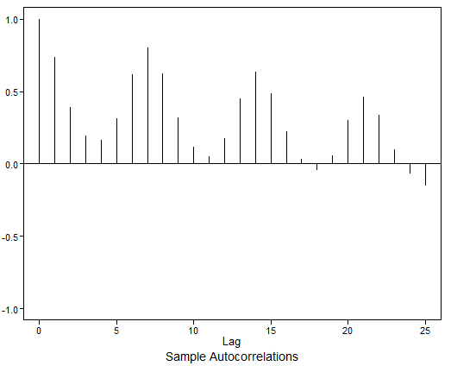
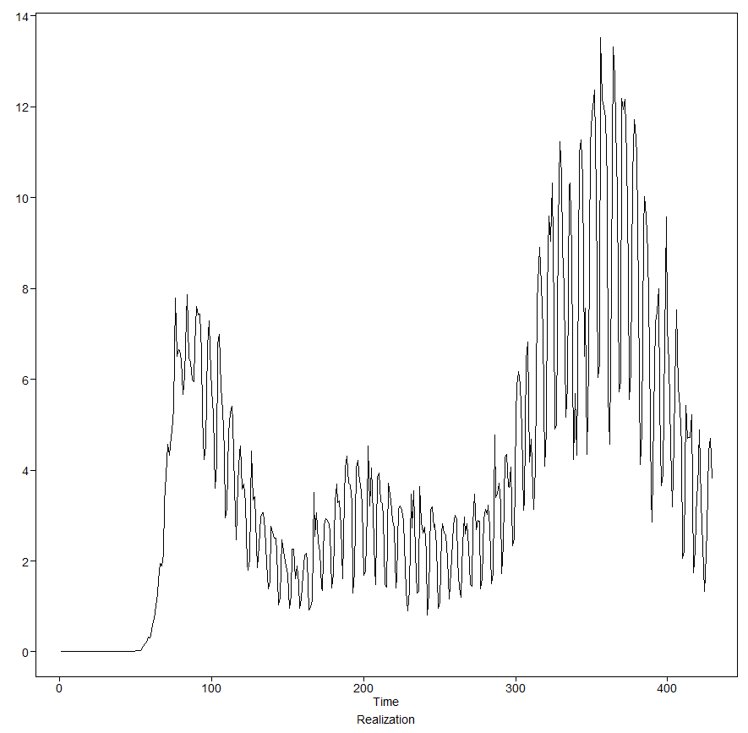
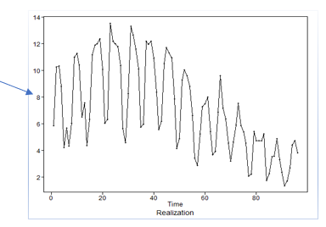
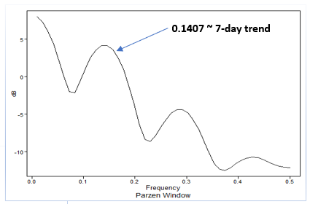
New COVID-19 Deaths per million per day since 01/23/2020
Visualizing the data – Part 1
First vaccine administered in the US
Non- Stationary wandering data
Autocorrelations are correlated (not white noise).
Damped sinusoidal ACFs indicate seasonality.
Frequency peak at 0.1407 indicates weekly trend (1/0.1407 ~ 7)
Notes:
https://www.worldometers.info/coronavirus/?utm_campaign=homeAdUOA?Si

Slide 4
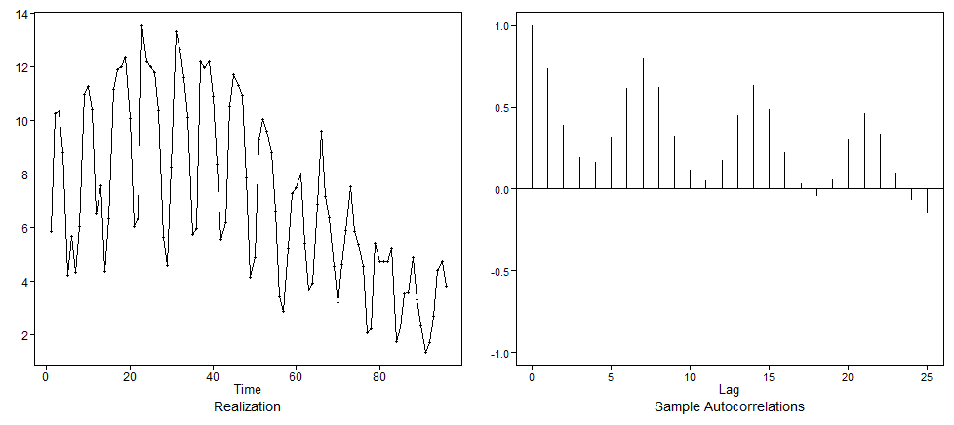
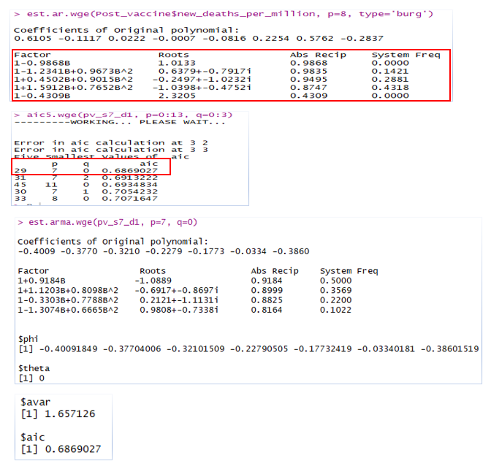
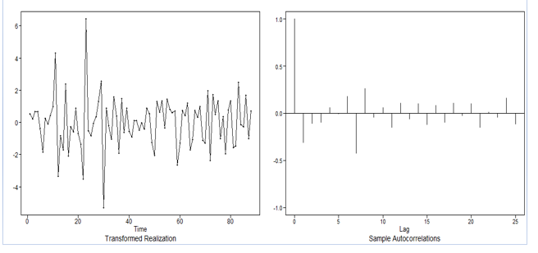
ARIMA: (1-B) plus seasonality (1-B⁷) term

Slide 5
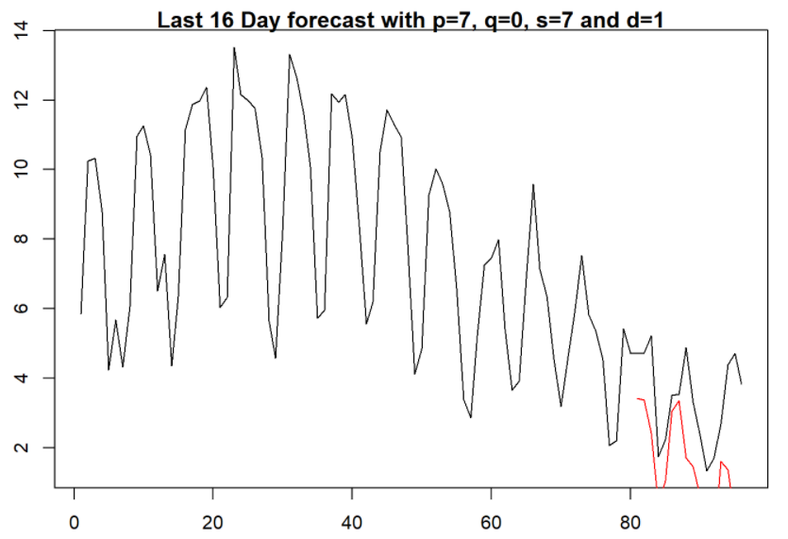
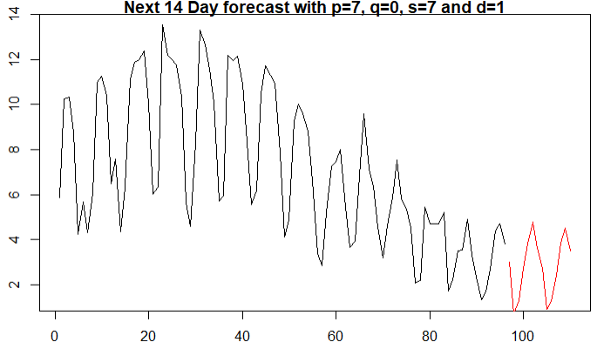
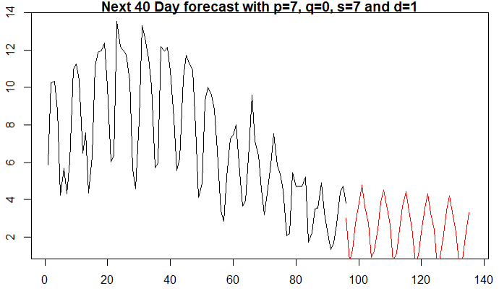
Forecasting – ARIMA(7,1,0) with s=7
Model equation: (1 – B)(1 – B⁷)φ₇ (B) (X_{t} – 7.09 ) = a_{t} , σ_{a}² = 1.657
φ₇ (B) = (1 + 0.40B + 0.37B² + 0.32B³ + 0.23B⁴ + 0.18B⁵ + 0.03B⁶ + 0.38B⁷)
 | AIC | ASE | Rolling Window ASE
ARIMA (7,1,0), s=7 | 0.61 | 1.11 | 1.92
ARIMA(5,1,2), s=0 | 0.65 | 1.16 | 2.02
ARIMA(4,0,1), s=7 | 0.81 | 2.07 | 2.25

Slide 6
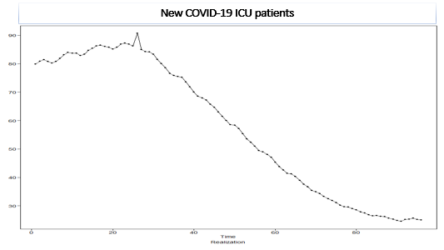
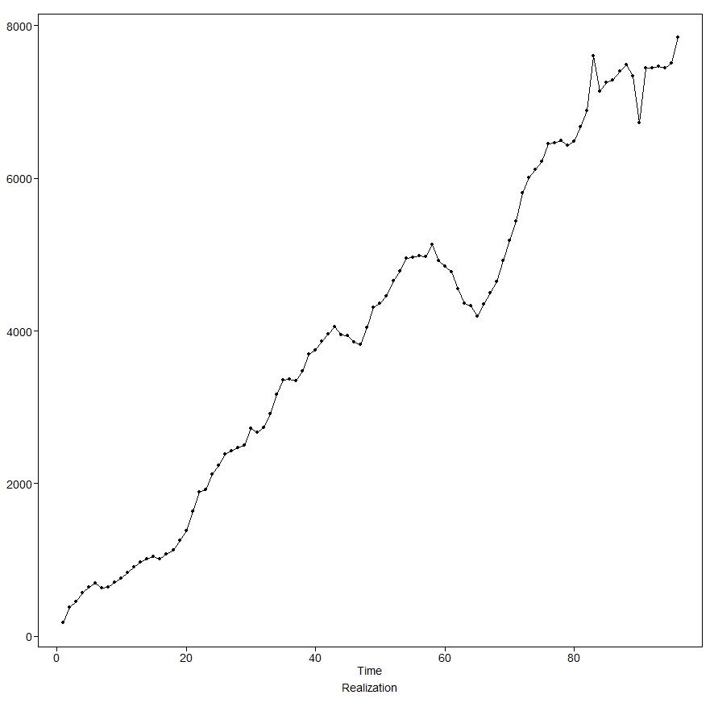
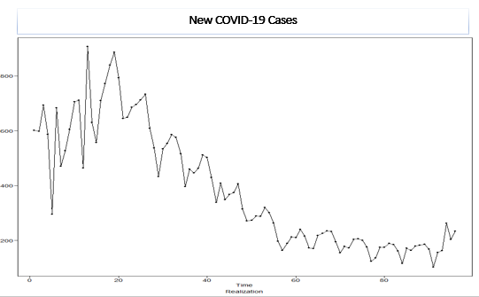
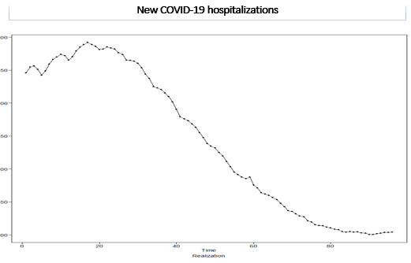
Visualizing the data – Part 2 (number are per-million per-day since 12/21/2020)
New COVID-19 Vaccinations
Notes:
https://www.worldometers.info/coronavirus/?utm_campaign=homeAdUOA?Si

Slide 7
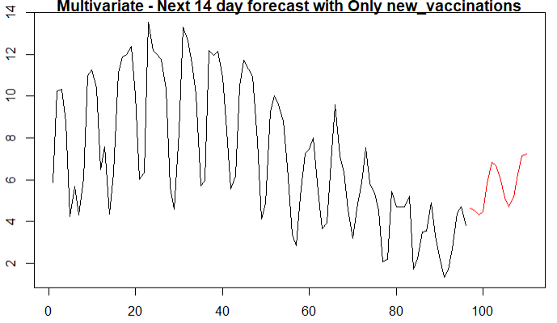
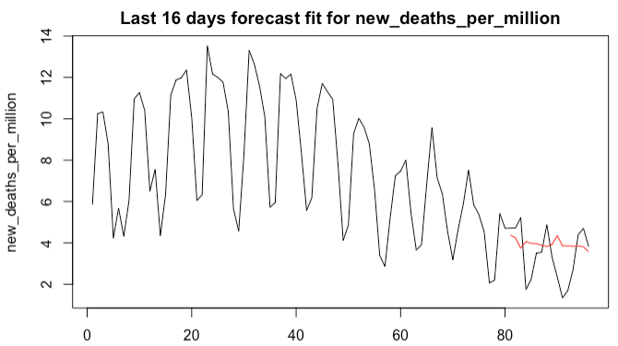
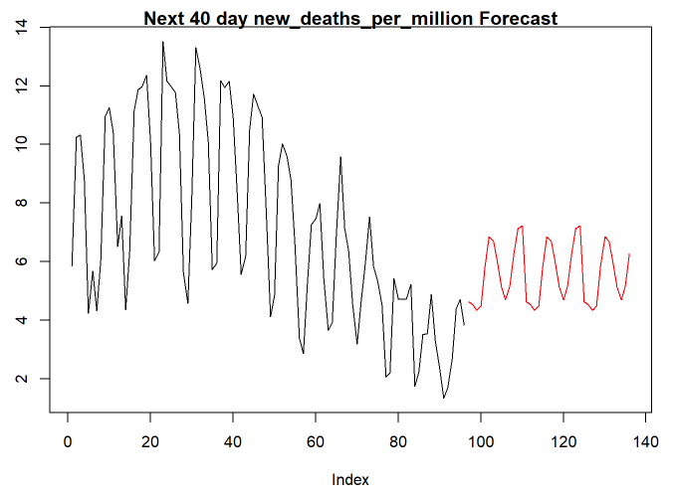
Multivariate
 | ASE
Only vaccine and trend | 1.89
With trend and lagged variables | 4.94
With trend but no lag and all variables | 5.27

Slide 8
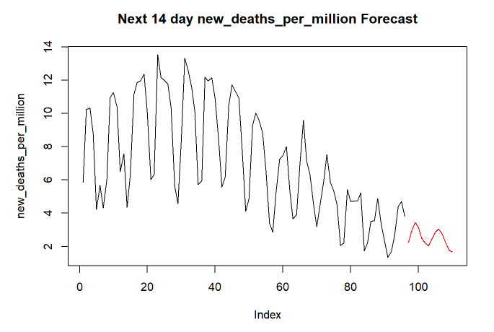
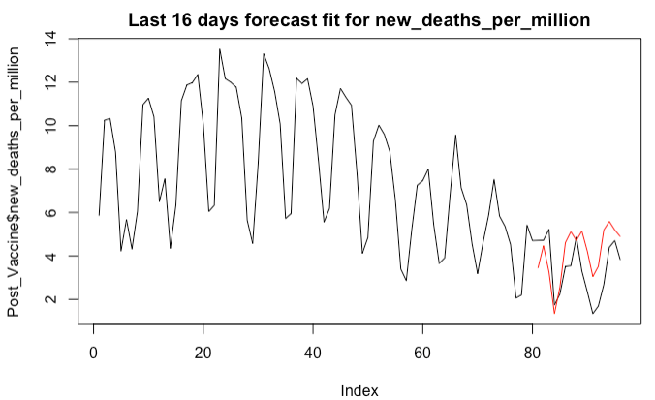
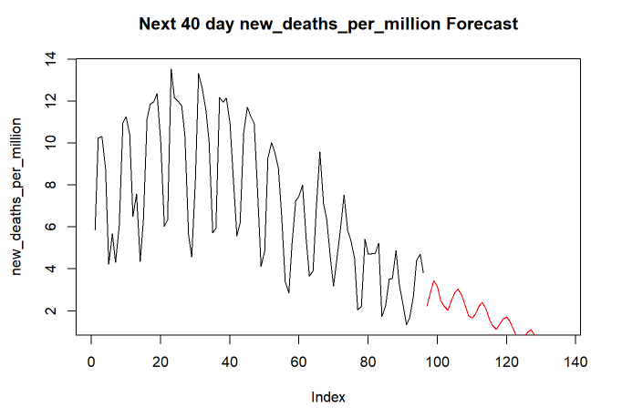
VAR, lag max=8
 | ASE
With lagged variables* | 1.98
No lagged variables | 2.23
* ICU Patients and Hospitalizations at one day lag

Slide 9
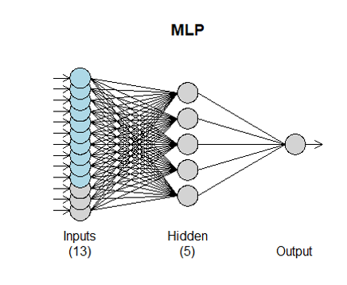
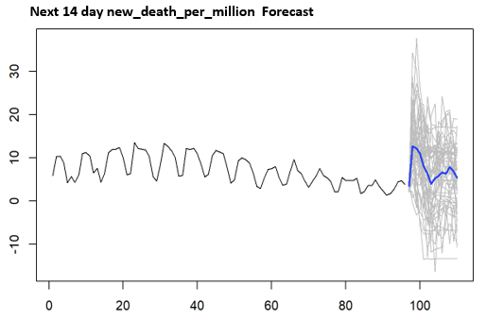
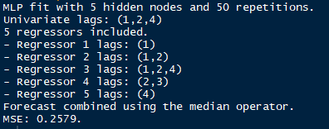
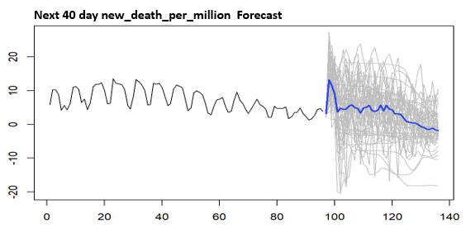
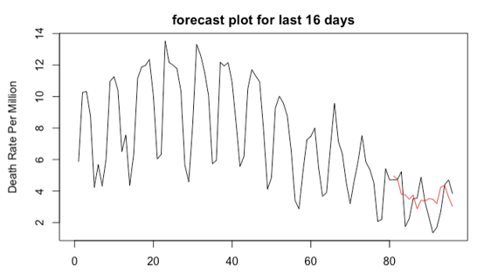
Neural Network
 | ASE
With all variables | 1.43
With only new vaccinations | 3.10
Notes:
Title is wrong in html

Slide 10
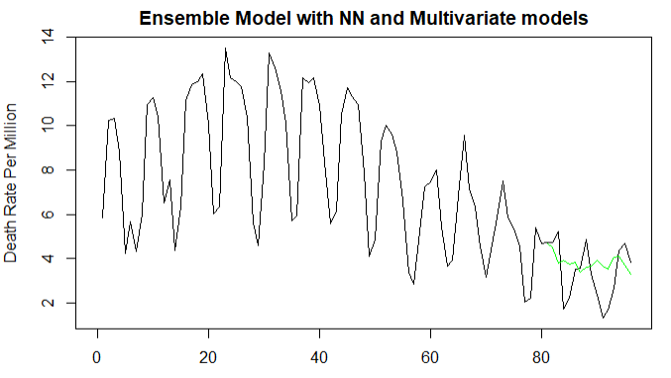
Ensemble
 | ASE
Multivariate + Neural Network | 1.59
Neural Network + ARIMA | 1.83

Slide 11
Summary
Model | ASE
Univariate - ARIMA (s=7, w/1-B) | 1.11
Multivariate - w/ one variable | 1.90
VAR - w/ lagged Variables | 1.98
NN - w/all explanatory variables | 1.43
Ensemble - Multivariate w/1 var. plus NN all var. | 1.59
New Cases (New variants?)
Hospitalizations and ICU(Herd Immunity?)
Vaccination Rate -Average 3 million people receiving per day.
Improved vaccination

