Slide 1
COVID-19: Impact of Vaccination on Death Rate
By
Simerpreet Kaur
Tai Chowdhury

Slide 2
Introduction
Covid-19 has emerged as one of the deadliest disease in our recent history. There are about 126 million cases worldwide and with about 2.7 million total death worldwide. In our research, we look total cases in the US along patient data from hospital and total death rate from this disease. Our objective is to analyze death rate data since vaccine started getting administered. Also, we have tried to notice whether patient data from hospital may have any significant impact on the death rates. These are the two data sets for our analysis:
All Covid-19 Data In US: insight on all cases from January 2020 to March 2021. This data set captures total new cases on daily basis for each of the months along with total number of deaths, total patients in ICU, total patients in hospitals, and total new vaccination per million.
Post Vaccine Impact in US: This a subset of ‘All Covid’ dataset. This dataset captures updated data for vaccination.
Note: The purpose of first dataset is to understand covid-19 data from beginning of 2020 (when cases have emerged) to March 2021. The second dataset provides number of vaccine data from December 2020 to March 2021.
Notes:
https://www.worldometers.info/coronavirus/?utm_campaign=homeAdUOA?Si

Slide 3
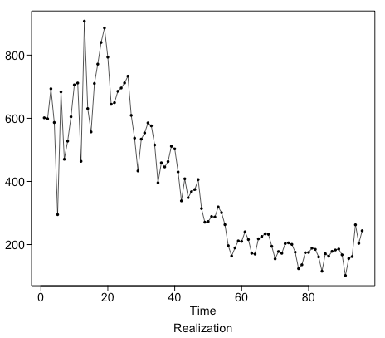
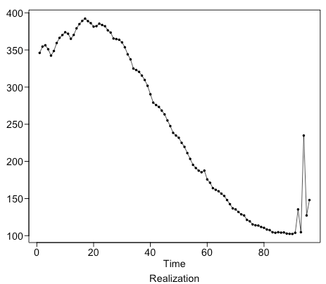
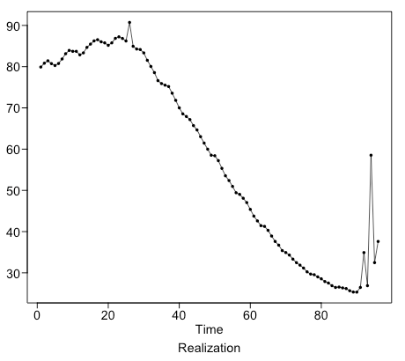
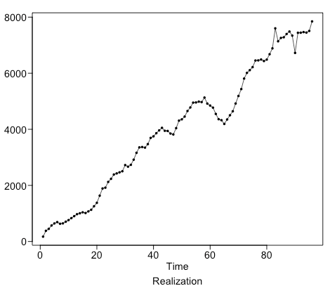
Exploratory Data Analysis - Realization Plots Timeline: Dec’20 – Mar’21
New Cases Per Million
Hospital Patients Per Million
ICU Patients Per Million
New Vaccine Smoothed Per Million

Slide 4
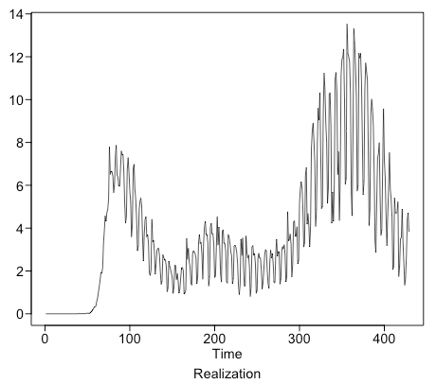
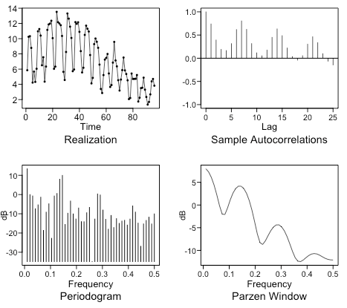
Exploratory Data Analysis – New Death Rate Per Million
The realization chart (top right) shows new daily death rate over time. We notice a spike in the beginning and then a temporary drop followed by significant increase again.
ACF shows non-stationary behavior as dampens with a periodic behavior.
The spectral density shows two
New Death Rate:
Jan’20 – Mar’21
New Death Rate:
Dec’20 - Mar’21

Slide 5
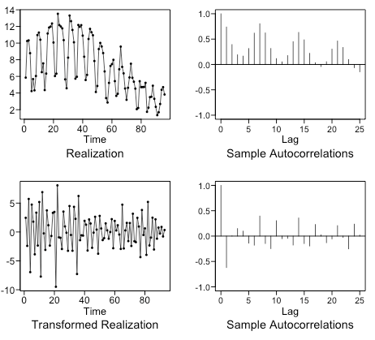
Differencing Dependent Variable
Stationary Realization after differencing, ACF within 95% limit
Non-stationary realization, acf beyond 95% limit

Slide 6
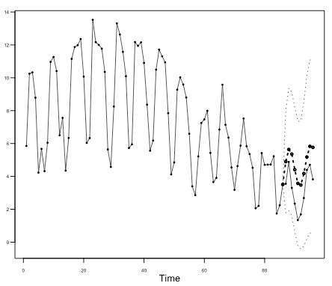
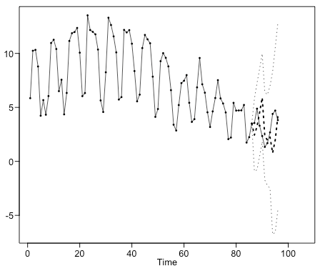
Forecast- New Death Rate Per Million (Short Term n = 10)
ARMA Forecast
ARIMA Forecast
ASE = 2.943246
ASE = 1.856851

Slide 7
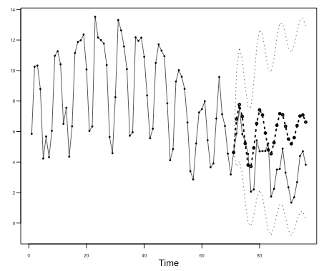
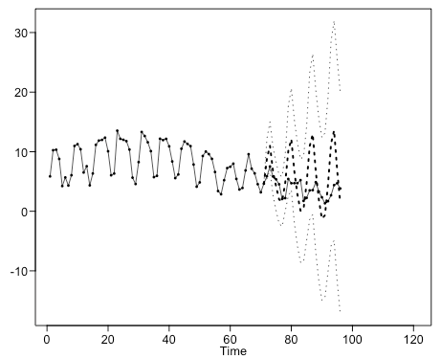
Forecast- New Death Rate Per Million (Short Term n = 25)
ARMA Forecast
ARIMA Forecast
ASE = 3.634228
ASE = 4.67033

Slide 8
Score Summary
Model | N (number of days) | ASE | Rolling ASE
ARMA | 10 | 2.94
ARIMA | 10 | 1.86
ARMA | 25 | 3.63
ARIMA | 25 | 4.67

