Slide 1
Software-based Realtime Recovery from Sensor Attacks on Robotic Vehicles
A procedure-faithful replication of Choi et al., RAID 2020
Focus: replication of the methodology and procedure — identical numerical results are not claimed.
Platform: ArduCopter 3.4 SITL · MATLAB R2026a · Python · C/C++ firmware patch
Presented by: [Your name] · Course: [Course] · Date: [Date]
Notes:
Introduce the work: this is a from-scratch replication of the RAID 2020 paper on recovering robotic vehicles from sensor attacks using software sensors. Emphasize up front that the goal is to reproduce the paper's PROCEDURE faithfully, not to claim identical numbers. State the platform and that evidence figures are produced from recorded flight data and the identified model.

Slide 2
Motivation: the sensor-attack recovery problem
• Robotic vehicles (drones, rovers) continuously act on sensor measurements (gyroscope, accelerometer, GPS, barometer, magnetometer).
• Physical / external attacks corrupt these readings — e.g. GPS spoofing, acoustic gyroscope injection — and can crash the vehicle.
• Prior defenses mostly DETECT attacks but do not RECOVER: the vehicle can still crash after detection.
• Hardware redundancy (triple-modular) is costly and still fails when multiple same-type sensors are attacked together.
• Need: a software-only, real-time method that keeps the vehicle stable DURING an attack.
Notes:
Set up the problem. Sensors are safety-critical. Attackers can manipulate them physically. Detection alone is insufficient — you also need to keep flying. Hardware redundancy is expensive and defeated by same-type multi-sensor attacks. This motivates a software-based recovery approach.

Slide 3
The paper's software-sensor idea
Paper: build a predictive state-space model of the vehicle that captures the controller, actuators, and dynamics.
Paper: a "software sensor" converts model outputs into the predicted reading of each physical sensor — a software backup running alongside the real sensor.
Paper: at runtime, compare software-sensor vs real-sensor; a large, sustained difference indicates the physical sensor is under attack.
Paper: replace the compromised reading with the software-sensor value to keep the control loop stable (single, multiple, or all-same-type sensor attacks).
Note: software sensors are model-based, so they are immune to physical-environment attacks.
Notes:
Explain the core idea in plain terms: a physics/model-based 'virtual sensor' that predicts what each real sensor should read. Under normal operation the two agree; under attack they diverge, and the system swaps in the trustworthy software value. This is what makes recovery (not just detection) possible.

Slide 4
Paper workflow we replicated
Paper: (offline): collect operation data → resample → system identification → build software sensors → select recovery parameters.
Paper: (runtime): insert the recovery monitor (Algorithm 1) right after sensor acquisition in the control loop.
Ours: every offline stage implemented in Python + MATLAB; runtime monitor implemented in C/C++ and inserted at the paper’s Figure-3 location.
• This deck follows the logical order: data → model → software-sensor prediction → correction → parameter selection → attack recovery → limitations.
Notes:
Give the roadmap. The paper has an offline modeling pipeline and a runtime monitor. We reproduced both. Tell the audience the slides will walk this exact pipeline in order.

Slide 5
Replication scope and environment
Ours: simulated quadrotor on ArduCopter 3.4 (SITL).
Ours: MATLAB R2026a (System Identification Toolbox); Python (pymavlink, scipy, dtaidistance, matplotlib); C/C++ firmware patch.
Ours: runtime monitor is a line-for-line implementation of Algorithm 1, verified by 25/25 unit tests.
Note: (deviation): model and monitor run at 50 Hz instead of the paper’s 400 Hz, due to a RAM constraint — the only intentional deviation.
Limitation: closed-loop in-flight attack/recovery validation is future work (see Limitations slide).
Notes:
State the scope honestly: one simulated quadrotor, the toolchain used, and that the monitor itself is unit-tested. Flag the single intentional deviation (50 Hz vs 400 Hz) now so it isn't a surprise later, and preview that live validation is future work.

Slide 6
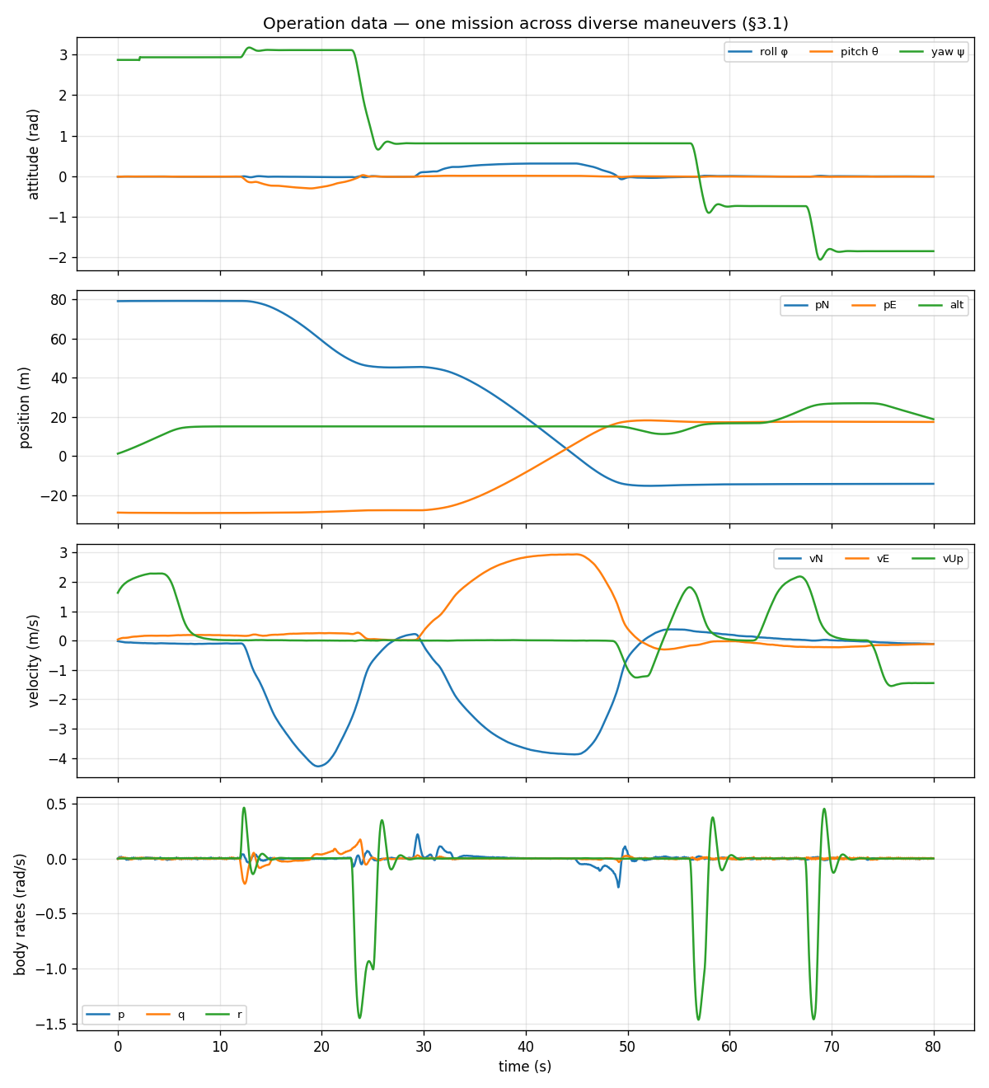
Operation data used for system identification
Paper: collect normal-operation logs under many maneuvers via randomly generated MAVLink missions; resample streams to one rate with spline interpolation.
Ours: 20 random GUIDED missions (straight / turn / climb / hover); cubic-spline resampled per flight segment to 50 Hz — 21 segments, ~41 minutes.
Ours: state x, input u (target states), output y built per Eq. (3); raw units, no detrending (consistent with runtime).
Figure: one mission across diverse maneuvers (attitude, position, velocity, body rates).
Notes:
Explain the data step. The paper needs varied maneuvers so the model captures the vehicle dynamics. We generated random missions and resampled with splines, exactly as the paper specifies. The figure shows the diversity of one mission.

Slide 7
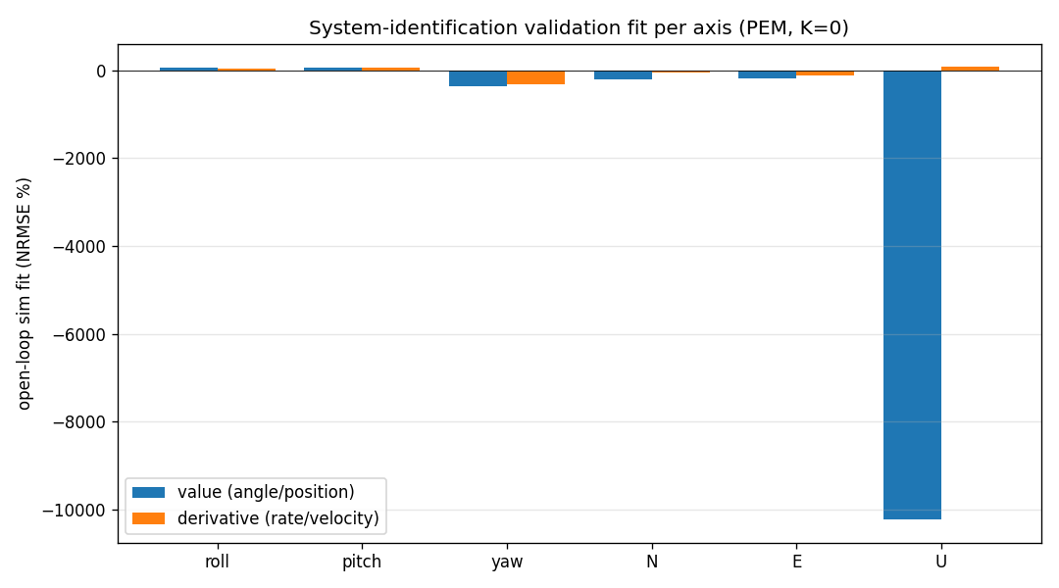
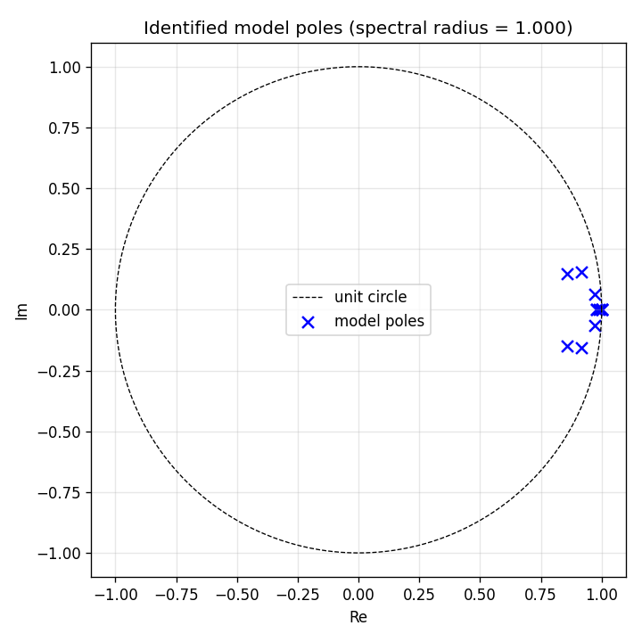
State-space model and system identification
Paper: discrete state-space model; per-variable 2nd-order order; fit by prediction-error minimization (PEM).
Eq.: xₖ₊₁ = A xₖ + B uₖ yₖ = C xₖ + D uₖ
Ours: 12-state model (Eq. 3); six per-axis 2nd-order PEM blocks; open-loop K = 0.
Note: roll/pitch fit well; translational/yaw under-excited by hover-dominant data.
Notes:
This is the model step. State the two governing equations (point at them). We fit a 12-state model with per-axis second-order blocks via PEM, with K=0 so it matches the open-loop predictor the runtime uses. Be honest that roll/pitch fit well but the translational/yaw models are weaker because the training data was hover-dominant.

Slide 8
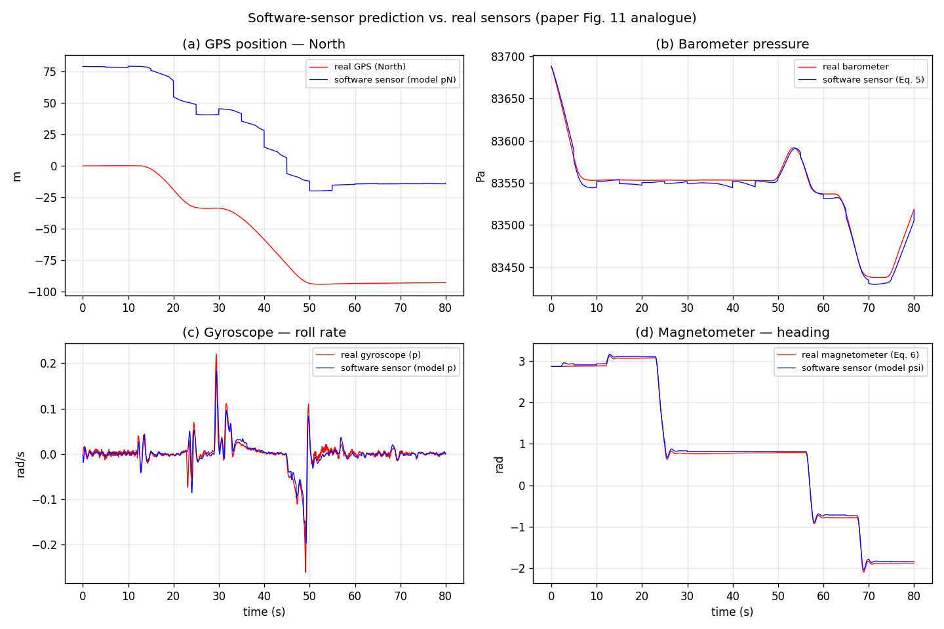
Software-sensor generation
Paper: (§3.2): convert model outputs to predicted sensor readings — gyroscope = rate states, accelerometer = Eq. (4), barometer = Eq. (5), magnetometer heading = Eq. (6), GPS = position/velocity states.
Ours: all conversion equations implemented in software_sensors.h, plus the Appendix-A frame transforms.
Figure: software sensor (blue) vs real sensor (red) for GPS, barometer, gyroscope, magnetometer heading.
Note: barometer / gyroscope / magnetometer track closely; GPS-North drifts — the documented under-excited translational model.
Notes:
The software-sensor step. We implemented every conversion equation from the paper. The figure shows predicted vs real for four sensor types. Point out the tight tracking on baro/gyro/mag, and honestly note the GPS drift due to the weaker translational model.

Slide 9
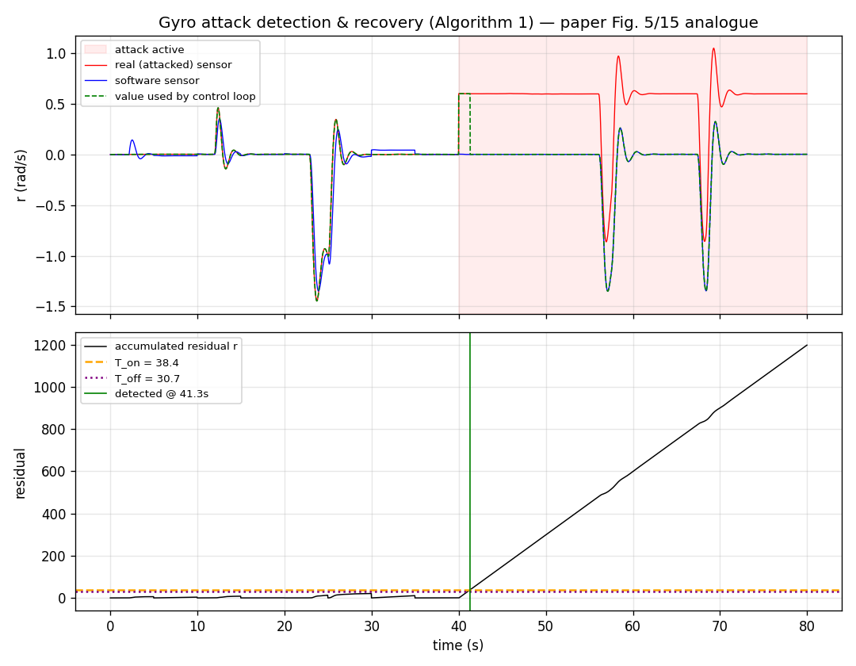
Recovery monitor — Algorithm 1
Paper: (§3.4): each tick — predict y = Cx + Du, advance x = Ax + Bu, filter the real measurement, convert to software sensor, accumulate residual, detect, substitute.
Eq.: rₖ = rₖ + |mₖ − msₖ| Recovery when r > T_on (switch back when r < T_off for K counts).
Ours: line-for-line Algorithm 1 in recovery_monitor.h; 25/25 conformance tests pass.
Figure: offline gyro attack — residual crosses T_on, monitor detects (~1.3 s) and substitutes the software sensor for the attacked reading.
Note: attack injected offline into a recorded trace (supported by our scripts); closed-loop in-flight recovery is future work.
Notes:
The heart of the method. Walk through Algorithm 1 at a high level and show the residual/threshold equation. Stress that our implementation is unit-tested line by line. The figure is an OFFLINE demonstration on a recorded trace: the attack drives the residual past T_on and the monitor swaps in the software sensor. Be explicit that this is offline, not a live flight.

Slide 10
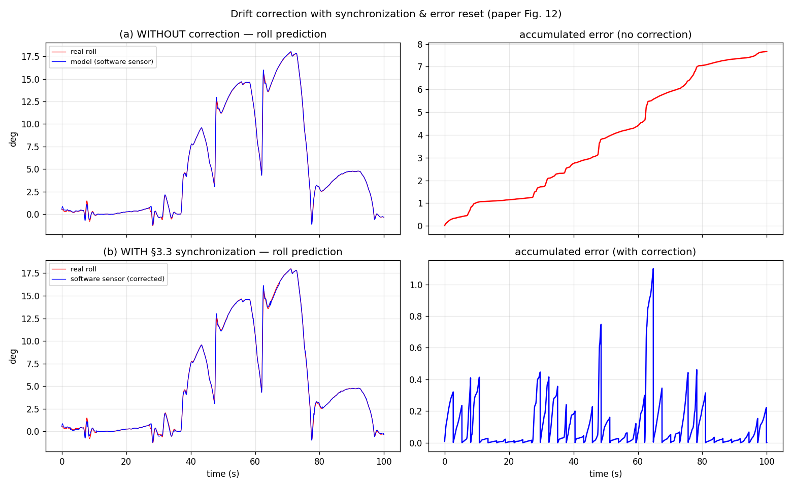
Drift correction and synchronization
Paper: (§3.3): an open-loop model prediction drifts over time; periodically synchronize the predicted state with the real state and reset accumulated error.
Ours: at each window checkpoint, re-seed the model state from the real reading and reset the residual accumulator.
Figure: accumulated prediction error grows without correction vs stays bounded with §3.3 synchronization.
Notes:
Explain why correction is needed: an open-loop model inevitably drifts. The paper's answer is periodic synchronization plus error reset. The figure shows the accumulated error growing unbounded without it and staying bounded with it.

Slide 11
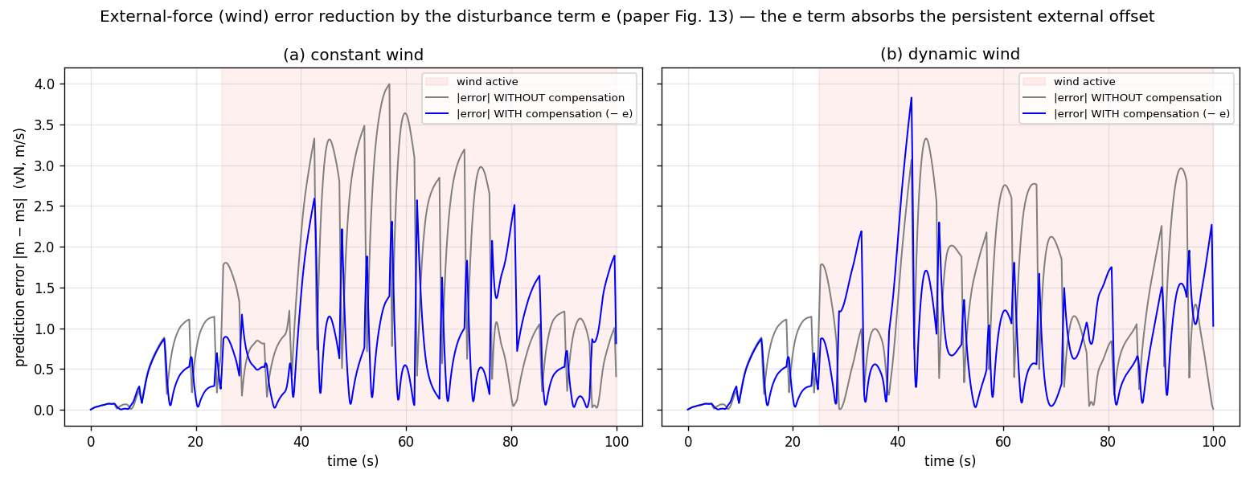
External disturbance / wind compensation
Paper: (§3.3): external forces (e.g. wind) cause a persistent prediction error; estimate the average error over the previous window (term e) and subtract it.
Ours: e = average(ms − m) over the previous window; corrected software sensor ms ← ms − e.
Figure: prediction error WITH vs WITHOUT the disturbance term, under constant and dynamic wind (disturbance injected offline).
Note: shown on a translational channel whose model is under-excited, so the trace is noisier than the paper’s.
Notes:
The external-error compensation step. Wind pushes the vehicle so the real sensor differs from the model by a persistent offset; the e term absorbs it. The figure shows the error shrinking when compensation is on. Note the disturbance is injected offline (a simulated wind), consistent with the paper's evaluation approach.

Slide 12
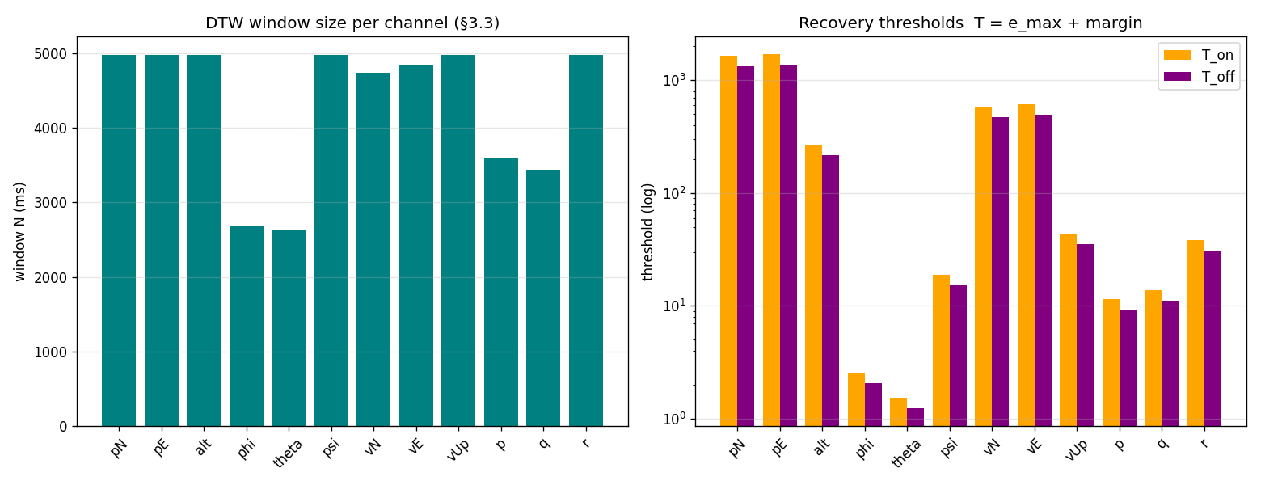
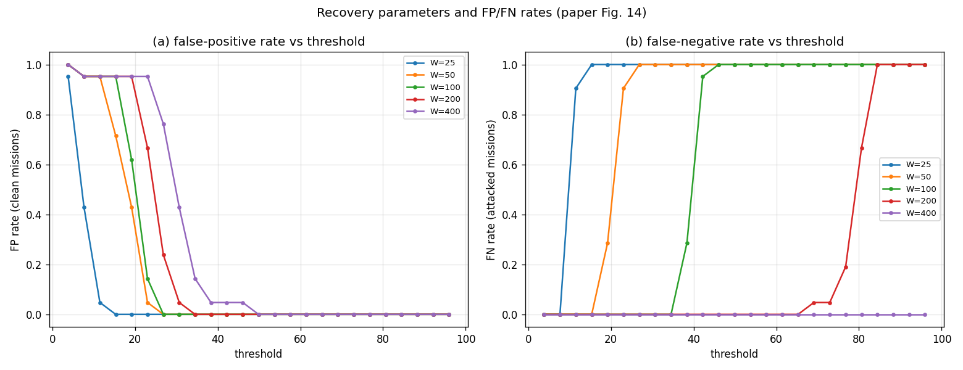
Recovery parameter selection
Paper: (§3.3): window N = max DTW time-displacement on clean data; threshold T = e_max + margin, with T_off < T_on.
Ours: DTW per channel (dtaidistance); per-channel N, T_on, T_off in recovery_params.h.
Figure: selected N and thresholds (left); FP & FN vs threshold across window sizes (right) — both ≈ 0 at the selected T_on.
Note: FP/FN measured offline with in-memory attack injection (paper’s parameter study).
Notes:
Parameter selection. The window comes from DTW; the threshold from the max clean residual plus a margin. The right figure reproduces the paper's FP/FN trade-off: a larger window gives more false positives and fewer false negatives, and at the chosen threshold both are about zero. State that FP/FN were measured offline by injecting attacks into recorded clean data.

Slide 13
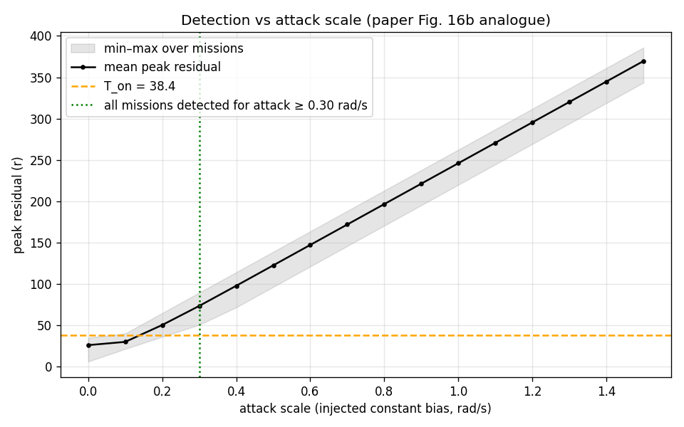
Attack detection versus attack scale
Paper: (§4.2.2): larger attacks produce larger errors; whether an attack is detected depends on its scale relative to the threshold.
Ours: sweep the injected constant gyro-bias magnitude; measure the peak accumulated residual per mission.
Figure: peak residual rises ~linearly with attack scale and crosses T_on; all missions are detected for attacks ≥ ~0.3 rad/s.
Note: attacks injected offline into recorded traces.
Notes:
Shows sensitivity vs attack strength. Small attacks stay under the threshold; once the bias is large enough the residual crosses T_on and detection is guaranteed. This mirrors the paper's attack-scale analysis. Again, offline injection on recorded data.

Slide 14
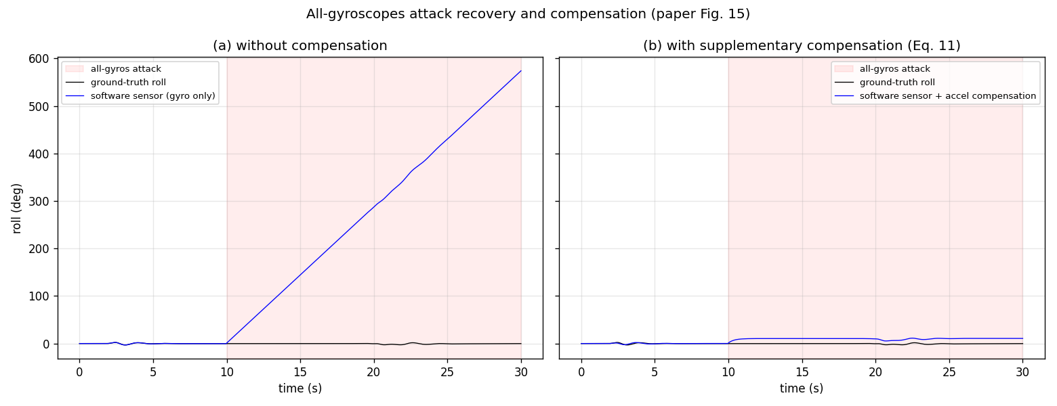
All-gyroscope attack compensation
Paper: (Appendix B): when ALL gyroscopes are compromised, the software gyro alone drifts; reconstruct roll/pitch from the accelerometer and yaw from the magnetometer (Eq. 11) and combine by weighted sum.
Ours: supplementary_compensation() implements Eq. 11; demonstrated offline using the recorded accelerometer and magnetometer streams.
Figure: gyro-only roll diverges (~575°) under the all-gyros attack vs stays bounded with accelerometer compensation.
Notes:
The hardest case in the paper: all gyros attacked at once. The software gyro has no real reference and drifts, so the paper adds accelerometer/magnetometer-based attitude reconstruction. The figure shows roll diverging without it and bounded with it. Demonstrated offline from the recorded IMU/compass log.

Slide 15
Code-to-figure mapping
Figure | Generating script (read-only) | Paper figure
Operation data overview (fig8) | make_figures_paper.py | §3.1 data
Sensor prediction (fig3) | make_figures_paper.py | Fig. 11
Sysid fit / model poles (fig4, fig5) | make_figures_paper.py | §3.1
Attack → recovery (fig2) | make_figures.py | Fig. 5 / 15
Drift correction (fig12, fig9) | make_figures_paper_12_15.py / eval | Fig. 12
Wind compensation (fig13) | make_figures_paper_12_15.py | Fig. 13
DTW params / FP-FN (fig6, fig14, fig10, fig7) | select_parameters.py / make_figures_* | Fig. 14
Attack scale (fig11) | make_figures_eval.py | Fig. 16b
All-gyros compensation (fig15) | make_figures_paper_12_15.py | Fig. 15
Notes:
Transparency slide: every figure is produced by a named, read-only script from the recorded data and the identified model. No figure uses invented data. Mention the scripts live in rv_recovery/python/.

Slide 16
Successfully replicated components
Ours: data pipeline — random-mission collection, spline resampling, x/u/y construction (§3.1).
Ours: system identification — per-variable 2nd-order PEM, open-loop K = 0, 12-state model (§3.1).
Ours: software sensors — Eq. 4 (accel), Eq. 5 (baro), Eq. 6 (magnetometer), frame transforms, Eq. 11 (supplementary) (§3.2 / App. A, B).
Ours: error correction (LPF, synchronization, disturbance term e) and DTW-based parameter selection (§3.3).
Ours: Algorithm 1 runtime monitor (25/25 tests) inserted at the paper’s Figure-3 point (§3.4).
Notes:
Summarize what matches the paper. Walk the checklist quickly: data, model, software sensors, correction, parameters, and the runtime monitor are all implemented to the paper's procedure. Point to the comparison checklist document for the full mapping.

Slide 17
Limitations and deviations
Limitation: 50 Hz instead of the paper’s 400 Hz (RAM) — the only intentional deviation; all downstream parameters are consistent at 50 Hz.
Limitation: translational / altitude sub-models are under-excited by hover-dominant data, so those channels are noisier (more aggressive maneuver data would improve them).
Limitation: closed-loop in-flight attack/recovery not produced — ArduCopter 3.4 SITL takes attitude from a perfect physics model and regenerates the IMU asynchronously, so a read-AHRS-level substitution (attack AND recovery, identically) is overwritten before the estimator reads it. Real hardware (the paper’s setting) would propagate it.
• Future work: live SITL / physical-drone A/B validation; the rover and hexrotor; the multi-sensor attack matrix (Tables 3 / 4).
Note: all figures are offline demonstrations on recorded data, not closed-loop flight.
Notes:
Be fully transparent. The 50 Hz deviation is intentional and consistent. The translational models are weaker due to data coverage. Most importantly, explain why live numbers aren't shown: the SITL sensor path overwrites the substitution before the estimator sees it, affecting attack and recovery identically — a simulator-architecture issue, not a flaw in the method. Real hardware would behave like the paper. List the remaining future work.

Slide 18
Conclusion
• We faithfully replicated the paper’s full offline + runtime procedure: data pipeline, system identification, software sensors, error correction, parameter selection, and the Algorithm 1 monitor.
• Evidence figures reproduce the paper’s effectiveness plots (Figs. 11–16b) on recorded data and the identified model.
• We focus on PROCEDURE replication — we do not claim identical numerical results.
• Remaining: closed-loop live validation and additional vehicles / attack combinations (future work).
Notes:
Wrap up: the methodology is replicated end to end and demonstrated with figures that mirror the paper's. Restate the honest framing — procedure replication, not identical numbers — and that live validation is the main piece of future work.

Slide 19
Backup: equations and parameter definitions
• State / output: xₖ₊₁ = A xₖ + B uₖ ; yₖ = C xₖ + D uₖ.
• Residual / detection: rₖ = rₖ + |mₖ − msₖ| ; recover if r > T_on ; exit if r < T_off for K consecutive counts.
• Conversions: accelerometer Eq. (4) ; barometer Eq. (5) ; magnetometer heading Eq. (6) ; supplementary attitude Eq. (11).
• Parameters: N = window size (DTW) ; T_on / T_off = recovery thresholds ; K = safe-count for switch-back ; margin in T = e_max + margin.
• Rate: 50 Hz (Ts = 0.02 s) — the sanctioned deviation from the paper’s 400 Hz.
Notes:
Backup reference for questions: the governing equations, the conversion equations by number, and the meaning of every parameter (N, T_on, T_off, K, margin) plus the rate.

